Slide 1
Transcribing foreign-accented English
UT Dallas
Phonetics SPAU 3343
William Katz

Slide 2
Background
L1 influences on L2, or “foreign accent”
Affected by many factors:
-- Subject’s age, verbosity, linguistic experience, intellect, motivation, social situation
-- Constraints from speech perception
… and production

Slide 3
Things to consider when transcribing
Foreign accents are complex
GAE sounds may be better realized in certain contexts than others (initial/medial/final; stressed vs. unstressed)
Suprasegmental patterns will play a large role
(phonemic length, tone, syllable vs. stress-timing, etc.)

Slide 4

A sample corpus – “Mary passage”
Mary is only five and she loves to play in the water. This morning she got so dirty that I heard her mother call her in to take a bath. It was very early for I was still boiling water for my coffee. Also, there was still a little fog. After a while, however, Mary came across the path into my yard and sat down with me to eat an orange. As I had my second cup of coffee, I asked her if she had been bad. “No,” she said, “the dog had been the one.” He had gotten her so dirty she couldn’t brush it off.
(GAE)

Slide 5
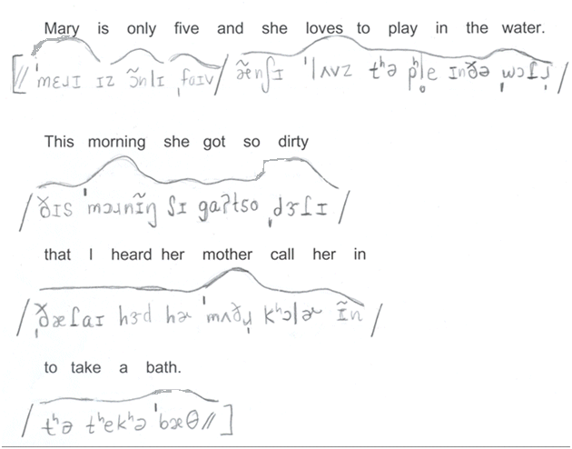
Sample GAE transcription

Slide 6
Example: Russian accent
Mary is only five and she loves to play in the water. This morning she got so dirty that I heard her mother call her in to take a bath. It was very early for I was still boiling water for my coffee. Also, there was still a little fog. After a while, however, Mary came across the path into my yard and sat down with me to eat an orange. As I had my second cup of coffee, I asked her if she had been bad. “No,” she said, “the dog had been the one.” He had gotten her so dirty she couldn’t brush it off.

Slide 7
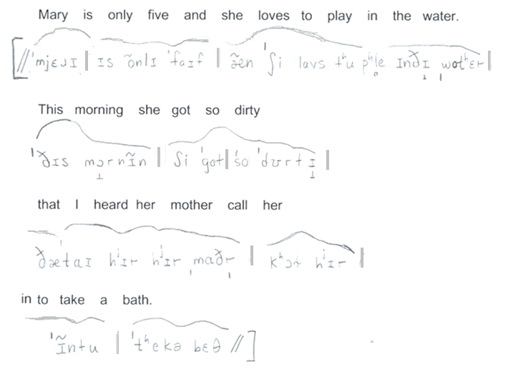
Russian: Narrow Transcription

Slide 8
“How do I know what sounds (s)he made?”
Listen
Research the talker’s native language (L1)

Slide 9
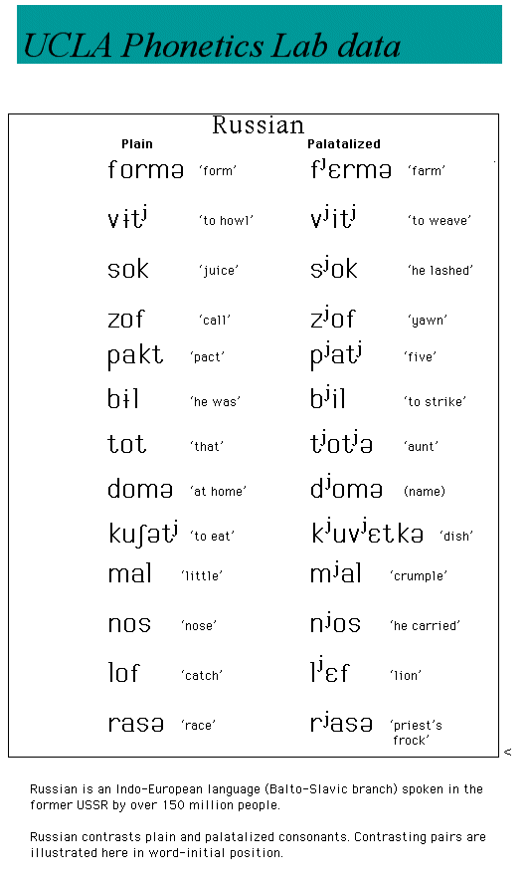
Sources
..from our
text materials…

Slide 10
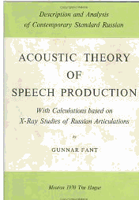
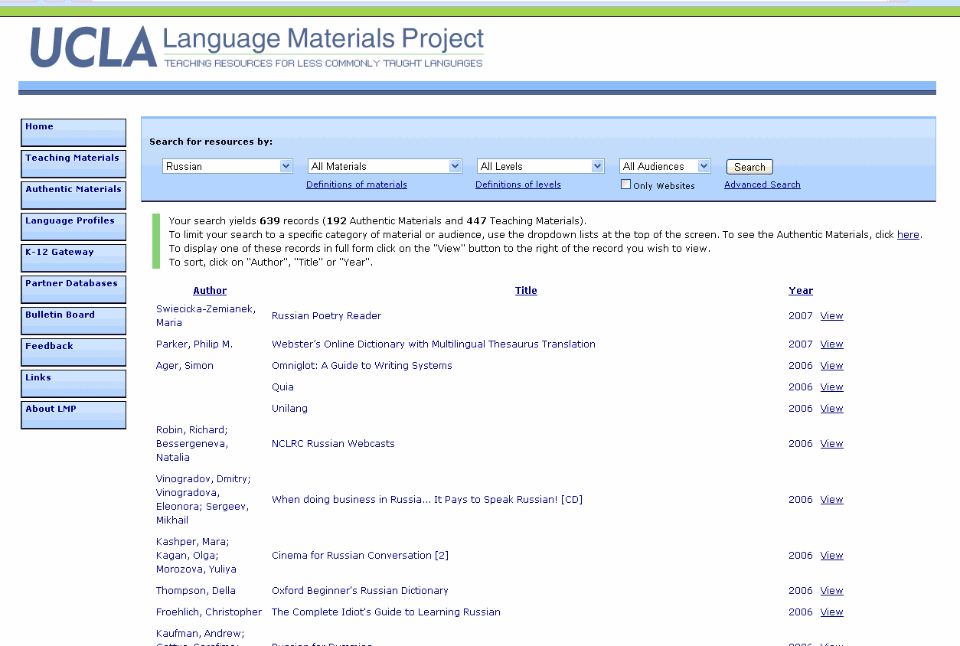

Books, websites
Welcome to PHOIBLE
PHOIBLE is a repository of cross-linguistic phonological inventory data, which have been extracted from source documents and tertiary databases and compiled into a single searchable convenience sample. Release 2.0 from 2019 includes 3020 inventories that contain 3183 segment types found in 2186 distinct languages.
A bibliographic record is provided for each source document; note that some languages in PHOIBLE have multiple entries based on distinct sources that disagree about the number and/or identity of that language’s phonemes.
Two principles guide the development of PHOIBLE, though it has proved challenging both theoretically and technologically to abide by them:
Be faithful to the language description in the source document (now often called ‘doculect’, for reasons indicated above)
Encode all character data in a consistent representation in Unicode IPA
In addition to phoneme inventories, PHOIBLE includes distinctive feature data for every phoneme in every language. The feature system used was created by the PHOIBLE developers to be descriptively adequate cross-linguistically. In other words, if two phonemes differ in their graphemic representation, then they necessarily differ in their featural representation as well (regardless of whether those two phonemes coexist in any known doculect). The feature system is loosely based on the feature system in Hayes 2009 with some additions drawn from Moisik & Esling 2011.
However, the final feature system goes beyond both of these sources, and is potentially subject to change as new languages are added in subsequent editions of PHOIBLE.
The data set also includes additional genealogical and geographical information about each language from Glottolog.

Slide 11
One web resource
Speech accent archive (George Mason University)
Gives sound files of foreign accents and regional American accents for a short read English corpus
A rather broad transcription is also provided for each case
http://accent.gmu.edu

Slide 12
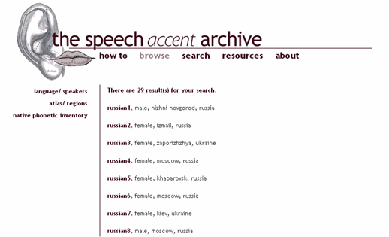

Slide 13
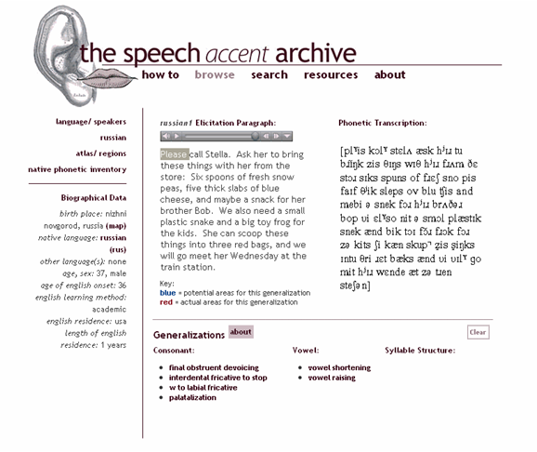

Slide 14
Another web resource
IDEA
https://www.dialectsarchive.com/
Paul Meier, Dylan Paul
VASTA (Voice and Speech Trainers Association)

Slide 15
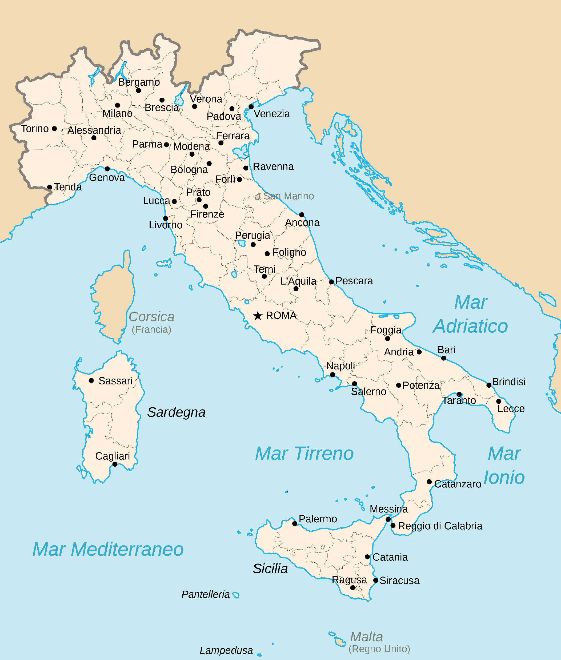
Example: Italy #23
Bio:
Female /Brindisi, Italy/ Student/ Bachelor’s degree
Student has never lived outside of Italy.
Raised in Brindisi, spent six years in Turin.
Recorded: 2/04/07

Slide 16

Sample spoken corpus
“I was born in Brindisi, a town located in the southeast area of Italy. I have a two wonderful parents and a wonderful big brother that I look up to. I’ve lived in Torino for six years. I went to college there, where I majored in psychology.”
(47 words)

Slide 17
Translation posted at IDEA site

Slide 18
Let’ start…broad
Suggestions:
Type out the gloss in large font with extra spacing
Do first pass in broad transcription
/ ‖ aɪ wəz bɔɹn ɪn bɹɪndisi ə taʊn loketɪd ɪn ðə saʊθ ist ɑɹiə əv ɪtəli ‖ /
“I was born in Brindisi, a town located in the southeast area of Italy”

Slide 19
→ Add detail
Include metrical (pause) marks, lexical stress and tonic stress
Listen for juncture
Add narrow detail (see next slide…)
/ ‖ aɪ wəz ˈbɔɹn ɪn ˌbɹɪndisi ǀ ə ˈtaʊn ˌloketɪd ɪnðə ˌsaʊθ ǀ ˈist ˌɑɹiə ǀ əv ˈɪtəli ‖ /
“I was born in Brindisi, a town located in the southeast area of Italy”

Slide 20
Let’s work on sections
[ aɪ wə̞z ˈbɔ̝ɹn ɪ̃n ˌbɹɪ̃ndisi
I was born in Brindisi
ə ˈtaʊ̃n ˌloketɪd ɪ̃ndɛ ˌsaʊθ ǀ ˈis ˌɑɹiə
a town located in the southeast area
ov ˈitəli ]
of Italy

Slide 21
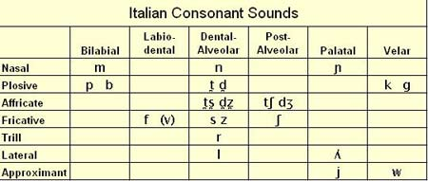

Resources: IPA charts - Italian
Except /z/, all consonants after a vowel and before /r/, /l/, a vowel or a semivowel may be geminated
Stressed vowels are long in non-final open syllables: fato [ˈfaːto], fatto [ˈfatto]

Slide 22
Tips: Praat can help with prosody
“I was born in Brindisi, a town located in the southeast area of Italy”

