Slide 1
Chapter 16
“Visiting Other Places, Other Manners”
SPAU 3343

Slide 2

Length matters!
Gemini
Long consonants analyzed as “double” = “geminate”
Example: in the middle of Italian “folla”
Careful: many English words are spelled with two consonants (e.g. “running”) but are NOT geminates – it is just a spelling rule
Image from 123RF. “Stock Photo – Wow road sign on sky background. Bottom grass.” 06/10/2016. Retrieved 06/10/2016. http://www.123rf.com/photo_10476929_wow-road-sign-on-sky-background-bottom-grass.html

Slide 3
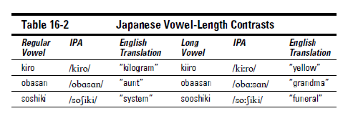
What about vowels? Can they be extra long?
Yes!
Table from Phonetics for Dummies. William Katz. “Visiting Other Places, Other Manners.” 2013.
www.utdallas.edu/~wkatz/PFD/Japanese_vowel_length_contrasts.html

Slide 4
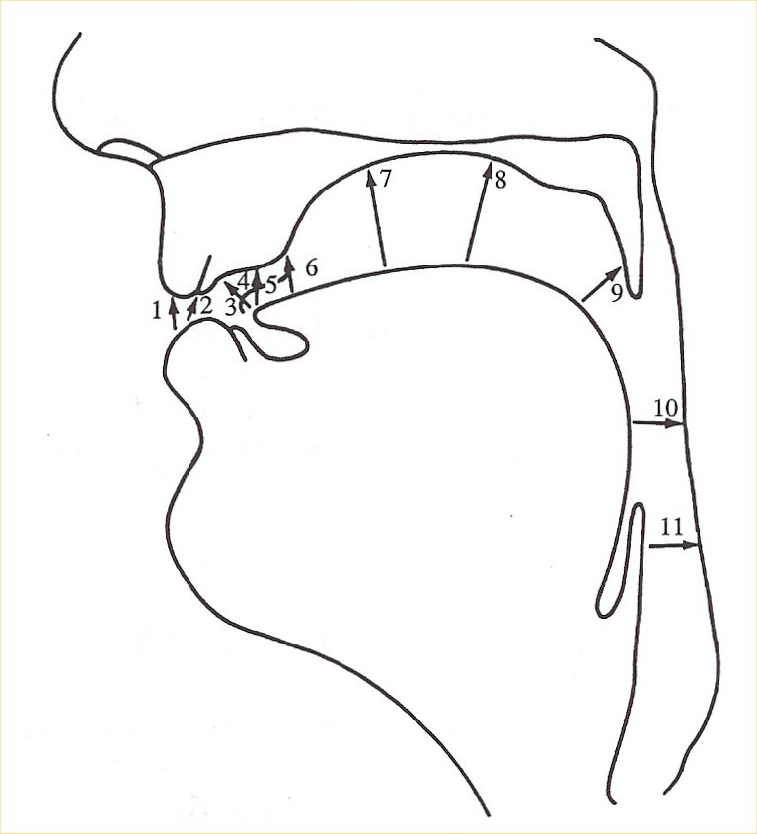
Tracking places of Articulation
….from the lips to the glottis……
Figure from A Course in Phonetics. Peter Ladefoged and Keith Johnson. “Consonantal Gestures.” 2011.

Slide 5
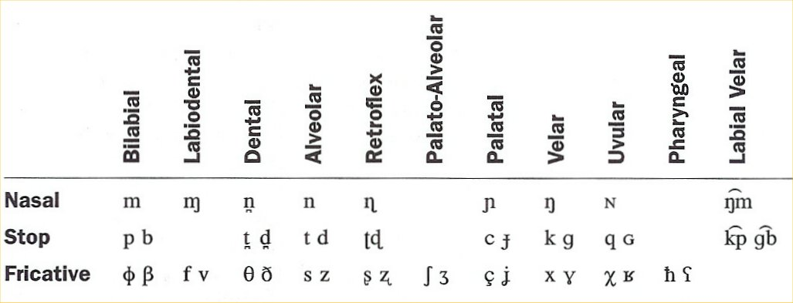
Nasals, Stops and Fricatives
Table from A Course in Phonetics. Peter Ladefoged and Keith Johnson. “Consonantal Gestures.” 2011.

Slide 6
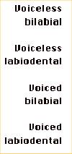
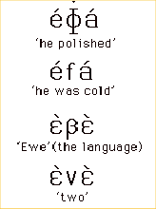
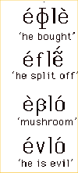

Bilabial fricatives
Ewe (W. Africa)
Bring the two lips nearly together, so that there is only a slit between them. Examples: [, ]
Ewe
Sounds may be found at: http://www.phonetics.ucla.edu/

Slide 7
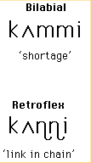
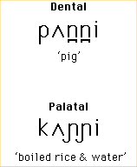

Contrasts of nasal place of articulation
Malayalam
(notice the DENTAL vs. ALVEOLAR contrast here!)
Sounds may be found at: http://www.phonetics.ucla.edu/

Slide 8
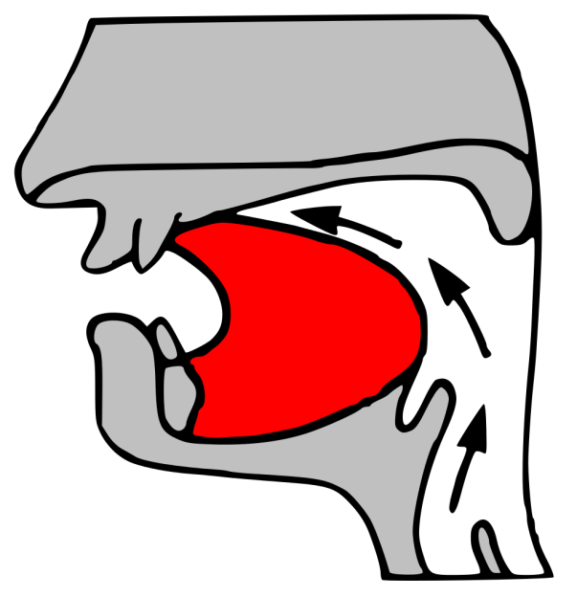
Alveolars
English has many
Across the world’s languages, this place of articulation seems common (unmarked)

Slide 9

Lateral alveolars
Fricatives found in Welsh, Navajo, Taiwanese, Icelandic, and Zulu
Table from Phonetics for Dummies. William Katz. “Visiting Other Places, Other Manners.” 2013.

Slide 10
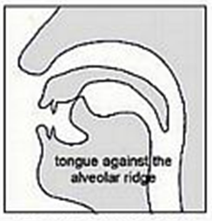
Retroflex
A place and a manner
Many of these sounds found on the Indian subcontinent (India/Pakistan)

Slide 11
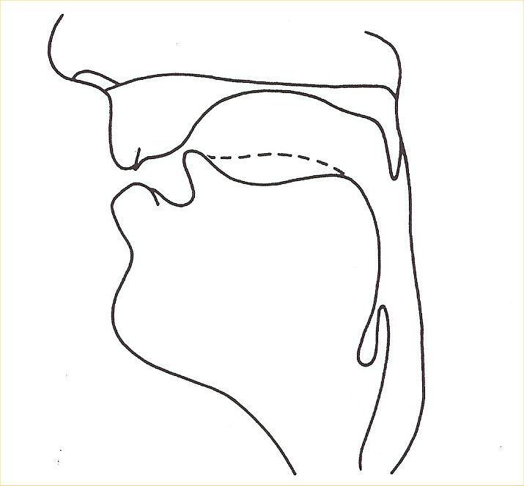
Retroflex fricative []
Figure from A Course in Phonetics. Peter Ladefoged and Keith Johnson. “Consonantal Gestures.” 2011.

Slide 12

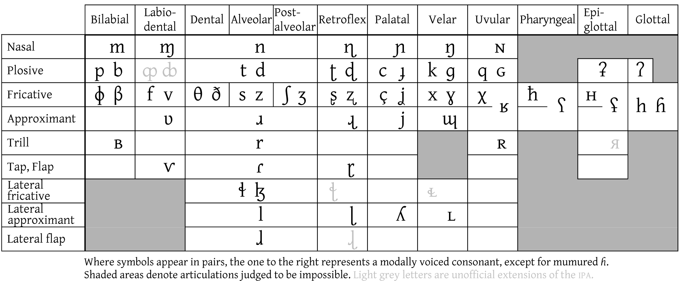

Retroflex Fricative //

Slide 13
Retroflex Fricative //

Slide 14
Retroflex – more detail
Retroflex = typically apical (post-alveolar)
Palato-alveolar = laminal
Apical
tongue tip
Laminal
tongue blade
Images from sail.usc.edu. “Differentiation of oral stop gestures.” Retrieved 6/3/16. http://sail.usc.edu/~lgoldste/General_Phonetics/Constriction_Location/

Slide 15
Palatal sounds
The only true palatal in English is /j/
Usually an approximant, but may be allophonically a voiceless fricative in words such as “hue”

Slide 16
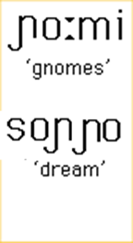


Palatal nasal sounds
Italian
/
/
Sounds may be found at: http://www.phonetics.ucla.edu/

Slide 17
Palatal Lateral Approximant
Italian
[ʎi] ‘to him’
[ˈfoʎʎa] ‘leaf’
[ˈveʎʎare] ‘keep watch’
Sounds may be found at: http://www.phonetics.ucla.edu/

Slide 18
Other palatals
Table from A Course in Phonetics. Peter Ladefoged and Keith Johnson. “Consonantal Gestures.” 2011.

Slide 19
Velar stops and nasals [,,]
Velar stops and nasals [,,] occur in English.
Unlike other languages such as German, we no longer have velar fricatives.

Slide 20
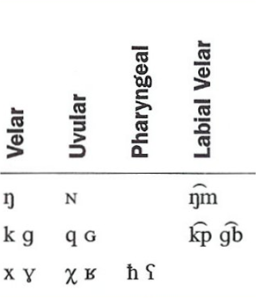
Sample velars from Spanish:
“hijo” (son) /ˈixo/
“pago” (to pay) /ˈpaɣo/
Table from A Course in Phonetics. Peter Ladefoged and Keith Johnson. “Consonantal Gestures.” 2011.

Slide 21
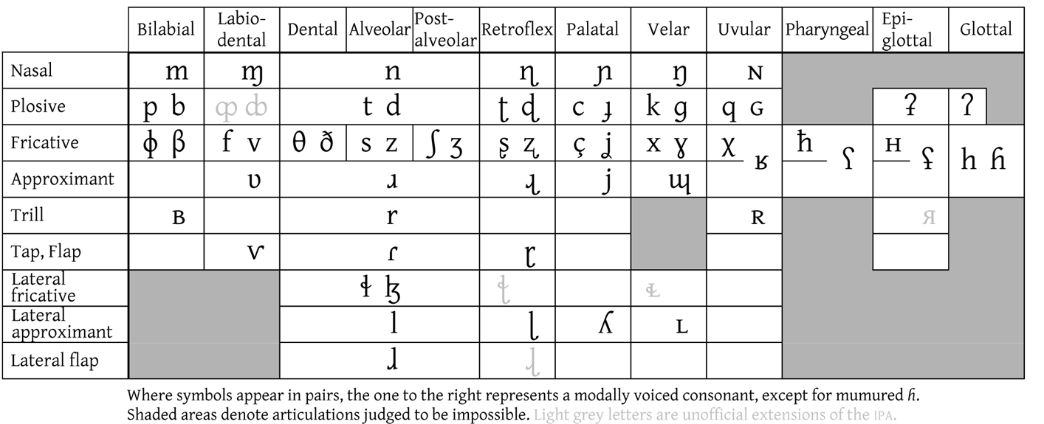
Velar Fricative //

Slide 22
Velar Fricative //

Slide 23
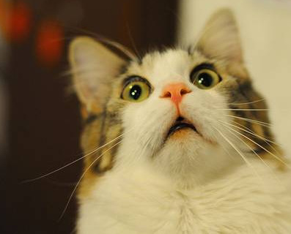
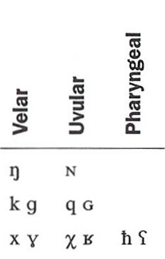
Ready to head “way back”?
(…shock/horror!)
Table from A Course in Phonetics. Peter Ladefoged and Keith Johnson. “Consonantal Gestures.” 2011.
Image from BOOMSbeat. “Cute surprised faces of fluffy cats (photos).” 2016. Retrieved 6/3/16. http://www.boomsbeat.com/articles/1367/20140317/cute-surprised-faces-fluffy-cats-photos.htm

Slide 24
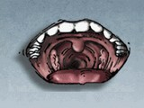
Uvular fricative
Uvular sounds - made by raising the back of the tongue toward the uvula.
Do not occur in most forms of English.
In French, a voiced uvular fricative [] is the common form of r in words.

Slide 25
Uvular Fricative (voiceless) //

Slide 26
Uvular Fricative (voiced) //

Slide 27


Voiced uvular fricative or approximant
French
Sounds may be found at: http://www.phonetics.ucla.edu/

Slide 28
Uvular stops [,❶], and nasals, []
These sounds occur in Eskimo, Aleut, and other American Indian languages.
One way of learning to produce uvulars is to start from a voiceless velar fricative [].
While making this sound, slide your tongue slightly further back in your mouth so that it is close to the uvula.
The result will be the voiceless uvular fricative [].

Slide 29



Contrasts involving stops in Quechua
Palato-Alveolar Velar Uvular
Sounds may be found at: http://www.phonetics.ucla.edu/

Slide 30
Pharyngeal sounds
Produced by pulling the root of the tongue back toward the back wall of the pharynx.
Many people cannot make a stop at this position.
Impossible to make a pharyngeal nasal, for closure at the point would prevent the airstream from coming through the nose.
Pharyngeal fricatives, [❻,].
(see next slide, Hebrew→)

Slide 31

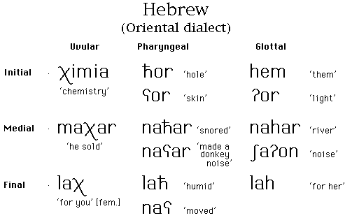

Language index
(Israel)
Sounds may be found at: http://www.phonetics.ucla.edu/

Slide 32

Epiglottal sounds
Produced with a constriction even deeper in the throat than pharyngeal sounds.
Some Arabic speakers actually use epiglottal rather than pharyngeal articulations, e.g. in the word shown in the next slide (→)
Image from 123RF. “Stock Photo – Wow road sign on sky background. Bottom grass.” 06/03/2016. Retrieved 06/03/2016. http://www.123rf.com/photo_10476929_wow-road-sign-on-sky-background-bottom-grass.html

Slide 33
Arabic example
Variants:
Ultrasound of voiced epiglottal fricative (U. Glasgow)
Voiced epiglottal fricative
[ʢ]
Voiceless epiglottal fricative [H]
Ultrasound of voiceless epiglottal fricative (U. Glasgow)
تَعَشَّى [tɑʕɑʃʃæ:]
'to have supper'
/ʕ/ (pharyngeal) in Standard Arabic
…. but voiced epiglottal fricative in some dialects?
Sounds may be found at: http://www.phonetics.ucla.edu/

Slide 34
Consonantal manners not found in GAE
Trills (e.g., Spanish)
Prenasalized stops (e.g., Swahili)
Prestopped nasals (e.g., Russian)
Advanced tongue root (e.g., Akan)

Slide 35
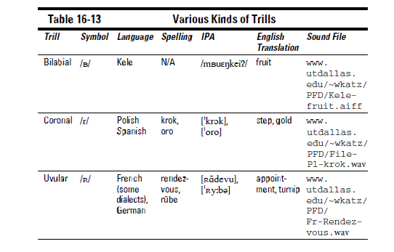
Trills
MRI of voiced alveolar trill
MRI of voiced uvular trill
Table from Phonetics for Dummies. William Katz. “Visiting Other Places, Other Manners.” 2013.

Slide 36

// Voiced uvular trill
French
[ˈlɛtR]
Sounds may be found at: http://www.phonetics.ucla.edu/

Slide 37

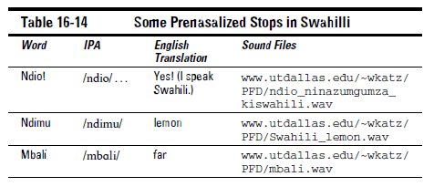
Prenasalized stops
(Kenya)
Table from Phonetics for Dummies. William Katz. “Visiting Other Places, Other Manners.” 2013.

Slide 38
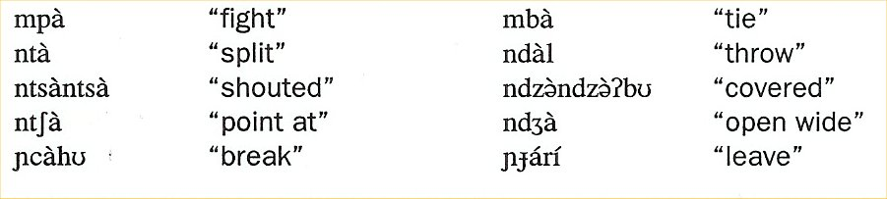

Prenasalized stops in Margi
(Nigeria)

Slide 39
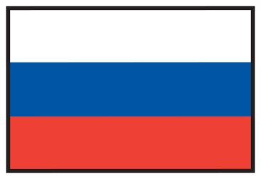
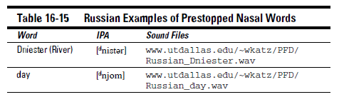
Prestopped nasals
(Russia)
Table from Phonetics for Dummies. William Katz. “Visiting Other Places, Other Manners.” 2013.
Links:
www.utdallas.edu/~wkatz/PFD/Russian_Dniester.wav
www.utdallas.edu/~wkatz/PFD/Russian_day.wav

Slide 40
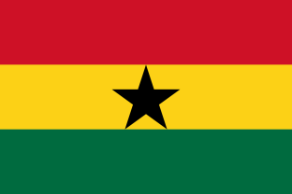
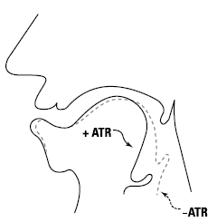
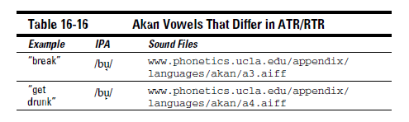
Advanced tongue root
(+ATR)
(Ghana)
http://www.phonetics.ucla.edu/appendix/languages/akan/a3.aiff
http://www.phonetics.ucla.edu/appendix/languages/akan/a4.aiff
Table from Phonetics for Dummies. William Katz. “Visiting Other Places, Other Manners.” 2013.

Slide 41
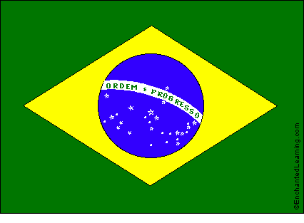
Nasalized vowels
(Brazil)

Slide 42
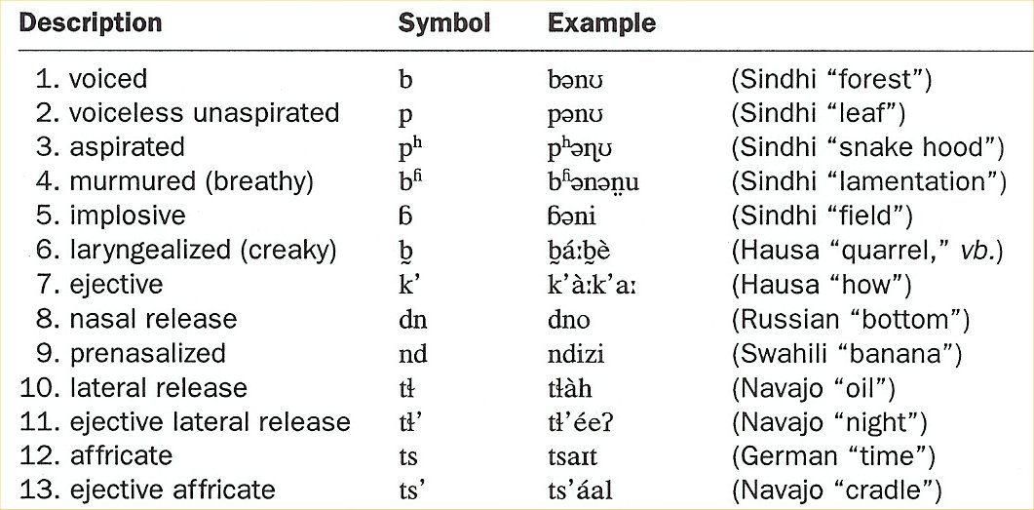
Some different stops across the world’s languages
Table from CD for A Course in Phonetics. Peter Ladefoged and Keith Johnson. “Consonantal Gestures” 2011.

Slide 43
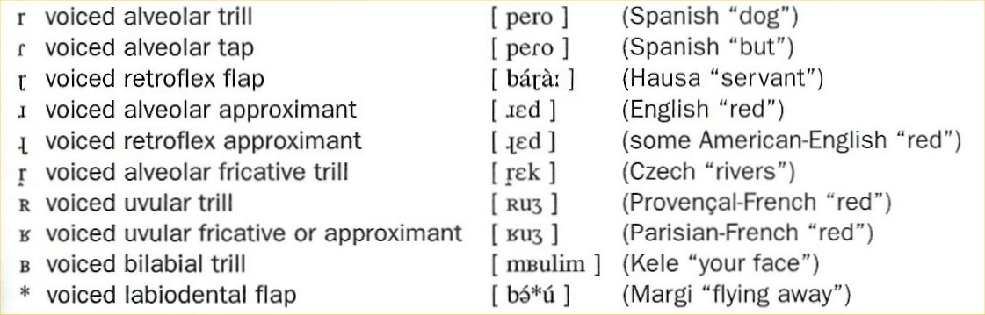
Different types of “r” across various languages

Slide 44
Stress vs. syllable timing
“Stress-timed languages”
Stress based on syllable structure
‘Heavy’ syllables (e.g. CCVCC) attract more stress than ‘light’ syllables (e.g. V, CV)
German, English, Dutch
“Syllable-timed languages”
Stress not based on syllable structure
Have simpler (lighter) syllables, such as V and CV
More monosyllabic, even rhythms
Spanish, Hawaiian, Mandarin

Slide 45
Stress timing: Quantified by PVI
“Pairwise variability index”
The higher the PVI, the more stress timing
Formulae on pg 275.

Slide 46
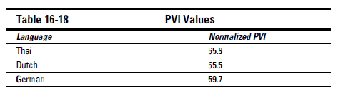
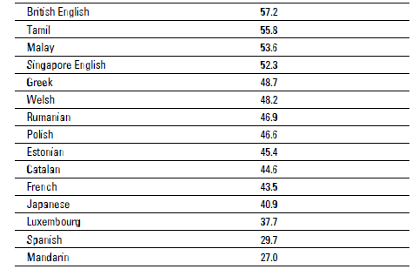
PVI values
Table from Phonetics for Dummies. William F. Katz. “Visiting Other Places, Other Manners.” 2013.

