Slide 1
Chapter 18
Workings with American English Accents (and beyond!)
William Katz, UT Dallas
Phonetics
SPAU 3343

Slide 2
In this PPT
Dialect/Accent
Vowel shifts
How to get a “corpus”?
Major dialects of American English
“Crossing the pond” → UK, Ireland, Aus, NZ, Caribbean and elsewhere

Slide 3
Key Terms
Dialect – regional or social variety of a language distinguished by pronunciation, vocabulary, or grammar,
Accent – refers to the pronunciation part of the language/dialect
“A language is a dialect with an Army and a Navy…”
(Max Weinreich, ~ 1944)

Slide 4
Aspects of dialect
Pronunciation / accent (e.g., “which”, “realtor” )
Lexical – e.g., “supper” vs. “dinner”
Grammar – e.g., “might could go”

Slide 5
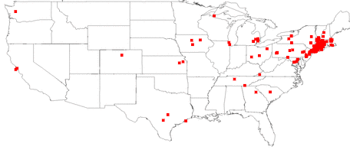
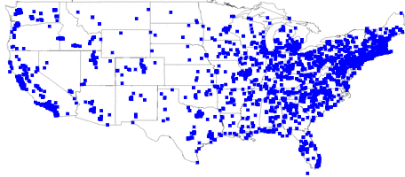
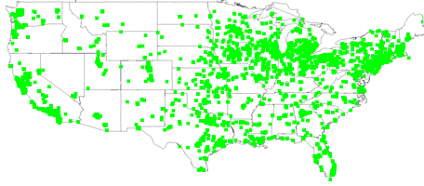
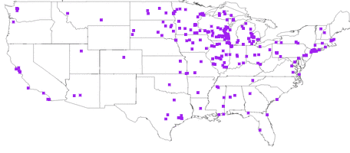
LEXICAL
tag sale (4%)
yard sale (36%)
garage sale (52%)
rummage sale (3%)
- Bert Vaux, Harvard University;
Scott A. Golder, MIT Media Labs

Slide 6
Review
Geographic
Social factors

Slide 7
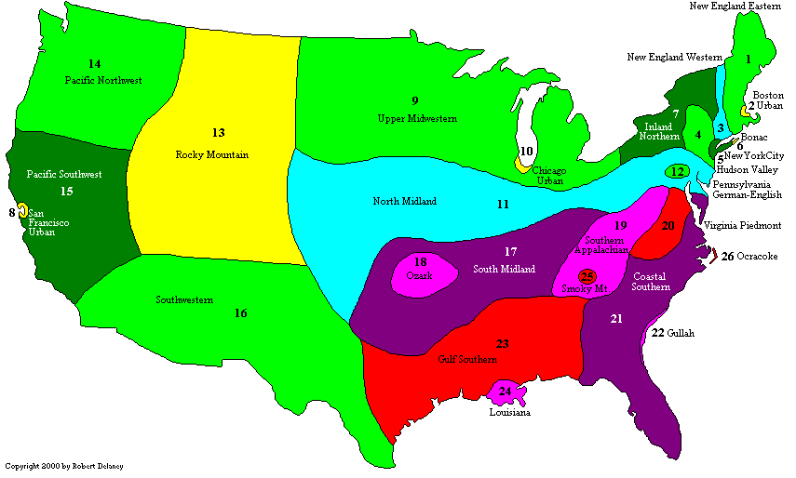
Dialect map – (extreme?) example

Slide 8

Sample Corpus
“Mary Passage”
"Mary is only five and she loves to play in the water.
This morning she got so dirty that I heard her mother call her in to take a bath. It was very early for I was still boiling water for my coffee. Also, there was still a little fog. After a while, however, Mary came across the path into my yard and sat down with me to eat an orange. As I had my second cup of coffee, I asked her if she had been bad. ‘No,’ she said, ‘the dog had been the one.’ He had gotten her so dirty she couldn't brush it off."
A foreign-accented example: (Cambodian)
Other corpuses:
“Comma gets a cure”
- Uses J.C. Wells standard lexical sets
“Stella/Snow Peas passage”
– for IDEA project
“Grandfather passage”, “Caterpillar passage”
–more common for speech pathology
Information from utdallas.edu/~wkatz/phonetics_course/. W. Katz. “Mary Passage Speech Samples”. Accessed 06/23/2016. http://www.utdallas.edu/~wkatz/phonetics_course/mary.html

Slide 9
An older corpus… http://dare.wisc.edu/audio/arthur-the-rat
ARTHUR THE RAT (1965-1970)
“Once upon a time there was a rat who couldn't make up his mind. Whenever the other rats asked him if he would like to come out hunting with them, he would answer in a hoarse voice, "I don't know." And when they said, "Would you rather stay inside?" he wouldn't say yes, or no either. He'd always shirk making a choice. One fine day his aunt Josephine said to him, "Now look here! No one will ever care for you if you carry on like this. You have no more mind of your own than a greasy old blade of grass!" The young rat coughed and looked wise, as usual, but said nothing. "Don't you think so?" said his aunt stamping with her foot, for she couldn't bear to see the young rat so coldblooded. "I don't know," was all he ever answered, and then he'd walk off to think for an hour or more, whether he would stay in his hole in the ground or go out into the loft. Next morning -- it was a foggy day -- some men came to look over the damage. It seemed odd that the old building was not haunted by rats. But at last one of them happened to move a board, and he caught sight of a young rat, quite dead, half in and half out of his hole…. …… Thus the shirker got his due, and there was no mourning for him.”
Nine Speakers: Brooklyn, NY; Rural Maine; Roxbury, MA; Memphis, TN; Eastern VA; S. Central GA; Witchita Falls, TX, N. West WA; NW Wisc;
…shows that accents CHANGE over time…..
Information from Dictionary of American Regional English. “Arthur the Rat”. Accessed 6/23/16. http://dare.wisc.edu/audio/arthur-the-rat

Slide 10
Read corpus - challenges
Naturalness?
Sampling adequacy?
Rapidly grow dated?

Slide 11
American Dialect Maps
North Central
New England (+ NYC)
Midland
South
West
Atlas of North American English
(formerly, the Phonological Atlas of North America).
William Labov, Sharon Ash and Charles Boberg
(Linguistics Laboratory, University of Pennsylvania)

Slide 12
Method
Searched phone books for ‘representative speakers’
…by ‘prominent national ancestry groups’
SCRIPT:
“Hi, my name is ___, I’m calling from the University Pennsylvania in Philadelphia. We’re doing research on communication between people from different parts of the country, so we’re looking for people who grew up in one place to help us by telling us a little about how people say things in your area. Did you grow up in ___? If yes: Can you take a few minutes now to answer some questions?”

Slide 13
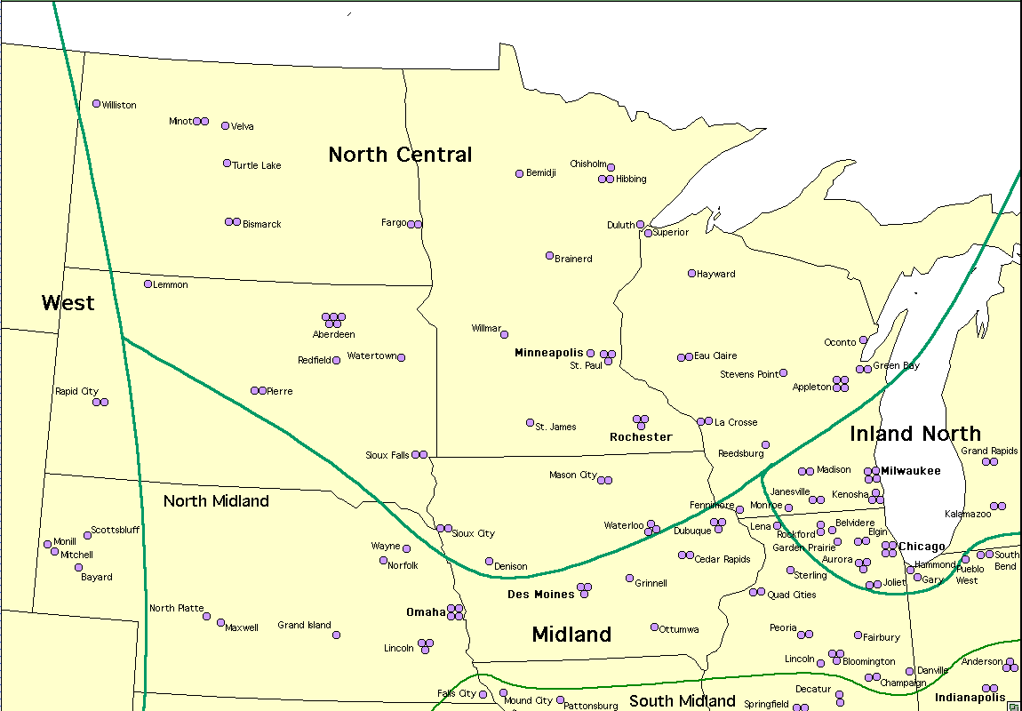
North Central
Image from ling.upenn.edu. “North Central Regional Map.” Accessed 20 June 2016. http://www.ling.upenn.edu/phono_atlas/maps/MapsNC/Map1NC.html

Slide 14
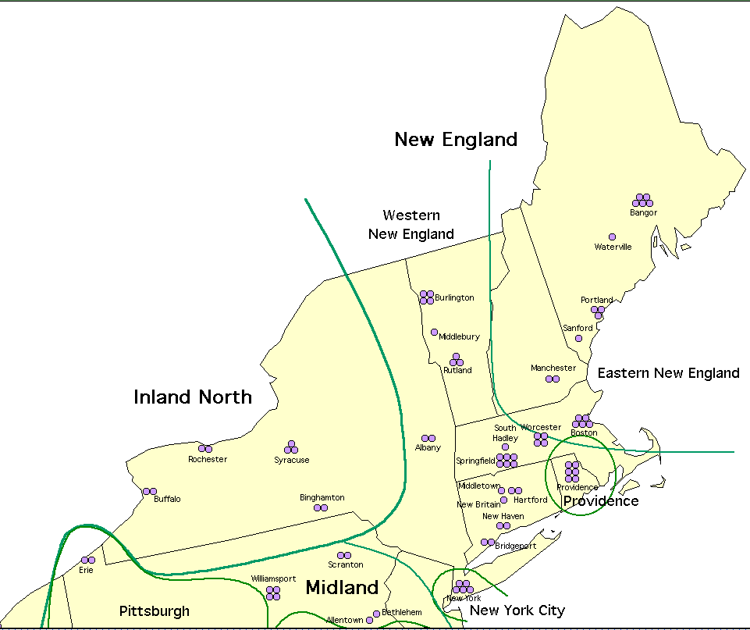
New England to NYC
Image from ling.upenn.edu. “New England Regional Map.” Accessed 20 June 2016. http://www.ling.upenn.edu/phono_atlas/maps/MapsNE/Map1NE.html

Slide 15
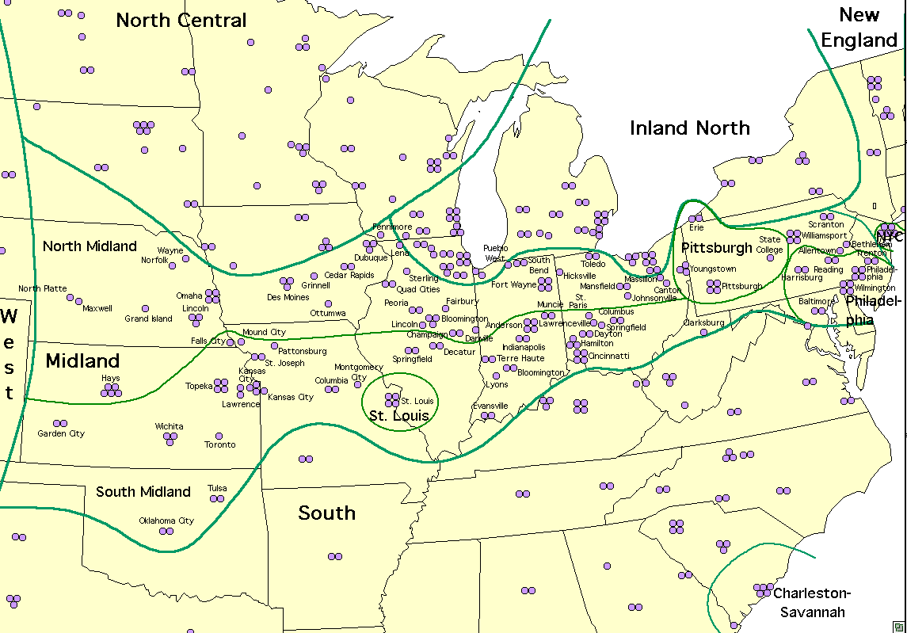
The Midland
Image from ling.upenn.edu. “Midland Regional Map.” Accessed 20 June 2016. http://www.ling.upenn.edu/phono_atlas/maps/MapsM/Map1M.html

Slide 16
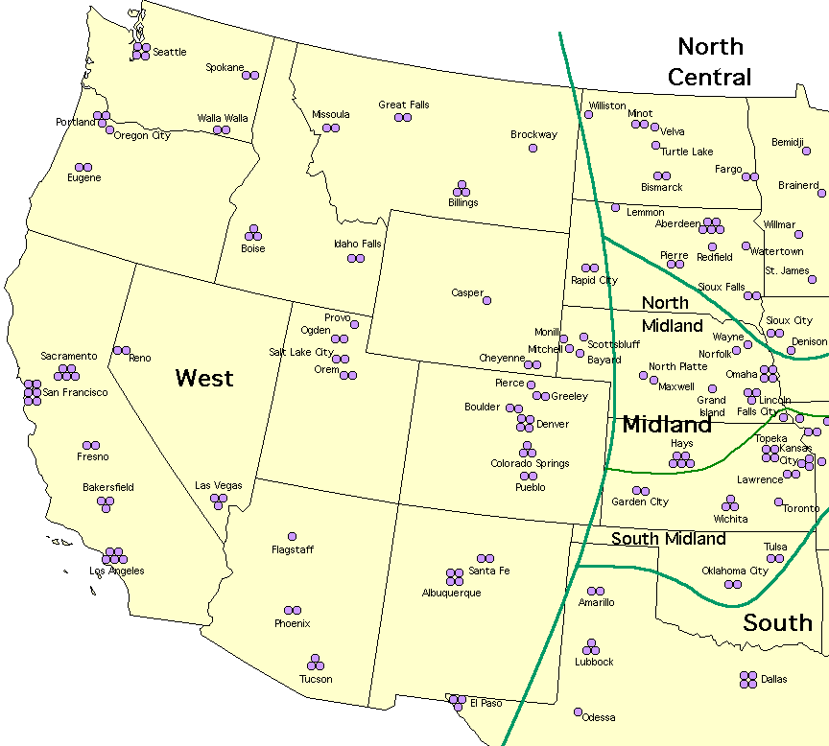
The West
Image from ling.upenn.edu. “West Regional Map.” Accessed 20 June 2016. http://www.ling.upenn.edu/phono_atlas/maps/MapsW/Map1W.html

Slide 17
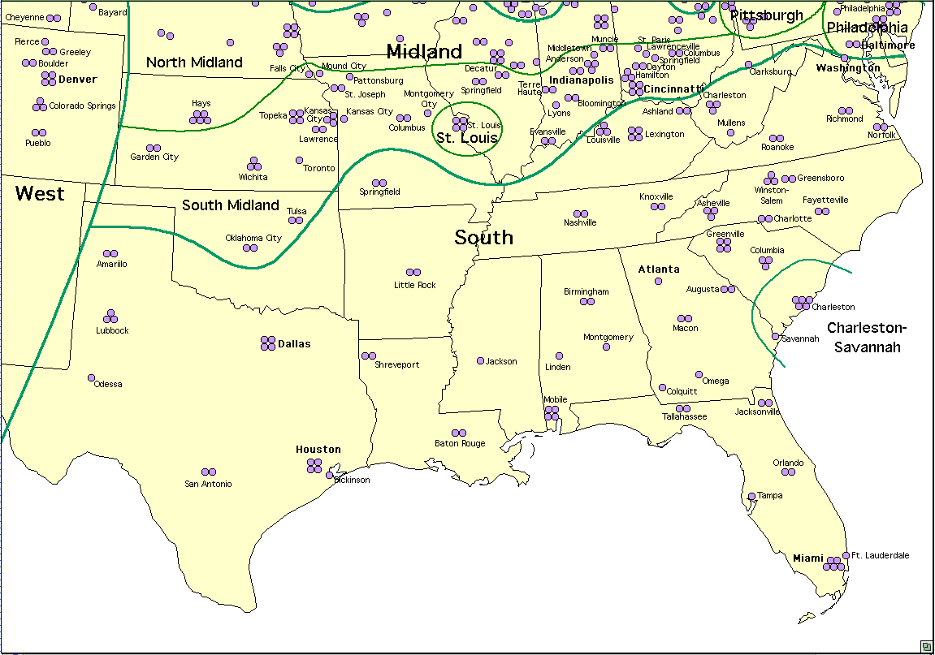
The South
Image from ling.upenn.edu. “South Regional Map.” Accessed 20 June 2016. http://www.ling.upenn.edu/phono_atlas/maps/MapsS/Map1S.html

Slide 18
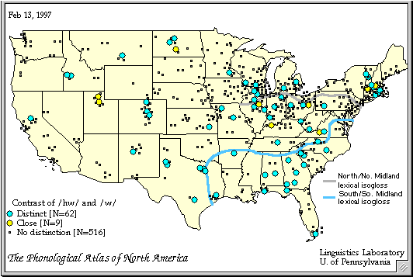
Example: Maintenance of the /hw/~/w/ contrast
Fr, Kurath and McDavid's Pronunciation of English in the Atlantic States (1961)
Characteristic of the North and the South, but not the Midland
Map from ling.upenn.edu. “Map 8.The maintenance of the /hw/~/w/ contrast.” Accessed 6/23/16. http://www.ling.upenn.edu/phono_atlas/maps/Map8.html

Slide 19
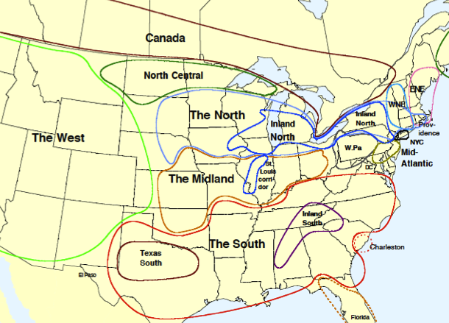
What about Texas?
Originally within “the South”
By 2006, “Texas South” division included
Based on degree of [aɪ]
monophthongization
Map from Discover Magazine. Julie Sedivy. “Votes and Vowels: A Changing Accent Shows How Language Parallels Politics”. March 28, 2012. Accessed June 23, 2016. http://blogs.discovermagazine.com/crux/2012/03/28/votes-and-vowels-a-changing-accent-shows-how-language-parallels-politics/#.V2wNstIrLcs

Slide 20

Texas
Texas English Project (UT Austin)
Morphosyntax:
Y’all’s car
Fixin’ to
Might could
Like’ta died
Done left
Phonetics:
[hw] vs. [w]
horse vs. hoarse (/oɹ/, /ɔɹ/ - distinct)
dew vs. do? /dju:/, /du/)
cot = caught (/ɔ/ = /ɑ/)
pin = pen (/ɪ / = /ɛ/)
oil → “ol” (monophthongization)
Information from UT Austin. Douglas S. Bigham. “Texas English Project”. 5 Jan 2010. Accessed 23 June 2016. http://laits.utexas.edu/texas_english/

Slide 21
Texas English Project -findings
Compared Underwood 1988 recordings (Austin)
..with 2010 recordings of same utterances
Featural and acoustic analyses
Analyzed for possible gender, age, time of recording, geographic factors
MAIN FINDINGS:
  Key property affecting accent was urban vs. rural divide
  Dialect leveling led by young females (expected);
  in some cases of minority ethnicities (unexpected)
Information from UT Austin. Douglas S. Bigham. “Texas English Project”. 5 Jan 2010. Accessed 23 June 2016. http://laits.utexas.edu/texas_english/

Slide 22

Let’s try some American accents

Slide 23
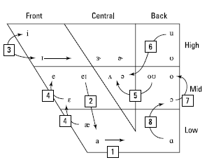
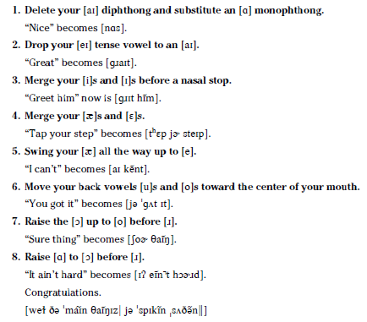
Southern vowel shift
(Pg. 296, Phonetics for Dummies, Fig 18-2)
Figure and Information from Phonetics for Dummies. William F. Katz. “Accentuating Accents”. 2013

Slide 24
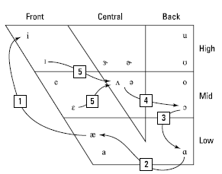
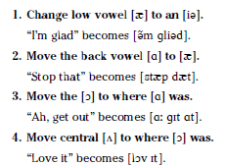

Northern Cities Shift
Figure and Information from Phonetics for Dummies. William F. Katz. “Accentuating Accents”. 2013

Slide 25
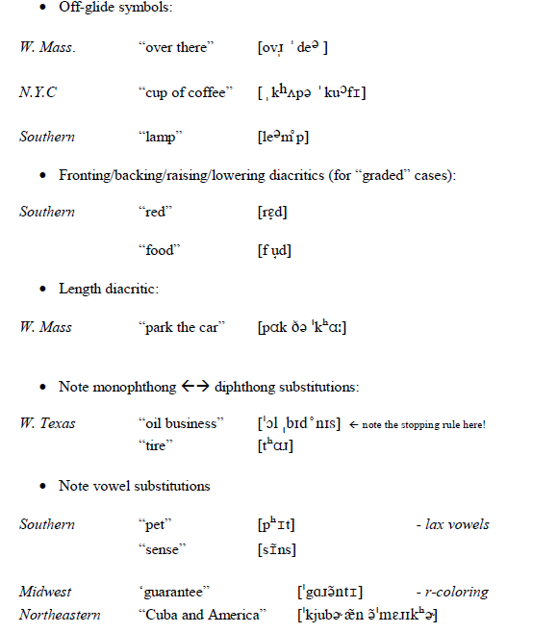
American English Accents - vowels

Slide 26
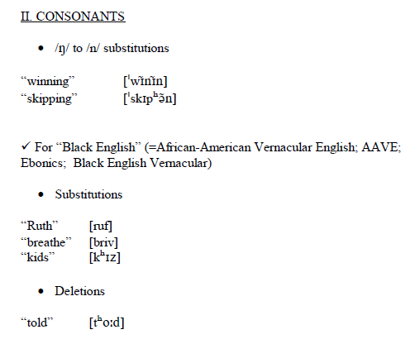
American English Accents - consonants
(for more info on “Black English”, including videos, see “languageandlife.org” – a project of NC State University)

Slide 27
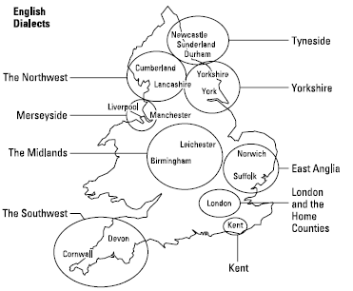

Now -- some British accents
Blimey!
Figure from Phonetics for Dummies. William F. Katz. “Accentuating Accents”. 2013
Image from Pinterest. Burlington’s Emporium. “Bulldogs”. Accessed 6/23/16. https://www.pinterest.com/Archiburlington/bulldog/

Slide 28
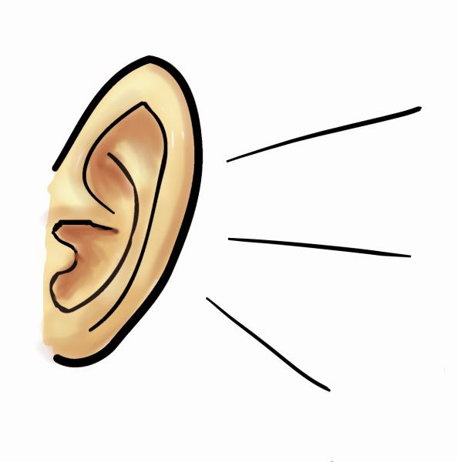
Features to listen for…
Raised vowels? “trap” → /trep/ and “cat” → /ket/
Rhoticity or not?
Trap-bath split? “dance” → /dɑns/
(pronounced with broad-a)
London vowel shift: Cockney “day” → /dæɪ/
Glottal Stopping: “better” → /ˈbeʔə/
L-vocalization: “pal” →/pɑʊ/
Th-Fronting: “thing” → /fɪŋ/, “mother” → /ˈmʌvə/

Slide 29

English examples
RP (Received Pronunciation), Margaret Thatcher http://www.youtube.com/watch?v=odb8ux3g9_8
Cockney, Actor Ray Winston
https://www.youtube.com/watch?v=ppswJ7sg-vU
“Estuary English”, (scolding) Chef, Jamie Oliver http://www.youtube.com/watch?v=jIwrV5e6fMY
West Country (Southwest) guy from Taunton (Devon) - too close to his mic! https://www.youtube.com/watch?v=rh5iMXvO5Gk
(Midlands/Birmingham), Les Ross, Broadcaster
https://www.youtube.com/watch?v=T1zbRls03Cs
Geordie (Newcastle-Upon-Tyne), Singer, Cheryl Cole http://www.youtube.com/watch?v=us6EPrD_kKM
(hat tip: dialectblog.com)
Video from YouTube. New York Times. ”Margaret Thatcher's Memorable Remarks: A Video Mash-up | The New York Times”. April 8, 2013. Accessed June 23, 2016. https://www.youtube.com/watch?v=odb8ux3g9_8
Video from YouTube. Actor Ray Winstron”. . Accessed June 23, 2016. https://www.youtube.com/watch?v=rSVieNOW7QM
Video from YouTube. Jamie Oliver. “Jamie Oliver’s TED Award Speech”. February 12, 2010. Accessed 6/23/16. https://www.youtube.com/watch?v=jIwrV5e6fMY
Video from YouTube. Wiltshire Museum. “Phil Harding’s favourite object – the Stonehenge Dagger”. September 7, 2009. Accessed June 23, 2016. https://www.youtube.com/watch?v=h3k4FuKx1aU
Video from YouTube. PETA (People for the Ethical Treatment of Animals). “Black Sabbath’s Geezer Butler”. May 5, 2009. Accessed June 23, 2016. https://www.youtube.com/watch?v=D5ASHXylc-g
Video from YouTube. Cheryl. “Cheryl Cole YouTube Fan Interview”. November 2, 2010. Accessed June 23, 2016. https://www.youtube.com/watch?v=us6EPrD_kKM

Slide 30

Elsewhere in the UK and Ireland
Welsh English – recording from ‘Mic’ project in Wales
https://youtu.be/AFMhtLnup-c
Scottish English – young lady from Glasgow –
https://www.youtube.com/watch?v=SGKoekcThLE
Scottish English (Edinburgh – Actor Ewen Bremner) http://www.youtube.com/watch?v=O4IzLhXoYvw
Irish accent (Dublin -Pardraig Harrington, Pro Golfer) http://www.youtube.com/watch?v=p8w0A9tg450#t=1m47s
Irish accent (Donnegal, N. Ireland) http://www.youtube.com/watch?v=z4zBULlOgVI
Video from YouTube. BBC. “Rhys Ifans - Friday Night with Jonathan Ross - BBC One”. March 27, 2009. Accessed June 23, 2016. https://www.youtube.com/watch?v=04KTau1b29E&list=PLFYJGopjdU096f81Pnq_6zyn4J2eGCox7
Video from YouTube. VocableLangues. “Peter Mullan NEDS interview Vocable”. August 31, 2011. Accessed June 23, 2016. https://www.youtube.com/watch?v=m5Llm8pWLVo
Video from YouTube. Sarajevo Film Festival. “Ewen Bremner”. July 29, 2010. Accessed June 23, 2016. https://www.youtube.com/watch?v=O4IzLhXoYvw
Video from YouTube. PGA TOUR. “In the Bag: Padraig Harrington”. April 23, 2009. Accessed June 23, 2016. https://www.youtube.com/watch?v=p8w0A9tg450#t=1m47s
Video from YouTube. Lainehh. “Strong Irish Accent – Tumblr Accent Challenge”. April 22, 2012. Accessed June 23, 2016. https://www.youtube.com/watch?v=z4zBULlOgVI

Slide 31
Some UK consonant differences
Feature | RP | Cockney | Estuary | Welsh | Scottish | Irish
/r/ at end of words | non-rhotic | non- rhotic | non-rhotic | usually non-rhotic | rhotic | usually rhotic
/r/ consonant | + | + | + | often trilled, tapped | often trilled, tapped | +
glottal stopping? | + | + | weak | - | + of /t/ | -
/θ, ð/ → /f,v/ | + | + | weak | - | - | becomes alveolar
/l/ allophones? | n/a | n/a | n/a | n/a | velarized | non-velarized
/l/ → /w/ | + | + | + | - | - | -

Slide 32
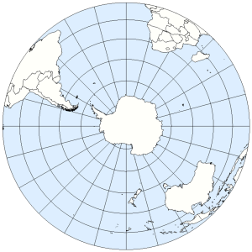
Heading ‘Down Under’
Australia (broad) the late Steve Irwin http://www.youtube.com/watch?v=N4_mWRnmWEs
New Zealand (cultivated) Prime Minister John Key http://www.youtube.com/watch?feature=player_embedded&v=_r-VSRTmjq0
South Africa (accent tag, Capetown) http://www.youtube.com/watch?v=vKqqH8jUo3k
Image from Live Journal. Kactaheda. "Перевернутая" Земля или Зеркальное отражение”. September 16, 2016. Accessed June 23, 2016. http://kactaheda.livejournal.com/72971.html
Video from YouTube. pbuk1. “Crocodile hunter,Steve Irwin with a lot of different snakes.” October 8, 2006. Accessed June 23, 2016. https://www.youtube.com/watch?v=N4_mWRnmWEs
Video from YouTube. NZNats. “Video Journal No.39 – John Key PM”. April 18, 2011. Accessed June 23, 2016. https://www.youtube.com/watch?feature=player_embedded&v=_r-VSRTmjq0
Video from YouTube. Jacques Hendriksz. “Accent Tag Cape Town South Africa”. July 5, 2012. Accessed June 23, 2016. https://www.youtube.com/watch?v=vKqqH8jUo3k

Slide 33
Some
Aussie – Kiwi - S. African consonant differences
Feature | AUSSIE | KIWI | SOUTH AFRICAN
/r/ at end of words | non- rhotic | Mostly non- rhotic | non-rhotic
linking- and intrusive /r/ | + | Mostly + | -
/θ, ð/ → /f,v/ | - | - | +
/l/ allophones | May all be velarized | velarized | -
/w/ vs. /hw/ | - | Merged in younger | Merged in younger

Slide 34

To the Islands
Trinidad (accent tag) http://www.youtube.com/watch?v=HF6zJeYIaXQ
Jamaica (the Night before Christmas)
http://www.youtube.com/watch?feature=player_embedded&v=zoWkNVctUtc#t=38
Grenada (making kites) http://www.youtube.com/watch?v=f7rytYKgWLk
Video from YouTube. Jamaica. “The Night Before Chriatmas in Jamaican Patois”. November 28, 2009. Accessed June 23, 2016. https://www.youtube.com/watch?feature=player_embedded&v=zoWkNVctUtc#t=38
Video from YouTube. EL SPICE FORRESTER. “HOW TO MAKE KITE MAKING WITH JOE IN GRENADA 2010 TOUCH-UP TV”. March 23, 2010. Accessed June 23, 2016. https://www.youtube.com/watch?v=f7rytYKgWLk

Slide 35
Summary: Vowels, /ae/ - /ar/
https://en.wikipedia.org/wiki/International_Phonetic_Alphabet_chart_for_English_dialects

Slide 36
Vowels – cont’d
https://en.wikipedia.org/wiki/International_Phonetic_Alphabet_chart_for_English_dialects

