Slide 1
Chap 14 Perceptual and linguistic phonetics
Staging speech perception
Lack of invariance
Cues and cue trading
Categorical perception
Ease of articulation vs. perceptual distinctiveness
W. Katz/ UT Dallas/ SPAU 3343

Slide 2
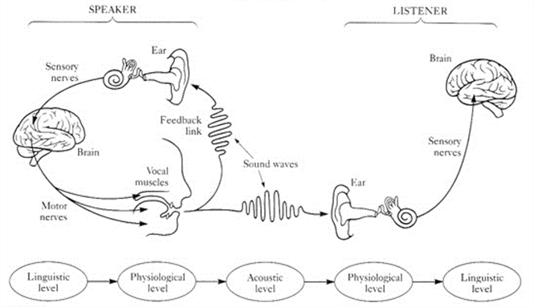
The speech chain
Figure from DEPA – Université Paris 8. Takeki Tamiyama. “Phonetics and Phonology”. 12 February 2015. Accessed 15 June 2016. http://www.depa.univ-paris8.fr/spip.php?page=imprimer&id_article=1353

Slide 3
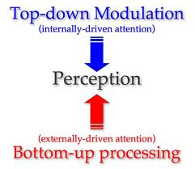
Bottom up/ top down
Image from Gazzaley Lab – UCSF. Adam Gazzaley. “Top-down Modulation/Cognitive Aging.” 2014. Accessed 6/15/16. http://gazzaleylab.ucsf.edu/neuroscience-research/background-and-findings/#backtotop

Slide 4
Lack of invariance
Each person produces different physical signals
Much variance!
A computer has a hard time decoding this
Human listeners do not
How do we explain this?
Image from colourbox.com. icondesign. “People icons dialog speech bubbles, vector”. November 8, 2013. Accessed June 15, 2016. https://www.colourbox.com/vector/people-icons-dialog-speech-bubbles-vector-8202706

Slide 5
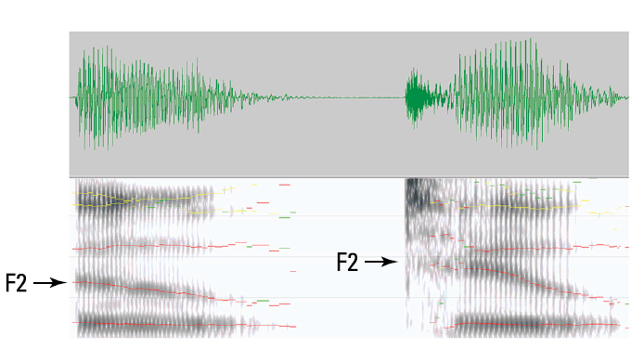
Lack of invariance - example
/u/ vs. /t^{h}u/
… /u/ F2 starts
much higher here!
Pg. 221.

Slide 6
Coarticulation
Anticipatory
(= “right to left”) /s u/ lip-rounding affects /s/
Perseverative
(= “left to right”)
/s u/ /s/ frication carries over onto /s/
Information from Phonetics for Dummies. William F. Katz. “Producing Speech: The How-To”. 2013.

Slide 7
Anticipatory coarticulation
Index of speech planning
Language dependent
For instance, lip rounding in English extends roughly 250 msec (~ 1 syllable)
In French, can extend up to ~ 6 syllables
“sinistr(e) structure”
/y/
LIP ROUNDING
ALREADY HERE!

Slide 8
Perseverative coarticulation
Measure of biomechanical, inertial properties of speech
An example is tongue twisters
Contain sounds with many close features
Left to right coarticulation causes speech errors

Slide 9
More coarticulation facts
Can..not..co..ar…ti..cu…late….laaate….
All people coarticulate in all speech!
Lack of coarticulation (e.g., in poor speech synthesis) sounds “robot-like”
Coarticulation mastered early by children
Seems to break down in some disorders, including apraxia of speech (AOS)

Slide 10
More than one way to signal a phonetic feature….
Example:
VOT and bursts can cue a stop consonant
Redundancy!
Cues can also trade off (see next slide)

Slide 11
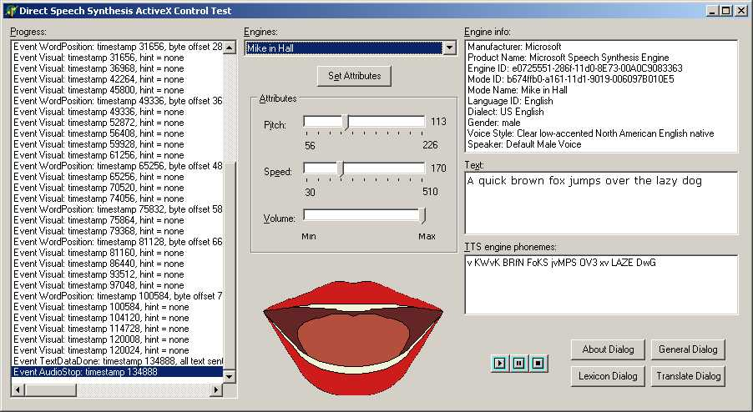
Synthesized Speech
Allows for precise control of sounds
Valuable tool for investigating perception
For samples in English, German, French and other languages:
http://www.ims.uni-stuttgart.de/institut/mitarbeiter/moehler/synthspeech/

Slide 12
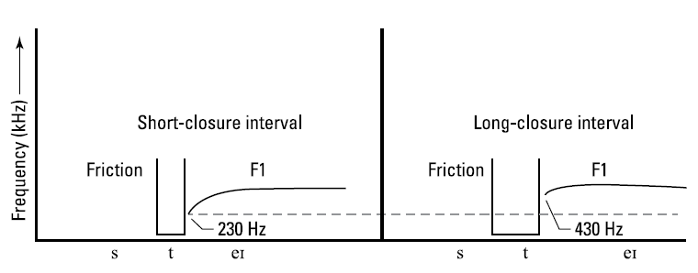
Cue trading in action
Pg. 225
Illustration by Wiley, Composition Services Graphics. Figure from Phonetics for Dummies. William F. Katz. “Confirming That You Just Said What I Thought You Said”. 2013.

Slide 13
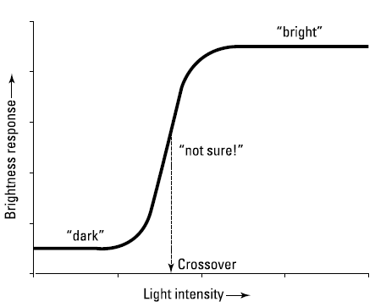
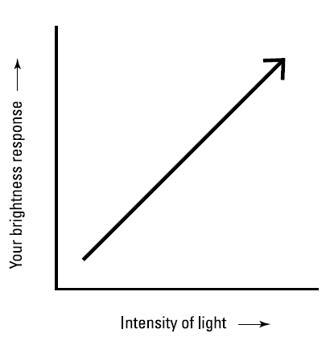
Two types of perception
Graded (usual) Categorical (Speech)
Illustration by Wiley, Composition Services Graphics. Figures from Phonetics for Dummies. William F. Katz. “Confirming That You Just Said What I Thought You Said”. 2013.

Slide 14
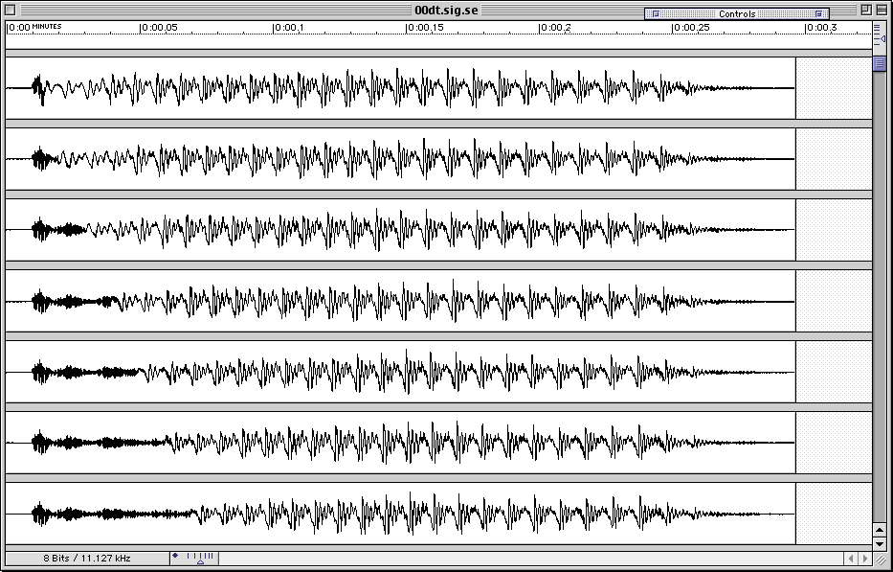
Voice Onset Time (VOT)
60 msec
Illustration by Wiley, Composition Services Graphics. Figure from Phonetics for Dummies. William F. Katz. “Confirming That You Just Said What I Thought You Said”. 2013.

Slide 15
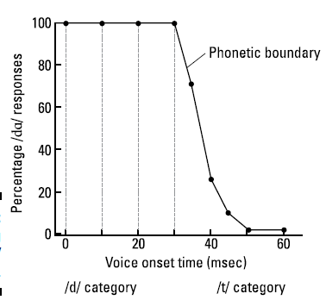
/dɑ/ vs. /tɑ/ identification
Illustration by Wiley, Composition Services Graphics. Figure from Phonetics for Dummies. William F. Katz. “Confirming That You Just Said What I Thought You Said”. 2013.

Slide 16
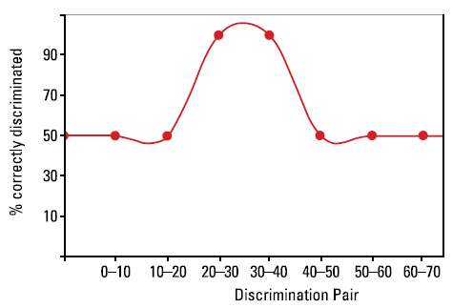
/dɑ/ vs. /tɑ/ discrimination
Illustration by Wiley, Composition Services Graphics. Figure from Phonetics for Dummies. William F. Katz. “Confirming That You Just Said What I Thought You Said”. 2013.

Slide 17
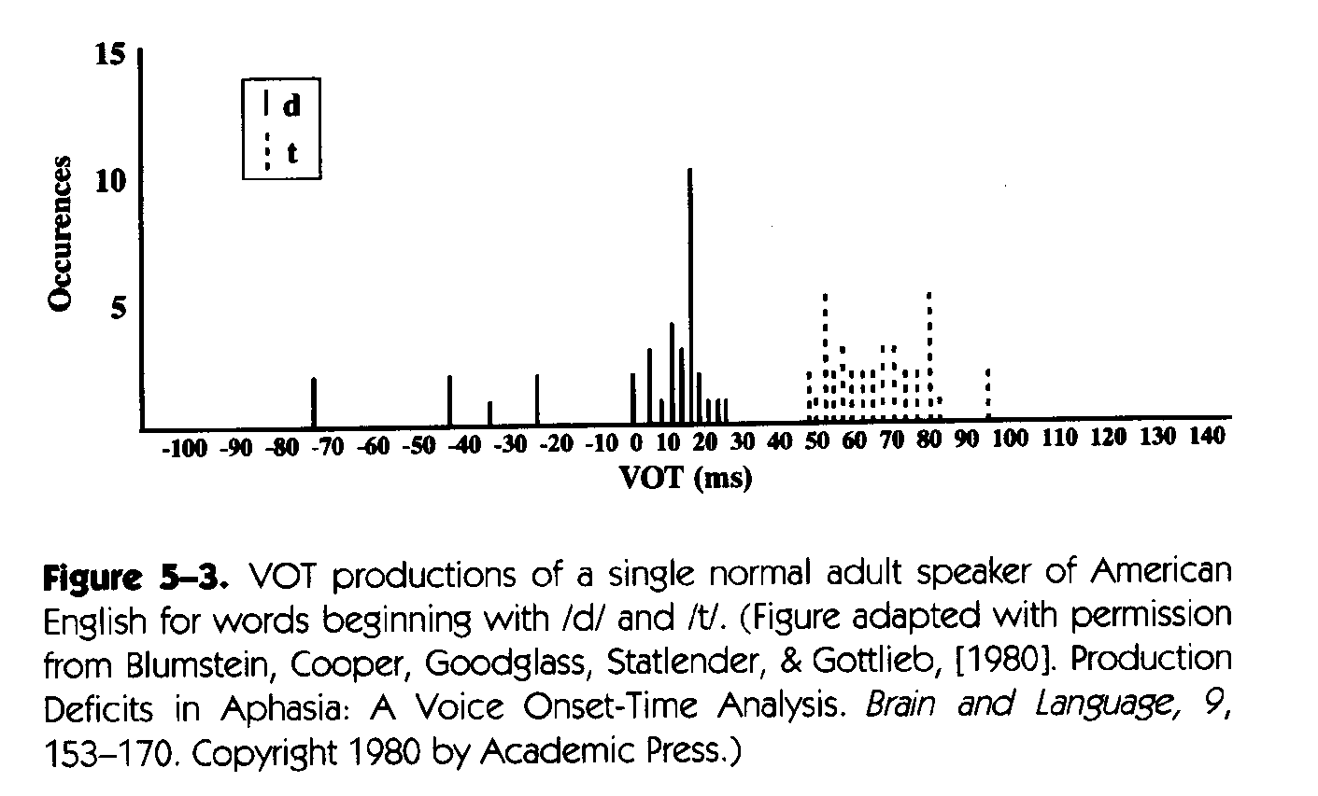
English VOT production
Not uniform
2 categories

Slide 18
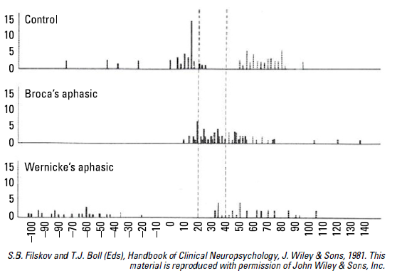
VOT production breaks down in aphasic speech (n=3/group)

Slide 19
Ease of articulation vs. Perceptual distinctiveness
Two properties which constrain language
Tend to balance each other in an opposing fashion….

Slide 20
Ease of articulation
EXAMPLES
“soften” /t/ -> 0 (ellipsis)
“in” + “possible” = “impossible” (assimilation)

Slide 21
Q: What is “easier” to produce in speech?
EXAMPLES:
Vowels easier than consonants
CV syllables easier than heavy syllables (e.g., CVC) – see infant babbling
Short vowels easier than long – evidence from language change (diachronic):
Longer vowels difficult to produce because of extra time and energy to expel air out of the lungs

Slide 22
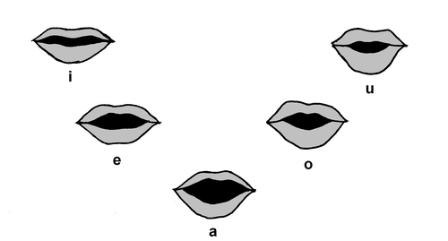
Perceptual distinctiveness
Vowel systems of world languages appear organized for maximal “listen-ability”
Languages with small vowel inventories tend to “hug the periphery” and be spread out
Languages with larger inventories tend to have additional features (e.g. length, nasalization) to ensure perceptual distinctiveness

Slide 23
Examples
From UPSID (UCLA Phonetic Segmental Inventory Database) > 317 languages
Range of 3 -15 vowel phonemes in inventory
Most common: 5 vowel system with /a i u e o/
Tellingly, no as “ /i ɨ ɪ e ԑ/” or “/u ʊ ɔ o ɑ /” systems found….
/

Slide 24
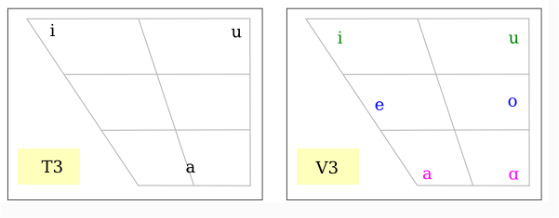
Common 3- and 4-vowel patterns

Slide 25
Common 5–vowel patterns
✓

