Slide 1
Lecture 1
Introduction
SPAU 3343
Phonetics and Phonology
William Katz, Ph.D.
University of Texas at Dallas

Slide 2
(A very brief) history of phonetics
“The history of phonetics—going back some 2.5 millennia—makes it perhaps the oldest of the behavioral sciences and, given the longevity and applicability of some of the early findings from these times, one of the most successful”
-- Prof. John Ohala, UC Berkeley, 1991

Slide 3
Early roots
India
Korea

Slide 4
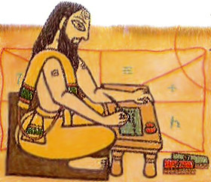
Panini
India ~ 7th - 4th centuries B.C.E.
His work on Sanskrit was surprisingly modern and systematic
Phonology/phonetics was explicitly dealt with
Discovery of Panini's grammar helped develop today’s linguistic science
Image from IndiaNetzone. “Panini, Sanskrit Grammarian.” 09/23/2009. Accessed 5/20/2016. http://www.indianetzone.com/31/panini_sanskrit_grammarian.htm

Slide 5

King Sejong of Korea
Wanted his people to be literate, but knew that the existing (Chinese-based) system was too difficult
Created (by himself!) an entirely new, scientific alphabet based on phonetics (see next slide →)
Named this alphabet Hun Min Jong Um, “Accurate Sounds to Educate the People”
His alphabet was largely neglected, almost until the 20th century
Now in general use in both South and North Korea
1397-1450
Image from JAARS Museum of the Alphabet. “Alphabet Makers: King Sejong of Korea.” 1999-2011. https://www.jaars.org/museum/alphabet/people/sejong.htm

Slide 6
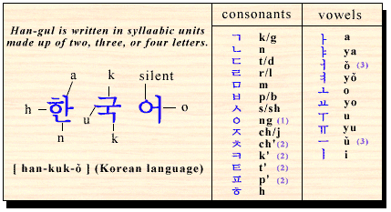
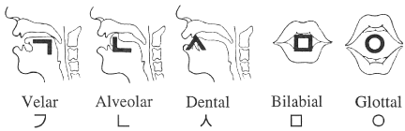
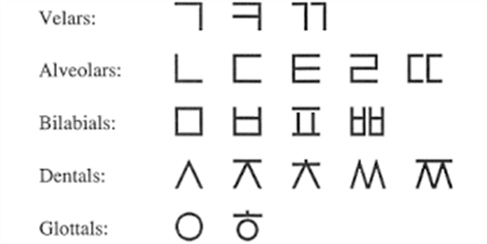
Han’gul
Image from Everyday Korea. “Bringing Back the Hangul.” 2014. Accessed 5/20/16. http://www.everydaykorea.com/2013/10/bringing-back-the-hangul/
Images from Wright-House. “Linguistic and Philosophical Origins of the Korean Alphabet (Hangul).” 7/13/07. Accessed 5/20/16. http://www.wright-house.com/korean/korean-linguistics-origins.html

Slide 7
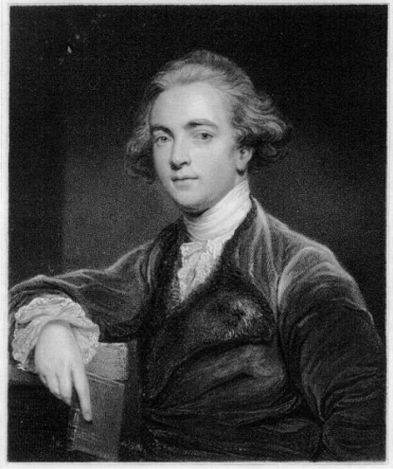
Sir William Jones
British scholar, linguist, and lawyer
Fluent in 7 languages by age 20
Came to India as Supreme Court Judge
In 1786, announced:
…Sanskrit and the European languages "have sprung from some common source which, perhaps, no longer exists"
Set a trend for studying Sanskrit as basis for the “Indo-European language family”
Roots of historical linguistics
Image from Lidahibu. “William Jones.” 2016. Accessed 5/20/16. http://lidahibu.com/edisi/11/
1746-1794

Slide 8
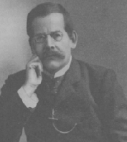
Henry Sweet
English philologist and phonetician
Authority on Anglo-Saxon and the history of the English language (Oxford, England)
Pioneer in modern scientific phonetics
His History of English Sounds (1874) was a landmark study.
Thought to be the model for “Professor Higgins” in G. B. Shaw’s play Pygmalion
(although it was actually Daniel Jones…)
1845–1912
Image from “Figures from the history of English.” Accessed 5/20/16. https://www.uni-due.de/SHE/SHE_Portrait_Gallery.htm

Slide 9
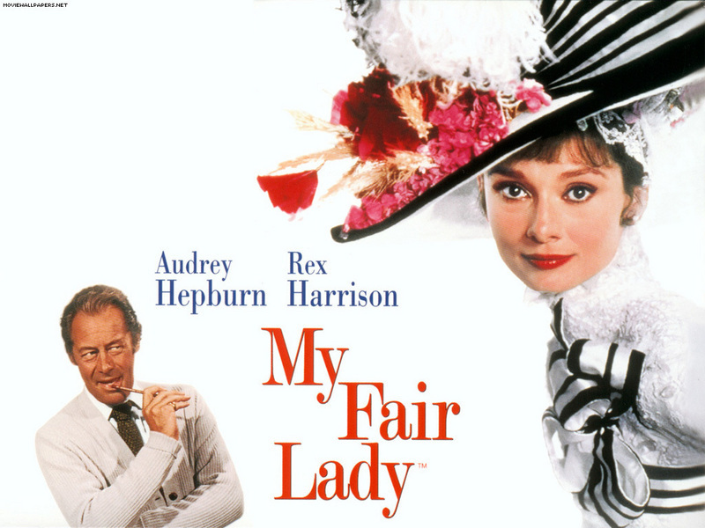
“Henry Higgins”
Phonetician character in the play “Pygmalion” by George Bernard Shaw
← “Eliza Doolittle”
→

Slide 10
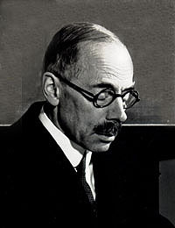
Daniel Jones
Professor at University College London
Used the term “phoneme” in the modern sense
Promoted the term “cardinal vowel”
A father of the IPA
Suggested a two-parameter diagram to visualize how vowels are produced
Popularized experimental phonetics
Developed new alphabets for African and Indian languages
1881 - 1967
Image from “Figures from the history of English.” Accessed 5/20/16. https://www.uni-due.de/SHE/SHE_Portrait_Gallery.htm

Slide 11

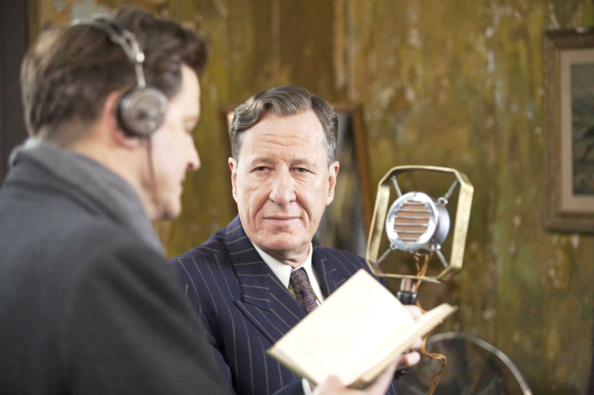
Lionel Logue (1880-1953)
Australian “elocutionist” who worked with speech defects
Consultant to King George VI
Featured in 2010 movie
Image from IMDB. “The King’s Speech (2010).” 2016. Accessed 5/20/16. http://www.imdb.com/title/tt1504320/
Image from AceShowbiz. “The King’s Speech Picture 6.” 2016. Accessed 5/20/16. http://www.aceshowbiz.com/still/00005854/the_king_s_speech05.html

Slide 12
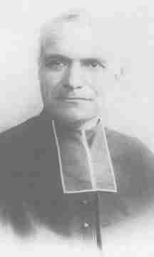
Abbé Rousselot
1843 – 1924
An early innovator in experimental phonetics
Professor with the College of France
Image accessed 5/20/16. http://charente.confolens.free.fr/confolens/saint_claud/saint_claud/saintclaud0650e.html

Slide 13
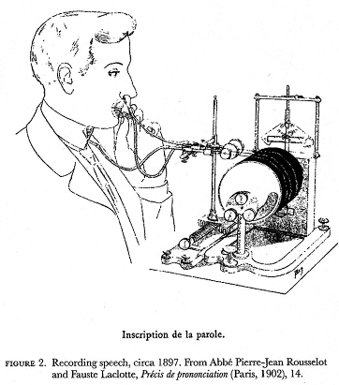
Rousselot cylinders
Speech sounds and articulatory information were recorded for analysis
“It will be possible hereafter to note the pronunciation of any language, dialect, or idiom whatever, without relying upon the testimony of the ear, which distinguishes but slight differences between the modes of speaking of several individuals”
Image from Language Log. Mark Liberman. “God’s own englishman with a tube up his nose”. April 23, 2007. Accessed July 5, 2016. http://itre.cis.upenn.edu/~myl/languagelog/archives/004436.html

Slide 14
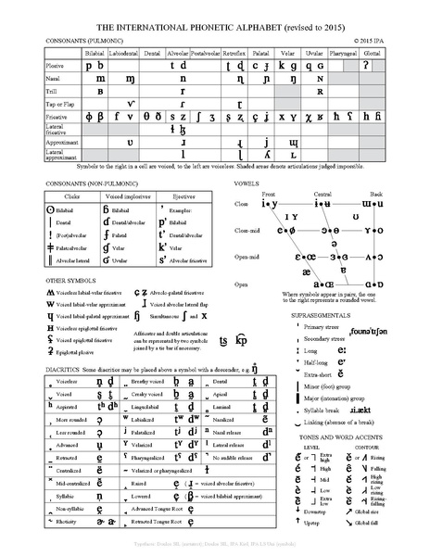
International Phonetic Alphabet (IPA)
(1888) First published by the Association Phonétique Internationale, a group of French language teachers
Modeled on an 1847 phonetic script for English
Goal: To devise a system for transcribing speech sounds independent of any particular language and applicable to all languages

Slide 15
IPA - Uses
Dictionaries, textbooks, phrase books
Creating new writing systems for previously unwritten languages
Non-native speakers learning English
Clinicians in speech language pathology and related disciplines

Slide 16
Modern Phonetics
Phonetics – Scientific study of speech sounds
Phonology – Study of sound systems, patterns, and rules
Phonetics and phonology are highly related… Both are within the field of …
Linguistics – Scientific study of Language

Slide 17
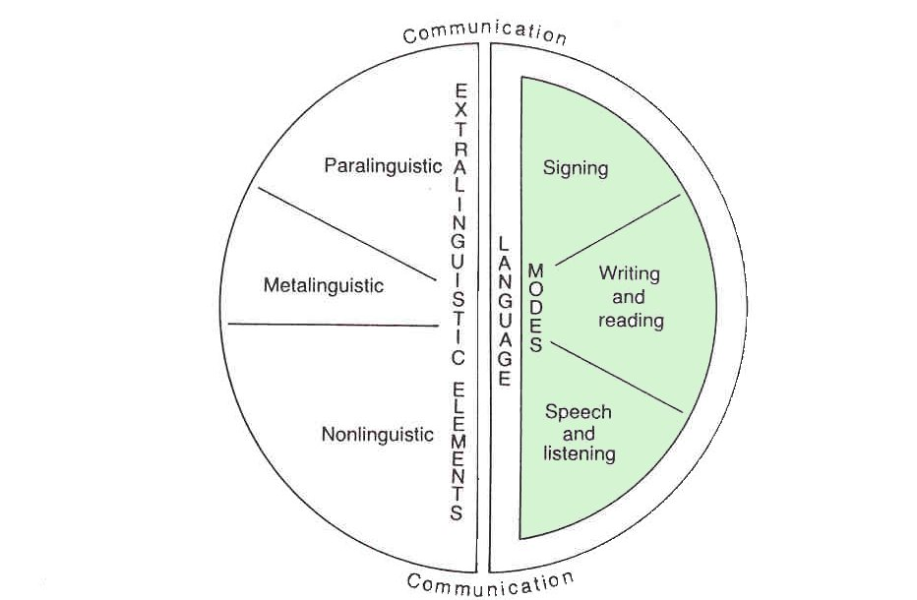
Important terms:
Communication, human language, speech
←
Phonetics is HERE!

Slide 18

Q: How do linguists study language?
By describing a grammar
(mental representation of language knowledge)
GOAL:
Language-particular → Universal
Q: What are the components of grammar?
(next slide)

Slide 19
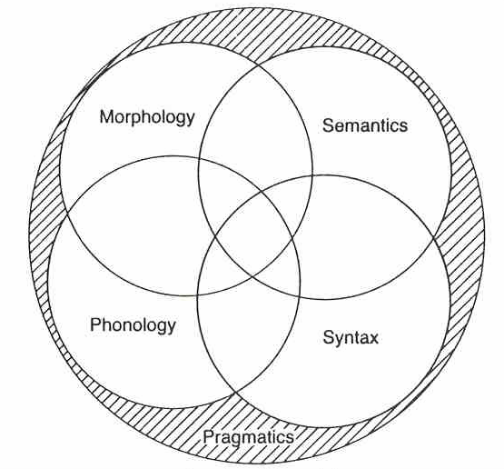
Levels of the grammar
We are HERE! ➔

Slide 20
Types of phonetics
Articulatory – How speech sounds are produced in the human vocal tract
Acoustic
Linguistic/Perceptual

Slide 21

Source-filter theory
Vocal source vocal tract filter speech

Slide 22
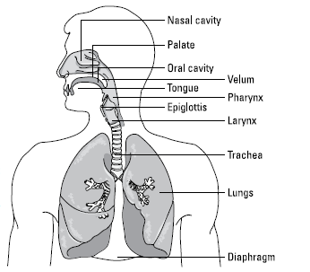
Source-filter system – cont’d
Illustration by Wiley, Composition Services Graphics
Image from Phonetics for Dummies. “The Lowdown on the Science of Speech Sounds.” 2013.

Slide 23
Features
Feature – A component of a sound with a discrete phonetic property – “smallest systematic part” of a speech sound
Binary ( + or - )
Graded
Information from Phonetics for Dummies. William Katz. “Classifying Speech Sounds: Your Gateway to Phonology”. 2013.

Slide 24
Articulatory features
THE BIG THREE!
Voicing
Place
Manner
Information from Phonetics for Dummies. William Katz. “Classifying Speech Sounds: Your Gateway to Phonology”. 2013.

Slide 25
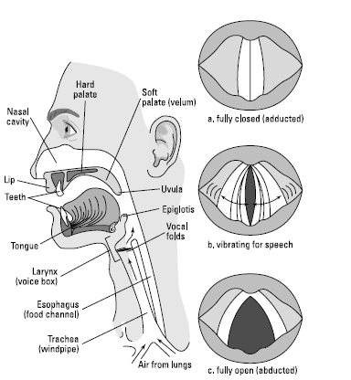
Voicing - anatomy
Illustration by Wiley, Composition Services Graphics
Image from Phonetics for Dummies. “Producing Speech: The How-To.” 2013.

Slide 26
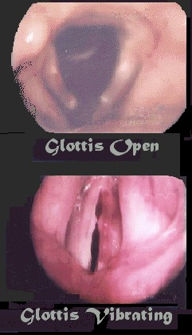
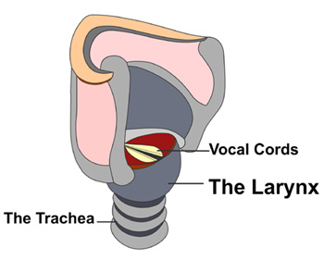
Voicing
Property of vibrating vocal folds
Occurs at the glottis
(literally, a hole or aperture)
Image from Cedars-Sinai. “Laryngeal Surgury.” 2016. Accessed 5/20/16. http://www.cedars-sinai.edu/Patients/Programs-and-Services/Head-and-Neck-Cancer-Center/Treatment/Laryngeal-Surgery.aspx
Image from plaza.ufl.edu. “Voicing and Phonation”. Accessed 6/27/16. https://www.google.com/search?q=open+glottis+vs+closed+glottis&espv=2&biw=1280&bih=923&source=lnms&tbm=isch&sa=X&ved=0ahUKEwj1gJX10MjNAhVL4iYKHdQRDFUQ_AUIBigB#imgrc=9SqboxeZmczh3M%3A
Information from Phonetics for Dummies. William Katz. “The Lowdown on the Science of Speech Sounds”. 2013.

Slide 27
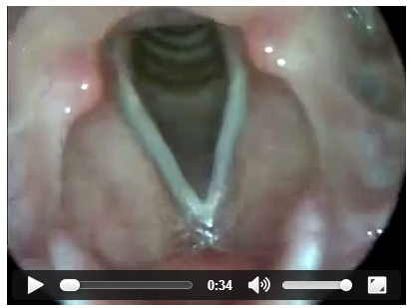
Laryngoscopy - video
Video from Auditory Neuroscience. “Human vocal folds in action.” Accessed 5/23/16.
https://auditoryneuroscience.com/vocfld

Slide 28
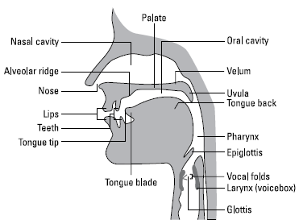
The speech articulators
Image from Phonetics for Dummies. “The Lowdown on the Science of Speech Sounds.” 2013.

Slide 29
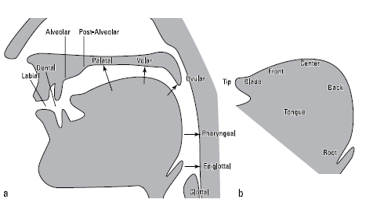
Places of articulation, parts of tongue
Images from Phonetics for Dummies. “The Lowdown on the Science of Speech Sounds.” 2013.

Slide 30
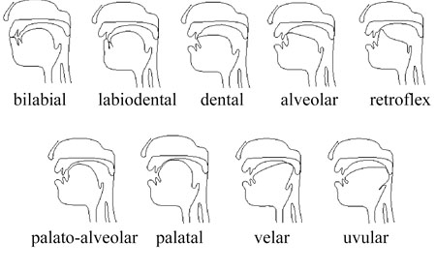
Place – where sounds are produced
*** Note-
Not GAE
***Note-
Not English
(but e.g., in French and Arabic)
Image from Dr. Christian DiCanio. University at Buffalo. “Places of Articulation.” Accessed 5/23/16. http://www.acsu.buffalo.edu/~cdicanio/pdfs/Lect_Place_9-15_9-17.pdf

Slide 31
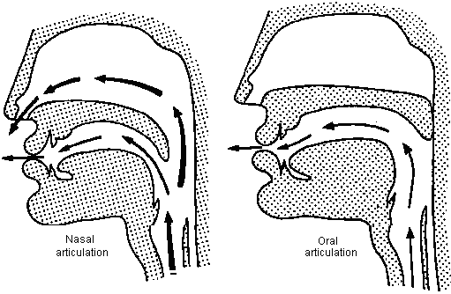
Manner* – How sounds are produced
*NOTE: generally refers to consonants because they involve airflow obstruction
Image from UNIL. “Introduction: Nasality.” Accessed 5/23/16.
https://www.unil.ch/sli/fr/home/menuguid/ressources/cours-et-livres-en-ligne/introduction-to-phonetics/introduction.html
Stop: Nasal vs. oral
Also – fricative, affricate, approximant, tap/flap
Information from Phonetics for Dummies. William Katz. “The Lowdown on the Science of Speech Sounds”. 2013.

Slide 32
Consonants of GAE
Also /Ɂ/ and /ɾ/
Image from Phonetics for Dummies. “Meeting the IPA: Your New Secret Code.” 2013.

Slide 33
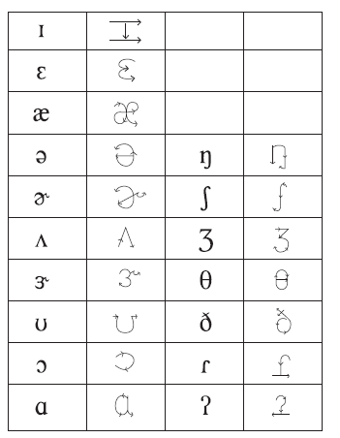

How to draw ‘em!
Image from Phonetics for Dummies. “Meeting the IPA: Your New Secret Code.” 2013.

Slide 34

The voiceless “w” (/ʍ/)
https://www.youtube.com/watch?v=xzBQlWBDJMM
Image from FBCOVERSTREET. “Cool Hhhwhip Stewie Griffin.” Accessed 5/23/16. http://fbcoverstreet.com/facebook-cover/cool-hhhwhip-stewie-griffin

Slide 35
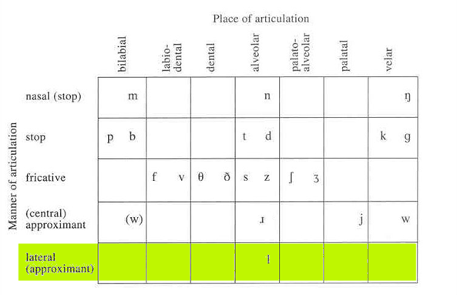
Other features:
Central vs. lateral
From A Course in Phonetics. P. Ladefoged and K. Johnson. “Phonology and Phonetic Transcription,” 2011.

Slide 36
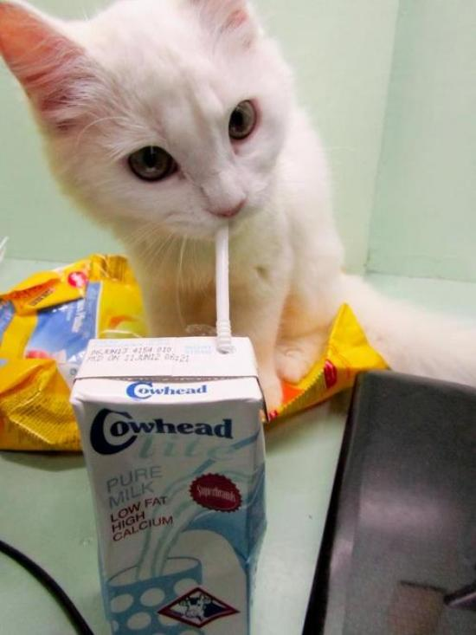
Markedness
We do not mark the more usual case
Thus, the less frequent a feature, the more “marked”
Example:
I’m going to the store to get cow milk
I’m going to the store to get soy milk
Image from Reddit. “My brother just found out who drinks his milk.” Jbee14. Accessed 5/25/16. https://www.reddit.com/comments/11y784
X
Information from Phonetics for Dummies. William Katz. “Classifying Speech Sounds: Your Gateway to Phonology”. 2013.

Slide 37
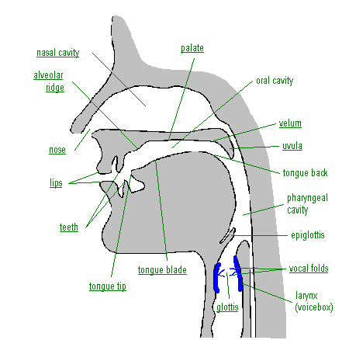
Let’s relate the features to the anatomy
Image from Phonetics for Dummies. William Katz. “Meeting the IPA: Your New Secret Code.” 2013.

Slide 38

Great! Now on to vowels

Slide 39
The setting
Image from Phonetics for Dummies. William Katz. “Meeting the IPA: Your New Secret Code”. 2013.

Slide 40
GAE vowel quadrilateral
Image from StudyBlue. “Phonetics Final: Communication Sciences and Disorders 3313 with Baldwin at Oklahoma State University – Stillwater *”. 2016. Accessed 6/27/2016. https://www.studyblue.com/notes/note/n/phonetics-final/deck/6489748

Slide 41
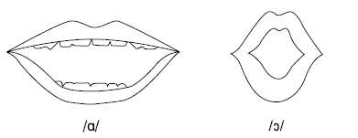
This should help?
Image from Phonetics for Dummies. William Katz. “Meeting the IPA: Your New Secret Code”. 2013.

Slide 42
Homework/ Reading
First e-learning homework set!

Slide 43
Lecture 2
More issues on broad transcription of GAE consonants and vowels
Finishing up concepts from text, chapters 1-3

Slide 44
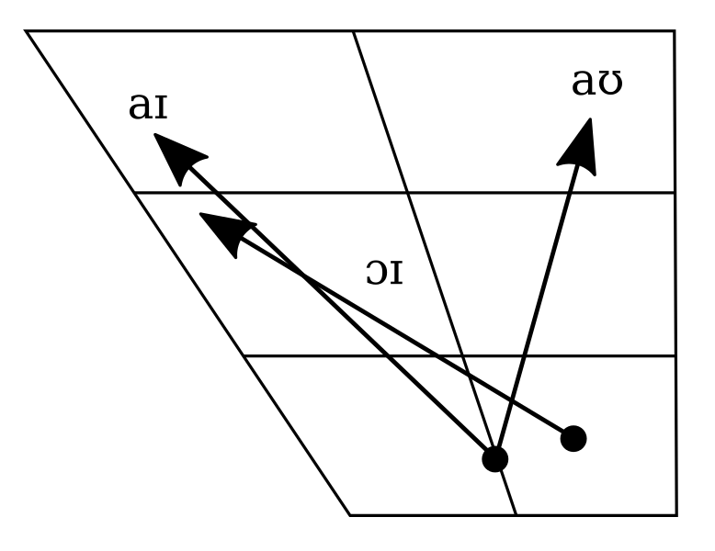
Mono – vs. Diphthongs
Monophthongs – constant vowel quality
Diphthongs – sweep across the vowel space
GAE
Image from Wikimedia Commons. “File:California English disphthong chart.svg”. 29 February 2016. Accessed 27 June 2016. https://commons.wikimedia.org/wiki/File:California_English_diphthong_chart.svg *based on the vowel chart in Peter Ladefoged, "American English", Handbook of the International Phonetic Association (Cambridge Univ. Press 1999), p. 42.

Slide 45
Q: Could there be a …(shudder).. Triphthong?
A: Yes!
Bernese German (a Swiss German dialect):
[iə̯w] as in Gieu 'boy'
[yə̯w] as in Gfüeu 'feeling'
[uə̯w] as in Schueu 'school'
[yə̯j] as in Müej 'trouble'
Spanish:
[wej] as in buey 'ox'
[waj] as in Uruguay

Slide 46
Tense vs. lax vowels in English
English lax vowels: //,//,//,//,//
Originally thought to be physiologically distinct
Now considered a phonological property
(Lax vowels cannot occur in stressed, open syllables)
Thus: “You are really veh!” (is not English)

Slide 47
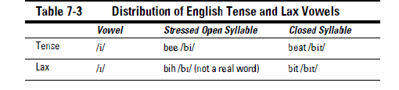
Tense/lax - examples
“beat” versus “bit”
“bait” versus “bet”
“Luke” versus “look”
Table from Phonetics for Dummies”. W. F. Katz. “Sounding Out English Vowels”. 2013.

Slide 48
Tense
Some tense vowels show offglide qualities:
/e/ = /e/ ✓
/u/ = /uw/
/i/ = /ij/
/o/ = /o/ ✓
For beginners, I prefer the simpler set on the left
Our AV materials also include examples from checked set on the right

Slide 49
GAE vowel “r-coloring”(blending)
Table from Phonetics for Dummies”. W. F. Katz. “Sounding Out English Vowels”. 2013.

Slide 50
Some vowel “adjustments”
/o/-/ɔ/ and /i/-/ɪ/
→ before /ɹ/,/l/ and nasals
Some examples:
“sore” /sɔɹ/
“selling” /ˈsɛlɪŋ/

Slide 51
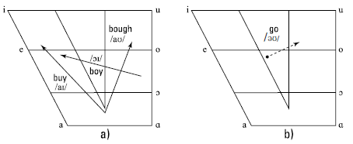
English diphthongs
American English British English
(contains one more diphthong)
Figures from Phonetics for Dummies”. W. F. Katz. “Sounding Out English Vowels”. 2013.

Slide 52
Segmental vs. supra-segmental
Segmental: consonants, vowels
Supra-segmental:
features larger than the individual segment
includes stress, intonation (“prosody”)

Slide 53
Homework set #2
e-learning, second set
Keep practicing with audiovisual and lab materials

Slide 54
Lecture 3
What is a phoneme?
What are allophones?
Why should we care?

Slide 55
Phoneme
“Smallest systematic unit of sound that changes meaning in a language”
Abstract
Psychological
Can be illustrated in a minimal pair:
/bt/ - /bit/
/bit/ - /biz/

Slide 56

Allophone
Systematic variant of a phoneme
Show complementary distribution (context-dependent variation)
(…like these guys…)
Image from iwantedwings. “Superman Returns & Man of Steel: Man vs. Myth”. June 1, 2014. Accessed July 5, 2016. https://iwantedwings.com/2014/06/01/superman-returns-man-of-steel-man-vs-myth/

Slide 57
Allophone example
In GAE, the phoneme /t/ can be…
[t] [bt]
[t^{h}] [t^{h}p]
[] [l]
[] [bn]

Slide 58
Complementary distribution
[t] [bt] syllable final
[t^{h}] [t^{h}p] syllable initial
[] [l] btwn stressed & unstressed syllable
* NOTE: As opposed to “free distribution”

Slide 59
Phoneme/allophone
Language 1 | Language 2
/ dsi / V. “to catch” | /  / N. “female cat”
/ ◻ati / Adj. “clever” | / sanmt / N. “muscle”
/ s◻lok / N. “debate” | / kl j / Adv. “rapidly”
/ di / V. “uncover” | /sfimi / V. “speaking”
■ In one language there are two separate phonemes, /s/ and //.
■ In the other, /s/ and // seem to be allophones of one underlying phoneme.
Q: WHICH IS WHICH, AND WHY?

Slide 60
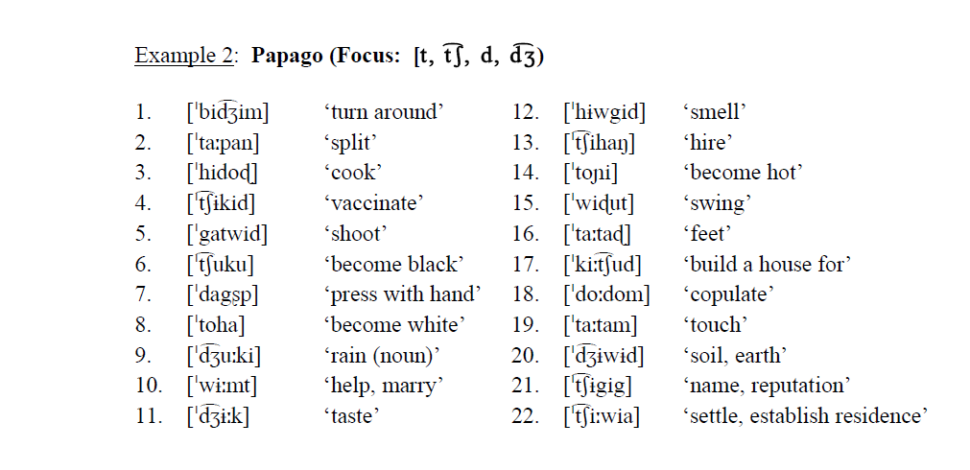
Real language example –
Find the phonemes vs. the allophones

Slide 61
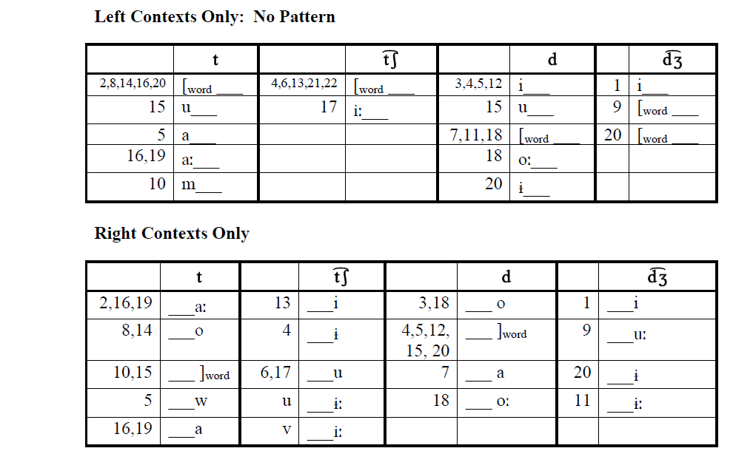
Look at vowel context….


Slide 62
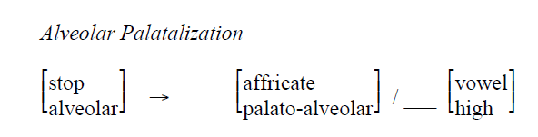
Answer
“The palato-alveolar affricates occur before high vowels, and the alveolar stops occur elsewhere”
(or, as formalized….)

Slide 63
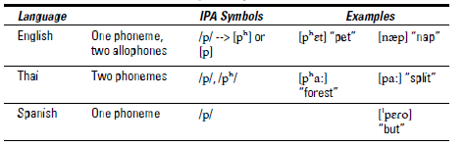
English / Thai / Spanish
Table from Phonetics for Dummies”. W. F. Katz. “Classifying Speech Sounds: Your Gateway to Phonology”. 2013.

Slide 64
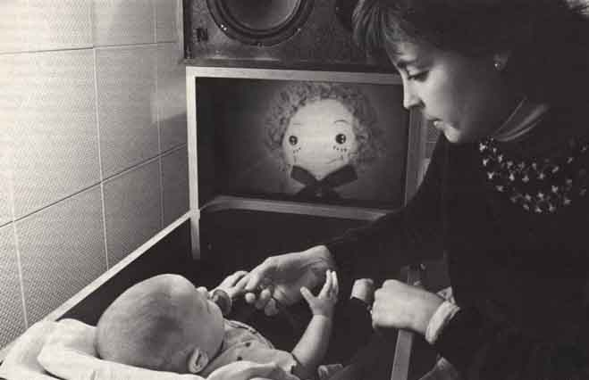
How are phonemes acquired?
Infants are born capable of learning any sounds of any language
They learn the phonemes of their language by ~ 9 - 12 months
  (by learning to ignore distinctions that are not phonemic)

Slide 65
Q: What about adults?
Are we each a prisoner of our phonemic inventory (?)
Second language issues
“Phonemic misperception” for disordered speech

