Slide 1
“Exploring different speech sources”
SPAU 3343 (Chapter 15)
A. Airstream mechanisms
B. Tone, Voice, VOT

Slide 2
Airstream mechanisms
The manner in which an airstream is set in motion for the purposes of speech.
May produce egressive (outward) or ingressive (inward) airflow.

Slide 3
Airstream Mechanism
(pg. 239)
 | Pulmonic | Glottalic | Velaric
Egressive | Plosives /, , , , , / | Ejectives /p’, t’, k’/ | NONE
Ingressive | NONE | Implosives /, , / | Clicks /, , !, , /
Illustration by Wiley, Composition Services Graphics. Image from Phonetics for Dummies. William Katz. “Going Global with Phonetics.” 2013.

Slide 4
Plosive production in initial position:
Time course:
Closure (air pressure builds…..)
Release (articulators blow apart, “burst” of air typically occurs)
Aspiration (glottal noise w/ release)
Voicing (start of vocal fold vibration)
(e.g. /pʰɑ/)

Slide 5
Pulmonic Airstream Mechanism
Plosives
Stops that use only an outward-moving pulmonic airstream = plosives.
GAE uses only an egressive pulmonic airstream.
All oral stops in English are plosives
This is not true for all languages

Slide 6
Airstream Mechanisms
 | Pulmonic | Glottalic | Velaric
Egressive | Plosives /p, t, k, b, d, g/ | Ejectives /p’, t’, k’/ | NONE
Ingressive | NONE | Implosives /, , / | Clicks /, , !, , /
Illustration by Wiley, Composition Services Graphics. Image from Phonetics for Dummies. William Katz. “Going Global with Phonetics.” 2013.

Slide 7
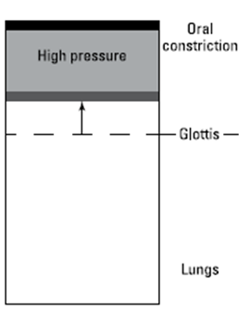
Glottalic Airstream Mechanism
Ejectives
Hausa
Quechua
Lakhota
Navajo
K’ekchi
Illustration by Wiley, Composition Services Graphics. Image from Phonetics for Dummies. William Katz. “Going Global with Phonetics.” 2013.

Slide 8

Glottalic Airstream Mechanism
Ejectives
Ejective ➔ A stop made with an egressive glottalic airstream, such as in Quechuan:
Aspirated velar stop | [kujui] | ‘to whistle’
Ejective | [k’ujui] | ‘to twist’
Sound samples: http://www.phonetics.ucla.edu/index/sounds.html

Slide 9
Glottalic Airstream Mechanism
Ejectives (cont’d)
Lakhota
Ejective | [ t’u] | ‘at all costs’
Unaspirated dental stop | [ tuwa] | ‘who’
Sound samples: http://www.phonetics.ucla.edu/index/sounds.html

Slide 10
Airstream Mechanisms
 | Pulmonic | Glottalic | Velaric
Egressive | Plosives* /p, t, k, b, d, g/ | Ejectives /p’, t’, k’/ | NONE
Ingressive | NONE | Implosives /, , / | Clicks /, , !, , /
Illustration by Wiley, Composition Services Graphics. Image from Phonetics for Dummies. William Katz. “Going Global with Phonetics.” 2013.

Slide 11
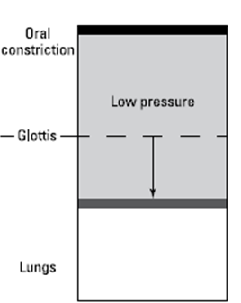
Glottalic Airstream Mechanism
Implosives
Sindhi
Igbo
Illustration by Wiley, Composition Services Graphics. Image from Phonetics for Dummies. William Katz. “Going Global with Phonetics.” 2013.

Slide 12
Glottalic Airstream Mechanism
Implosives
Implosive ➔ A stop made with an ingressive glottalic airstream, such as Sindhi //.
Implosive | [ani] | ‘field’
Voiced bilabial stop | [banu] | ‘forest’
Sound samples: http://www.phonetics.ucla.edu/index/sounds.html

Slide 13
Glottalic Airstream Mechanism
Implosives
Another Sindhi Example
Implosive | [anu] | ‘handle’
Voiced velar stop | [guu] | ‘quality’
Sound samples: http://www.phonetics.ucla.edu/index/sounds.html

Slide 14

“Billions and billions…”
Image from John Tebeau. “Mark Roth: ‘Joan of Arc Riding My Little Pony’ (with Carl Sagan sing backup)”. November 15, 2012. Accessed May 25, 2016. http://tebeau.com/mark-roth-joan-of-arc-riding-my-little-pony-with-carl-sagan-singing-backup
www.utdallas.edu/~wkatz/PFD/carl_sagan_billions.mov
Text, pg. 242

Slide 15
Airstream Mechanisms
 | Pulmonic | Glottalic | Velaric
Egressive | Plosives /p, t, k, b, d, g/ | Ejectives /p’, t’, k’/ | NONE
Ingressive | NONE | Implosives /, , / | Clicks /, , !, , /
Illustration by Wiley, Composition Services Graphics. Image from Phonetics for Dummies. William Katz. “Going Global with Phonetics.” 2013.

Slide 16
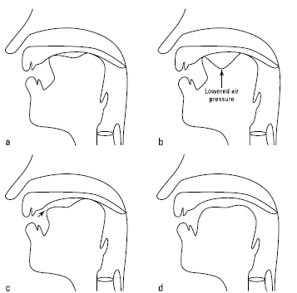
Velaric Airstream Mechanism
Clicks
Nama
!Xhosa
Zulu
Illustration by Wiley, Composition Services Graphics. Image from Phonetics for Dummies. William Katz. “Going Global with Phonetics.” 2013.
Producing alveolar clicks (pg. 244)

Slide 17
Velaric Airstream Mechanism
Clicks
Click ➔ A stop made with an ingressive velaric airstream, such as in Nama:
Dental | Alveolar | Palatal | Alveolar Lateral
[koa] ‘put into’ | [k!oas] ‘hollow’ | [kais] ‘calling’ | [karos] ‘writing’
Sound samples: http://www.phonetics.ucla.edu/index/sounds.html

Slide 18
Velaric Airstream Mechanism
Clicks (cont’d)
!Xhosa
Dental | Alveolopalatal | Alveolar lateral
[ukúkola] ‘to grind fine’ | [ukúk!oa] ‘to break stones’ | [úkolo] ‘peace’
Sound samples: http://www.phonetics.ucla.edu/index/sounds.html

Slide 19
Airstream Mechanism - Review
 | Pulmonic | Glottalic | Velaric
Egressive | Plosives /, , , , , / English | Ejectives /p’, t’, k’/ Lakhota, Hausa | NONE
Ingressive | NONE | Implosives /, , / Sindhi | Clicks /, , !, , / !Xhosa, Zulu
Illustration by Wiley, Composition Services Graphics. Image from Phonetics for Dummies. William Katz. “Going Global with Phonetics.” 2013.

Slide 20
Tone Languages
Languages in which the meaning of a word is affected by the pitch.
Two kinds:
Register tone: e.g., high/mid/low
Contour tone: include rising, falling, dipping (with slopes)

Slide 21
Register tone
Found in many African languages:
Ewe
Yoruba
Hausa
FUN FACT: Most of the tone languages in the world are register tone languages

Slide 22
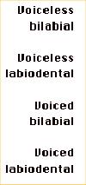
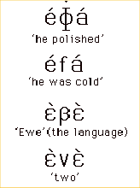
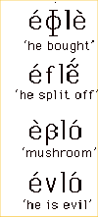
An example
Ewe (West Africa)
Table from A Course in Phonetics. 6th ed. Peter Ladefoged and Keith Johnson. “Articulatory Targets.”
Sound samples: http://www.phonetics.ucla.edu/index/sounds.html

Slide 23
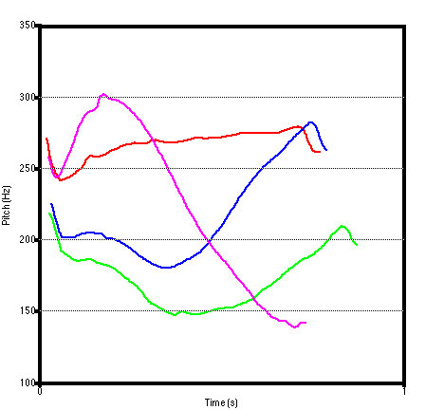
Contour tone
For instance:
Mandarin
Cantonese
Vietnamese
1
2
3
4
(Louis Goldstein, Mandarin f₀ in Praat)

Slide 24

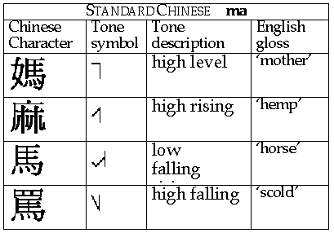
Mandarin Chinese
Image from A Course in Phonetics. Peter Ladefoged. “Chinese (Standard) Tones.” Accessed 5/25/16. http://www.phonetics.ucla.edu/course/chapter10/chinese/chinese.html
Sound samples: http://www.phonetics.ucla.edu/index/sounds.html

Slide 25
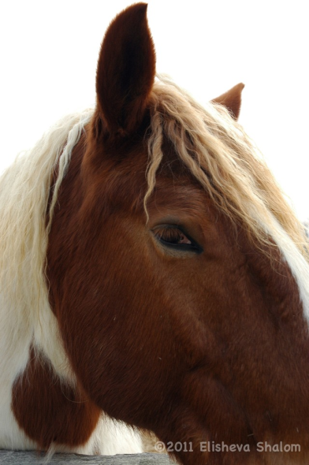
A Mandarin tongue twister
Does mother scold the horse's hemp?
("mā mā mà mǎ de má ma?")
mā mā - mother (high level)
mà - scold (high falling)
mǎ - horse (low falling)
má - hemp (rising)

Slide 26
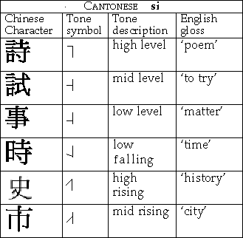
Cantonese Chinese
Image from Wiley-Blackwell: Vowels and Consonants. “Pitch and Loudness.” 2012. Accessed 5/25/16. http://www.vowelsandconsonants3e.com/chapter_2.html
Sound samples: http://www.phonetics.ucla.edu/index/sounds.html

Slide 27
States of the glottis
Breathy voice (murmur)
Creaky voice (laryngealized)

Slide 28
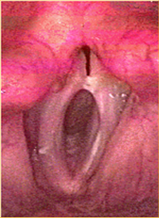
Larynx: breathy vs. creaky voice
https://www.youtube.com/watch?v=BYSZS1LaABQ
https://www.youtube.com/watch?v=9cKnUFZjs8k
Images: Vocal folds at one moment in the cycle
(click links above to see videos)
Image from CD for A Course in Phonetics. Peter Ladefoged and Keith Johnson. “CD 6.5.” 2011.

Slide 29

Breathy Voice Examples
Gujarati
Diacritics: [bʱ], [dʱ],[mʱ], [a ]
[bar] | ‘outside’
[bar] | ‘twelve’
[ml] | ‘palace’
[ml] | ‘dirt’
Sound samples: http://www.phonetics.ucla.edu/index/sounds.html

Slide 30
Creaky/Laryngealized Voice
[a ]
Hausa
Diacritic
[jaː] | ‘he’
[jaː] | ‘daughter’
Sound samples: http://www.phonetics.ucla.edu/index/sounds.html

Slide 31
Voice Onset Time (VOT)
Important cue for voicing
For stop consonants at the beginning of syllables
For example: “pat” vs. “bat”
Much of what you hear in this contrast has to do with precise timing!

Slide 32
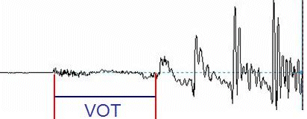
VOT- cont’d
/p^{h}/
/æ/
[30 ms]
Time interval (measured in milliseconds)
..between the release of air closure and the beginning of vocal cord vibration (voicing)
In English, stop consonants with a VOT >25 milliseconds = voiceless (such as /p/),
VOTs < 25 milliseconds = voiced (such as /b/)

Slide 33
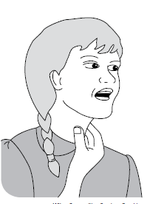
Try it!
Short VOT (voiced) /b/,d,/g/ Long VOT →(voiceless) /p/, /t/, /k/
Illustration from Wiley, Composition Services Graphics. Image from Phonetics for Dummies. William Katz. “Producing Speech: The How-To.”

Slide 34
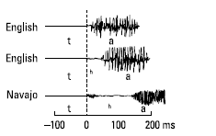
English vs. Najavo
VOT:
Short
Longer
Longest
(as in “stop”)
Listen to:
http://www.utdallas.edu/~wkatz/PFD/Navajo_Keshmish.wav
for very long lag VOT of [k^{h}] in Najavo
Phonetics for Dummies, pg. 250
Illustration from Wiley, Composition Services Graphics. Figure from Phonetics for Dummies. William Katz. “Exploring Different Phonemes.”

