Slide 1

SPAU 3343
Clinical Phonetics
Children (healthy / phonological disorders)
Adults (AOS / cerebellar ataxia)

Slide 2

Samples of children’s speech
Early sounds – 6 mo.
Babbling – 1 yr.
Some early words -18 mo.
2 years
3 years
(Thanks to the Louisville Science Museum)

Slide 3
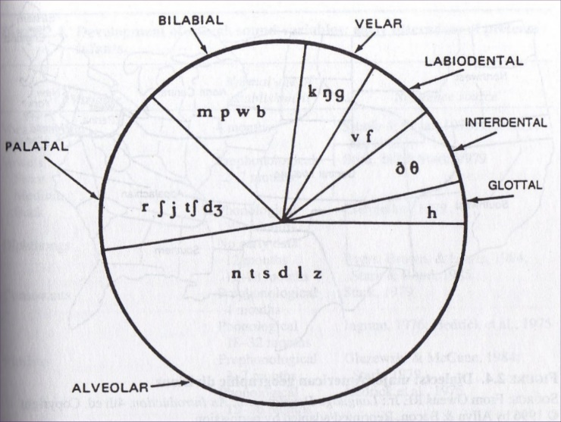
GAE: phoneme
C/V frequency of occurrence
e.g. Milnes et al., 1978
(Hayden, 1950)

Slide 4
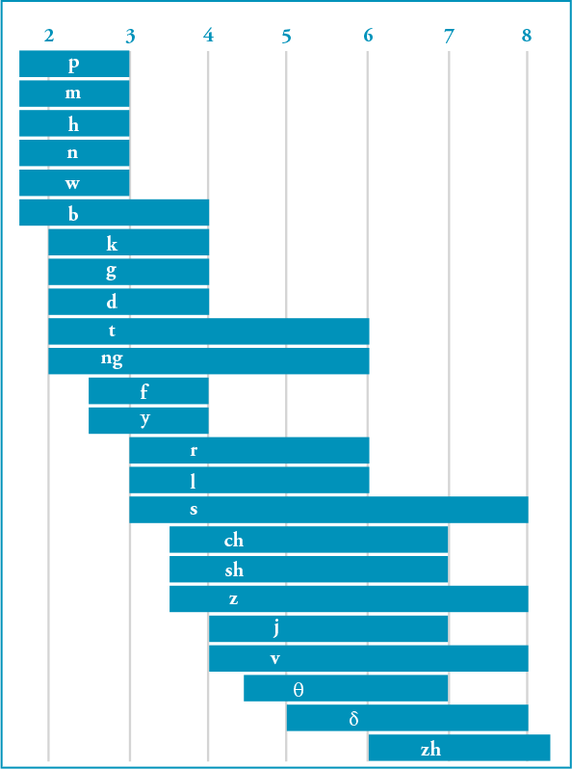
Children’s consonant acquisition
(GAE)
(years)
Sander, E. (1972). When are speech sounds learned? Journal of Speech and Hearing Disorders, 37, 55-63.

Slide 5
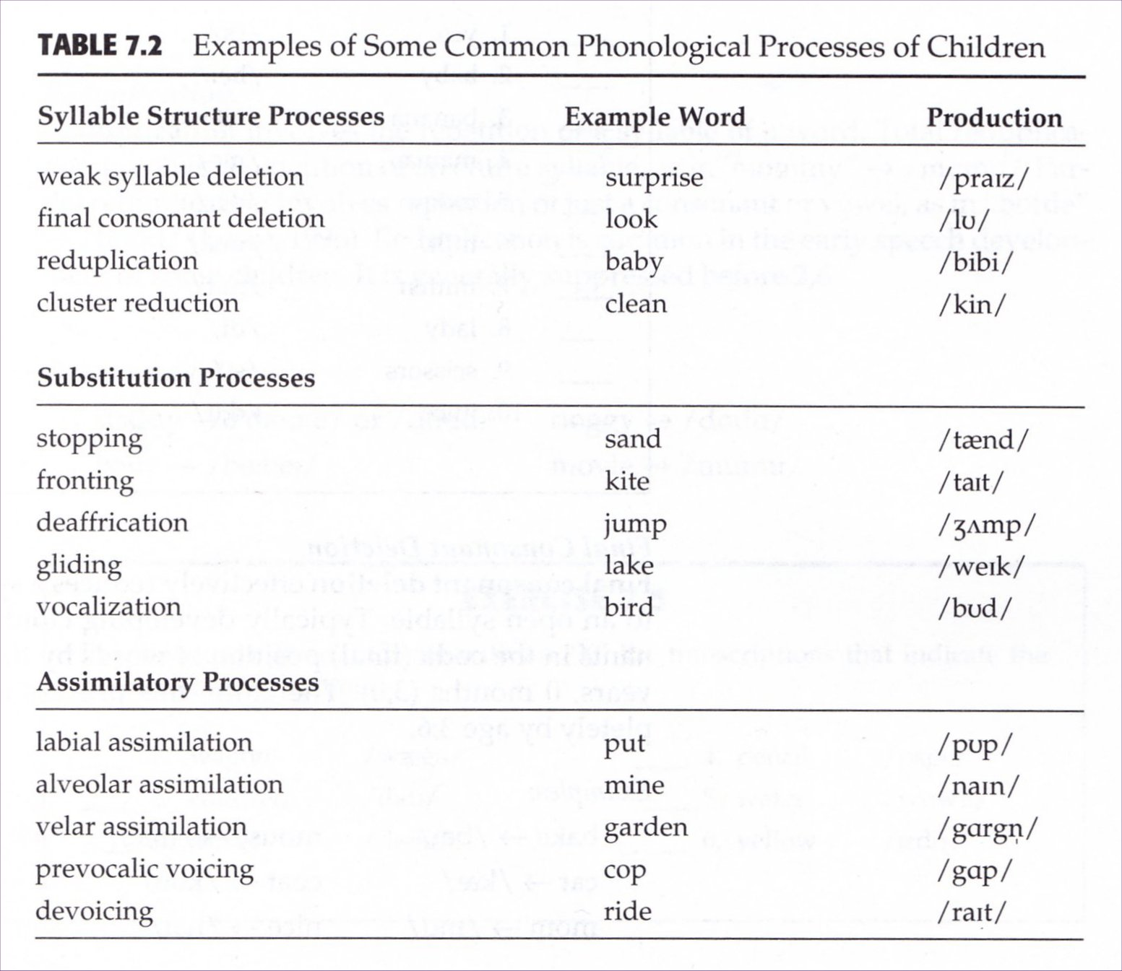
(Stoel-Gammon & Dunn, 1985)

Slide 6
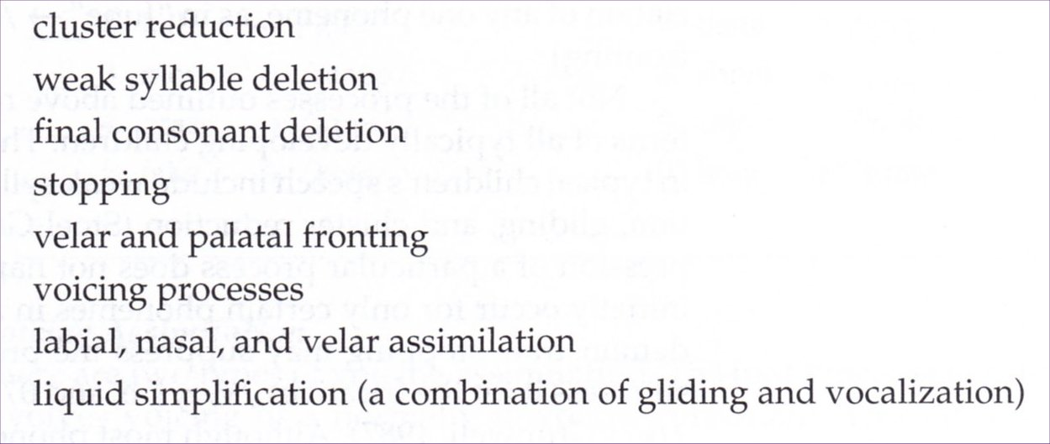
Shared phonological processes:
Healthy children, Children with Phonological Disorders
(Stoel-Gammon & Dunn, 1985)

Slide 7
Phonological problems
“Mixed receptive, expressive language and phonological delay” (3 yrs; 4 mo)
http://www.youtube.com/watch?v=mFguWOufFrs&feature=player_embedded

Slide 8
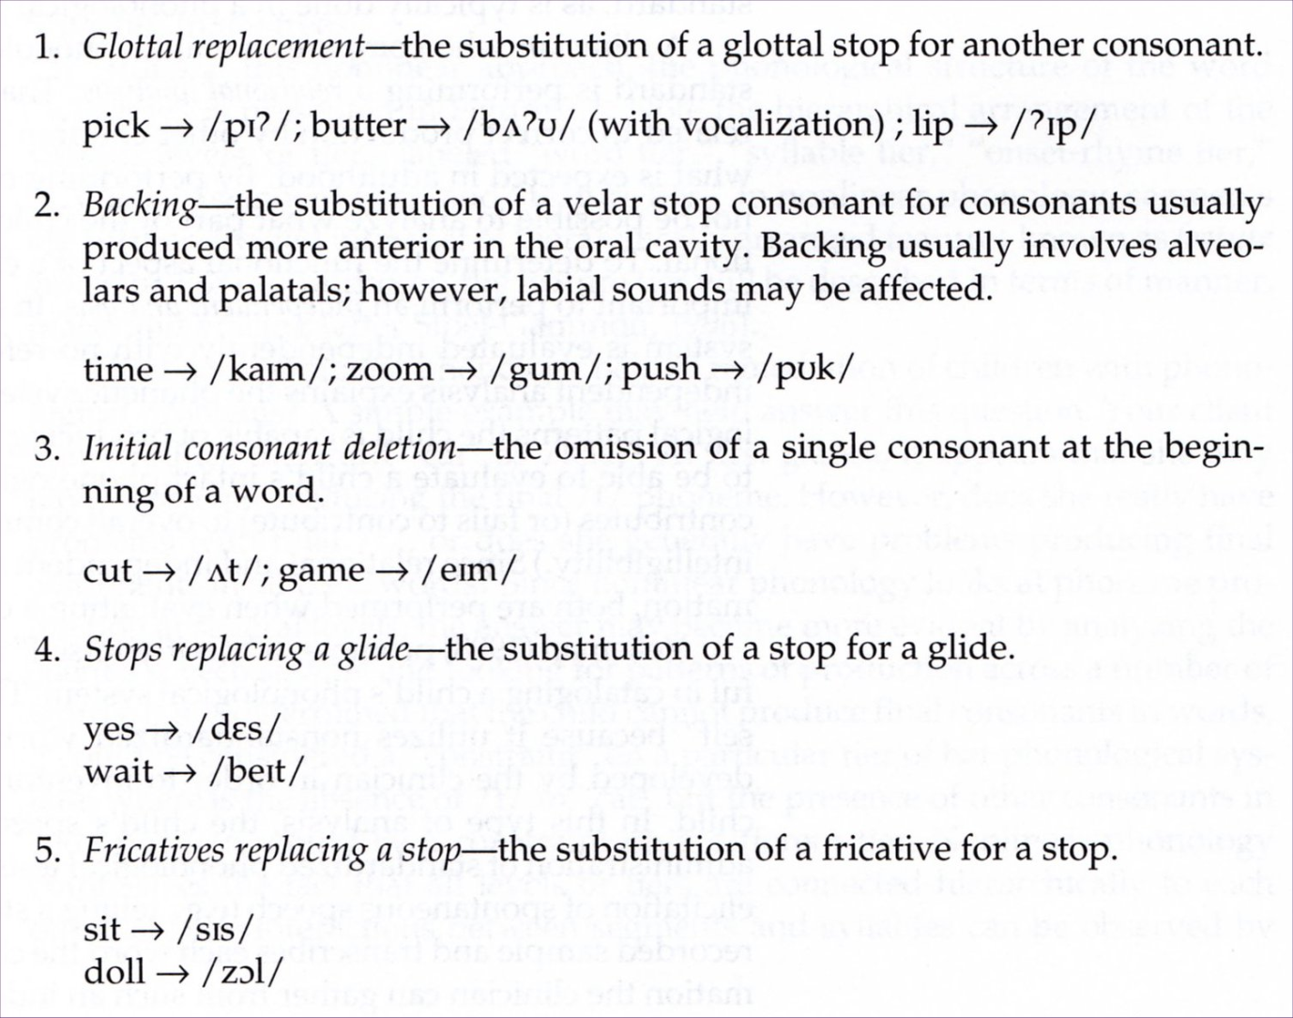
Idiosyncratic processes of children with PD
(Stoel-Gammon & Dunn, 1985)

Slide 9
Transcription of speech sound disorders: Useful diacritics
(unusual) aspirated stops – “spoon” → [sp^{h}un]
Unaspirated stop – “keys” → [k⁼iz]
Nasality – “pan” → [p^{h}æ̃]
Nasal emission “snow”→ [s͋no]
Denasalization “nice” → [n͊͊ais]
Dentalization (frontal lisp) “shoe” → [s̪u]
Labiodentalized [ɱ] “unfair”→ [əɱˈfɛɹ]

Slide 10
Diacritics for sound disorders:
Non-English examples
Fricatives “fit” → [ɸɪt]
“go”→ [ɣo]
Affricates “Joe” → [dzo]
Approximant “red” → [ʋɛd]*
Stops “nope” → [nop’]
“girl” → [ɠɝɫ]
* (vd labiodental)

Slide 11
Childhood apraxia of speech (CAS)
Speech motor programming/planning problem
Difficulty with sound transitioning
Vowel distortions
Prosodic errors
Inconsistent error patterns upon word repetition

Slide 12
Video sample - CAS
3 ½ year-old girl:
http://www.youtube.com/watch?v=szjfC9K190U

Slide 13
Disordered child audio examples
5-yr-old boy /gliding
[ˈwɑb̥ster] …
7-yr-old girl / dentalization of alveolars
[ˈtʃɛɹɪz̪]…
7-yr-old girl / dentalization & vocalization of alveolars
[ˈz̪іbɹə]…
From L.H. Small, Fundamentals of Phonetics, Pearson, Fourth Ed.

Slide 14
Sample spectrograms illustrating disordered adult speech
✓Apraxia of speech (AOS)
✓ Cerebellar Ataxia (dysarthria)

Slide 15
Apraxia of speech (AOS)
Phonetic-motoric disorder of speech production¹
Problem with motor planning² and/or programming¹
Characterized by¹:
      Distortions
      Prosodic abnormalities
      Intersegment transitionalizing problems
      Relatively inconsistent errors
      ¹ McNeil, Robin & Schmidt, 1997
      ² Van der Merwe, 2011

Slide 16
Etiology
Most common:
  Stroke
  Brain Injury
  Degenerative disease
Patients often describe:
“I know what I want to say, I just can’t get it out”

Slide 17
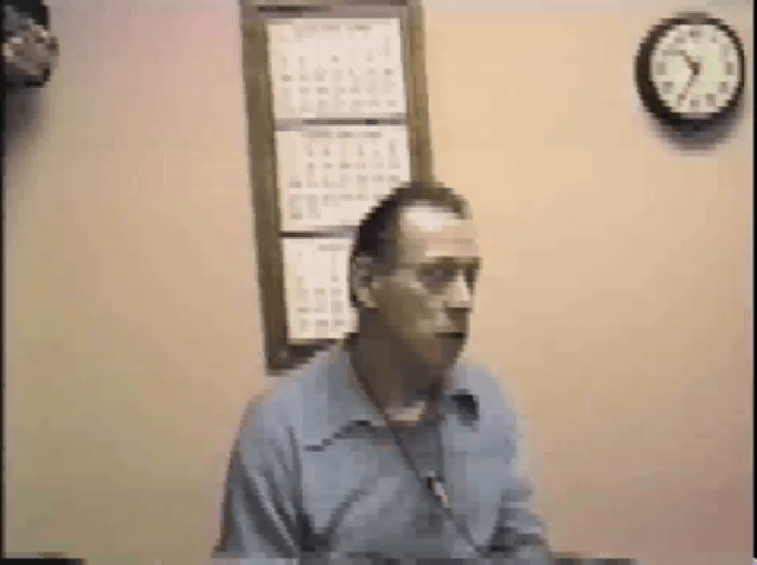
Example of adult AOS
(Pt. of R. Marshall, Purdue Univ.)

Slide 18
AOS – Syllable segregation
Ballard et al., Logopenic and nonfluent variants of primary progressive aphasia are differentiated by acoustic measures of speech production; PLOS One, 2014

Slide 19
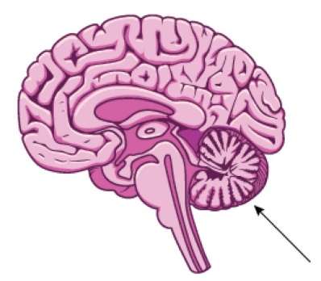
Ataxic dysarthria
results from cerebellar damage
deficits in coordination
inaccuracy in force, range, timing and direction of speech movement
“slurred speech” – distortions
excess and equal stress
excess loudness variation, dysprosody

Slide 20
Ataxic dysarthia - example
Dallas male w/ speech problems from
W. Nile Disease (encephalitis)

Slide 21
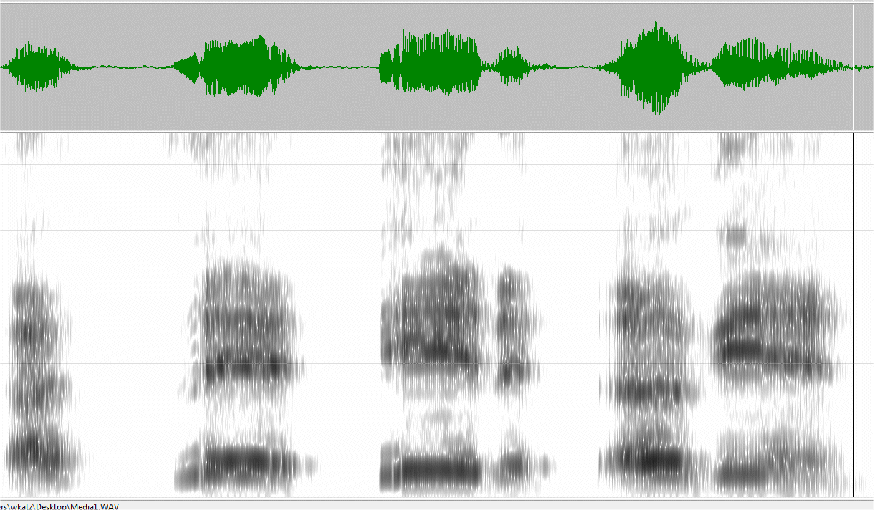
Clinician Pt with dysarthria
“I said hid again”
“I said hid a gain”
(2119 ms)
(4215 ms)

Slide 22
Two proposed feature systems for describing disordered speech
Voice Quality Symbols
Extended IPA (“extIPA”)

Slide 23
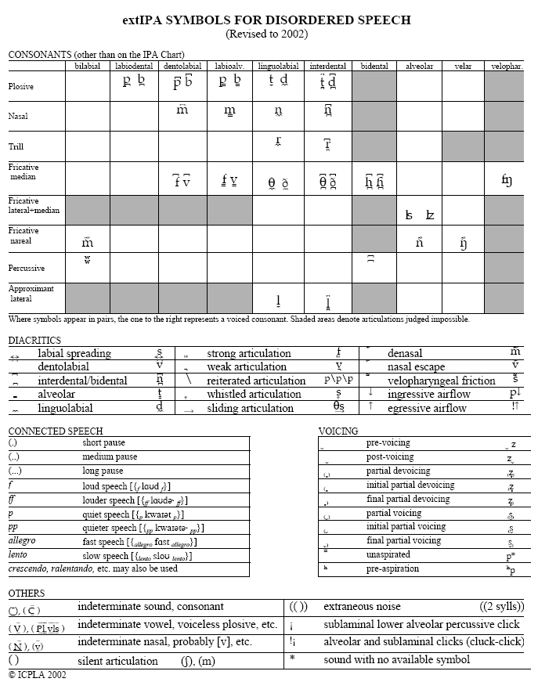

Slide 24
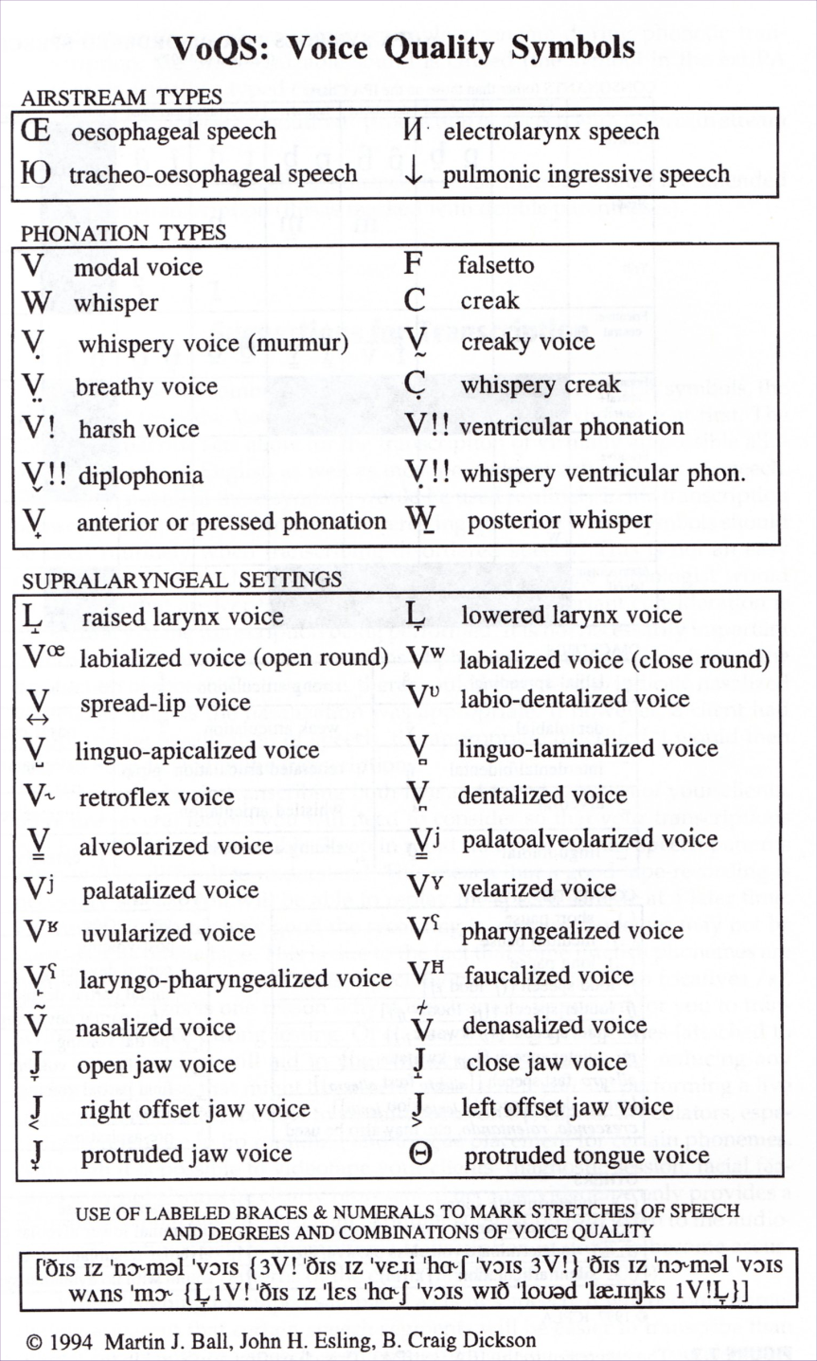

Slide 25
Sample transcription –
Individual with AOS, UTD Callier Center
(target) (attempts)

Slide 26
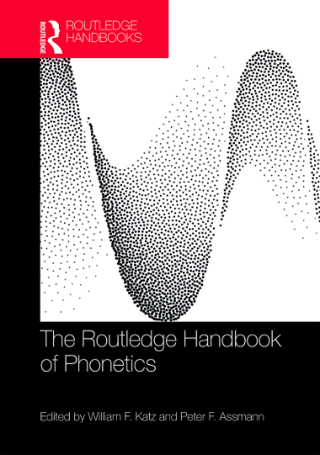

For more information
W. Katz, “New horizons in clinical phonetics”, In Katz & Assmann,
The Routledge Handbook of Phonetics
(2019). London: Routledge.
(Available at UTD library)
Print ISBN: 9781138648333
eBook ISBN: 9780429056253

