Slide 1
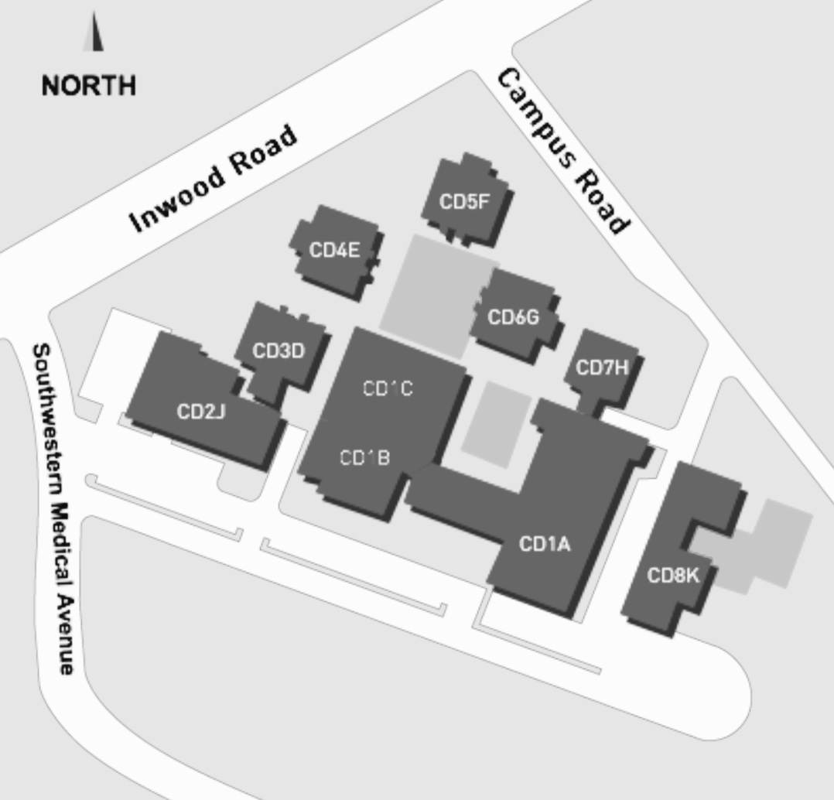
CD2 J.108 Callier Dallas
Phonetics

