Slide 1
Vowels of American English
Copyright 2017 – Please do not copy without permission.
Thank you. ;-)

Slide 2






Front Vowels
Back Vowels
Central Vowels
Diphthongs
R-Colored Vowels
Quiz

Slide 3
Front Vowels
/i, ɪ, e, ɛ, æ/

Slide 4

“bead”
/bid/
[bid]
None

Slide 5
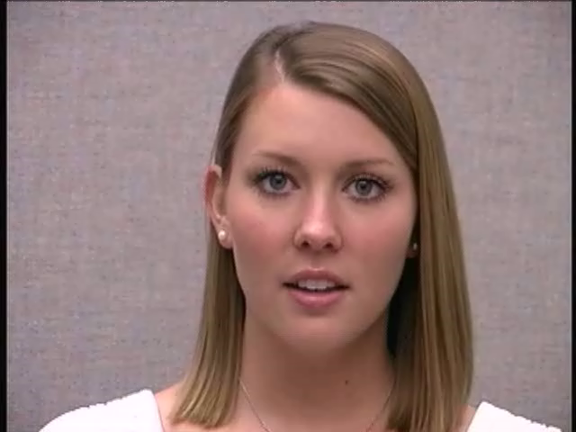

“came”
/kem/
[kʰem]
[kʰeɪm]

Slide 6

“left”
/lɛft/
[lɛft]
None

Slide 7
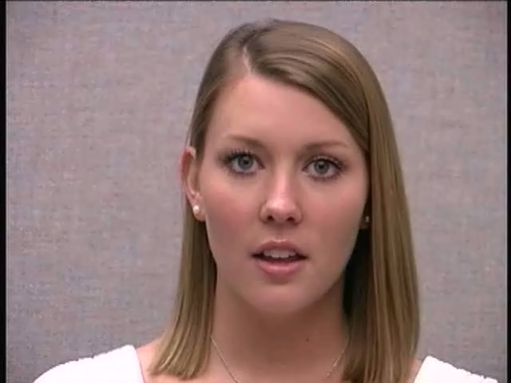
“fad”
/fӕd/
[fӕd]
None

Slide 8

“bit”
/bɪt/
[bɪt]
[bɪɁt]

Slide 9
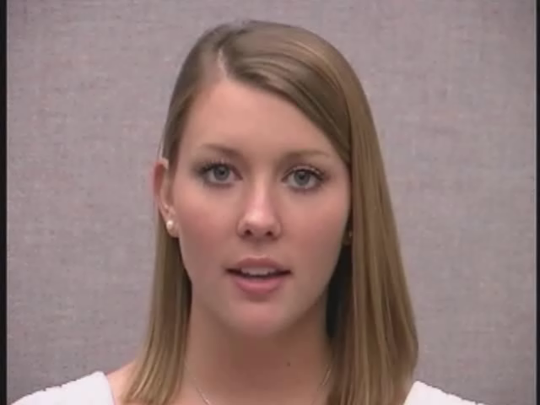
“game”
/ɡem/
[ɡem]
[ɡeɪm]

Slide 10
Back Vowels
/u, ʊ, o, ɔ, ɑ/

Slide 11

“could”
/kʊd/
[kʰʊd]
None

Slide 12
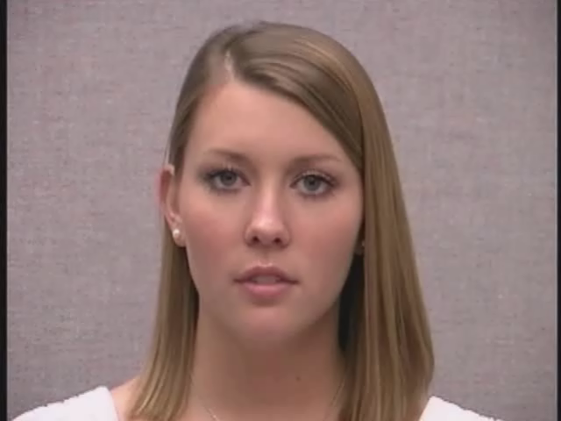
“good”
/ɡʊd/
[ɡʊd]
None

Slide 13

“bombed”
/bɑmd/
[bɑ̃m˺d]
None

Slide 14

“Paul”
/pɔl/
[pʰɔƚ]
None

Slide 15

“moan”
/mon/
[mon]
[moʊn]

Slide 16
Central Vowels
/ʌ, ə, ɝ, ɚ/

Slide 17
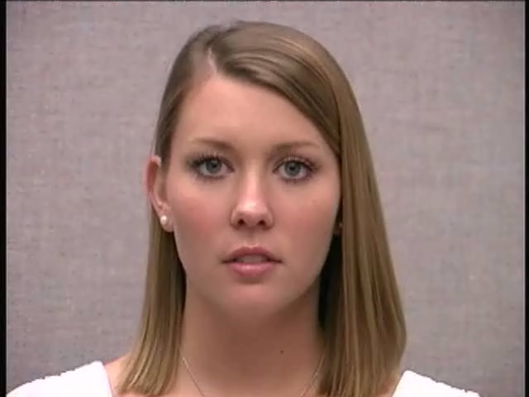
“offer”
/ˈɔfɚ/
[ˈɁɔf ɹ̩]
None

Slide 18

“abut”
/әˈbʌt/
[Ɂәˈbʌt]
[Ɂәˈbʌtʰ] if marking “with audible release” (unusual)

Slide 19

“buddy”
/ˈbʌdi/
[ˈbʌɾi]
[ˈbʌɾɪ] – Note – choice of final high front vowel “i” symbols can vary according to different transcribers

Slide 20

“burger”
/ˈbɝɡɚ/
[ˈbɝɡɹ̩]
None

Slide 21
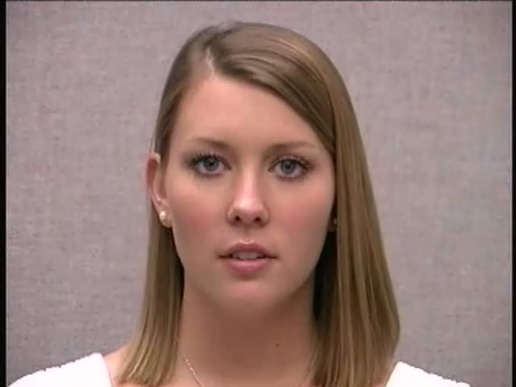
“convey”
/kәnˈve/
[kʰә̃nˈve]
[kʰә̃nˈveɪ]

Slide 22
Diphthongs
/aɪ, aʊ, ɔɪ/

Slide 23

“cloud”
/klaʊd/
[kʰl̥aʊd]
None

Slide 24

“Roy”
/ɹɔɪ/
[ɹɔɪ]
None

Slide 25
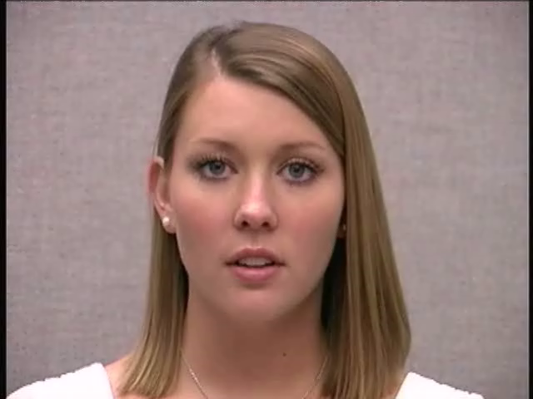
“alloy”
/ˈӕlɔɪ/
[ˈʔӕlɔɪ]
None

Slide 26

“bright”
/bɹaɪt/
[bɹaɪt]
[bɹaɪtʰ] - if marking “with audible release” (unusual)

Slide 27

“mountain”
/ˈmaʊntɪn/
[ˈmaʊ̃n˺tʰɪ̃n]
None

Slide 28
R-Colored Vowels
/ɪɹ, ɛɹ, ɑɹ, ɔɹ, ʊɹ/

Slide 29

“bar”
/bɑɹ/
[bɑɹ]
None

Slide 30
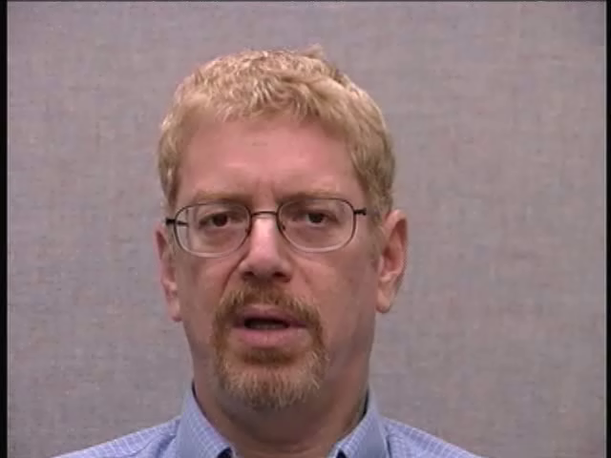
“sear”
/sɪɹ/
[sɪɹ]
[si^{ɪ}ɹ]

Slide 31

“tour”
/tʊɹ/
[tʰʊɹ]
None

Slide 32

“berry”
/ˈbɛɹi/
[ˈbɛɹi]
[ˈbɛɹɪ] – see previous note
about the final “i” selection

Slide 33

“perform”
/pɚˈfɔɹm/
[pʰɚˈfɔɹm]
None

Slide 34
Test yourself !
Quiz 2
(next 10 slides)

Slide 35
“game”

Slide 36

“kick”

Slide 37

“hut”

Slide 38

“heard”

Slide 39
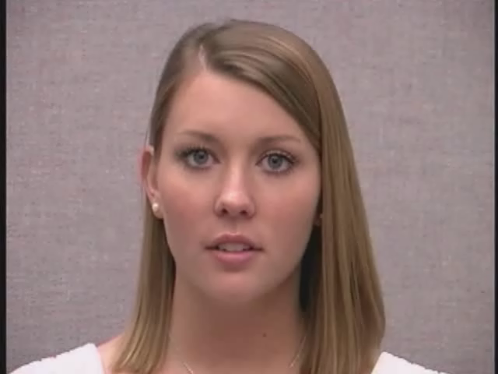
“cracker”

Slide 40
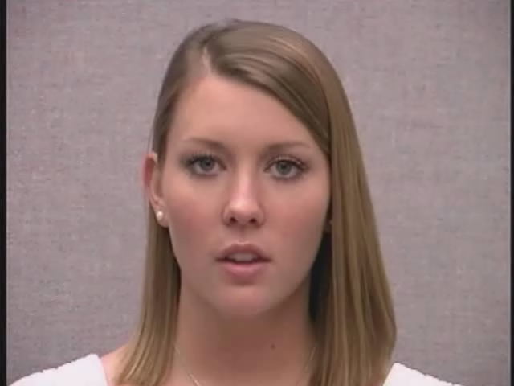
“shoe”

Slide 41

“prize”

Slide 42
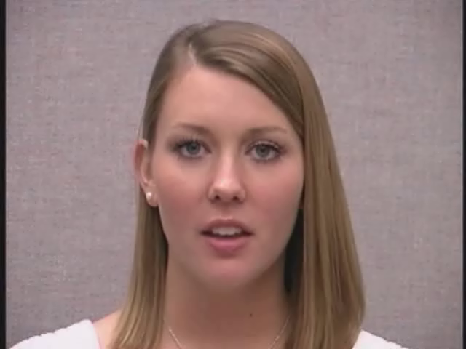
“toys”

Slide 43
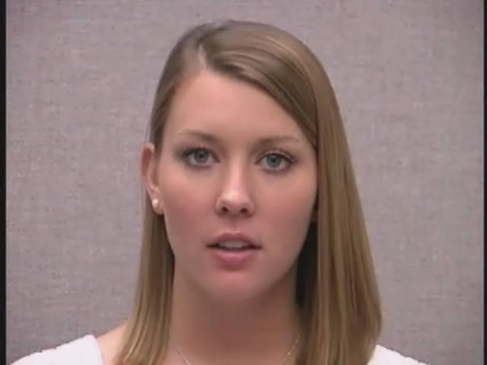
“pew”

Slide 44

“force”

Slide 45
End of
Vowels of G.A.E.
Check your answers at:
“Quiz_Answers_Broad_Narrow.pdf”
Menu

