Slide 1
Chapter 12
Models and theories of speech production and perception
Theories vs. models
Issues: Serial order/ degrees of freedom/ context sensitivity
Models: Target/ Feedback vs. Feedforward/ Dynamic systems/Connectionist (PDP)
Link between production ←→ perception
Updated 2019

Slide 2
Model/ Theory/ Hypothesis
Model – Simplification of a system or any of its parts
Theory – underlying principles and assumptions
Hypothesis – a specific, testable prediction (typically grounded in a certain theory)
Careful:
Although last two terms are sometimes used interchangeably, a theory has been extensively tested and is generally accepted, while a hypothesis is a speculative guess that has yet to be tested

Slide 3
Models
Can be manipulated in a controlled manner to test hypotheses or theories
Can be physical, or (more commonly these days) mathematical

Slide 4
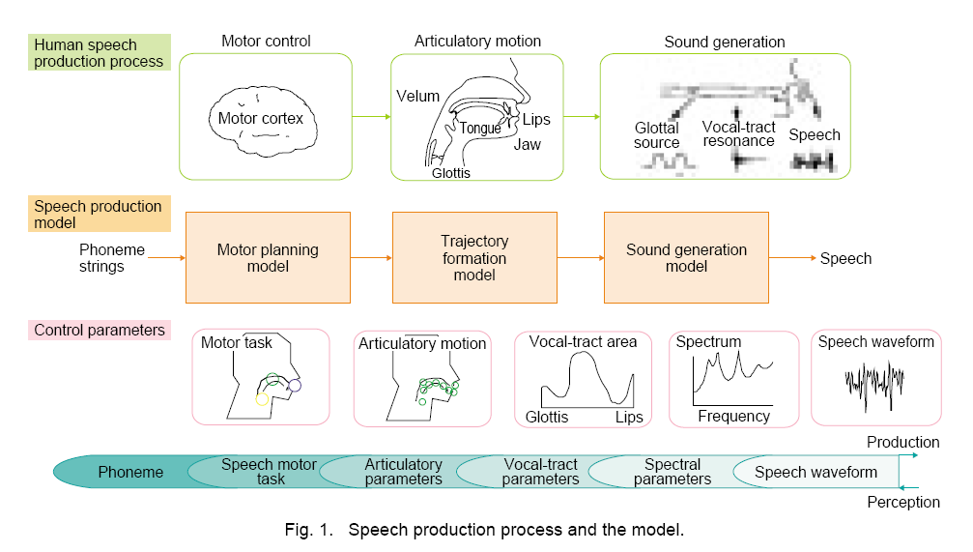
Model example
M. Honda, NTT (2003)

Slide 5
The role of theory in speech science
Theories are important!
Our clinical tools are only as good as the theories they are based on
A popular misconception: Theories are never ‘proven’ or ‘mis-proven’
Instead, theories are either supported or not supported by data

Slide 6
Issues
Regulating serial order
Degrees of freedom
Context sensitivity
Also: Are speech goals acoustic or articulatory (or both)?

Slide 7
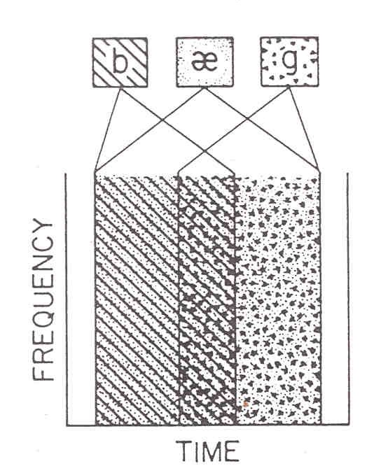
1. Regulating serial order
Coarticulation:
Anticipatory vs. Perseverative
Language-specific
Q: How do we do it?

Slide 8

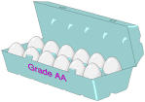
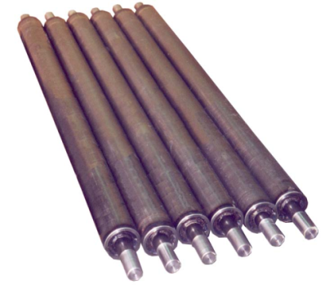
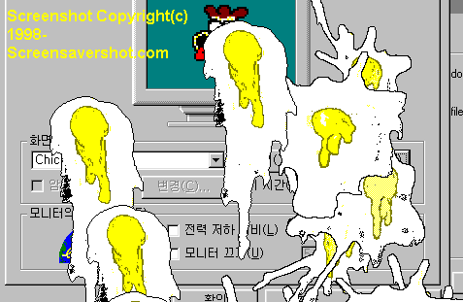
Charles Hockett (1955)
Invariant units of speech become smeared in the process of articulation
But the listener manages to recover these invariant units during perception

Slide 9
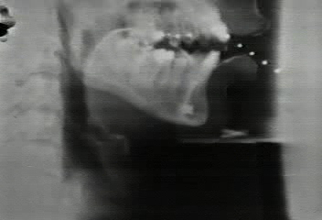
2. Controlling degrees of freedom (df)
Approx. # of muscle pairs that move the
  Tongue: 9
  Velum: 3
  Lips: 12
  Mandible: 7
  Hyoid bone: 10
  Larynx: 8
  Pharynx: 4
PLUS - muscles of the respiratory system
HOW DO WE DO IT?
- Perkell, 2003

Slide 10
Differing proposals…
Motor programs
Hierarchies
Functional groupings, coordinative structures
Dependency on environment, “affordances”

Slide 11
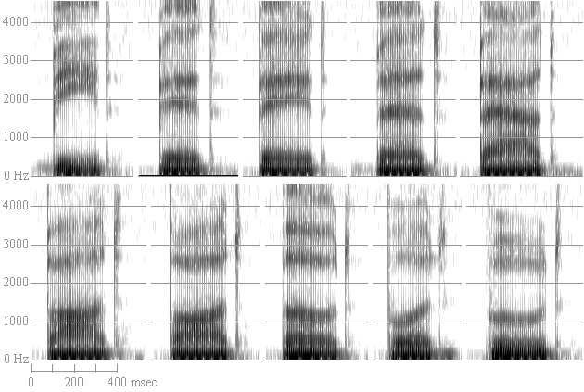
3. Context sensitivity
* Vowel cues are affected by their flanking consonants, and consonant cues are affected by their flanking vowels
EXAMPLE: American English vowels in /b_d/ context
TOP ROW (front vowels): “bead bid bade bed bad”
BOTTOM ROW (back vowels) “bod bawd bode buhd booed”

Slide 12
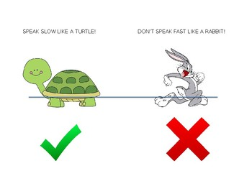
Another example
Rate normalization
Same phonetic content is preserved although absolute signal differs greatly

Slide 13
Models of speech production
Target
Feedback vs. Feedforward
Dynamic systems/ Connectionist (PDP)

Slide 14
Target Models
Spatial? (e.g., “place tongue body HERE for /k/ in the context of the preceding vowel /u/…”)
OR
Acoustic – auditory? (e.g., “create a silent gap with certain formant transitional characteristics…”)
Each explanation has strengths and weaknesses

Slide 15
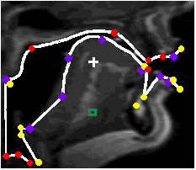
Evidence supporting the hypothesis of spatial (or articulatory) goals:
Articulatory synthesis can generate plausible vowel- and consonant- like sounds
(Mermelstein, 1972; Rubin & Goldstein, 1995)

Slide 16
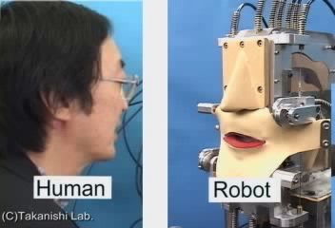
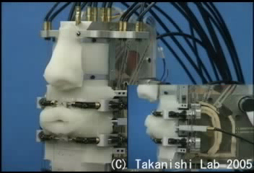
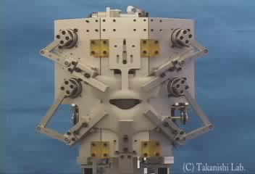

Articulatory synthesis robot

Slide 17
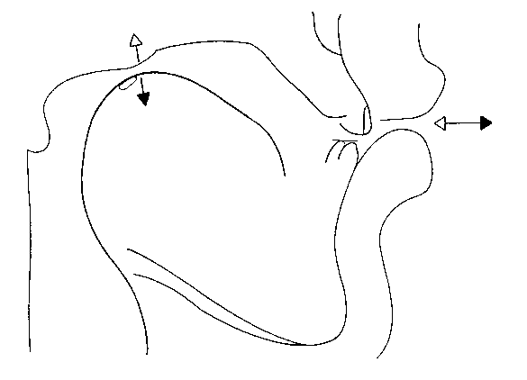
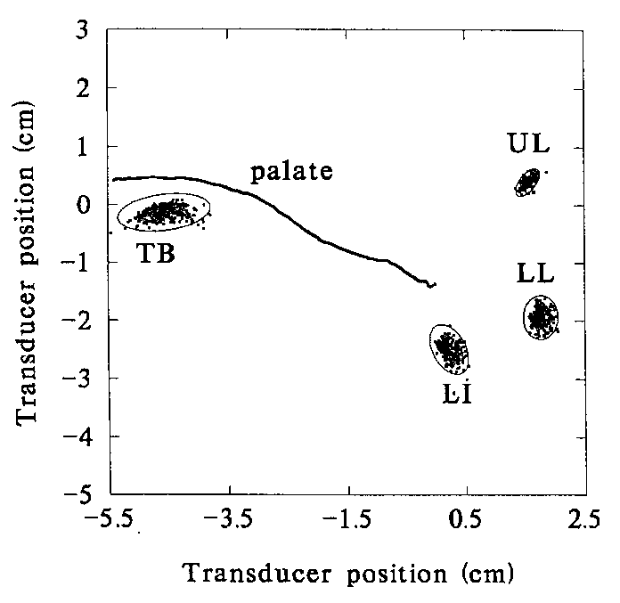
Evidence supporting auditory goals:
Motor equivalence in production of /u/
Negative correlations between tongue-body raising and lip protrusion
Thus, the goal for the articulatory movements is in acoustic/auditory frame of reference.
- Perkell, 2003

Slide 18
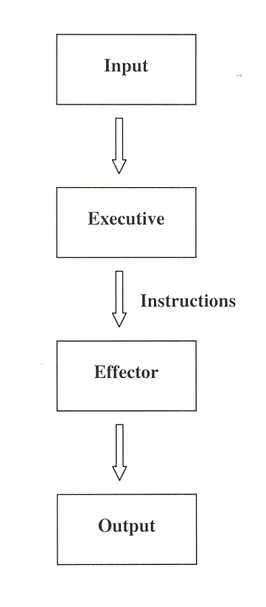
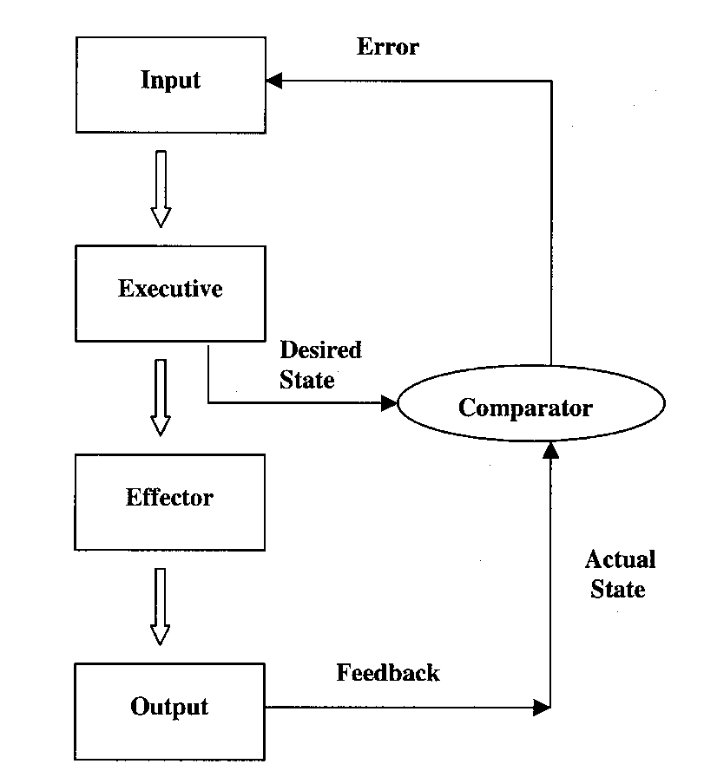
Feedback vs. feedforward systems
Adapted from: Schmidt, R. A. & Wrisberg, C.A. (2000). Motor Learning and Performance (2nd ed).
Champaign, IL: Human Kinetics.

Slide 19
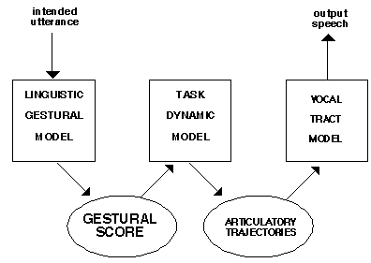
Dynamic Systems Theory (Action theories)
Motor acts are task-specific
Motor control works via coordinative structures (synergies)
EXAMPLES:
Lip closure, opening
Velar lowering
Tongue fronting, backing
- Haskins, Gestural model

Slide 20
Dynamic Systems Theory (Action theories) – cont’d
Gestural theory - assumes phonology is encoded in abstract articulatory gestures
Can explain magnitude of movements (e.g., rate and stress effects), syllable organization, effects in disordered speech
Figure 7.8 The coupling graph for “spot” (top) in which the tongue tip (fricative) gesture and the lip closure gesture are coupled (in-phase) to the tongue body (vowel) gesture, while they are also coupled to one another in the anti-phase mode.
Figure 7.2 The organization of the task-dynamic model of speech production (Saltzman and Munhall, 1989; Browman and Goldstein, 1992; Nam and Saltzman, 2003).

Slide 21
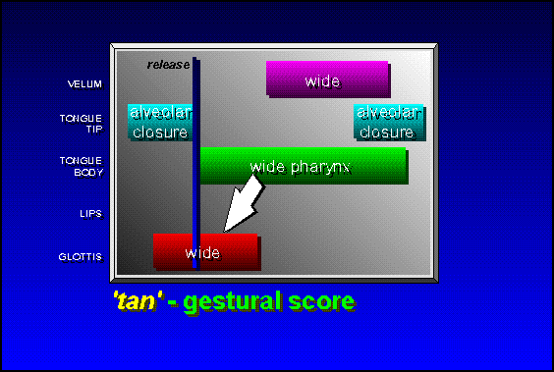
Gesture score - example

Slide 22
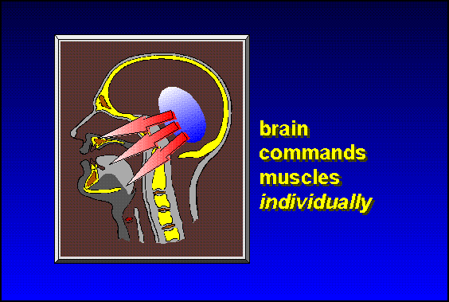
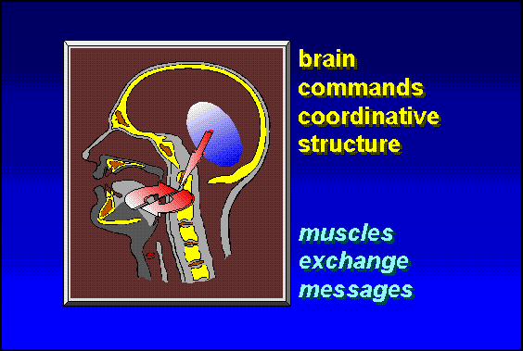
Gesture theory - gist
Old view --------→ New view

Slide 23
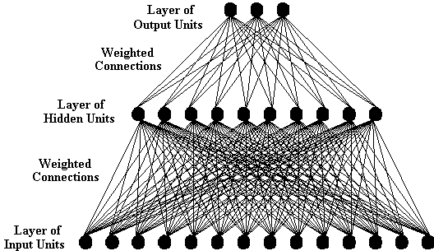
Connectionist Theories (or PDP models)

Slide 24
Parallel Distributed Processing models (PDP)
Processing = interactions of a large number of simple processing elements called units, each sending excitatory and inhibitory signals to other units
Knowledge → represented in the strength of connections between units in the network
A concept is not stored, but exist only as long as a particular pattern of activation persists
What is stored is the ability to regenerate that pattern, given an appropriate input cue
Learning is the development of the right connection strengths

Slide 25
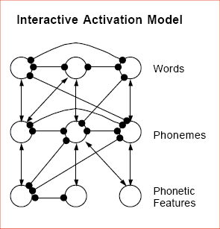
Sample application to speech

Slide 26
The appeal of PDP models
Seem more closely tied to the physiology of the brain than are other kinds of information-processing models.
Potentially offer a computationally sufficient and psychologically accurate account of human cognition
Have altered the way we think about the time-course of processing, the nature of representation, and the mechanisms of learning.

Slide 27
Some quick tutorial links..
A very basic introduction
A bit more detail
Learn from a pro – Geoffrey Hinton (2016) -Neural Networks for Machine Learning

Slide 28

Potential problems of PDP (?)
Too powerful – how to constrain?
Only like the brain in a “toy” sense?
Do these systems really “learn?”
Just because a mathematical model can simulate human behavior, do we really have to believe that humans work that way?

Slide 29
DIVA model
‘Directions Into Velocities of Articulators’
Frank Guenther, BU
Brain activity
Sensory targets
Speech motor outputs
Auditory/ Somatosensory
Sensations
Note:
Runs in MATLAB:
We will demo!

Slide 30
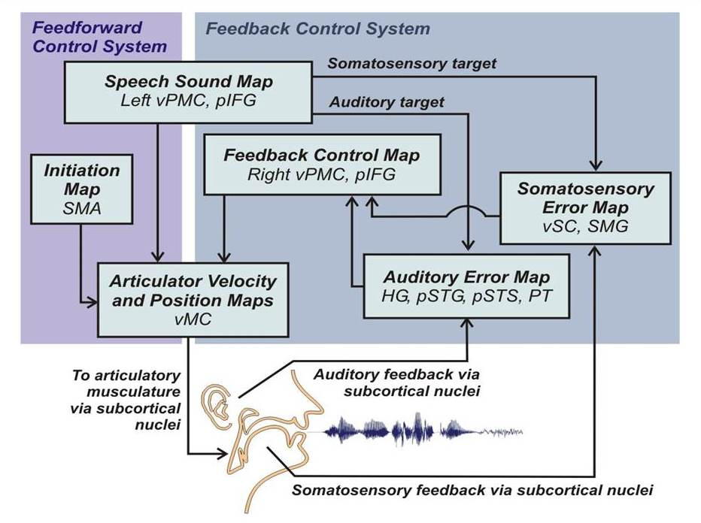
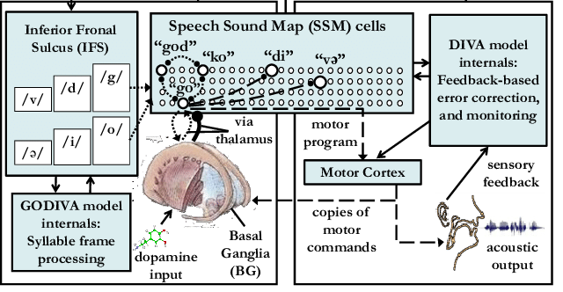
Current neurocomputational models
DIVA
GODIVA
(Civier et al., 2011)

Slide 31
COMD applications
Stuttering, AOS/BA as problems with feed-forward control (feedback is intact)
Problems may be over-reliance on slower feedback routes

Slide 32

Speech perception
Some highlights for speech language pathologists

Slide 33
A key problem
LACK of invariance
Invariance = perceptual constancy
Listeners effortlessly decode phonemes, but where is this invariant information in the signal?

Slide 34
Other important features of human speech perception
Active process
Depends on clarity of signal
Sound order is important
Signal is fleeting and impermanent (not like print)
Listeners can show flexible processing

Slide 35
Speech Perception - Key Concepts
Bottom-up vs. Top-down
Active vs. Passive
  (Very similar to “controlled” vs. “automatic”)
Autonomous vs. Interactive

Slide 36
Bottom up processes
Information comes in from periphery to central processing systems
Example:
Ear → auditory nerve → primary auditory cortex → Wernicke’s area → greater peri-sylvian cortex

Slide 37
Top-down Processes
Processes whereby pre-existing knowledge sources are brought to bear on the decision as to what speech sounds are being heard.
Examples:
  VOT boundaries shift based on whether a sound is a word in the language:
  “boat” and not “poat”
  “cope” and not “gope”
  (see next slide →)

Slide 38
Top-down processing in speech perception
VOT identification experiment
Word at one end, non-word at the other
Perception is more forgiving when the
sound means something!
nonword-word: dask-task
word-nonword: dash-tash
100
% /d/
0
short VOT (d) long VOT (t)
  - Ganong (1980)

Slide 39
Active vs. Passive Processing
Active (or controlled) requires processing resources (e.g. attention), can be manipulated
Passive (or automatic) is relatively effortless and not affected by external conditions

Slide 40
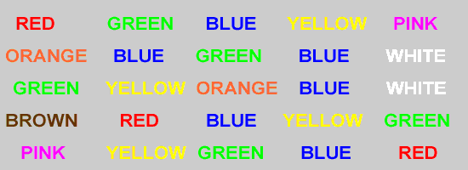
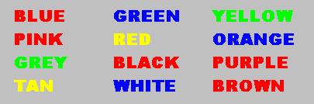
Example of automatic vs. controlled: Stroop effect
Fast, accurate
Slow, inaccurate

Slide 41
Autonomous vs. Interactive
Autonomous vs. Interactive
Autonomous – closed system of decision making (capsulated, modular)
Interactive – decision-making process relies on various sources of information outside the perceptual processor

Slide 42
Classic experiment - illustrates autonomous vs. interactive properties (..for lexical access)
“Lexical Access During Sentence Comprehension: (re) Consideration of Context Effects” -- D. Swinney (1979)
An online measure – “Cross-modal priming”
Subjects hear sentences containing ambiguous words (e.g. BUG) while seated in front of a computer screen. At the same moment the ambiguous word is uttered, a simultaneous string of letters, either a word or a non-word, is flashed on the computer screen.
These words reflect one or another meaning of the ambiguous word (e.g. ANT, SPY) or are unrelated controls (e.g. SEW).
Subjects respond as quickly as possible – by hitting a button - once the probes were processed.
The idea is that multiple meanings are activated at the moment an ambiguity is encountered -- priming related concepts.

Slide 43
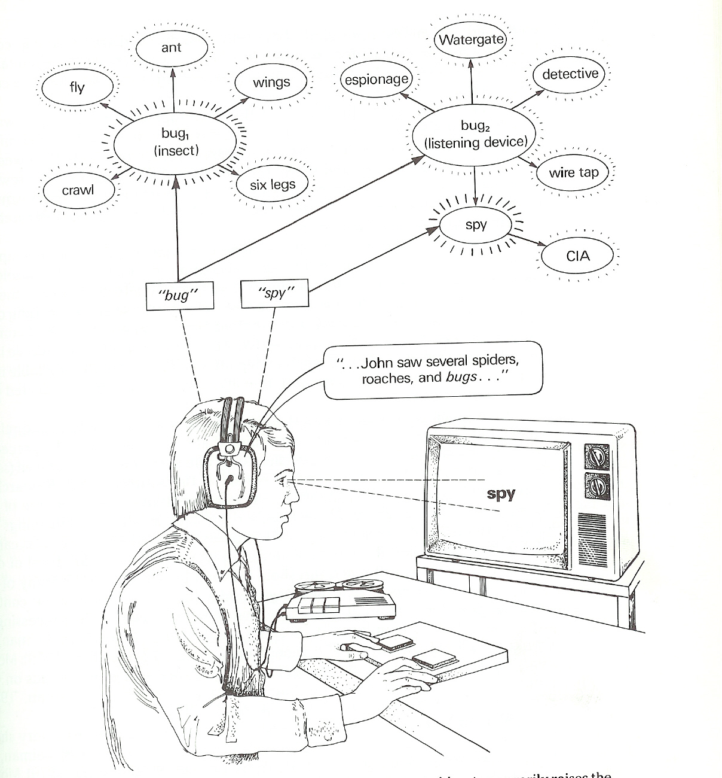
“Lexical Access During Sentence Comprehension: (re) Consideration of Context Effects” -- D. Swinney (1979)

Slide 44
Motor theory of speech perception
“Speech is understood in terms of how it is produced”
Speech relies on an auditory code
The auditory signal reflects complex encoding
Nevertheless, the claimed invariant is articulatory
That is, motoric gestures must be recovered from the acoustic signal.
Examples include the “locus” for stop consonant place of articulation.

Slide 45
Motor theory
Evidence for:
Evidence against:
Duplex perception
Mirror neurons?
Comprehension precedes production (e.g. in development)
Parsimony

Slide 46
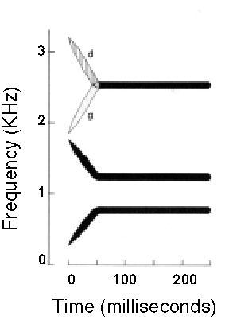
Duplex perception - introduction
Experiments make use of stimuli in which direction of F3 transitions distinguish [da] from [ga]. Without this transition, the rest of the stimulus pattern is ambiguous between [da] and [ga].

Slide 47
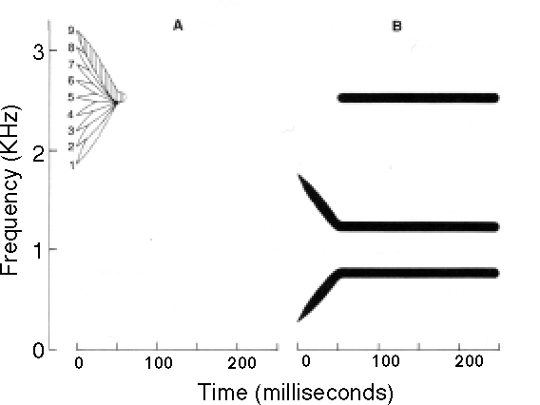
Duplex perception - methodology
The critical formant transition (A) is presented to one ear, and everything else (the ambiguous "base", B) is presented to the other.

Slide 48
Duplex perception - results
WHAT IS HEARD:
Listeners hear a syllable in the ear that gets the base (B). Its identification is determined by which of the nine F3 transitions are presented to the other ear (A).
Listeners also hear a non-speech "chirp" in the ear that gets the isolated transition (A).
Thus, perception is “duplex”

Slide 49
Duplex perception - implications
Same stimulus is simultaneously part of two distinct types of percepts
Thus, percepts are produced by separate mechanisms, or modules, that are both sensitive to the same range of stimuli.
The discrimination functions for the isolated "chirp" and the speech percept are quite different.
The speech percept exhibits categorical perception, the chirp percept exhibits continuous perception.

Slide 50
Duplex perception
Concerns…..
“Why does this necessarily support the motor theory?”

Slide 51
Other theories of speech perception
  Acoustic invariance theory
  Direct realism
  TRACE model
  Logogen theory
  Cohort theory
  Category decision models: Prototypes, fuzzy logical models, native language magnet theory

Slide 52
For more information on these other speech perception models, see:
http://www.utdallas.edu/~wkatz/courses/More_info_speech_perc_models.pptx
NOTE: (Optional and for fun! Not needed for final exam)

Slide 53
McGurk Effect
MacDonald & McGurk (1976)
Visual modality may complement or even override auditory input
Effects are complex -- the basis for these effects remains controversial
See e.g. http://www.youtube.com/watch?v=T4fUi0eG1X4
OR http://www.youtube.com/watch?v=aFPtc8BVdJk&feature=related
Clinical import:
  Lip reading and/or facial cues in deaf language
  Added difficulty of non-visual modes of communication (e.g., the telephone) for communication disordered patients

Slide 54
Life course issues
Young infants may be equipped with a “universal phonetic analyzer”
By ~ 1 year old, infants have already tuned in to their native language(s)
Young children’s perception appears remarkably adult-like at very young ages; chief difference seems to be increased variability. However, more research needed in these areas.
Morphemes with “low phonetic substance” (e.g., -ed, -s) may be particularly affected in children with specific language impairment (SLI)
Speech perception seems to be well maintained in normal aging

