Slide 1
Chapters 8, 9
The Auditory System and clinical applications
UTD/ Speech Science
COMD 6305
William F. Katz, Ph.D.

Slide 2
Chap 8 - issues
Auditory system structure and function
Perception of speech
Acoustic patterns of consonants and vowels

Slide 3
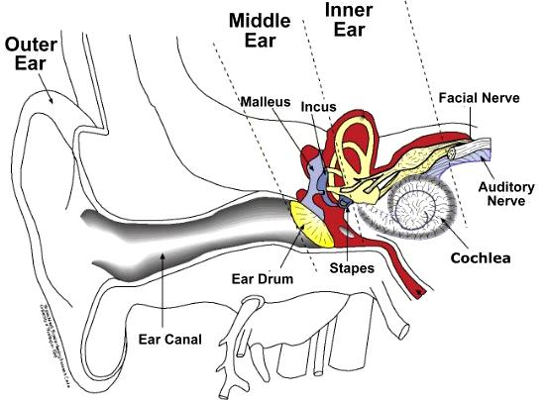
Outer/ middle/ inner ear
Pinna, external auditory meatus
(Ear canal) – ¼ wave resonator – boosts high frequency sound
Together, pinna and ear canal give 10–15 dB amplification for 2500-5000 Hz sounds

Slide 4
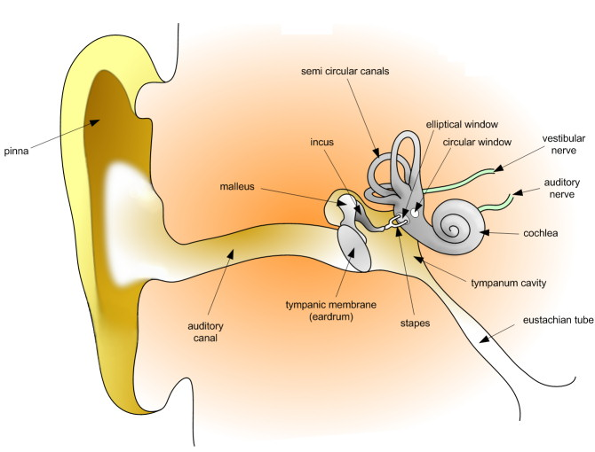
A closer view

Slide 5
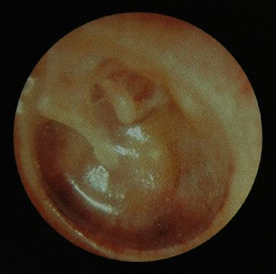
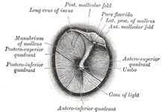
Tympanic membrane
Grey’s Anatomy
Photo

Slide 6
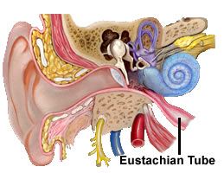
Middle ear - overview
Anatomy
Ossicles
Muscles (stapedius, tensor tympani)
Auditory (Eustacian) tube
Physiology
Overcome impedance mismatch of middle/inner ear by increasing pressure changes at oval window

Slide 7
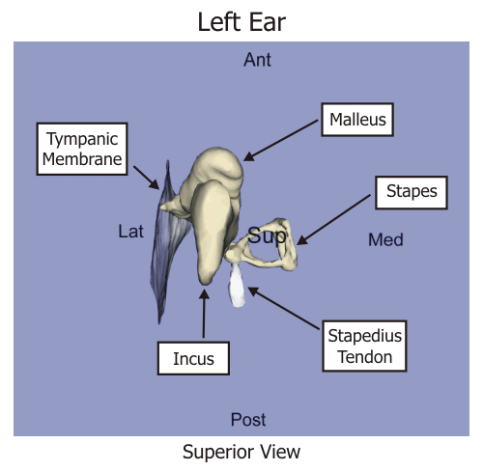
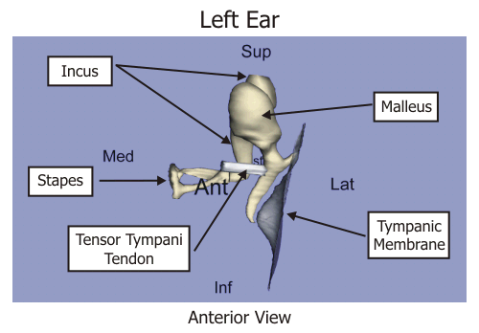
Muscles of middle ear
Stapedius
Tensor Tympani



Slide 8
Acoustic (stapedial) reflex
Stapedius
In response to 80 dB or more
Contraction pulls stapes to the side
Reduces sound pressure by ~ 10 dB
Initiates in fractions of a second, fatigues after time

Slide 9
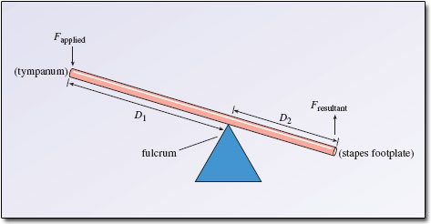
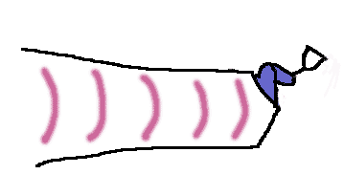
Two means of overcoming impedance mismatch
Lever action of ossicles
Surface area differential pressure amplification

Slide 10
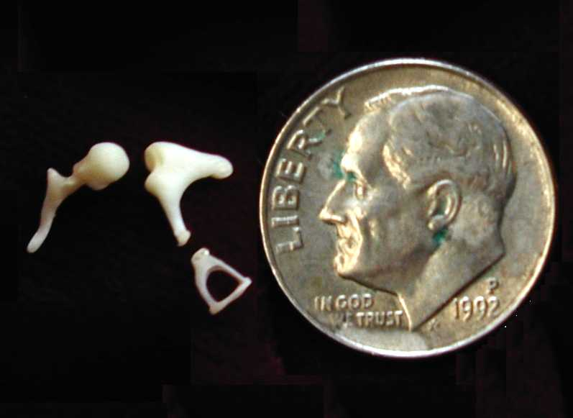
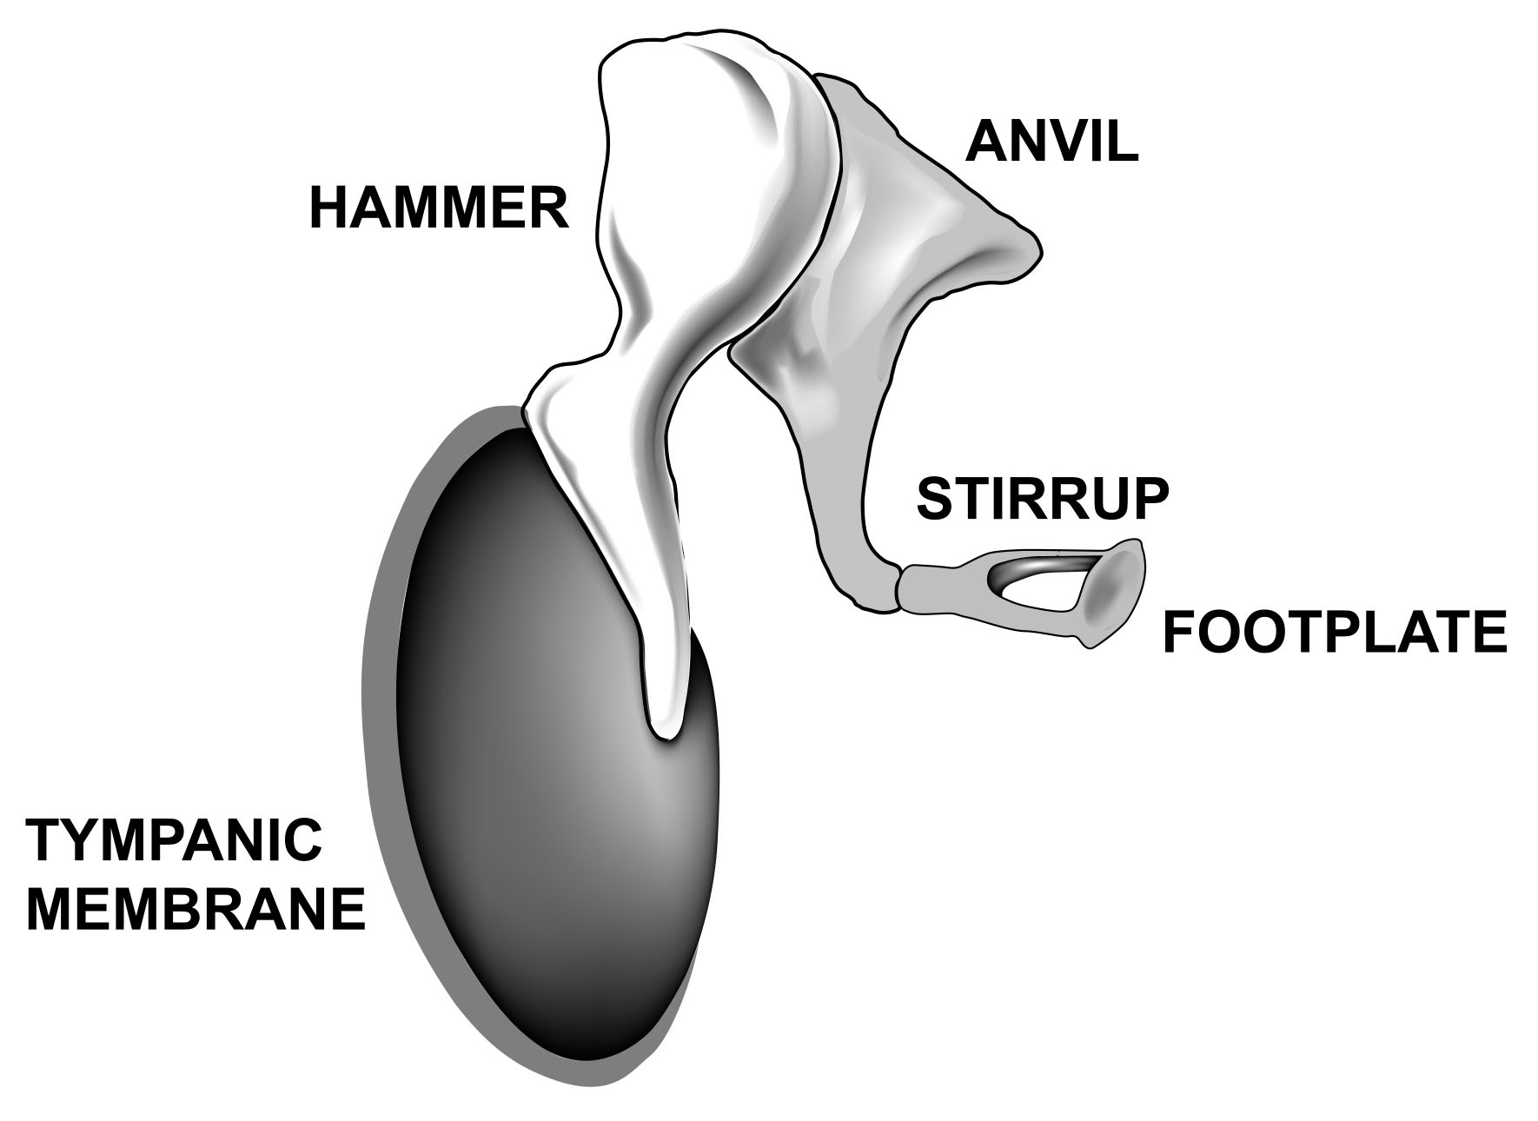
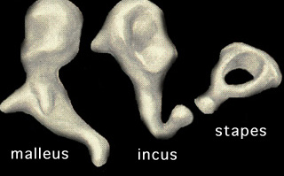
Ossicles

Slide 11
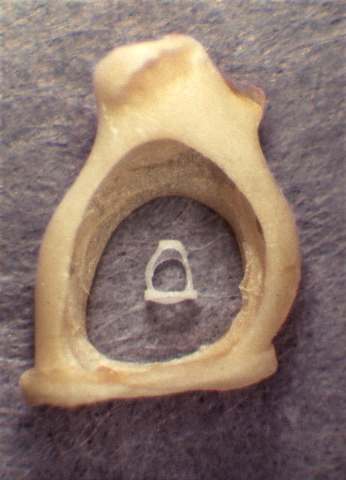
Man vs. mouse
… I couldn’t resist…

Slide 12
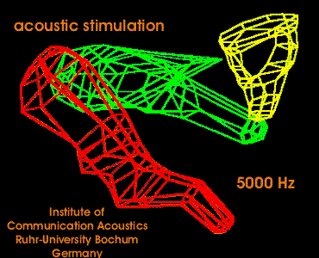
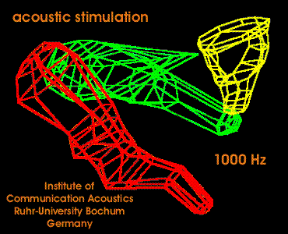
Simulations of ossicle function

Slide 13
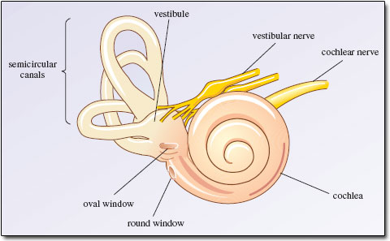
Inner Ear
Cochlea 
Basilar membrane
Cochlear function
Tonotopic organization
(Semicircular canals and vestibule – for balance)

Slide 14
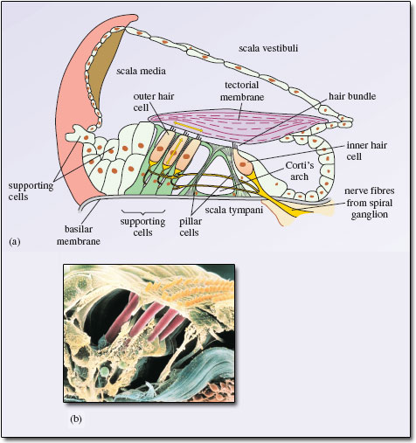
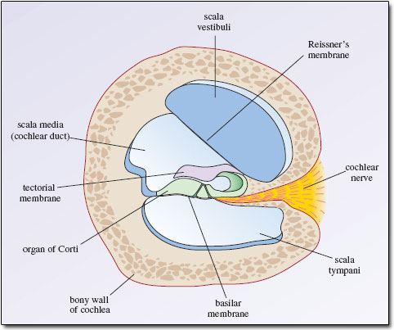
Cochlea – cross section
A
A
←
Organ of Corti
(electron-micrograph) showing
4 rows of hair cells supported by pillar cells

Slide 15
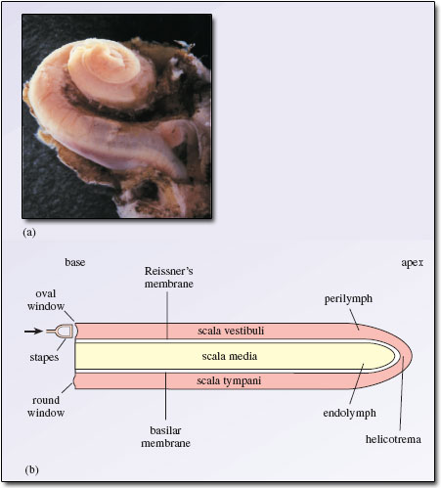
Cochlea - terms
Perilymph
Endolymph
Cochlear duct
Basilar membrane (BM)
Vestibular membrane
Round window
Helicotrema
Organ of Corti
Tectoral membrane

Slide 16
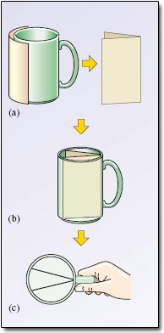
Make your own cochlea
You have just divided the mug into 3 chambers: the scala vestibuli, media, and tympani (top, middle, bottom)
Top arm of the ‘V’ is Reissner’s (Vestibular) membrane, the bottom is the Basilar membrane

Slide 17
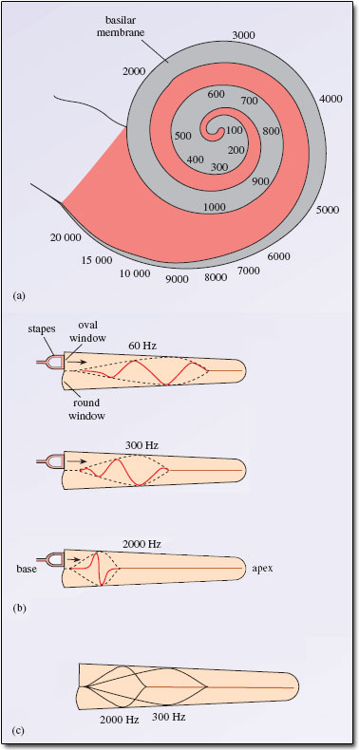
Cochlea – continued
Broad → narrow from lateral →medial
However, BM is opposite (shown in grey), from narrow -> broad as it approaches the apex
Stiffer at narrow (basal) end; 100x more compliant at wider (apical)
Tonotopic organization
Lying on BM is Organ of Corti (the organ of hearing!)
- 3500 inner hair cells ✓ (to 8th Nerve)
- 20,000 outer hair cells …?
Basal

Slide 18
Hair cell function
Inner
Directly reach brain via 8th nerve
Fewer
Outer
Long a mystery
Ear actually creates sound (external otoacoustic emissions)
OHCs amplify them
“Cochlear amplifier”
Refines frequency and sensitively of mechanical vibrations

Slide 19
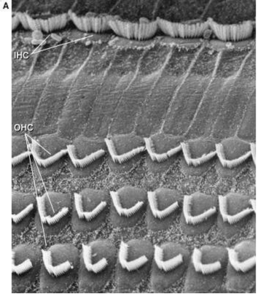
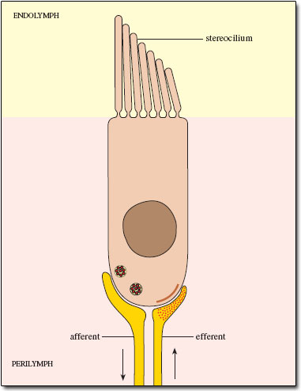
Hair cells

Slide 20
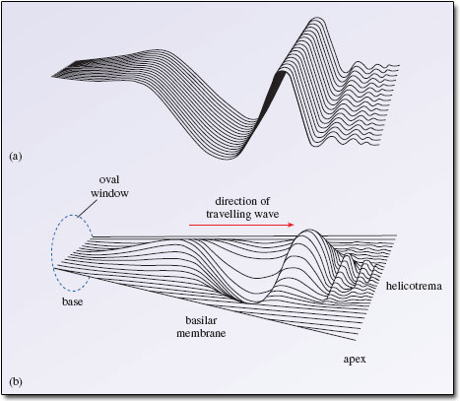
Cochlear function – continued
Cochlea essentially performs a Fourier analysis
With hearing loss, spectral sensitivity typically compromised, “spectral smear”
Video: https://www.youtube.com/watch?v=dyenMluFaUw

Slide 21
Speech Perception – some key issues
* How do we derive meaning from the stream of sounds we hear? (“the segmentation problem”)
* Role of redundancy
* What are the “units?”
  Individual sounds (phonemes)
  Syllables
  Words
  Sentences

Slide 22

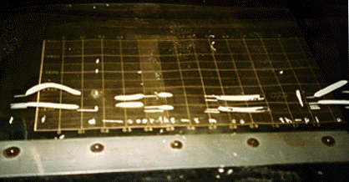
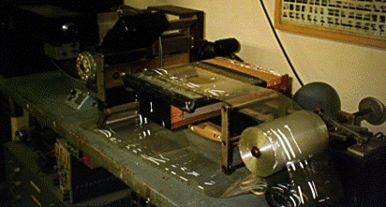
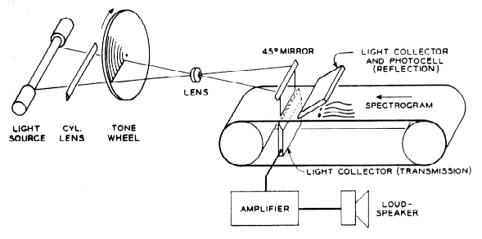
Instrumental Analysis –
History - Pattern Playback

Slide 23
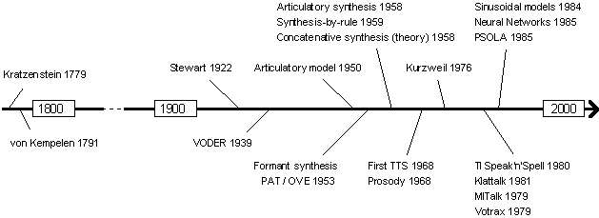
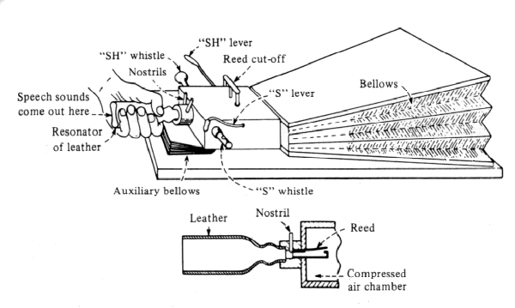
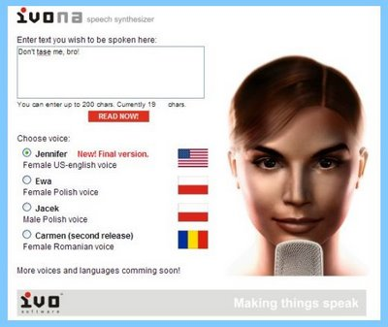
Speech synthesis.. A long history
↓

Slide 24
Perception of vowels and diphthongs
Steady state cues-
Is it relationships between the formants that are important?
OR Constant ratios of F2/F1?
Dynamic cues –
“silent center” experiments show that even when vowel nucleus removed from syllables, listeners can still recover vowel quality

Slide 25
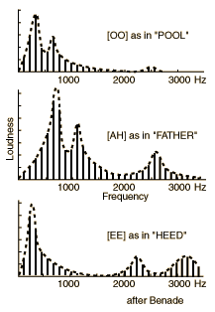
Vowel and diphthong perception – cont’d
Back vowels (e.g. [u, a]) are perceived on the basis of the average of F1 and F2, as well as F3
Front vowels (e.g. [i]) are perceived on basis of F1 frequency and average of F2 and F3
F1/F2
F3
F1
F2/F3

Slide 26
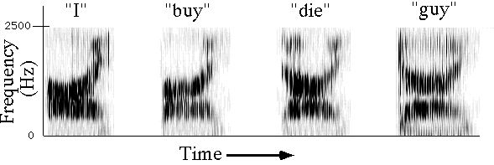
Perception of Diphthongs
Perceived on basis of their formant transitions
Salient feature: rapidity of transition
(rate of formant change)

Slide 27
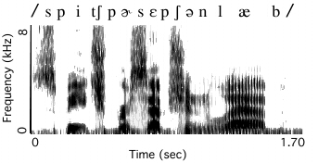
Consonant Perception
Perception different for consonants than vowels
Greater variety of consonant types than vowels
Greater complexity for consonants
Many consonants perceived categorically

Slide 28
Categorical vs. Non-categorical (Graded) Perception
Categorical perception
Graded perception
“All-or-none” response.
Listeners can identify stimuli well across categories and cannot discriminate well within categories.
No sharp differences in identification or discrimination functions

Slide 29
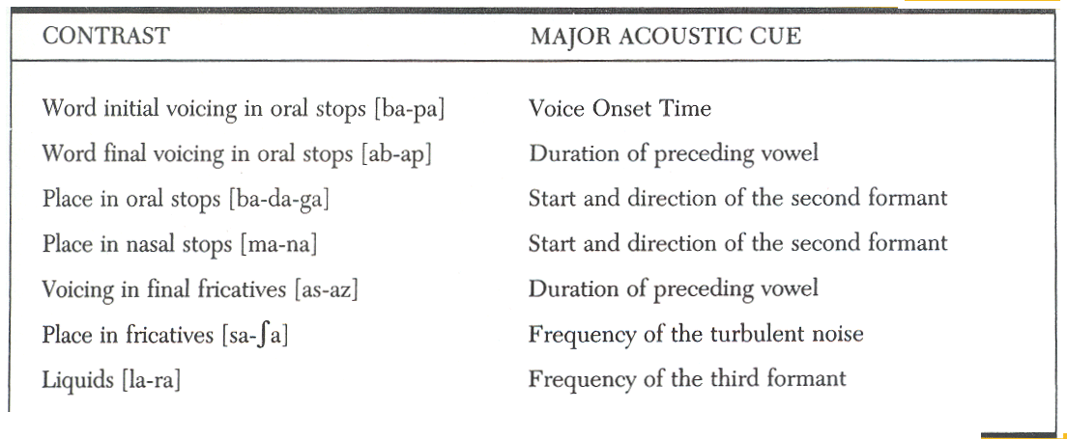
Examples of Categorical Perception in Speech

Slide 30
Two important tasks in psychology
Identification – “Label the sound you hear” (arguably more complex or “higher-level” than discrimination?)
Discrimination – “Indicate whether the two sounds you hear are same or different”

Slide 31
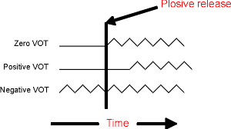
VOT - review
/b/ vs. /p/
/d/ vs. /t/
/k/ vs. /g/

Slide 32
VOT – an example of a categorical cue:
Identification
Important cue for voicing of syllable-initial stop consonant

Slide 33
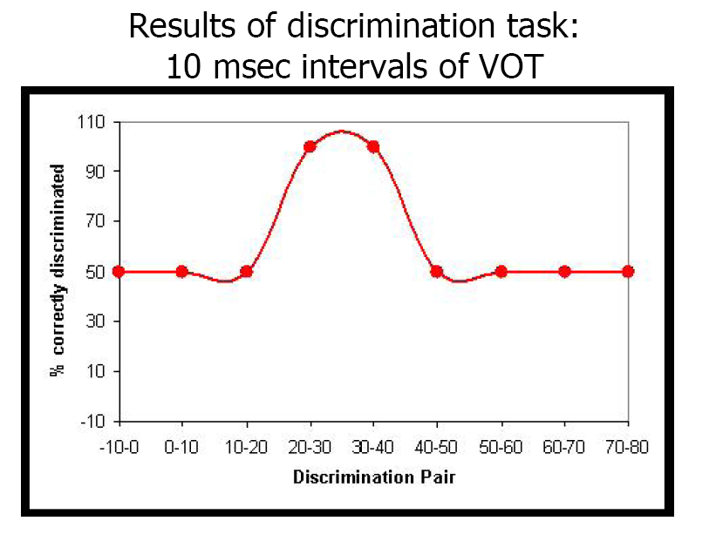

Slide 34
Cross-linguistic VOT studies
VOT boundaries vary in different languages.
For example, Thai has a 3-way boundary between voiceless aspirated, voiceless unaspirated, and voiced stops (see next slide).
Nevertheless, different languages may show a common ground in VOT boundaries reflecting general characteristics of the auditory system
This could relate to ‘matched’ or ‘tuned’ systems between perception and production

Slide 35
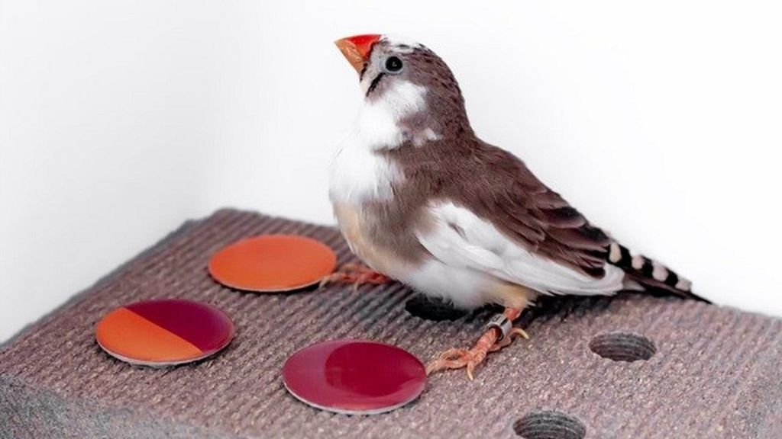
VOT studies in animals
Humans talk, frogs croak
Frogs have auditory systems tuned to their species-specific calls
Animals appear to perceive categorically.
Work with frogs and chinchillas shows that categorical perception is not uniquely human

Slide 36
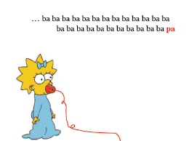
VOT experiments in infants
HASP (high-amplitude sucking) and head-turning paradigms indicate that young infants show categorical effects for VOT, much like adults [see next slide →]
Infants can discriminate speech sounds of all of the worlds languages
However, as they become experienced in their native language(s), infants ‘unlearn’ foreign sounds and hone in on only those sounds needed for their native languages

Slide 37
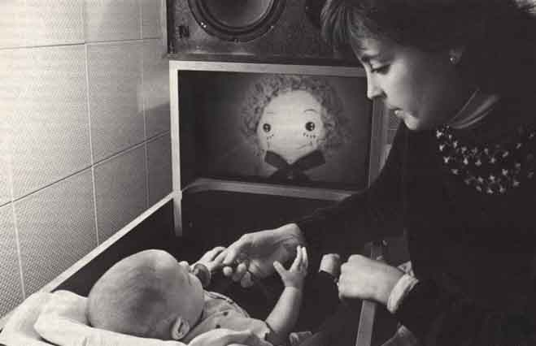
High amplitude sucking paradigm
(shortly after birth)
For more info and videos: https://www.youtube.com/watch?v=EFlxiflDk_o

Slide 38
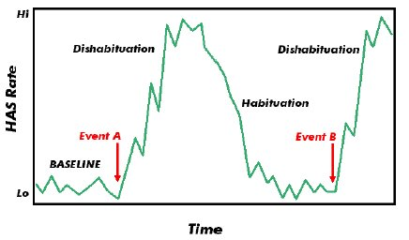
HASP (High amplitude sucking paradigm) data

Slide 39
Infant speech perception - summary
Infants are born preferring the sound of their own language (through prosodic cues available in utero)
They learn the phonemes of their language by ~ 9 - 12 months (by ignoring distinctions not phonemic in their language).
Infants use stress patterns and statistical regularities to help segment words from continuous speech.

Slide 40
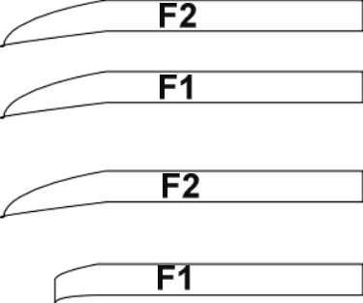
Multiple acoustic cues in consonant perception
Example: Voicing cue in syllable-initial stops
‘F1 cutback’
/ba/
/pa/
with
F1
cutback

Slide 41
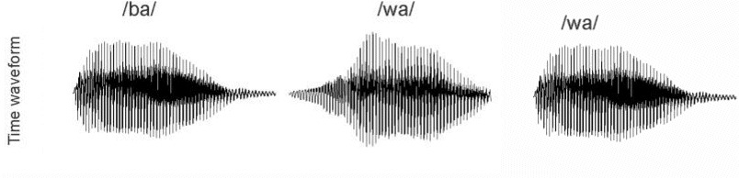
Another example – manner of articulation
Example:
Stop vs. glide distinction
“ba” vs. “wa”
If the vowel portion of the syllable /ba/ is truncated, the consonant will sound more like ‘wa’
‘’
“
(←
a “/ba/” with end of syllable cut off)

Slide 42
Chapter 9
Clinical Applications
HearING LOSS
Audiometry, otoacoustic emissions, brainstem testing
Cochlear implants
OM and effects on speech perception
Language, reading disabilities and speech perception
Relation between speech perception and articulation

Slide 43
Types of hearing loss
TYPE: Outer ear (conductive), sensorineural*, or mixed
DEGREE:
CONFIGURATION:
flat
rising (lower frequencies more affected than higher)
gradually or precipitously sloping (higher more affected than lower)
*e.g., noise exposure, aging, genetics
mild | moderate | moderately severe | severe | profound
25 – 40 dB |  |  |  | > 90 dB

Slide 44
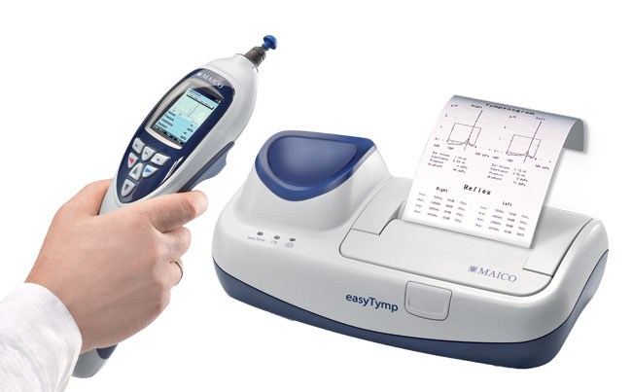
Immitance audiometry
Immitance = “how easily a system can be set into vibration by a driving force”
Im(pedence) + Ad(mittance)
Tympanometer
For ME problems
High admittance (milliohms) = low impedence

Slide 45
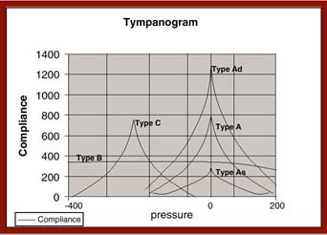
(hypermotility;discontinuity)
(healthy - negative pressure)
(healthy)
(restricted mobility)
(reduced motility; stiffness)

Slide 46
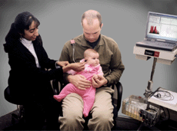
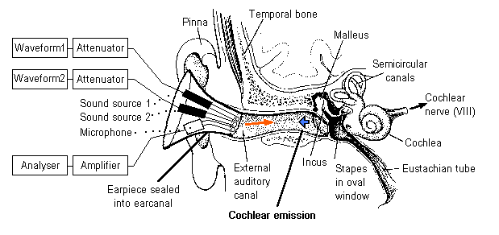
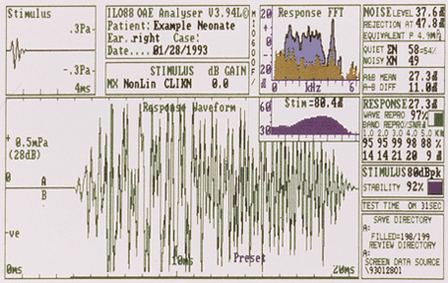
Otoacoustic emissions testing
Low intensity sounds – present in healthy ears
Can be spontaneous (SOAEs), or evoked (EOAEs), e.g. with clicks
Diagnostic of sensory hearing loss
Easily tested, even in babies
https://www.youtube.com/watch?v=QvrBogzziXA

Slide 47
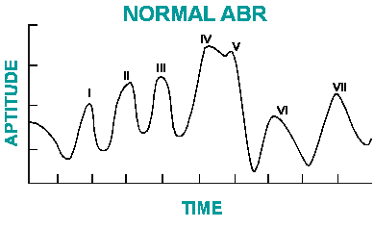
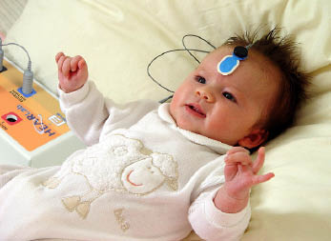
Auditory brainstem response (ABR) testing
8th nerve
brainstem
Used to identify hearing loss type and degree
Can be done during sleep
Brief video:
https://www.youtube.com/watch?v=QTKvtKYLlQ8

Slide 48
HI and speech perception
Vowel perception does not pose as great a problem as consonant impairment (esp. fricatives!)
Place of articulation most common perceptual errors (because rapid and high frequency)
Task of identification esp. difficult (e.g. compared to discrimination)
For adults, likely due to redundancy of acoustic cues in the signal
For children, Vs with high frequency components (high vowels, e.g. /i/ <-> /u/ confusion) may pose more problems

Slide 49
Consonant perception in HI – factors
Audibility – whether a specific speech cue is presented at a level that the person can hear (=Suprathreshold level)
Hi lack of recognizing speech cues as audible suggests possible lack of ability to use dynamic information(?)

Slide 50
Evaluation of speech perception
Articulation index (AI) used to predict amount of speech audible to patients with HI
Range: 0-1
Some suggest counting 100 dots on an audiogram (between 1-3 kHz)

Slide 51
CI/Amplification/ New directions
Amplification with FM (wireless), directional microphones
Cued Speech
Microphone arrays for directional hearing(?)
CIs offer one treatment option – research is expanding at a rapid pace

Slide 52
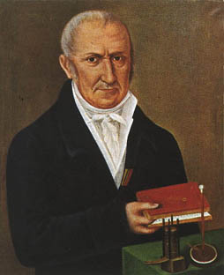
Cochlear implants - origins
Count Volta (Italian physicist) who developed the electric battery, connected batteries to two metal rods that he inserted in his ears.
In 1800 he described that when the circuit was completed he received a 'jolt in the head' and then a sound 'a kind of crackling, jerking or bubbling as if some dough or thick stuff was boiling'

Slide 53




Cochlear implants - developments
Developed and implanted in 1960s by Dr. William House (USA) and expanded by Jack Urban
Additional development/marketing by Graeme Clark of Australia in 1970sm

Slide 54


Modern CIs

Slide 55
Cochlear implants - demo
https://www.youtube.com/watch?v=00WOao4kpwM
Michael Dorman, Ph.D. (ASU)
Tones
Speech

Slide 56
CI Speech Coding Strategies
ACE™: Unique to Cochlear’s Nucleus 24 CI system. ACE optimizes detailed pitch and timing information.
SPEAK: (spectral peak or ‘M-of-N’) Increases richness of important pitch information by stimulating electrodes across the entire electrode array.
MPEAK: multipeak
CIS : (Continuous-Interleaved Sampling) This high rate strategy uses a fixed set of electrodes. Emphasizes detailed timing information of speech.

Slide 57

A challenge for CI technology
Fundamental frequency resolution:
Q: What about speakers of tone languages?
A: Current practice: use CIs that minimally damage cochlea, then boost low freq auditory amplification

Slide 58

Otitis Media
OME
ME that cannot be ventilated, causing retraced tympanic membrane →
Approx 20 – 40 dB loss
Phonetic processing difficulties

Slide 59
Chronic OME in children
SOUND DEMOS: https://acoustics.org/pressroom/httpdocs/133rd/2paaa2.html
Small group studies in the 1990s suggest subtle disturbances of speech perception:
-Perceptual weighting strategies
- Phonemic awareness
Subsequent large-scale NIH funded, multi-site studies have been less conclusive

Slide 60



Language and reading disability
“Specific Language Impairment (SLI)” →
Or, more currently:
DLD = Developmental Language Disorder
-Temporal processing disorder?
-Difficulty with low phonetic substance?
OR:
- Working memory limitations?
- Syntactic difficulties?
ALSO: How “specific” is it, really?
(related deficits also found in Developmental dyslexia)
(Larry Leonard, Purdue)
(Bruce Tomblin, Univ. Iowa)
(Paula Tallal, Rutgers Med. School)

Slide 61





Temporal Processing Disorder/ Details
/ba/ /ba/ /ba/ … /da/…/ga/

Slide 62
Normal Development
Younger children rely more on auditory discrimination of small acoustic differences than older children
A “perceptual weighting shift” may take place

Slide 63
Links between perception and production
Q: Do children with articulation problems have problems with the same processes in perception?
Synthetic speech experiments have been used to address this question
A: Rather mixed findings to date. There may be subgroups.

Slide 64

Tinnitus
https://www.youtube.com/watch?v=5bTfb3JxioU
Current UTD research

