Slide 1
COMD #6305
The Phonatory system
Chapters 4, 5
Laryngeal function
Jitter, shimmer
Vocal registers
Normal vs. abnormal voice qualities
Measurements of voice quality
Clinical applications
Instrumentation

Slide 2
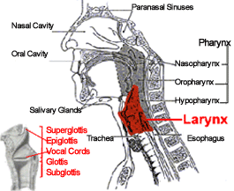
The larynx- review
Division between glottal, subglottal, and superglottal regions

Slide 3
Laryngeal Actions
Safety (preventing aspiration)
Valsalva (see next slide)
Phonation

Slide 4
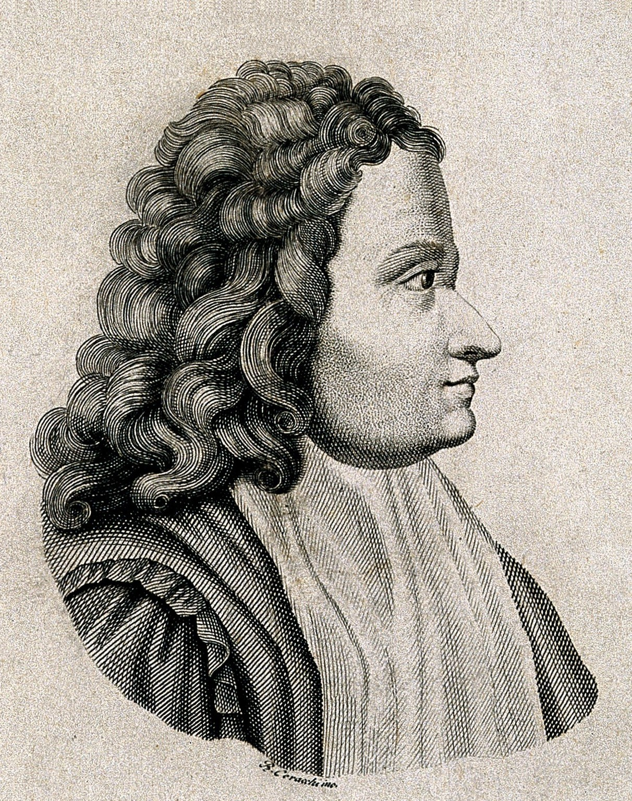
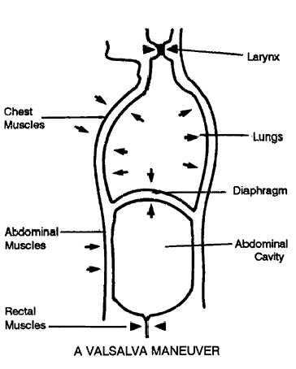
Valsalva mechanism
Antonio Maria Valsalva (1666-1723)
Larynx closes (adducts), diaphragm raises, abdominal and chest muscles constrict
Lung pressure increases: Assists with physical exertion
Also clears ears

Slide 5
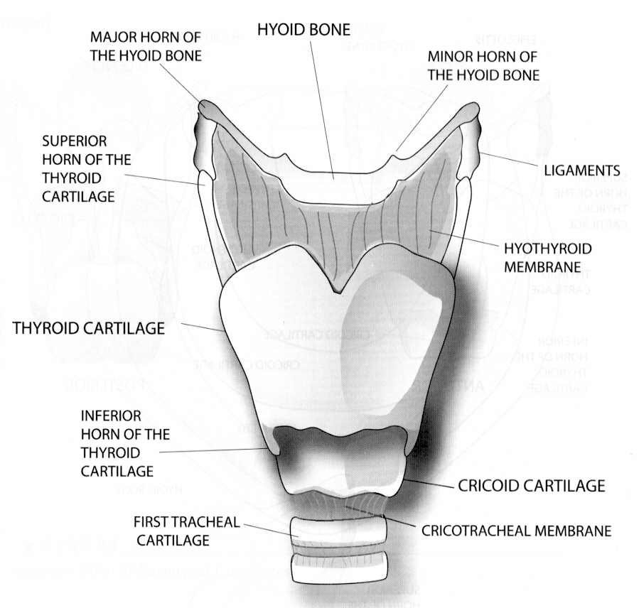
Fig. 6.1. Anterior View - Larynx, Trachea

Slide 6
CARTILAGES
UNPAIRED
Thyroid Cartilage
Cricoid cartilage
Epiglottis
PAIRED
Arytenoids
Corniculates
Cuneiforms

Slide 7
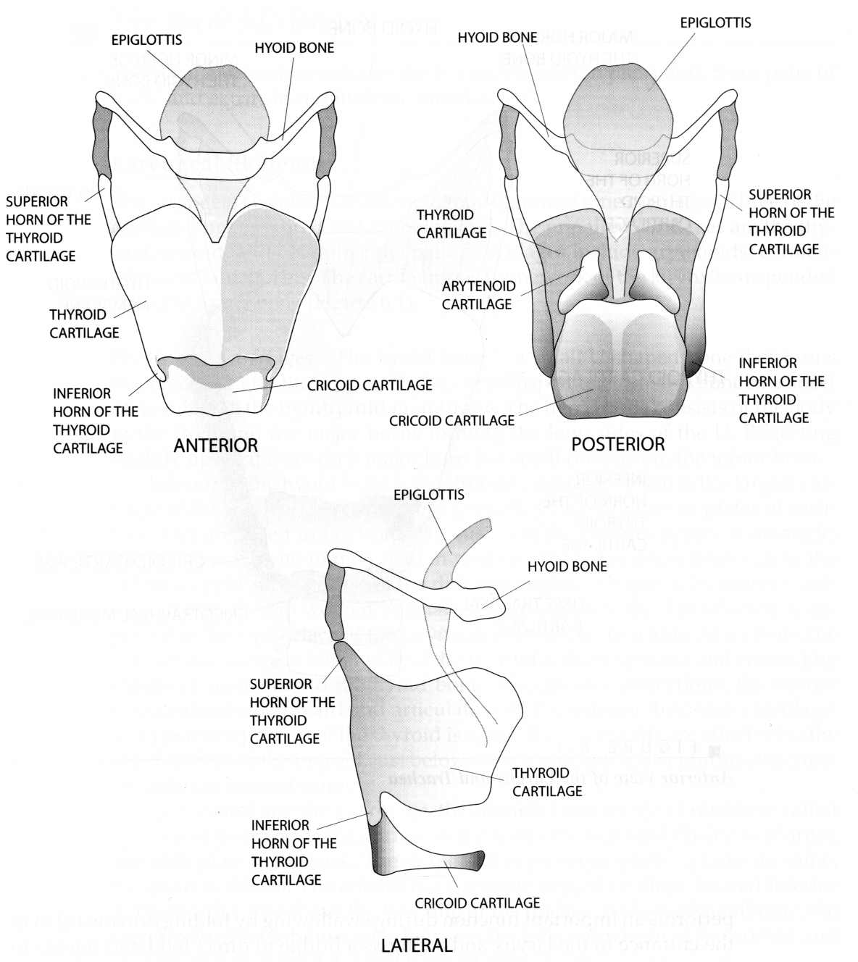
Fig. 6.2 Cartilages

Slide 8
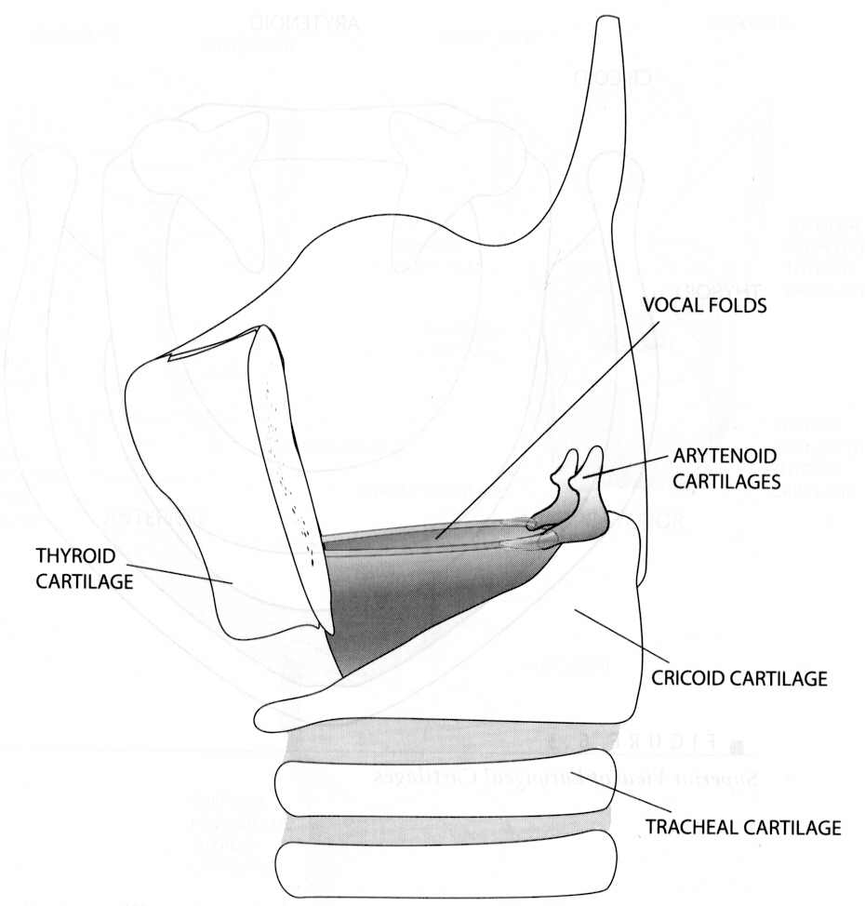
Fig. 6.4. Larynx – cutaway view

Slide 9
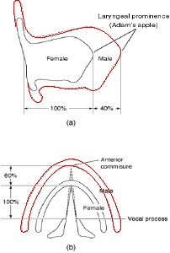
Thyroid cartilage – male/female differences

Slide 10
6.5. Larynx – coronal view

Slide 11
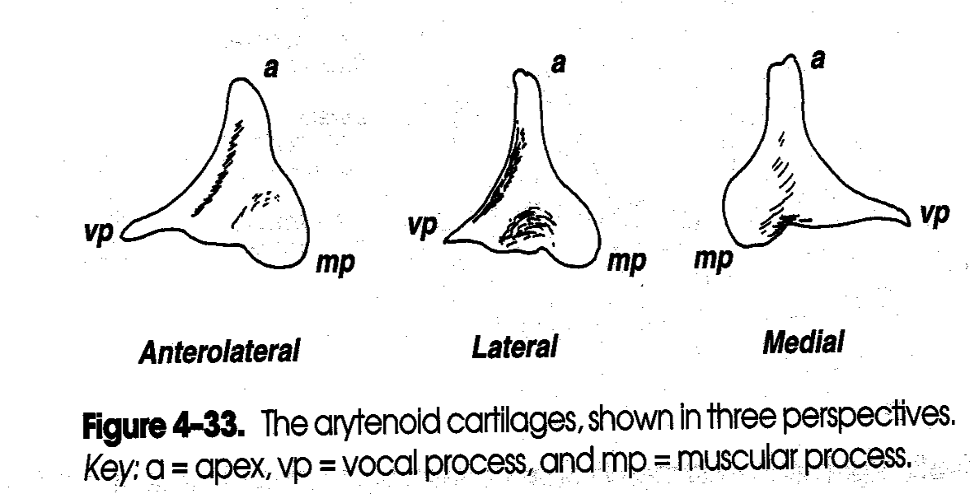
Arytenoids (lit. “ladle-like”)
- Kent, Speech Sciences

Slide 12
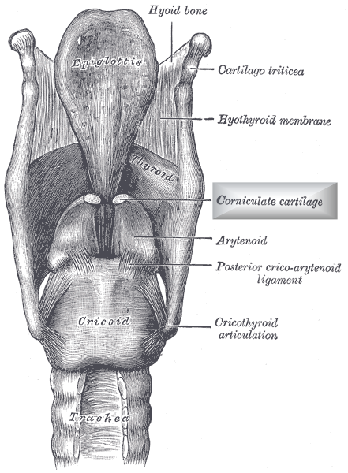
(Gray’s Anatomy, 1858 )

Slide 13
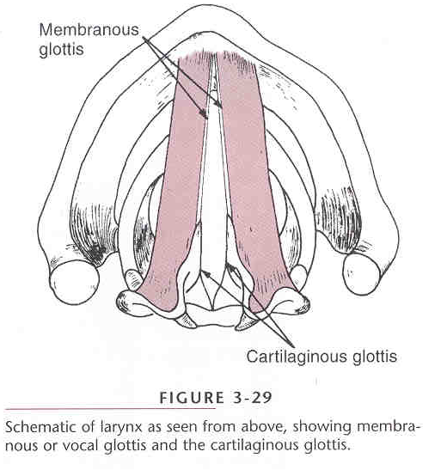
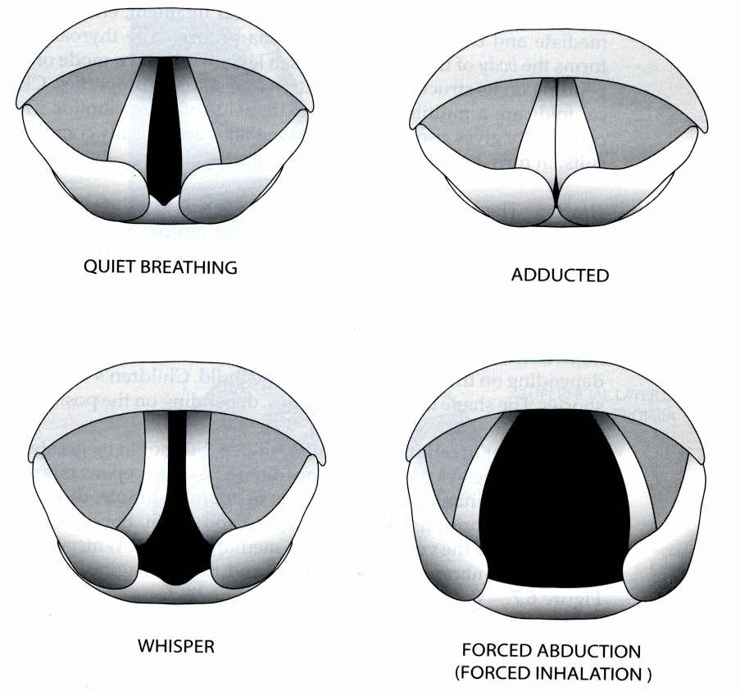
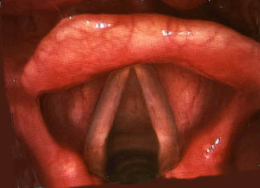
Vocal Folds

Slide 14
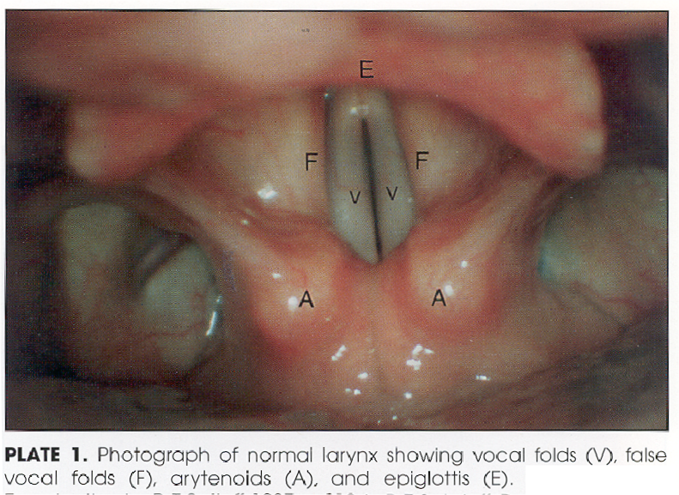
Vocal Folds
- Kent, Speech Sciences

Slide 15
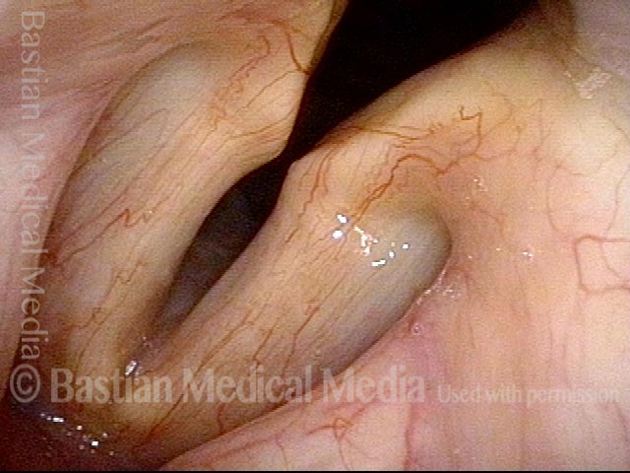
Glottis
Membranous glottis (vocal folds) = anterior 2/3 (also space between this segment)
Cartilaginous glottis (post. 2/5 – back towards artytenoids)
CG must be closed at arytenoids for voiced modal speech to begin

Slide 16
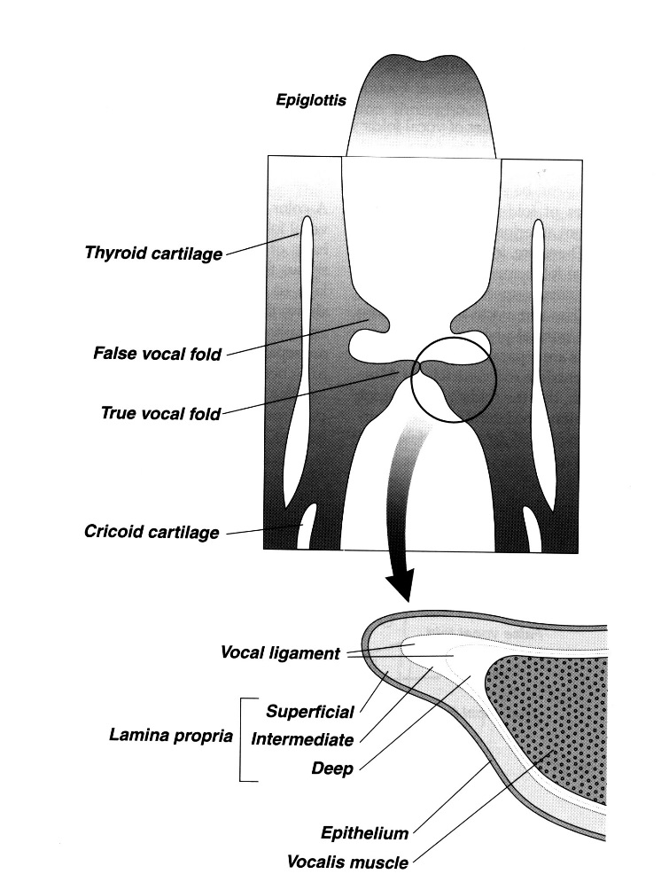
VOCAL FOLDS
True vocal folds lie inferior to the false folds.
Separated by a small cleft called the ventricle.
TRUE FOLDS, FALSE FOLDS and the VENTRICLE divide the subglottic, glottic and supraglottic regions.

Slide 17
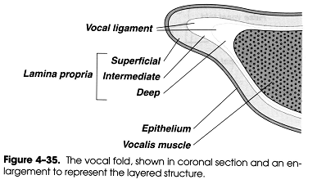
TRUE VOCAL FOLDS
VOCAL FOLD
  1. Mucosa
  2. Muscle (Thyroarytenoid)
  THREE MAJOR LAYERS
  1. Cover – epithelium and superficial lamina propria
  2. Transition – intermediate and deep lamina propria
  3. Body – vocalis muscle

Slide 18
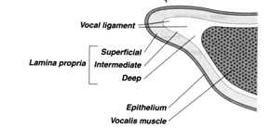
Cover-body model (Hirano)
Cover* is least stiff
Vocal ligament is more stiff
Body (muscle) has greatest stiffness
*cover = epithelium & superficial layer

Slide 19
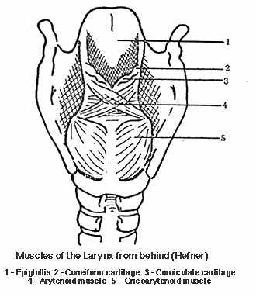
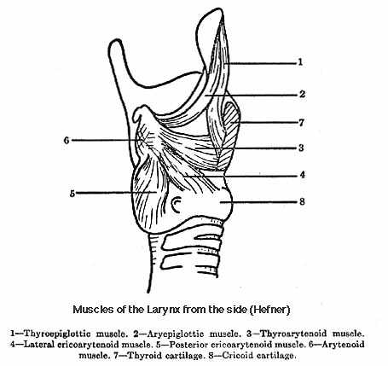
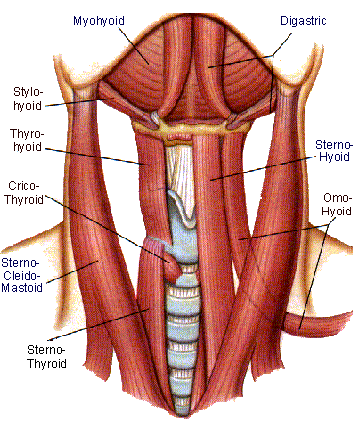
Muscles of Larynx
Intrinsic
  Have origin and insertion within larynx
Extrinsic
  Have one point of attachment → larynx and other attachment → other structure

Slide 20
INTRINSIC MUSCLES
OF LARYNX
Abduct (open) or adduct (close) the folds.
Vocal fold length and tension.
Attach at origin and insertion of different cartilages
Roles in respiration, swallowing, and vocalization.

Slide 21
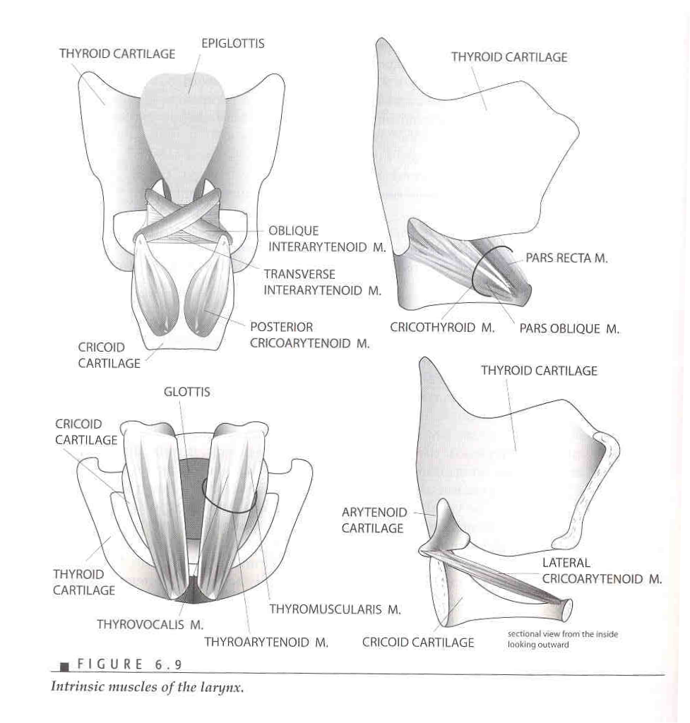

Slide 22
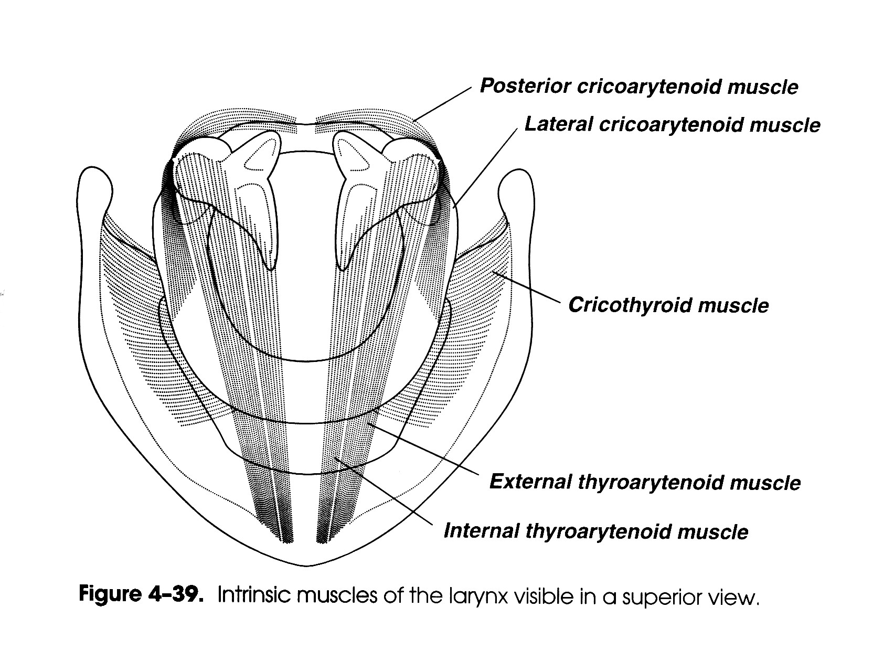
Post.
Ant.

Slide 23
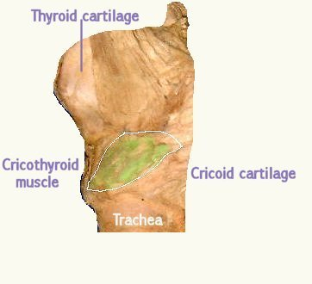
Cricothyroid Muscle
Attached to thyroid and cricoid cartilages
Rocks thyroid forward; stretching and tensing the vocal folds
Raises pitch –push on this and mechanically raise your pitch!

Slide 24
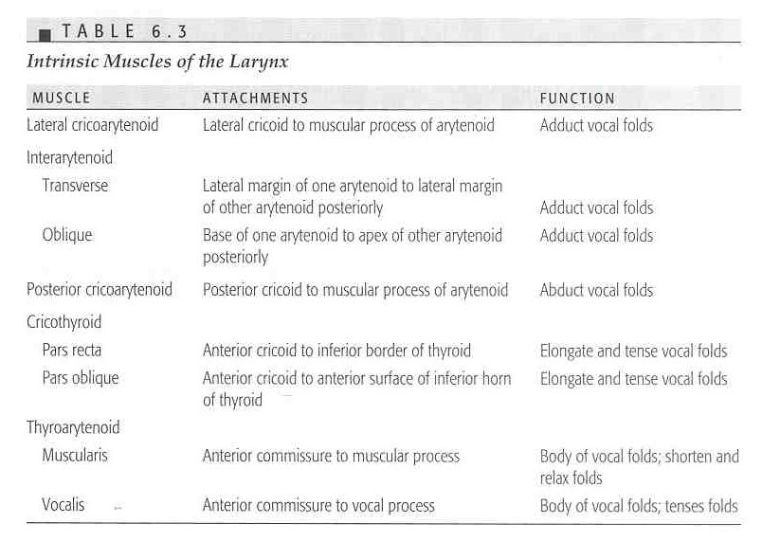
Intrinsic Muscles
Main| Adductors|
|
Only Abductor →
Raises pitch →
Together make
Up vocal folds

Slide 25
The Only ABDUCTION MUSCLE
Posterior Cricoarytenoids (PCA)
Open the glottis
Move arytenoids away from midline

Slide 26
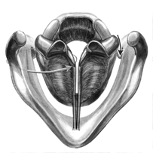
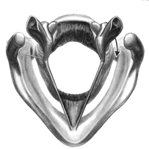
Abduction
Adduction

Slide 27
Adductor Muscles
Move arytenoids to midline
Rock forward
Interarytenoids (Transverse and Oblique)
Lateral Cricoarytenoids

Slide 28
Extrinsic Muscles
“One attachment to a laryngeal and an external structure”
SUPRAHYOID
  Stylohyoid
  Digastric
  Mylohyoid
  Geniohyoid
INFRAHYOID
  Sternohyoid
  Sternothyroid
  Thyrohyoid
  Omohyoid

Slide 29
Infrahyoid muscles
When contracted, pull the entire larynx downward

Slide 30
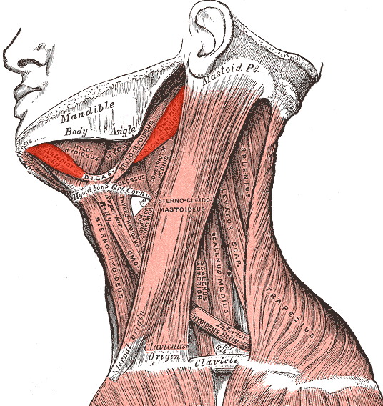
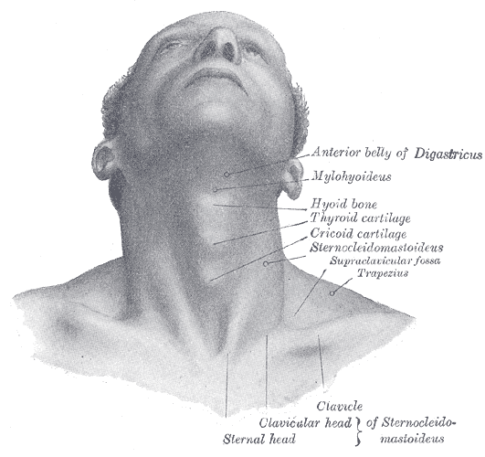
Digastric

Slide 31
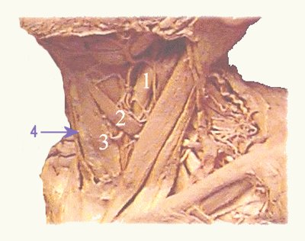
Suprahyoid muscles
Pulls the entire larynx upwards in the neck.
These large up and down movements occur mainly during swallowing.

Slide 32
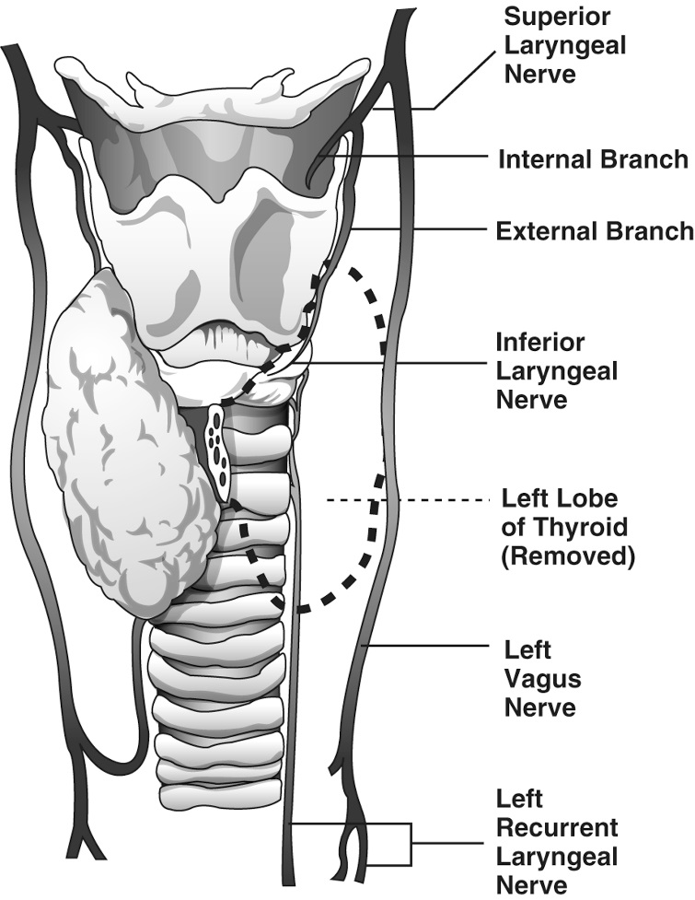
3 Branches – Vagus (CN X)
(upper = Pharyngeal Nerve)
Superior Laryngeal Nerve
sensory
Recurrent Laryngeal Nerve
motor
sensory
motor

Slide 33
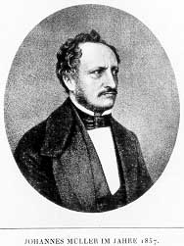
Myoelastic Theory of Phonation
Orig. by Johannes Muller (1858), then Janwillem van den Berg (1958)
Basically accurate (but with some RECENT revision)
Myo = muscle, Elastic = recoil
Pulmonic air = active force; vocal folds = passive actors
Johannes Müller

Slide 34
VOCAL FOLD VIBRATION
Muscle Action
Subglottal pressure build-up
> Subglottal than supraglottal pressure
Creates delta force
Pressure drop, Bernoulli effect

Slide 35

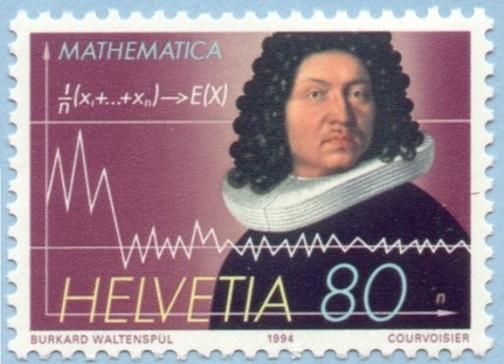
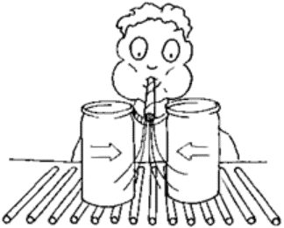
Daniel Bernoulli (1700 – 1782)
The man
The stamp→
The effect →

Slide 36
Muscosal wave
Vertical phase difference (see next 2 slides)
Longitudinal phase difference (from posterior to anterior, “like a zipper”)

Slide 37
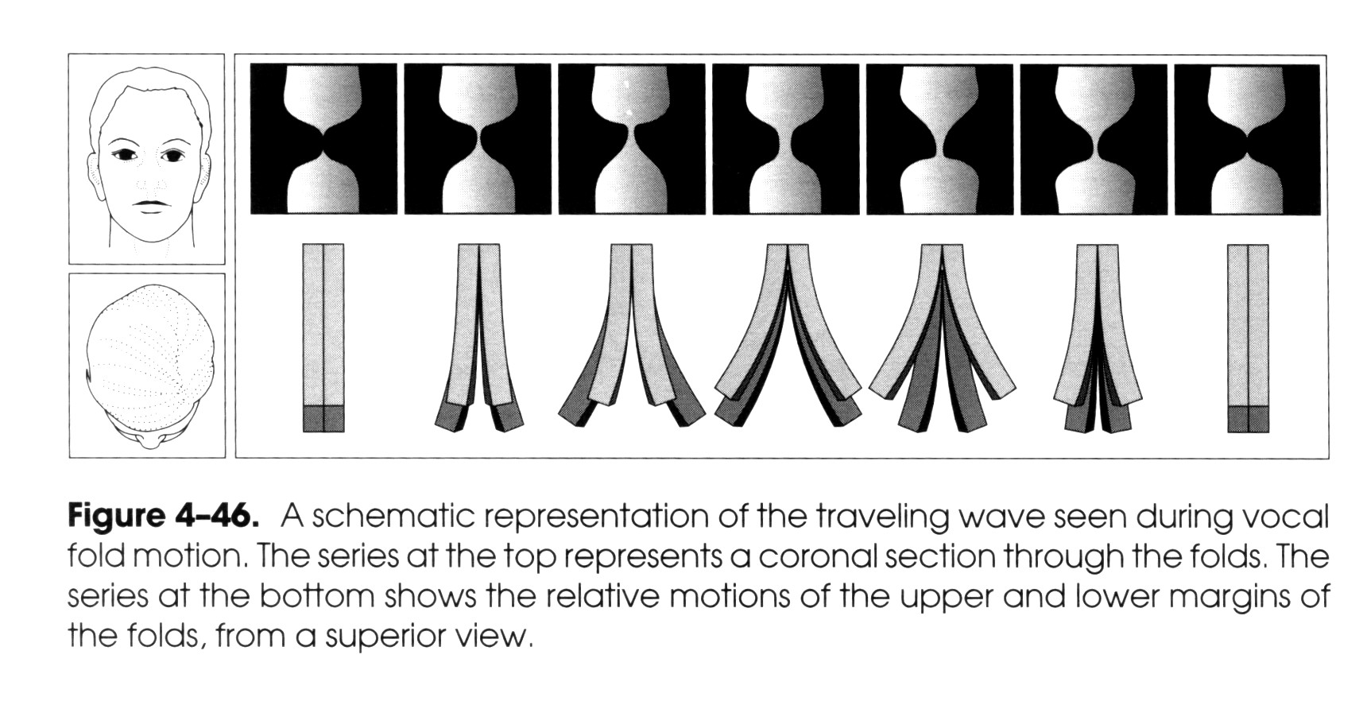
ANT
POST
Note: In middle snapshots we also see “longitudinal” phase difference”
- Kent, Speech Sciences

Slide 38
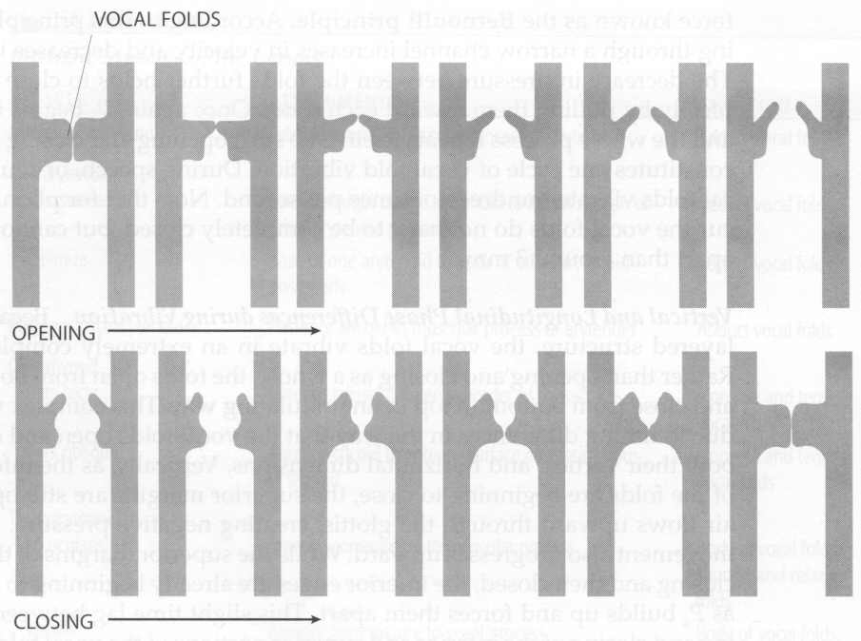
Vocal Fold Phonation
Determined by mass, length, and tension
Changes throughout utterance (question vs. statement, etc.)
Males (F₀: 80-150Hz)
Females (180-250 Hz)
Children (250-300 Hz)

Slide 39
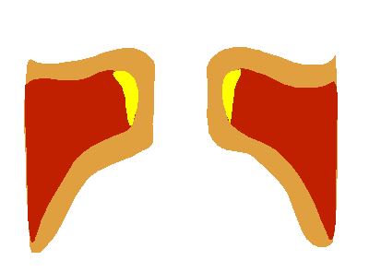
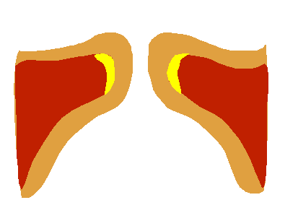
Animations
VF modal
VF falsetto

Slide 40
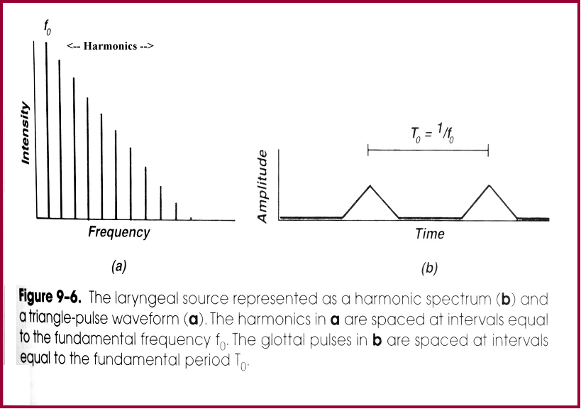
F₀ and Harmonics
→ The human voice is nearly periodic

Slide 41
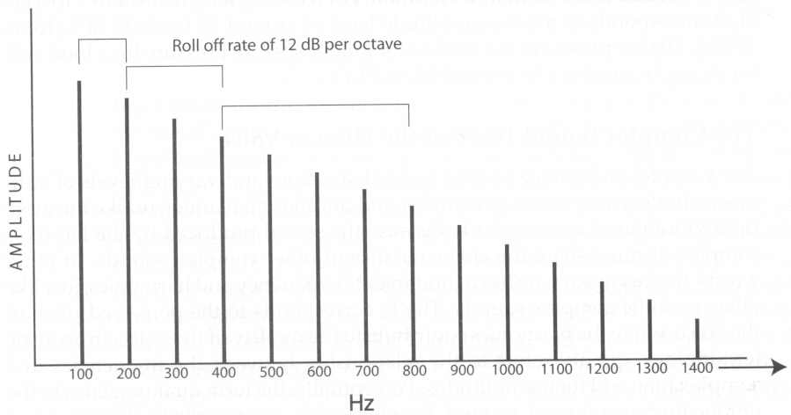
Glottal Spectrum
Glottal F₀ with harmonics
Does not represent what is heard (due to vocal tract modulation)
The F₀ corresponds to the perceived pitch of the voice
The harmonics contribute to the quality of the voice
This is what we would see if we lowered a microphone down just over the larynx

Slide 42
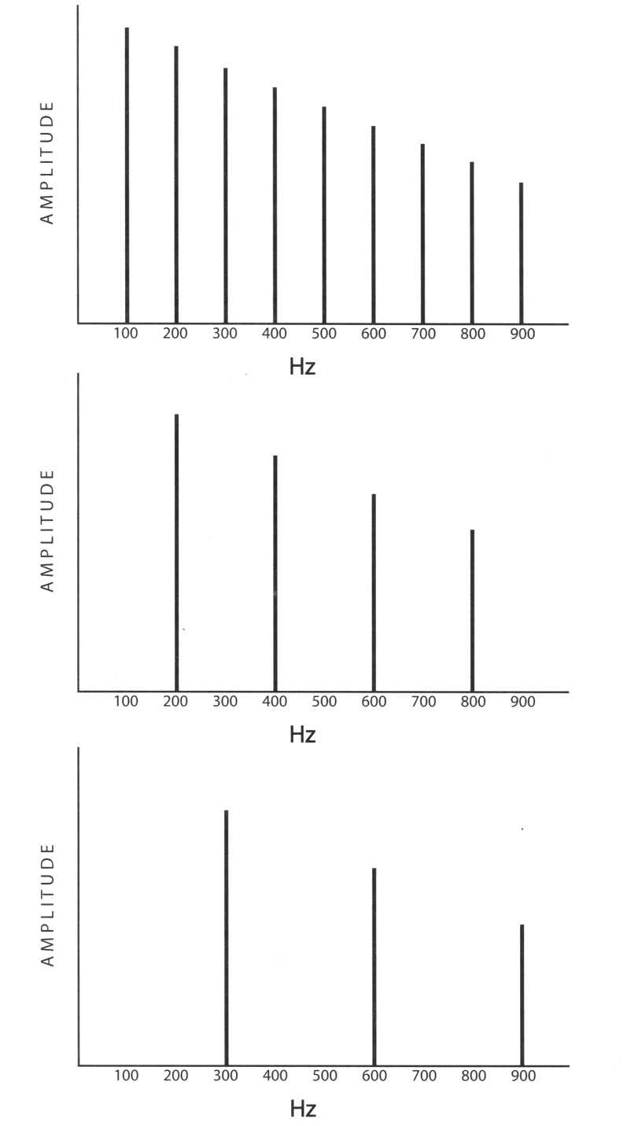
F₀ & Harmonic Spacing
Adult Male
Adult Female
Child

Slide 43
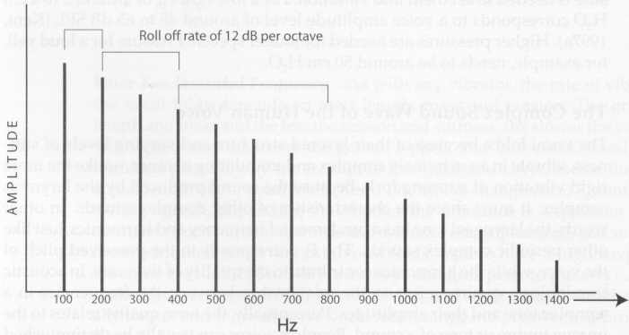
Roll Off—F₀
“About 40 harmonics have at least some acoustic energy in the human voice”

Slide 44
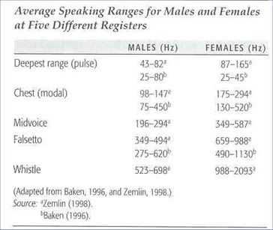
Vocal Registers
Pulse (= Fry, Creaky)
Modal
Falsetto
(cf. Table 5.5)

Slide 45
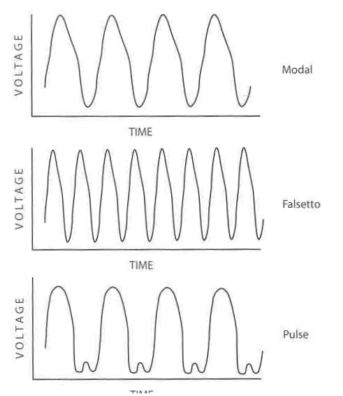
Registers – continued
Falsetto –
Folds long and
stiff,
Thinner quality sound
Pulse –
Folds closed 90% of time
biphasic or multiphasic
Leaves an acoustic temporal gap

Slide 46
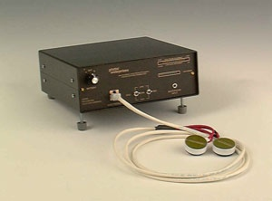
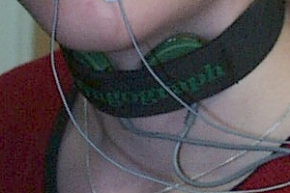
Electroglottography (EGG)
Best at detecting closing phase
More contact between vocal folds → greater conductivity between electrodes
Works better on men than women

Slide 47
EGG Readout

Slide 48
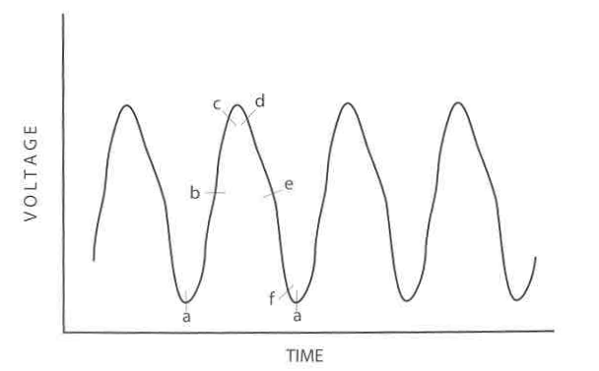
EGG – Lx wave
Reflects surface area of contact of the vocal folds
“Duty cycle” of vocal fold vibration

Slide 49
Lx wave – continued
CLOSING
2. Btwn b - c, superior
margins closing
1. Btwn a - b, lower margins closing
OPENING
3. Btwn d-e inferior
margins separate
4. At e (“knee”) – superior begins
to open
5. By f, width of glottis is widest

Slide 50
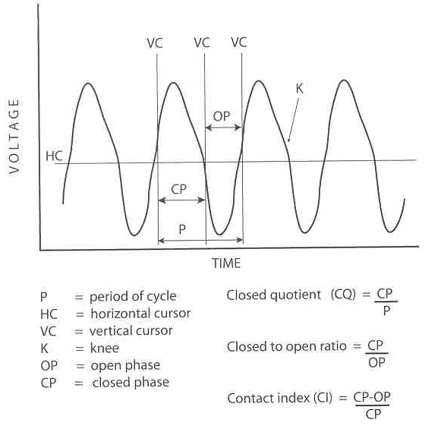
EGG quotients
OP – open phase
CP closed phase
CQ closed quotient = CP/P
Closed to open ratio = CP/OP
Etc.

Slide 51
Open Quotient
= time glottis is open
period of voicing cycle
Reliable differences between the three voicing types:
  Breathy → high open quotient
  Creaky → low open quotient
  Modal → in-between

Slide 52
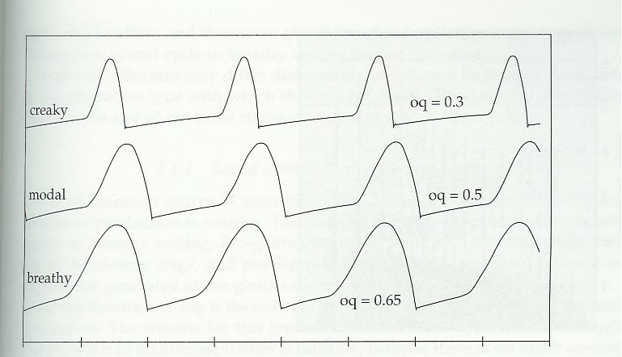
Open Quotient Samples

Slide 53
Hyper- hypo- adduction
Hyper - Vocal abuse, spastic dysphonia; takes more Ps to overcome resistance of folds
Hypo – inappropriate usage, VF paralysis; VFs do not offer enough resistance

Slide 54
Abnormal voice (dysphonia)
Breathiness (aspirated)
Roughness (raspiness /low pitch)
Hoarseness (combination)

Slide 55
(Clinical) Vocal Quality
No clear acoustic correlates
However, clinical terms suggest distinct categories
Some common Terms
Breathy
Tense/strained
Rough
Hoarse

Slide 56
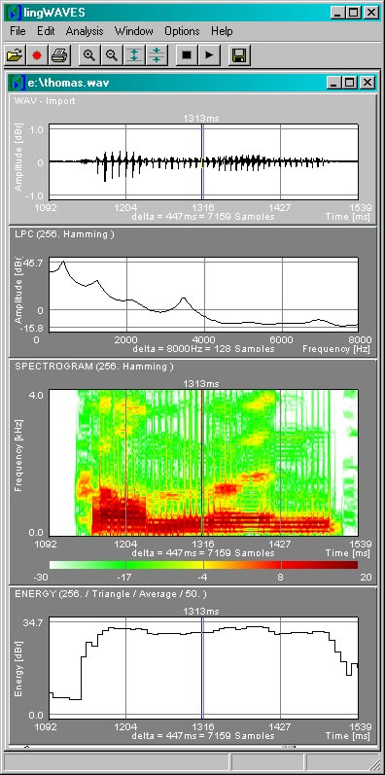
Tools for acoustic analysis
Praat, TF32,
Wavesurfer etc.

Slide 57
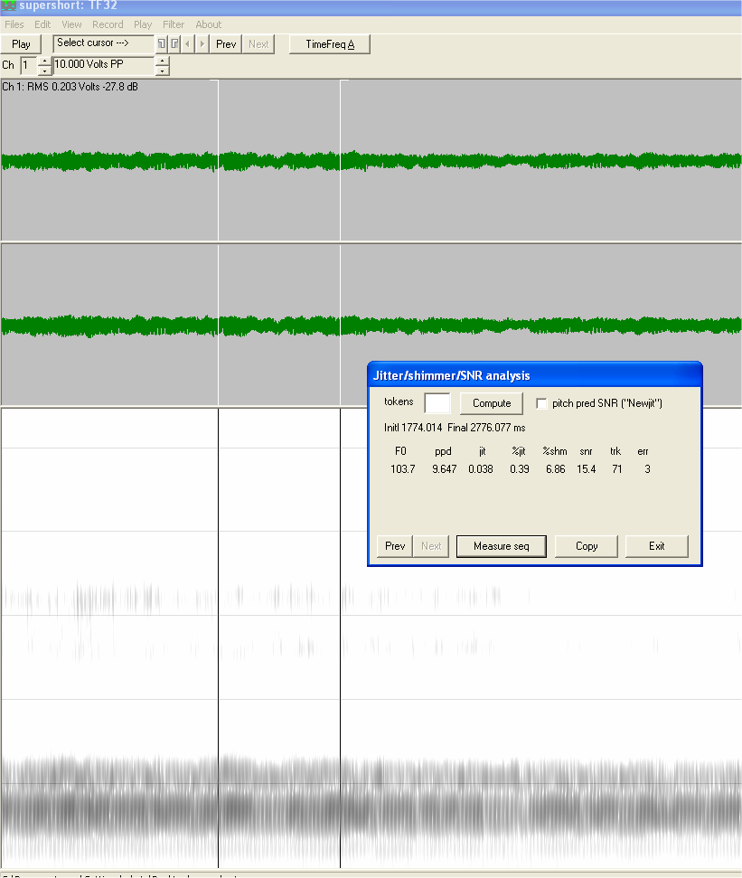

Jitter, Shimmer -
Sample computing in TF32 program


Slide 58
Period/frequency & amplitude variability
A. Jitter -: variability in the period of each successive cycle of vibration (A)
B. Shimmer: - variability in the amplitude of each successive cycle of vibration (B)
A
B

Slide 59
Jitter and Shimmer
Sources
Small structural asymmetries of vocal folds
“Material” on the vocal folds (e.g. mucus)
Biomechanical events, such as raising/lowering the larynx in the neck
Small variations in tracheal pressures
“Bodily” events – system noise
Measuring
Variability in measurement approaches
…and how measures are reported
Jitter
  Typically reported as % or msec
  Normal ~ 0.2 - 1%
Shimmer
  Can be % or dB
  Norms not well established

Slide 60

Harmonic to Noise Ratio
(HNR)
Noise is introduced into the vocal signal via irregular or asymmetric adduction of the vocal folds.
Too much noise is perceived as hoarseness ( = lower HNR)
Laryngeal pathology may lead to poor adduction of the vocal folds and, therefore, increase the amount of random noise in the vocal note.

Slide 61
Tense/Pressed/Effortful/Strained Voice
Sounds “effortful”
Physiologic
Longer closed phase
Reduced airflow
Potential Acoustics
Change in harmonic (periodic) energy
  Flatter harmonic roll off

Slide 62


Slide 63
Roughness
Perceptual Description
  Perceived cycle-to-cycle variability in voice
Physiologic Factors
  Vocal folds vibrate, but in an irregular way
Potential Acoustic Consequences
  Cycle-to-cycle variations F0 and amplitude
  Elevated jitter
  Elevated shimmer

Slide 64
Harmonics (signal)-to-noise-ratio (SNR/HNR)
Index of BREATHINESS
↑ HNR
  Relatively more signal
  Indicative of normality
↓ HNR
  Relatively more noise (thus, disorder)
Normative values depend on method of calculation
“normal” HNR ~ 15

Slide 65

What are norms?
Good source:
Baken & Orlikoff (2000)

Slide 66
Suggested Norms for Praat
jitter: | <= 1.040 %
shimmer: | <= 3.810 %
HNR: | < 20
 | adult males | adult females
mean pitch: | 128 Hz | 225 Hz
minimum pitch: | 85 Hz | 155 Hz
maximum pitch: | 196 Hz | 334 Hz

Slide 67
HABITUAL PITCH (SPEAKING F₀)
Depends on sex and age
Affected by type of communication type, emotional state, background noise, reading aloud, talking on telephone, any intoxication (alcohol)
 | children | women | men
Mean SF₀ (Hz) | 265 | 225 | 128
Frequency range (Hz) | 208-440 | 155-334 | 85-196
Table 1. Average Speaking Fundamental Frequencies [Source: (Williamson, 2006, p. 177)]

Slide 68
Frequency variability
Table 5.7 (pg. 182)
Highest for infants, generally decrease with age
Men lower than women

Slide 69

Voice range profile
Fig. 5.17 (pg. 185)
Max phon range (x-axis, F₀) X dynamic range (y-axis, dB SPL)
“dip” = change from modal to falsetto

Slide 70
CLINICAL APPLICATIONS
CHAP 5
Instrumentation: EGG, register, quotients
Pathology, injury, special surgeries
Botox injections for SD

Slide 71
Laryngeal aging
Presbylaryngis starts by 3rd or 4th decade
Can lead to presbyphonia (breathiness and hoarseness)
Increased F₀ in males, decreased in females
See table 6.5 (pg. 206) for more detail

Slide 72
Neurological disorders
Amyotrophic lateral sclerosis (ALS)
Parkinson’s disease (PD)
Unilateral VF paresis/paralysis
Spastic Dysphonia (SD)
Nodules/ Muscle Tension Dysphonia (MTD)/or Gastroesophageal Reflux Disease (GERD)

Slide 73

Amyotrophic lateral sclerosis (ALS)
Degenerative disease of upper & lower motor neurons
Changes in laryngeal musculature or difficulties eliminating mucous secretions(?)
Jitter and shimmer tend to be greater
Perhaps diagnostic of perceptually subclinical cases
66% intelligibility
“say kite again”

Slide 74
Parkinson’s Disease (PD)
Dopamine deficiency (excessive muscle contraction)
Voice symptoms visible
  Hoarseness
  Reduced loudness (lower intensity)
  Limited pitch range
Male, Healthy
Age-matched, PD

Slide 75
VF paralysis
http://www.youtube.com/watch?v=pcTPOmNStPI
This 15 min. video shows a range of cases

Slide 76
VF paresis
Paresis
A partially immobile vocal fold. Similar to a paralysis, except there has been some neurologic recovery.
Note the limited motion of the right arytenoid (left side of the screen) compared with the left (right side of the screen), and the asymmetry of the mucosal wave. This has been referred to as "chasing asymmetry.“
http://www.youtube.com/watch?v=gouMMiH6HI0

Slide 77
Spasmodic Dysphonia (SD)
  VF paralysis yields inability to initiate or maintain phonation; strangled voice quality
  Adductor and Abductor varieties (and subtypes)
  BOTOX injections are a new avenue of treatment (see video)
SD speech samples can be browsed here:
http://www.fauquierent.net/voicesd.htm

Slide 78
Botox injection video
http://www.fauquierent.net/voice/misc/botoxinj.mov

Slide 79
MTD: Muscle Tension Dysphonia
Compensatory or “squeeze” to make up for e.g. infection or obstruction in larynx
Tx often consists of relaxation or anaesthesia
http://www.fauquierent.net/voice/29aphonia/29aphonia.mov

Slide 80

Vocal Fold Nodules
Typically appear on the anterior 1/3 of the vocal fold, where contact is most forceful
Found primarily in women and preadolescent boys

Slide 81

Vocal Fold Polyps
Mass usually found at the midpoint the vocal cord.
Result of heavy trauma (“screamer’s nodule”)
Treatment: rest, steroids, or surgery

Slide 82

Contact Granuloma
Result of injury
Heaped up tissue near arytenoids
Pinkish-white

Slide 83
Granuloma
Video

Slide 84


Gastroesophageal Reflux Disease (GERD)
Extraordinary degree of edema following 80 episodes of LPR
(laryngopharyngeal reflux)

Slide 85
Laryngeal Trauma
(Video)
Right vocal fold detachment from the vocal process of the arytenoid cartilage.
It appears shortened, rounded, and sited at higher level than the left on phonation.
There is accompanying stridor.
http://www.youtube.com/watch?v=DZFAJgB3d-Y

Slide 86
Stuttering
Jitter/shimmer may help identify children at risk(?)
We will cover stuttering in our speech perception/production unit.
→ A teaser: Choral speech

Slide 87

Lie Detection – via voice?
Deceptive stress
Detected above chance with F₀ changes, not jitter
Many problems with this concept

Slide 88
Laryngeal Cancer
Most common type of laryngeal cancer is squamous cell carcinoma
Prominent symptom: hoarseness – changes in vibration
Radiation, chemotherapy, surgery are treatment options
Jitter can in some cases document chemotherapy effectiveness

Slide 89


Laryngeal Cancer
1) Chronic laryngitis in pt following radiation therapy for glottic carcinoma
2) A nonsmoker with severe documented LPR and squamous cell carcinoma on both true vocal folds

Slide 90
Scar tissue (post op)
Affects
  Aerodynamics
  Acoustics
  Vibratory patterns

Slide 91

In-dwelling voice prosthesis after laryngeal cancer (TEP)
Electrolarynx, Esophogeal, Tracheoesophageal voice prosthesis (TEP) - Samples
https://www.atosmedical.com/support/speaking-with-a-voice-prosthesis/
Insertion video
HME = heat/moisture exchange

Slide 92
Under current development:
Silent speech interface (SSI)
Jun Wang, Ph.D. (UTD)
Subject silently articulates
System displays text on screen
Synthesizer ‘speaks’ in female voice
https://www.youtube.com/watch?v=23RxvetISac

Slide 93
Transgender issues
Counseling – speaking styles
Surgery?
Laryngoplasty
(audio samples/ before-after)

