Slide 1
Phonological processes 1
Copyright 2017 – Please do not copy without permission.
Thank you. ;-)

Slide 2



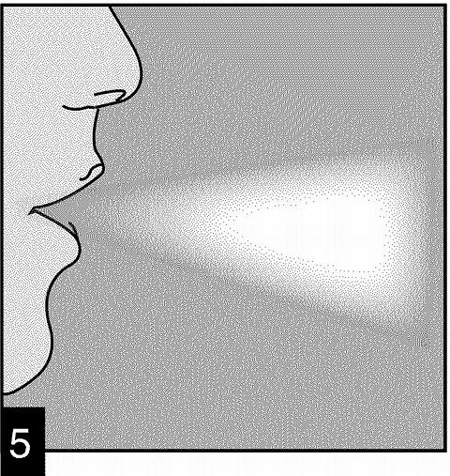

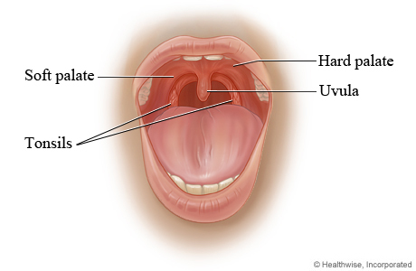
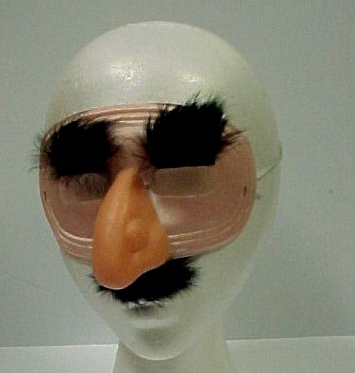

Unstressed Syllable Deletion
Cluster Reduction
Epenthesis
Aspiration
Unreleased Stops
Palatal Assimilation
Nasal Place Assimilation
Quiz

Slide 3
Unstressed Syllable deletion

Slide 4
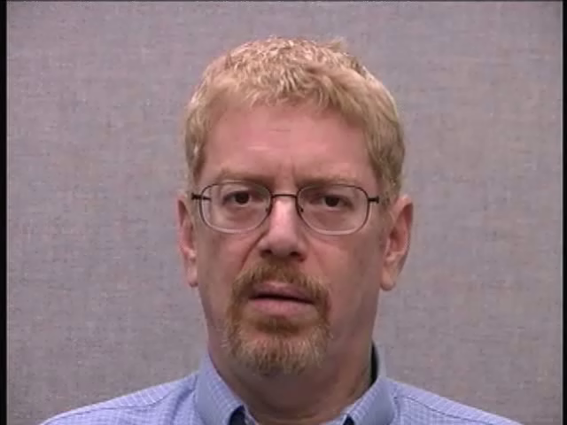

“machinery”
/mәˈʃinɚi/
[mәˈʃinɚi]
[mәˈʃinɚɪ]

Slide 5
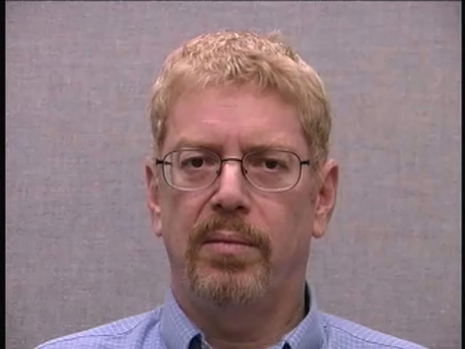
“machinery”
/mәˈʃinɹi/
[mәˈʃinɹi]
[mәˈʃĩnɹɪ]

Slide 6
Cluster Reduction

Slide 7
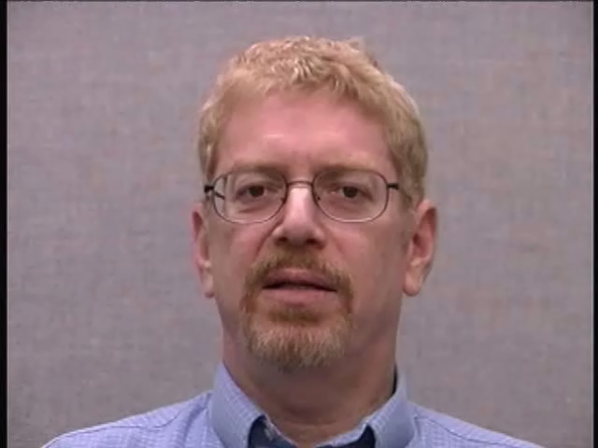
“sandpaper”
/ˈsӕndpeɪpɚ/
[ˈsӕ̃n˺d˺peɪpɹ̩]
[ˈsӕ̃n˺d˺pepɹ̩]

Slide 8
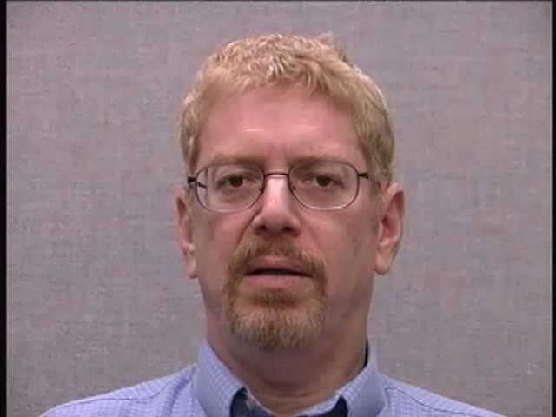
“sandpaper”
/ˈsӕnpeɪpɚ/
[ˈsӕ̃n˺peɪpɹ̩]
[ˈsӕ̃n˺pepɹ̩]

Slide 9
Epenthesis

Slide 10
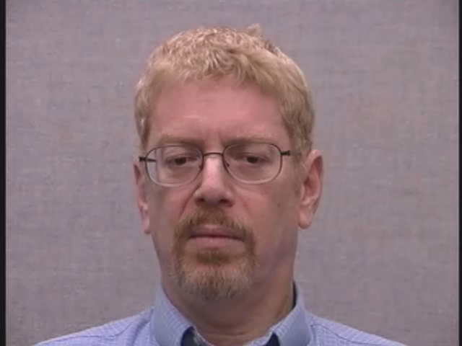
“warmth”
/ˈwɔɹmθ/
[ˈwɔ̃ɹmθ]
None

Slide 11
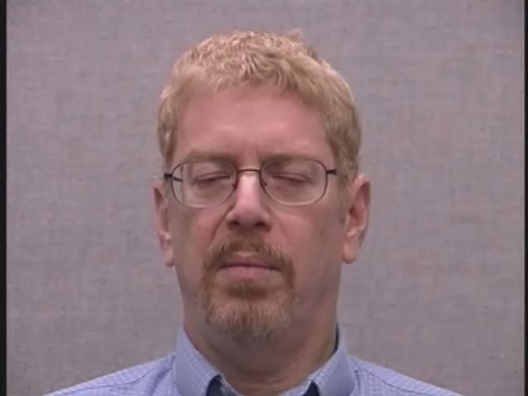
“prance”
/pɹӕnts/
[pʰɹ̥ӕ̃n̚ts]
None

Slide 12
Aspiration

Slide 13
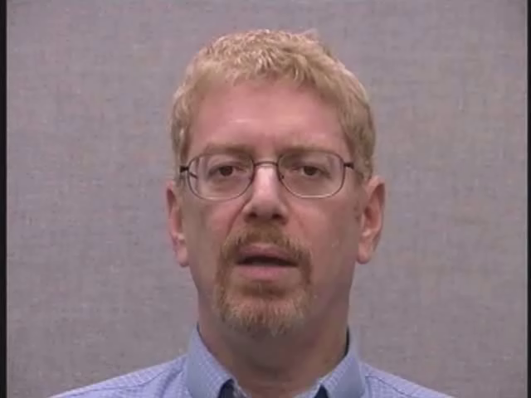
“ticket”
/ ˈtɪkɪt/
[ˈtʰɪkɪʔt]
[ˈtʰɪkɪt]

Slide 14
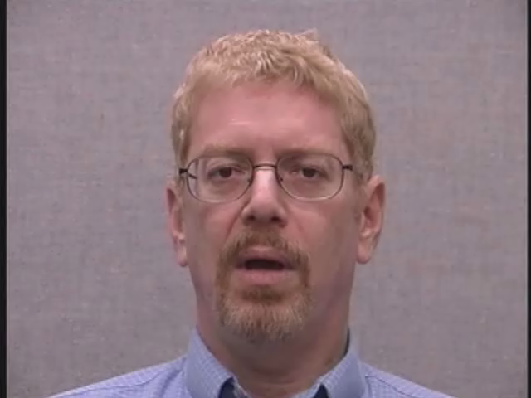
“accrue”
/әˈkɹu/
[ʔәˈkʰɹ̥u]
None

Slide 15
Unreleased stops

Slide 16
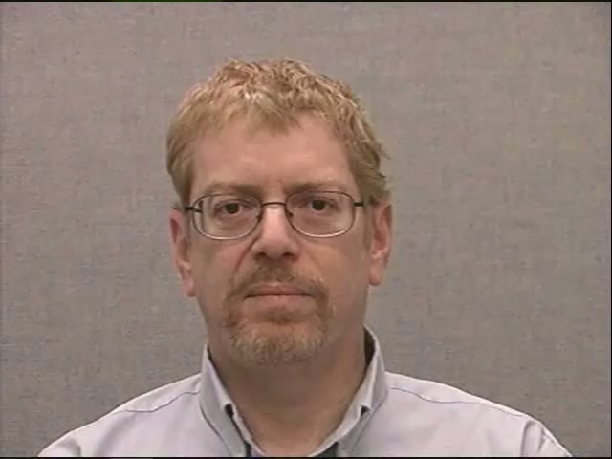
“ape”
/ep/
[ʔeɪʔp]
[ʔeɪʔpʰ] or [ʔeʔpʰ]
(audible release can be marked with
[ ^{h} ] - but not usually needed)

Slide 17
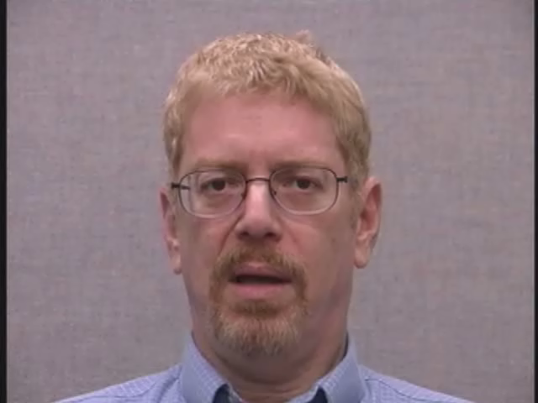
“ape”
/ep/
[ʔeɪʔp]
[ʔeɪʔp̚] or [ʔeʔp̚]
(*with “no audible release” marked, upper right corner angle diacritic following a voiceless stop – not normally needed)

Slide 18
Palatal assimilation

Slide 19
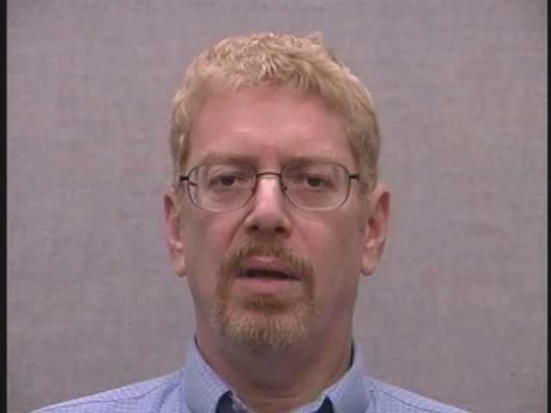
“miss you”
/ˈmɪsju/
[ˈmɪsju]
None

Slide 20
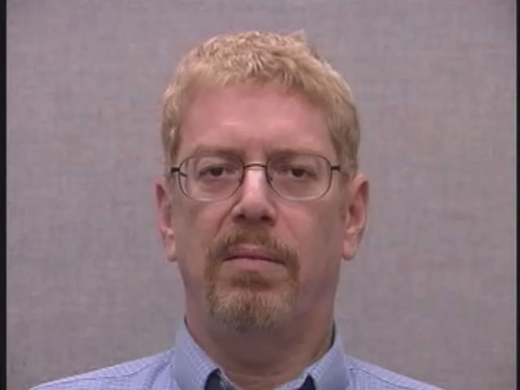
“miss you”
/ˈmɪʃju/
[ˈmɪʃju]
None

Slide 21
Nasal place assimilation

Slide 22
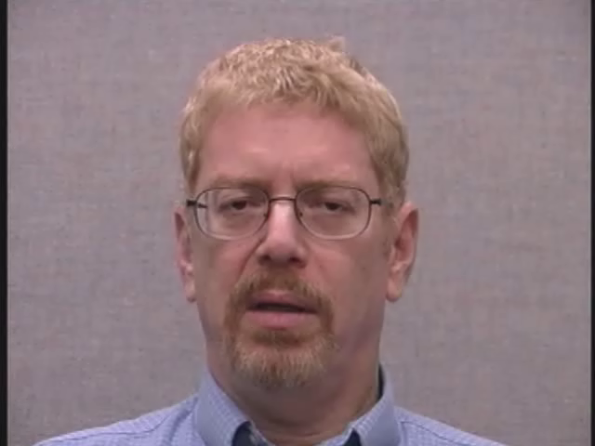
“in Bombay”
/ɪn bɑmˈbe/
[ı̃n˺ bɑ̃m˺ˈbe]
[ı̃n˺ bɑ̃m˺ˈbeɪ]

Slide 23
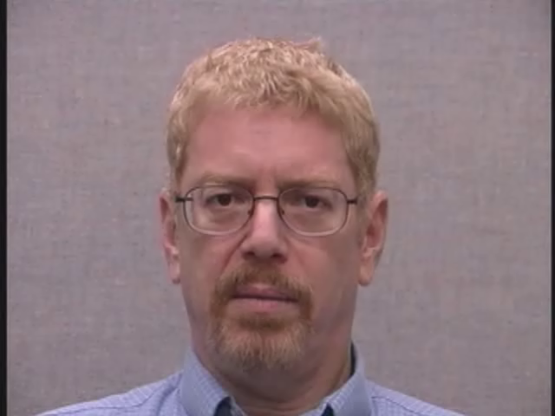
“in Bombay”
/ɪm bɑmˈbe/
[ɪm˺bɑ̃m˺ˈbe]
[ɪ̃m˺bɑ̃m˺ˈbeɪ]

Slide 24
Test yourself !
Quiz 3
(next 10 slides)

Slide 25
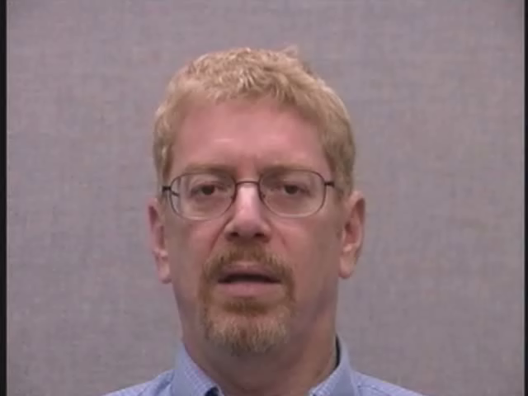
“breastbone” (1)

Slide 26
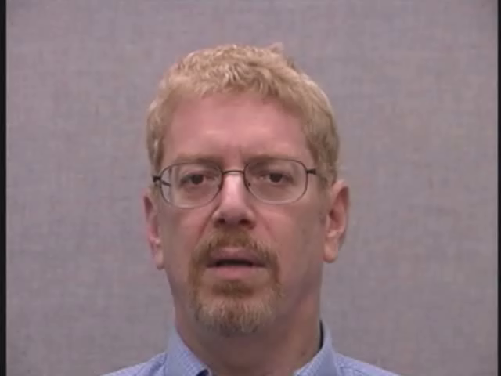
“breastbone” (2)

Slide 27
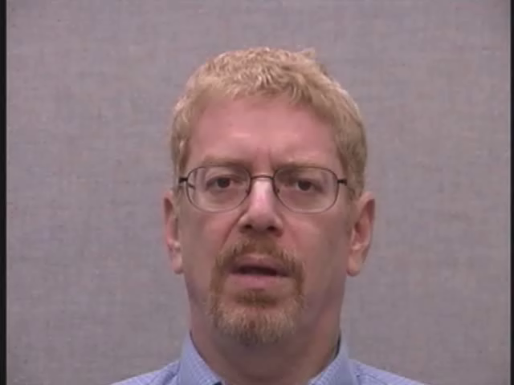
“appear”

Slide 28
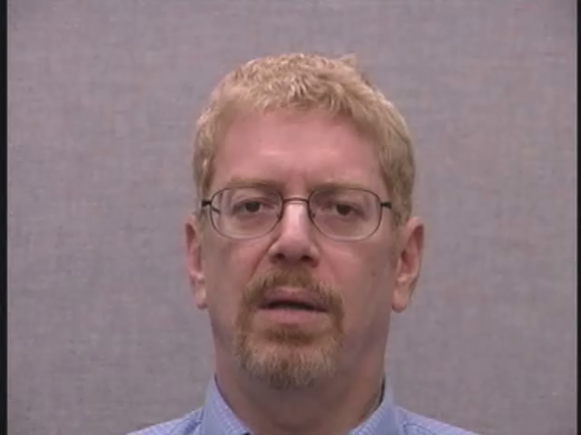
“tiger”

Slide 29
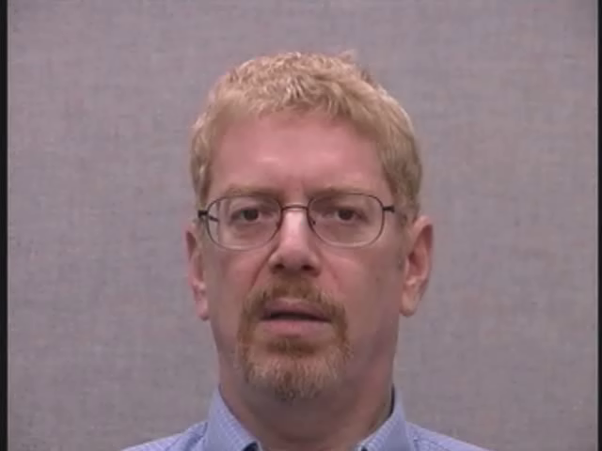
“ducked”

Slide 30
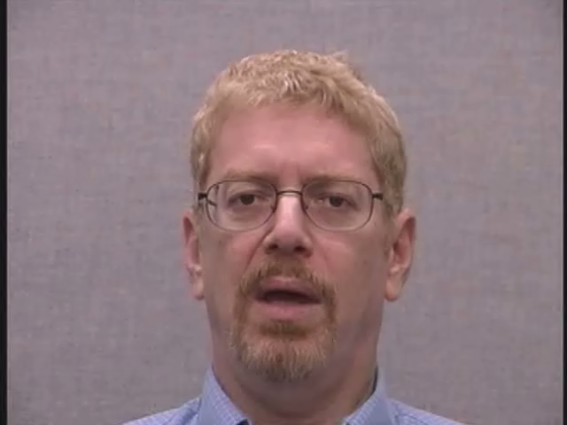
“tent”

Slide 31
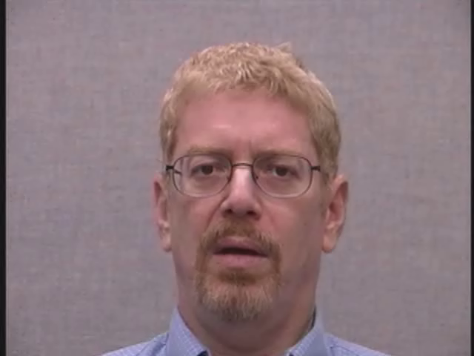
“bad news” (1)

Slide 32
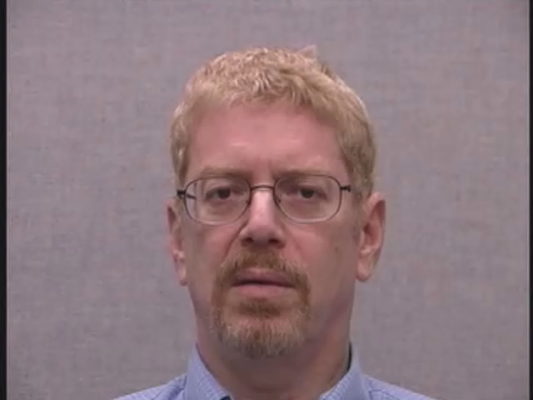
“bad news” (2)

Slide 33
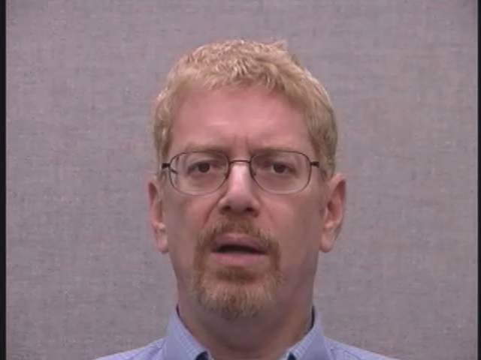
“trade you” (1)

Slide 34
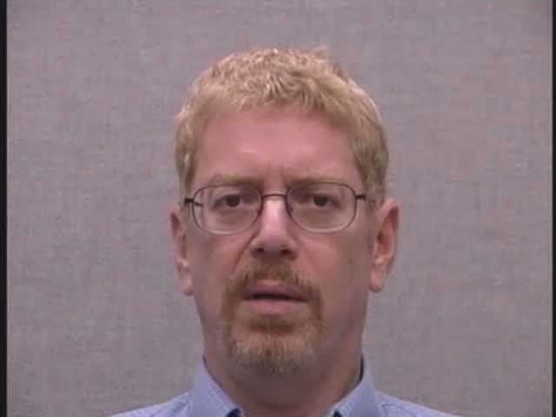
“trade you” (2)

Slide 35
End of
Phonological Processes 1
Check your answers at:
“Quiz_Answers_Broad_Narrow.pdf”
Menu

