Slide 1
Disorders of sentence processing in Aphasia
Chapter 10, Jane Marshall
in Papathanasiou et al.
Aphasia and Related Neurogenic Communication Disorders
(WK)

Slide 2
Garrett model (1988)
Message Level (conception/event)
→ Functional Level (semantic lexical selection, create predicate argument structure)
→ Positional Level (phonological lexical selection, select planning frame)
→ Phonetic encoding
→ Articulation of the sentence

Slide 3
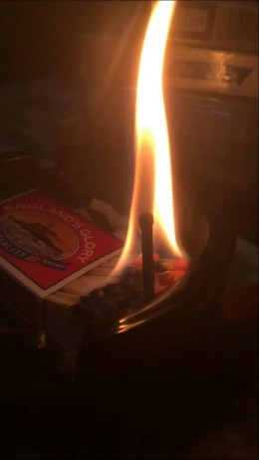
Deficit at Message Level? (event)
Shown videos of events taking place and later results (e.g. a woman setting fire to a box and later things being burnt etc.)
….Some subjects not sure who did what to which….(Marshall et al., 1993; 1995)
Other naming studies show subjects get “agency” but don’t structure key argument nouns around it very well (Cairns et al., 2007)

Slide 4
Therapy at Event Level?
VERB: chase vs. flee
Add video with perspective
Perspective + language ✓ -- only this combo worked, with small effect
(Cairns, 2006)

Slide 5
Therapy at Message Level #2?
try structured therapy pointing out main event?
Video clips of actions at 3 levels, subject makes decisions about agents and objects
Slightly more successful, but only at two-argument events
(Marshall et al., 1993)

Slide 6
Functional level ? (predicate argument structure)
ASSESSMENT
Verb and Sentence Test (VAST) 2002
PALPA (Psycholinguistic assessment of language in aphasia) 2002

Slide 7
Therapy for word order
MAPPING THERAPY, via:
Comprehension tasks (e.g., picture matching)
Production tasks (help subjects compose word order)
EVIDENCE?
Not bad for same types of sentences
For untreated sentence types, not so good…
Might carry over to narratives, thus “everyday life..”

Slide 8
What about more complex structures?
TUF: Treatment of Underlying Forms (Thompson, 2008)
Can handle, e.g.
-wh questions (Who did the boy pinch?)
Clefts (It was the teacher who the boy pinched – Obj. cleft, wh move)
Passive (The teacher was pinched by the boy)

Slide 9
TUF
FUN!: https://www.youtube.com/watch?v=jY5wu9v2ypY
Thematic role training
Sentence Building
Thematic role training
Practice
EVIDENCE?
Best generalization from complex → simple, must involve similar operations
Generally seems good?

Slide 10
Verb impairments
Common problem for agrammatic aphasics
Many reasons
Complex argument structure makes it worse
Also, imageability, information load

Slide 11
Therapy for verb impairments
Naming therapy techniques? (treated verbs improve, non-treated do not…)
Gesture therapy? (results don’t seem very promising)
Emphasizing role of verb in a sentence (e.g., Bastiaanse et al., 2006) – good results reported
BUT – “gains typically confined to treated verbs…no evidence that one approach is better than another…”

Slide 12
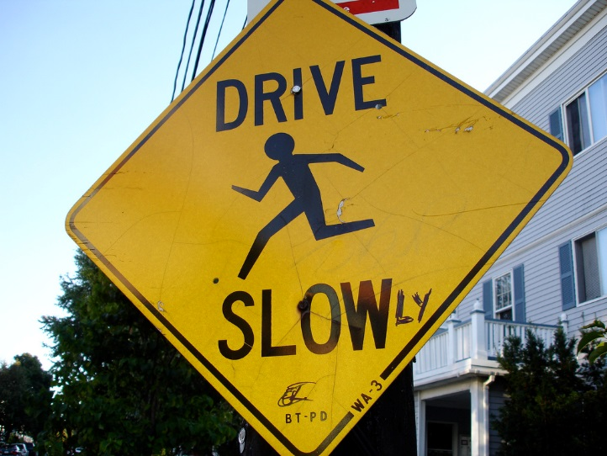
Impairments with grammatical morphology?
WHAT DO WE TYPICALLY SEE?
All “little words” omitted (freestanding and bound morphology) -- OR
All syntactic markers eliminated
Verbs more impaired than nouns
Tense very vulnerable* (not sure WHY: Morphology? Phonology? Semantics?)
Overuse of –ing in English

Slide 13
Grammatical morphology
ASSESSMENT
NAVI (Northwestern Assessment of Verb Inflection)
KGIT (Katz, Guataco Assessment of Verb Inflection)

Slide 14
Tense therapy?
1. (Mitchum and Berndt, 1994). n = 1. Pix of things about to happen, happening, completed. Reported good results.
2. Faroqi-Shah (2008) n = 4. Morphophonological (do these words sound the same? washes, washed?) and morphosemantic (Is this OK? Yesterday, the boy will wash his hands) conditions. Found morphosemantic treatment more encouraging.

Slide 15
Competence versus performance
Competence not the problem, but performance ?
EVIDENCE?
Agrammatic subjects could carry out online syntactic priming tasks that they couldn’t do offline
Work of Kolk and others suggesting that given more time and less noise, agrammatic talkers could perform better
THUS, ellipsis due to timing problems…

Slide 16
Implications for assessment?
Need to test for latent skills (e.g., repeating questions, using non-verbal stimuli, etc.)
Determine extent to which subjects respond to cueing

Slide 17
Implications for therapy
REST (Reduced Syntax Therapy) – Springer et al., 2000
Encourages LESS morphosyntax, but word order structures of increased length
Minimalism, economy of effort
SENTENCE SHAPER (Linebarger and colleagues, 2000)
Removes time constraints from productions

