Slide 1
Consonants of
American English
Copyright 2017 – Please do not copy without permission.
Thank you. ;-)

Slide 2

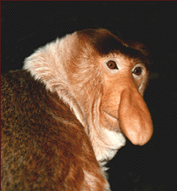





Stops
Nasals
Approximants
Non-Sibilant Fricatives
Sibilant Fricatives
Affricates
Quiz

Slide 3
Stops
/p, t, k, b, d, ɡ/

Slide 4

“bat”
/bӕt/
[bæt]
None

Slide 5

"dog"
/dɔɡ/
[dɔɡ]
None

Slide 6

“deep”
/dip/
[dip]
None

Slide 7

"period"
/ˈpɪɹiɪd/
[ˈpʰɪɹiɪd]
[ˈpʰɪɹi^{ɪ}d]

Slide 8

“kicker”
/ˈkɪkɚ/
[ˈkʰɪkɹ̩]
None

Slide 9
Nasals
/m, n, ŋ/

Slide 10
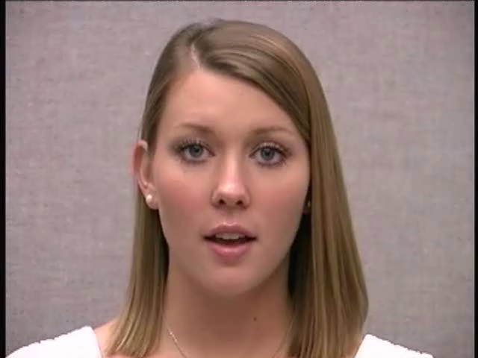
"amount"
/әˈmɑʊnt/
[әˈmɑʊ̃n˺t]
None

Slide 11
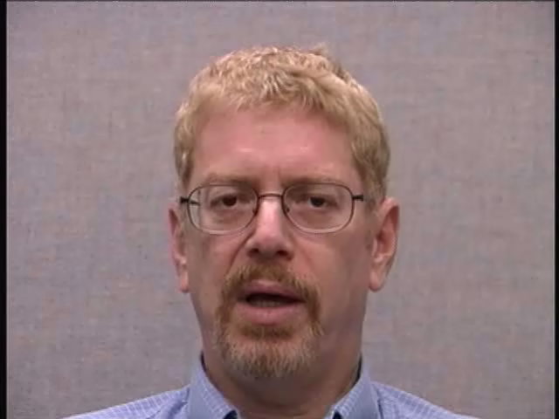
“hang”
/hŋ/
[hŋ]
None

Slide 12

"money"
/ˈmʌnɪ/
[ˈmʌ̃nɪ]
None

Slide 13

“wedding"
/ˈwɛdɪŋ/
[ˈwɛdĨŋ]
None

Slide 14

"mound"
/maʊnd/
[maʊ̃n˺d]
None

Slide 15
Approximants
/l, ɹ, w, j/

Slide 16

“wet”
/wɛt/
[wɛt]
None

Slide 17

“you”
/ju/
[ju]
None

Slide 18

“Halloween”
/ˈhlәwin/
[ˈhlәwin]
None

Slide 19


“pure”
/pjɝ/
[pʰjɝ]
None

Slide 20

“nearly”
/ˈnɪɹlɪ/
[ˈnɪɹlɪ]
[ˈnɪɹli]

Slide 21
Non-Sibilant Fricatives
/f, v, θ, ð/

Slide 22

“thigh”
/θaɪ/
[θaɪ]
None

Slide 23

“found”
/faʊnd/
[fɑʊ̃n̚d]
None

Slide 24

“further”
/ˈfɝðɚ/
[ˈfɝðɹ̩]
None

Slide 25

“birth”
/bɝθ/
[bɝθ]
None

Slide 26

"convey"
/kәnˈve/
[kʰә̃nˈveɪ]
[kʰә̃nˈve]

Slide 27
Sibilant Fricatives
/s, z, ʃ, ʒ/

Slide 28

“cease”
/sis/
[sis]
None

Slide 29

“confusion”
/kәnˈfjuʒɪn/
[kʰә̃nˈfjuʒn̩]
None

Slide 30

“assure”
/әˈʃɝ/
[Ɂәˈʃɝ]
None

Slide 31

“cures”
/kjɝz/
[kʰjɝz]
None

Slide 32

“regime”
/ɹәˈʒim/
[ɹәˈʒĩm]
None

Slide 33
Affricates
/ʧ, ʤ/

Slide 34

“adjust”
/әˈdʒʌst/
[әˈdʒʌst]
None

Slide 35

“launch”
/lɔntʃ/
[lɔ̃ntʃ]
None

Slide 36

“soldier”
/ˈsoʊldʒɚ/
[ˈsoʊƚdʒɹ̩]
[ˈsoƚdʒɹ̩]

Slide 37

“lecture”
/ˈlɛktʃɚ/
[ˈlɛktʃɹ̩]
[ˈlɛʔktʃɹ̩]

Slide 38

“unchanged”
/әnˈtʃendʒd/
[ә̃nˈtʃeı̃ndʒd]
None

Slide 39
Test yourself !
Quiz 1
(next 10 slides)

Slide 40

“mint”

Slide 41

“yellow”

Slide 42

“landing”

Slide 43

“ethics”

Slide 44

“sizzle”

Slide 45

“zipper”

Slide 46

“shave”

Slide 47

“measure”

Slide 48

“batch”

Slide 49

“wedge”

Slide 50
End of
Consonants of G.A.E.
Check your answers at:
“Quiz_Answers_Broad_Narrow.pdf”
Menu

