Slide 1
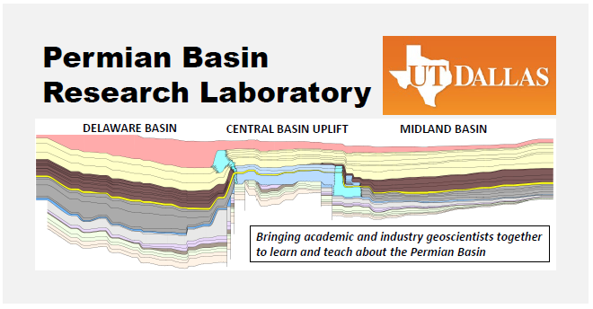
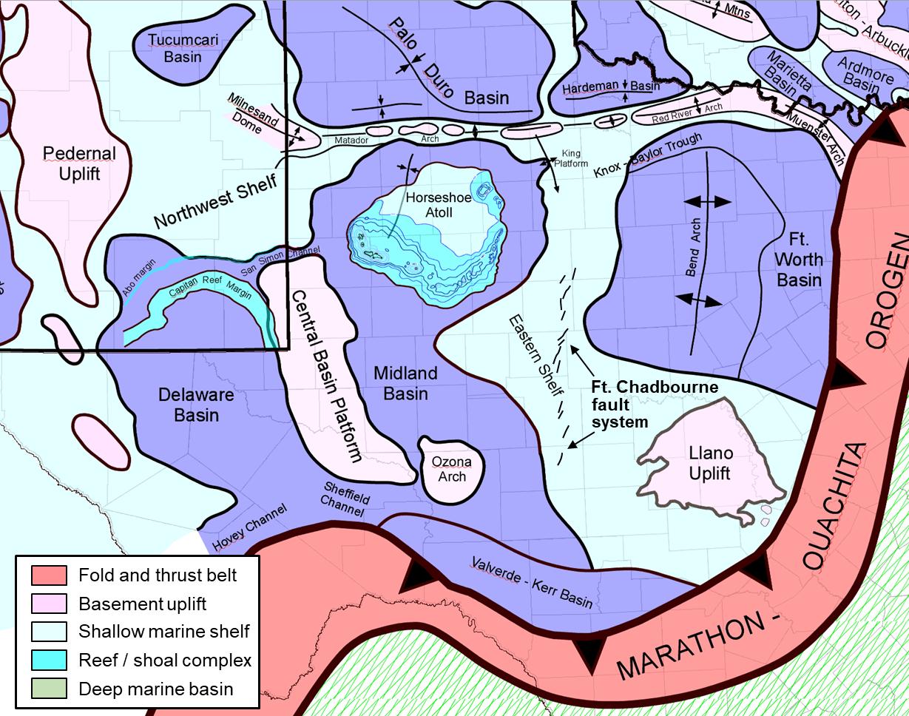
Re-exploring the Eastern Shelf of the Midland Basin
Permian Basin Section - SEPM
May 16, 2023
Lowell Waite
Department of Geosciences
Permian Basin Research Lab
University of Texas at Dallas

Slide 2
The Eastern Shelf Region: Introduction
Over a century of exploration has proven the Eastern Shelf of the Midland Basin to be a prolific conventional hydrocarbon-producing region
Main reservoirs include Lower Ordovician Ellenburger dolomite and a number of middle Pennsylvanian to early Permian sandstones and limestones at relatively shallow drill depths (~ 4000 – 8000 ft MD)
The stratigraphic complexity of the region, coupled with large number of producing zones and the inherent incomplete state of the historical well data base, provides opportunities for future exploration (both conventional and semi-unconventional reservoirs)
Note: “semi-conventional” reservoirs include:
Lower-perm, “tight” sandstones / limestones
Thermally immature / marginally-mature shales

Slide 3
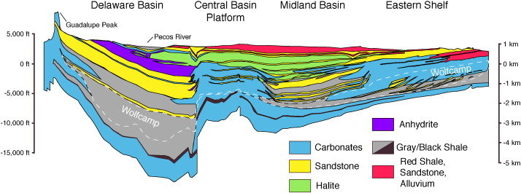
Greater Permian Basin of west TX and SE New Mexico: Paleogeographic elements
A
A’
Uplift
A’
(Engle et al., 2016)
A
Eastern Shelf one of several high-standing Permo-Pennsylvanian shelves surrounding deeper Delaware and Midland basins
Ft. Chadbourne
Ft.
Eastern Shelf dips westward ~ 1.3 degrees
General stratigraphy: thin Pre-Penn (mostly L. Ord. Ellenburger dolomite and U. Camb. Ss) unconformably overlain by thick Pennsylvanian to lower Permian carbonate and clastic units (~ 4000 – 8000 ft. MD)
Note location of Ft. Chadbourne fault system: chain of small basement-involved structural blocks;
upthrown to east
100 mi.

Slide 4
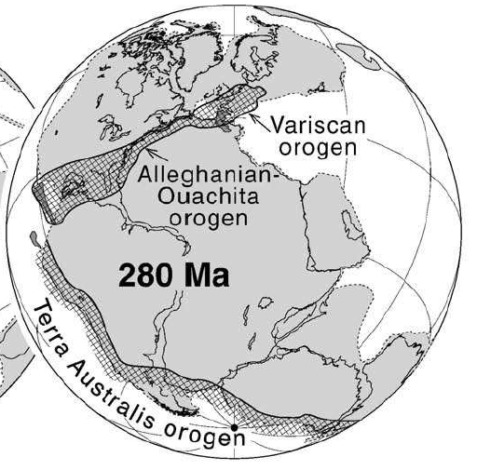
Pennsylvanian – Early Permian Themes
SW Laurentian region during assembly of Pangea; active margin phase: Hercynian orogeny & rise of Ancestral Rockies (Tobosa Basin becomes Permian Basin)
Climate: Icehouse phase throughout Penn. – Early Permian, transitioning to greenhouse; Permian Basin in low-latitudes (tropics); humid w/ monsoonal precipitation
Sea level: long-term rise and expansion of Penn. seaway; short-term: Penn cyclothems (high frequency, high amplitude glacioeustatic cycles)
Dominance of phylloid algae as main reef builders (aragonite skeletons; limestones susceptible to early leaching )
Early Penn. (Atokan)
Late Penn. (Missourian)
Permian Basin
Laurentia
LAURENTIA
Hercynian
orogen
LAURENTIA
Gondwana
(Murphy et al., 2009)

Slide 5
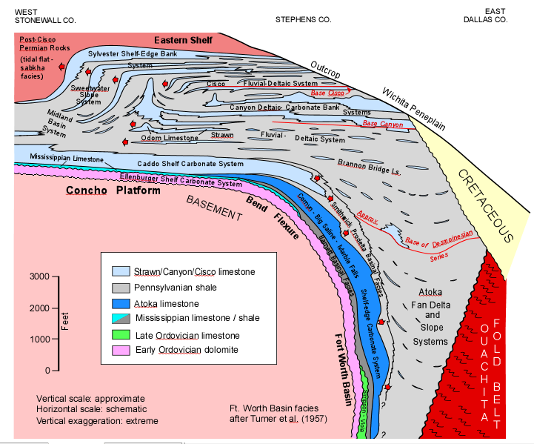
Eastern Shelf Depositional Systems
west
east
Prior to middle Strawn time (pre-Odom; thick dashed line), the Eastern Shelf was a shallow-water carbonate platform (Concho Platform) constituting the eastward dipping, western margin of the actively subsiding Ft. Worth Basin
NOLAN CO.
STEPHENS CO.
DALLAS CO.
50 miles
Mid Strawn – L. Permian
Eastern Shelf
Following the rapid filling of the Ft. Worth Basin by Early Penn. Atoka and early Strawn clastics, deposition shifted to westward-dipping sedimentary systems defining the Eastern Shelf of the subsiding Midland Basin
Pre-Penn. – early Strawn
Concho Platform
Penn – L. Perm sediments represent a thick assemblage of numerous alternating cyclothem deposits (lowstand clastics, highstand carbonates)
(modified from Alton Brown, 2021, after Frank Brown, BEG, 1973)

Slide 6
General Stratigraphy of the Eastern Shelf
west
east
Prior to middle Strawn time (pre-Odom; thick dashed line), the Eastern Shelf was a shallow-water carbonate platform (Concho Platform) constituting the eastward dipping, western margin of the actively subsiding Ft. Worth Basin
NOLAN CO.
STEPHENS CO.
DALLAS CO.
50 miles
Mid Strawn – L. Permian
Eastern Shelf
Paleogeography/
Eustasy
Following the rapid filling of the Ft. Worth Basin by Early Penn. Atoka and early Strawn clastics, deposition shifted to westward-dipping sedimentary systems defining the Eastern Shelf of the subsiding Midland Basin
Pre-Penn. – early Strawn
Concho Platform
Penn – L. Perm sediments represent a thick assemblage of numerous alternating cyclothem deposits (lowstand clastics, highstand carbonates)
(modified from Alton Brown, 2021, after Frank Brown, BEG, 1973)

Slide 7
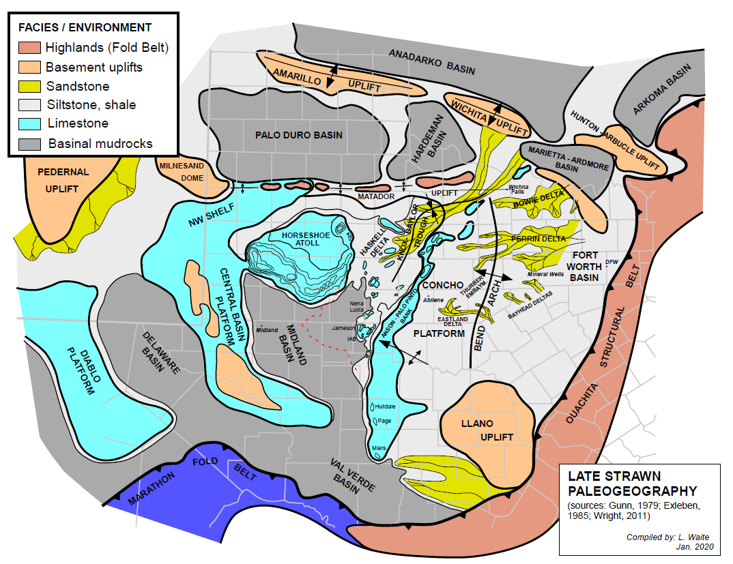
Pennsylvanian Eustasy
Sea Level
Late Desmoinesian - Missourian (Upper Strawn - Canyon) Paleogeography
(after Wright, 2020)
rise
Regional Stage
Group
+100
0m
Bursam
Virgilian
Cisco
Missourian
Canyon
Demoinesian
Strawn
Atokan
Atoka
long-
term
MUENSTER UPLIFT
Morrowan
Morrow
short-
term
Long-term sea-level (tectonic control)
Prolonged transgression drowns the underlying L. Strawn Concho Platform; organic-rich black shales (Wolfcamp D / Cline) deposited in rapidly subsiding “starved” basins
Nolan Co.
Short-term sea-level (glacioeustacy)
During glacial maxima (S.L. lowstands), tectonically-active Ancestral Rockies uplifts and Ouachita Fold Belt shed voluminous amounts of clastics (channel/delta/slope systems) across Eastern Shelf
During glacial minima (highstands), massive shallow-water carbonate deposition occurs along outboard shelf margins, including a series of large, isolated carbonate mounds/reefs

Slide 8
Eastern Shelf Depositional Systems
west
Large-scale Sequence Architecture
east
Prior to middle Strawn time (pre-Odom; thick dashed line), the Eastern Shelf was a shallow-water carbonate platform (Concho Platform) constituting the eastward dipping, western margin of the actively subsiding Ft. Worth Basin
NOLAN CO.
STEPHENS CO.
DALLAS CO.
50 miles
Mid Strawn – L. Permian
Eastern Shelf
Following the rapid filling of the Ft. Worth Basin by Early Penn. Atoka and early Strawn clastics, deposition shifted to westward-dipping sedimentary systems defining the Eastern Shelf of the subsiding Midland Basin
Pre-Penn. – early Strawn
Concho Platform
Penn – L. Perm sediments represent a thick assemblage of numerous alternating cyclothem deposits (lowstand clastics, highstand carbonates)
(modified from Alton Brown, 2021, after Frank Brown, BEG, 1973)

Slide 9
Schematic stratigraphic architecture, Penn. – lower Permian, Eastern Shelf
West
East
Landward
Interregional unconformity
.
.
.
Regressive
phase
.
.
.
.
Cisco Group
(Lower Wolfcamp)
.
.
.
.
.
2nd- order sequence
~ 12 million yr. duration
.
.
max. transgressive interval
Large, isolated
Regional
organic-rich
source (Cline)
reef
Transgressive
phase
Canyon –
complex
Strawn
Interregional unconformity
Shelf Limestone
Shale
Approximate scale
Reef
Organic-rich shale
100 m
Slope & basinal Limestone
Sandstone
50 km
Dolomite
(L Waite, 1988, unpublished)

Slide 10
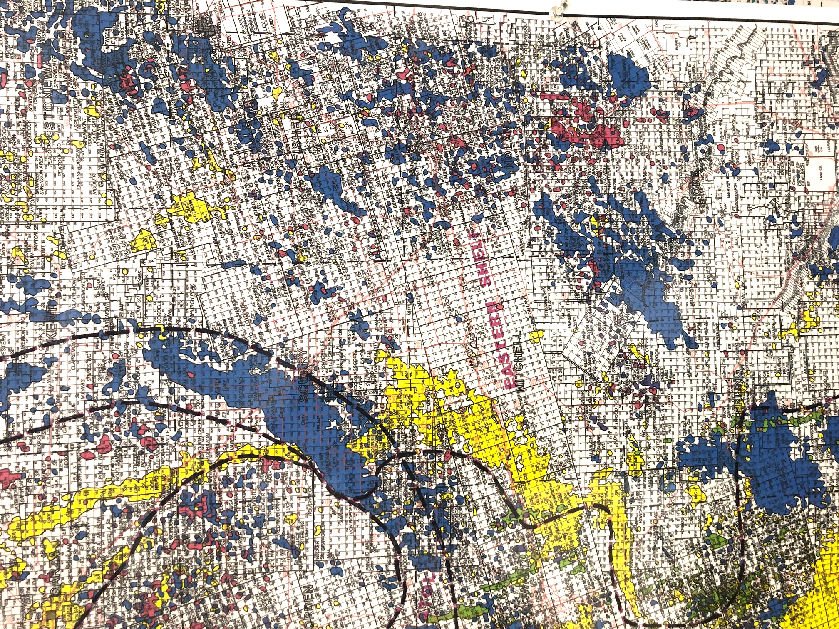
Goal of study: better understanding of producing trends along western margin of Eastern Shelf
Question: what is remaining potential ?
(via field growth, exploration, horizontal drilling, etc.)
Starting point: Nolan County
Centrally-located; previously worked (late 1980s)
ATOLL
Two small Caddo core samples provided by UTD alum Jerry Bergthold
HORSESHOE
Age of
reservoir
EASTERN SHELF
Nolan
Permian
Penn.
L. Ord.
(Ellen-
burger)
30 miles
(Midland Map Co.)
10 miles

Slide 11
Analysis of Nolan Co. producing trends: Method
Export Nolan County wells from Enverus database including producing zone (n = 5123)
Utilizing Petra, check perforated zones for each well; amend Enverus producing zones (n_{ammended} = 4926)
3.8 % of wells in eliminated mainly due to non-reported perfs
Some wells eliminated due to missing API#
Identify & map a number of high-resolution producing zones (11 total; color-coded by zone)
Analyze drilling and producing statistics (not discussed here)
Note: Individual checking of perf zone(s) in all wells is a very time-consuming, but critical step in the identification and assignment of correct, high-resolution producing zones

Slide 12
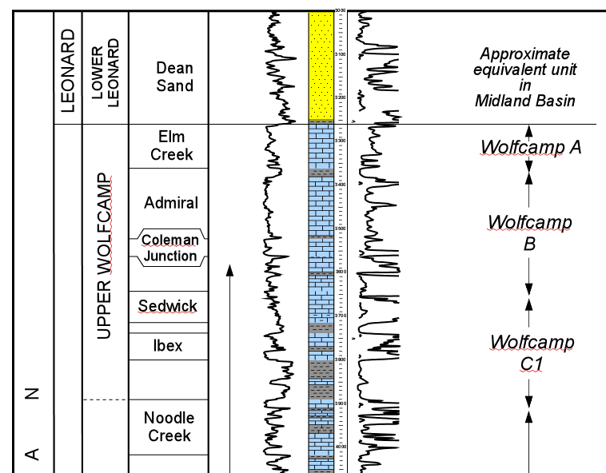
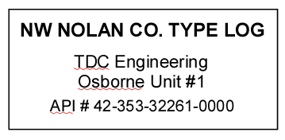
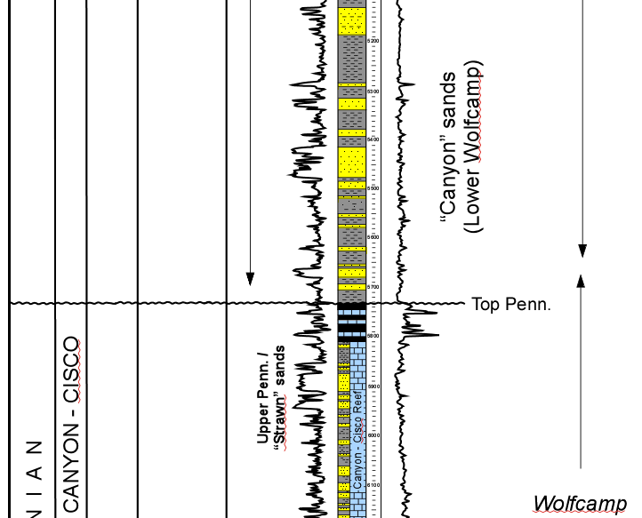
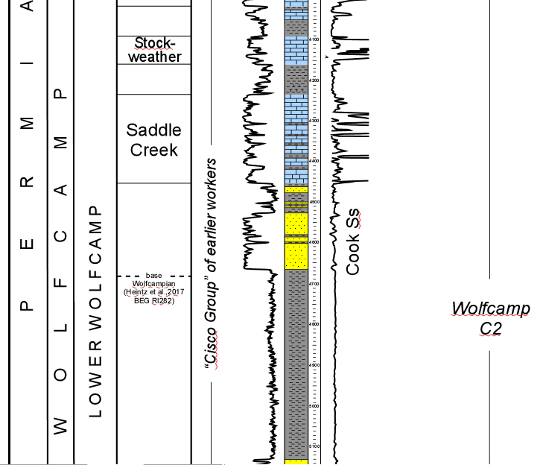
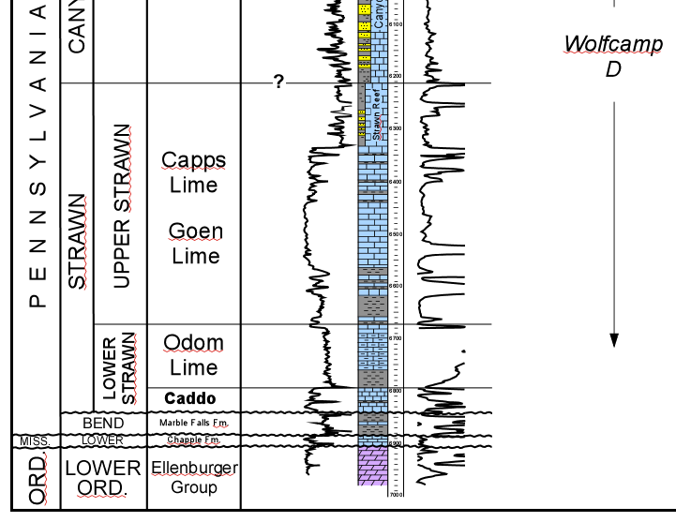
NW Nolan Co. type log
showing strat. position of high-resolution producing zones (11)
Eastern Shelf
GR
Resis.
Formations
GR
Resis.
GR
Resis.
“Canyon” (L. Wfmp)
Sandstone
200 ft.
0
Penn. Reef
Cisco (L. Wfmp)
Limestone
Strawn Sandstone
Cisco (L. Wfmp)
Sandstone
U. Strawn Limestone
Odom Limestone
Caddo Limestone
Mississippian Ls
Ellenburger (L. Ord.)
U. Cambrian Ss
U. Cambrian Ss

Slide 13
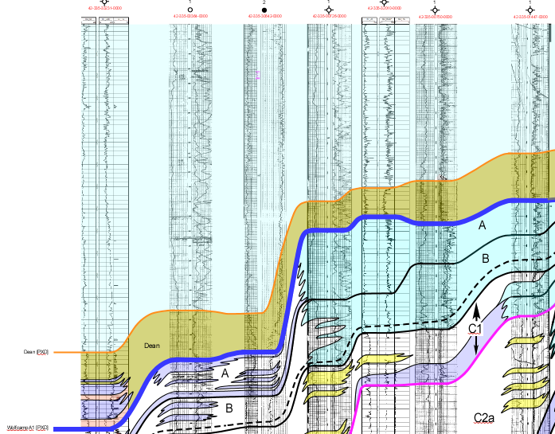
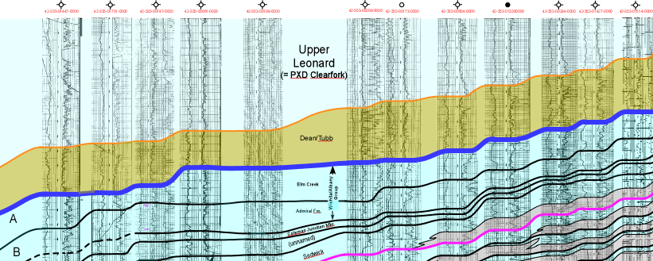
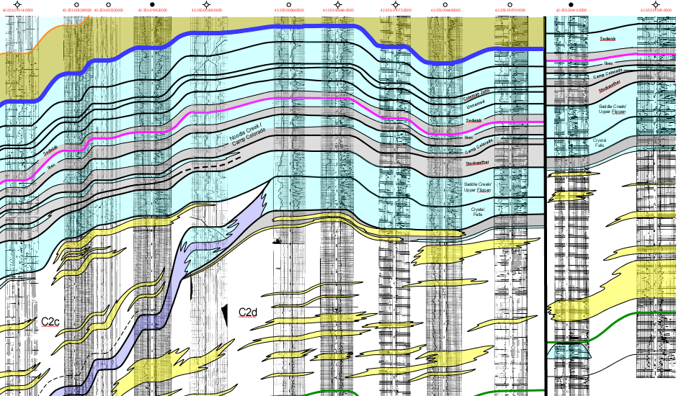
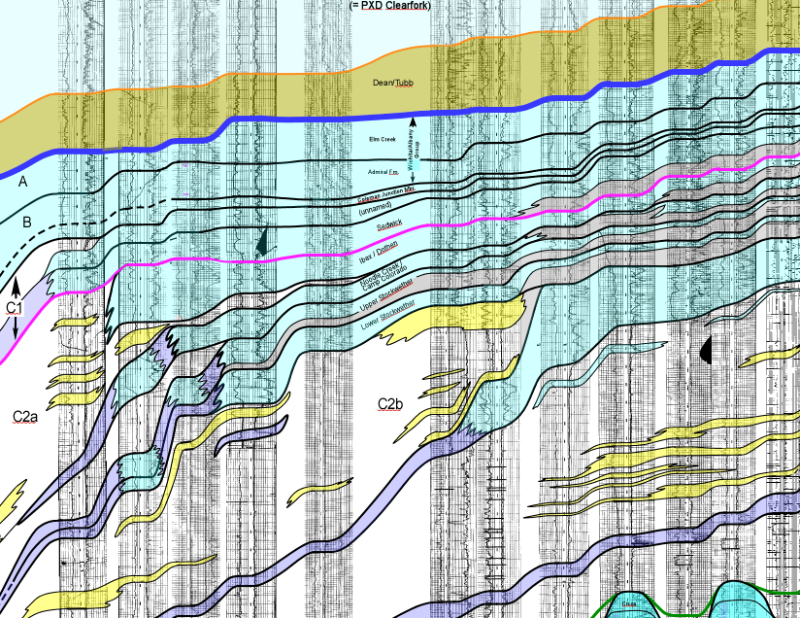
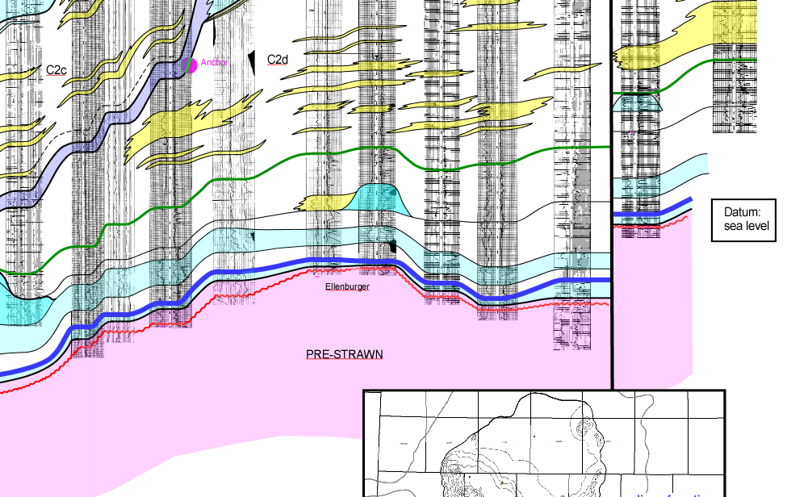
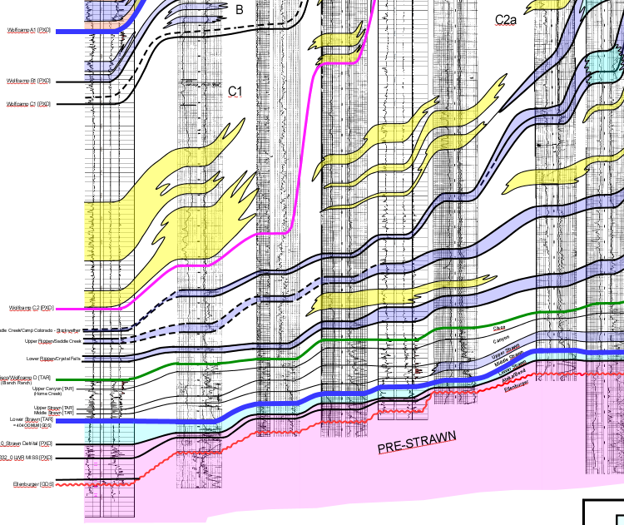
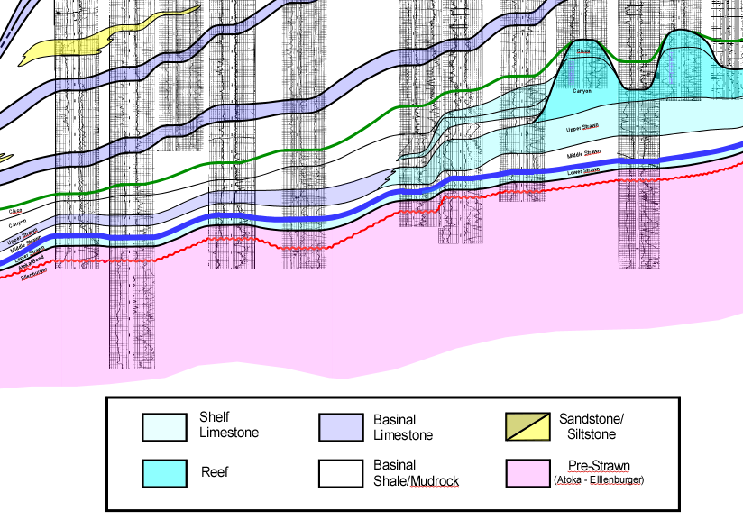
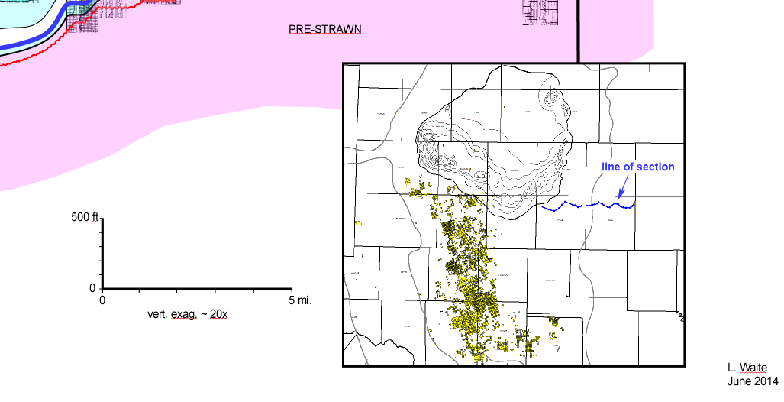
MITCHELL COUNTY
NOLAN COUNTY
Regional W-E detail cross-section showing Penn. – lower Perm stratigraphic architecture across western margin of Eastern Shelf
Cisco (L. Wfmp)
Sandstone
Cisco (L. Wfmp)
Limestone
Saddle Creek shelf
Crystal Falls
shelf
Ivan shelf
(not shown)
Top Wolfcamp
“Canyon”
Sandstone
Strawn
Ss
Odom
Ls
Penn Reef
Caddo
Ls
Cambrian
Ss
Ft. Chadbourne
fault
A wide variety of structural and stratigraphic traps…
Ellenburger
Top Penn.
Mississippian
Top Ellenburger
Top Lower Strawn (Caddo)
(modified from Brown et al, 1990)

Slide 14
NOLAN COUNTY PRODUCING TRENDS MAP

Slide 15
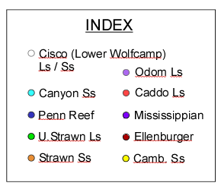
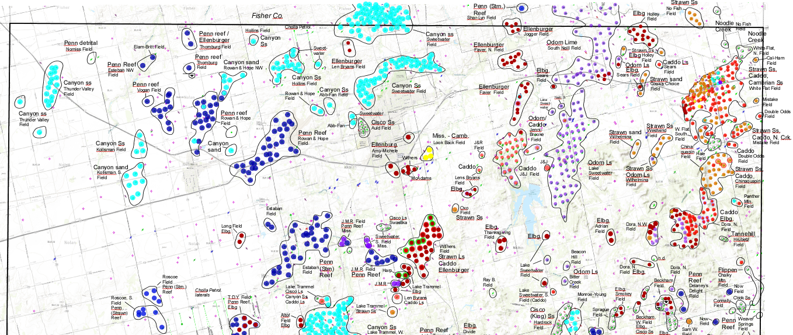
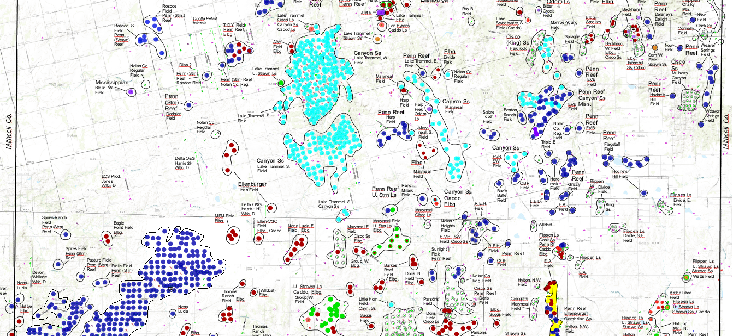
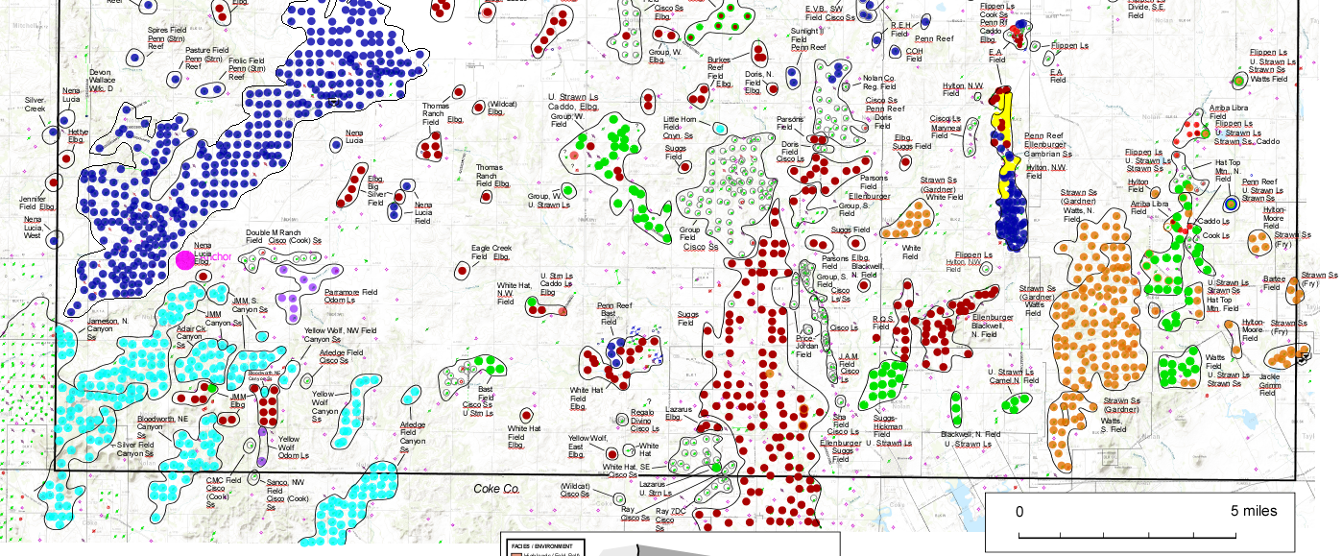
Nolan County
Producing Trends
1
1
Ft. Chadbourne structural and combination traps; multiple zones (Cambrian Ss, Elbg., Caddo Ls, Strawn Ss., U. Strawn Ls, Penn Reef. Canyon Ss) (faults from Ewing, Tectonic Map of TX)
1
1

Slide 16
2
Nolan County
Producing Trends
1
Ft. Chadbourne structural and combination traps; multiple zones (Cambrian Ss, Elbg., Caddo Ls, Strawn Ss., U. Strawn Ls, Penn Reef. Canyon Ss) (faults from Ewing, Tectonic Map of TX)
L. Strawn
shelf margin
2
Odom low-relief, mid-shelf carbonate buildups inboard of shelf margin; also, Caddo grainstones
(Waite, 1991)

Slide 17
Nolan County
Producing Trends
3
1
Ft. Chadbourne structural and combination traps; multiple zones (Cambrian Ss, Elbg., Caddo Ls, Strawn Ss., U. Strawn Ls, Penn Reef. Canyon Ss) (faults from Ewing, Tectonic Map of TX)
Saddle Creek
shelf margin
(Heintz et al., 2017)
L. Strawn
shelf margin
2
Odom low-relief, mid-shelf carbonate buildups, inboard of shelf margin; also, Caddo grainstones
(Waite, 1991)
3
Ellenburger trend (karsted cave systems?); also, large Cisco (Cook) Ss delta system inboard of Saddle Creek shelf margin
3

Slide 18
4
Nolan County
Producing Trends
Crystal Falls
shelf margin
(Heintz et al., 2017)
1
Ft. Chadbourne structural and combination traps; multiple zones (Cambrian Ss, Elbg., Caddo Ls, Strawn Ss., U. Strawn Ls, Penn Reef. Canyon Ss) (faults from Ewing, Tectonic Map of TX)
4
L. Strawn
shelf margin
2
Odom low-relief, mid-shelf carbonate buildups, inboard of shelf margin; also, Caddo grainstones
(Waite, 1991)
3
Ellenburger trend (karsted cave systems?); also, large Cisco (Cook) Ss delta system inboard of Saddle Creek shelf margin
4
Canyon Ss (L. Wolfcamp) channel, delta, and proximal slope systems (Crystal Falls shelf margin)
5
Canyon Ss (L. Wolfcamp) distal slope system
5

Slide 19
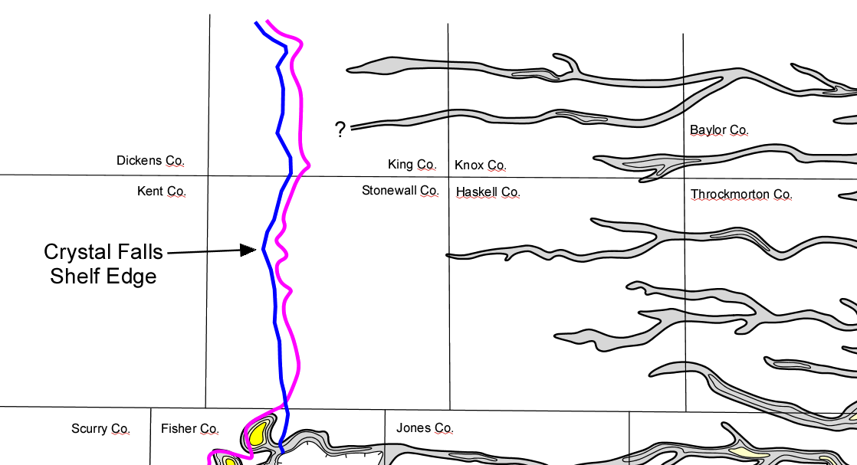
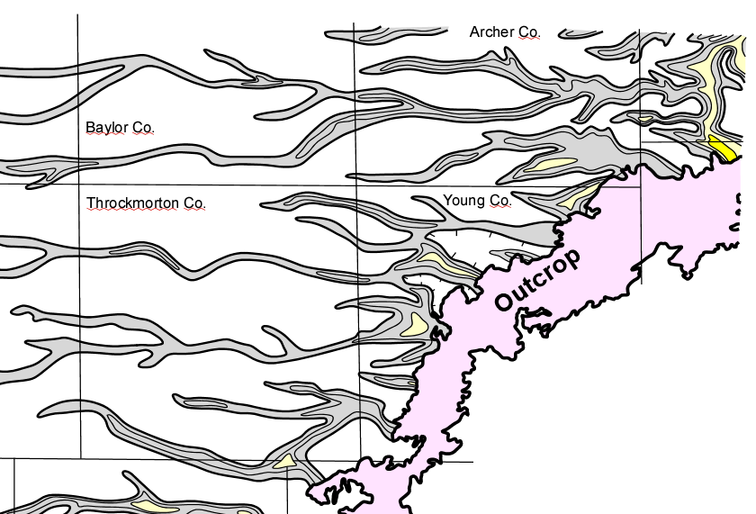
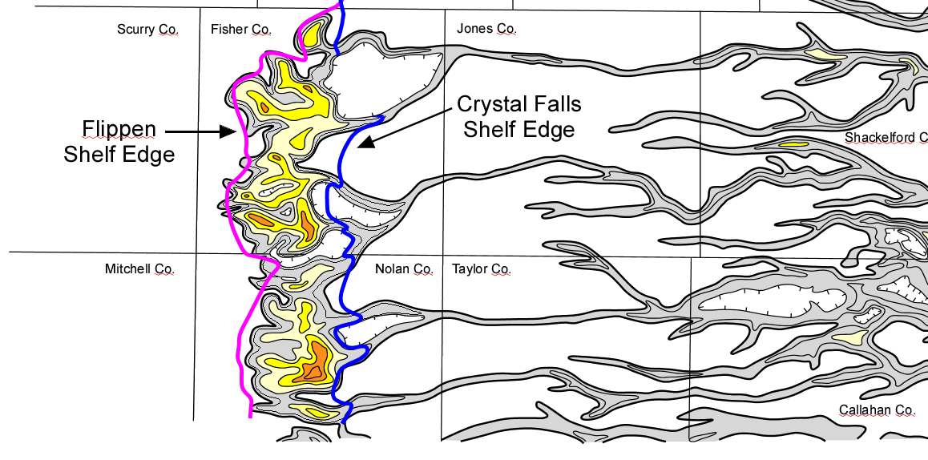
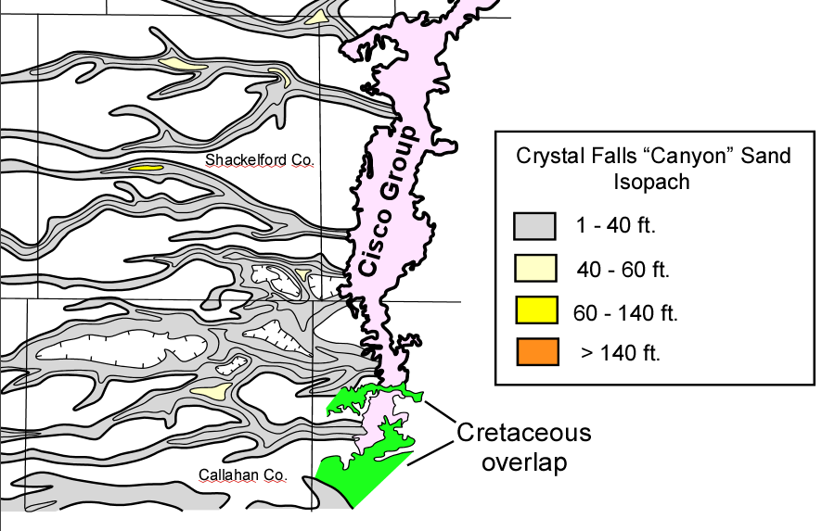
CISCO GROUP - CRYSTAL FALLS
(“Canyon Sand)
DEPOSITONAL SYSTEM
Lake Trammel,
Lake Trammel S.
fields
(from Brown et al., 1990)

Slide 20
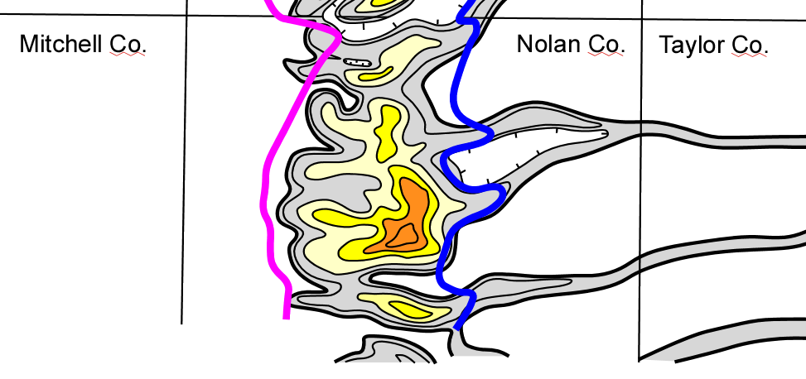
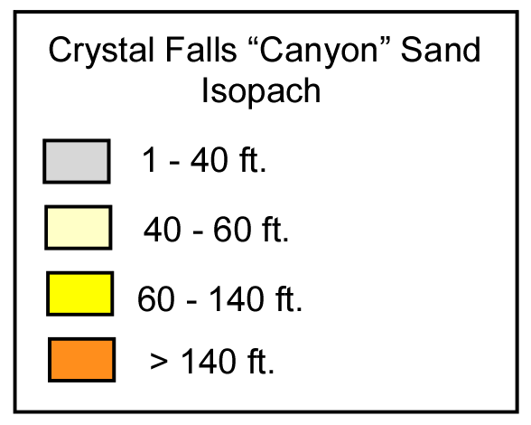

Slide 21
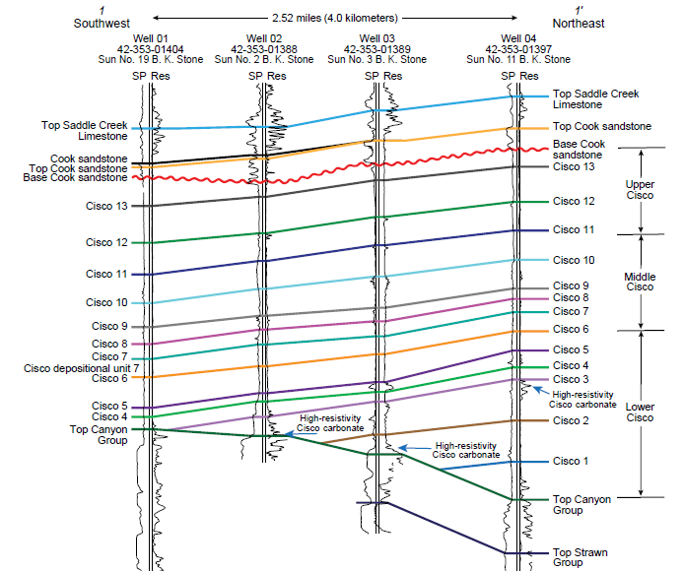
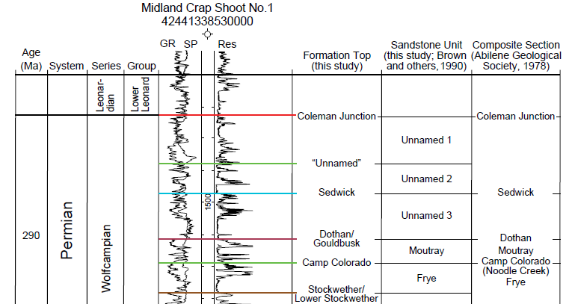
Correlations: low-angle clinoform interpretation
(Ambrose et al., 2022)

Slide 22
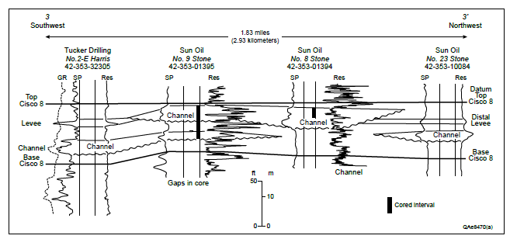
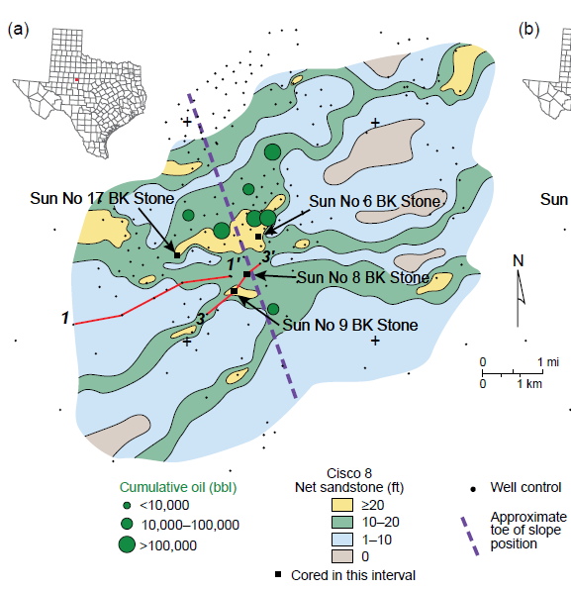
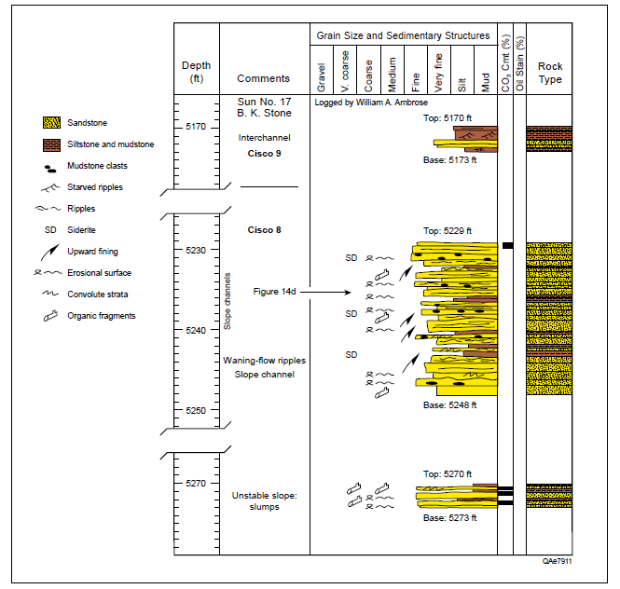
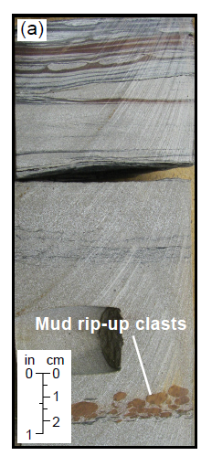
Tidally-influenced slope channel systems
(Ambrose et al., 2022)

Slide 23
Nolan County
Producing Trends
6
1
Ft. Chadbourne structural and combination traps; multiple zones (Cambrian Ss, Elbg., Caddo Ls, Strawn Ss., U. Strawn Ls, Penn Reef. Canyon Ss) (faults from Ewing, Tectonic Map of TX)
Drowned
L. Canyon/U Strn
Platform
(w/ small pinnacles)
Drowned
Middle Strawn Platform
(w/ large isolated reef mounds)
L. Strawn
shelf margin
2
Odom low-relief, mid-shelf carbonate buildups, inboard of shelf margin; also, Caddo grainstones
(Waite, 1991)
Midland
Basin
ANSON BANK
3
Ellenburger trend (karsted cave systems?); also, large Cisco (Cook) Ss delta system inboard of Saddle Creek shelf margin
6
6
4
Canyon Ss (L. Wolfcamp) channel, delta, and proximal slope systems (Crystal Falls shelf margin)
L. Canyon –
U. Strawn
shelf margin
3
5
Canyon Ss (L. Wolfcamp) distal slope system
ANSON (U. CANYON) BANK
6
Small pinnacle reefs on L. Canyon drowned platform; large isolated reefs on L. Strawn drowned platform (bank margins from Waite, 1991)

Slide 24
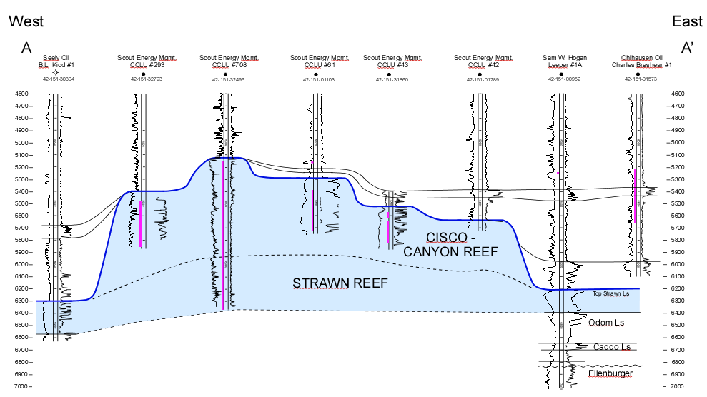
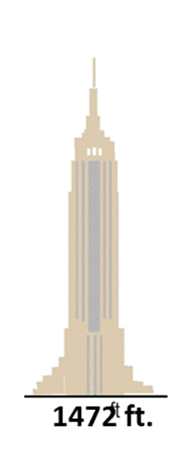
Pennsylvanian Reef Trend
(from Counselman, 1960)
Dickens
King
Claytonville Reef, Fisher County
Salt
Creek
Boomerang
Claremont
one mile
Cogdell
Kent
Stonewall
Double
Mtn.
Ocho
Juan
Atoll
Round Top
Horseshoe
Fisher
Perforated
interval
Scurry
Claytonville
Kelly
Snyder
Eskota
Mitchell
Nolan
Esteban
Rowan & Hope
Nena Lucia
Empire State Bldg.
Jameson
I.A.B.
Millican
Coke
Sterling
Higgins
Ranch
500 ft.
Massive carbonate buildups (algal reef complexes)
Irion
Tom Green
Some buildups terminate in Strawn; others, like Claytonville, continue into Canyon - Cisco
15 mi.
H.J.
Hulldale
Important conventional oil reservoirs Claytonville: ~ 67 MMBO
Kelly Snyder: 1300 MMBO
Page
Schleicher

Slide 25
Nolan County
Producing Trends
1
Ft. Chadbourne structural and combination traps; multiple zones (Cambrian Ss, Elbg., Caddo Ls, Strawn Ss., U. Strawn Ls, Penn Reef. Canyon Ss) (faults from Ewing, Tectonic Map of TX)
Drowned
Midland
Basin
7
L. Strawn
shelf margin
2
Odom low-relief, mid-shelf carbonate buildups, inboard of shelf margin; also, Caddo grainstones
(Waite, 1991)
3
Ellenburger trend (karsted cave systems?); also, large Cisco (Cook) Ss delta system inboard of Saddle Creek shelf margin
4
Canyon Ss (L. Wolfcamp) channel, delta, and proximal slope systems (Crystal Falls shelf margin)
5
Canyon Ss (L. Wolfcamp) distal slope system
6
Small pinnacle reefs on L. Canyon drowned platform; large isolated reefs on L. Strawn drowned platform (bank margins from Waite, 1991)
7
Recent horizontal wells along far eastern edge of starved Midland Basin

Slide 26
4
2
Nolan County
Producing Trends
Crystal Falls
shelf margin
6
(Heintz et al., 2017)
1
3
1
Ft. Chadbourne structural and combination traps; multiple zones (Cambrian Ss, Elbg., Caddo Ls, Strawn Ss., U. Strawn Ls, Penn Reef. Canyon Ss) (faults from Ewing, Tectonic Map of TX)
Saddle Creek
shelf margin
7
4
(Heintz et al., 2017)
1
L. Strawn
shelf margin
2
Odom low-relief, mid-shelf carbonate buildups, inboard of shelf margin; also, Caddo grainstones
(Waite, 1991)
3
Ellenburger trend (karsted cave systems?); also, large Cisco (Cook) Ss delta system inboard of Saddle Creek shelf margin
6
6
1
4
Canyon Ss (L. Wolfcamp) channel, delta, and proximal slope systems (Crystal Falls shelf margin)
L. Canyon –
U. Strawn
shelf margin
3
5
Canyon Ss (L. Wolfcamp) distal slope system
ANSON (U. CANYON) BANK
5
6
Small pinnacle reefs on L. Canyon drowned platform; large isolated reefs on L. Strawn drowned platform (bank margins from Waite, 1991)
7
Recent horizontal wells along far eastern edge of starved Midland Basin

Slide 27
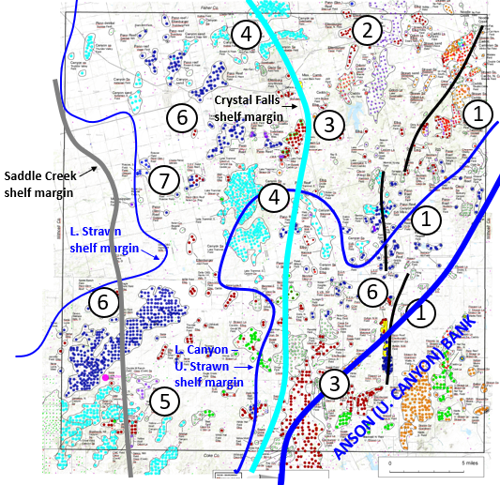
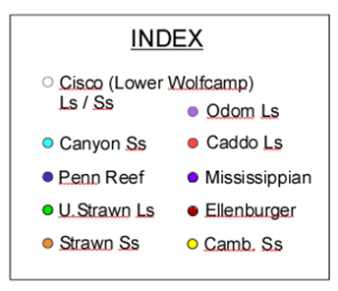
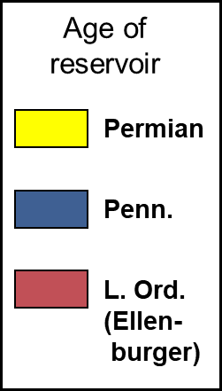
Goal of study: better understanding of producing trends along western margin of Eastern Shelf (Nolan County)
30 miles
(Midland Map Co.)

Slide 28
Current work
Producing zones identification for:
Fisher Co.
Scurry Co. (eastern half)
Kent Co. (eastern half)
Stonewall Co.
NOLAN CO.
Coke Co.

Slide 29
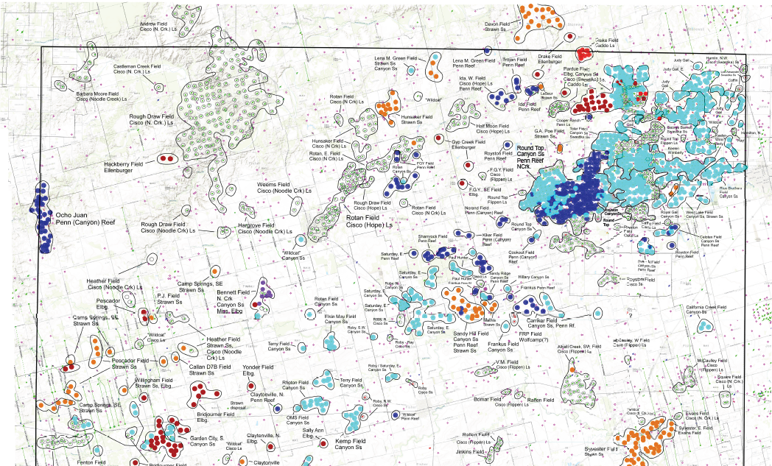
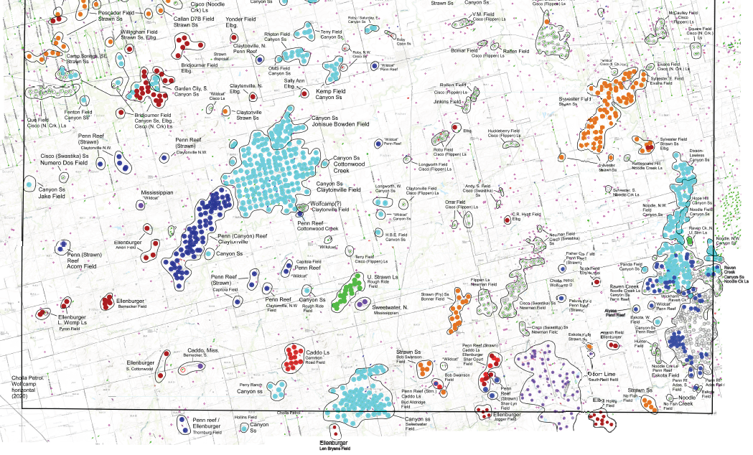
Fisher Co.
production
Initial impressions:
Fewer producing wells compared to Nolan Co.
Reduced Ft. Chadbourne faulting
Fewer Penn reefs (but larger complexes)
Large Canyon Ss fields; more Strawn sandstone production
Areally-large Canyon Ss, Wolfcamp Ss & Ls fields
Fewer Ellenburger fields
More dry holes in-between existing fields; but less deep well control

Slide 30
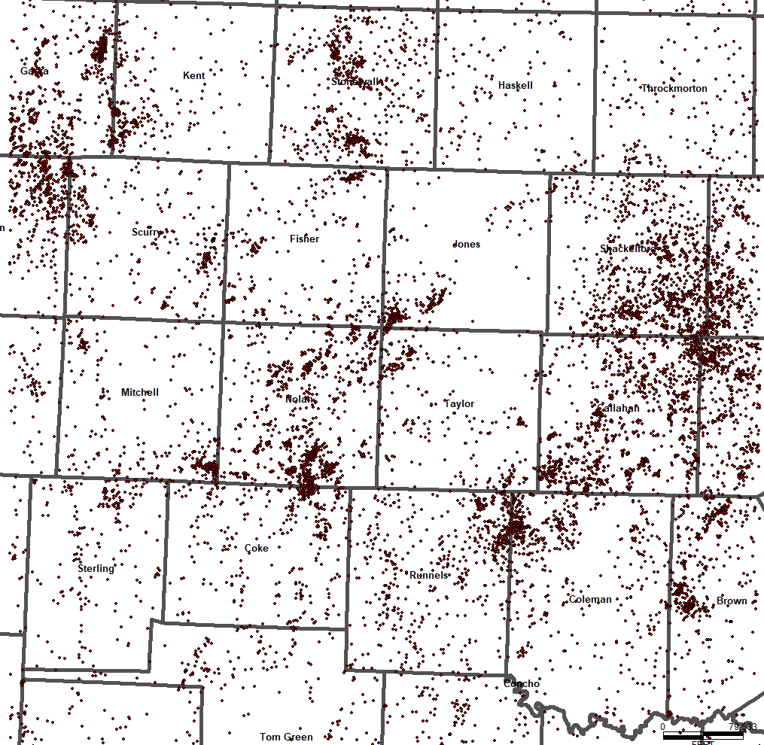
Wells that
penetrate the
Ellenburger

Slide 31
Re-exploring the Eastern Shelf of the Midland Basin
Summary
The Eastern Shelf is a complex geologic region with multiple producing horizons
Stratigraphic complexity, coupled with poorly-constrained data reporting, provide opportunity for further exploration
Vertical infill drilling of existing conventional zones
Application of horizontal drilling & completion technologies to tight sands and limestones
Relatively low cost of drilling and completing should continue to provide favorable economics for smaller independents
Future work
“Next-level” analysis of producing fields and trends (e.g., recent BEG report)
Application of machine learning / data mining techniques
Documentation of source rocks and migration pathways

Slide 32
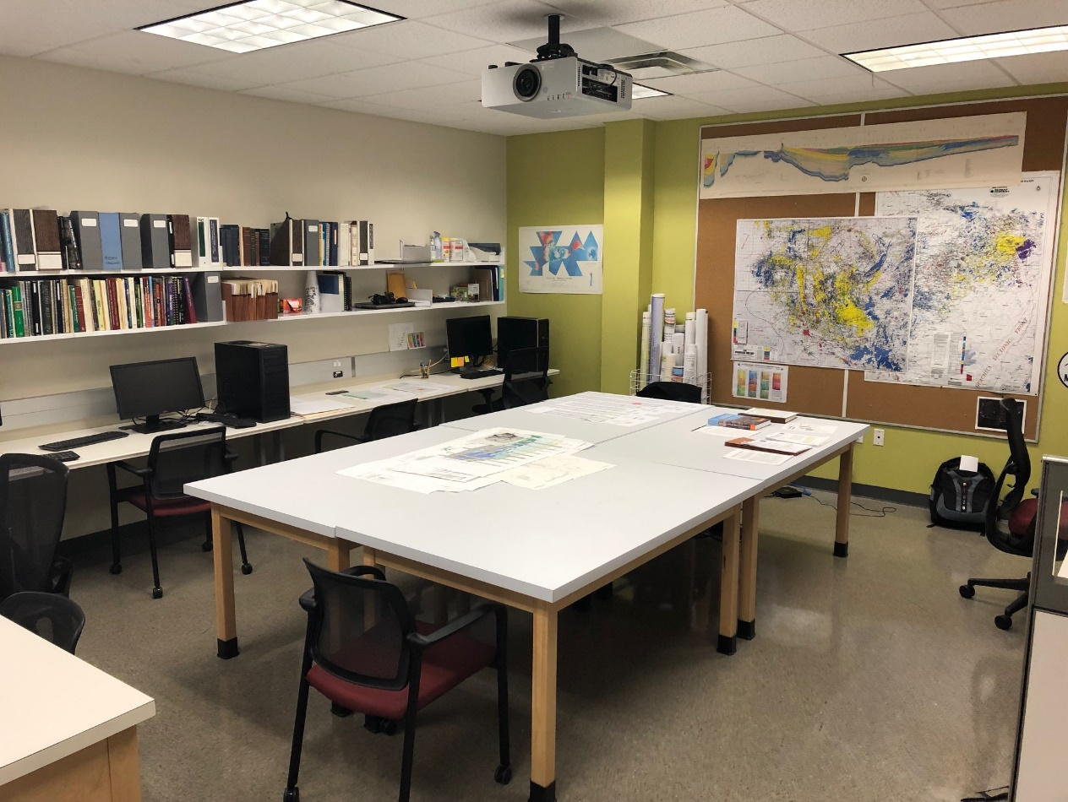
Permian Basin Research Lab at UT Dallas
Dr. Robert J. Stern and Mr. Lowell Waite, Co-Directors
-- established January 2019 --
Goals:
Advance understanding of all geologic aspects of the Permian Basin through open applied research,
linking academia and local industry (sharing info benefits all)
Educate and provide skills to students interested in careers in industry (experience w/ subsurface data sets)
WEBSITE:
https://labs.utdallas.edu/permianbasinresearch/
search “Permian Basin Research Lab”
(access to publications, presentations, key illustrations)
Email: Lowell.waite@utdallas.edu

