Slide 1
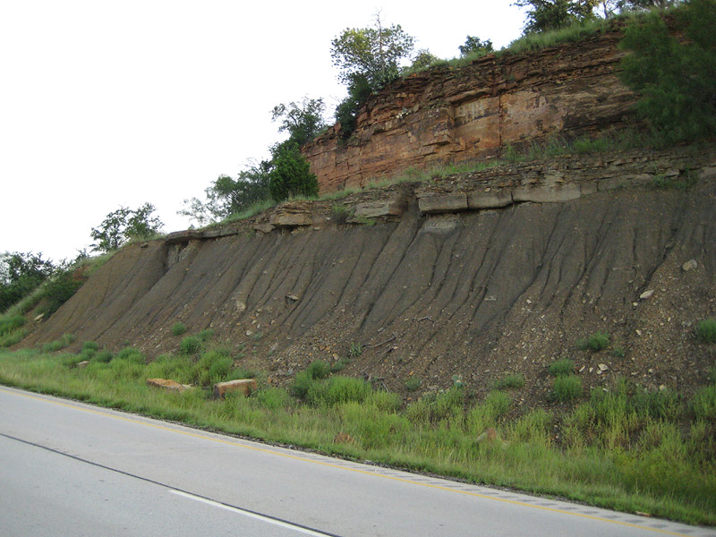
Geology of the Permian Basin
Pennsylvanian
(including Wolfcamp D)
Lowell Waite
UT Dallas Geoscience
Permian Basin Research Lab
11/15/2021

Slide 2
Geology of the Permian Basin: ELS (Endeavor Lecture Series)
Horseshoe Atoll
Tectonic history – Part 1 (Big Picture)
Tectonic history – Part 2 (Regional elements: ARM, CBU, MFB)
Basement
Cambrian – Lower Ord (Wilberns/Bliss Ss., Ellenburger Gp)
Tobosa Basin stratigraphy (Mid Ord. – Mississippian)
Pennsylvanian (Morrow-Atoka-Strawn-Canyon-Cisco)
Lower Permian (Wolfcamp – Spraberry)
Middle and Upper Permian / Permian Basin petroleum system

Slide 3
Permian Basin Stratigraphy and Tectonic History
Ma
System
Series
Delaware Basin
CBP & NW Shelf
Midland Basin
Tectonic Phase
252
Formations
Formations
Formations
final basin fill/termination
Dewey Lake
Dewey Lake
Dewey Lake
Ochoan
Rustler
Rustler
Rustler
Salado
Salado
Salado
Castile
Lamar
Tansill
Tansill
Post Orogenic Loading Rapid Subsidence;
Onset of HC Generation
Bell Canyon
Capitan
Yates
Yates
Guadalupian
Delaware Mtn
Group
Seven Rivers
Seven Rivers
Permian
Cherry Canyon
Goat
Seep
Queen
Queen
Grayburg
Grayburg
Brushy Canyon
Upper San Andres
San Andres
Cutoff Member /
1st Carb / Avalon
Lower San Andres
Clear-
fork
Holt /Upper Leonard
( ~ 50 million yrs. duration )
Active Margin
Lwr San Andres
Holt / Upr Leonard
PERMIAN BASIN PHASE
Bone
Spring
1st Sand
Glorieta
Upper
Leonardian
2nd Carb
Upper Clearfork
Spraberry
Middle
2nd Sand
Yeso /
Clearfork
Middle Clearfork
Lwr
Jo Mill
3rd Carb
Stray Sd
Dean
L. SPBY Sh
3rd Sand
Tubb
Lower Clearfork
Wolfcamp A
Wolfcamp
Wolfcamp
Wichita / Abo
Wolfcamp
Wolfcamp B
mid – Wolfcamp unconformity
299
Wolfcampian
Wolfcamp C1
Virgilian
Cisco
Cisco
Cisco
Wolfcamp C2
Early WFMP Event
Missourian
Canyon
Canyon
Canyon
Wolfcamp D
Penn. – Early Permian
Foreland Deformation
Pennsylvanian
Desmoinesian
Strawn
Lime
Strawn
Lime
Strawn
Lime
Detrital
Detrital
Detrital
Strawn Event
Bend Lm
(~ 30 million yrs.
duration)
Atokan
Atoka
Atoka
Atoka
Sh & Detrital
Atokan Event
323
Morrowan
Morrow
Morrow (NW Shelf Only)
Morrow
Morrow Event
Chesterian
Barnett
U. Miss Lm
L. Barnett
U. Barnett
U. Miss Lm
L. Barnett
U. Barnett
Mississippian
Meramecian –
Osagean
L. Miss Lm
L. Miss Lm
L. Miss Lm
359
Kinderhookian
Woodford
Woodford
Woodford
Tobosa Basin
(Middle Ordovician to
Late Mississippian)
Moderate Subsidence
Devonian
Upper
Middle
TOBOSA BASIN PHASE
419
Lower
Devonian (Thirtyone)
Devonian (Thirtyone)
Devonian (Thirtyone)
Silurian
U. Niagaran
Upper Silurian (Wristen)
Upper Silurian (Wristen)
Upper Silurian (Wristen)
L. Niagaran
Fusselman
Fusselman
Fusselman
(~ 150 million yrs. duration)
Passive Margin
444
Alexandrian
Montoya
Montoya
Sylvan Sh.
Cincinnatian
Montoya
Mohawkian
Tulip Crk.
Bromide
Tulip Crk.
Bromide
Tulip Crk.
Bromide
Simpson
Mclish
McKee Sd.
Simpson
Mclish
McKee Sd.
Simpson
Mclish
McKee Sd.
Ordovician
Chazyan
Oil Creek
Waddell Sd.
Oil Creek
Waddell Sd.
Oil Creek
Waddell Sd.
Joins
Connell Sd.
Joins
Connell Sd.
Joins
Connell Sd.
Canadian
Ellenburger
Ellenburger
Ellenburger
Great American Carbonate Bank
485
Ozarkian
(Late Cambrian – Early Ordovician)
Cambrian
Upper
Bliss
Absent
Wilberns
541
Bliss / Hickory / Riley
Precambrian
Basement
Precambrian
Basement
Precambrian
Basement
Basement assembly and breakup of
Rodina supercontinent
Precambrian
Grenville Orogeny (1.3 to 1.0 bya)
(Reed and Waite, 2016)

Slide 4
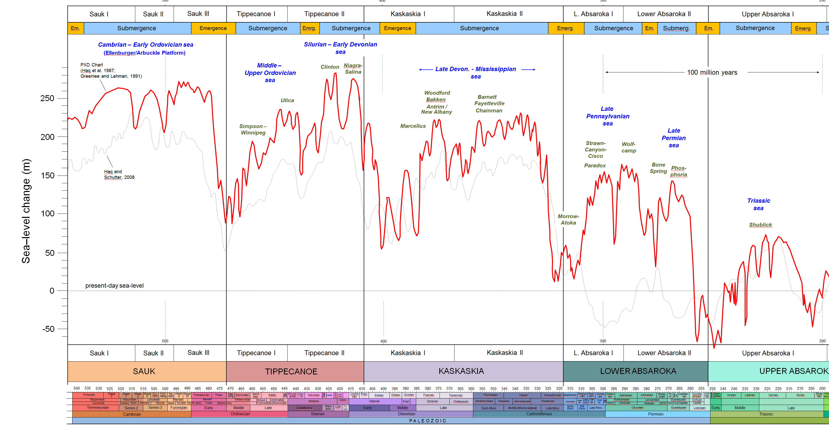
Four long-term cycles of sea level during the Paleozoic (4 megacycles)
Subcycle 4a
Begins with birth of Pennsylvanian seaway following end Miss. lowstand and exposure
1
2
3
Long-term transgression throughout Pennsylvanian
4
1a
1b
2a
2b
3a
3b
Subcycle terminates with sea-level fall during earliest portion of Permian time
4a
4b
4c
Fusselman-
Wristen-
Thirtyone
eroded/
not
deposited
U. Miss./Barnett –
Lower Miss. Lime –
Woodford
WFMP C2 –
WFMP D –
L. Strawn –
Morr. - Atoka
SPBY/B.Spr.-
Ochoan
Permian
Basin
stratigraphic
units
eroded/
not deposited
(Basement)
Ellen-
burger
Simpson-
Montoya
Dean -
Tans.-Yates
Trans. Ss.
WFMP A -
Quen.-SNRV
WFMP B -
GBRG
WFMP C1
San Andres
Early
Mid.
Late
Early
Mid.
Late
Lu.-
Late
Early
Middle
L.
E.
Lland.
Wn.
Pri.
Early
Mid.
Late
E.
M
Cisuralian
Gua.
Lop.
Middle
Late
Cambrian
Ordovician
Silurian
Devonian
Mississippian
Penn.
Permian
Triassic
540
520
500
480
460
440
420
400
380
360
340
320
300
280
260
240
220
200
Icehouse
Greenhouse
I
Greenhouse
Icehouse
Greenhouse

Slide 5
Pennsylvanian – Early Permian Themes
Penn: Active margin phase (Tobosa Basin becomes Permian Basin) Hercynian orogeny & rise of Ancestral Rockies
Climate: Icehouse phase throughout Penn. – Early Permian, transitioning to greenhouse; increasing aridity with time (Pangea assembly); Permian Basin in low-latitudes (tropics)
Sea level: long-term rise and expansion of Penn. seaway; short-term: Penn cyclothems (high freq, high amplitude cycles)
Dominance of phylloid algae as main reef builders
Early Penn. (Atokan)
Late Penn. (Missourian)
Early Permian (Wolfcampian)

Slide 6
Schematic diagrams illustrating structural evolution of the Permian Basin
Early Ordovician through Mississippian: 500 – 318 mya)
Intracratonic Basin Phase –
Formation of Tobosa Basin
(Early Ordovician through Mississippian)
Broad, bowl-shaped sag
Dominated by shallow water platform carbonate
deposition with periodic sand and shale input
Early Pennsylvanian (Morrowan to Earliest Desmoinesian: 318 – 308 mya)
Initial phases of uplift due to NE-SW compression
Erosion of Central Basin Uplift & Pennsylvanian detrital deposition
Carbonate deposition during intermittent periods of minimal compression
(tectonic quiescence)
Pennsylvanian to early Permian Active Margin/Orogenic Phase
Two initial orogenic pulses (Early Penn. -- Morrowan to mid Atokan and late Atokan )
First tectonic quiescence phase (Early Penn. – latest Atokan to early Desmoinesian)
Third orogenic pulse (Early Penn. – early Desmoinesian)
Second tectonic quiescence phase (mid Desmoinesian to early Permian)
Fourth orogenic pulse (early Permian – Wolfcampian)
4 tectonic pulses
2 periods of quiescence
(Tim Reed, 1989, unpublished)

Slide 7
Pennsylvanian and Permian Sediment Input Sources for Permian Basin
Morrowan &
Atokan
Morrowan &
Atokan
Pennsylvanian &
Early Wolfcampian
Late Pennsylvanian &
Early Wolfcampian
Pennsylvanian &
Wolfcampian
Pennsylvanian &
Wolfcampian
Diablo Uplift
Wolfcampian
Source area &
Sediment Transport
Wolfcampian
Marfa
Basin
Thrust Belt
Carbonate
Debris
Clastic
Basement Uplift
Deep Basin
Significant
Shallow Shelf
Less
Significant
(Base Map by L. Waite 2013)

Slide 8
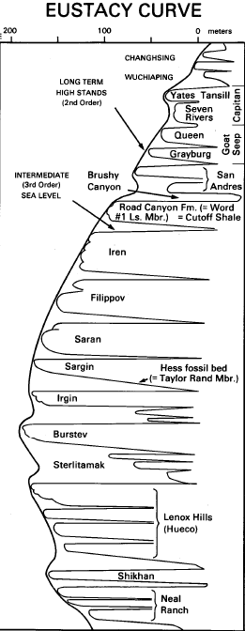
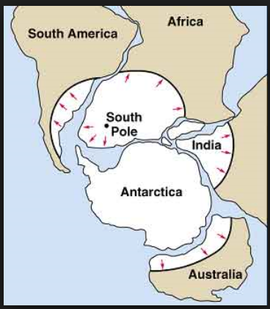
Late Paleozoic Glacial Frequency Deposits and Sea Level
Glacial
Frequency
Sea Level
(Ross & Ross, 1987)
Global
Climate
Phase
Global ice age (“icehouse” climate phase) initiates in late Mississippian time
High
Low
Age
2
6
10
14
200
100
0 m
Late
Tartarian
Kazinian
Green-
house
“peak” icehouse occurs in two pulses
Permian
Kungurian
mid Pennsylvanian / Westphalian
Artinskian
Early
earliest Permian / Asselian - Sakmarian
Sakmarian
Asselian
Frequent high-amplitude sea-level change during icehouse exerts a fundamental control on late Penn. – early Permian sediment distribution and early diagenesis
Stephanian
Pennsylvanian
West-
phalian
Icehouse
Carboniferous
Namurian
Mississippian
Visean
Green-
house
Tournaisian
(Modified from Frakes, et al., 1992)

Slide 9
PENNSYLVANIAN
SEA-LEVEL CHANGES

Slide 10
(Wright, 2020)
Two sea-level themes for Penn time
Short-term (3rd- and higher- order) high frequency and high amplitude cycles: climate; cyclothems
Long-term (second-order) sea-level rise / transgression: tectonic; drowns/starves the basins

Slide 11
Drowning of shelves in Permian Basin during mid-late Strawn time
SW
NE
Central Basin Platform
Up to 700 ft. of Water
Midland Basin
Highstand Sea Level
Eastern Shelf or Atoll
Mid to Upr
Strawn Lime
Water
Lowstand Sea Level
Mid to Upr
Strawn Lime
Mid to Upr Strawn Condensed Shale & Mudstone
Lower Strawn Lime
Strawn Detrital
Pre-Strawn
2
2
Sea level rises. Carbonate deposition limited to bathymetrically higher areas. Basin receives condensed shale.
Central Basin Platform
Midland Basin
Eastern Shelf or Atoll
Grainstones & Boundstones Wackestones
100 – 150 ft. of Water
Sea Level
1
Shallowing Upward Cycles
Water
Shallowing Upward Cycles -- Grainstones to Wackestones
Crinoidal
Wackestones to Packstones
Lower Strawn Lime
Strawn Detrital
Pre-Strawn
1
Sea level lowstand. Shallow-water carbonate deposition extends across entire
Permian Basin

Slide 12
Glacial
Frequency
Sea Level
(Ross & Ross, 1987)
Global
Climate
Phase
Midland Basin
Formations
High
Low
Age
2
6
10
14
200
100
0 m
These short-term (3rd- and higher-order) sea-level changes are the result of glacioeustasy (growth and melting of glaciers during the Penn ice age); packages of strata generated during one short-term cycle are known as cyclothems
Tartarian
Evaporites
Late
Yates, Seven Rivers,
Queen, Greyburg
Kazinian
San Andres
Green-
house
Kungurian
Holt / Upper Leonard / PXD Clearfork
Permian
Spraberry & Dean
Artinskian
Early
Wolfcamp A
Sakmarian
Wolfcamp B
Asselian
Wolfcamp C1
298
Wolfcamp C2
Stephanian
Cisco
Canyon
Wolfcamp
D
Pennsylvanian
Strawn
Icehouse
West-
phalian
This long-term (2nd-order) rise in global sea-level during Early Penn time is coincident with development of Ouachita-Marathon fold and thrust belt;
“drowns” the Midland and Delaware basins during mid-late Strawn time
Atoka
323
Morrow
Carboniferous
Namurian
Upper Miss Lm /
Barnett
Mississippian
Visean
Lower Miss
Lime
Green-
house
Tournaisian
(Modified from Frakes, et al., 1992)

Slide 13
Cyclothems
Cyclothems are alternating stratigraphic sequences of non-marine and marine strata, typically stacked packages each 5 – 15m thick, a product of glacially-controlled, short-term sea-level change
Coals seams are common in the non-marine potion of some cyclothems (the term “cyclothem” was first defined by European coal geologists in the 1800’s who were mining coals of Late Carboniferous age)
Each cyclothem consists of a short-term (~ 0.5 million-year) transgressive-regressive cycle capped by a short-term exposure surface
Cyclothems are characteristic of Upper Carboniferous / Pennsylvanian – early Permian strata worldwide

Slide 14
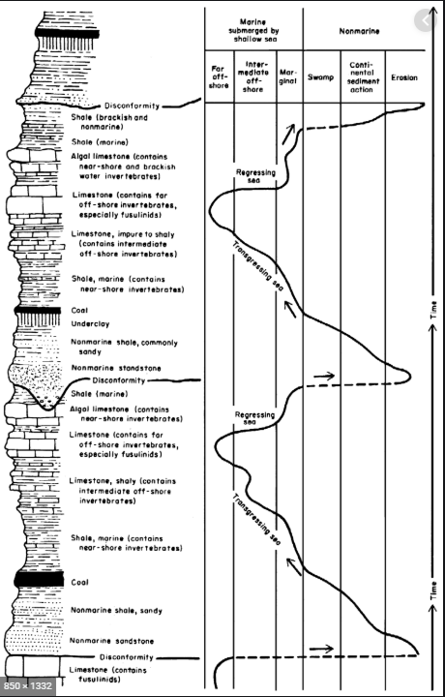
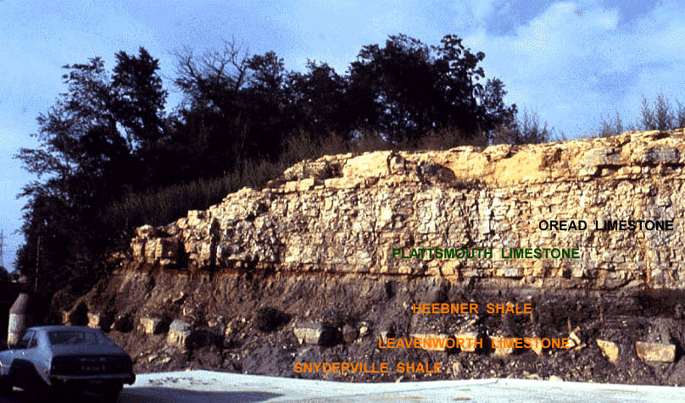
Typical Penn. cyclothems are 5 – 15 m thick
Cyclothem 2
Cyclothem 1
(Moore, 1964)

Slide 15
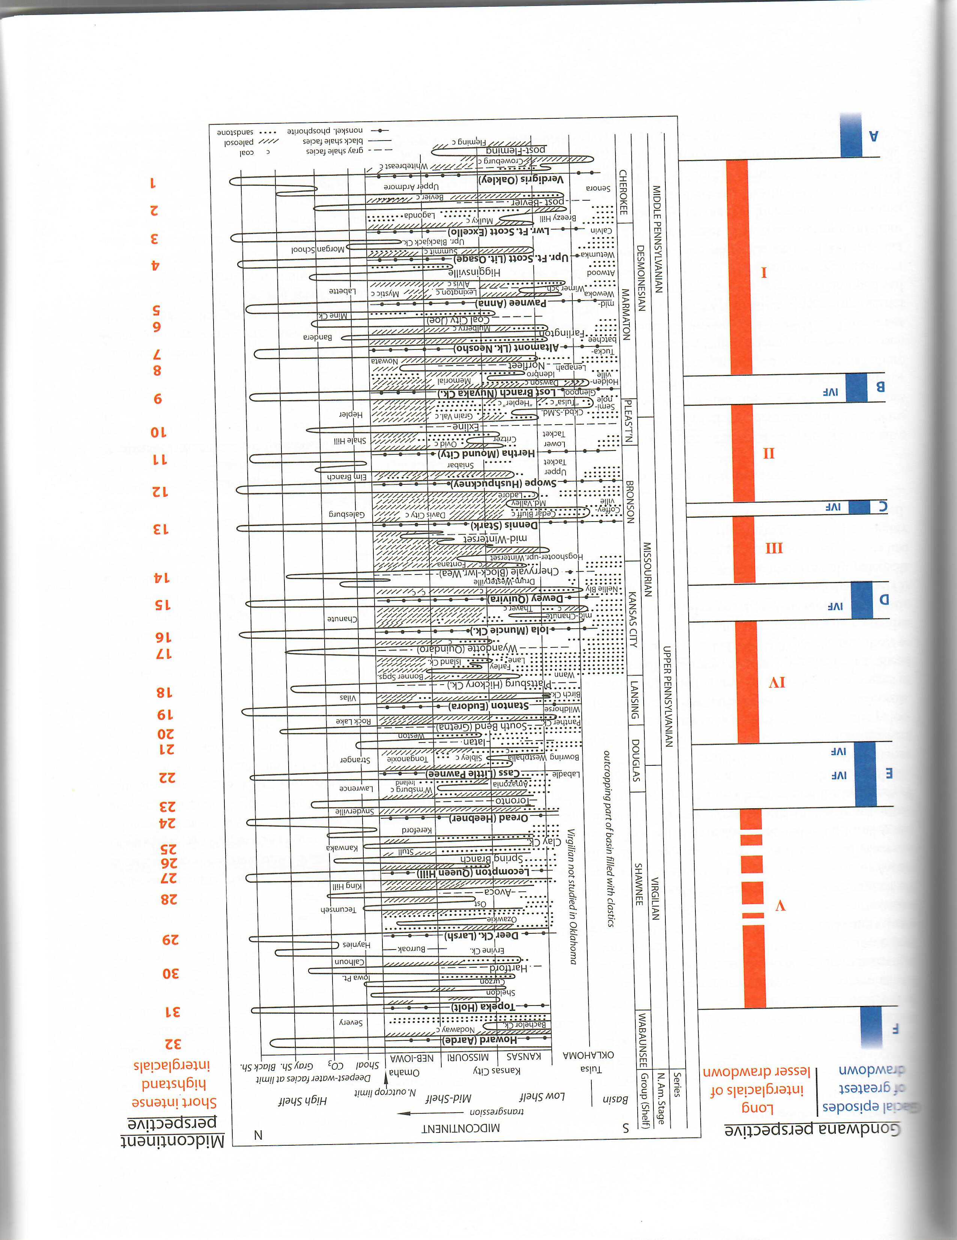
Midcontinent cyclothems
(Heckel, 2008)
Fusulinid foraminifera:
biostratigraphic control
(Myers et al., 1956)
0.5 mm

Slide 16
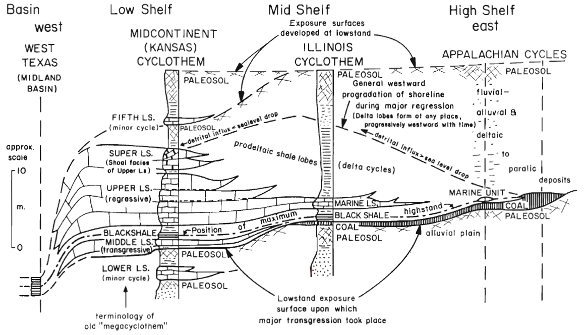
Nearshore cyclothems are dominated by terrigenous clastic (including coals)
Offshore cyclothems are dominated by shallow marine carbonates
Note starved Midland Basin
Sacramento
Mountains,
New Mexico
(modified from Heckel, 1994)

Slide 17
Major reef builders throughout Phanerozoic time
PERIODS
BUILDUPS
MAJOR SKELETAL ELEMENTS
0
Tertiary
CORALS & SKELETAL ALGAE
Pennsylvanian –
Lower Permian
reef systems including those in the Permian Basin
CHALKS
rudists
100
Creta-
ceous
RUDISTS
corals & stromatop.
CORALS
sponges
stromatoporoids
Jurassic
200
Triassic
TUBIPHYTES
corals sponges
Permian
SPONGES + TUBIPHYTES
Penn.
PHYLLOID ALGAE
300
BRYOZOA
Miss.
Devonian
STOMATOPOROIDS corals
400
Silurian
Ordovician
STOMATOPOROIDS + CORALS
SPONGES + SKELETAL ALGAE
500
Cambrian
SKELETAL ALGAE
ARCHAEOCYATHIDS + ALGAE
Precamb
BLUE-GREEN ALGAE
600
reefs
mounds
mass extinction
(modified from James and Mountjoy, 1983)

Slide 18
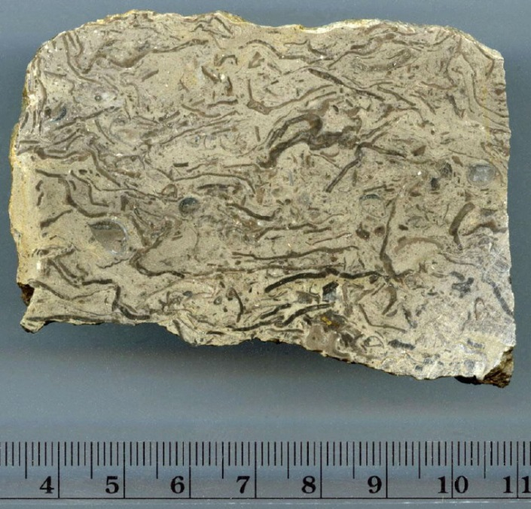
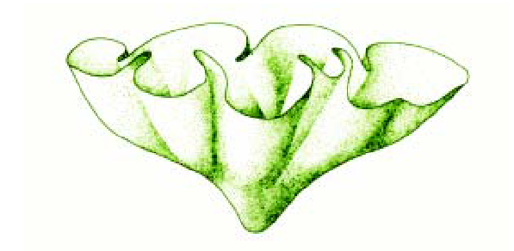
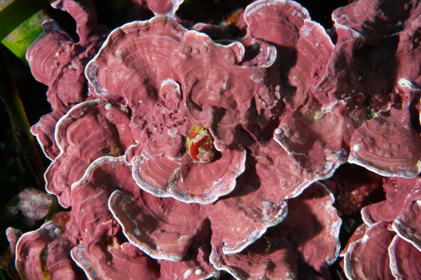
Phylloid Algae
An extinct group of algae of problematic taxonomy – most likely a red algae
Age range: Late Carboniferous (Pennsylvanian) to late Permian
Major component of Penn reefs in Permian Basin and elsewhere
Present in middle – late Permian reefs, but much reduced; replaced by sponges and other algal forms
Platy, “lettuce-like” morphology; mostly aragonitic forms (secondary porosity important in subsurface)
Individual fronds have dark amber color in hand specimen and thin-section
(Scholle and Ulmer-Scholle, 2003)
Modern red algae – analog
Calcipatera, a phylloid algae from the Wolfcamp of Kansas (Sawin and Wood, 2005)
(N. King, University of Southern Indiana)
(www.thefossilforum.com)

Slide 19
PENNSYLVANIAN
STRATIGRAPHY
OF THE PERMIAN BASIN

Slide 20
Cycle 4a: Lower Absaroka I cycle (Penn. – early Permian)
1a
1b
2a
2b
3a
3b
4a
4b
4c
Fusselman-
Wristen-
Thirtyone
eroded/
not
deposited
U. Miss./Barnett –
Lower Miss. Lime –
Woodford
WFMP C2 –
WFMP D –
L. Strawn –
Morr. - Atoka
SPBY/B.Spr.-
Ochoan
Permian
Basin
stratigraphic
units
eroded/
not deposited
Ellen-
burger
Simpson-
Montoya
Dean -
Tans.-Yates
WFMP A -
Quen.-SNRV
WFMP B -
GBRG
WFMP C1
San And.
Early
Mid.
Late
Early
Mid.
Late
Lu.-
Late
Early
Middle
L.
E.
Lland.
Wn.
Pri.
Early
Mid.
Late
E.
M
Cisuralian
Gua.
Lop.
Middle
Late
Cambrian
Ordovician
Silurian
Devonian
Mississippian
Penn.
Permian
540
520
500
480
460
440
420
400
380
360
340
320
300
280
260
240
220
200
Permian Basin Cycle 4a strat. units
(from youngest to oldest):
Triassic
Permian
mid Wolfcamp
lowermost
Wolfcamp
Interregional unconf.
Wolfcamp D
(Cline shale)
in basins
Cisco
Tectonic uplift
Penn-
sylvanian
Canyon
early Strawn
Strawn
Atoka
Atoka
Morrow
Interregional unconf.
Morrow (?)
Miss.

Slide 21
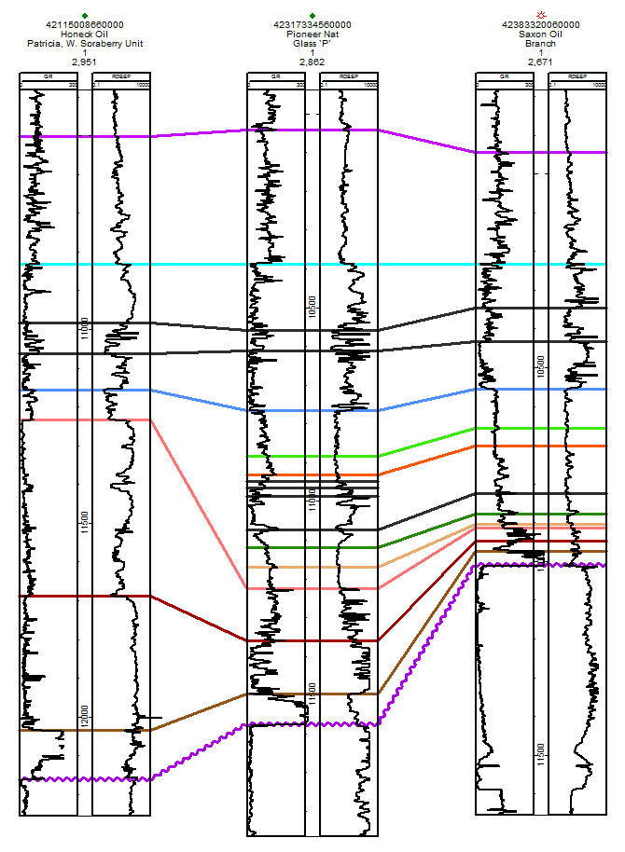
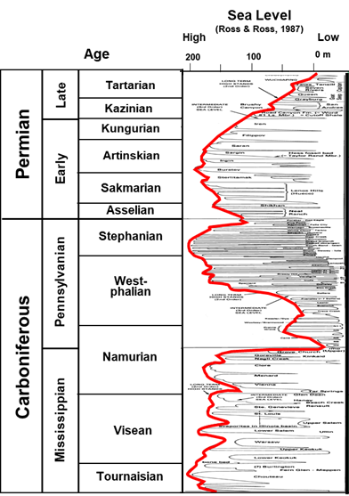
Midland Basin Stratigraphic Units and Facies
System
Series
Midland Basin
Lithology
Formations
North
South
Dewey Lake
Ochoan
Rustler
Salado
Tansill
Yates
Guadalupian
Whitehorse
Seven Rivers
Permian
Queen
Wolfcamp
D
(Penn Sh;
Cisco –
Canyon)
Grayburg
Word
San Andres
S
Clear-
fork
Holt / Upper Leonard
Spraberry
Upper
S
Lwr Strawn
Lm
Leonardian
Mid
Dean
Lower
Jo Mill
Wolfcamp A
S
Strawn Det
Pennsylvanian
Wolfcamp
Wolfcamp B
Wolfcampian
Wolfcamp C1
Atoka
Bend Lm
Virgilian
Cisco
Wolfcamp C2
S
Missourian
Canyon
Wolfcamp D
Pennsylvanian
Desmoinesian
Strawn
Lime
Detrital
Atokan
Atoka
Bend Lm
S
Morrowan
Morrow
Sh & Detrital
8
Atoka Shale & Detritals
7
S
6
Chesterian
U. Miss Lm
U. Barnett
5
Mississippian
Meramecian –
Osagean
L. Barnett
Upper
Miss
Lm
4
L. Miss Lm
2
3
Kinderhookian
S
Morrowan Sh
Upper
Woodford
1
Barnett
Thirtyone
Devonian
Middle
Presence of Morrow-age rocks in Midland Basin is questionable (biostrat in one well indicates Barnett unconformably overlain by Atokan)
Lower
Devonian (Thirtyone)
Lower
Miss
Lm
Devonian
Silurian
U. Niagaran
Upper Silurian (Wristen)
L. Niagaran
Fusselman
Alexandrian
Montoya
Sylvan Sh.
Woodford
Cincinnatian
Wristen
Wristen
Mohawkian
Tulip Crk.
Bromide
Silurian
Simpson
Mclish
McKee Sd.
S
Wristen
Fusselman
Ordovician
Chazyan
Oil Creek
Waddell Sd.
Joins
Connell Sd.
Atoka is a 2nd-order lowstand unit that fills-in pre-existing Miss depositional topography
Canadian
Ellenburger
Ozarkian
Cambrian
Upper
Wilberns
Bliss / Hickory / Riley
Precambrian
Precambrian
Basement
S – Source Rocks

Slide 22
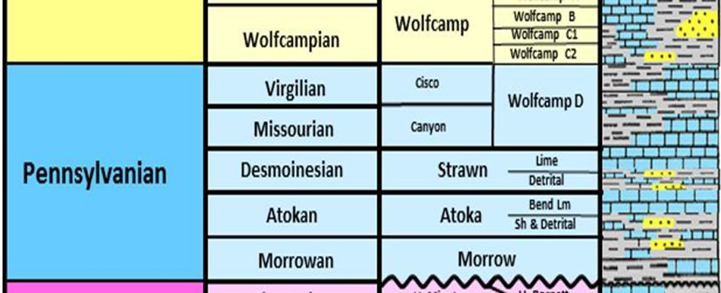
EARLY PENNSYLVANIAN:
MORROW - ATOKA

Slide 23
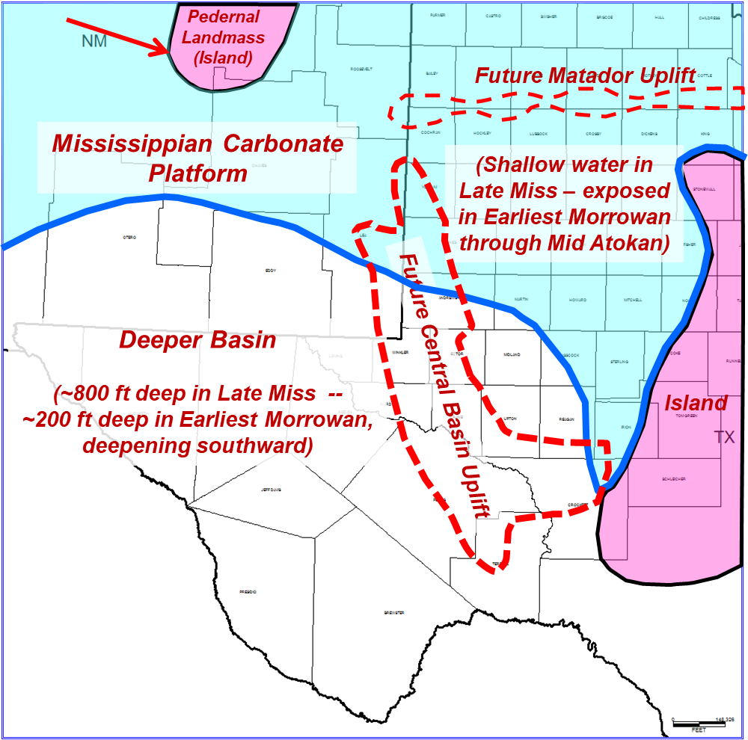
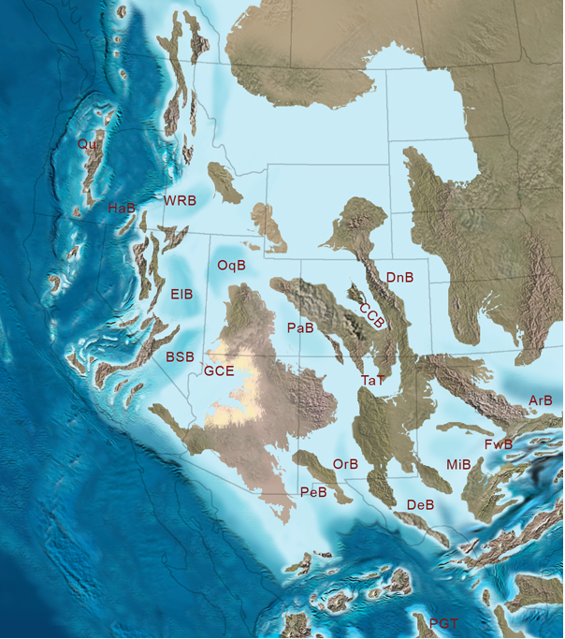
Morrow – Atoka Paleogeography
Latest Mississippian Paleogeography
LAURASIA
MiB – Midland Basin
DeB – Delaware Basin
ArB –Anadarko Basin PaDuB – Palo Duro Basin
OrB – Orogrande Basin
PeB – Pedregosa Basin
VVB – Val Verde Basin
Ancestral Rockies Uplift
Uncompahgre Uplift
Wichita Uplift
Pedernal
Uplift
Palo
Duro B.
Matador U.
Exposed Miss
Platform
Initial tectonic break-up of Tobosa Basin (Gondwana arc, Ancestral Rockies basement uplifts)
CBU
Delaware
Basin
Midland B.
Subduction
Diablo U.
VVB
Sea-level lowstand at end of Miss. exposes carbonate platform
Oceanic Crust
Continental Collision
Tesnus & Haymond Deposition
Ensuing transgression occurs during break-up of former passive margin and Gondwana collision and rise of Ancestral Rockies basement uplifts
(modified from Ron Blakey)
GONDWANA

Slide 24
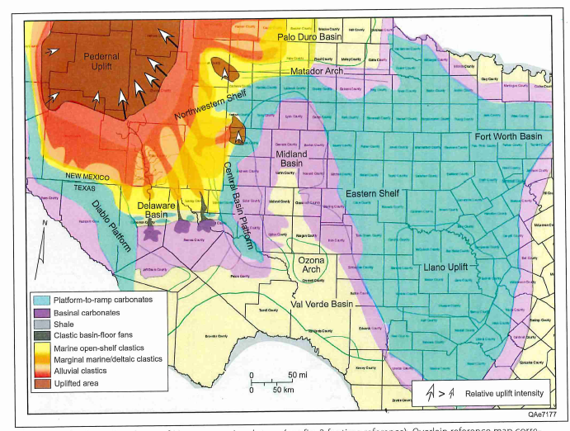
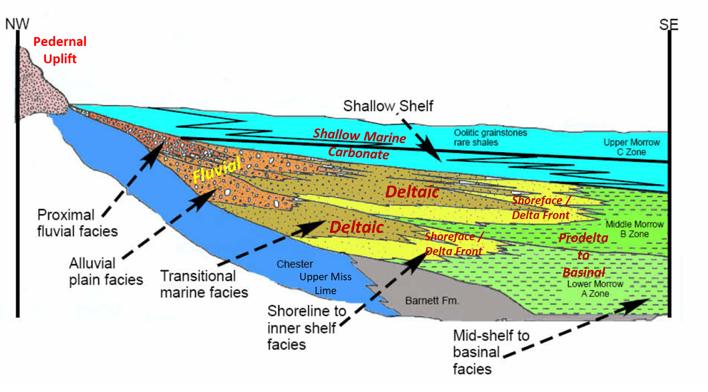
Morrow Facies in the Northern Delaware Basin and Northwest Shelf
(Wright, 2020)
(From Wright, 2011 – Modified from Mazullo, 1984)

Slide 25
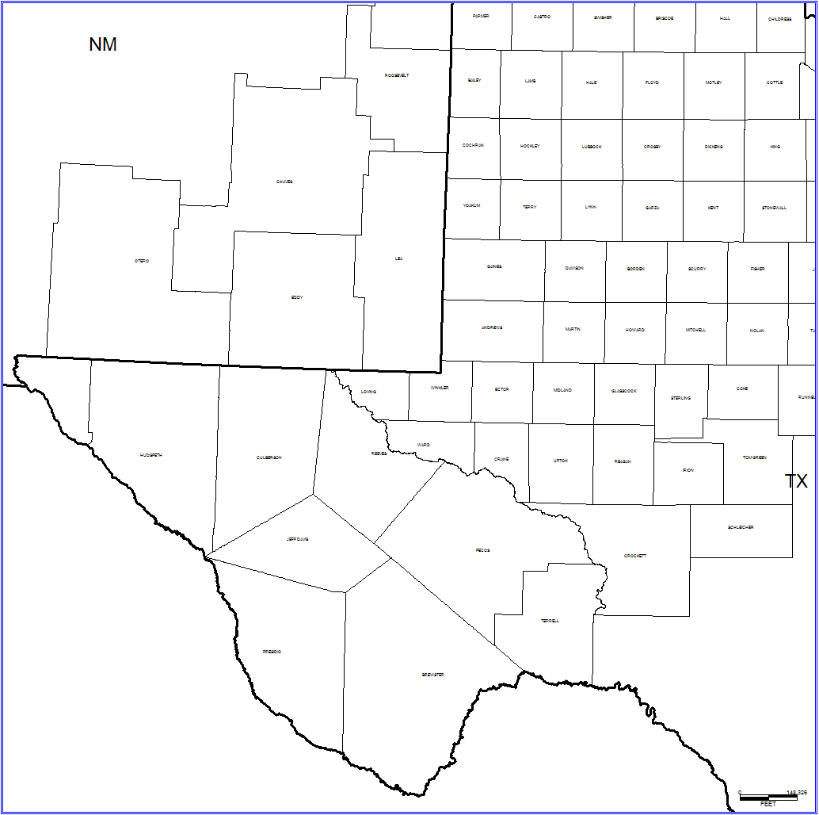
Atoka Facies
Fan Delta
Carbonate & Shale
Relative low sea level
Miss carb. platform & Eastern
Shelf Exposed
Pedernal and Matador
Uplifts rise and shed
clastics southward
Central Basin Uplift rising
and shedding clastics
(1st major tectonic “pulse”
during Morrow time, 2nd in Atoka)
Series of large streams delivering coarse clastics off Pedernal Uplift into Delaware Basin; streams into Midland basin are smaller, muddier
Some thin coal-beds present were observed in cores in Midland Basin
Shoreline
Pedernal
Uplift
Fan Deltas
Matador Uplift
Edge of underlying
Miss Platform
Fluvial
Fluvial
Exposed Miss
Platform
Shoreline
Central Basin Uplift
Deltaic to Shoreface
Delaware
Basin
Midland
Basin
Basinal Shale
Deltaic
Land
(Former
Island)
Mid-Atokan
Prodelta
Delaware
Basin
Deltaic ?
Ft.
Stockton
High
Diablo Uplift
(Submerged Bathymetric High)
Ozona Uplift
(Submerged
Bathymetric High)
Basinal Shale
Shoreline
Thin Basinal Shale ?
Future Val Verde Basin
Foredeep Basin
(Map compiled by T. Reed)
Tesnus & Haymond
Turbidites

Slide 26
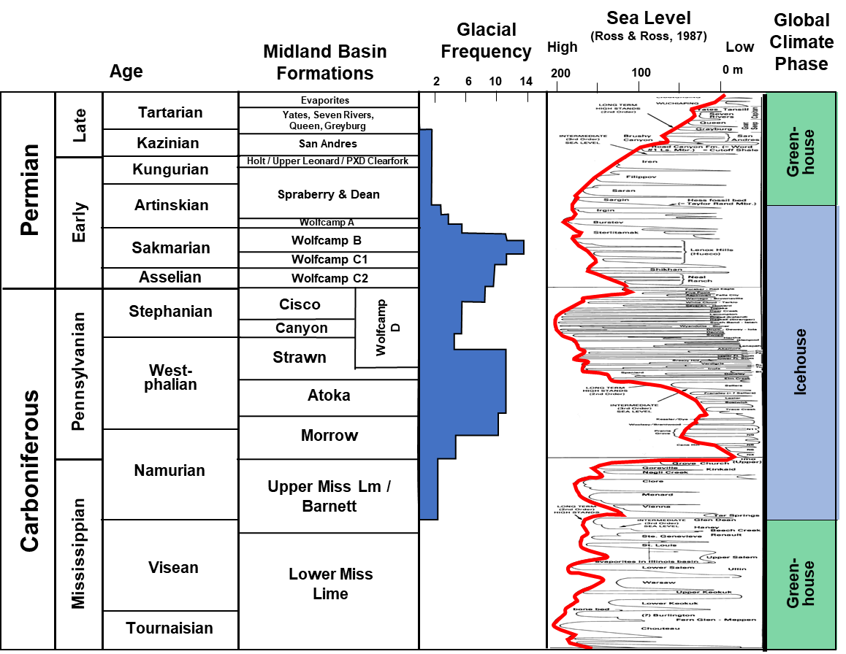
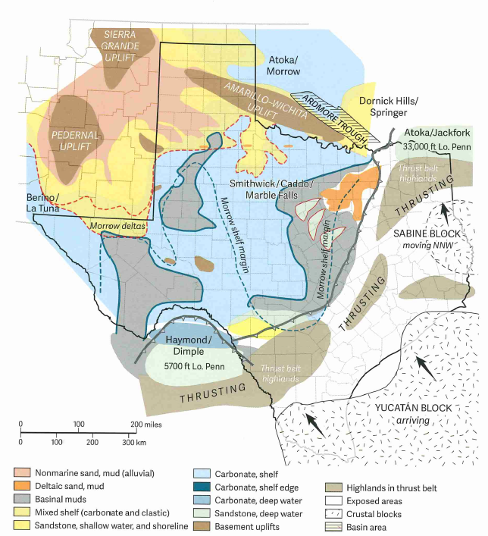
Late Atoka
By late Atoka time, a long-term rise in sea-level reduces main sources of terrigenous clastics; expansion of carbonate shelves
Some areas of deep-water shale deposition
Note small exposed land area in southern Central Basin Uplift (Fort Stockton block)
(Ewing, 2016)

Slide 27
Middle and Upper Pennsylvanian of the Permian Basin:
Strawn -- Canyon -- Cisco
(Wolfcamp D)

Slide 28
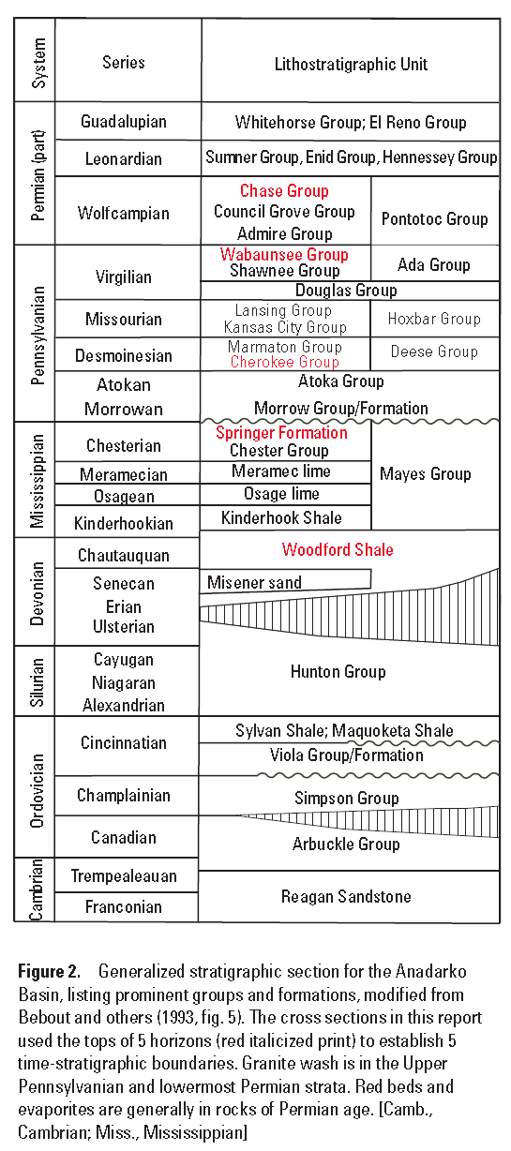
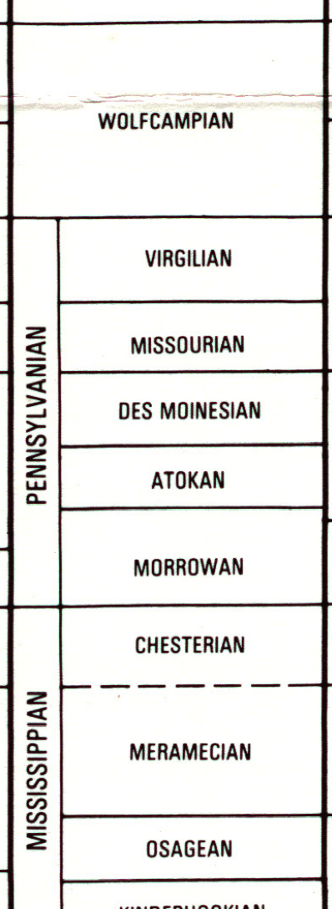
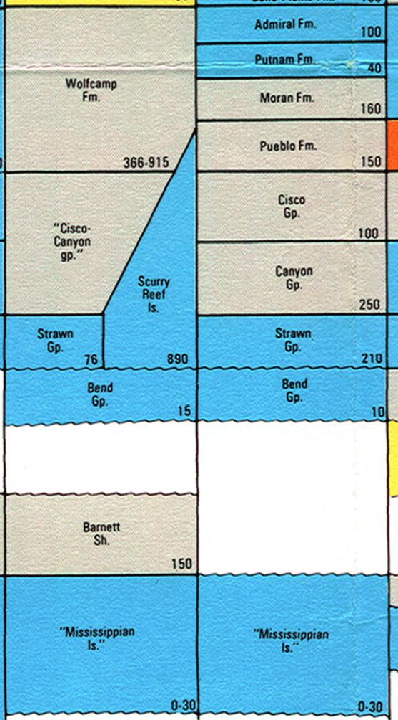
Mid Continent / Anadarko Basin
AAPG COSUNA chart (1985)
Midland Basin
Eastern Shelf
WC A - B
WC C
In the Midland & Delaware basins:
WC D
Early Strawn = Strawn Detrital and Lower Strawn Limestone
Middle & Upper Strawn, Canyon, and Cisco = Wolfcamp D
Limestone
(Gianoutsos et al, USGS, 2014)
Organic-rich shale

Slide 29
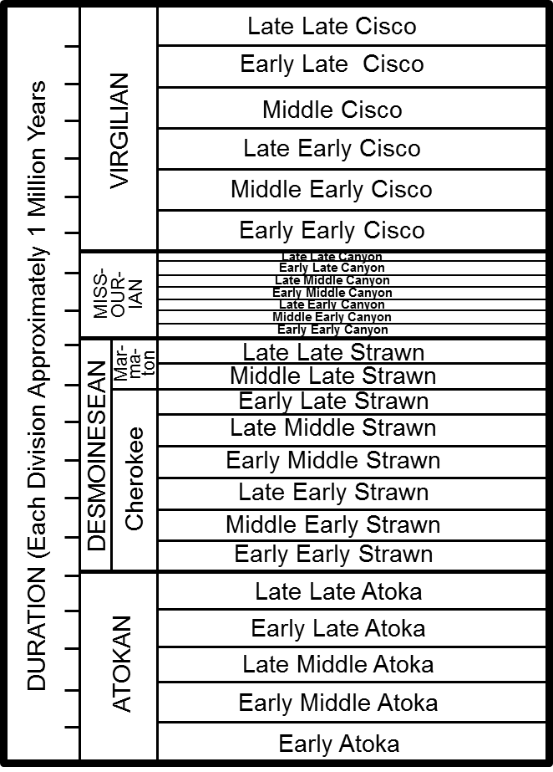
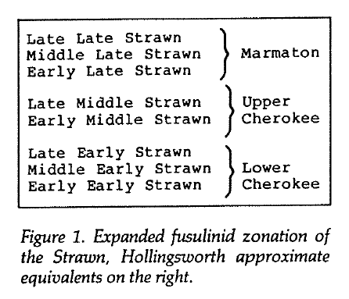
Fusulinid foraminifera: Biostratigraphy for Permo-Penn
Midland Basin
Revised fusulinid zonation
0.5 mm
(Myers et al., 1956)
Midland Basin
Fusulinid zonation
(Reed and Mazzullo, 1987)
(Reid et al., 1988 and Reid and Reid, 1991)

Slide 30
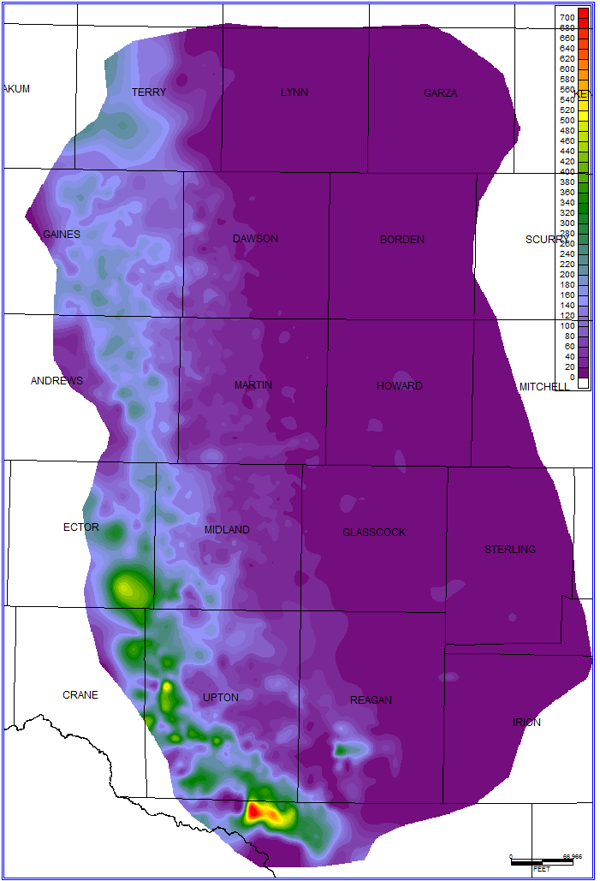
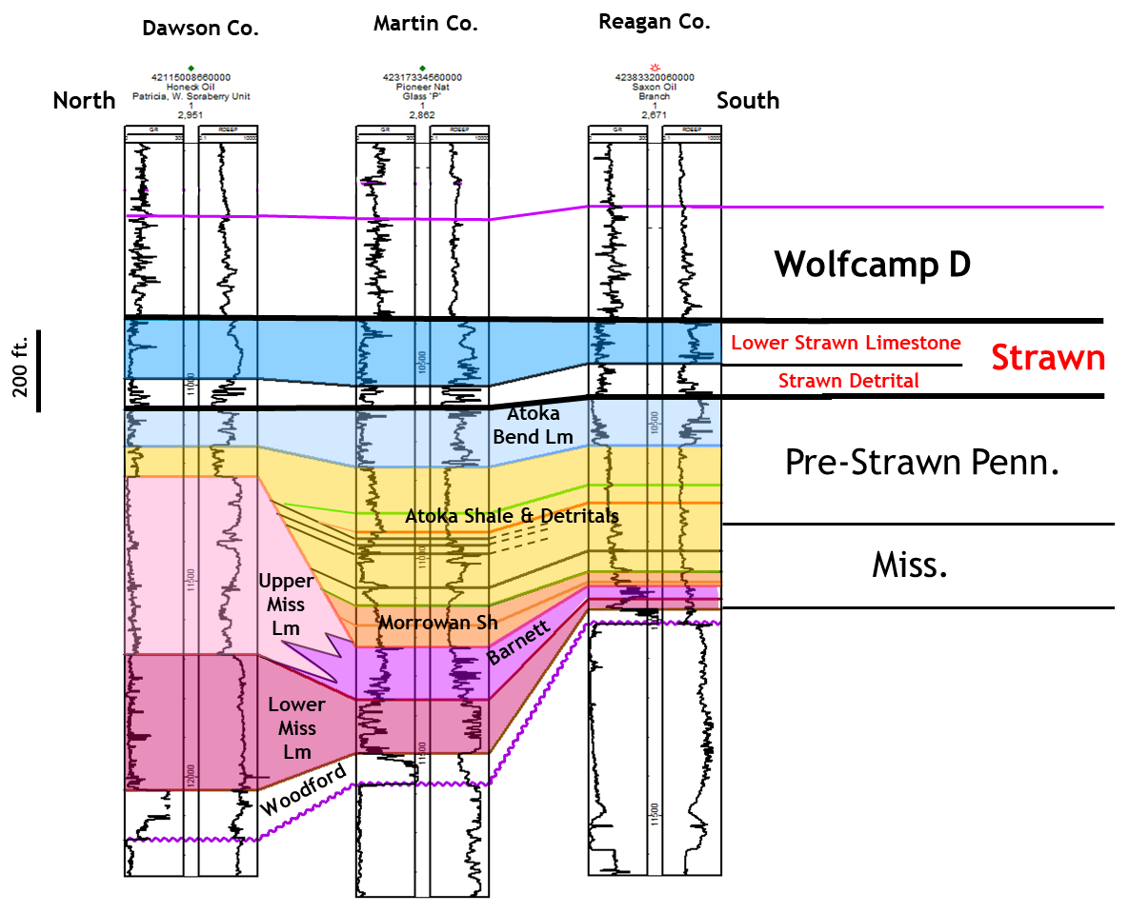
Strawn detrital unit of Midland Basin:
3rd major tectonic pulse of Central Basin Uplift
Strawn Detrital isopach
Absent by
Nondeposition
or Highly
Condensed
Micrite and
Shale
Clastic Dominated Facies
Micrite and Shale
Micrite and Shale
Clastic Dominated Facies
Ft. Stockton
uplift

Slide 31
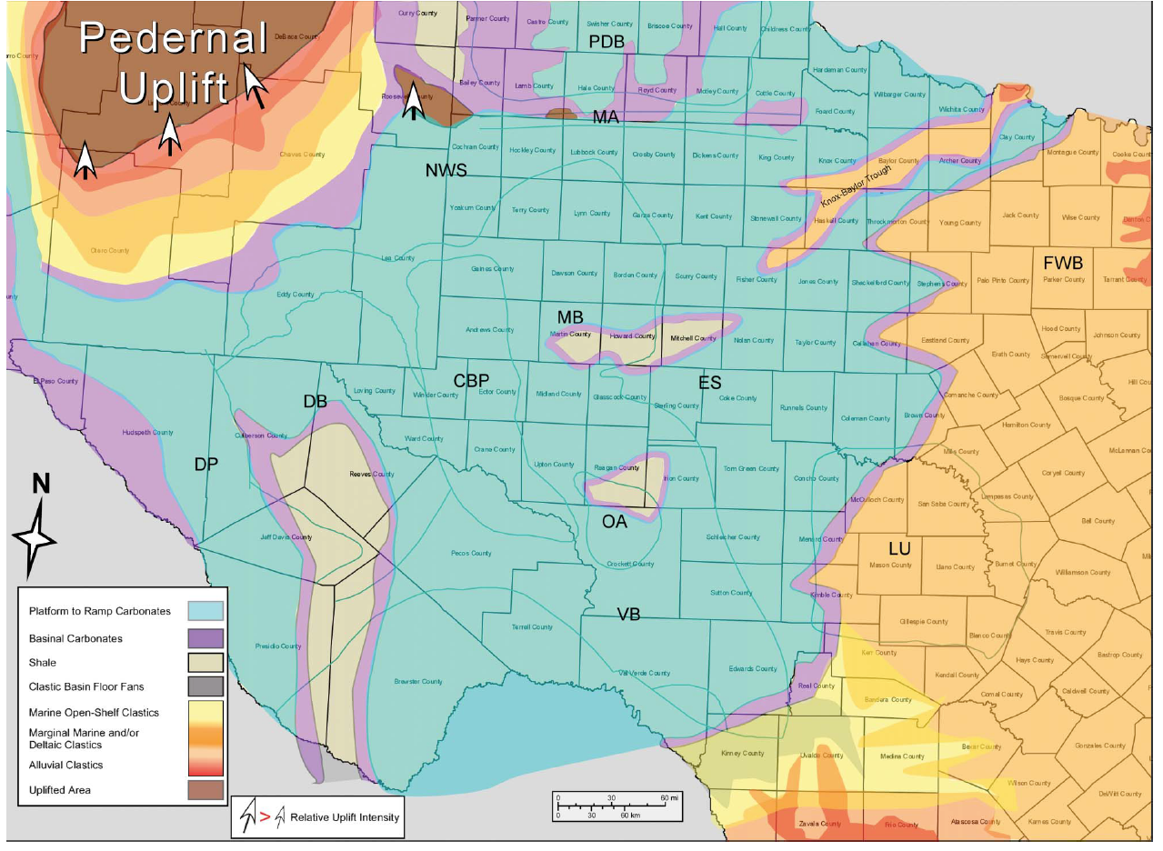
Lower Strawn Limestone (Lower Desmoinesian) Facies
Shallow water platform carbonate facies extend across entire Midland Basin and Eastern Shelf region
Lower Strawn Limestone is generally < 200 ft. thick in Midland Basin
Core analyses indicate typical Penn shelf cyclothem deposits: burrowed skeletal wackestones grading upward into phylloid algal packstones and skeletal grainstones, capped by exposure surfaces
Pre-dates drowning of Midland, Delaware basins
(Wright, 2011)

Slide 32
Carbonate deposition backsteps to surrounding shelves.
Basins become “starved,” receiving relatively little deep-water seds.

Slide 33
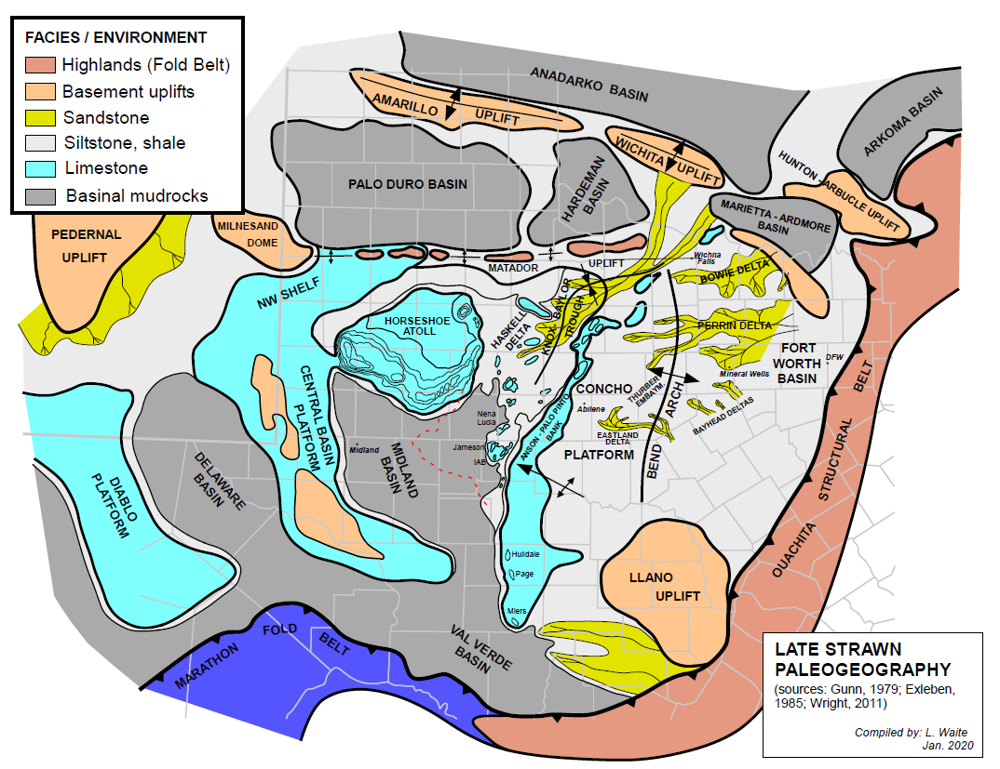
Upper Strawn (Late Strawn time)
Early Strawn

Slide 34
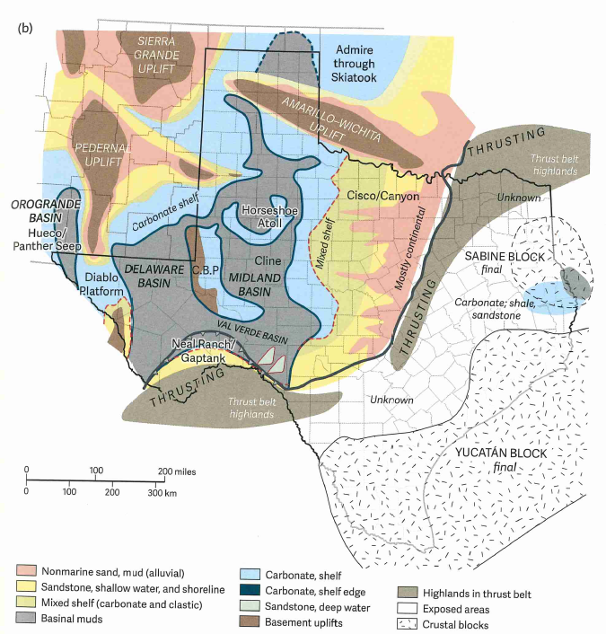
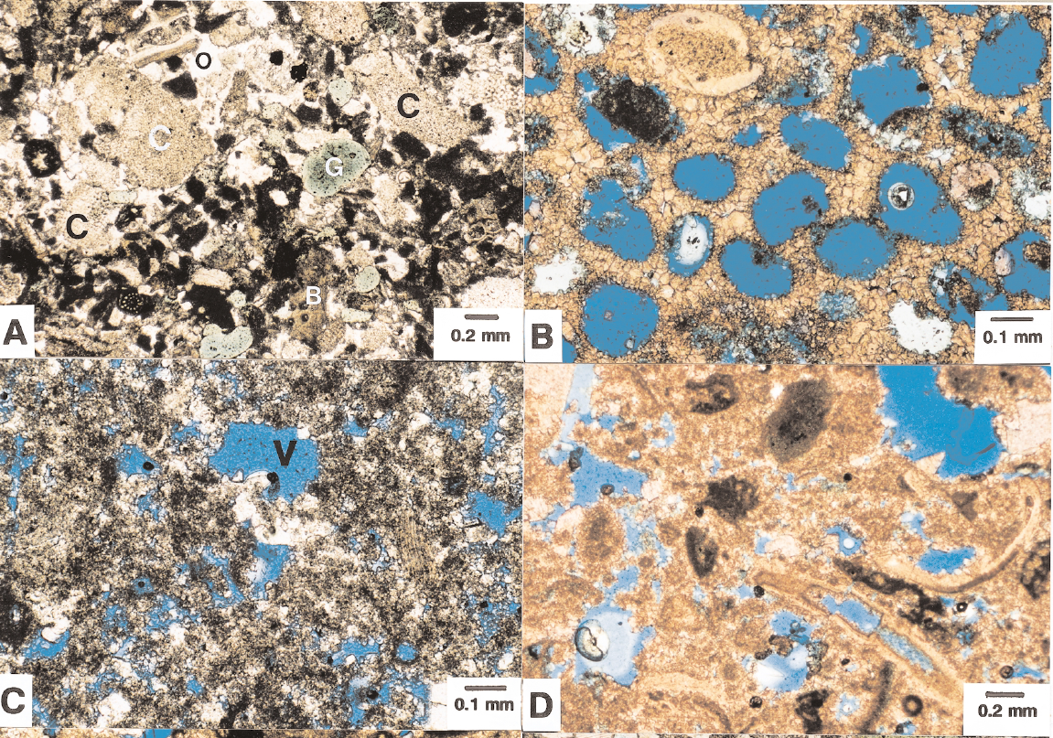
Canyon – Cisco facies
Photomicrographs of
highly porous limestones
of the Horseshoe Atoll
reef complex
(Saller et al., 1999)
Organic-rich Wolfcamp D (Canyon – Cisco)
black shales in core from the center of Midland Basin
(Ewing, 2016)
2 in.

Slide 35
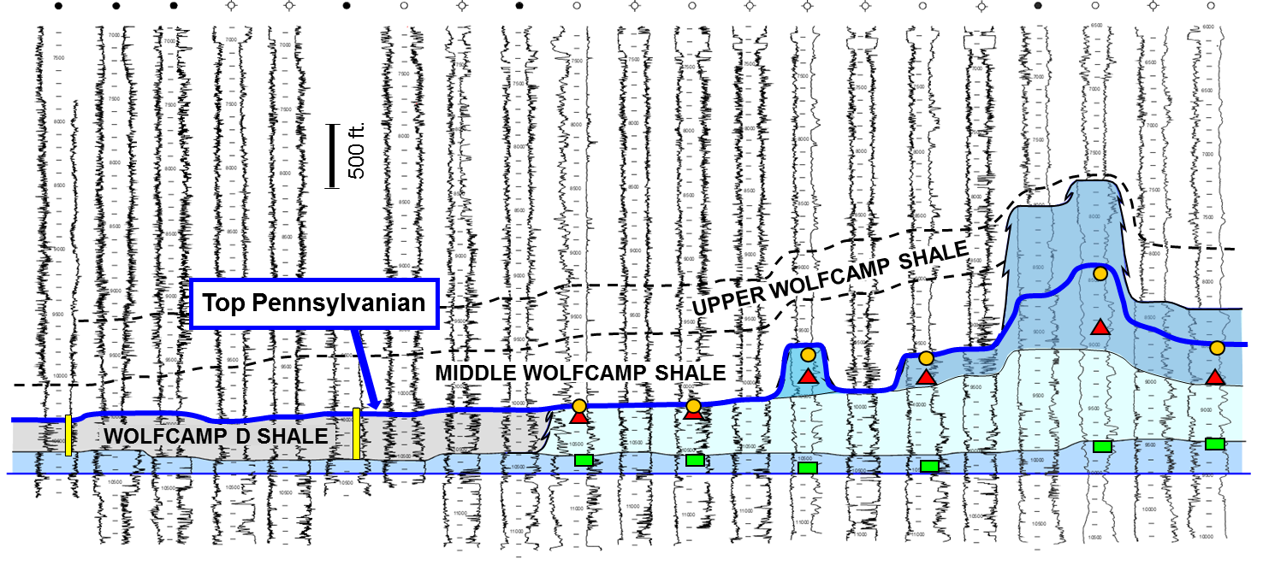
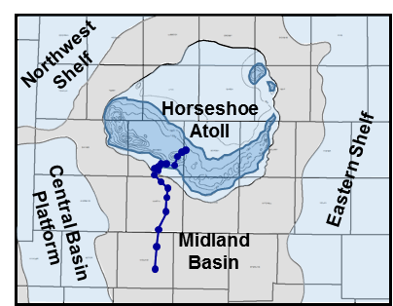
South
North
Log correlation first suggested that Wolfcamp D shale was actually Pennsylvanian in age (i.e., “Penn black shale” of days of yore)
This has since been verified with conodont data from basinal shales
Wolfcamp D represent basinal cyclothem, equivalent to classic cyclothems on shelves
Paleo control
(datum: base Lower Strawn Lime;
no horiz. scale)
Cisco fusulinids
Canyon fusulinids
Lower Strawn fusulinids
cored interval
Figure 2. Wire-line log correlation demonstrating Late Pennsylvanian age of the Wolfcamp D shale (gray, left side) as
projected from fusulinid-bearing platform and reef facies of the Horseshoe Atoll (light and darker blue, right side).
Location of section shown on inset map. (from Waite et al., unpublished, 2015)

Slide 36
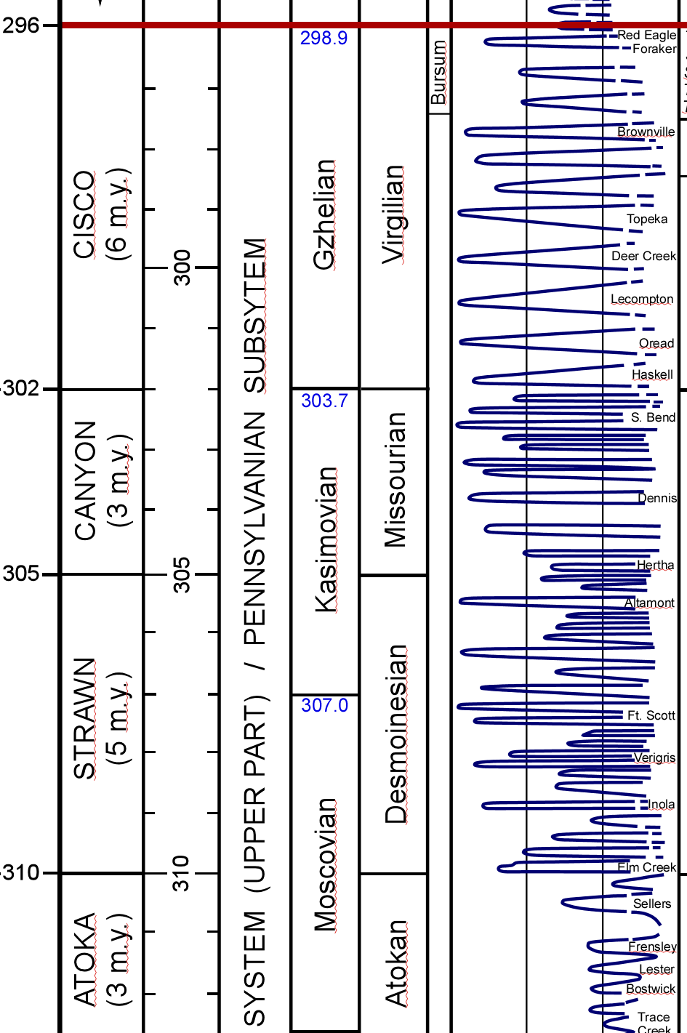
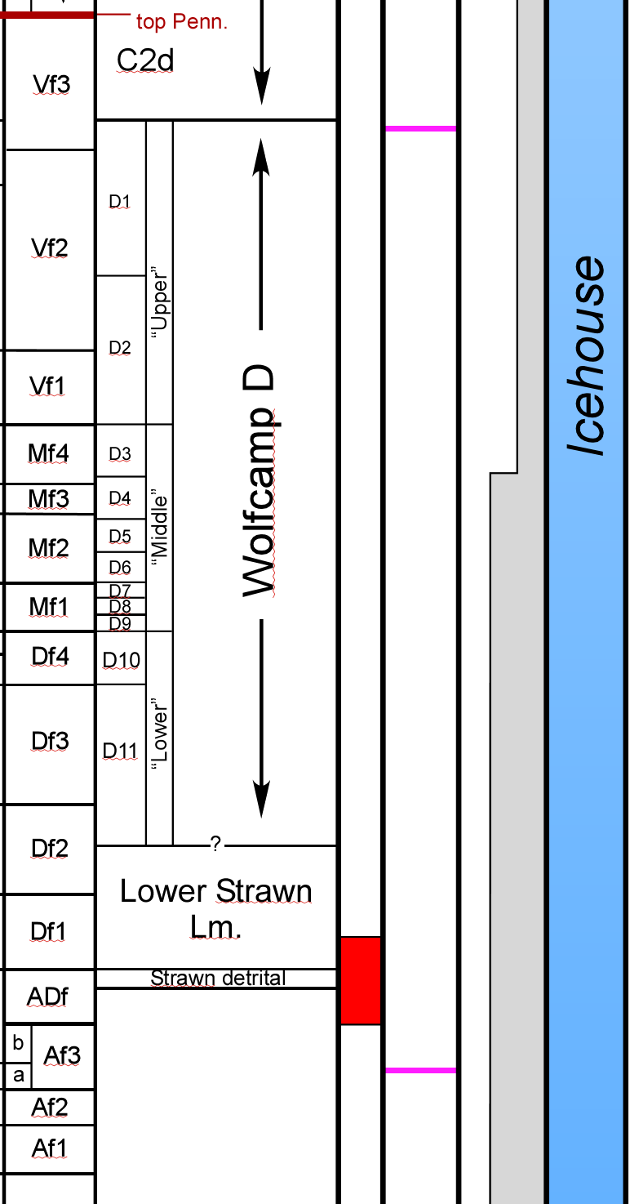
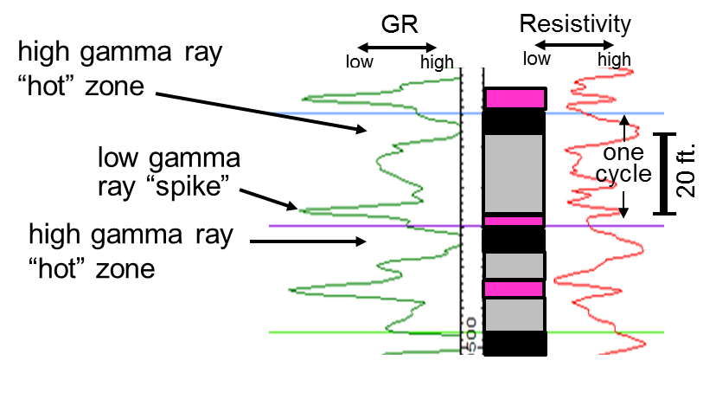
Wolfcamp D: Basinal cyclothems
Silica – rich shales; relatively high clay content
Each consists of a clay-rich gray shale and an organic-rich black shale capped by a thin LS/dolomite
R
Each basinal cyclothem = 15 – 45 ft. thick
1
Major horizontal drilling target
Deep (pressured, but gassier in basin depocenters)
T
OM partitioned into thin layers; clay-rich
These gamma-ray spikes are excellent markers and can be correlated across the entire Midland and Delaware basins
0
GR
150
0.2
Res.
2000
10400
Wolfcamp D
10500
non-porous, thin dolomite or LS
100 ft.
organic-rich, silica-rich shale
10600
L. Strawn
clay-rich, low TOC shale

Slide 37
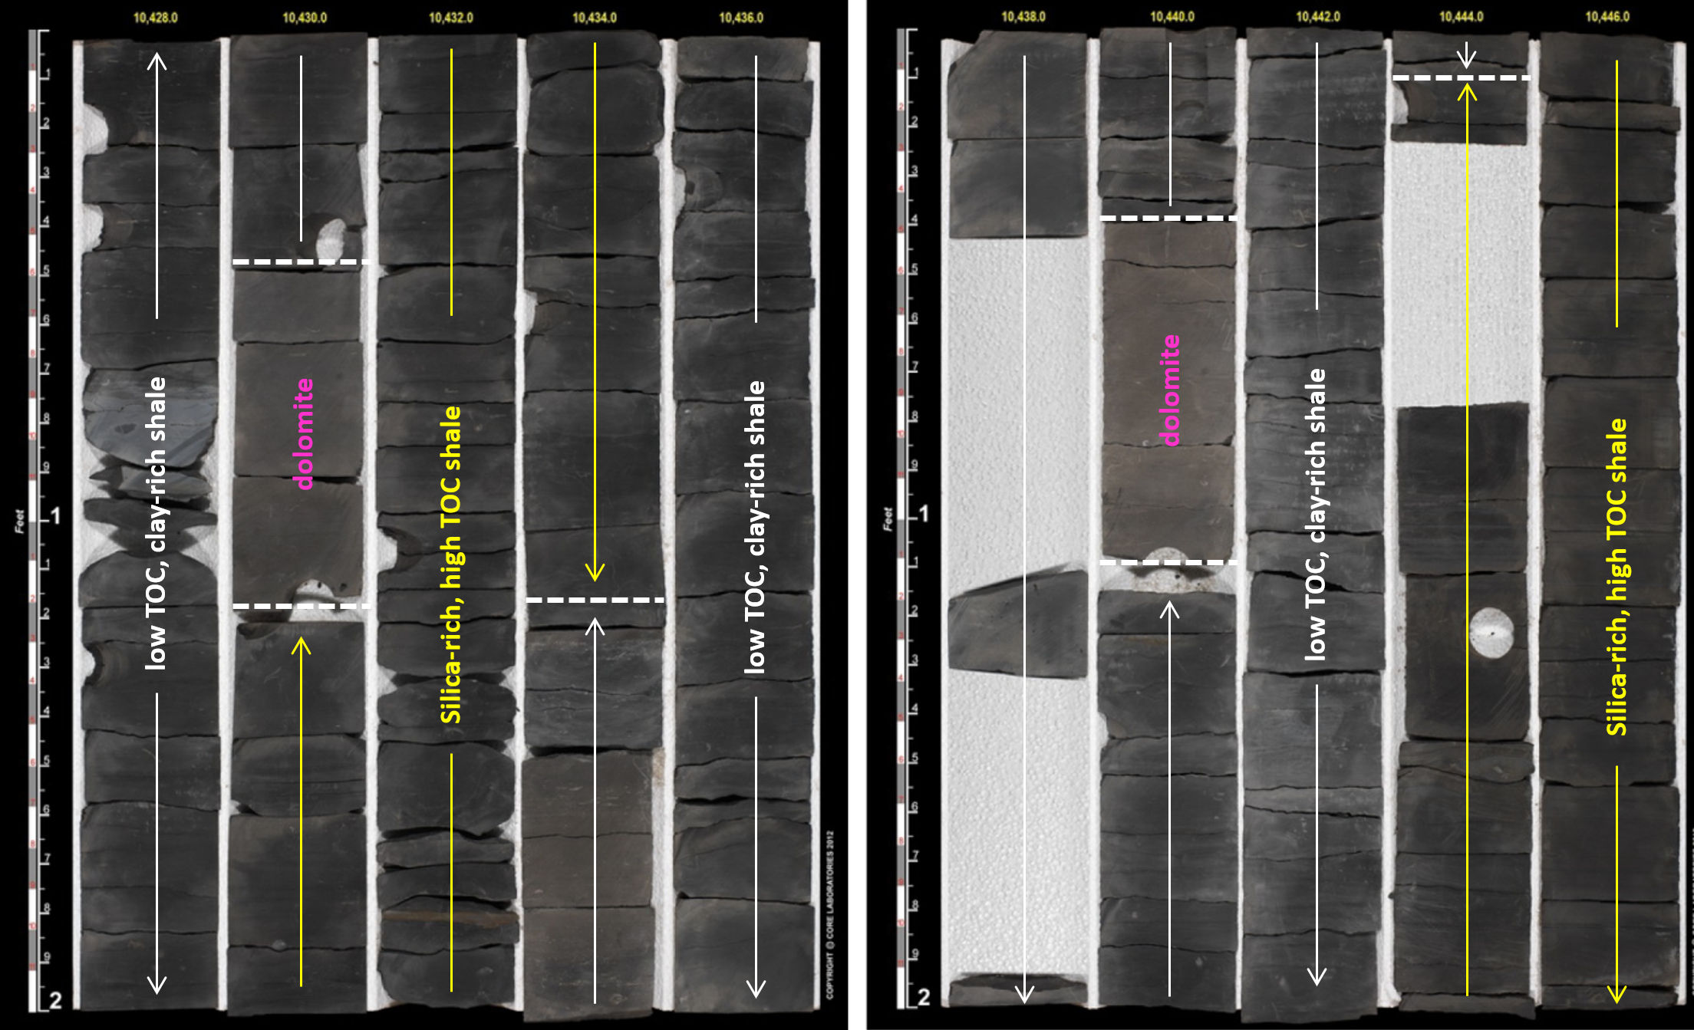
Wolfcamp D basinal cyclothems in the Midland Basin
Note color differences
Organic-rich: dark gray
Organic-poor: light gray
Dolomites: brownish
Some carbonates are debris flows; but most are cement hardgrounds
Mudrocks are silica-rich (largely biogenic silica)
Facies relationship to sea-level cycle remains to be fully understood

Slide 38
Pennsylvanian of the Permian Basin: Summary
Onset of active margin orogenic phase
Pennsylvanian to early Permian Active Margin/Orogenic Phase
Two initial orogenic pulses (Early Penn. -- Morrowan to mid Atokan and late Atokan )
First tectonic quiescence phase (Early Penn. – latest Atokan to early Desmoinesian)
Third orogenic pulse (Early Penn. – early Desmoinesian)
Second tectonic quiescence phase (mid Desmoinesian to early Permian)
Fourth orogenic pulse (early Permian – Wolfcampian)
4 tectonic pulses
2 periods of quiescence
Onset of global icehouse: glacioeustasy generates cyclothems
Alternating stratigraphic sequences of non-marine and marine strata
Lowstands = terrigenous clastics; highstands = carbonates
Carbonate shelves including reefs: phylloid algae; fusulinid forams for biostratigraphy
Pennsylvanian units of the Permian Basin
Morrow
Atoka
Strawn
Canyon
Cisco
Wolfcamp D shale (in basins)
Penn sea-level cycle includes lowermost Wolfcamp of early Permian age
Wolfcamp D: organic matter partitioned into multiple thin cycles

Slide 39
Geology of the Permian Basin: ELS (Endeavor Lecture Series)
Horseshoe Atoll
Tectonic history – Part 1 (Big Picture)
Tectonic history – Part 2 (Regional elements: ARM, CBU, MFB)
Basement
Cambrian – Lower Ord (Wilberns/Bliss Ss., Ellenburger Gp)
Tobosa Basin stratigraphy (Mid Ord. – Mississippian)
Pennsylvanian (Morrow-Atoka-Strawn-Canyon-Cisco)
Lower Permian (Wolfcamp – Spraberry)
NEXT SESSION
Middle and Upper Permian / Permian Basin petroleum system

