Slide 1
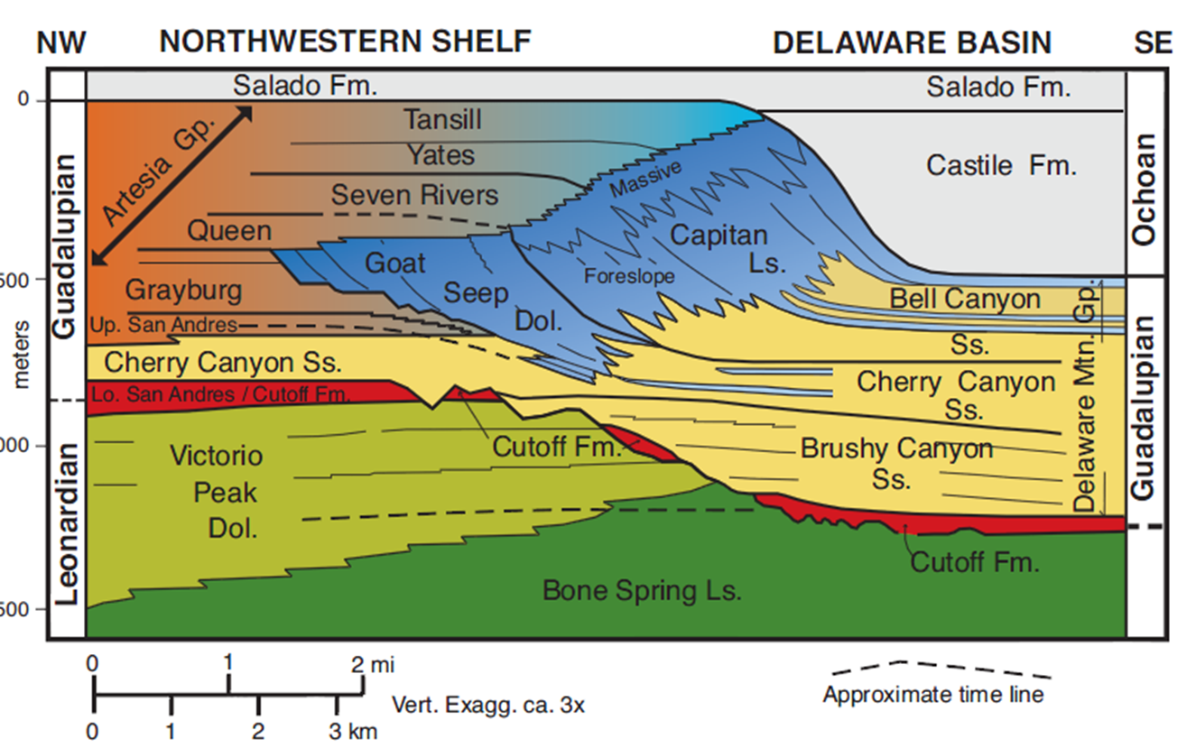
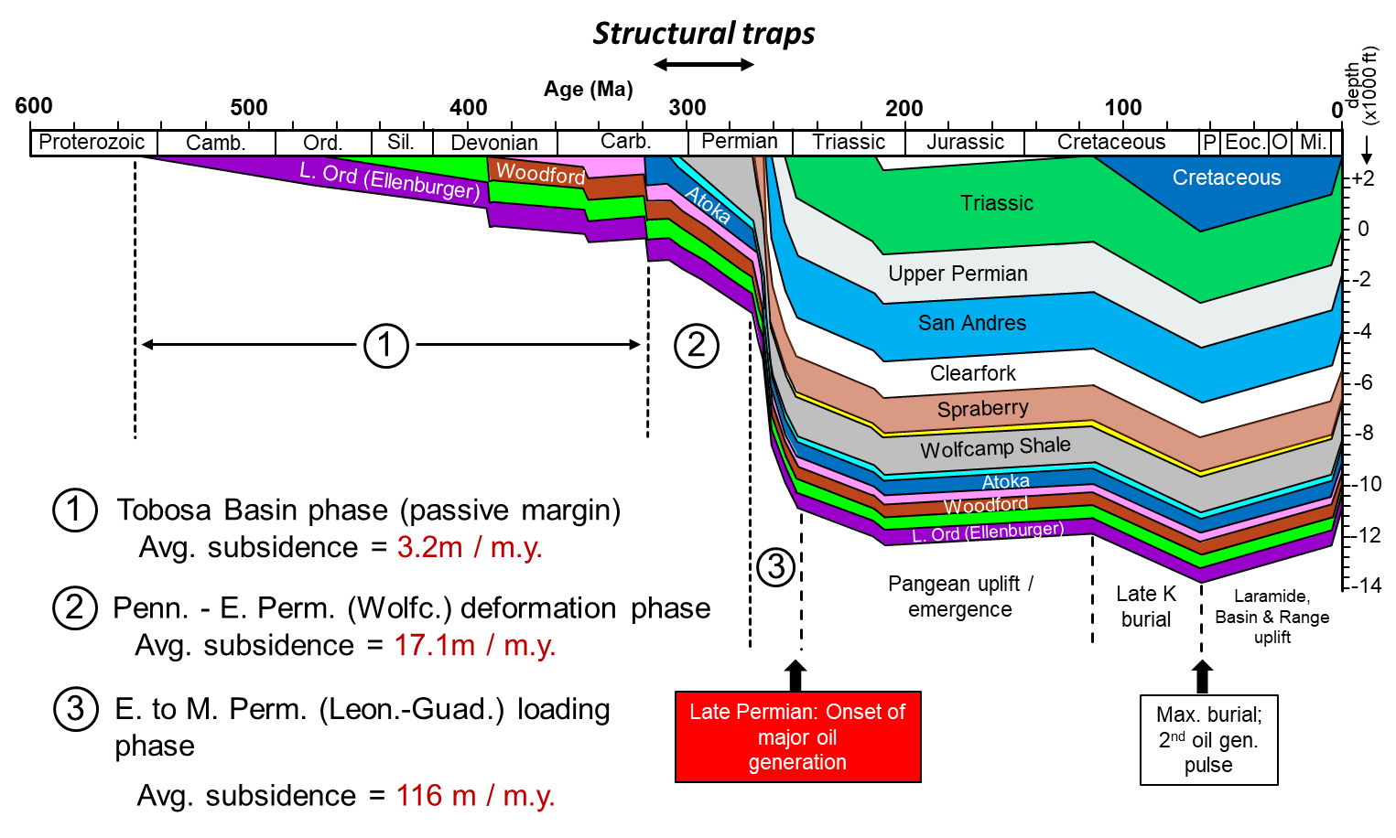
Geology of the Permian Basin
Middle & Upper Permian
Post-Permian
Permian Basin
Petroleum System
Lowell Waite
UT Dallas Geoscience
Permian Basin Research Lab
1/24/2022

Slide 2
Geology of the Permian Basin: ELS (Endeavor Lecture Series)
Horseshoe Atoll
Tectonic history – Part 1 (Big Picture)
Tectonic history – Part 2 (Regional elements: ARM, CBU, MFB)
Basement
Cambrian – Lower Ord (Wilberns/Bliss Ss., Ellenburger Gp)
Tobosa Basin stratigraphy (Mid Ord. – Mississippian)
Pennsylvanian (Morrow-Atoka-Strawn-Canyon-Cisco)
Lower Permian (Wolfcamp – Spraberry)
Middle and Upper Permian / Permian Basin petroleum system

Slide 3
AGE
(Ma)
SERIES
GLOBAL
STAGE
N. AMER.
STAGE
Magnetic
Permian Chronostratigraphy
250
polarity
252
251.90
units
254
Changhsingian
Lopin-
gian
254.14
Duration: 47 m.y. (298.9 – 251.9 Ma)
256
Wuchiapingian
Ochoan
258
259.1
Three Global Series
260
Permo-Triassic
Mixed Superchron
262
Capitan-
ian
lower Permian = Cisuralian
264
Guad-
alup-
ian
middle Permian = Guadalupian
Guadalupian
265.1
266
Wordian
upper Permian = Lopingian
268
268.8
270
Roadian
9 Global Stages; 4 North American Stages
272
272.95
274
GSSPs currently undefined for three lower Permian global stage bases (Kungurian, Artinskian, Sakmarian)
276
278
Kungurian
Leonard-
ian
280
282
Klaman Reversed Superchron
Lower Permian reversed magnetic superchron; middle – late Permian mixed superchron
284
283.5
Cisuralian
286
Artinskian
288
290
290.1
Wolf-
camp-
ian
292
Sakmarian
293.52
Global Boundary Stratotype Section and Point (GSSP)
294
296
Asselian
298
298.9
300
CARBONIFEROUS
(Chen and Xu, 2019)

Slide 4
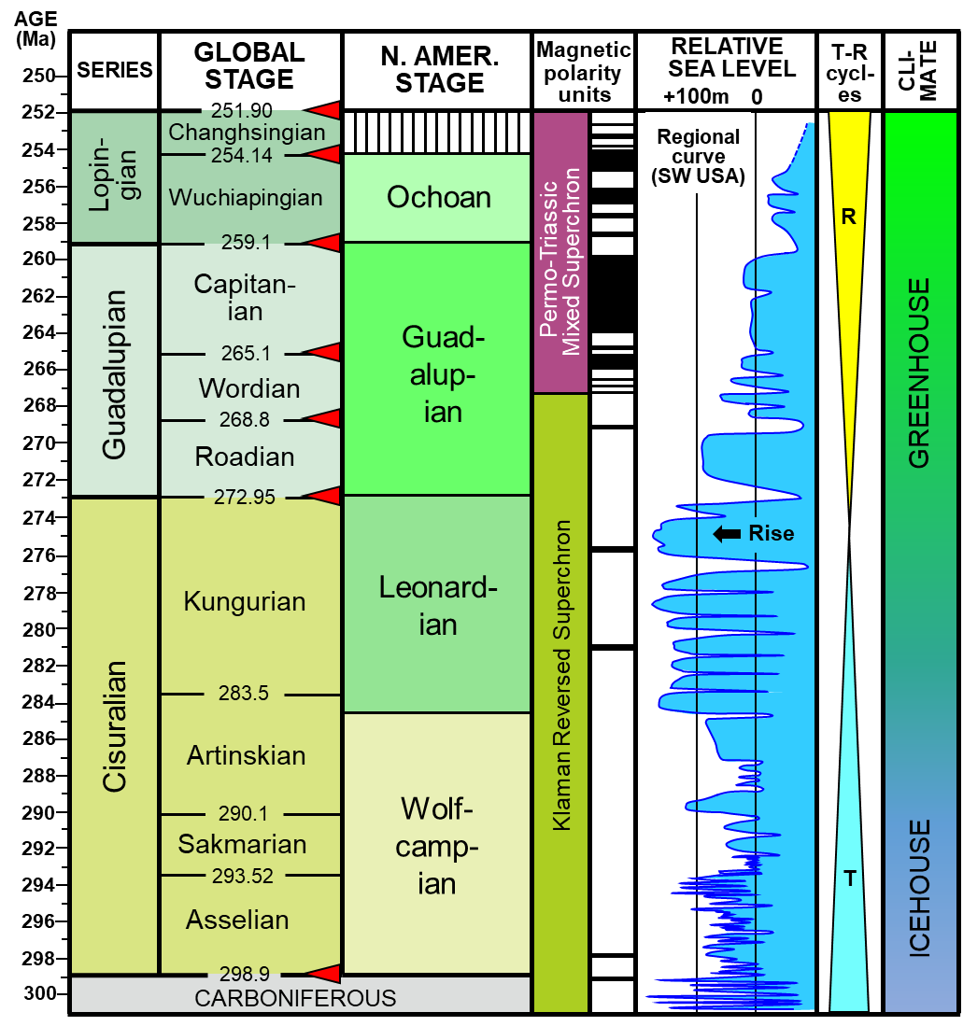
Select Permian Global Secular Trends
MASS
EXTINCTIONS
SEA TEMP (ºC)
VOLCANISM
CARBON
BIO-
DIVERSITY
15
25
35
ISOTOPES
del ¹³C
sudden drop
Siberian
0
2
4
end
Permian
Traps
arc magmatism
South China
increase
Emeishan
LIP
Kamura
event
Silicic Choiyoi igneous province
end
Guada-
lupian
fluc-
ua-
ting
O₂ levels:
115% of
modern
Tarim III
CO₂:
900 ppm
Qiangtang
basalt
Panjal Traps
moderate
Tarim II
decline
Permian
Glacial
Intervals
rapid
1.
Siberia
increase
2.
W. Australia
1
3.
Antarctica
2
3
4
Tarim I
(Waite et al., 2020; data from Chen and Xu, 2019; Chen et al., 2013, Ross and Ross, 2009 )
4.
E. Australia

Slide 5
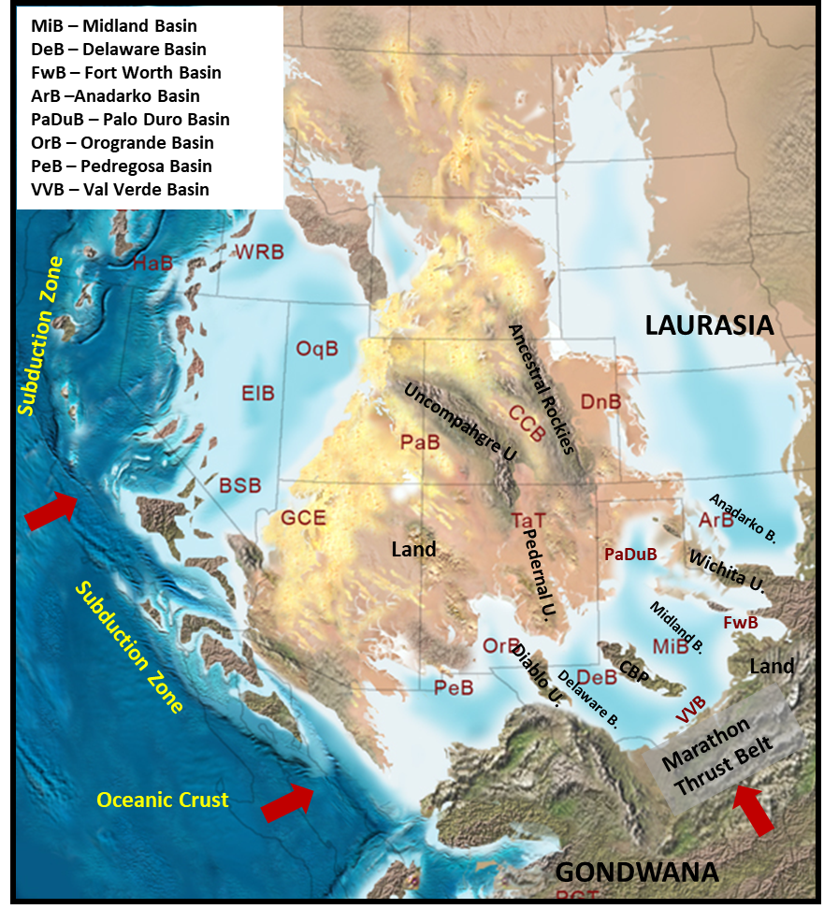
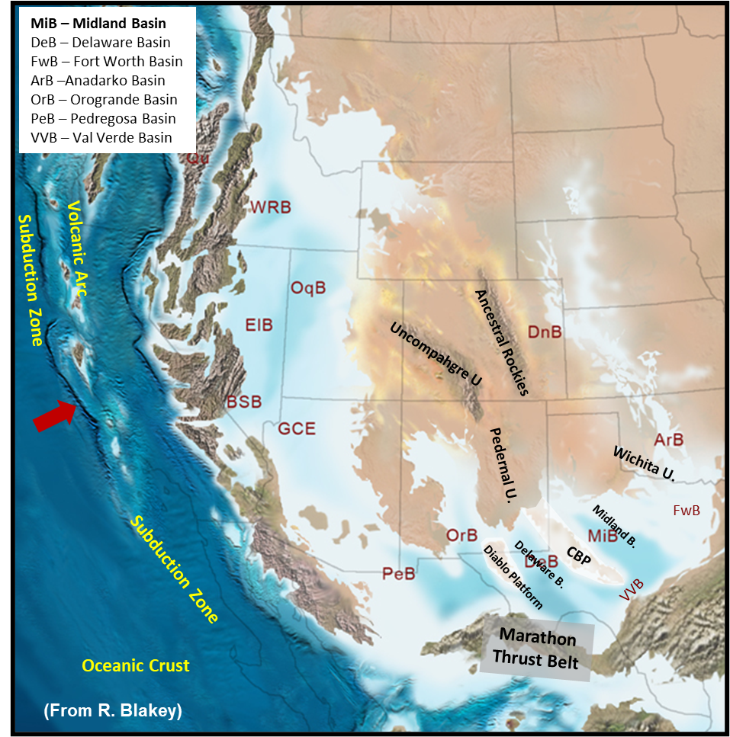
Early Permian Paleogeography
Middle Permian Paleogeography
Long-term lowering of eustatic sea-level and draining of Pennsylvanian - Permian seaway
(From R. Blakey)
Hot greenhouse climate: increasing aridity (increasing deposition of marine evaporites in Permian Basin

Slide 6
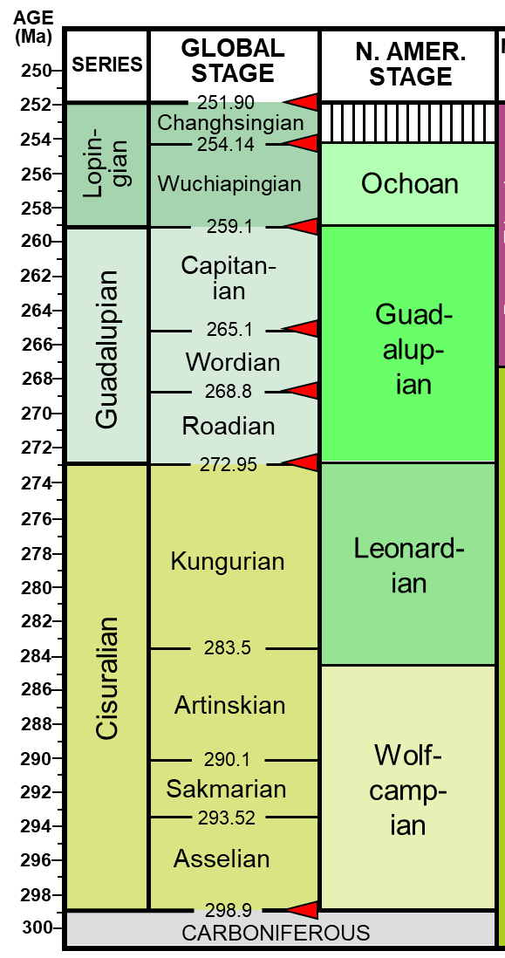
Middle Permian:
Guadalupian

Slide 7
Permian Basin Stratigraphy and Tectonic History
Ma
System
Series
Delaware Basin
CBP & NW Shelf
Midland Basin
Tectonic Phase
252
Formations
Formations
Formations
final basin fill/termination
Dewey Lake
Dewey Lake
Dewey Lake
Ochoan
Rustler
Rustler
Rustler
Salado
Salado
Salado
Castile
Lamar
Tansill
Tansill
Post Orogenic Loading Rapid Subsidence;
Onset of HC Generation
Bell Canyon
Capitan
Yates
Yates
Guadalupian
Delaware Mtn
Group
Seven Rivers
Seven Rivers
Permian
Cherry Canyon
Goat
Seep
Queen
Queen
Grayburg
Grayburg
Brushy Canyon
Upper San Andres
San Andres
Cutoff Member /
1st Carb / Avalon
Lower San Andres
Clear-
fork
Holt /Upper Leonard
( ~ 50 million yrs. duration )
Active Margin
Lwr San Andres
Holt / Upr Leonard
PERMIAN BASIN PHASE
Bone
Spring
1st Sand
Glorieta
Upper
Leonardian
2nd Carb
Upper Clearfork
Spraberry
Middle
2nd Sand
Yeso /
Clearfork
Middle Clearfork
Lwr
Jo Mill
3rd Carb
Stray Sd
Dean
L. SPBY Sh
3rd Sand
Tubb
Lower Clearfork
Wolfcamp A
Wolfcamp
Wolfcamp
Wichita / Abo
Wolfcamp
Wolfcamp B
mid – Wolfcamp unconformity
299
Wolfcampian
Wolfcamp C1
Virgilian
Cisco
Cisco
Cisco
Wolfcamp C2
Early WFMP Event
Missourian
Canyon
Canyon
Canyon
Wolfcamp D
Penn. – Early Permian
Foreland Deformation
Pennsylvanian
Desmoinesian
Strawn
Lime
Strawn
Lime
Strawn
Lime
Detrital
Detrital
Detrital
Strawn Event
Bend Lm
(~ 30 million yrs.
duration)
Atokan
Atoka
Atoka
Atoka
Sh & Detrital
Atokan Event
323
Morrowan
Morrow
Morrow (NW Shelf Only)
Morrow
Morrow Event
Chesterian
Barnett
U. Miss Lm
L. Barnett
U. Barnett
U. Miss Lm
L. Barnett
U. Barnett
Mississippian
Meramecian –
Osagean
L. Miss Lm
L. Miss Lm
L. Miss Lm
359
Kinderhookian
Woodford
Woodford
Woodford
Tobosa Basin
(Middle Ordovician to
Late Mississippian)
Moderate Subsidence
Devonian
Upper
Middle
TOBOSA BASIN PHASE
419
Lower
Devonian (Thirtyone)
Devonian (Thirtyone)
Devonian (Thirtyone)
Silurian
U. Niagaran
Upper Silurian (Wristen)
Upper Silurian (Wristen)
Upper Silurian (Wristen)
L. Niagaran
Fusselman
Fusselman
Fusselman
(~ 150 million yrs. duration)
Passive Margin
444
Alexandrian
Montoya
Montoya
Sylvan Sh.
Cincinnatian
Montoya
Mohawkian
Tulip Crk.
Bromide
Tulip Crk.
Bromide
Tulip Crk.
Bromide
Simpson
Mclish
McKee Sd.
Simpson
Mclish
McKee Sd.
Simpson
Mclish
McKee Sd.
Ordovician
Chazyan
Oil Creek
Waddell Sd.
Oil Creek
Waddell Sd.
Oil Creek
Waddell Sd.
Joins
Connell Sd.
Joins
Connell Sd.
Joins
Connell Sd.
Canadian
Ellenburger
Ellenburger
Ellenburger
Great American Carbonate Bank
485
Ozarkian
(Late Cambrian – Early Ordovician)
Cambrian
Upper
Bliss
Absent
Wilberns
541
Bliss / Hickory / Riley
Precambrian
Basement
Precambrian
Basement
Precambrian
Basement
Basement assembly and breakup of
Rodina supercontinent
Precambrian
(Reed and Waite, 2016)
Grenville Orogeny (1.3 to 1.0 bya)

Slide 8
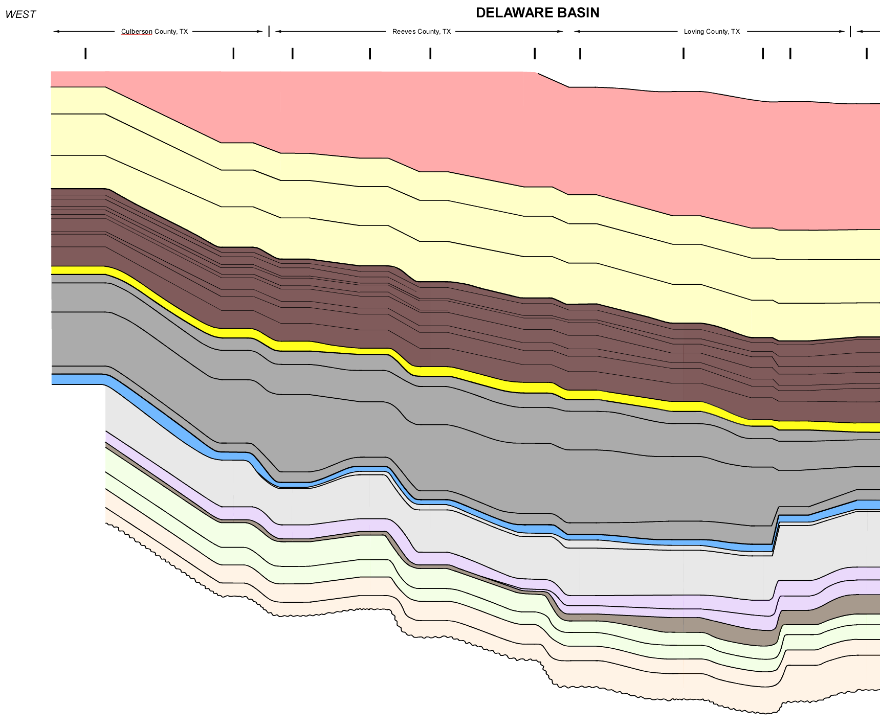
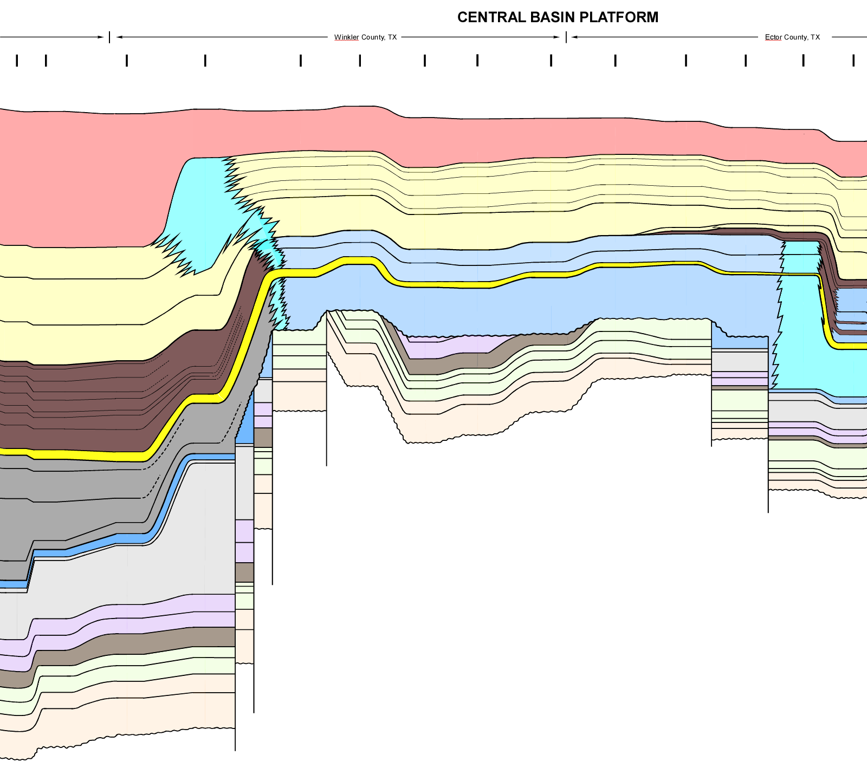
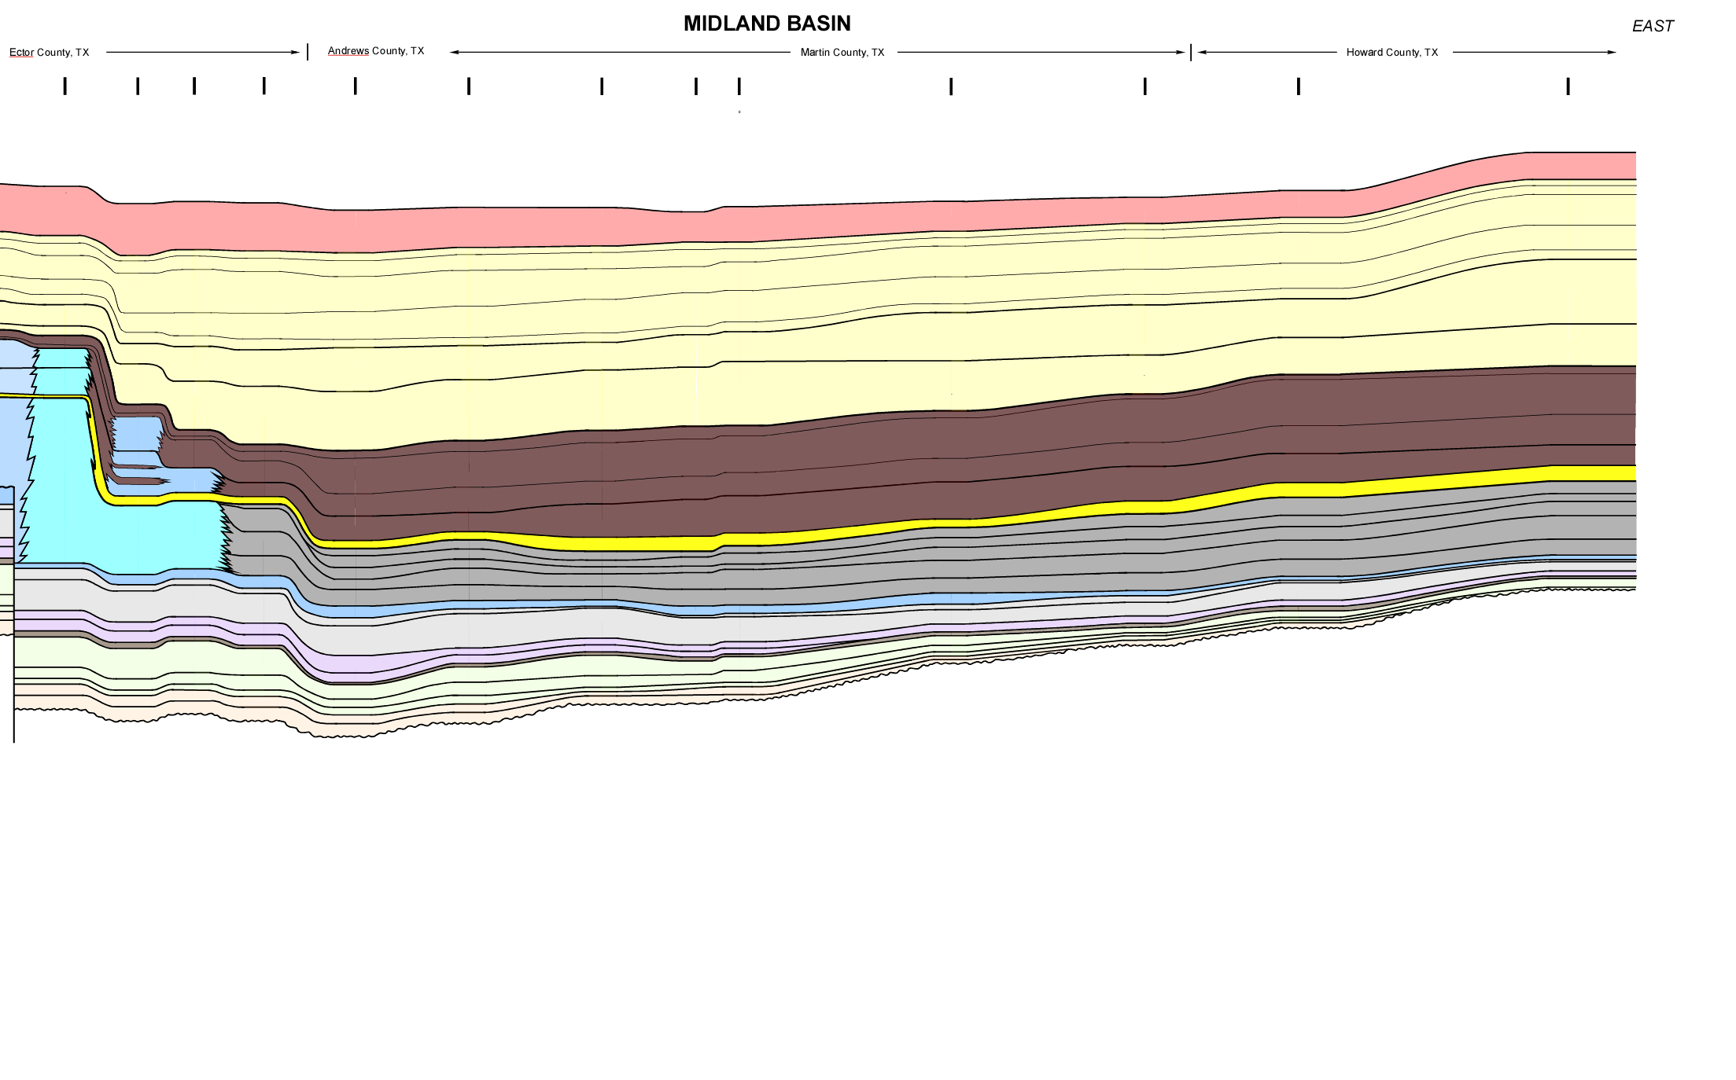
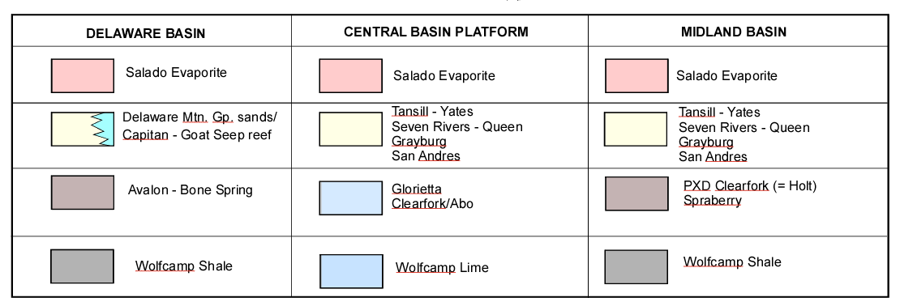
The middle Permian (Guadalupian)
Delaware Basin
Deep-water
basinal
sandstones
and shale
W. margin of Central Basin Platform
Massive sponge-algal barrier reef
Central Basin Platform and Midland Basin
Shallow-water, backreef carbonates (limestones, dolomite) and evaporites
West
East
DELAWARE BASIN
CENTRAL BASIN PLATFORM
MIDLAND BASIN
Culberson
Reeves
Loving
Winkler Co. TX
Ector Co. TX
Martin Co. TX
Howard Co. TX
Subsea
elev.
(feet)
Subsea
elev.
(feet)
+2000
Rustler - Salado
+2000
0
datum: sea level
Tansill-Yates
0
Permian
Capitan
Reef
Glorietta Ss
Seven Rivers-Queen-Grayburg
-2000
Delaware Mtn. Gp.
Upper Clearfork
San Andres
- 2000
Tubb Ss
U. Clearfork
-4000
Lower Clearfork
-4000
Avalon
Abo
Spraberry
Dean Ss
-6000
Bone Spring
Wolfcamp
-6000
-8000
3rd Bone Spring Ss
-8000
Penn.
-10000
Ellenburger
-10000
Ord-Miss
Wolfcamp
0
30 mi.
-12000
-12000
-14000
Strawn
-16000
Atoka
-18000
Ellenburger
L. Paleozoic
Wood-
ford
-20000

Slide 9
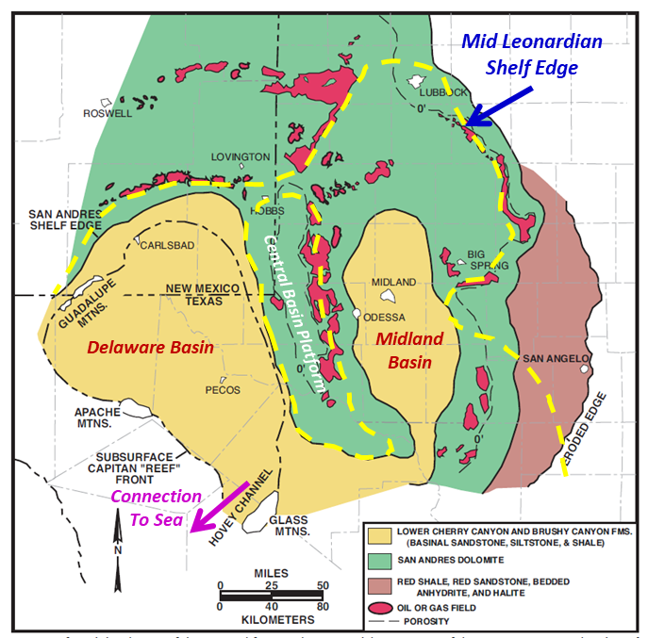
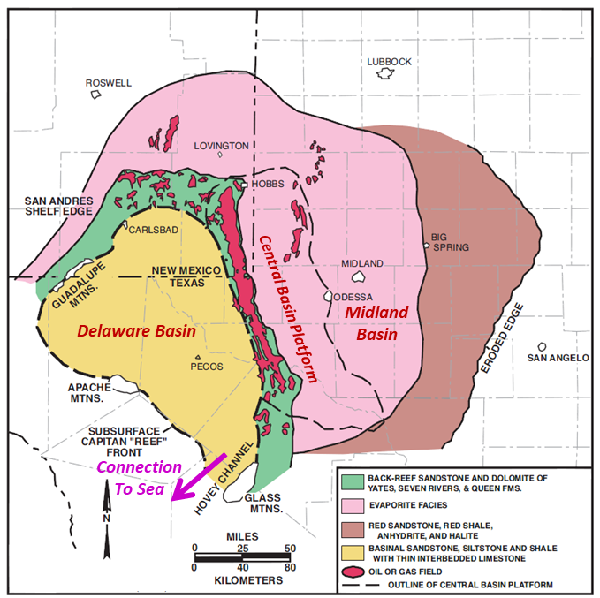
Guadalupian Depositional Facies in the Pemian Basin
Lower Guadalupian Depositional Facies
Upper Guadalupian Depositional Facies
(From Scholle, Goldstein, and Ulmer-Scholle, 2007)

Slide 10
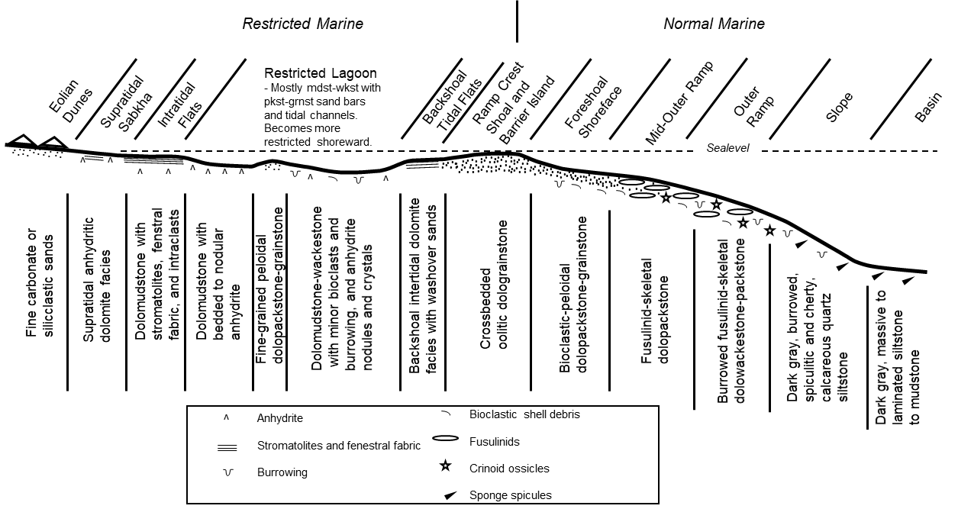
San Andres Depositional Model
(courtesy of Greg Wahlman)

Slide 11
Middle Permian dolomitic limestone facies of the San Andres Formation, Midland Basin, as seen in core
Cross-bedded ooid grainstones
Fusulinid packstones
Anhydrite nodules
Dolomitic siltstones (not shown)

Slide 12
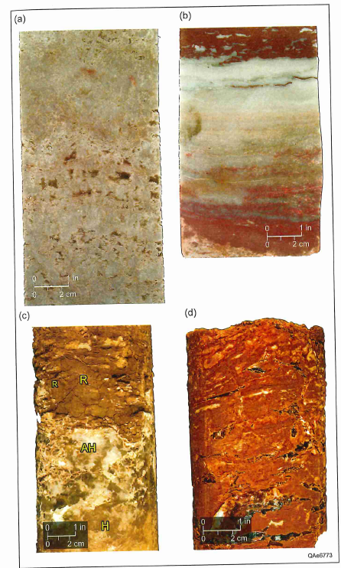
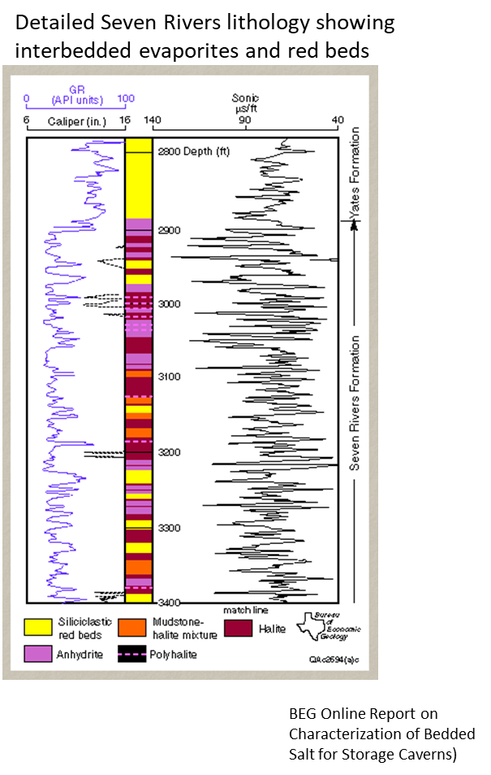
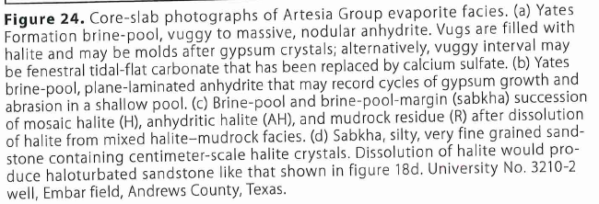
Middle Permian evaporites,
Artesia Group, Permian Basin
(Nance, 2020)

Slide 13
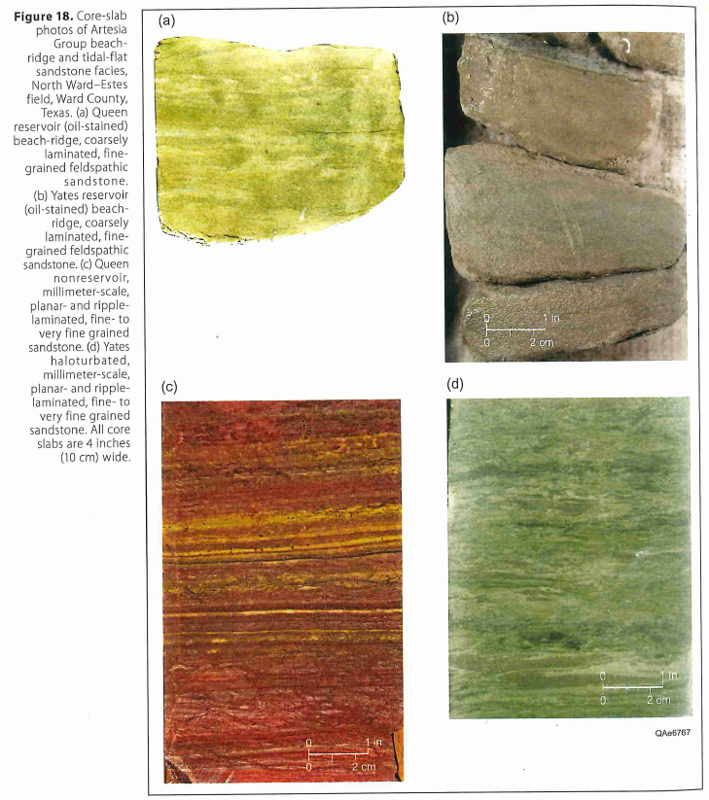
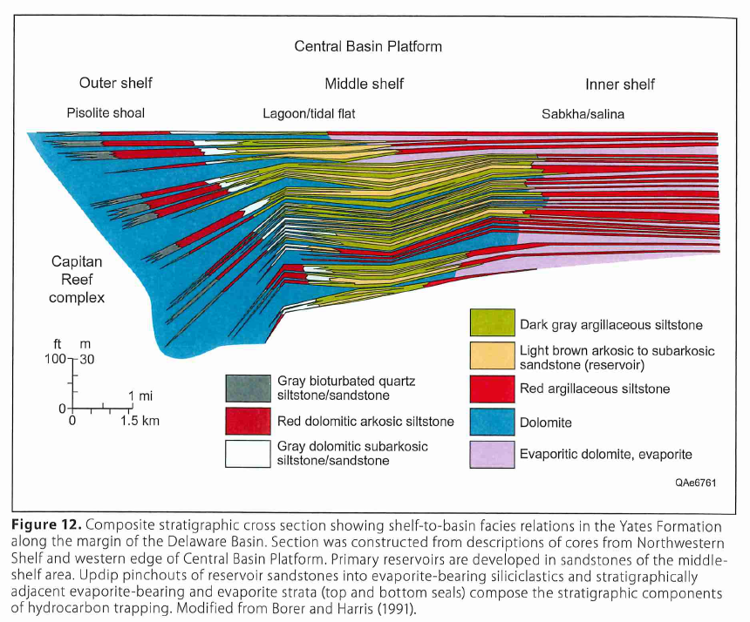
Middle Permian shallow-water platform
sandstones of the Permian Basin
(Nance, 2020)

Slide 14
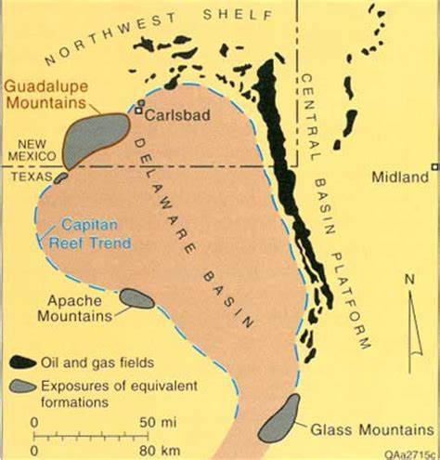
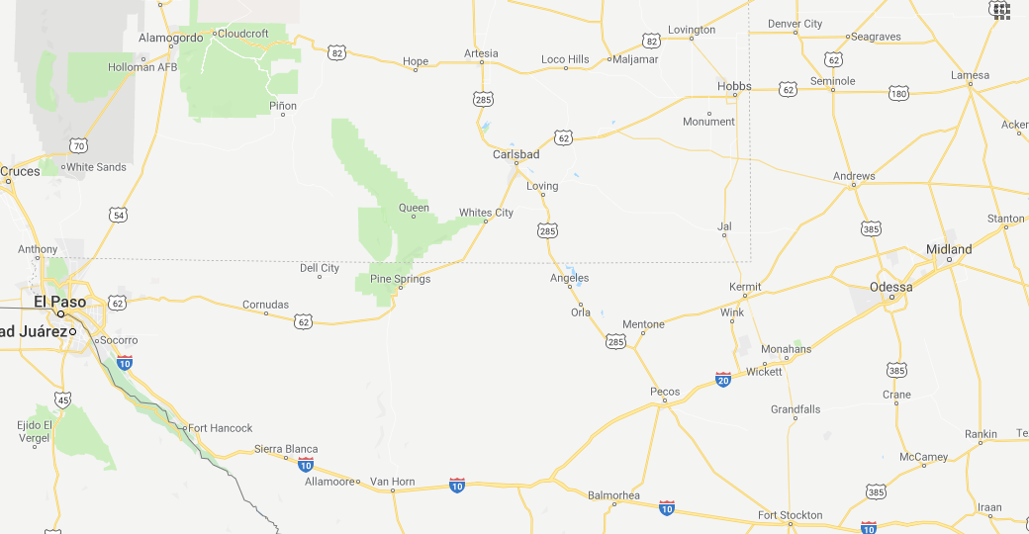
The world-famous Capitan reef, Guadalupe Mountains
Middle Permian (Guadalupian) reef trend of the Permian Basin:
Capitan Limestone
Guadalupe Peak
Capitan LS (reef)
El Capitan (forereef LS)
Artesia Gp. (back-reef LS)
Delaware Mtn. Gp. (basinal sandstones)
cross-section
(next slide)
Capitan
reef
Guadalupe Peak
elev. 8,751 ft
(2,667 m)

Slide 15
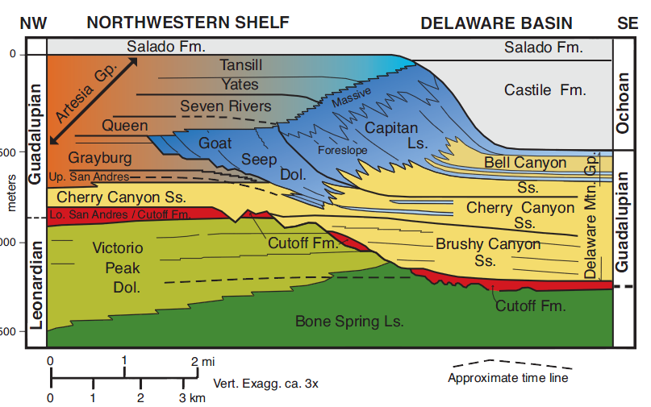
Depositional Units of Middle to Late Permian exposed in the
Guadalupe Mountains of west Texas and SE New Mexico
Shelf Evaporitic Lagoon, Tidal, and Sabkha Deposits
Basin Gravity Flow
Sands & Carbonates
Shelf Edge Reefs
Cherry Canyon
Tongue
(From Scholle and Ulmer-Scholle, 2007)

Slide 16
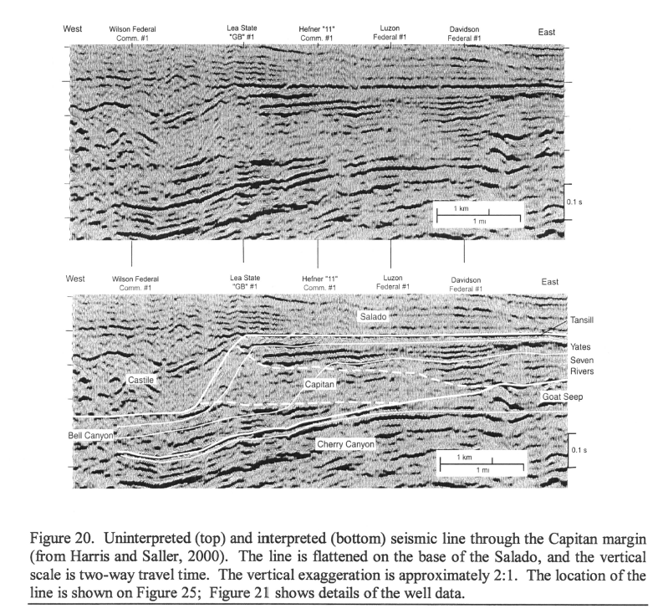
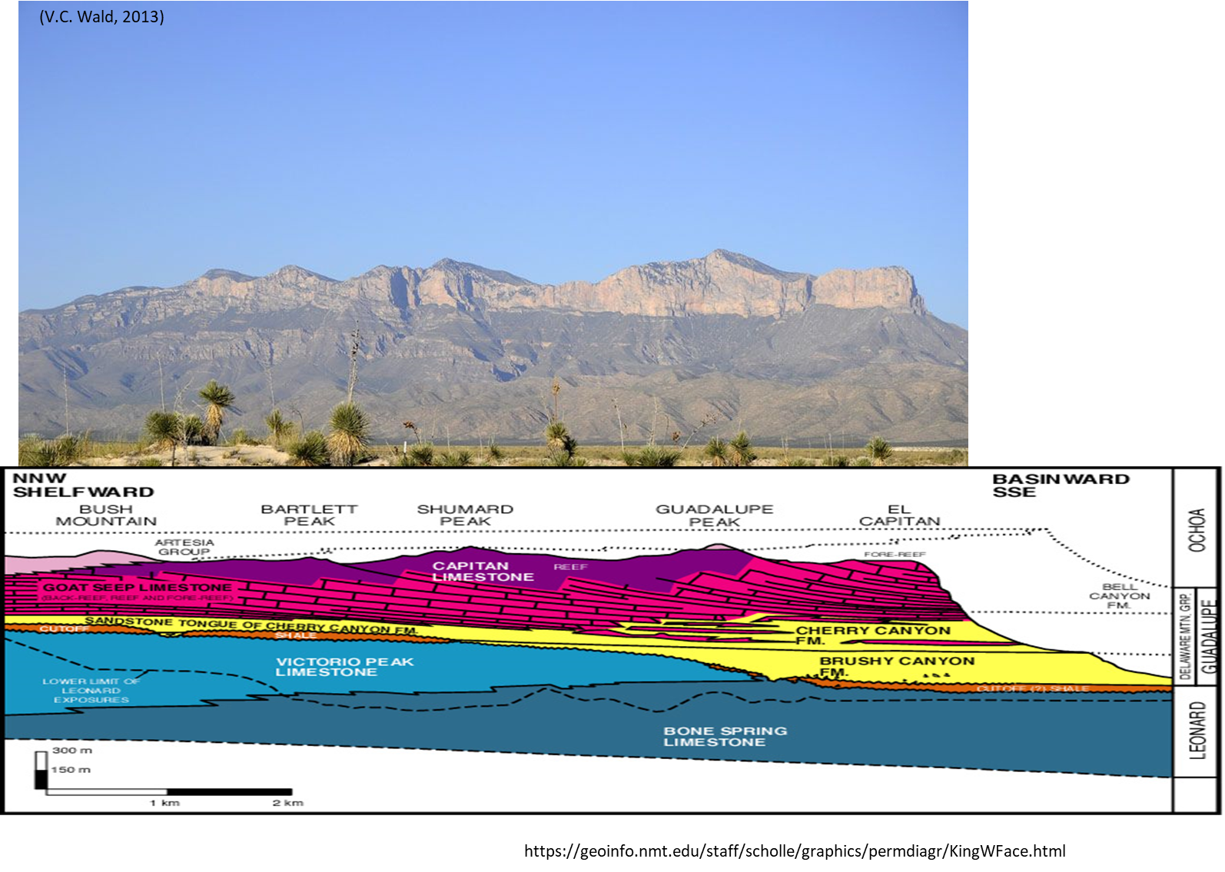
Capitan reef outcrop, Western Escarpment, Guadalupe Mtns.
Seismic expression of Capitan reef
(Harris, 2009)

Slide 17
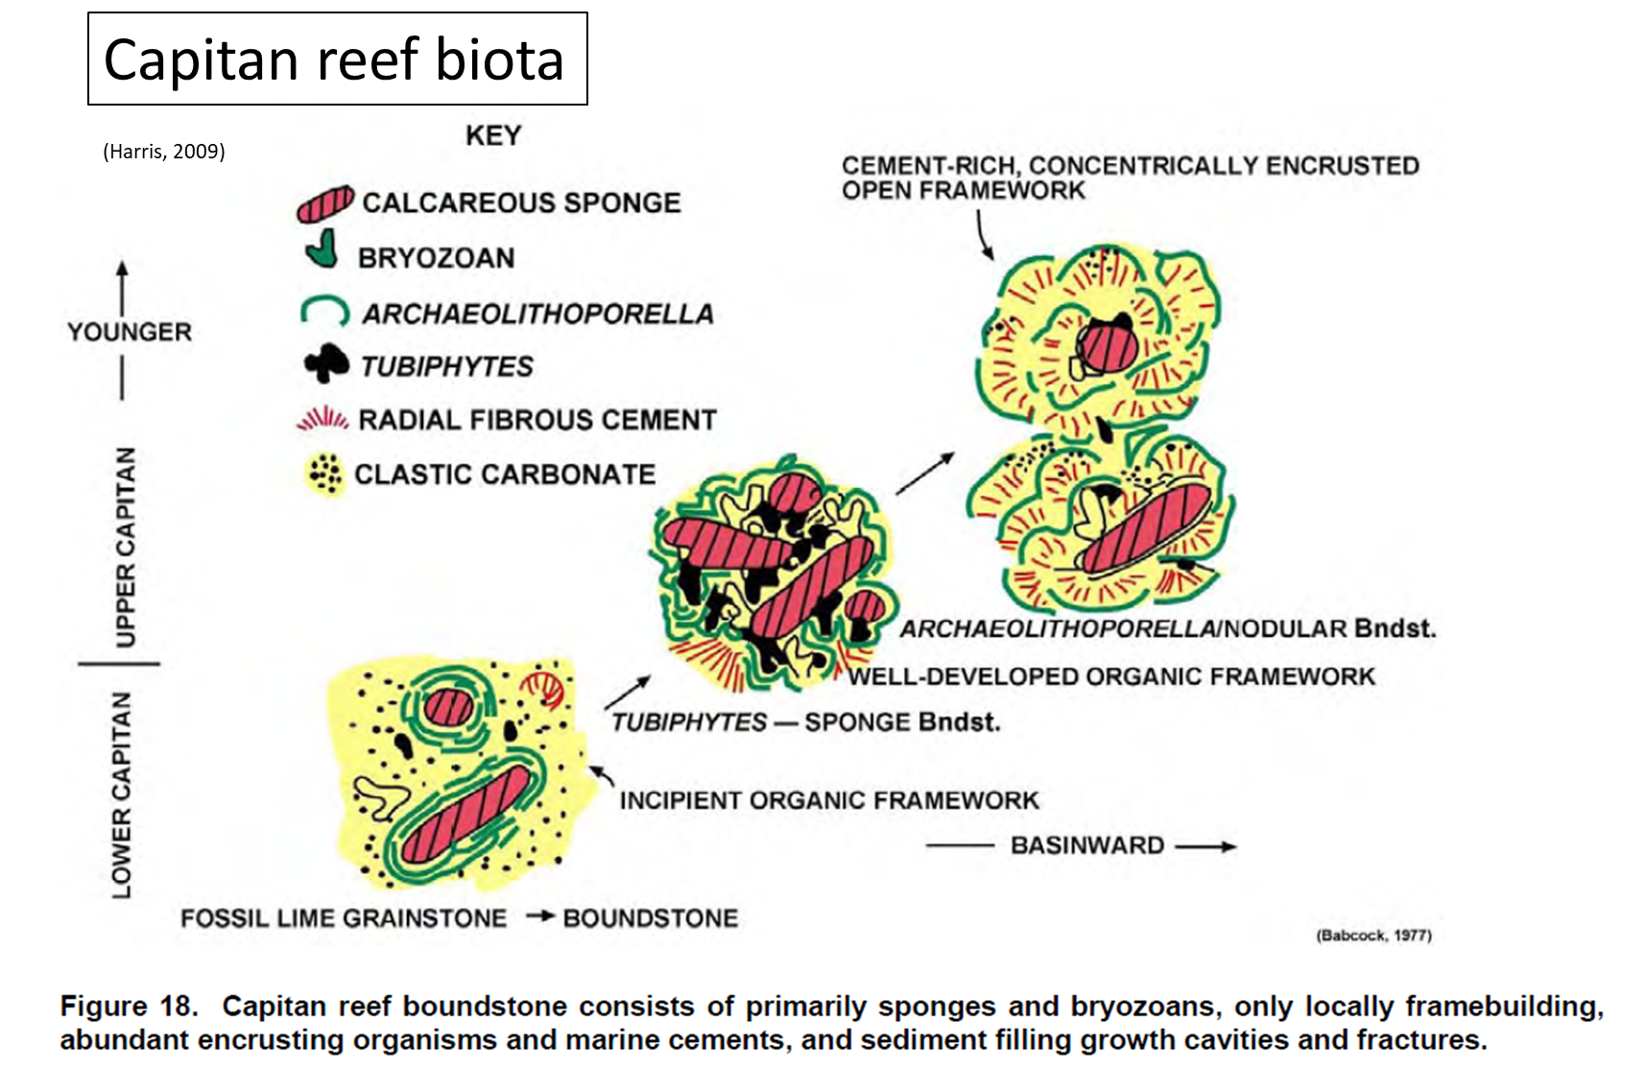
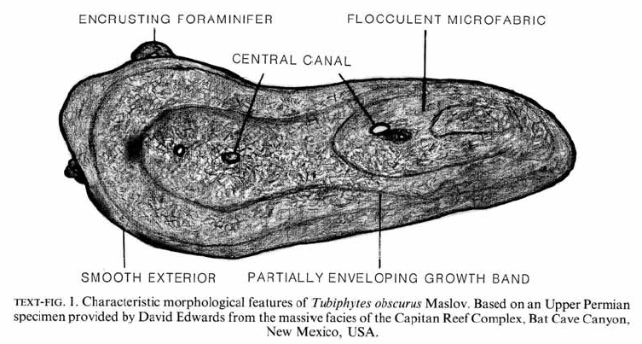
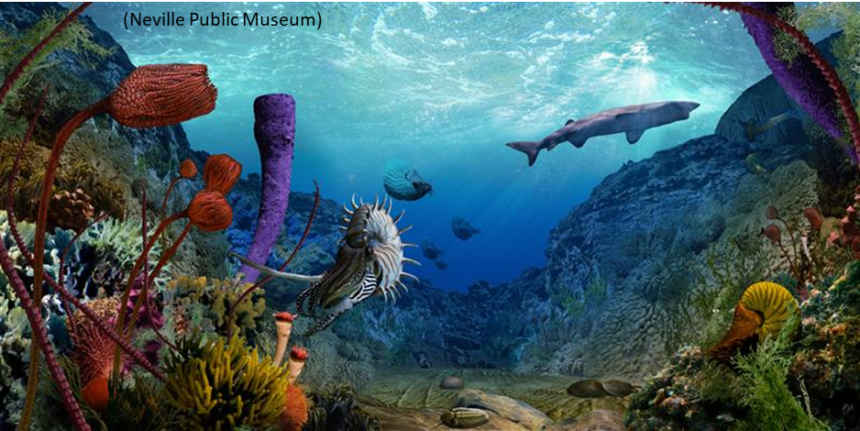
Tubiphytes: A problematical fossil (early Carboniferous – mid Cretaceous) common in middle – late Permian and Triassic reefs

Slide 18
Depositional Units of Middle to Late Permian exposed in the
Guadalupe Mountains of west Texas and SE New Mexico
Shelf Evaporitic Lagoon, Tidal, and Sabkha Deposits
Basin Gravity Flow
Sands & Carbonates
Shelf Edge Reefs
Cherry Canyon
Tongue
Basinal
deposits
(From Scholle and Ulmer-Scholle, 2007)

Slide 19
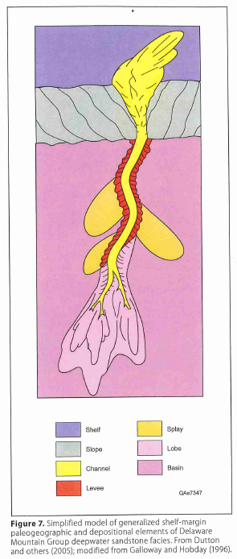
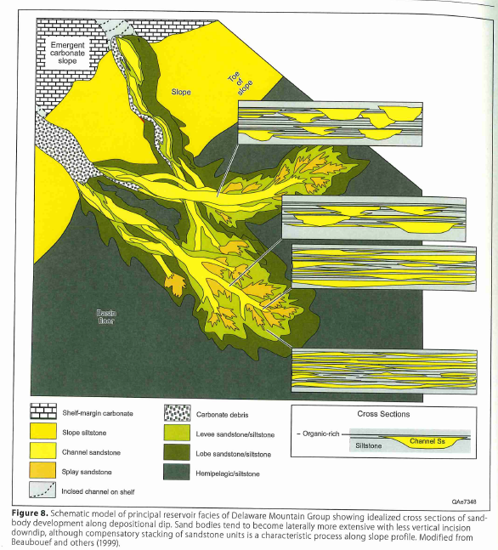
Delaware Mtn. Group
Highly channelized, deep-water submarine fan complexes
Sands were derived from the shelf and delivered via submarine canyons (gaps in the reef?)
(Nance, 2020)

Slide 20
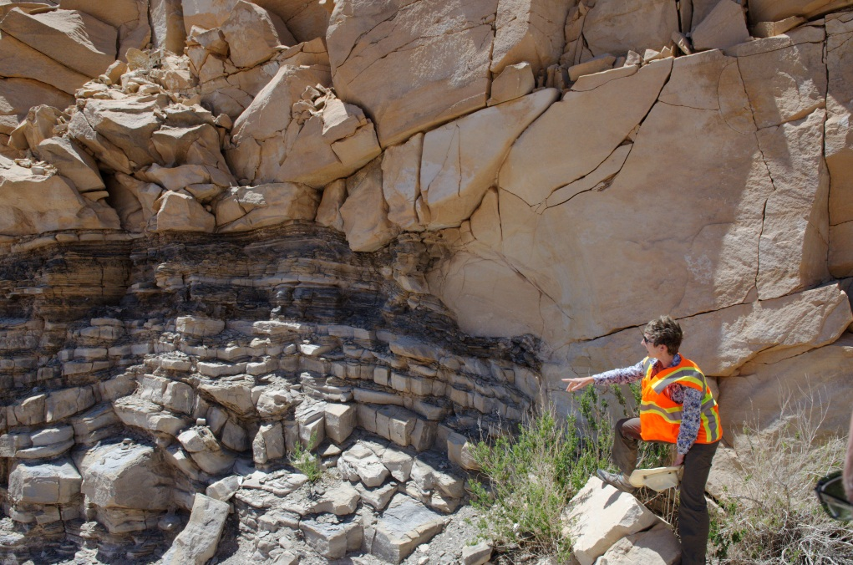
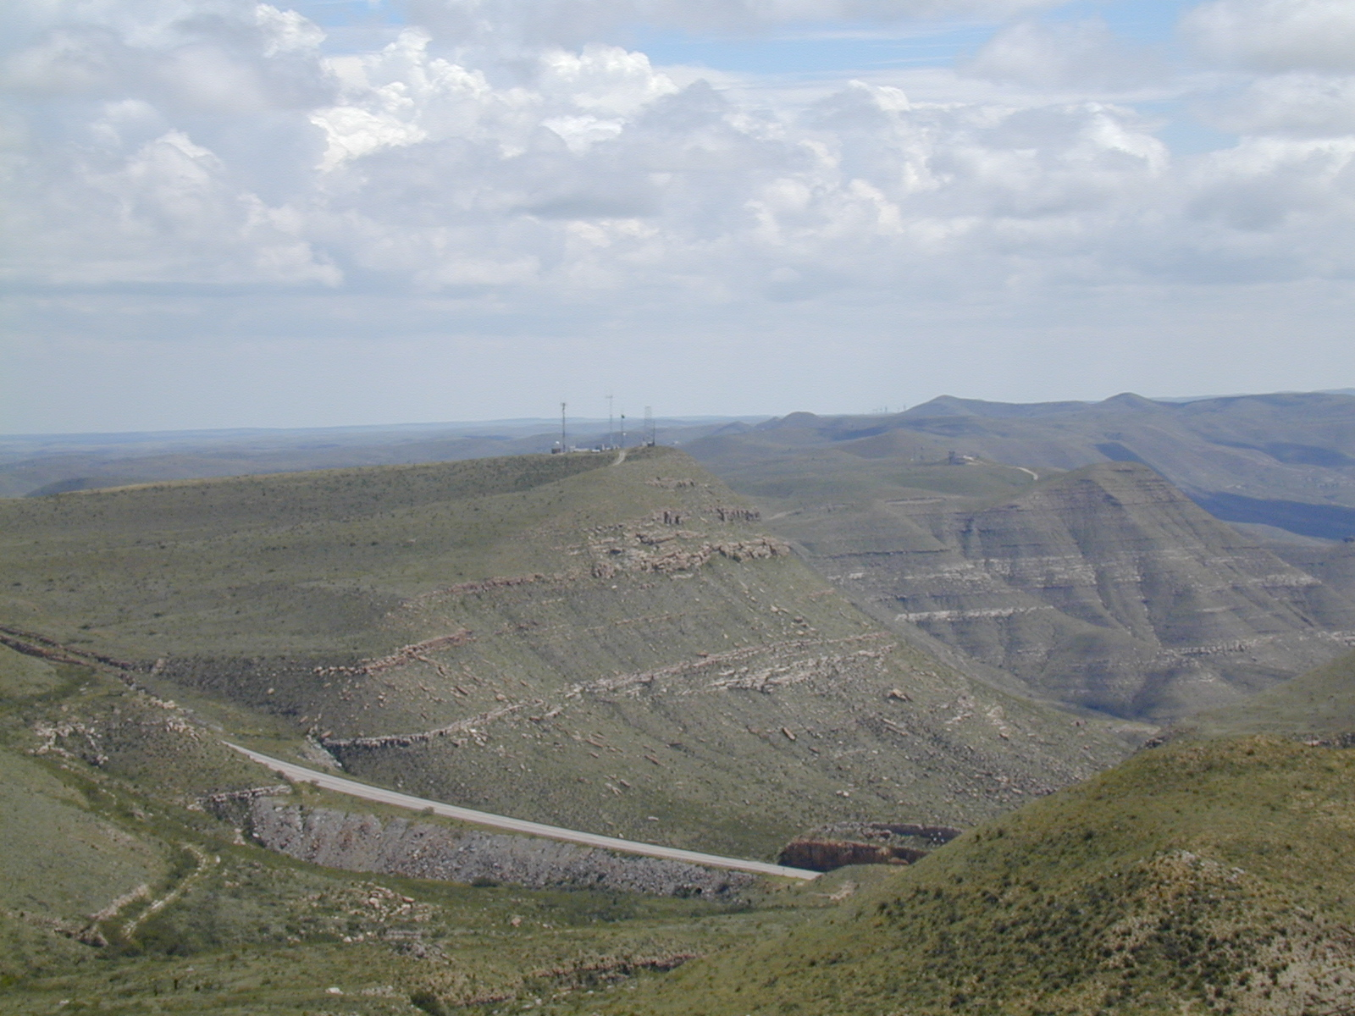
Deep-water channel sands in
Permian Brushy Canyon Fm,
Guadalupe Mountains, west Texas
Delaware Mountains
Channels

Slide 21
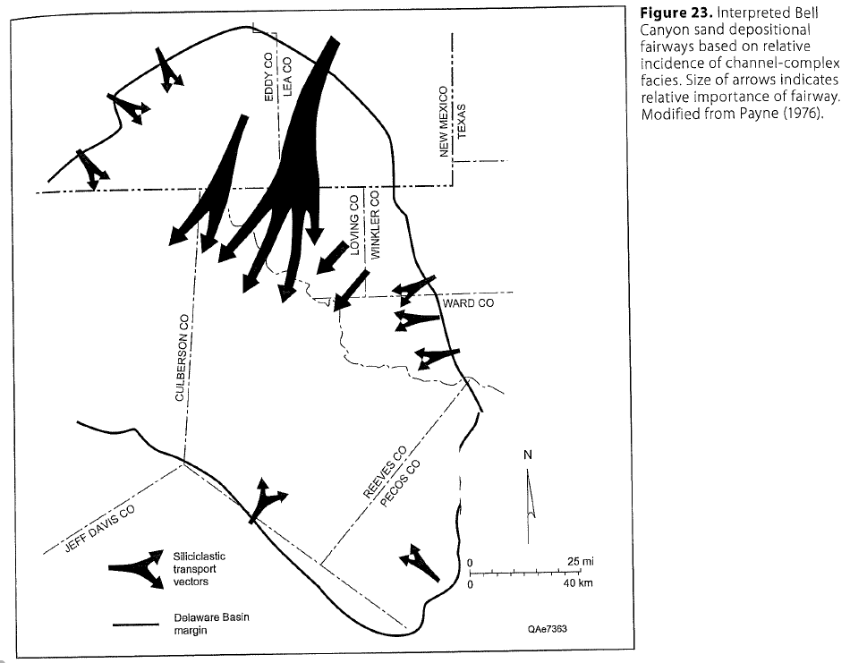
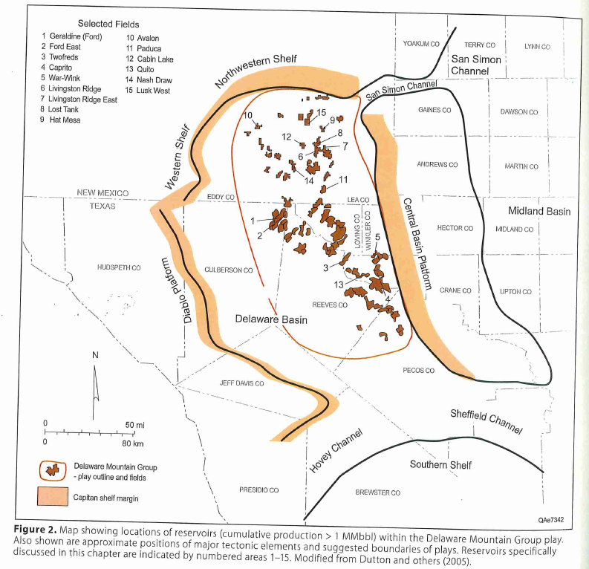
(Nance, 2020)

Slide 22
Upper Permian:
Ochoan

Slide 23
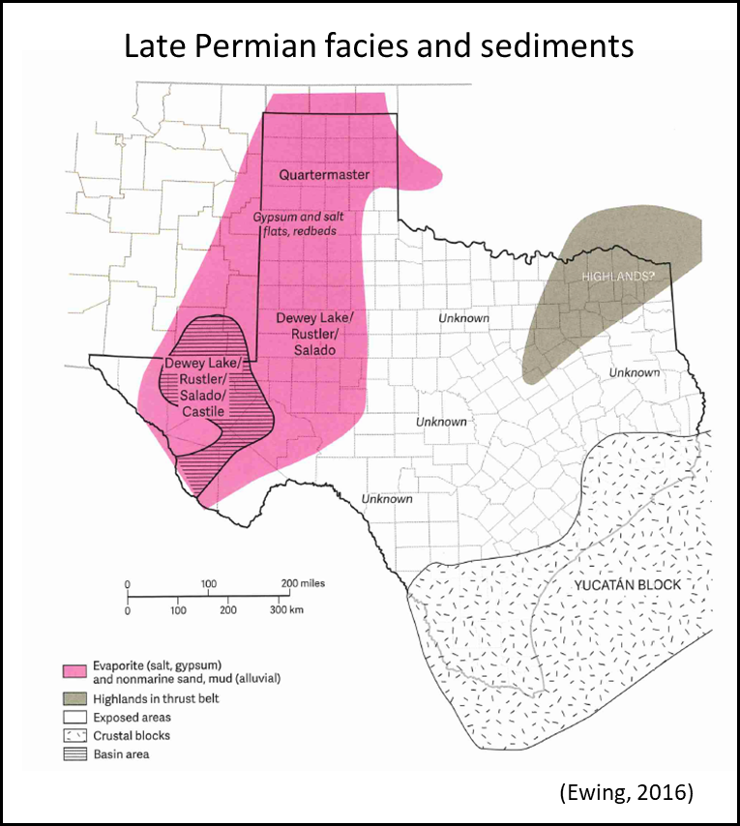
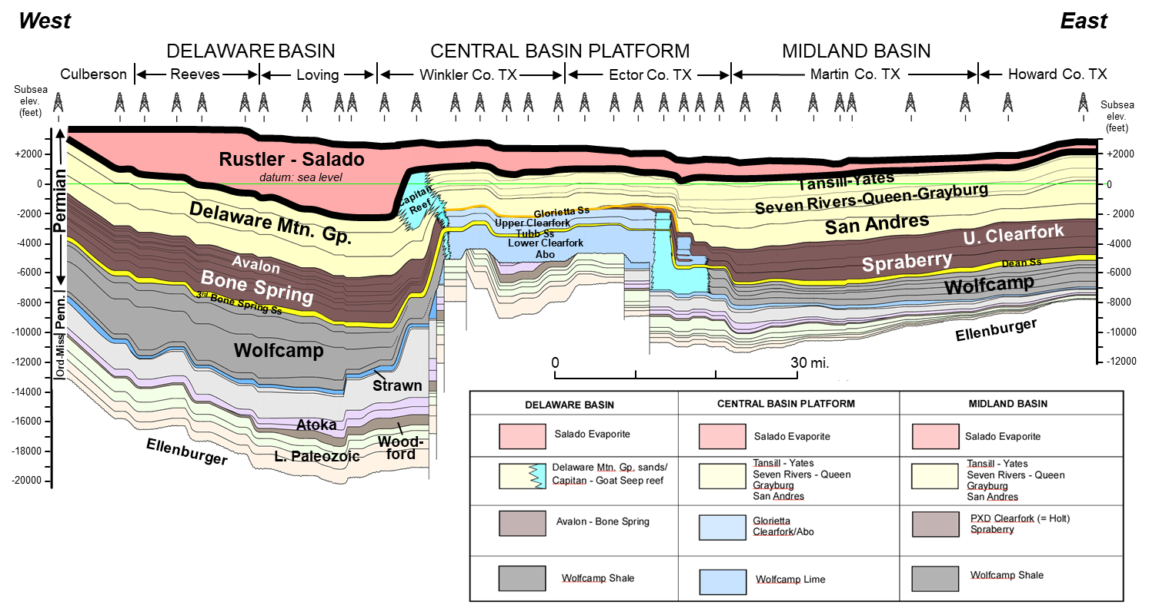
Late Permian Evaporites
Last phase of basin infill
Represents a regional seal for the Permian Basin petroleum system
Latest Permian: onset of oil generation

Slide 24
Lithologies of upper Permian units of the Permian Basin
Triassic
Dockum
Group
Dewey Lake
Dewey Lake – Red beds (ss & sltstn); wadi channel, eolian
Upper Permian
(Ochoan)
Rustler
Rustler – Anhydrite, halite, red beds; evaporitic lagoon, sabkha
Salado
Dominantly halite, minor anhydrite, red beds;
evaporitic lagoon, sabkha
Tansill
Red beds, anhydrite, halite; sabkha, evaporitic lagoon
Yates
Ss, Sltstn, anhy, dol; eolian, lagoonal, sabkha
Seven
Rivers
red beds, mudstone, anhy, halite;
sabkha, evaporitic lagoonal, intertidal
Artesia Group
Queen
ss, sltstn, carbonate mudstone, evaporites;
eolian, sabkha
Middle Permian
(Guadalupian)
Grayburg
Shelf to basinal carbonates (dol & ls), ss; normal marine
San
Andres
Shelf to basinal carbonates (dol & ls), ss, shale; normal marine
Shelf to basinal carbonates (dol & ls), organic-rich shale; normal marine
Lower Permian
(Leonardian)
Upper
Leonard
Upper
Spraberry
basinal silt- and sandstones interbedded with organic-rich shale

Slide 25
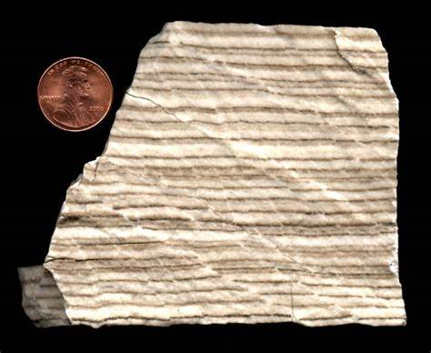
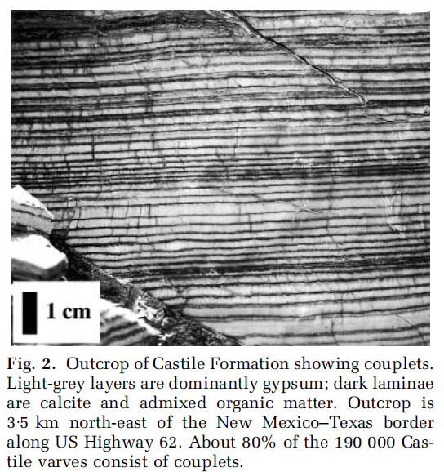
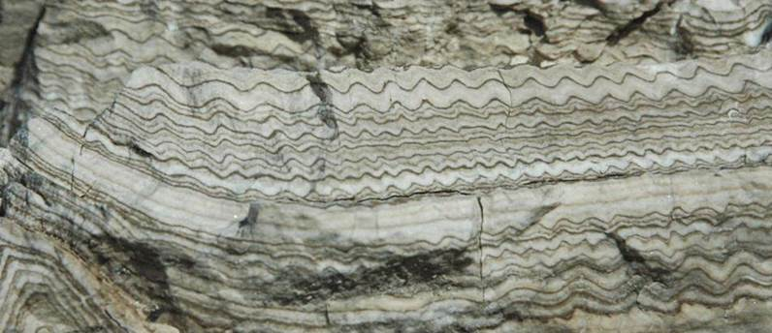
Castile varves

Slide 26
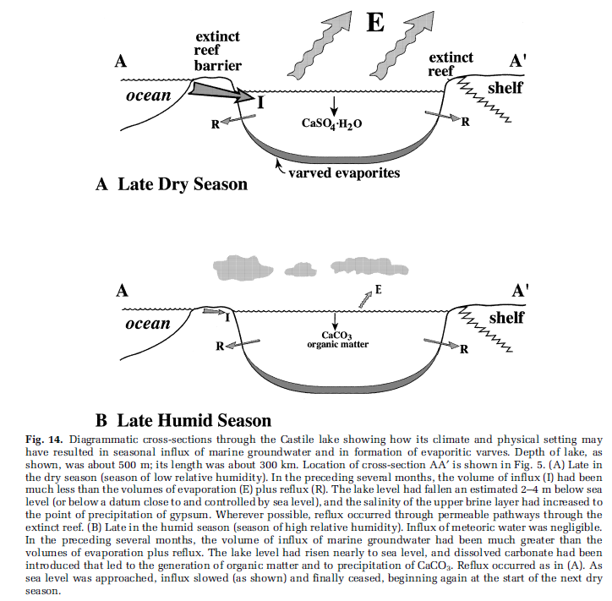
carbonate
(Kirkland, 2003)

Slide 27
POST-PERMIAN

Slide 28
Permian Basin Foreland Cenozoic & Mesozoic Stratigraphic Columns & Tectonic Events
Erathem
System
Series & Stages
Permian Basin
Cenozoic and Mesozoic Tectonic Events
Quaternary
Pleistocene & Holocene
Formations
Pliocene
Ogallala
Basin & Range
Extension
In Westernmost
Permian Basin
Regional Uplift Of Permian Basin Due To Thermal Uplift Associated With Basin And Range Extension West Of
Permian Basin
Neogene
Miocene
Cenozoic
Oligocene
Various Local
Intrusives and
Volcanics
Paleogene
Eocene
Laramide Compression – Reactivation Of
Some Late Paleozoic Faults
Paleocene
Maastrichtian
Late Cret. burial and 2nd period of major oil generation
Late
Campanian
Santonian
Coniacian
Inundation By Cretaceous Seaway
Turonian
Cenomanian
Cretaceous
Albian
Fredericksburg
Edwards
Paluxy
Comanche Peak
Early
Aptian
Barremian
Hauterivian
Valanginian
Mesozoic
Berriasian
Tithonian
Regional Uplift Of Permian Basin Due To Thermal Uplift Associated With Late
Stage GOM Rifting And Initiation Of GOM Spreading
Late
Kimmeridgian
Wichita peneplain
Oxfordian
Callovian
MIddle
Bathonian
Jurassic
Bajocian
Aalenian
Toarcian
Rifting In Gulf of Mexico (GOM)
Early
Pliensbachian
Sinemurian
Hettangian
Rhaetian
Late
Norian
Triassic sedimentation derived from uplift south of Permian Basin associated with initial stages of Gulf of Mexico rifting
Dockum /
Chinle
Group
Cooper Canyon
Triassic
Carnian
Trujillo
Tecovas
Ladinian
Santa Rosa
Middle
Anisian
E.
Scythian
onset of major oil generation (Late Permian)

Slide 29
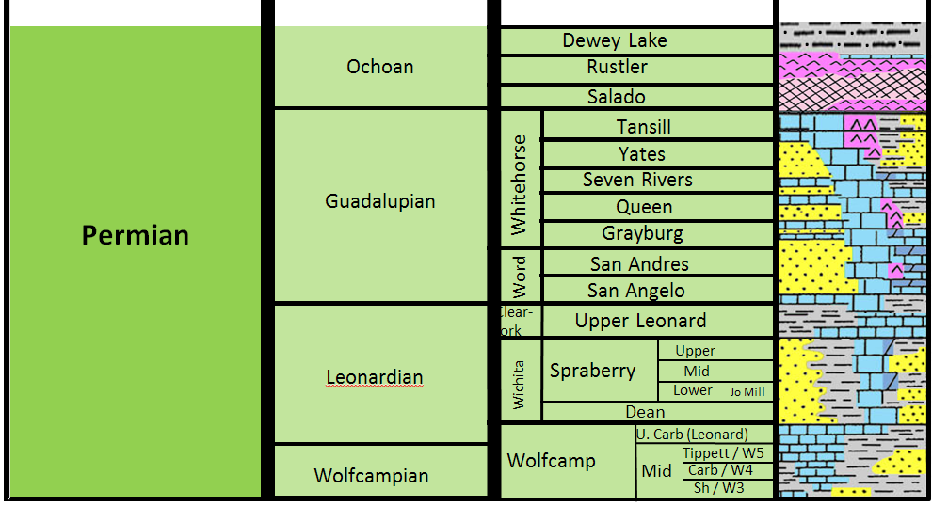
Dockum Group subsurface waters, Midland Basin
Fresh Water
Trinity
Tecovas
Trujillo
Tecovas
Brackish Water
Santa
Rosa
Saline Water
Dewey
Lake
Rustler
Salado
(Display by Evan Kelly, Pioneer)

Slide 30
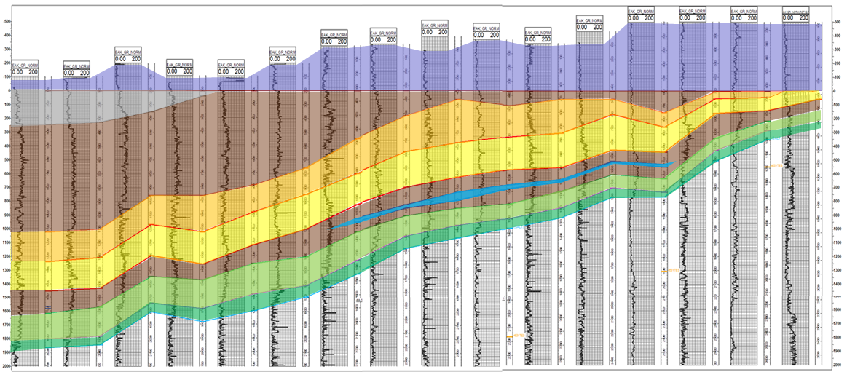
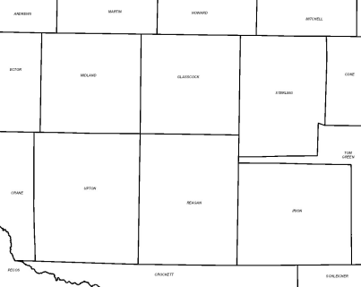
NW – SE cross section across Midland Basin showing increasing truncation of Dockum Group to south
NW
Midland
Upton
Reagan
Irion
SE
B
B’
5
10
15
Flattened on Cretaceous unconformity
Cretaceous
Trinity
Trujillo
Trujillo
Tecovas
M Santa Rosa
U Santa Rosa
L Santa Rosa
Tecovas
Dewey Lake
Tecovas
Rustler
Triassic
Salado
U Santa Rosa
Water Zone
M Santa Rosa
Permian
U Santa Rosa
L Santa Rosa
M Santa Rosa
Dewey Lake
L Santa Rosa
Rustler
Salado
Dewey Lake
Rustler
Salado
B
Dockum Group becomes progressively truncated to the south due to Late Jurassic (Late Callovian to Early Oxfordian) erosion, which was caused by thermal uplift associated with end of rifting breakup in the Gulf of Mexico
N
Midland
Sterling
5
Glasscock
10
This eroded surface, the sub-Cretaceous unconformity, is known as the Wichita peneplain
Upton
Reagan
Irion
15
B’
(cross-section courtesy of Evan Kelly, Pioneer)

Slide 31
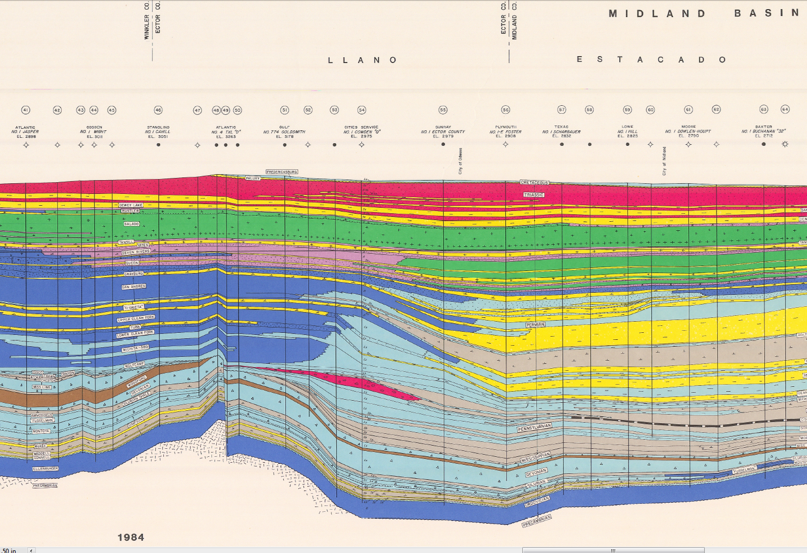
Evidence of Subtle Upper Cret. – Paleogene Laramide Reactivation of Central Basin Uplift
Winkler
Ector
Midland
West
East
Central Basin Platform
Midland Basin
Cretaceous, Triassic, Upper Permian evaps, and Yates are all slightly flexed and uplifted along edge of Central Basin Uplift
Horizontal Reference Line
Flexing and uplift
of shallow strata
Cretaceous
Dewey Lake & Triassic
Salado
Salado
Yates
Yates
More significant uplift occurs in Neogene (Basin and Range) that significantly impacts petroleum system along western margin of Delaware Basin
(WTGS 1984 Cross Section)
(Tim Reed, Pioneer)

Slide 32
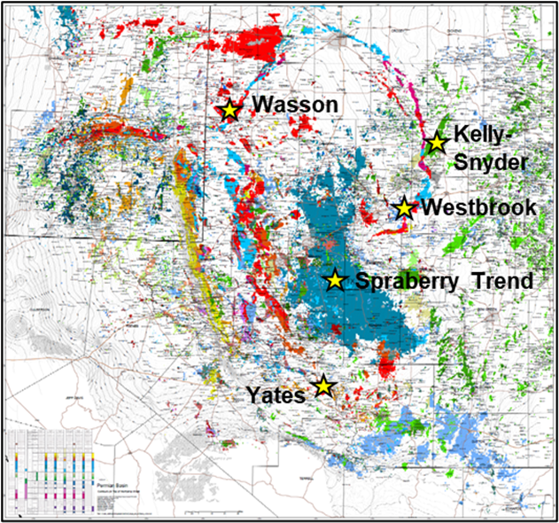
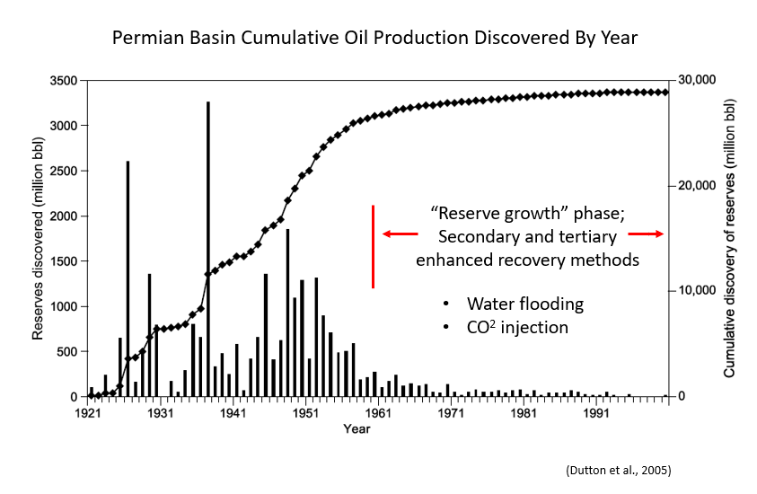
Permian Basin Petroleum System

Slide 33
Permian Basin, West Texas: A World-class Hydrocarbon Province
Oil and gas fields colored by age of reservoir
Slaughter
1.25 BBO
Cumulative oil production ~ 36.5 billion barrels of oil + 109 trillion cubic ft. gas
Wasson
> 2.1 BBO
Kelly-Synder
1.3 BBO
51 oil fields with “giant” status (>100 million barrels of oil cumulative production), including
5 fields with > 1 BBO
Carlsbad
NMex
TX
Spraberry Trend
1.1 BBO
Reservoirs at every
stratigraphic interval;
numerous prolific
HC source rocks
Midland
Vast unconventional
reserves, primarily in
Late Penn, Wolfcampian,
and Leonardian shales
U. Permian – Yates
U. Permian – Queen
U. Permian – San Andres
M. Permian – San Andres/Grayburg
L. Permian - Leonard
Yates
> 1.4 BBO
L. Permian - Wolfcamp
Penn – Canyon/Cisco
Penn - Strawn
30 mi
L. & U. Ordovician
map source: Geomap

Slide 34
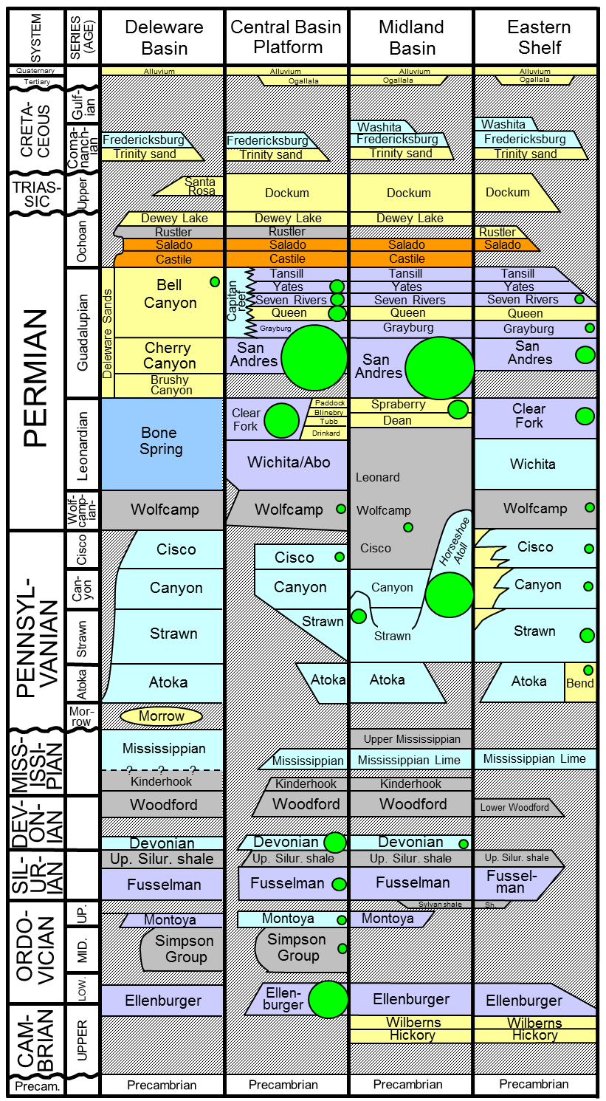
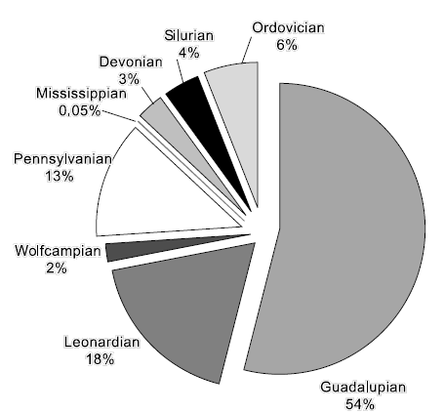
Permian Basin Conventional Reservoirs and Source Rock Intervals
(size of green bubbles are proportional to total conventional reserves)
regional
seal
Middle Permian: 54%
*
*
Lower Permian: 20%
*
*
Main Lithologies
*
Evaporites
Barnett
*
Dolomite
Limestone
Sandstone/siltstone
*
Shale
*
HC source rock interval
(modified from BEG, 1983, Atlas of Major Texas Oil Reservoirs,
and Dutton et al., 2005)

Slide 35
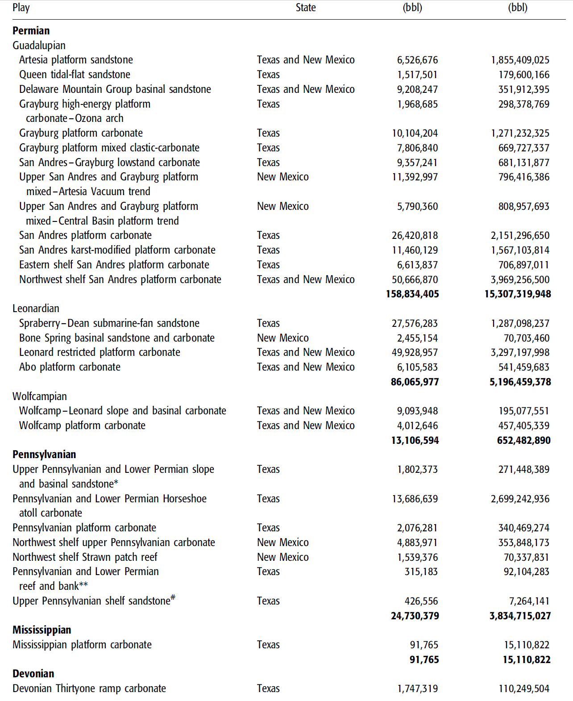
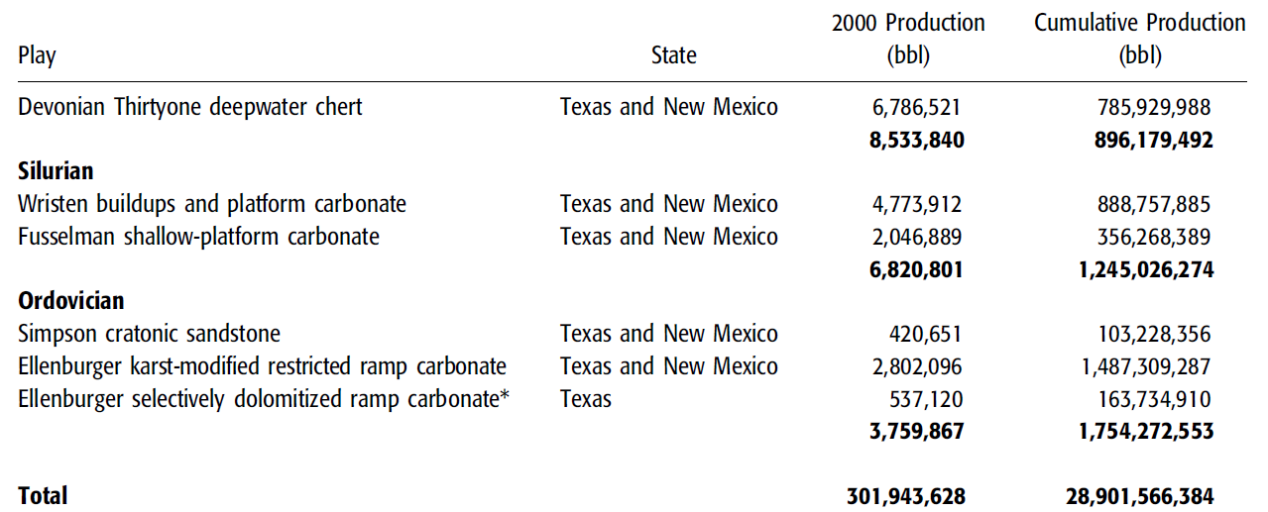
Conventional hydrocarbon play types of the Permian Basin
(Dutton et al., 2005, AAPG Bulletin, v. 80, p. 553-576)
(n = 13)
34 total conventional play types recognized and mapped by Texas BEG
These plays are fully documented in 2004 DOE report
(n = 4)
(n = 2)
(n = 7)
(n = 2)
(n = 3)
(n = 1)
(n = 2)

Slide 36
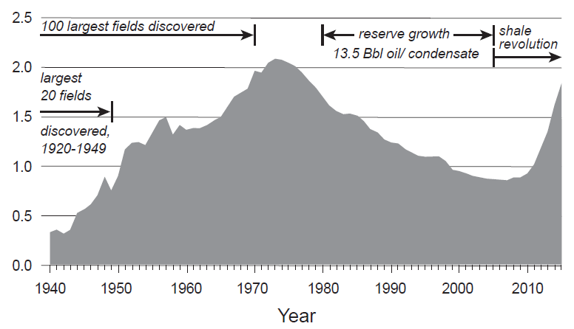
Permian Basin Crude Oil Production
Unconventional petroleum systems
Conventional petroleum systems
“peak oil”
Millions of Barrels per Day
(Potter et al., 2020)

Slide 37
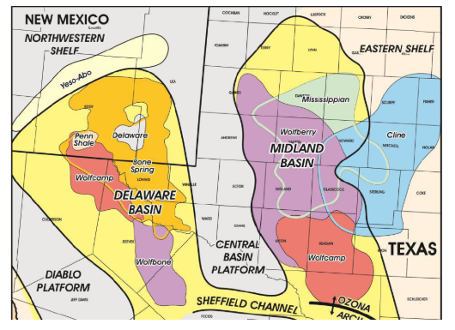
Permian Basin Unconventional Shale Plays
Note overlapping areas of multiple shale plays in both Midland and Delaware basins
Thermal maturity, reservoir pressure, small increases in perm matter!
(shaleexperts.com)

Slide 38
Timing: Burial History (Midland Basin center 1D model)
Structural traps
Age (Ma)
depth
(x1000 ft)
600
500
400
300
200
100
0
Proterozoic
Carb.
Permian
Eoc.
Camb.
Ord.
Sil.
Devonian
Triassic
Jurassic
Cretaceous
P
O
Mi.
L. Ord (Ellenburger)
Woodford
Cretaceous
+2
Atoka
Triassic
0
Upper Permian
-2
1
2
San Andres
-4
Clearfork
-6
Spraberry
Wolfcamp Shale
-8
1
Atoka
-10
Tobosa Basin phase (passive margin)
Woodford
Avg. subsidence = 3.2m / m.y.
L. Ord (Ellenburger)
-12
3
2
Penn. - E. Perm. (Wolfc.) deformation phase
Pangean uplift /
emergence
Late K
burial
Laramide,
Basin & Range
uplift
-14
Avg. subsidence = 17.1m / m.y.
3
E. to M. Perm. (Leon.-Guad.) loading phase
Late Permian: Onset of
major oil
generation
Max. burial;
2nd oil gen.
pulse
Late Tertiary
uplift
Avg. subsidence = 116 m / m.y.

Slide 39
Impact of Tectonic Uplift on Hydrocarbon Accumulations
Empirical studies of uplifted areas worldwide have shown that uplift of previously trapped oil and gas
accumulations results in dissipation and loss of those hydrocarbons. With only
1500 m (~4900 ft) of uplift, most hydrocarbons can be lost from a trap, depending on seal strength.
Impact of uplift:
Hydrocarbon generation shuts down in kitchens.
Uplift may distort original trap and induce remigration.
Uplift results in erosion, diminishing overburden pressure. With less
overburden pressure, the original reservoir pressure can exceed the strength
of the seal, causing it to fracture and hydrocarbons escape (blown seal)
If seal integrity is largely maintained, then less overburden pressure can
reduce reservoir pressure below bubble point, causing gas to come out of
solution and cause gas cap expansion in the reservoir, which forces liquid
hydrocarbons beyond the spill point. This can result in gas-only
accumulations or highly variable GOR’s across an area
For uplifted source rocks, low permeability may allow them to retain
hydrocarbons, but subject to pressure reduction and solution gas expansion, resulting in
low or erratic pressure and variable GOR’s
(list from Tim Reed, Pioneer)

Slide 40
WTGS Regional Cross Section Across Delaware Basin & Diablo Uplift Showing Post-Permian Uplift
Basin and Range
Down-faulting
Basin and Range
Down-faulting
Western side of Delaware Basin uplifted > 4900 ft.
CBP and Midland Basin uplifted < 3000 ft.

Slide 41
Burial history curve, western margin of Delaware Basin
0.65 km
1.8 km
(5,900 ft)
of
uplift
2.45 km
(modified from Barker and Pawlewicz, 1987)

Slide 42
Oil and gas fields
colored by age of reservoir
Slaughter
Prolific conventional hydrocarbon basin:
Kelly-Snyder
Cumulative oil production (through yr. 2000) =
29 BBO (+ 75 TCFG)
Wasson
First discovery was at Westbrook Field, Mitchell Co, TX (1921)
51 oil fields with “giant” status (>100MM BO cumulative prod.)
Midland
5 individual fields with >1 BBO cumulative production
Spraberry
Trend
New unconventional reserves will likely eclipse historical conventional production
U. Permian – Yates
U. Permian – Queen
U. Permian – San Andres
M. Permian - Leonard
Yates
L. Permian - Wolfcamp
Penn – Canyon/Cisco
Penn - Strawn
30 mi
L. & U. Ordovician

Slide 43
Consequences of too much tectonic uplift on a major petroleum basin
> 1500 m uplift
30 mi
(Midland Map Co.)

Slide 44
Permian Basin petroleum system: Summary
System
Series
Midland Basin
Lithology
Numerous world-class hydrocarbon source rocks
Formations
U. Perm evaps.
(Regional seal)
Dewey Lake
Ochoan
Rustler
Salado
Tansill
Yates-Grayburg
Porous and permeable reservoirs at virtually every stratigraphic level
Yates
Guadalupian
Whitehorse
Seven Rivers
Permian
Queen
San Andres
Grayburg
Word
San Andres
Clear-
fork
Holt / Upper Leonard
L. Sprab./
Bone Spring
Dean-Spraberry /Bone Spring
Spraberry
Upper
Leonardian
Mid
Numerous traps (structural and stratigraphic)
Dean
Lower
Jo Mill
Wolfcamp
Wolfcamp A
Wolfcamp carbonates and shale
Wolfcamp
Wolfcamp B
Wolfcampian
Wolfcamp C1
Virgilian
Cisco
Wolfcamp C2
Missourian
Canyon
Wolfcamp D
Penn.
Penn. carbonates and clastics
Pennsylvanian
Desmoinesian
Strawn
Lime
Upper Permian evaporites constitute a highly efficient regional seal
Detrital
Atoka
Atokan
Atoka
Bend Lm
Morrowan
Morrow
Sh & Detrital
Barnett
Chesterian
U. Miss Lm
L. Barnett
U. Barnett
L. Miss carbonates (minor)
Mississippian
Meramecian –
Osagean
L. Miss Lm
Kinderhookian
Woodford
Woodford
Devonian
Upper
Reserves from unconventional resource plays rival those of conventional reservoirs
Middle
Devonian (Thirtyone)
Devonian carbonates
Lower
Silurian
U. Niagaran
Upper Silurian (Wristen)
Silurian carb.
L. Niagaran
Fusselman
Alexandrian
Montoya
Sylvan Sh.
Cincinnatian
Mohawkian
Tulip Crk.
Bromide
Preservation issue in western portion of Delaware Basin due to > 1500 m of tectonic uplift
Simpson
Mclish
McKee Sd.
Simpson
Ordovician
Chazyan
Oil Creek
Waddell Sd.
Joins
Connell Sd.
Canadian
Ellenburger
L. Ord (Ellenburger)
Ozarkian
Wilberns
Cambrian
Upper
Bliss / Hickory / Riley
= Major hydrocarbon reservoir interval
Precambrian
Precambrian
Basement
Hydrocarbon Source Rock Interval

Slide 45
Thank you to Endeavor for this opportunity!
Permian Basin Research Lab at UT Dallas
Dr. Robert J. Stern and Mr. Lowell Waite, Co-Directors
-- established January 2019 --
Goals:
Advance understanding of all geologic aspects of the Permian Basin through open applied research,
linking academia and industry
Educate and better prepare students for professional careers in the oil and gas industry
Graduate courses offered:
Geology of the Permian Basin
Petroleum Geoscience
Paleo Earth Systems: Global Themes
Carbonate Sedimentology
https://labs.utdallas.edu/permianbasinresearch/

