Slide 1
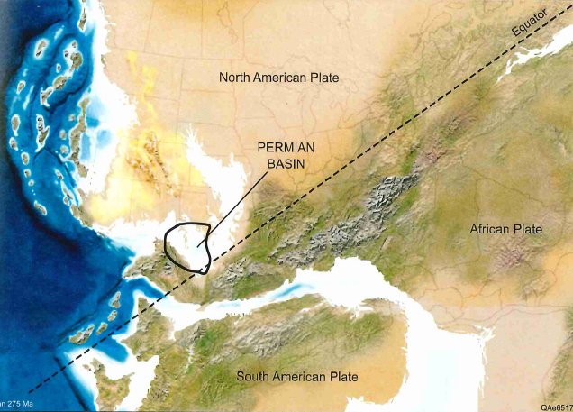
Geology of the Permian Basin
Lower Permian:
Upper Wolfcamp
and Leonardian (Spraberry - Bone Spring)
Lowell Waite
UT Dallas Geoscience
Permian Basin Research Lab
12/6/2021

Slide 2
Geology of the Permian Basin: ELS (Endeavor Lecture Series)
Horseshoe Atoll
Tectonic history – Part 1 (Big Picture)
Tectonic history – Part 2 (Regional elements: ARM, CBU, MFB)
Basement
Cambrian – Lower Ord (Wilberns/Bliss Ss., Ellenburger Gp)
Tobosa Basin stratigraphy (Mid Ord. – Mississippian)
Pennsylvanian (Morrow-Atoka-Strawn-Canyon-Cisco)
Lower Permian (Wolfcamp – Spraberry)
Middle and Upper Permian / Permian Basin petroleum system

Slide 3
AGE
(Ma)
SERIES
GLOBAL
STAGE
N. AMER.
STAGE
Magnetic
Permian Chronostratigraphy
250
polarity
252
251.90
units
254
Changhsingian
Lopin-
gian
254.14
Duration: 47 m.y. (298.9 – 251.9 Ma)
256
Wuchiapingian
Ochoan
258
259.1
Three Global Series
260
Permo-Triassic
Mixed Superchron
262
Capitan-
ian
lower Permian = Cisuralian
264
Guad-
alup-
ian
middle Permian = Guadalupian
Guadalupian
265.1
266
Wordian
upper Permian = Lopingian
268
268.8
270
Roadian
9 Global Stages; 4 North American Stages
272
272.95
274
GSSPs currently undefined for three lower Permian global stage bases (Kungurian, Artinskian, Sakmarian)
276
278
Kungurian
Leonard-
ian
280
282
Klaman Reversed Superchron
Lower Permian reversed magnetic superchron; middle – late Permian mixed superchron
284
283.5
Cisuralian
286
Artinskian
288
290
290.1
Wolf-
camp-
ian
292
Sakmarian
293.52
Global Boundary Stratotype Section and Point (GSSP)
294
296
Asselian
298
298.9
300
CARBONIFEROUS
(Chen and Xu, 2019)

Slide 4
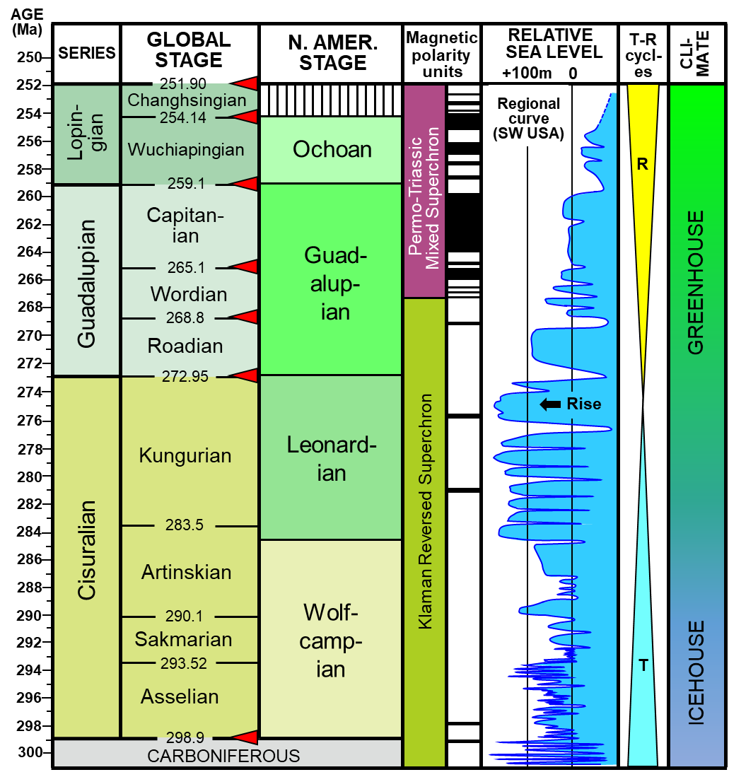
Select Permian Global Secular Trends
MASS
EXTINCTIONS
SEA TEMP (ºC)
VOLCANISM
CARBON
BIO-
DIVERSITY
15
25
35
ISOTOPES
del ¹³C
sudden drop
Siberian
0
2
4
end
Permian
Traps
arc magmatism
South China
increase
Emeishan
LIP
Kamura
event
Silicic Choiyoi igneous province
end
Guada-
lupian
fluc-
ua-
ting
O₂ levels:
115% of
modern
Tarim III
CO₂:
900 ppm
Qiangtang
basalt
Panjal Traps
moderate
Tarim II
decline
Permian
Glacial
Intervals
rapid
1.
Siberia
increase
2.
W. Australia
1
3.
Antarctica
2
3
4
Tarim I
(Waite et al., 2020; data from Chen and Xu, 2019; Chen et al., 2013, Ross and Ross, 2009 )
4.
E. Australia

Slide 5
Major reef builders throughout Phanerozoic time (James and Mountjoy, 1983)
2nd-order seq.
framework
PERIODS
BUILDUPS
MAJOR SKELETAL ELEMENTS
During the Pennsylvanian and earliest Permian, reef builders are dominated by mud-rich, phylloid algae mounds; Chaetetes and Palaeoaplisina are also important in some regions
0
Tejas II
Tertiary
CORALS & SKELETAL ALGAE
Tejas I
*
CHALKS
rudists
Zuni III
100
Creta-
ceous
RUDISTS
corals & stromatop.
Zuni II
CORALS
sponges
stromatoporoids
Zuni I
Jurassic
*
U. Absar. II
200
Triassic
TUBIPHYTES
corals sponges
U. Absaroka I
*
Permian
SPONGES + TUBIPHYTES
L. Absaroka II
Above the mid-Wolfcamp unconformity, the muddy, low-relief phylloid algal mounds are largely replaced by cemented, high-relief barrier reefs consisting of calcitic sponges, Tubiphytes, and Archaeolithoporella, a calcareous algae
Penn.
PHYLLOID ALGAE
L. Absaroka I
300
BRYOZOA
Kaskaskia II
Miss.
*
Devonian
Kaskaskia I
STOMATOPOROIDS corals
400
Silurian
Tippecanoe II
*
Ordovician
STOMATOPOROIDS + CORALS
Tippecanoe I
SPONGES + SKELETAL ALGAE
Sauk III
500
SKELETAL ALGAE
Sauk II
Cambrian
ARCHAEOCYATHIDS + ALGAE
Sauk I
Precamb
BLUE-GREEN ALGAE
*
Mass Extinction
Event (MEE)
600
reefs
mounds

Slide 6
The Lower Permian
of the
Permian Basin

Slide 7
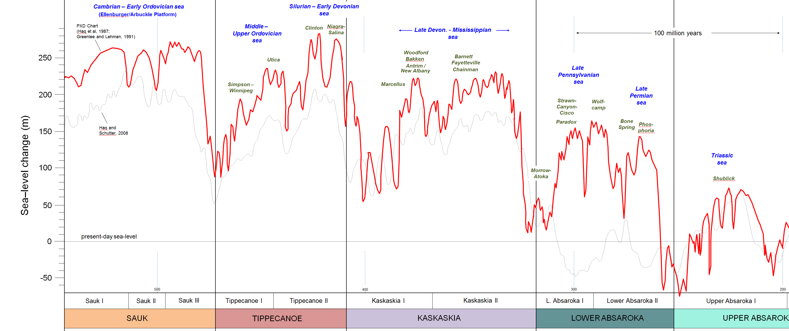
Long-term cycles of sea level during the Paleozoic and cratonic sequences (4 total)
4a. Pennsylvanian – earliest lower Permian
4b. lower Permian
4c. middle and upper Permian
Upper Precamb. –
Lower Ordovician
Mid. Ordovician –
Lower Devonian
1
2
3
Lower Devonian –
Mississippian
4
1a
1b
2a
2b
3a
3b
4a
Pennsylvanian –
Permian
4b
4c
Fusselman-
Wristen-
Thirtyone
eroded/
not
deposited
U. Miss./Barnett –
Lower Miss. Lime –
Woodford
WFMP C2 –
WFMP D –
L. Strawn –
Morr. - Atoka
SPBY/B.Spr.-
Ochoan
Permian
Basin
stratigraphic
units
eroded/
not deposited
Ellen-
burger
Simpson-
Montoya
Dean -
Tans.-Yates
Trans. Ss.
WFMP A -
Quen.-SNRV
WFMP B -
GBRG
WFMP C1
San And.
Early
Mid.
Late
Early
Mid.
Late
Lu.-
Late
Early
Middle
L.
E.
Lland.
Wn.
Pri.
Early
Mid.
Late
E.
M
Cisuralian
Gua.
Lop.
Middle
Late
Cambrian
Ordovician
Silurian
Devonian
Mississippian
Penn.
Permian
Triassic
540
520
500
480
460
440
420
400
380
360
340
320
300
280
260
240
220
200

Slide 8
Summary of lower Permian stratigraphic nomenclature, Permian Basin region
2nd-order
sea-level cycles /
sequences
4C
*
4B
mid-Wolfcamp
unconformity
4A

Slide 9
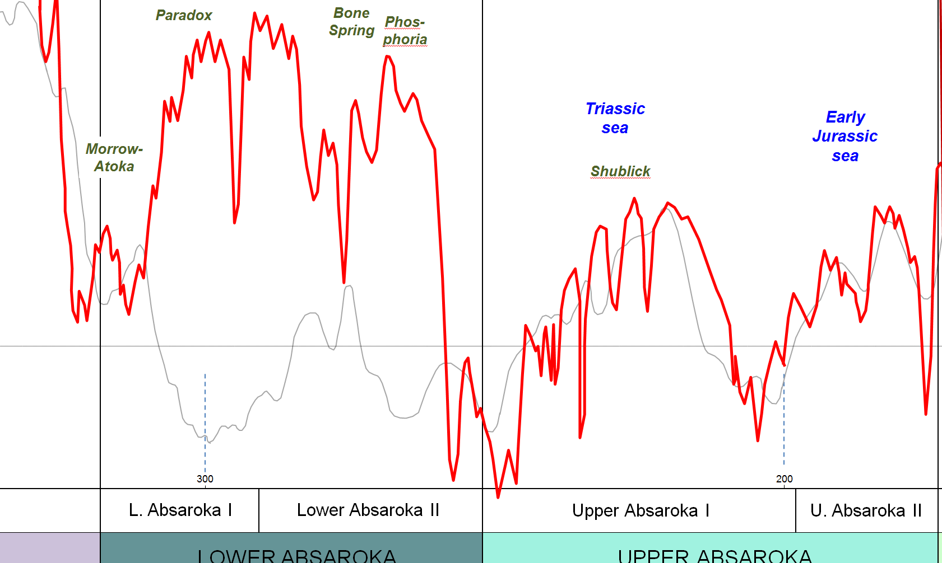
Early to Mid Paleozoic Sea Level Chart
Glacially-Induced Sea Level Changes
Late Wolfcamp: continuation of Late Penn. to Early Wolfcamp long-term transgression
High
Sea Level
End Leonardian: onset of long-term sea-level lowering; increasing aridity / return to greenhouse climate
PXD Chart
(Haq et al, 1987;
Greenlee and Lehman,
1991)
Absent /
No
Deposition
Haq and
Schutter, 2008
Evaporites
Yates, Seven Rivers, Queen, Grayburg
Low
Sea Level
Upper Leonard / “Clearfork”
Dockum
Group
Wolfcamp
D
Wolfcamp
A to C2
San Andres
Spraberry &
Dean

Slide 10
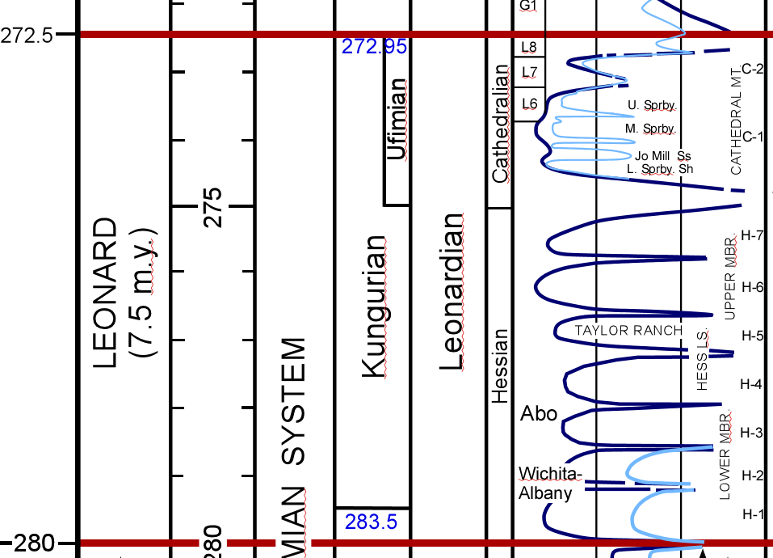
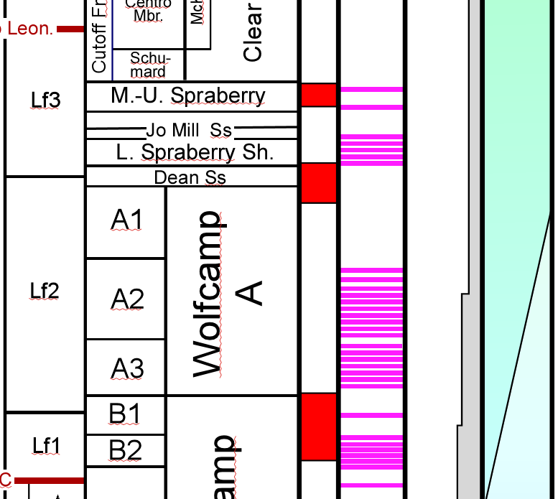
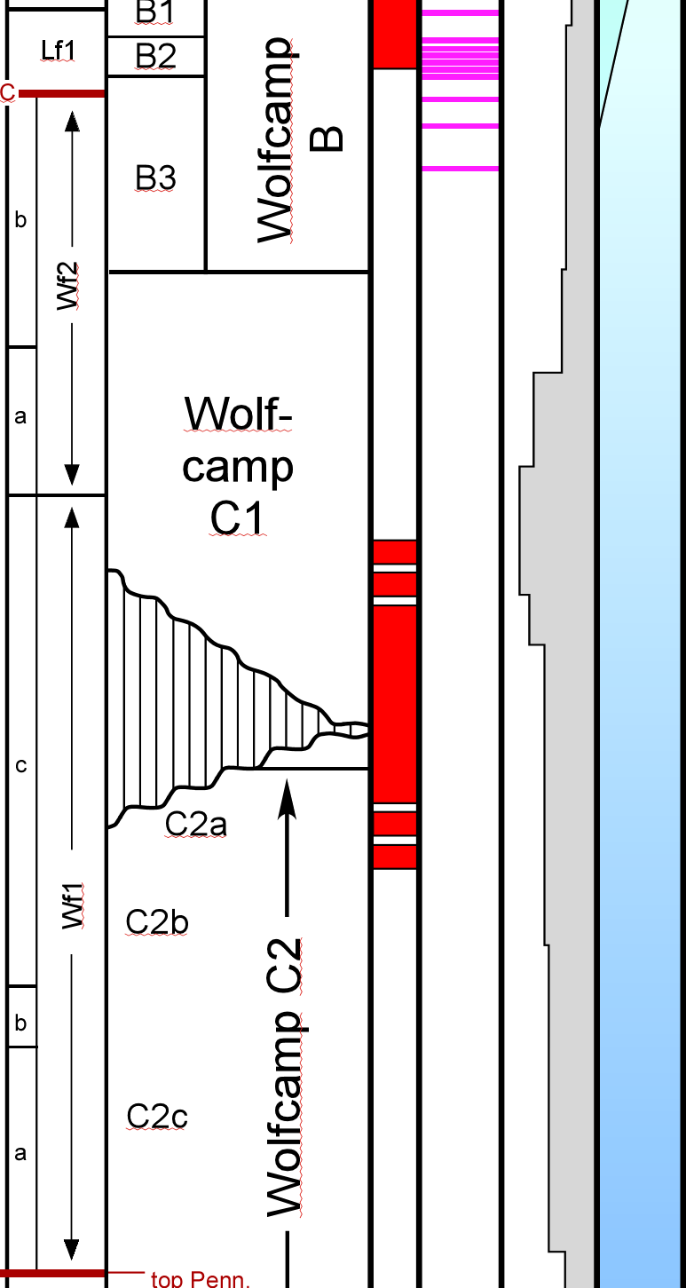
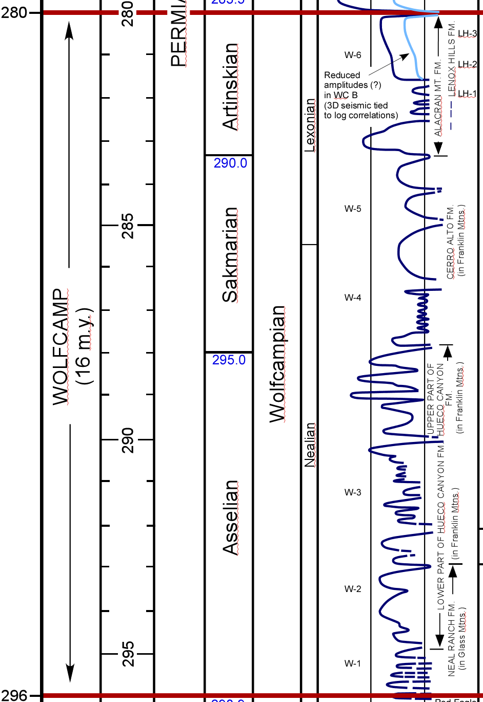
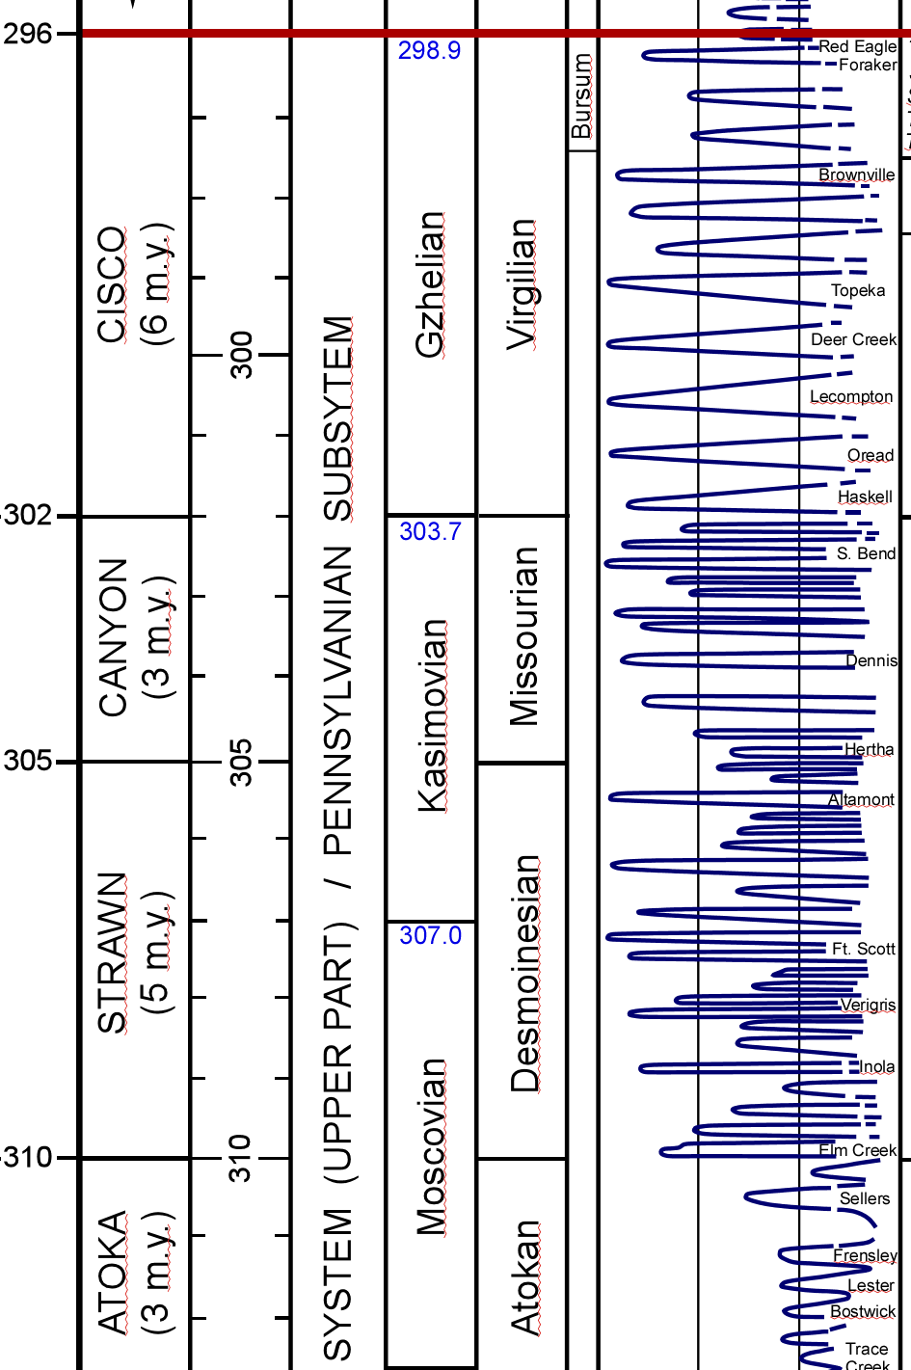
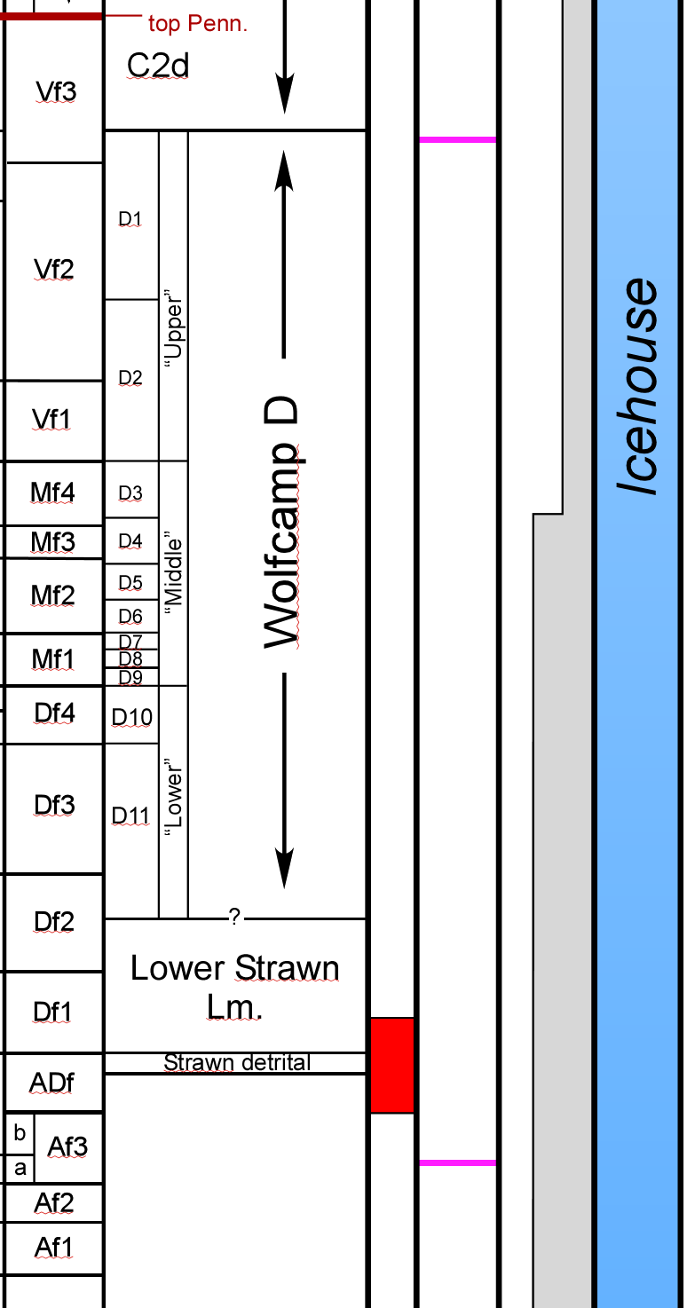
Stratigraphic framework,
Wolfcamp - Spraberry
Chrono-
stratigraphy
Sea-level
2nd-order
cycles
Operational
Units
rise
FZ
a.
b.
c.
5
FZ. Fusulinid
zonation
T
Greenhouse
(Waite et al., 2019, AAPG SW Section mtg)
R
a. Tectonic
pulses
4
T
b. Ash beds
Numerous 3rd- and higher-order cycles of sea-level change organized into larger 2nd-order trends (5 – 10+ m.y. in duration); these include:
Climate
phase
R
3
T
R
mwu
mwu: mid-Wolfcamp
unconformity
2
5
Dean – Spraberry / Bone Spring
T
4
WC A - B
3
WC C1
R = Regression
T = Transgression
R
2
WC C2
1
1
Atoka - WC D - lowermost WC C2
T
(Sea-level curve from Ross and Ross, 2009;
Fusulinid zonation from Wahlman, 2019)

Slide 11
Early Permian Paleogeography (Leonardian)
Increasing aridity
Note large “Sahara” desert located to the north and west of the Permian Basin (large aeolian dunes)
Time-equivalent shallow- and deep-marine facies in Permian Basin
(Ruppel, 2020)

Slide 12
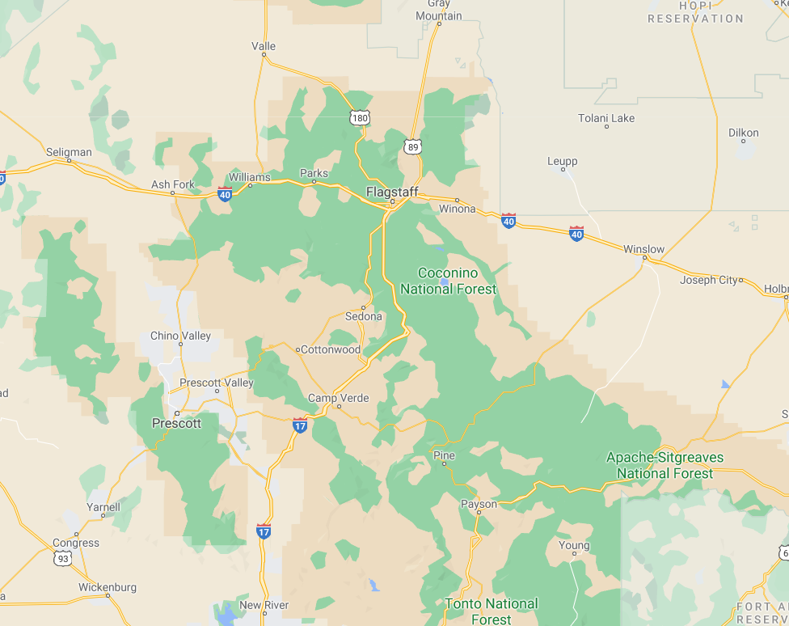
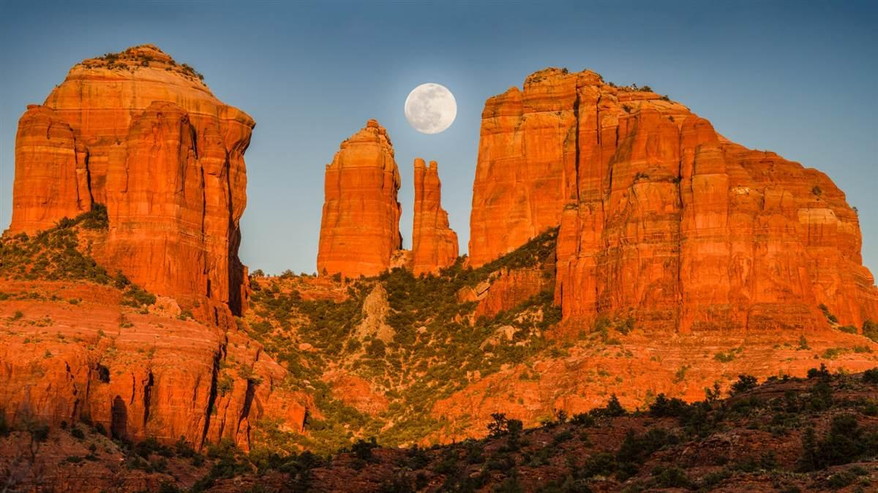
Red Rock area, Sedona, Arizona: lower Permian aeolian dunes
This immense dune field impacts deposition of lower Permian basinal clastics in Permian Basin

Slide 13
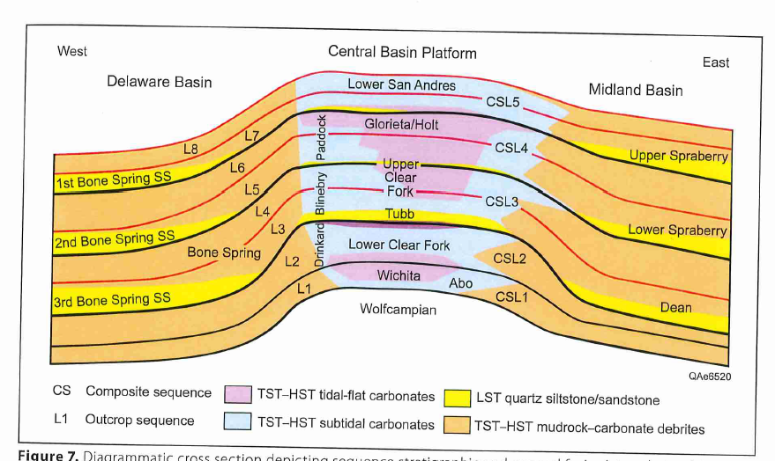
Lower Permian Facies and Sequences, Permian Basin
Central Basin Platform
Midland Basin
shallow-water carbonates
deep-water clastics
Delaware Basin
(sandstones, organic-rich
mudrocks)
deep-water clastics
(sandstones, organic-rich
mudrocks)
Upper Wolfcamp
Upper Wolfcampian
(modified from Ruppel, 2020)

Slide 14
Lower Permian Platform Carbonates

Slide 15
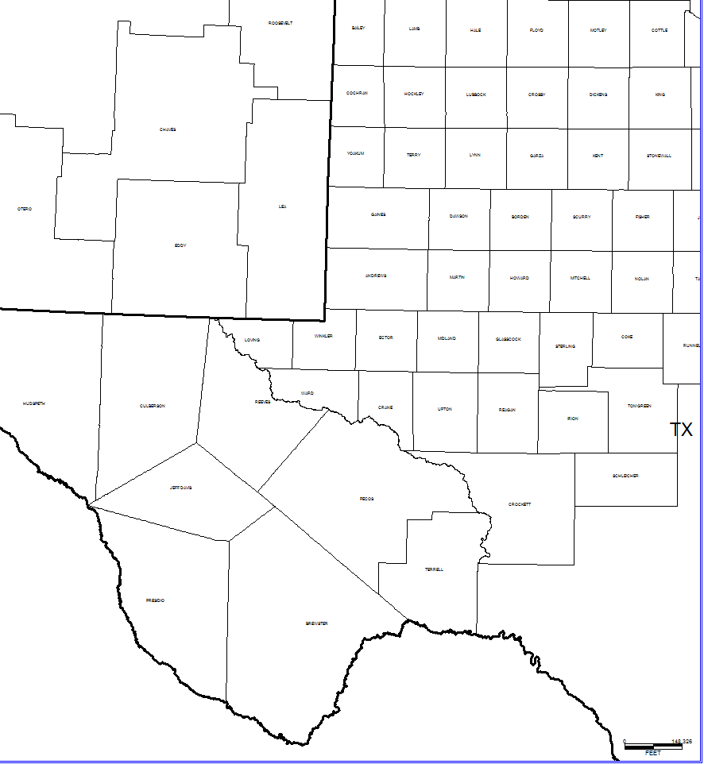
Leonardian Carbonate Platforms and Basins of the Permian Basin
Shallow shelf
Carbonate
During highstands, shelves and platforms are submerged and undergo carbonate deposition; basins receive organic-rich
shale and carbonate gravity-flow deposits
The Sheffield and Hovey channels at the southern end of the Permian Basin region connect the basins to the sea (Panthalassic = paleo-Pacific Ocean)
During lowstands, carbonate shelves and platforms are exposed, but basins remain submerged; wind and streams bring clastics across exposed shelves; clastics
deposited in basins via gravity flows,
forming submarine fan complexes
(1st major influx of course clastics into basins)
Deep basin
Northwest Shelf
San Simon Channel
Carbonate
Fold belt
Central Basin
Platform
Eastern Shelf
Midland Basin
Delaware Basin
Carbonate
Diablo Platform
Carbonate
Sheffield Channel
Hovey Channel
Southern Shelf
Marfa
Basin
Marathon
Thrust Belt
Val Verde Basin
Connection
To Sea
Lowlands
(Modified from Ward, 1999)

Slide 16
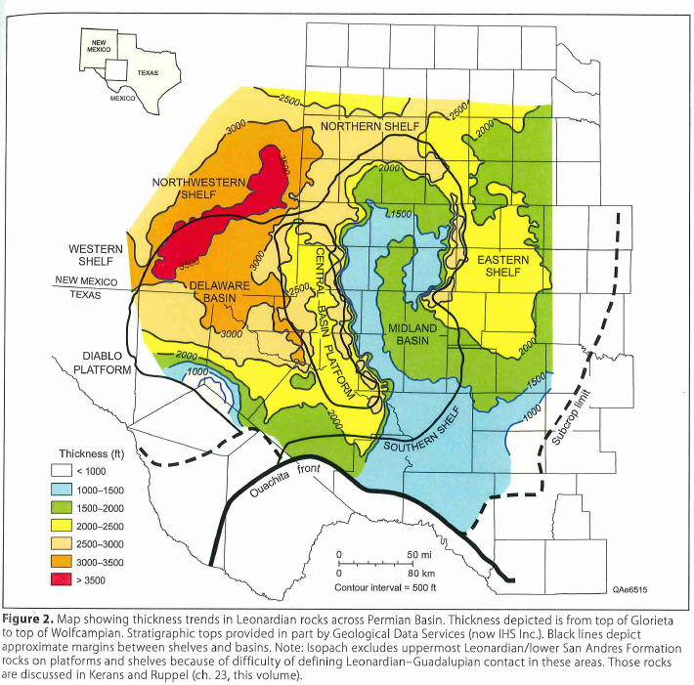
Thickness of Leonardian strata, Permian Basin
Abo reef trend
(thick carbonate
buildups)
(Ruppel, 2020)

Slide 17
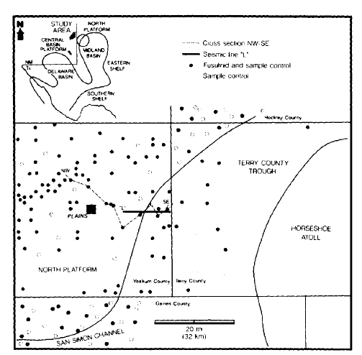
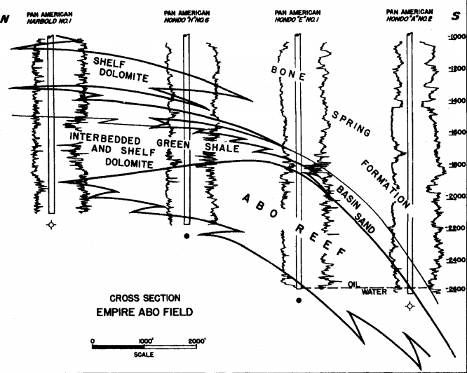
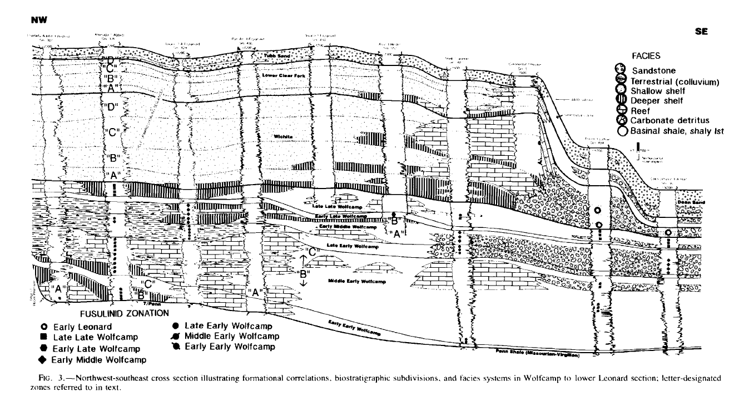
Early Permian (Leonardian) platform margin, Northwest Shelf, Permian Basin
Ramps transition to rimmed platforms containing large, barrier-like reefs that reach apex during middle Permian time
Abo reef trend,
New Mexico
(LeMay 1960)
Leonard (rimmed platform)
Wolfcamp (ramp)
(Mazzullo and Reid, 1989)

Slide 18
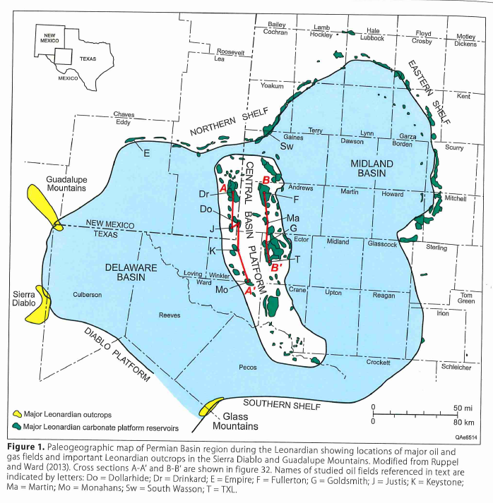
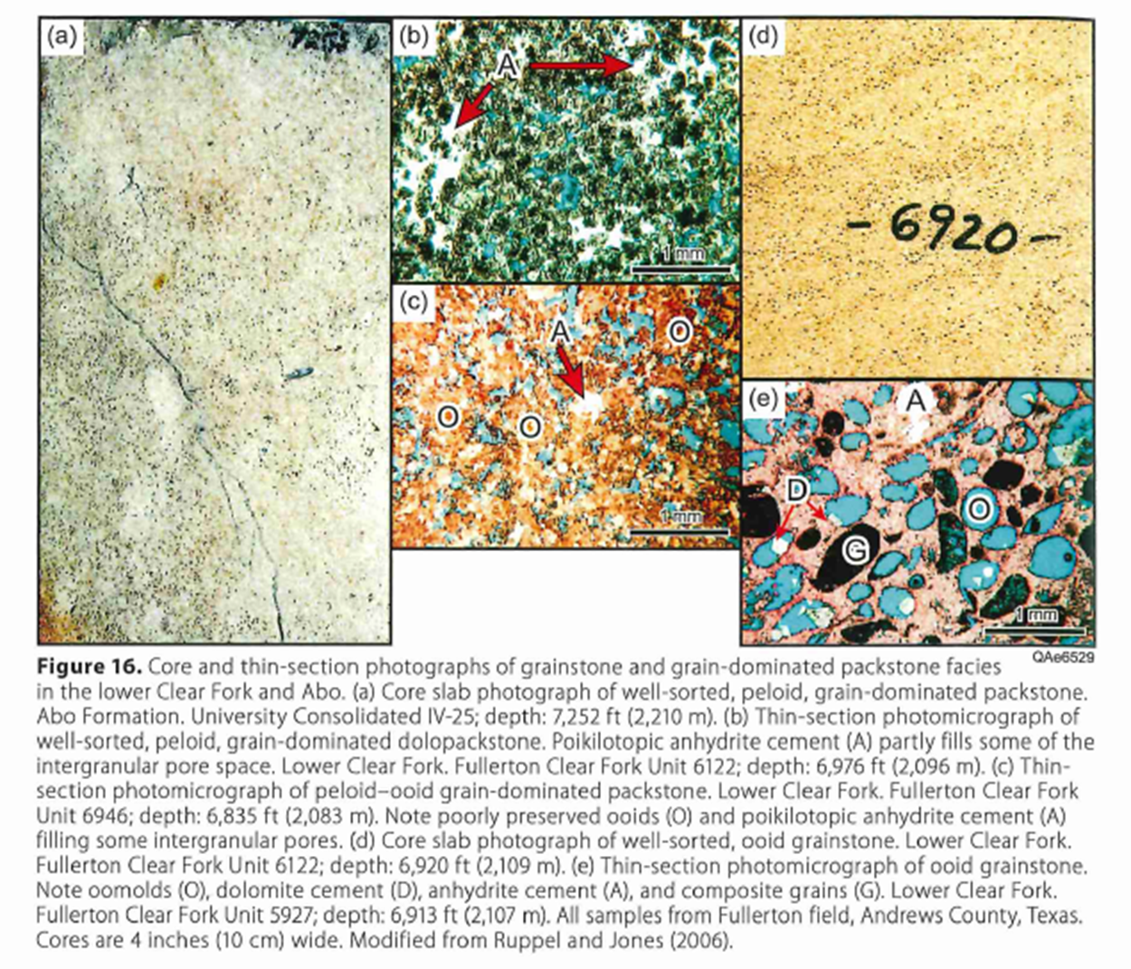
Major oil fields within early Permian shelf carbonates
(~ 3.7 BBO)
Howard-Glasscock trend (initial oil disc. in Permian Basin in 1920)
(Ruppel, 2020)

Slide 19
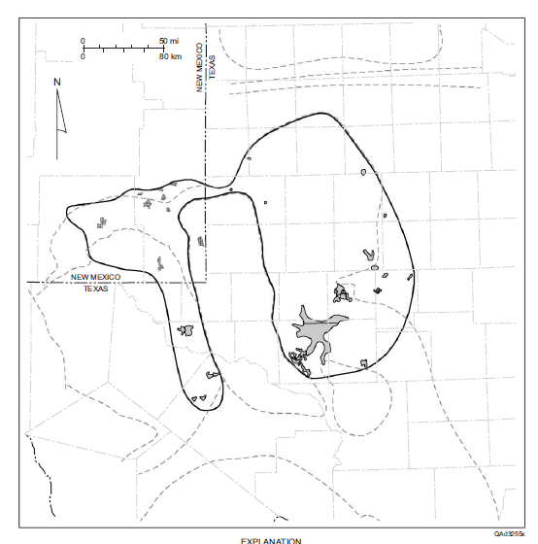
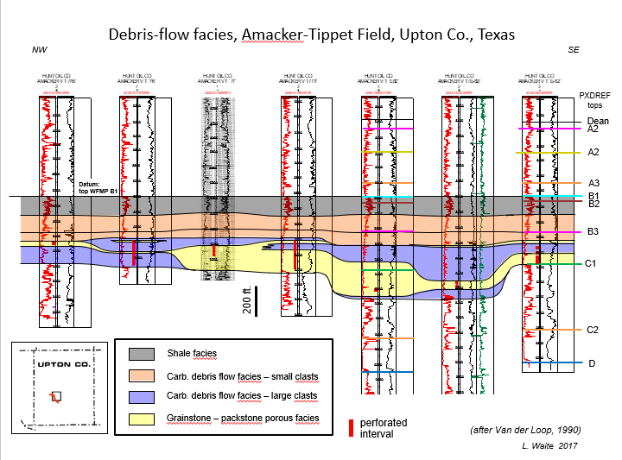
Wolfcamp – Leonard slope and basin carbonate debrite play
(Reservoirs with > 1 MMBO cumulative production; Dutton et al., 2004)

Slide 20
Lower Permian Basinal Shales
and
Deep-water clastics

Slide 21
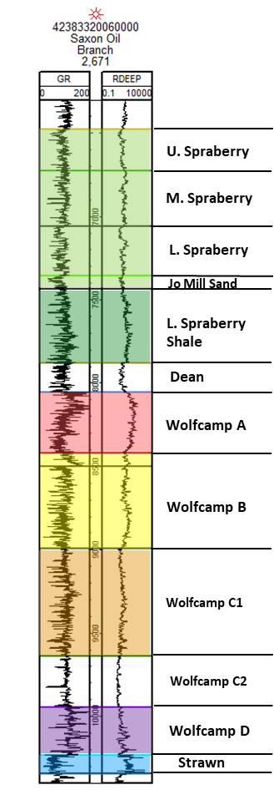
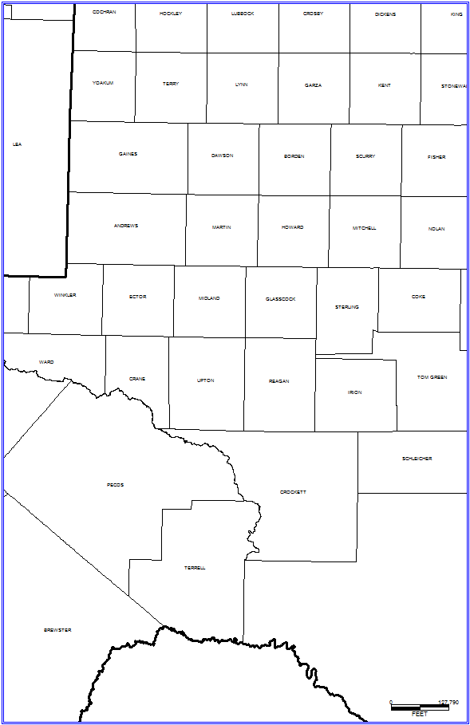
Early Permian of the Midland Basin
Platform Carbonate
Land
View from NW
Platform
Carbonate
Shelf Edge Carbonate
Clastic Detrital
Pelagic Sediments
Slope Sediments & Reef Talus
Fluvial - Deltaic
Silt Cloud in Suspension
Midland
Basin
Carbonate Debris Flows
Delta
Anaerobic Zone
(Organic-rich Sediments)
CBP
Block Diagram Outline
Carbonate Gravity Flows
Clastic Slope Sediments
Basinal Sediments
Clastic Gravity Flows
Land
Sea Level
Marathon
Thrust Belt
Fluvial-
Deltaic
Land
Marathon
Thrust Belt
Glasscock
Nose
Pelagic Sed.
Clastic
Slope
Land
Suspended Silt
Wolfcamp A & B Facies Map
Carbonate Slope
Organic-rich Basinal
Sediments
Older
Wolfcamp
Clastics
Debris
Flow
Clastic
Gravity Flow
Platform
Carbonate
Land
Val Verde Basin
Carb
Gravity Flow
Central Basin Platform
Schematic Block Diagram of
Wolfcamp Facies
In Midland Basin
North Basin
Platform
San Simon
Channel
Simultaneous deposition of organic-rich carbonate
and clastic sediments in an anaerobic basin results in
hydrocarbon-rich, interbedded, conventional
and unconventional reservoirs
North
(Diagram by T. Reed, Pioneer)

Slide 22
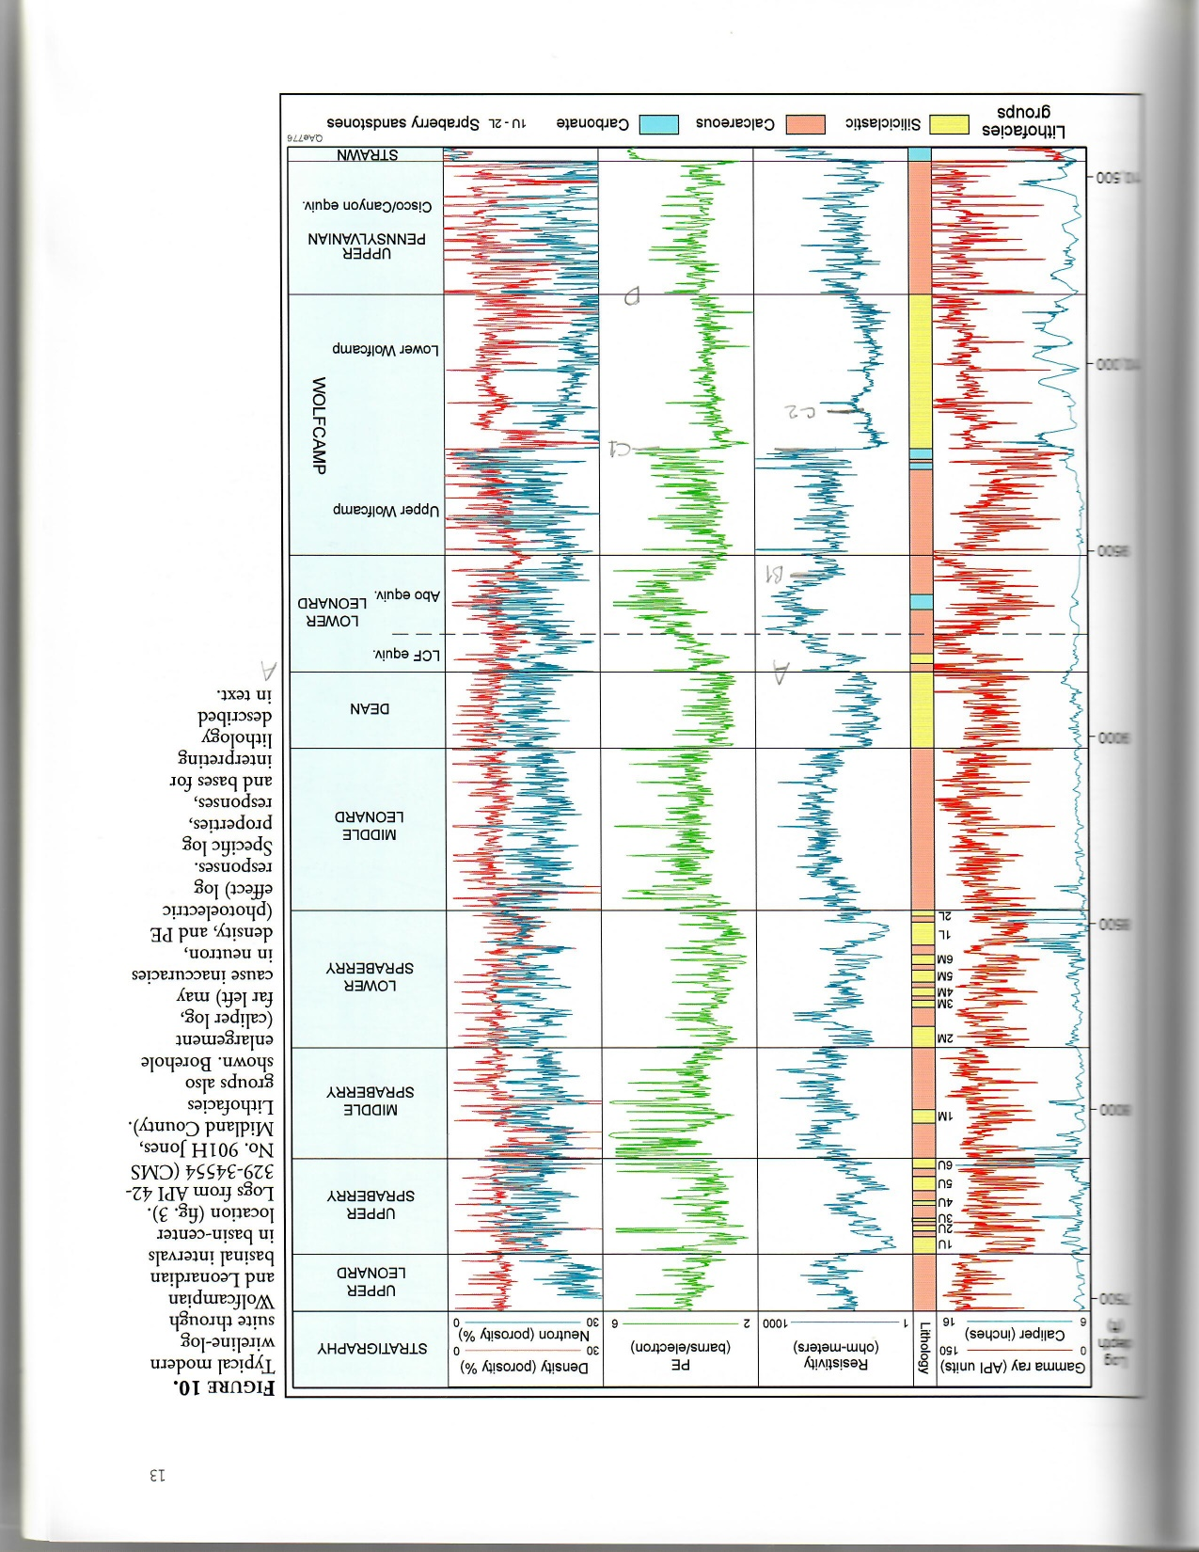
Midland Basin Type Log
MD
(ft.)
Strati-
graphy
GENERAL DESCRIPTION / DEPOSITIONAL FACIES
7500
Upper
Leonard
Upper
Spraberry
8000
Middle
Spraberry
Spraberry – Dean (= Bone Spring in Delaware Basin):
silty mudstones and clay-rich siltstones punctuated by multiple deeper-water submarine fan complexes
(incl. massive to laminated, fine-grained sandstones)
Lower
Spraberry
8500
Jo Mill
Leonardian
Lower
Leonard
Shale
9000
1st influx of course clastics (siltstones, sandstones) into basin
Dean
A
Wolfcamp A – B:
silty- and calcareous organic-rich mudstones;
carbonate percentage increases upward
9500
B
Wolfcamp-
ian
C1
mid-WC
unconformity
Wolfcamp
Wolfcamp C: Clay-rich shale
(progradation of Eastern Shelf deltas & Glasscock Nose)
10000
C2
Penn.
WFMP
D
Wolfcamp D: Basinal cyclothems (starved basin)
10500
Lower Strawn: shallow-water platform limestones
(modified from Hamlin and Baumgardner, 2012)

Slide 23
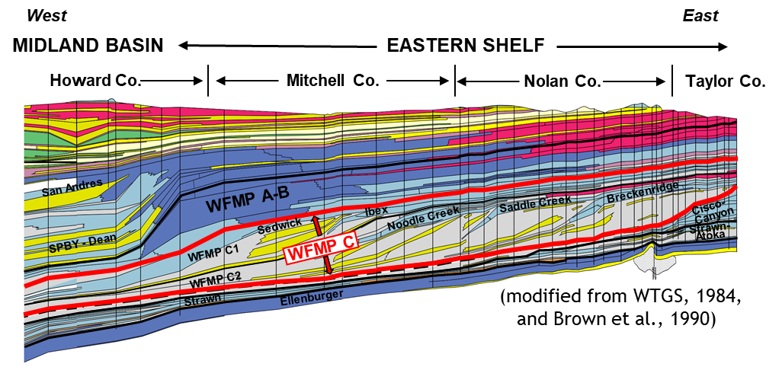
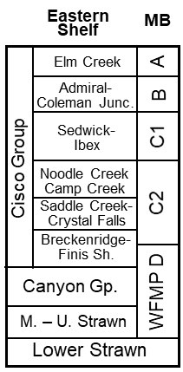
Wolfcamp C
Preliminary correlation of MB tops to Eastern Shelf
Westward progradation of Eastern Shelf delta systems and platform margins (100 -150 km)
C2 basinal shales are largely clay-rich
Initial development of Glasscock Nose during WFMP C1 time
(Sinclair et al., 2018)
Uplift of CBP structural blocks and development of mid-Wolfcamp unconformity

Slide 24
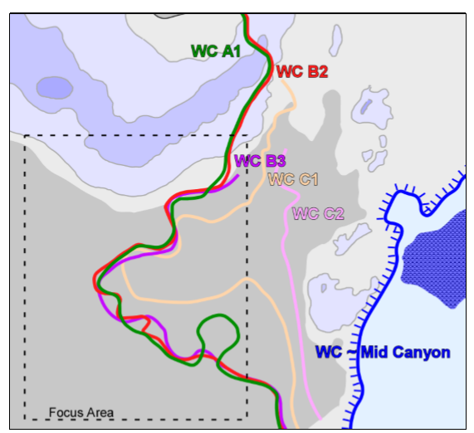
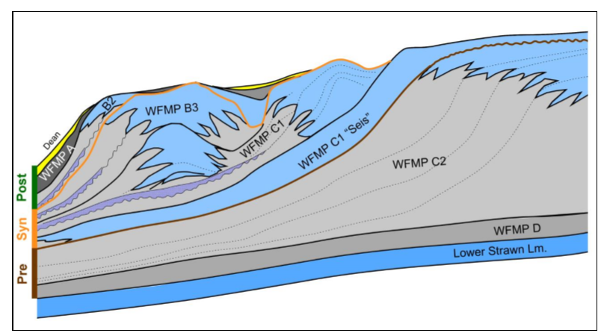
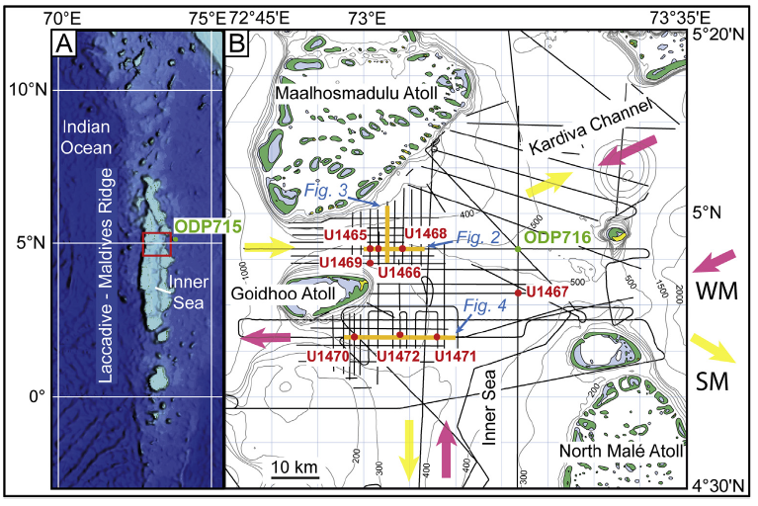
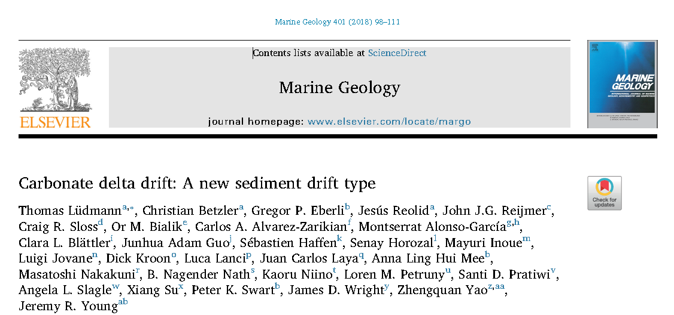
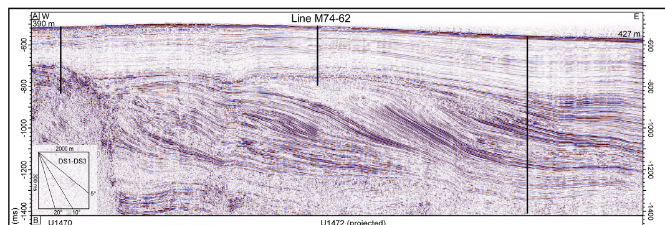
Sequential development of the Glasscock Nose
prograding, mounded deep-water carb. flows
(Sinclair et al., 2017)
SW
(Sinclair et al., 2017)
Possible analog: carbonate delta drift
Indian Ocean/Maldives seismic line

Slide 25
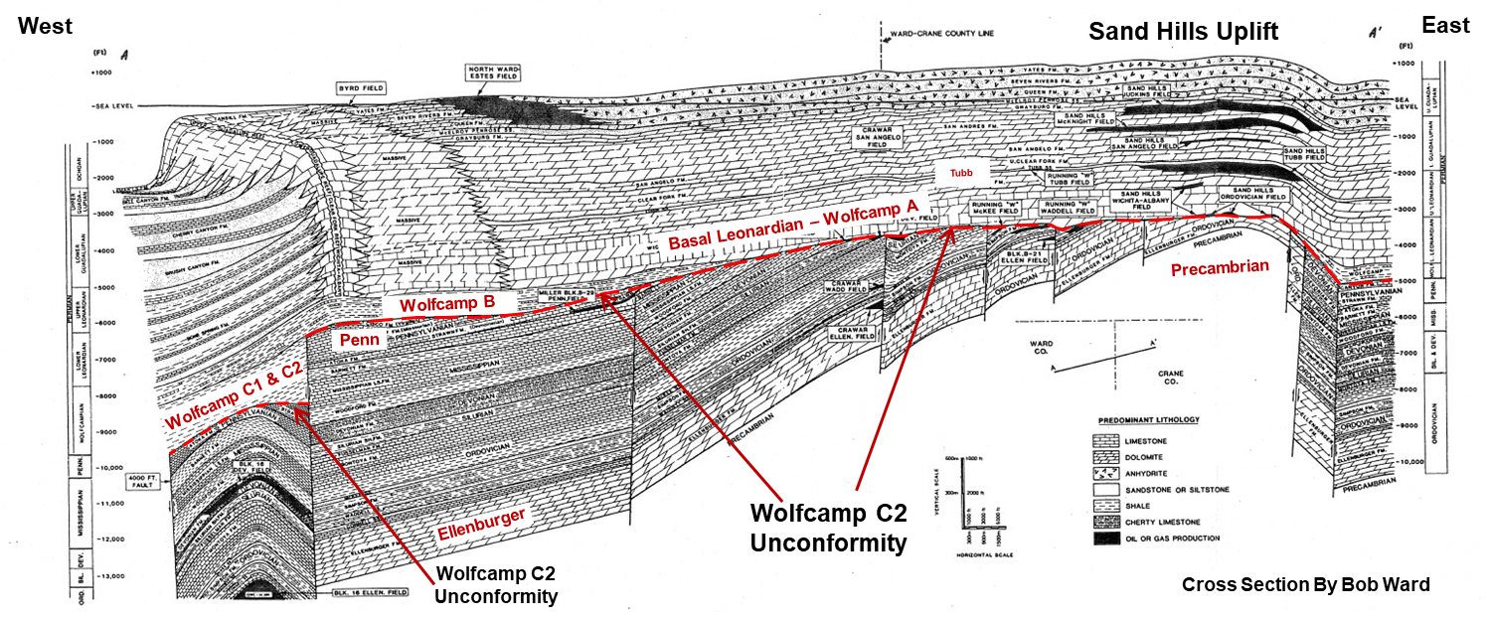
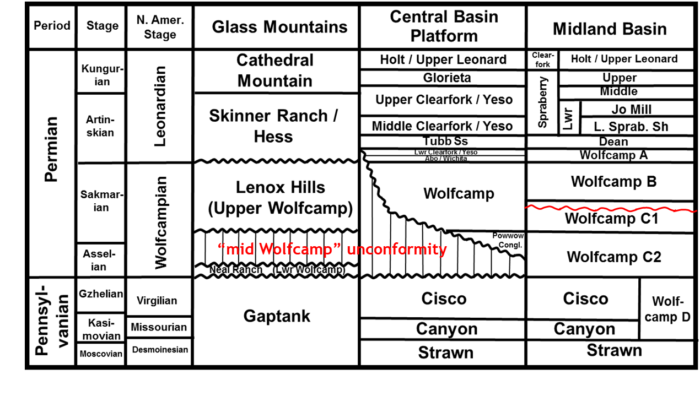
mid-Wolfcamp unconformity on the CBP
(Reed, 2014)
last major tectonic pulse prior to middle – late Permian subsidence phase
note diachronous nature of unconformity across Permian Basin region
Midland Basin: angular unconf. identified on regional seismic

Slide 26
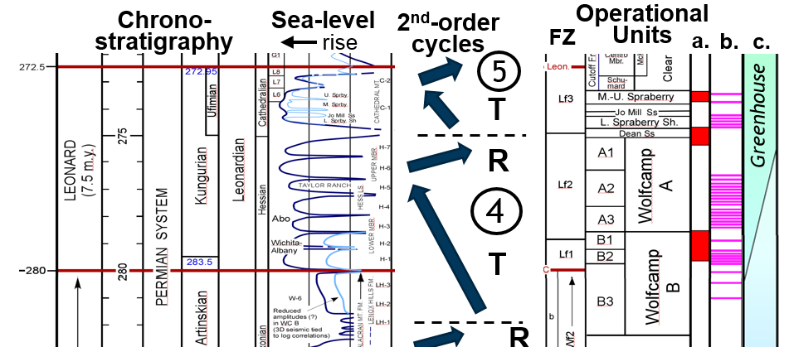
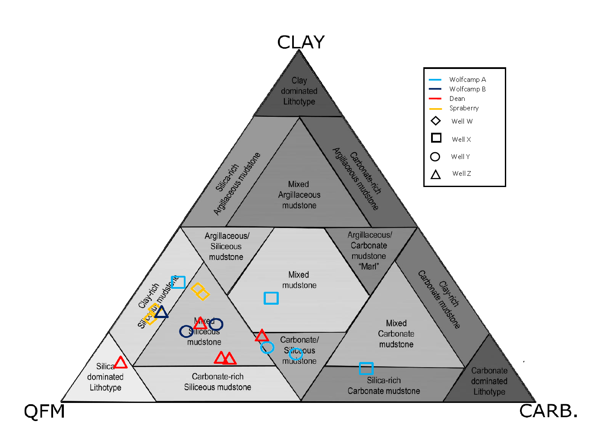
Wolfcamp A - B
700+ ft. of organic-rich, silica- and calcareous-rich mudstone punctuated by numerous density flows (carb. turbidites and debris flows)
Six operational sub-units:
A1
B1
A2
B2
A3
B3
WC B are predominantly siliceous mudstones
XRD analyses from core
(n = 476)
WC A are mixed carb-silica mudstones
L. Leonard Shale
Aggradation of carbonate margins during second-order highstand increase percentage of CaCO₃ into basin during WFMP A time
Dean
Wolfcamp A
Wolfcamp B
Interval currently resides in peak oil window in Midland Basin; remains a main horizontal drilling target
(Sinclair et al., 2018)
(Mzee, 2018)

Slide 27
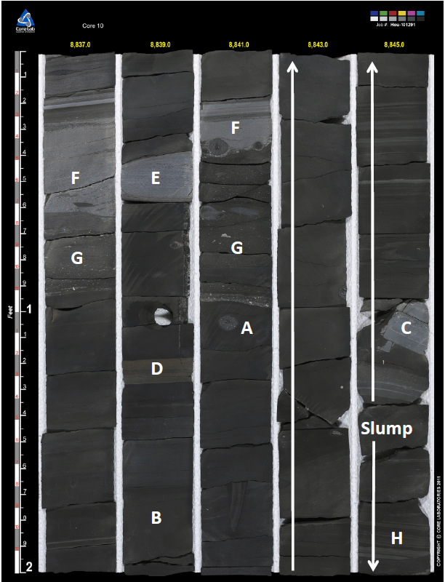
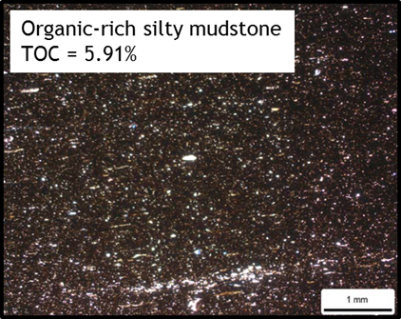
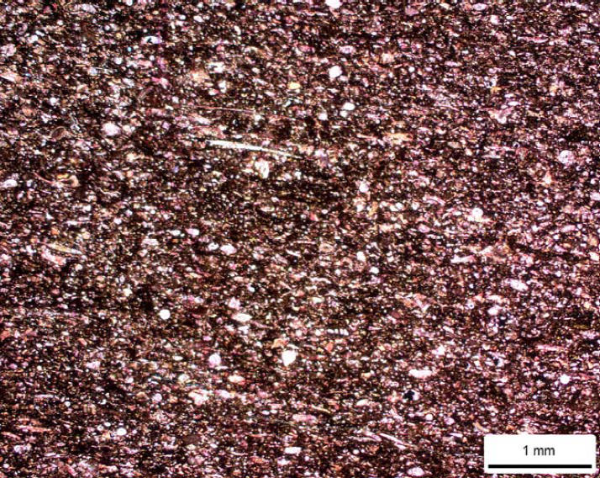
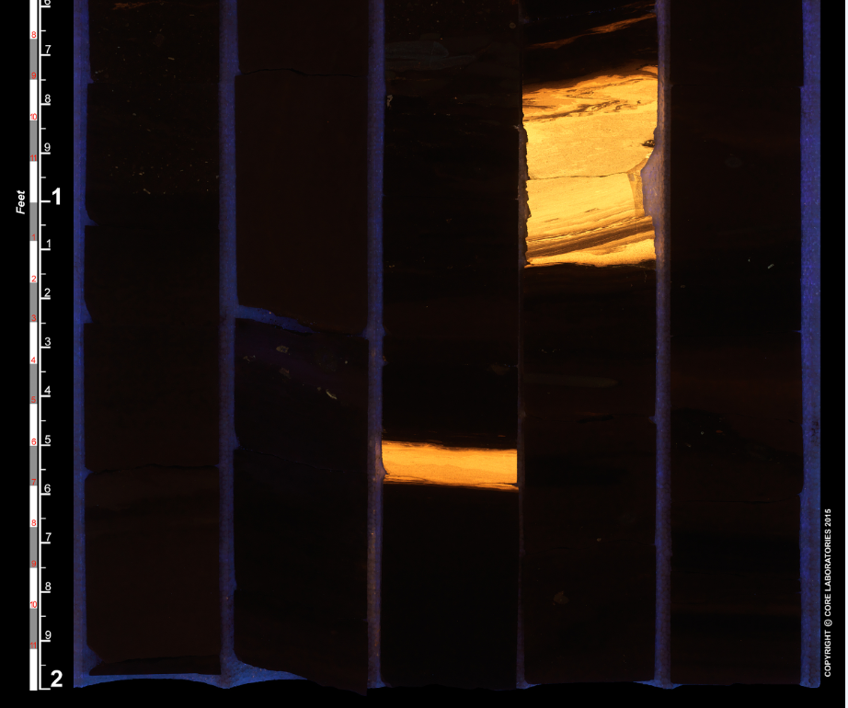
Wolfcamp B2
Wolfcamp A3
Calcareous mudstone
(Murphy, 2105)
Ash beds in core box
(UV light)

Slide 28
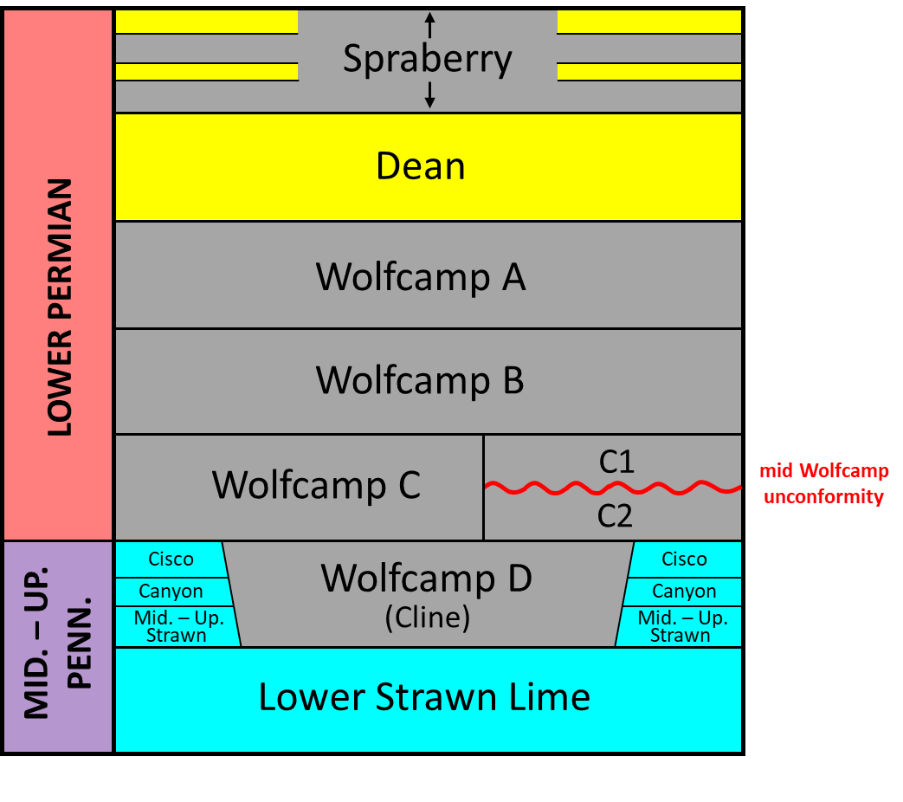
Spraberry – Dean
(= Bone Spring)

Slide 29
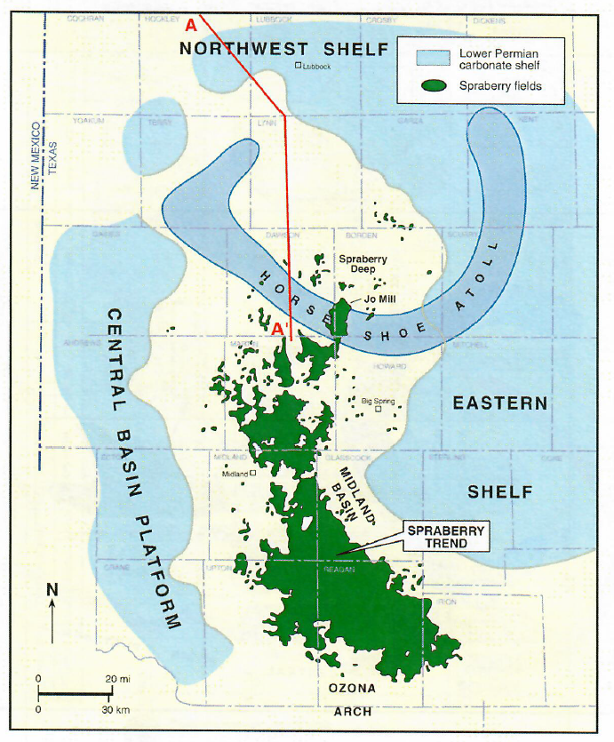
Spraberry Trend of the
Midland Basin
Discovered in 1948
Productive trend spans ~120 mi (193 km), encompassing 1.6 million acres
Low permeability deep-water sandstones (submarine fan complexes) have estimated 6 – 10 billion barrels of oil in place (15% recovery factor)
1000’s of vertical wells; now being drilled as a horizonal play
(C & C Reservoirs report)

Slide 30
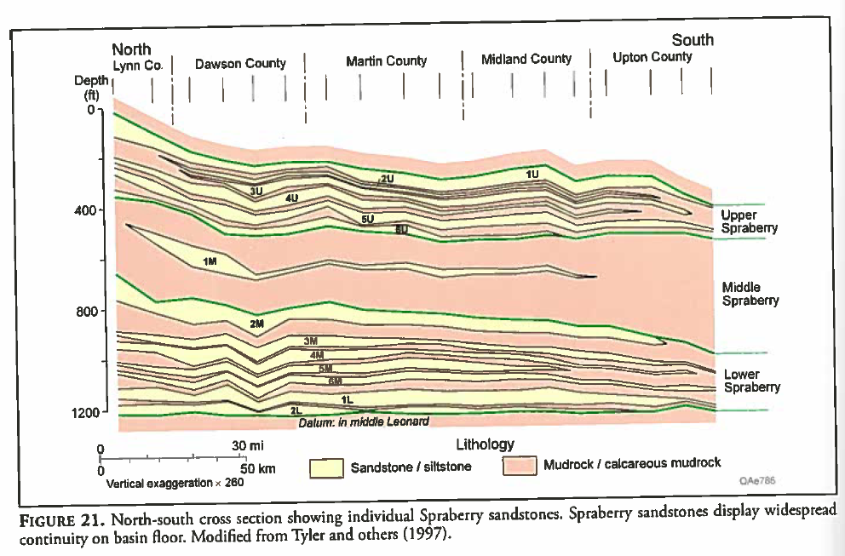
North-South cross section showing individual Spraberry sands units of the Midland Basin
Most Spraberry sands are interpreted to have been sourced from the north, and thin and shale- out southward
Some, however, clearly were sourced from the south and southeast and thin to the north
(From Hamlin and Baumgardner, 2012, 2020)

Slide 31
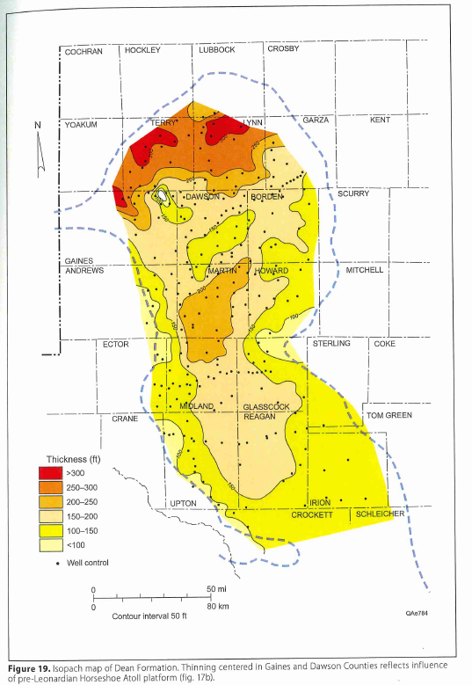
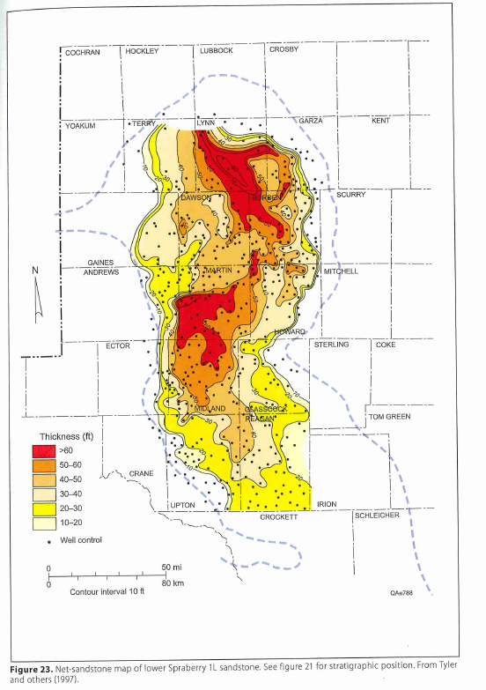
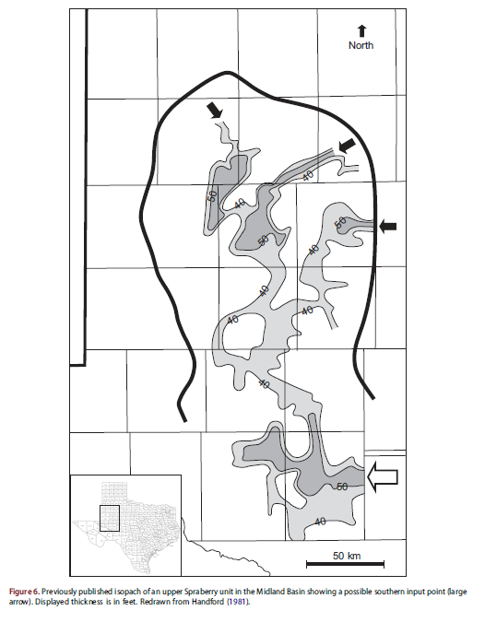
Dean sandstone thickness
Lower Spraberry 1L sandstone thickness
Upper Spraberry sandstone thickness
(Waite et al., 2020)
(Hamlin and Baumgardner, 2012, 2020)

Slide 32
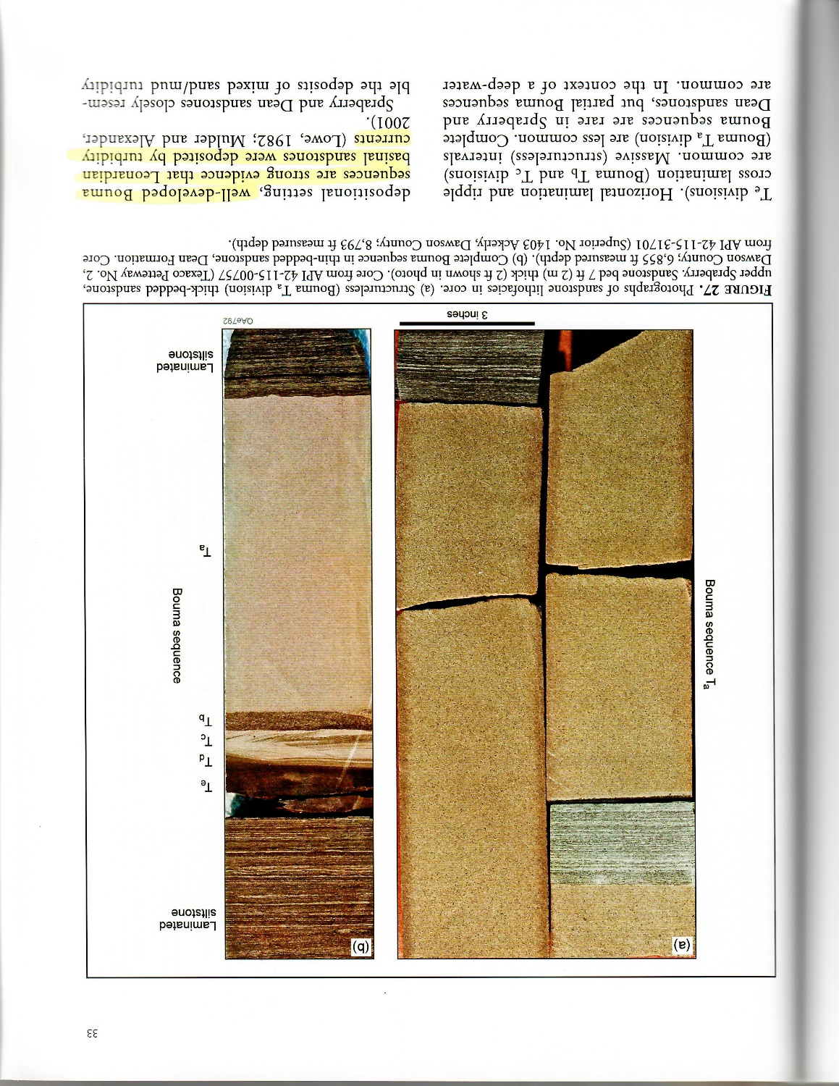
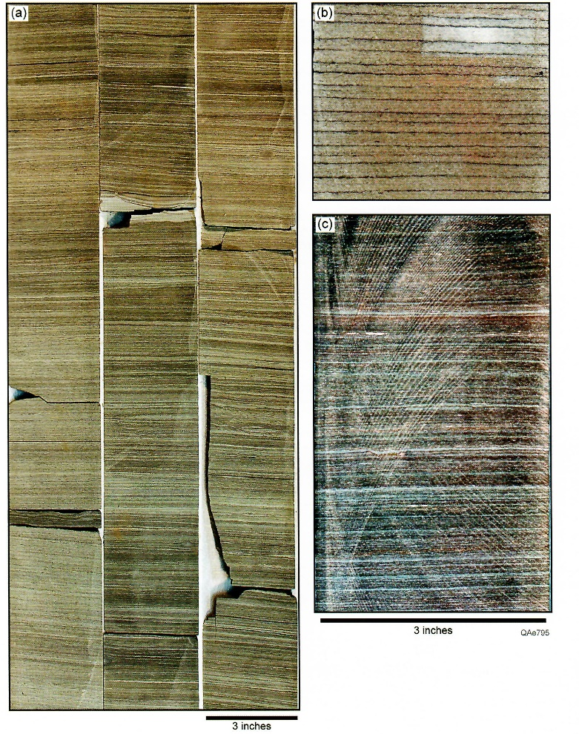
Laminated
siltstones
Massive sandstone
Bouma sequence
In Midland Basin, all fans (Dean, Jo Mill, Middle & Upper Spraberry) are similar in appearance
(Hamlin and Baumgardner, 2012)
Porous
sandstone
Main facies:
Massive f.g. sandstones (“Bouma A”)
Laminated siltstones / shales
Sandstone
cemented w/
ferroan
dolomite
Burrowed siltstones / shales (O₂)
Black shale (thin caps)
Historically a conventional play now an unconventional “shale” play

Slide 33
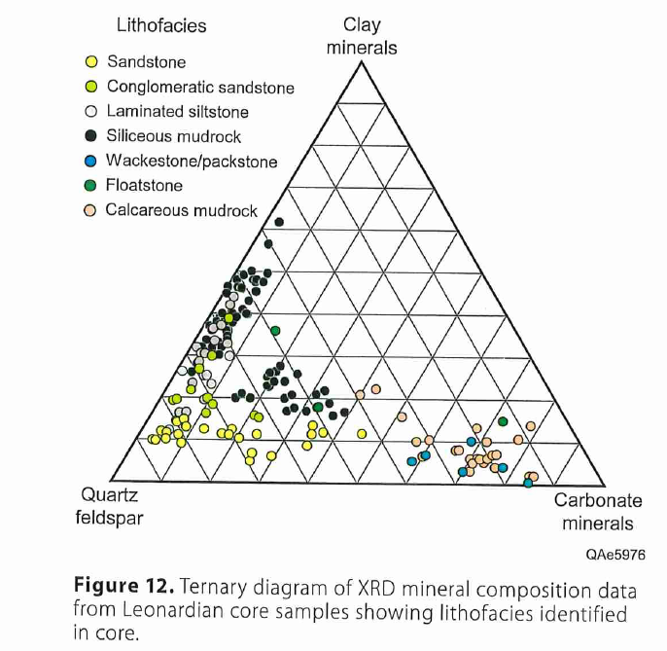
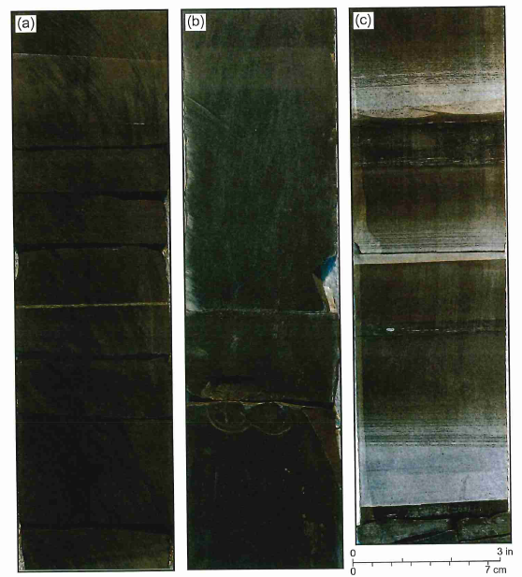
Spraberry:
Complex lithologies
Spraberry source rocks
Laminated mudrocks
High TOC (source rocks)
(Hamlin and Baumgardner, 2020)

Slide 34
Bone Spring, Delaware Basin
Thickness
Structure
(Nance and Hamlin, 2020)

Slide 35
Bone Spring type log and lithofacies
Carbonate facies consist of debrites and hemipelagic skeletal wackestones
Carbonate facies become shale rich to the south
Terrigenous clastics similar to Spraberry facies (turbidites w/ thin sand- and siltstones, laminated siltstones, and siliceous mudstones
(Nance and Hamlin, 2020)

Slide 36
Log Comparison of Leonardian & Wolfcampian units, Delaware vs. Midland Basin
Big Eddy Unit Log, Delaware Basin
MD
7300
Bone Spring is alternating series of clastics and carbonate-rich intervals
7500
1st Carbonate
(Avalon)
Spraberry is mainly siliciclastic
8000
Martin Co., TX
Midland Basin
Bone Spring is more calcitic
1st Ss
8500
MD
Holt / Upper Leonard /
PXD Clearfork
BONE SPRING FORMATION
7700
2nd
Carb
Upr Spraberry
U_A1
9000
8000
Upper
Mid Spraberry
M_A1
2nd
Ss
Middle
9500
SPRABERRY
Lwr Spraberry
L_A1
8500
Lower
3rd
Carb
Jo Mill
Jo Mill L_B1
Lower SPBY Sh
Lwr Spraberry Sh
L_C1
10000
9000
3rd
Ss
DEAN
‘A’
10500
9500
‘A’
Tippet Sh.
B1
‘B’
‘B’
WOLFCAMP
11000
C1
WOLFCAMP
200 ft.
‘C’
C1
10000
C2
‘C’
200 ft.
C2
‘D’
11500
10300
‘D’
STRAWN
STRAWN
ATOKA

Slide 37
Spraberry & Dean (Bone Spring) Depositional Model
(based on Hanford, 1981)
Early Permian
Spraberry and shelf equivalents are alternating sand-rich and organic shale/carbonate-rich packages deposited during alternating high and low sea levels.
L. Spraberry
Shelf Edge
M. Spraberry
Shelf Edge
N
S
Jo Mill
U. Spraberry
Wolfcamp
Dean
& U. L. SPBY
Middle Spraberry
Wolfcamp A
Shelf Edge
Lower Spraberry Sh
Sands are very fine-grained turbidites with partial Bouma sequences
Organic-rich shales highly laminated and not bioturbated; Organic-poor shales bioturbated
Thin dolomitic hard grounds observed in sands and shales
Highstand –
Shelf submerged
Carbonates on shelf
Carbonate gravity flow deposits and organic-rich
shales in basin
Carbonate Debris Flows
High Sea Level
Basinal Shales
Lowstand and ensuing transgression–
Shelf exposed
Clastics move across shelf via wind and in wadis
Clastic gravity flow deposits bypass shelf during
lowstand and are cannabalized during early transgression
Low Sea Level
Gravity Flow Deposits

Slide 38
Possible modern analog for Dean - Spraberry:
Offshore Mauritania, African Sahara
Core data (Zuhlsdorff et al., 2008)
Sand/mud ratio
Sea level
low
high
0
1
2
High-
3
stand
4
5
Age (x 1000 yrs.)
6
7
8
Transgress.
core
sample
9
10
11
Low-
12
stand
13
14

Slide 39
Provenance of early Permian terrigenous clastic sediments
(Lawton et al., 2021)

Slide 40
Lower Permian of the Permian Basin: Summary
Includes strata of upper Wolfcampian and Leonardian age
Completion of tectonic phase, beginning of subsidence phase; brief highstand in late Wolfcampian followed by long-term lowering of sea-level in Leonardian; transition from icehouse to greenhouse climate, increasing aridity (large desert in western U.S.)
Leonardian: 1st major influx of deep-water terrigenous clastics into basin (submarine fan complexes); multiple provinances
Midland Basin: Dean sandstone, Spraberry Formation
Delaware Basin: 1st, 2nd, and 3rd Bone Spring sandstones
Lower Permian platform carbonates represent important conventional hydrocarbon reservoirs; reefs are dominated by calcareous sponges (barrier reefs)
Lower Permian basinal sandstones and organic-rich shales represent important unconventional hydrocarbon reservoirs (historically, the Spraberry represents an important conventional reservoir)

Slide 41
Geology of the Permian Basin: ELS (Endeavor Lecture Series)
Horseshoe Atoll
Tectonic history – Part 1 (Big Picture)
Tectonic history – Part 2 (Regional elements: ARM, CBU, MFB)
Basement
Cambrian – Lower Ord (Wilberns/Bliss Ss., Ellenburger Gp)
Tobosa Basin stratigraphy (Mid Ord. – Mississippian)
Pennsylvanian (Morrow-Atoka-Strawn-Canyon-Cisco)
Lower Permian (Wolfcamp – Spraberry)
NEXT TIME:
FINALE
Middle and Upper Permian / Permian Basin petroleum system

