Slide 1
GEOS 5341 Spring 2022
Paleo Earth Systems: Global Themes
Lecture 2:
Complex Dynamic Systems
Instructor: Lowell Waite

Slide 2
Schedule: Paleo Earth Systems / Spring 2022
Jan 19: Intro / Syllabus / Grading
Jan 26: Complex dynamic systems
Feb 2: Geologic time scale / Stratigraphic record
Feb 9: Global tectonic and magmatic cycles / Global climate states
Feb 16: Biologic evolution / Ocean Anoxic Events (OAEs)
Feb 23: Sea-level analysis /Global Themes Test #1 handout (take-home; due by Start of class Mar 2)
Mar 2: Megacycle 1: Late Precambrian – Early Ord (Sauk)
Mar 9: Megacycle 2: Mid Ord – Early Devonian (Tippecanoe)
Mar 16: No class (Spring Break)
Apr 13: Megacycle 6: Mid Jur. – Low. Paleocene (Zuni)
Mar 23: Megacycle 3: Early Dev – Mississippian (Kaskaskia )
Apr 20: Megacycle 7: Up. Paleocene – Recent (Tejas)
Mar 30: Megacycle 4: Penn – Permian (Low. Absaroka)
Apr 27: Course wrap-up /Summary Test #2 handout
Apr 6: Megacycle 5: Triassic – Early Jurassic (Up. Absaroka)
May 4: No class (Test #2 due by 5pm)

Slide 3
Founding principle
Earth is a complex dynamic system with an interconnected
athenosphere / lithosphere / hydrosphere / biosphere
Past 60 yrs: tremendous convergence of geo-knowledge
emphasizing a “systems” approach:
Plate tectonics
Sequence stratigraphy
Paleobiology
Paleoclimatology and oceanography
Petroleum systems
(Ron Blakey, NAU)
“Past” Earths differ from “Present Earth”: each chapter of Earth history
is unique and is characterized by a specific set of dynamic geologic
and astronomical variables
Late Jurassic Earth
sea level
geography
tectonics
climate
biologic evolution
impact events / mass extinctions
This information can be assembled into “Global Themes” for each time-slice and used to construct
predictive geologic models (e.g., depositional facies, diagenetic susceptibility, stratal relationships,
petroleum system components)

Slide 4
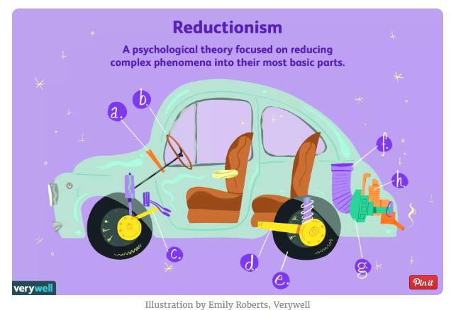
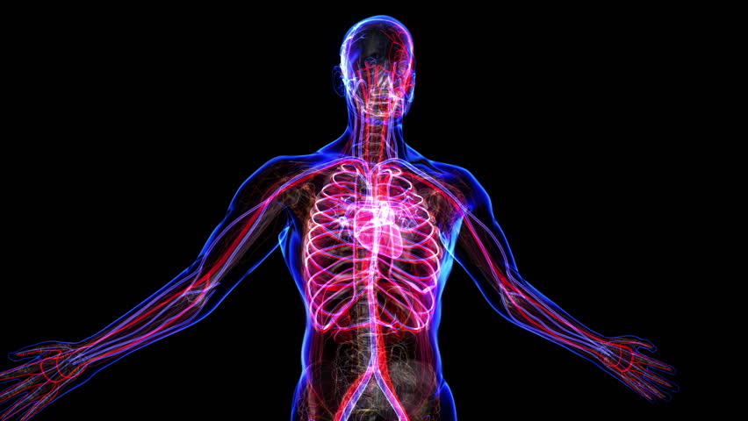
Reductionism verses a Systems-based approach
Reductionism
traditional approach to science
study of individual parts
emphasis on simple, linear relationships
observation hypothesis experimentation
System-based
holistic approach emphasizing an analysis of the interconnected whole
Complements (not opposes) a reductionist method
emphasis on complex, non-linear relationships
observation hypothesis computer simulation

Slide 5
The non-linear realm of the natural study of complex systems
Physicists
Astronomers
Quantum Mechanics;
3-body problem
Ecologists
Animal & plant ecosystems
Biologists
Physicians
Psychologists
Organisms; Mind & Consciousness
Carbonate platforms, Florida-Bahamas
Mathematicians
Comp. scientists
Computer networks; artificial life
Meteorologists
Weather; climate
Economic systems;
business networks
Economists
Archeologists
Historians
Civilizations; social systems
(photo from NASA)
Earth scientists
Geologic systems

Slide 6
Adaptive
Non-adaptive
General Systems
Theory
Traditional
Physical
Sciences
1950’s
Earth Science
16th Century
onward
Biological Sciences
Order
Study of highly-organized
cells, organs, organisms,
and ecosystems
Physics
and Chemistry
Self-organized Criticality
Study of emergent systems that
self-organize to critical states
1980’s –
1990’s
Complexity Theory
Study of systems on the cusp
between order & disorder
Earth science bridges the gap between the
physical & biological sciences, between
adaptive and non-adaptive, linear and
non-linear systems
Disorder
Chaos Theory
Study of non-linear systems
with an emphasis on the
symmetry of dynamic patterns
(fractals)
1960’s
Nonlinearity
Linearity
(modified from Hall, 1997)

Slide 7
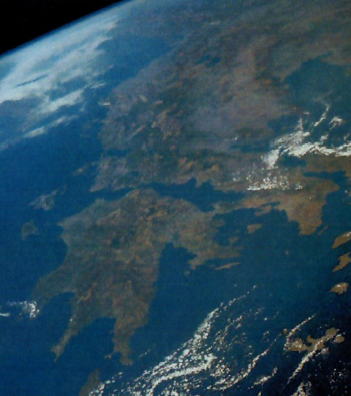
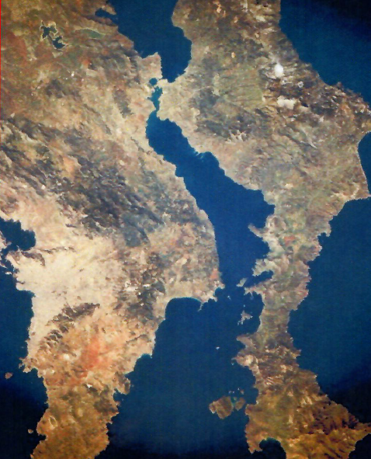
Complex systems
One definition:
A complex system is one composed of many components (one or more layers) that display a high-degree of variability over a wide-range of scales; geologic examples include landscapes and shorelines
Aspects of complex systems
behavior is difficult to model due to dependencies, interactions, relationships, and competing nature of a many-component system
Properties of complex systems include:
Complex systems represent structures that reside in time and space between the boundary of
rigid order and complete randomness
Non-linearity
Adaption
Feedback and chaos
Scale-free distributions (fractals / power laws)
Networks
Emergence
Self-organized criticality

Slide 8
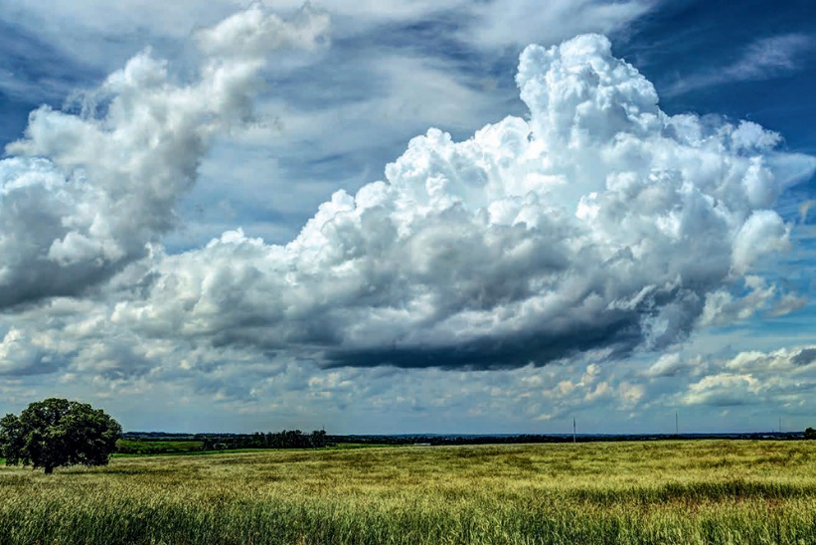
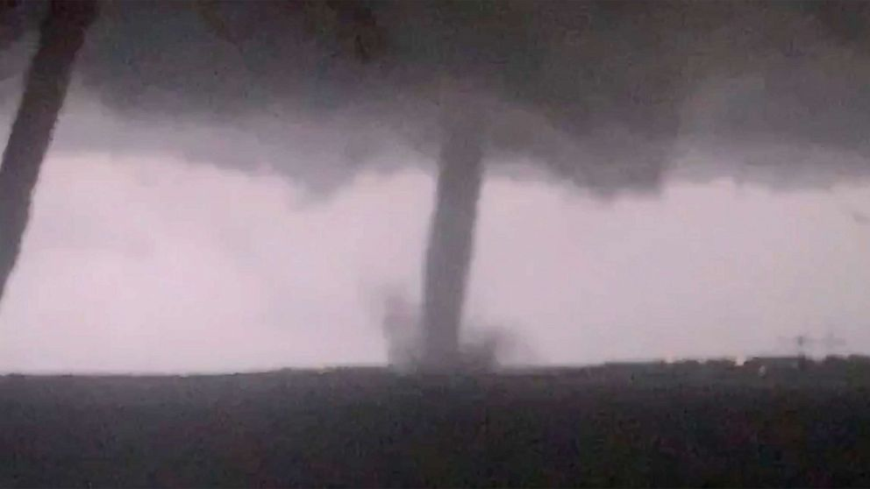
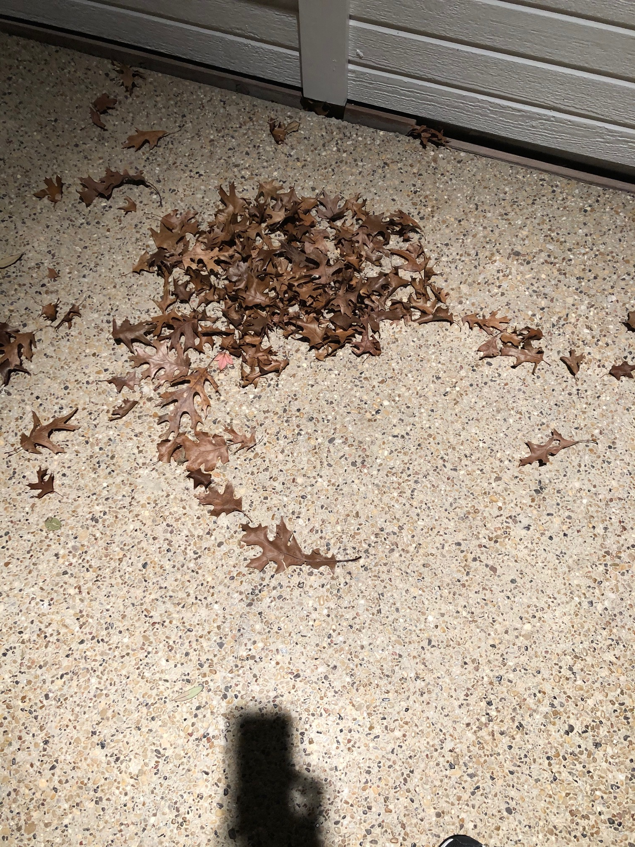
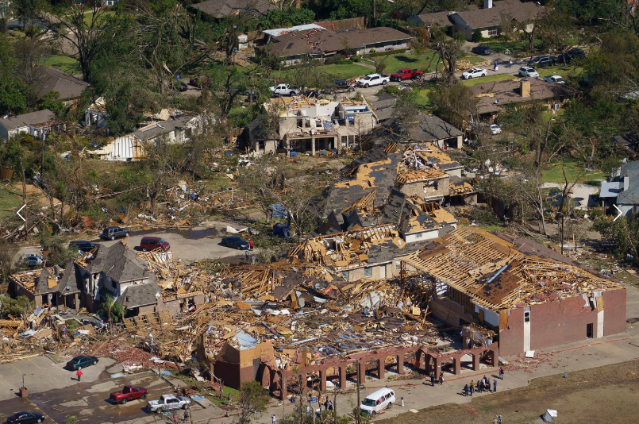
Natural systems are largely non-linear
Non-linear: output is not proportional to input (i.e., a small change may produce a large effect)
Example: weather systems (few degrees of temp/humidity change result in formation of supercell thunderstorms,
tornadoes)
Instead
of
this
This
Dallas tornado,
Oct. 2019
Instead
of
this
This

Slide 9
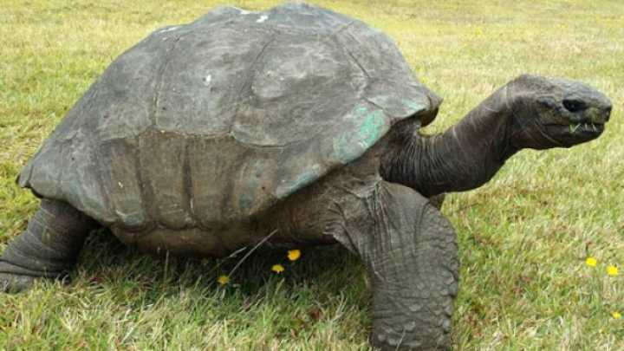
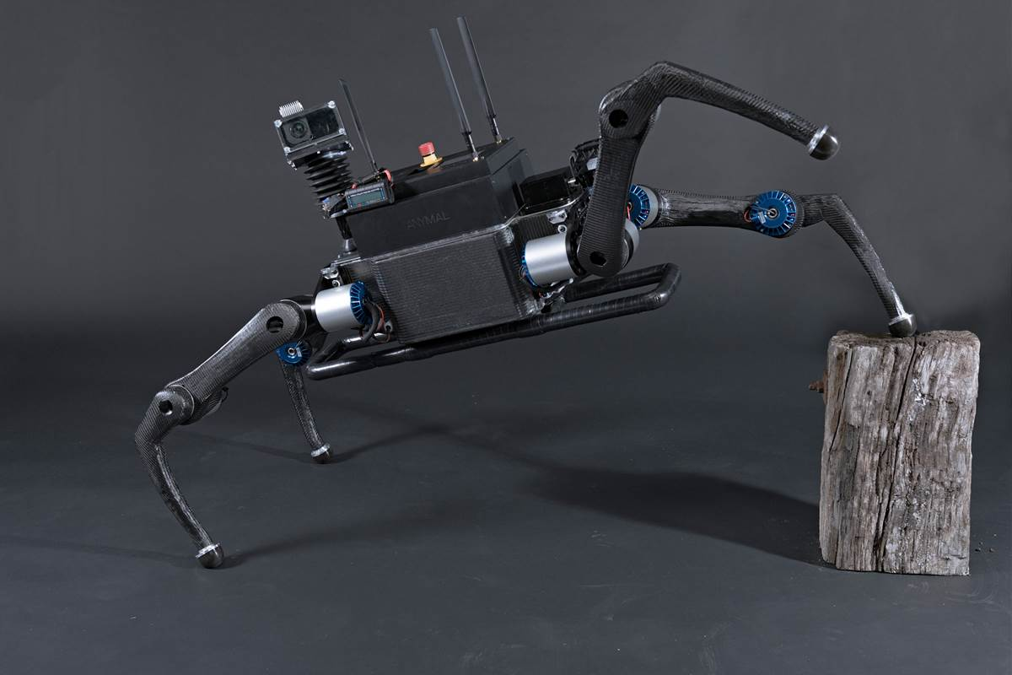
Adaptive systems
An adaptive system is a set of interacting or interdependent entities, real or abstract, forming an integrated whole that together are able to respond to environmental changes or changes in the interacting parts
Natural adaptive systems include plants and animals
Artificial adaptive systems include robots with control systems that utilize feedback to maintain desired states

Slide 10
Complex systems
One definition:
A complex system is one composed of many components (one or more layers) that display a high-degree of variability over a wide-range of scales; geologic examples include landscapes and shorelines
Aspects of complex systems
behavior is difficult to model due to dependencies, interactions, relationships, and competing nature of a many-component system
Properties of complex systems include:
Complex systems represent structures that reside in time and space between the boundary of
rigid order and complete disorder
Non-linearity
Adaption
Feedback and chaos
Scale-free distributions (fractals / power laws)
Networks
Emergence
Self-organized criticality

Slide 11
Feedback: A simple yet important component of complex systems

Slide 12
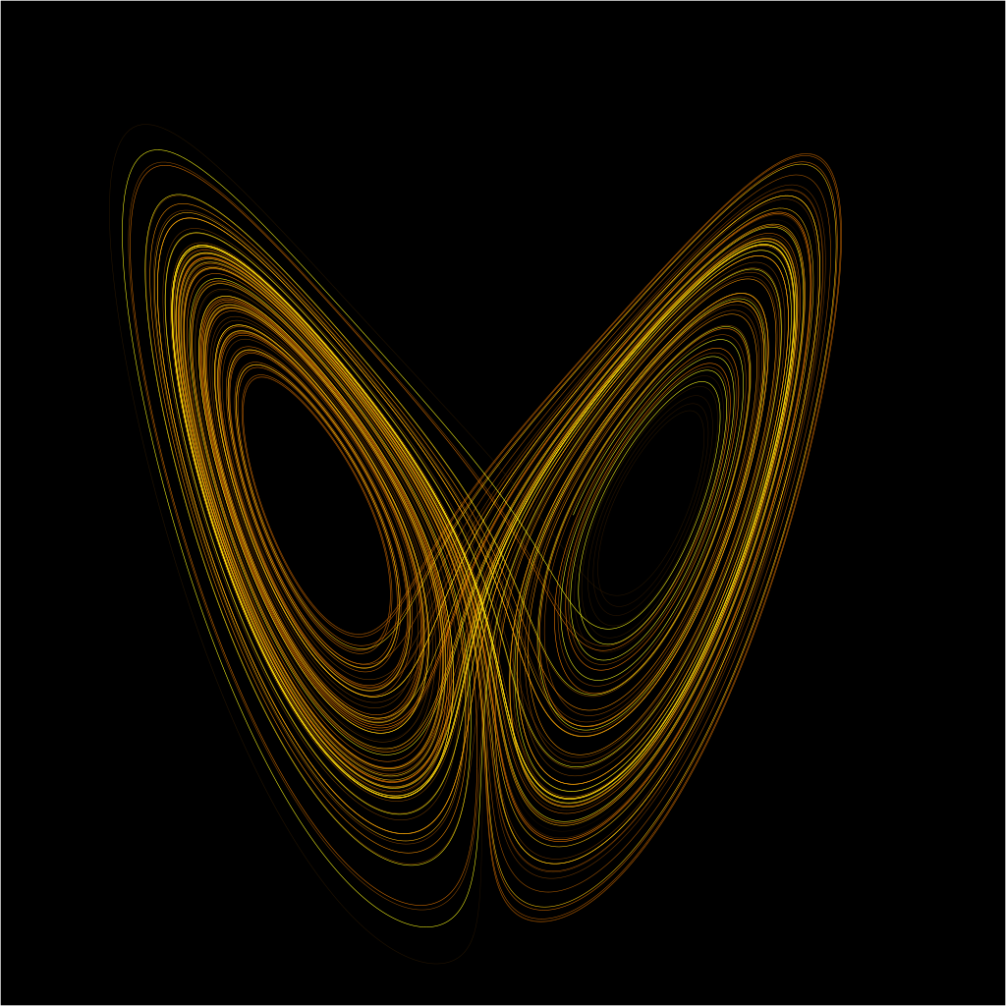
Feedback and Chaos
Under certain conditions, simple oscillating systems possessing non-linear feedback may display erratic behavior known as chaos
Chaos (definition)
-- unstable, aperiodic, apparently random behavior within deterministic, nonlinear dynamical systems
Chaotic systems display:
sensitive dependence on initial conditions
(Butterfly Effect)
non-periodicity
inherent unpredictability within specified limits
(attractors)
Example of
an “Attractor”

Slide 13
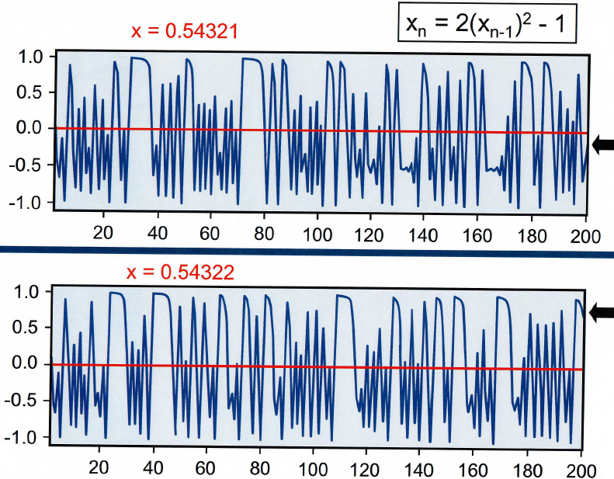
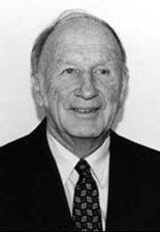
Chaos: sensitive dependence on initial conditions
Edward Lorenz was an early pioneer of chaos theory. His interest in chaos came about accidentally through his work on weather prediction in 1961
Edward Lorenz
1917 - 2008

Slide 14
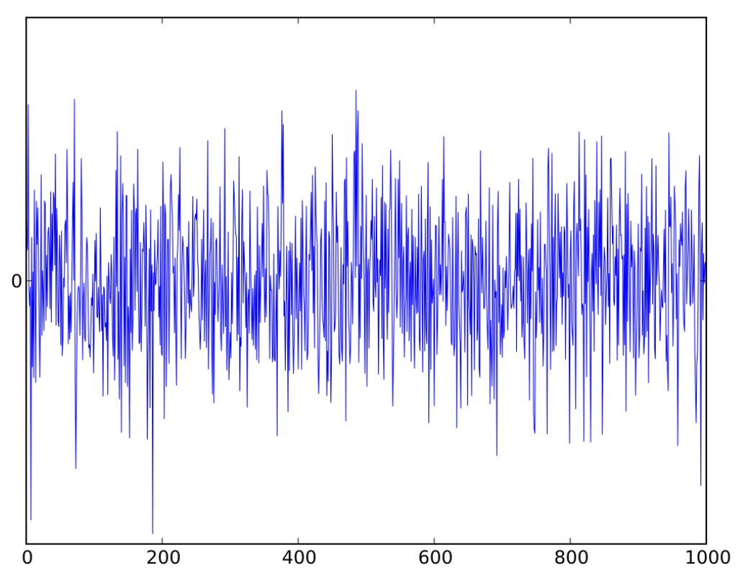
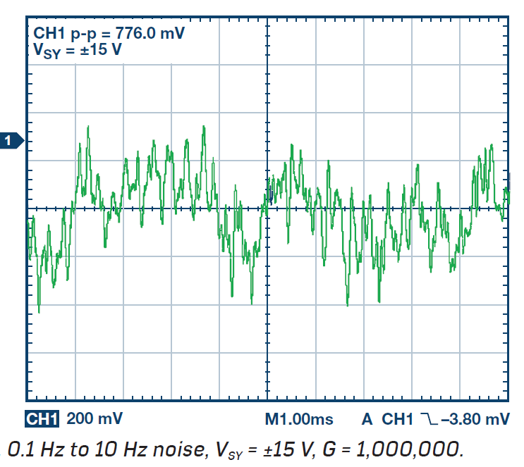
1/f Noise (a.k.a. “pink noise”): the road to complexity
What Is 1/f Noise?
1/f noise is low frequency noise for which the noise power (signal) is inversely
proportional to the frequency. 1/f noise has been observed not only in
electronics, but also in music, biology, and even economics. The sources
of 1/f noise are still widely debated and much research is still being done
in this area. (from Kiely, 2017)
White noise: Chaotic signal
Pink noise: Complex signal
White noise:
irritating to the human ear
Pink noise:
more soothing
(waterfall, falling rain)

Slide 16
Close-to-home example of a complex signal
Data: National Weather Service
https://www.weather.gov/fwd/d100data
number of days tempuratue exceeds 100º F
Year

Slide 17
Complex systems
One definition:
A complex system is one composed of many components (one or more layers) that display a high-degree of variability over a wide-range of scales; geologic examples include landscapes and shorelines
Aspects of complex systems
behavior is difficult to model due to dependencies, interactions, relationships, and competing nature of a many-component system
Properties of complex systems include:
Complex systems represent structures that reside in time and space between the boundary of
rigid order and complete disorder
Non-linearity
Adaption
Feedback and chaos
Scale-free distributions (fractals / power laws)
Networks
Emergence
Self-organized criticality

Slide 18
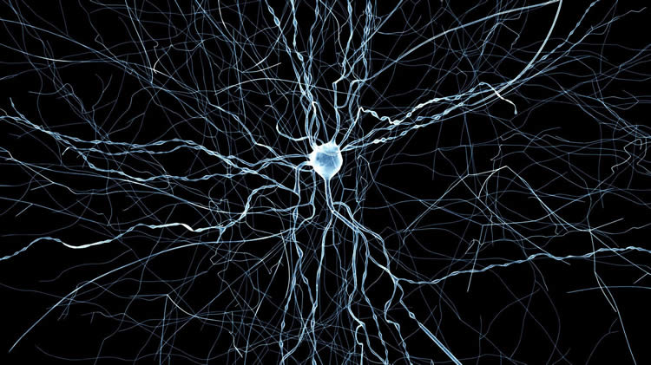
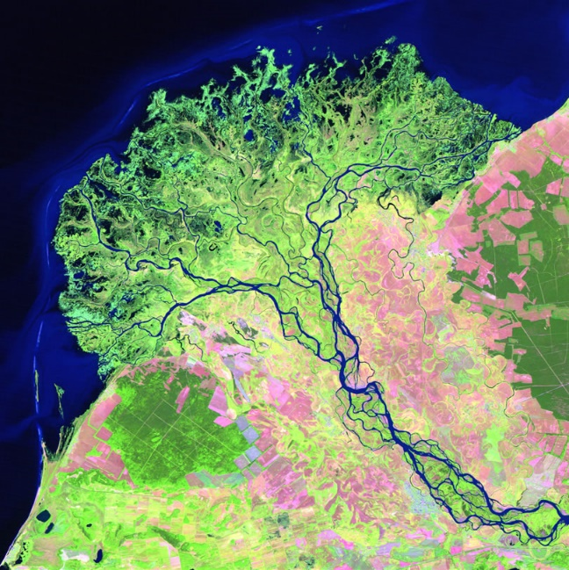
Scalar properties of complex systems
Urban: Euclidean
Complex systems often display scale-free spatial / temporal properties characterized by fractals and power laws
Rural: fractal
Fractals: Complex, non-Euclidean, self-similar shapes that display
irregularities at all scales (“the shape of nature”)
Euclidean
shapes
brain neuron
river delta

Slide 19
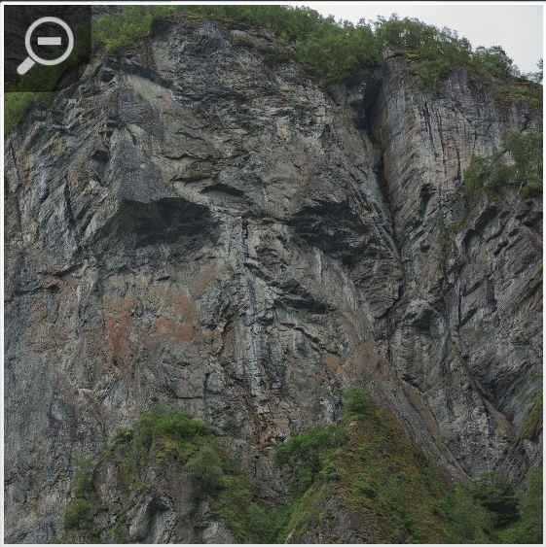
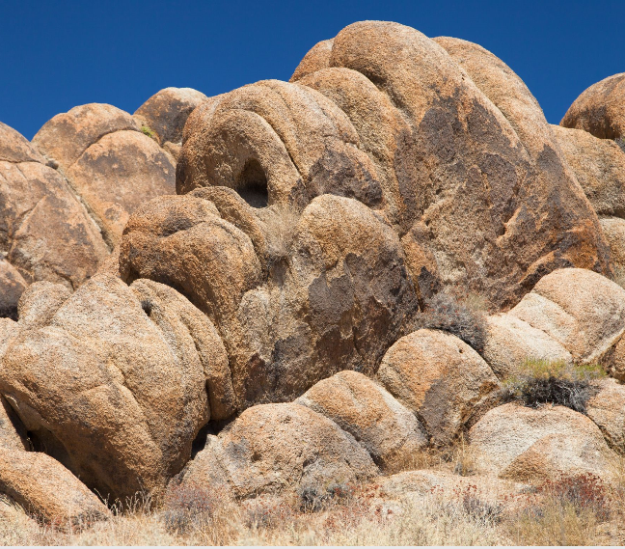
Fractures and weathering patterns in rocks result in fractal shapes…like human faces!

Slide 20
Some examples of fractal patterns in geologic systems
Landforms and faults / fracture swarms (Turcotte, 1997; Phillips, 1999)
River basins (Rodriguez-Iturbe & Rinado, 2001)
Lake Systems (Bohacs et al., 2003)
Oil & gas fields (Barton & Lapointe, 1995)
Stratigraphic hiatuses (Plotnick, 1986)
Stratigraphic sequences (Schlager, 2004)
Stratigraphic record (Bailey, 1998)
…and many others!
One would assume that complex patterns/behavior are derived from complex underlying rules: Not so!

Slide 21
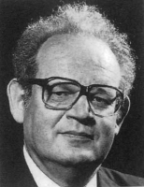
Simple rules may lead to complex patterns/behavior
The Mandelbrot set
visualized
Ben Mandelbrot (1924-2010)
Polish-born American mathematician
“The father of fractals”
The iteration formula to generate the Mandelbrot set is very simple: Z = Z² + c; yields an infinite complex pattern
https://www.youtube.com/watch?v=b005iHf8Z3g

Slide 22
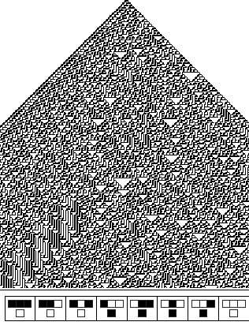
Computer-generated cellular automata models
Changing just one rule generates a highly complex pattern;
small change
makes a
significant
difference
Generating rules

Slide 23
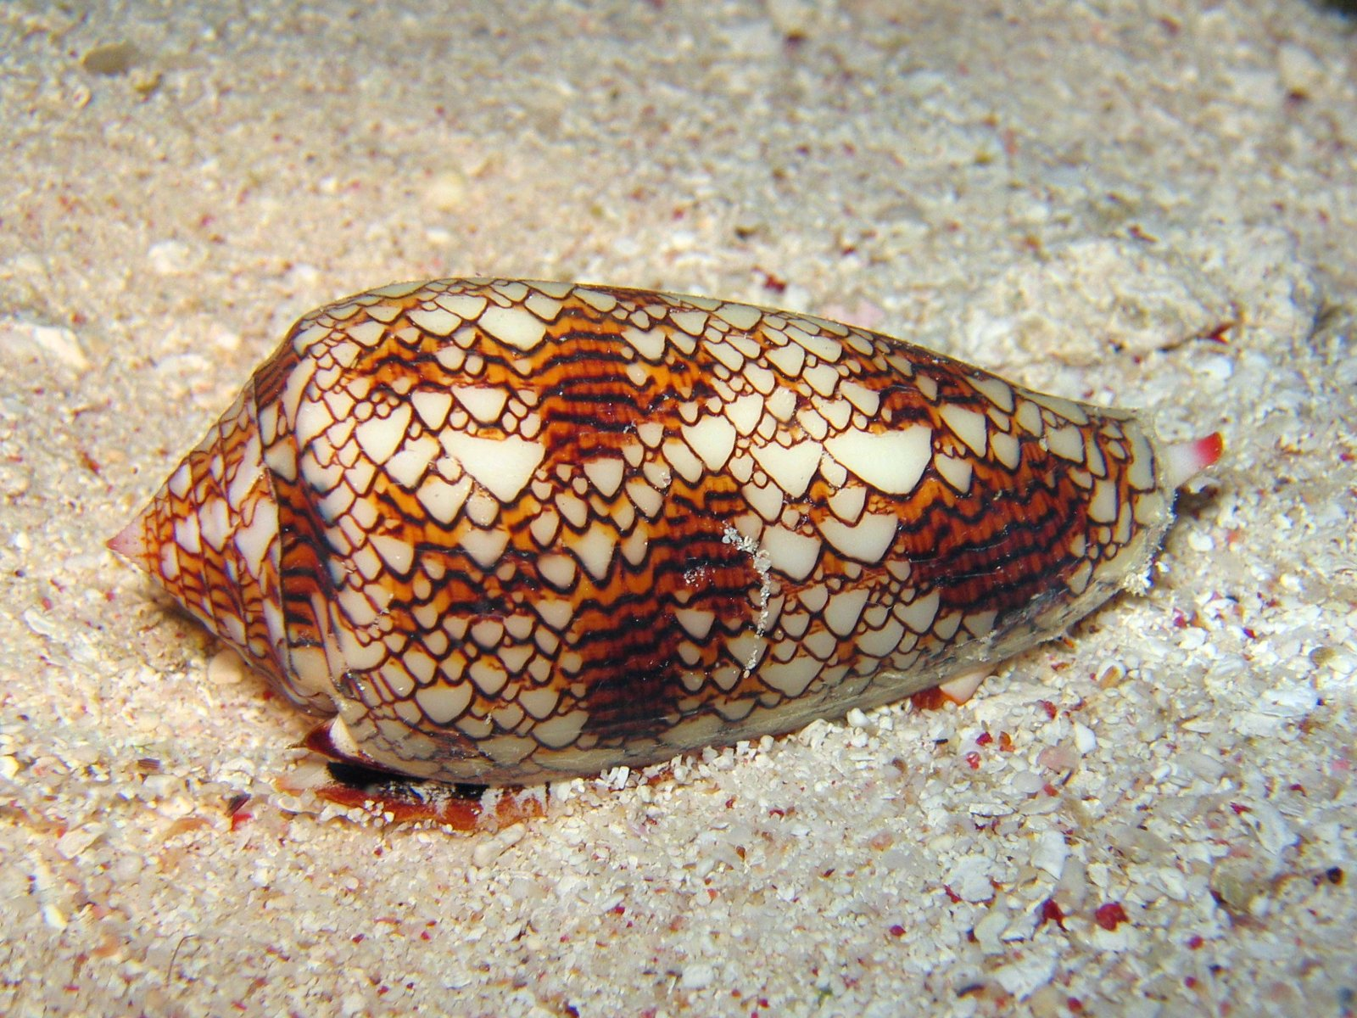
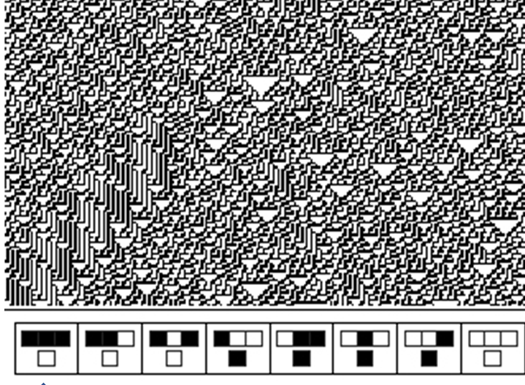
Complex pigmentation pattern
on modern gastropod shell:
Product of a very simple rule governing mineral arrangement?

Slide 24
Scalar Properties of
Complex Systems:
Power Laws

Slide 25
Scalar properties of complex systems: Power laws

Slide 26
Zipf’s law
Zipf's law is an empirical law formulated using mathematical statistics that refers to the fact that many types of data studied in the physical and social sciences can be approximated with a Zipfian distribution, one of a family of related discrete power law probability distributions. (from Wikipedia)
Log-log plot for word usage in the English language (follows Zipf’s law)
Earthquakes follow a similar pattern:
few large quakes, many small ones
(Gutenberg–Richter law)
(Bak, 1996)

Slide 27
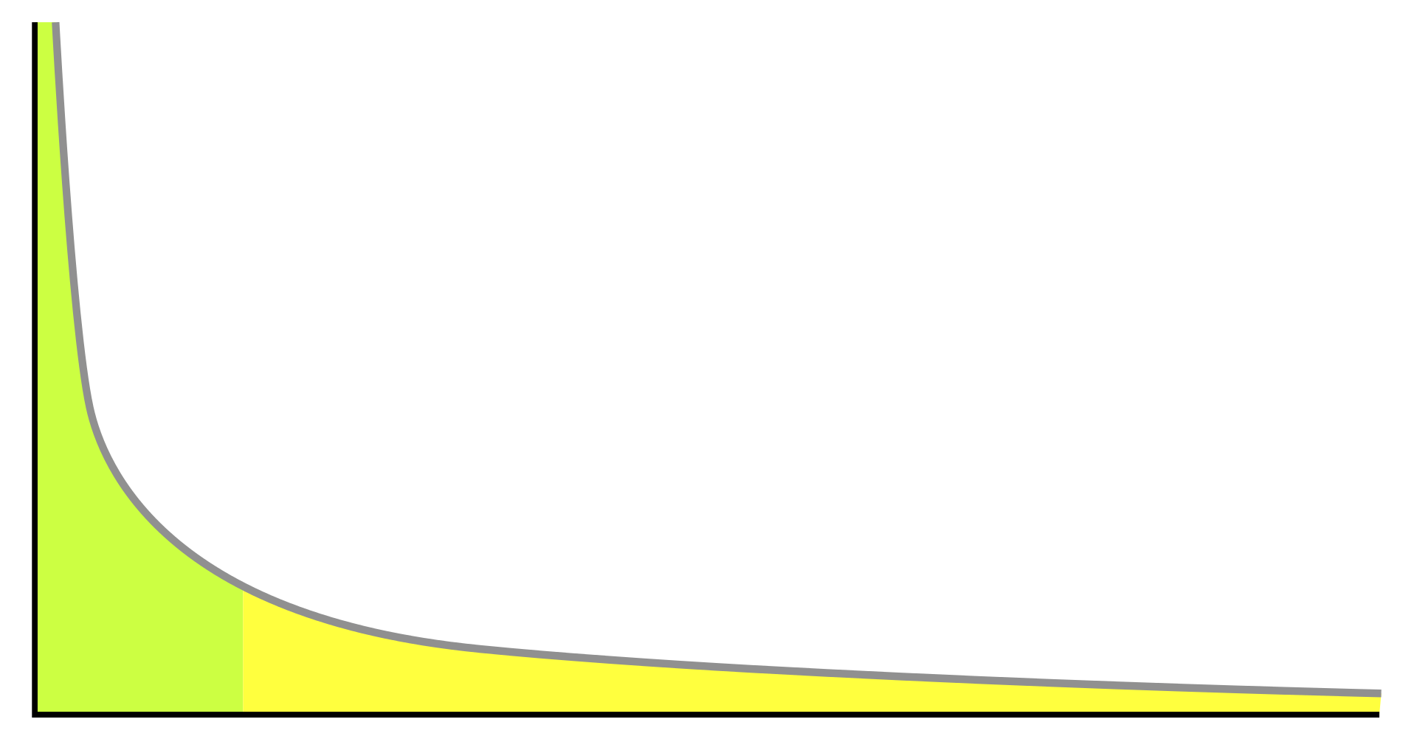
Power-law distributions: Log-normal plot (80 – 20 rule)
80 – 20 rule: 80% of the “goodies” occurs in 20% of the population
n
“Power law distributions are the patent signatures of self-organization in complex systems”
Value
Albert-Laszlo Barabasi, Professor of Physics, University of Notre Dame
“long tail”
1
1
n
ordinal rank

Slide 28
Power law distribution: Original petroleum reserves of major geologic basins and provinces
ARABIAN-
IRANIAN
Top 10 provinces contain 77%
of world’s total reserves
(730)
Hydrocarbon Reserves
(Billion barrels of oil equivalent)
WEST SIBERIA (240)
U.S. GULF COAST (120)
WEST TEXAS PERMIAN (53)
NORTH CAUCASUS (50)
SOUTHERN MEXICO (56)
EASTERN VENEZUELA (48)
VOLGA-URAL (66)
SOUTHERN NORTH SEA (30)
MARACAIBO (62)
NORTHERN NORTH SEA (35)
ANADARKO (50)
ALBERTA (46)
NORTH CASPIAN (42)
S. ATLANTIC (14)
ERG ORIENTAL - ILLIZI (38)
PRIPYAT, DNIEPER-DONETS (12)
NIGER DELTA (37)
CALIFORNIA (31)
NORTH SLOPE (20)
INDONESIAN BASINS (19)
SOUTH CASPIAN (18)
APPALACHIAN (11)
SONGLIAO (9.5)
ROCKY MTNS (9)
TIMAN-PECHORA (9)
GREEN RIVER (7.5)
NORTH KALIMANTAN (7.5)
SUEZ (7)
NORTH CHINA (5.5)
SICHUAN (4)
ILLINOIS (5.5)
COOPER (1)
WILLISTON (5)
VILYUY (4.5)
MACKENZIE DELTA (5)
PLOESTI-W. UKRAINE (3)
MICHIGAN (2.5)
MAHAKAM DELTA (3)
2
4
6
8
10
12
14
16
18
20
22
24
26
28
30
32
34
36
38
RANKING
(data from Ulmishek & Klemme, 1990)

Slide 29
Complex systems
One definition:
A complex system is one composed of many components (one or more layers) that display a high-degree of variability over a wide-range of scales; geologic examples include landscapes and shorelines
Aspects of complex systems
behavior is difficult to model due to dependencies, interactions, relationships, and competing nature of a many-component system
Properties of complex systems include:
Complex systems represent structures that reside in time and space between the boundary of
rigid order and complete disorder
Non-linearity
Adaption
Feedback and chaos
Scale-free distributions (fractals / power laws)
Networks
Emergence
Self-organized criticality

Slide 30
Networks
Components:
Nodes
Links
node
link

Slide 31
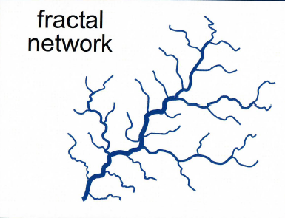
Network types (from Barabasi, 2002)
Centralized
Decentralized
Distributed
Fractal
hub
example: river systems
(node)
example: small businesses
example: airports
example: internet

Slide 32
It’s a small world after all…strong vs. weak links
Ties between nodes can either be strong or weak
In social networks, strong ties = close friends
weak ties = acquaintances
It has been proven that weak ties play an important role in a number of social activities (e.g., spreading rumors; getting a job offer; e.g., Linkedin)
(Barbarasi, 2002)
Networks with weak links have a generic property known as the “small world phenomenon,” otherwise known as “six degrees of separation” -- all people are connected by a minimum of five links
On the internet, any page is, on average, only nineteen clicks away from any other

Slide 33
Clustering and the power of a few random links
(Barbarasi, 2002)

Slide 34
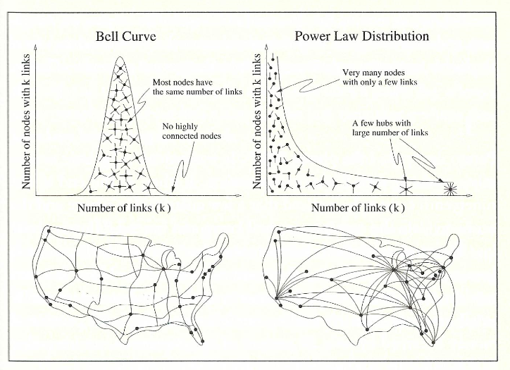
Distributed vs. scale-free networks
Distributed network
Scale-free network
Distributed networks: node linkage follows a normal distribution
Scale-free networks: node linkage follows a power law distribution (nodes are “hubs”)
Scale-free networks are most efficient for many systems (e.g., commercial air travel)
However, scale-free networks are also highly vulnerable; loss of one or more major hubs can be disastrous
roads
airports
(Barbarasi, 2002)

Slide 35
The stratigraphic record as a network
Stratal record: the result of a highly complex, coupled system of interactions and feedbacks
Most stratigraphers consider only one or a few controls; yet what new insights might be gained by modeling the sedimentary record as a complex, dynamic system?

Slide 36
Complex systems
One definition:
A complex system is one composed of many components (one or more layers) that display a high-degree of variability over a wide-range of scales; geologic examples include landscapes and shorelines
Aspects of complex systems
behavior is difficult to model due to dependencies, interactions, relationships, and competing nature of a many-component system
Properties of complex systems include:
Complex systems represent structures that reside in time and space between the boundary of
rigid order and complete disorder
Non-linearity
Adaption
Feedback and chaos
Scale-free distributions (fractals / power laws)
Networks
Emergence
Self-organized criticality

Slide 37
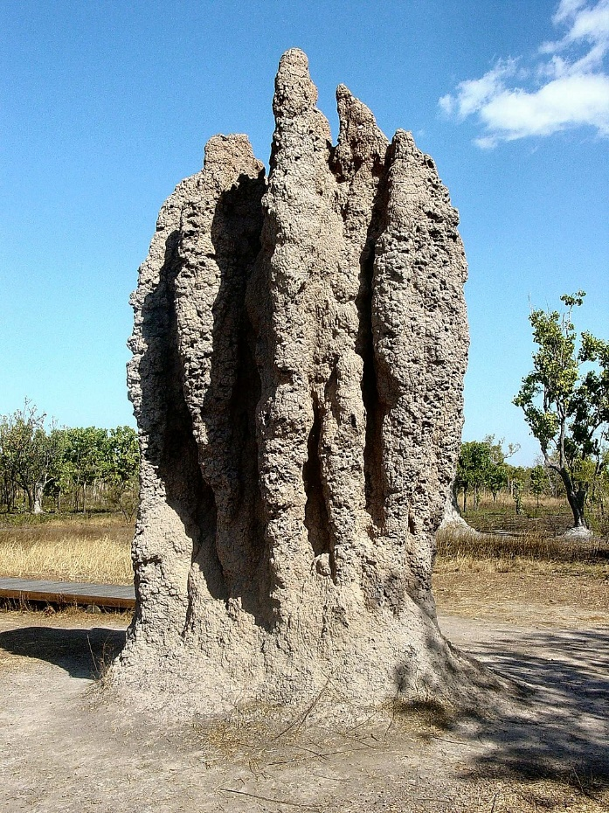
Self-organization and emergence
Many natural complex systems with the properties of feedback, scale-free distributions (fractals, power-laws), and connectivity (networks), self-organize to higher levels of organization/complexity in absence of any guiding hand or designated leader
During this process, higher-level patterns, properties, or functions emerge that transcend those of lower levels; examples include the behavior of ant and termite colonies; the physical and chemical properties of water; sedimentary complexes such as carbonate tidal flats and river deltas; and human consciousness
Termite colony
The emergence of artificial intelligence from advanced computer networks is another example, and currently a topic of some concern to some researchers

Slide 38
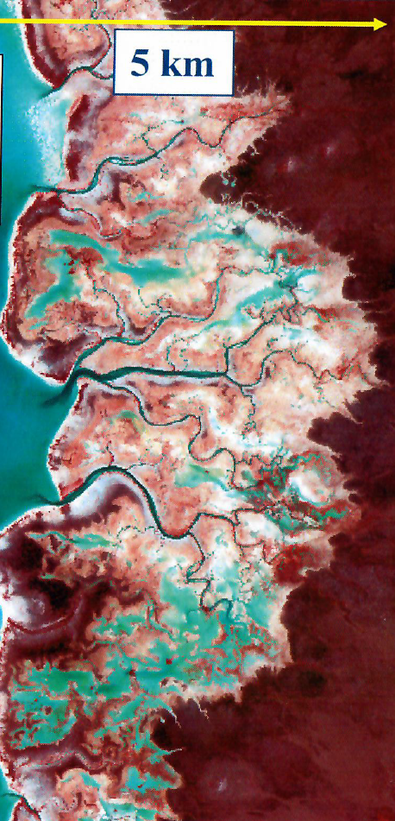
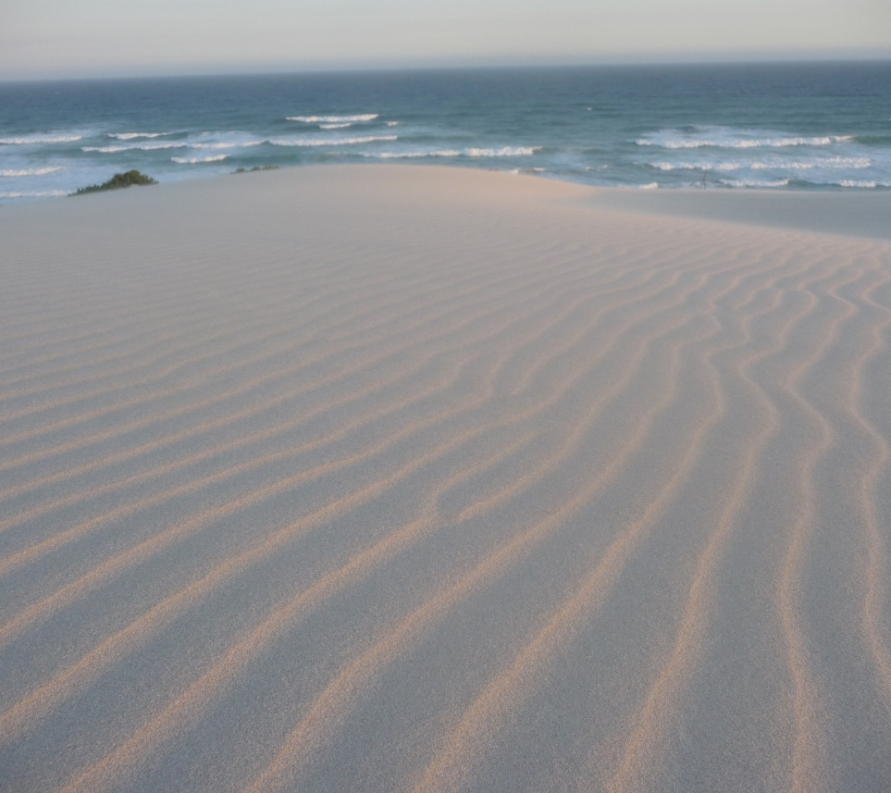
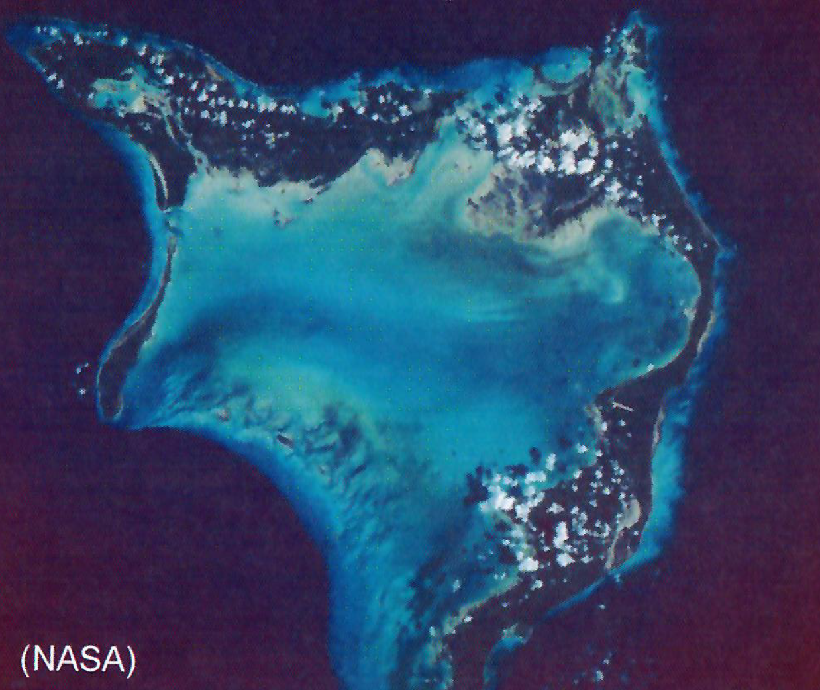
Examples of emergent structures in sedimentology
Carbonate tidal flat
Ripple marks
Carbonate platform / reefs
50 km

Slide 39
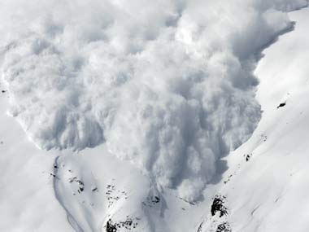
Self-organized criticality (SOC)
A concept put forth in 1987 by physicists Per Bak, Chao Tang, and Kurt Wiesenfeld which states that open dynamical complex systems naturally evolve towards non-equilibrium, resulting in a critical state prone to phase changes, and where minor disturbances can lead to catastrophic events (“the straw that broke the camel’s back”)
Examples include avalanches, stock market crashes, solar flares, forest fires, and traffic jams
SOC is a useful theory to explain many natural and social phenomena
SOC remains a theory, as there remains no general agreement with regards to its mechanisms in abstract mathematical form
Can the concept of SOC help predict the timing of geologic events such as major earthquakes, changes/flips in the Earth’s magnetic fields, or volcanic eruptions?

Slide 40
At this point you may be thinking that this is all very interesting…
but…
How does this relate to geoscience?
For one, thinking of the Earth and its many interconnected parts as a complex dynamic system provides new insights to old problems and existing theories; applying the tools of complexity science to geoscience may lead to the next big breakthroughs in understanding
Again, this is not meant to replace the tried-and-true reductionist method, but to augment it
-- Let’s look at some possible applications to geologic and geophysical problems --

Slide 41
Some possible applications of complexity theory to geoscience & business
Improved geologic and geophysical models
vertical and horizontal distribution of depositional facies
porosity distribution and subsurface movement of fluids
seismic imaging (trap presence & configuration)
More efficient organization of companies
Better price forecasting
Understanding change: fossil record as a guide to business and economy
industrial age to information age
global economy based on renewable energy sources

Slide 42
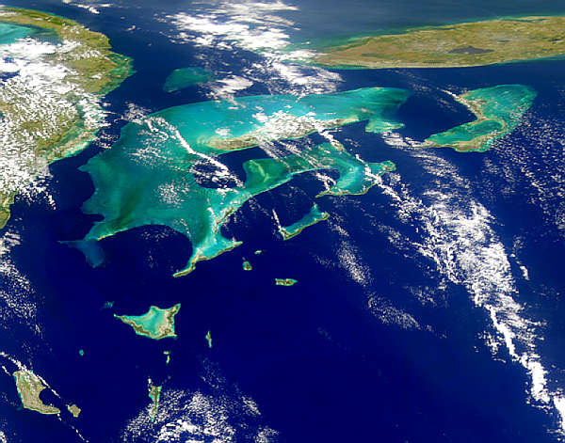
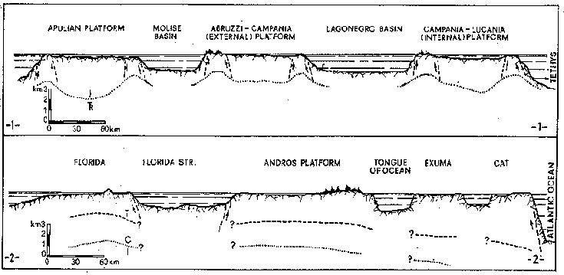
Bahamian Carbonate Platform (Holocene)
North
Florida
Cuba
Self-similarity of
carbonate platforms
Apulian
Platform
Molise
Basin
Abruzzi
Platform
Lagonegro
Basin
Lucania
Platform
Mesozoic Platforms, Italy
Florida
Florida
Straits
Andros
Platform
Exuma-Cat
Platforms
TOTO
(photo from NASA)
Florida-Bahama Platforms (Meso-Cenozoic)

Slide 43
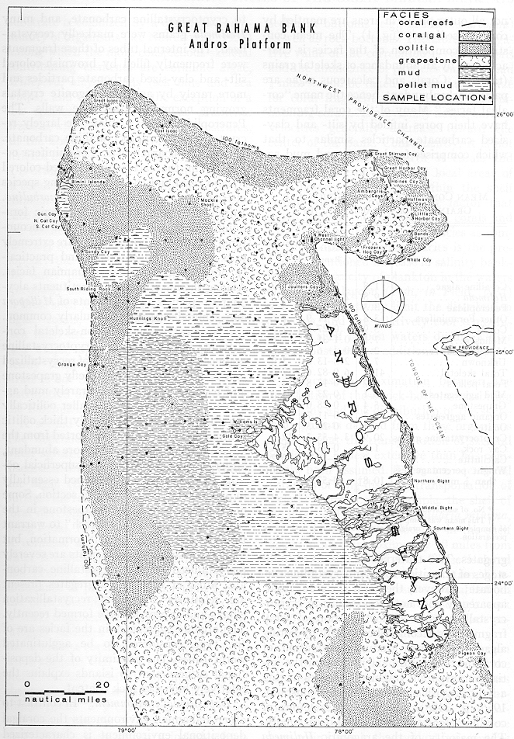
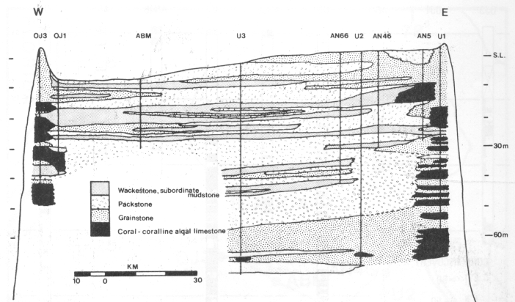
Great Bahama bank
(photo from NASA)
Prediction of facies distribution
coral-algal
grainstone
Area
shown
Reefs (orange) and ooid grainstones (pink) occur on both sides of the platform
Note abundance of high-energy ooid grainstones on the windward side
winds
E
W
Note complex interlayering of facies in vertical space
reef
W
E
oolitic
grainstone
(modified from Purdy, 1963 & Beach and Ginsburg, 1980)

Slide 44
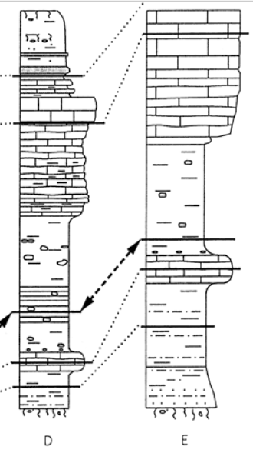
Σ(I)
0.188
0.271
0.295
0.246
0.644
1.644
Self-organizing cellular model of
shallow water CaCO₃ accumulation
F = 0
r = 0.376
l = 0.188
F = 1
r = 0.295
l = 0.295
new F = 0
(Drummond and Dugan, Jour. Sed. Res., 1999)
F = 0
r = 0.541
l = 0.271
F = 0
r = 0.491
l = 0.246
F = 1
r = 0.644
l = 0.644
1.644
5
= 0.329
Example 20 x 20 grid showing
horizontal distribution of
rare facies (dark blue)
Synthetic
vertical section
(24 iterations)
Actual vertical
sections
(Penn, N.cen. TX)
Limit = 0.350
100 x 120 cellular matrix
F = Facies
1 = rare
O = common
Rules
Value of central cell
determined by 4 neighbors
assigned a random variable ( = r )
I = influence on future state
I = r (F=1)
l = r/2 (F=0)
If avg. I > 0.35, new state = 1

Slide 45
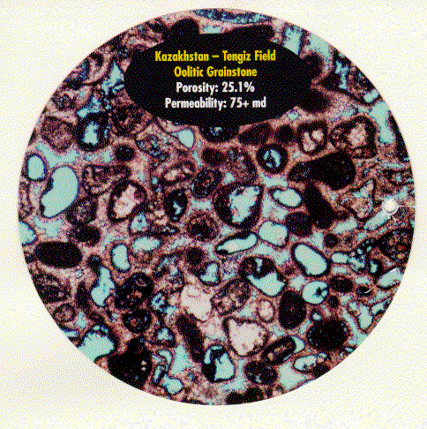
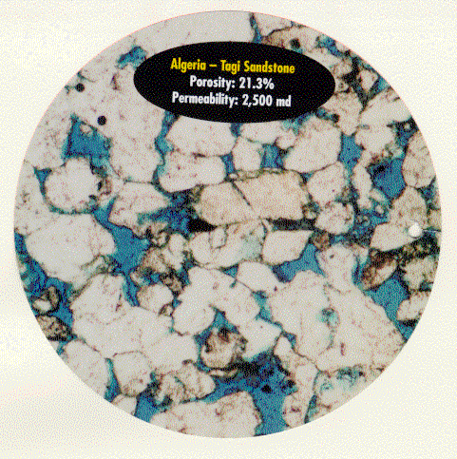
Tengiz Field - Kazakstan
Oolitic grainstone
Porosity: 25.1 %
Permeability: 75 md
Porosity and permeability in
petroleum reservoirs
TAGI Sandstone - Algeria
Porosity: 21.3 %
Permeability: 2,500 md
1 mm
1 mm
(photos courtesy of Core Labs)

Slide 46
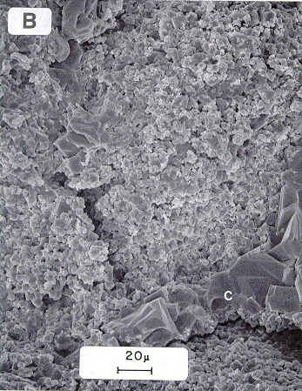
Computer-generated cellular automata model
Microporous
Jurassic limestone,
East Texas Basin
- 12,100 ft.
(a complex pattern generated by a simple “neighbor” rule)
generating
rules
Can porosity distribution in rocks be modeled as cellular automata ?

Slide 47
Use of neural networks in geophysics
24-group geophone spread
0
(a)
(b)
Shot-
point
0
2000 ft
a. Ideal minimum-phase wavelet
generated by Vibroseis source
b. Fourier transform to zero-phase
Measured / observed parameters: arrival time, amplitude, character, and pattern
The earth acts linearly with respect to
seismic waves in almost all practical
situations…The geophone response
is simply the sum (linear superposition)
of the effects of all the waves
striking the geophone.
Normal processing of seismic data uses
linear algorithms
Wedge pattern
5 mi
(modified from Sheriff, 1992)

Slide 48
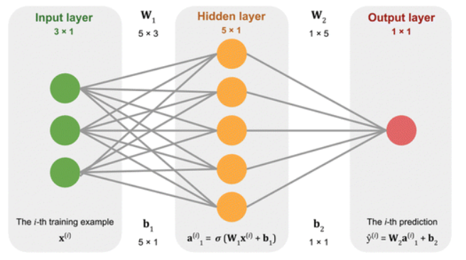
Neural networks: non-linear algorithms
A neural network consists of a nonlinear system of equations like
A complete neural network consists three or more layers:
Example:
Input layer
One or more hidden layers
Output layer
Processing the data in this nonlinear manner allows the software to “learn-as-it-goes,” accurately modeling real data (e.g., well or core data), thereby more accurately extrapolating between control points
source: https://wiki.seg.org/wiki/Neural_networks

Slide 49
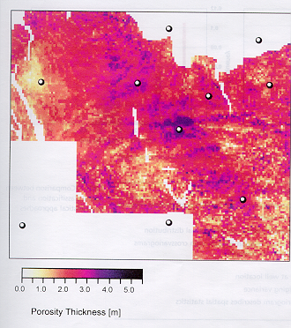
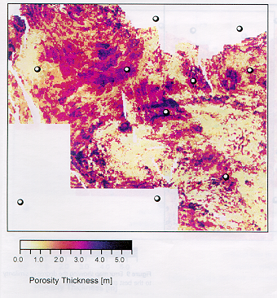
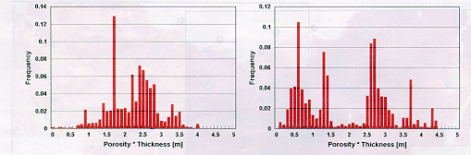
0.5 mi
Comparative results
Oil wells
Map made
with standard processing
Map made
with neural net
process
Standard
Neural
net
(from Trappe and Hellmich, 2000, Using neural networks to predict porosity thickness from 3D seismic data; First Break, v.18. p.377-384)

Slide 50
Introduction to Complex Dynamic Systems: Summary
Natural entities such as Planet Earth are complex dynamic systems
Key characteristics of complex dynamic systems
Non-linear relationships between variables
Fractal (non-Euclidean) geometry
Sensitivity to initial conditions (small changes in variables often result in significant changes to system)
Chaos dynamics (non-periodic “attractor” states; inherent unpredictablity within certain limits)
Feedback / adaptiveness
Scale-free distribution (80 – 20 rule)
Networks
Emergence and self-organized criticality
Although not yet a defined by a rigorously-defined mathematical framework, the study of complex dynamic systems appears to have relevance to a wide-range of scientific and social studies, including geoscience

Slide 51
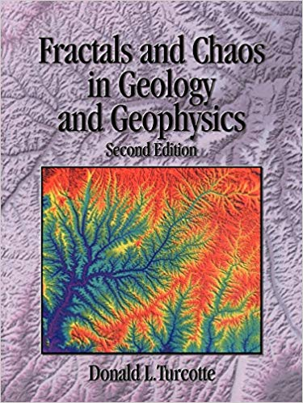
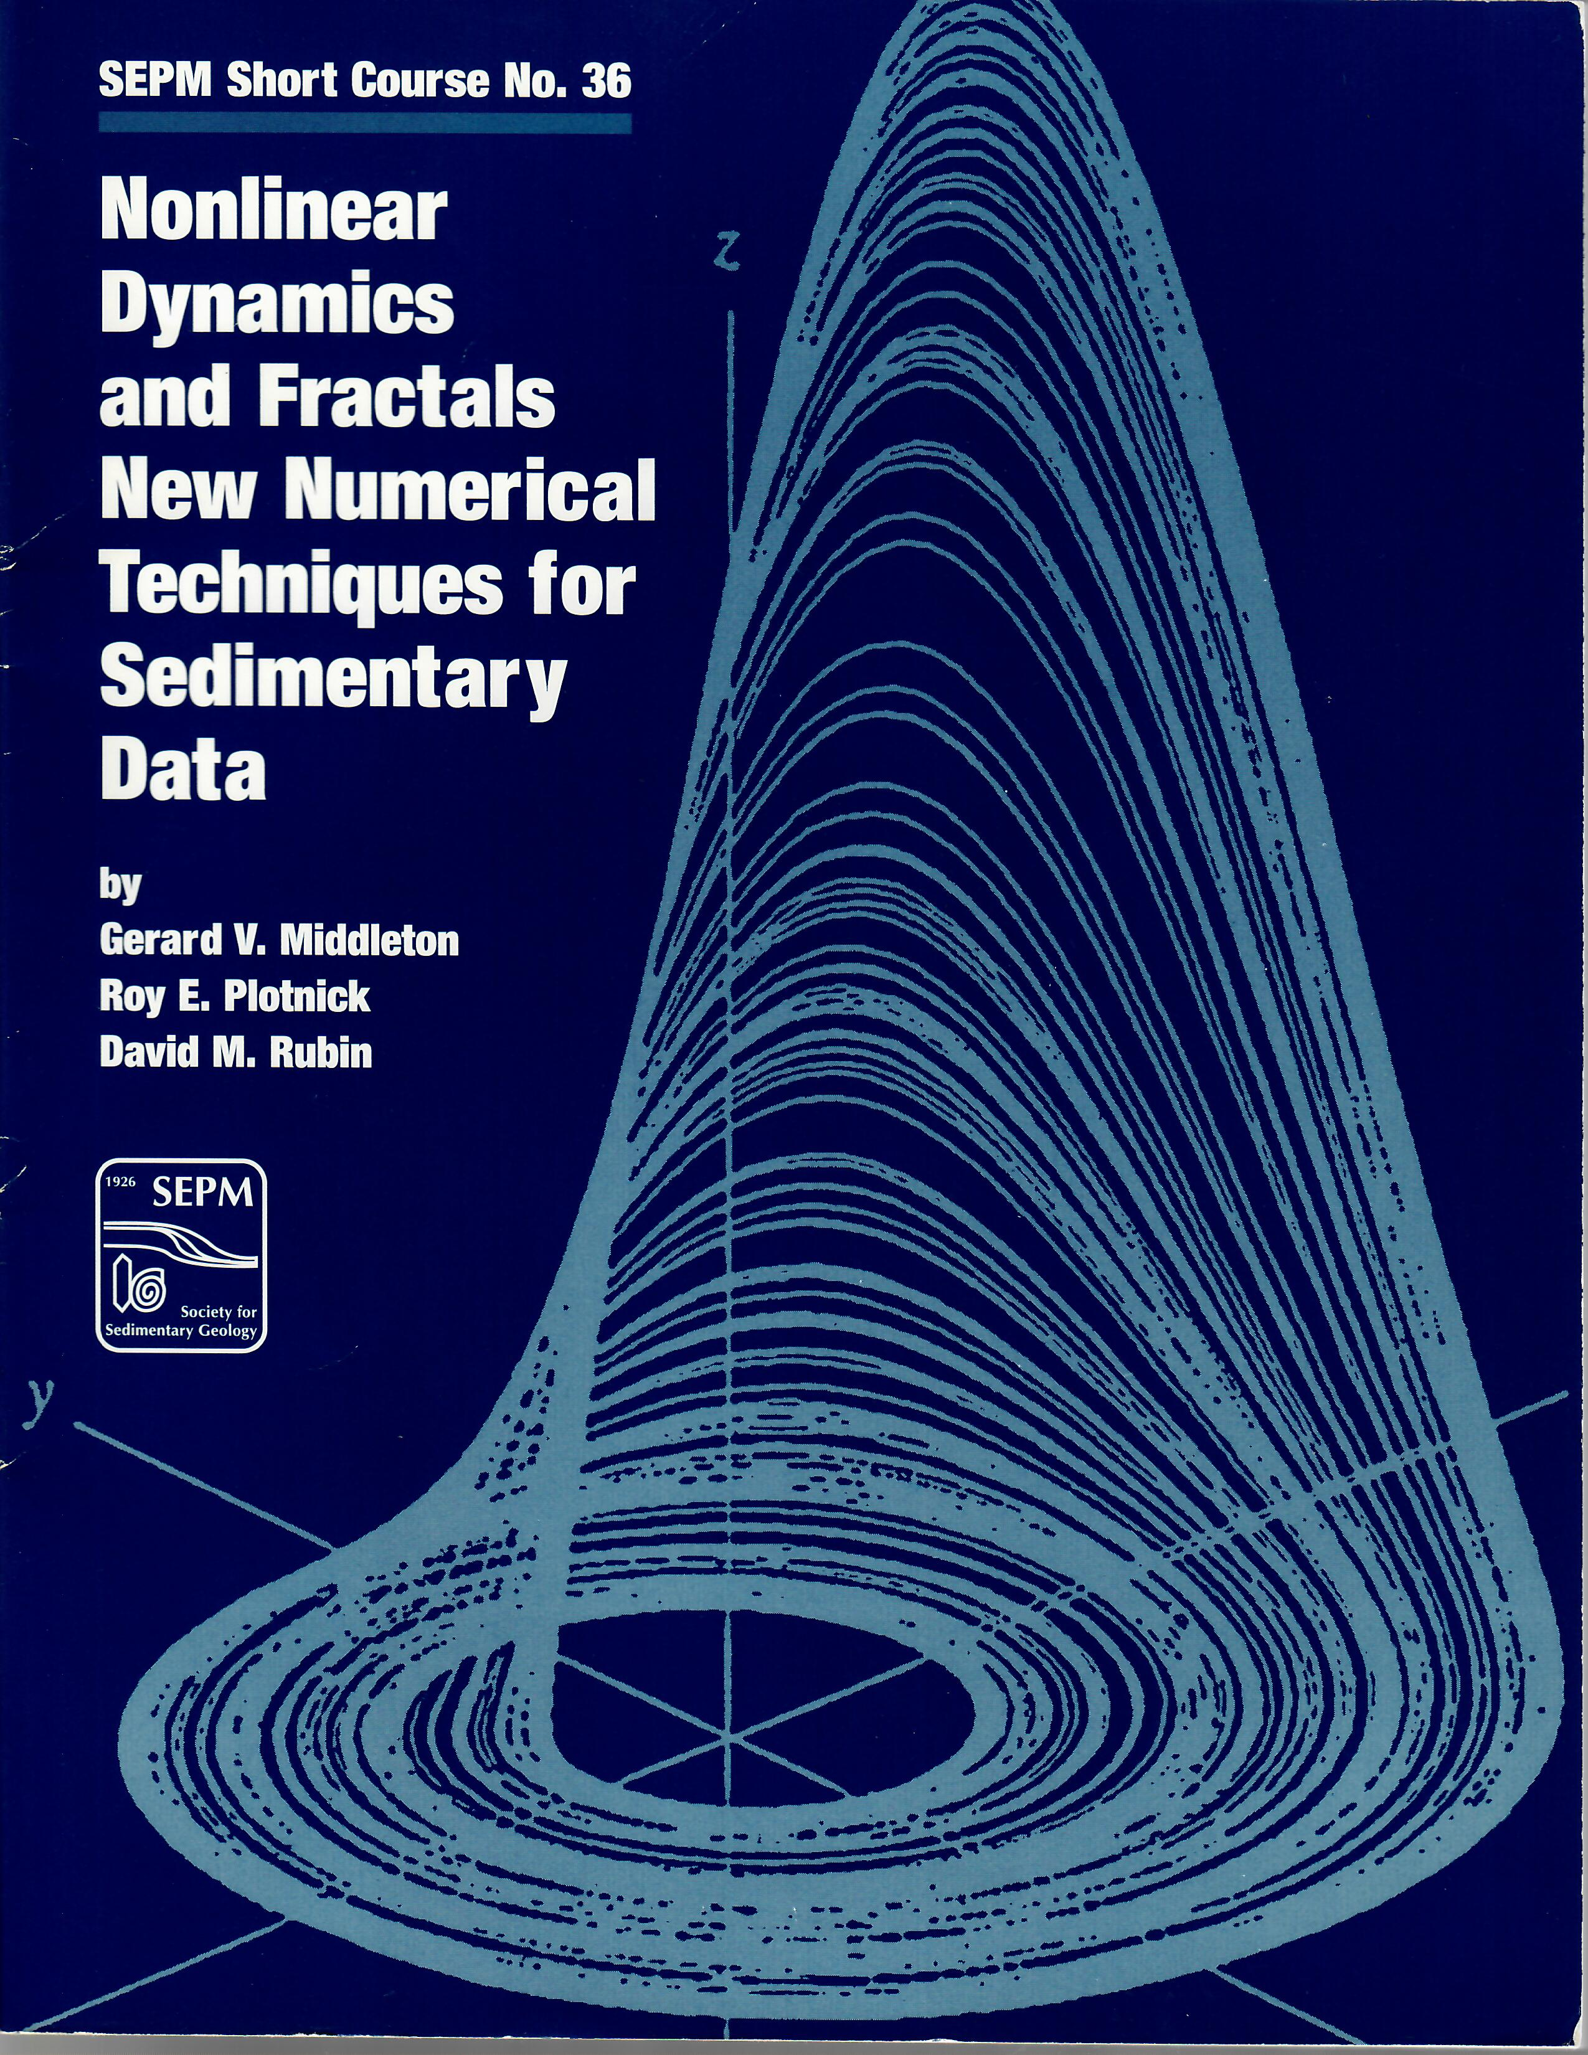
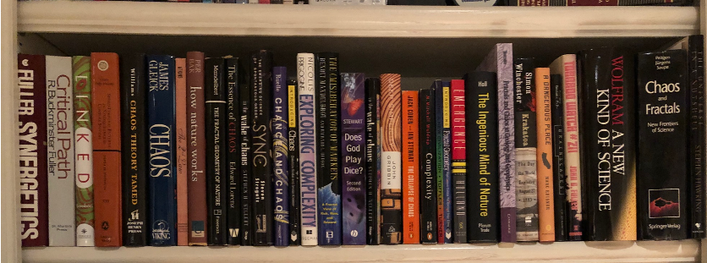
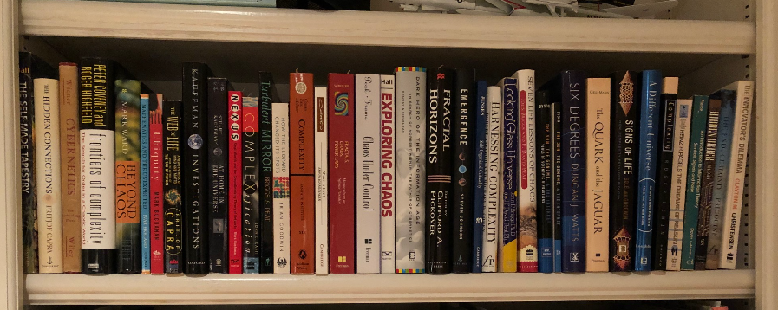
Recommended books and references if you are interested in further investigation

Slide 52
Schedule: Paleo Earth Systems / Spring 2022
Jan 19: Intro / Syllabus / Grading
Jan 26: Complex dynamic systems
Feb 2: Geologic time scale / Stratigraphic record
NEXT LECTURE
Feb 9: Global tectonic and magmatic cycles / Global climate states
Feb 16: Biologic evolution / Ocean Anoxic Events (OAEs)
Feb 23: Sea-level analysis /Global Themes Test #1 handout (take-home; due by Start of class Mar 2)
Mar 2: Megacycle 1: Late Precambrian – Early Ord (Sauk)
Mar 9: Megacycle 2: Mid Ord – Early Devonian (Tippecanoe)
Mar 16: No class (Spring Break)
Apr 13: Megacycle 6: Mid Jur. – Low. Paleocene (Zuni)
Mar 23: Megacycle 3: Early Dev – Mississippian (Kaskaskia )
Apr 20: Megacycle 7: Up. Paleocene – Recent (Tejas)
Mar 30: Megacycle 4: Penn – Permian (Low. Absaroka)
Apr 27: Course wrap-up /Summary Test #2 handout
Apr 6: Megacycle 5: Triassic – Early Jurassic (Up. Absaroka)
May 4: No class (Test #2 due by 5pm)

