Slide 1
Geology of the Permian Basin
Cambrian – Lower Ordovician
(Bliss Ss – Ellenburger Group)
Interregional unconformity
Interregional unconformity
Lowell Waite
UT Dallas Geoscience
Permian Basin Research Lab
10/4/2021

Slide 2
Geology of the Permian Basin: ELS (Endeavor Lecture Series)
Horseshoe Atoll
Tectonic history – Part 1 (Big Picture)
Tectonic history – Part 2 (Regional elements: ARM, CBU, MFB)
Basement
Cambrian – Lower Ord (Wilberns/Bliss Ss., Ellenburger Gp)
Tobosa Basin stratigraphy (Mid Ord. – Mississippian)
Pennsylvanian (Morrow-Atoka-Strawn-Canyon-Cisco)
Lower Permian (Wolfcamp – Spraberry)
Middle and Upper Permian / Permian Basin petroleum system

Slide 3
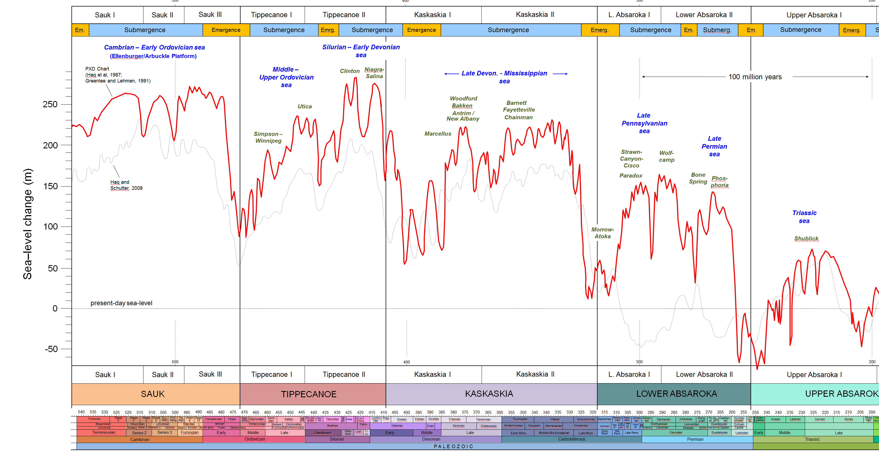
Long-term cycles of sea level during the Paleozoic and cratonic sequences (4 total)
Upper Precamb. –
Lower Ordovician
Mid. Ordovician –
Lower Devonian
1
2
3
Lower Devonian –
Mississippian
4
1a
1b
2a
2b
3a
3b
4a
Pennsylvanian –
Permian
4b
4c
Fusselman-
Wristen-
Thirtyone
eroded/
not
deposited
U. Miss./Barnett –
Lower Miss. Lime –
Woodford
WFMP C2 –
WFMP D –
L. Strawn –
Morr. - Atoka
SPBY/B.Spr.-
Ochoan
Permian
Basin
stratigraphic
units
eroded/
not deposited
Ellen-
burger
Simpson-
Montoya
Dean -
Tans.-Yates
Trans. Ss.
WFMP A -
Quen.-SNRV
WFMP B -
GBRG
WFMP C1
San And.
Early
Mid.
Late
Early
Mid.
Late
Lu.-
Late
Early
Middle
L.
E.
Lland.
Wn.
Pri.
Early
Mid.
Late
E.
M
Cisuralian
Gua.
Lop.
Middle
Late
Cambrian
Ordovician
Silurian
Devonian
Mississippian
Penn.
Permian
Triassic
540
520
500
480
460
440
420
400
380
360
340
320
300
280
260
240
220
200

Slide 4
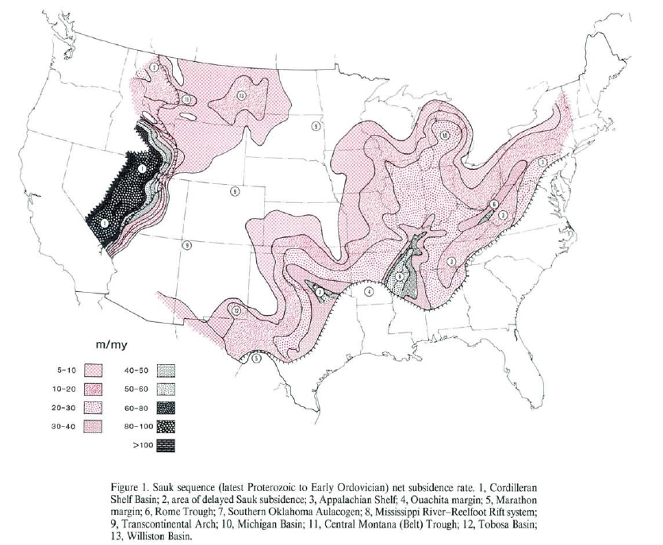
Net subsidence rate, latest Proterozoic – Early Ordovician (Megacycle 1)
Transcontinental Arch
Initial subsidence in west Texas (future site of Tobosa Basin)
Texas Arch
Eastern and southern margin basins are yoked
Note embryonoic Texas Arch (TXA)
(Sloss, DNAG, 1988)

Slide 5
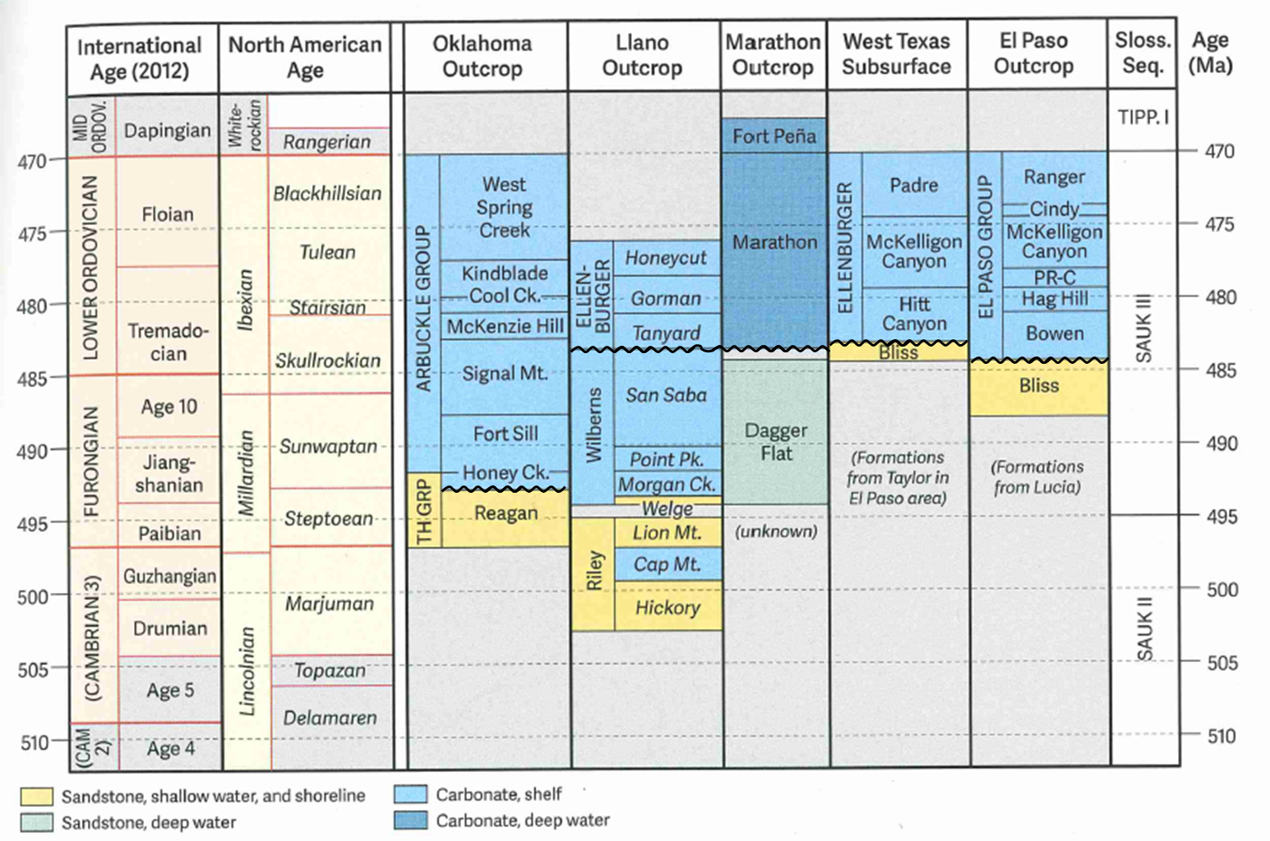
Megacycle 1: Cambrian – Lower Ordovician stratigraphic units of Texas and Oklahoma
We are looking here at two basic units:
basal transgressive sandstone
overlying carbonate (largely dolomite)
Note position of unconformities
minor (short-term) diastem at top of Bliss Ss
minor (short-term) exposure surfaces within Ellenburger Group (not shown)
Major (interregional) unconformity at top of Ellenburger – significant karst event, termination of megacycle 1
(Ewing, 2016)

Slide 6
BASAL TRANSGRESSIVE
CAMBRIAN SANDSTONE

Slide 7
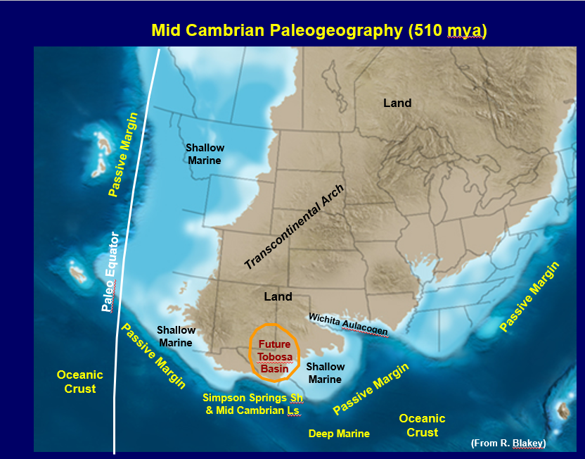
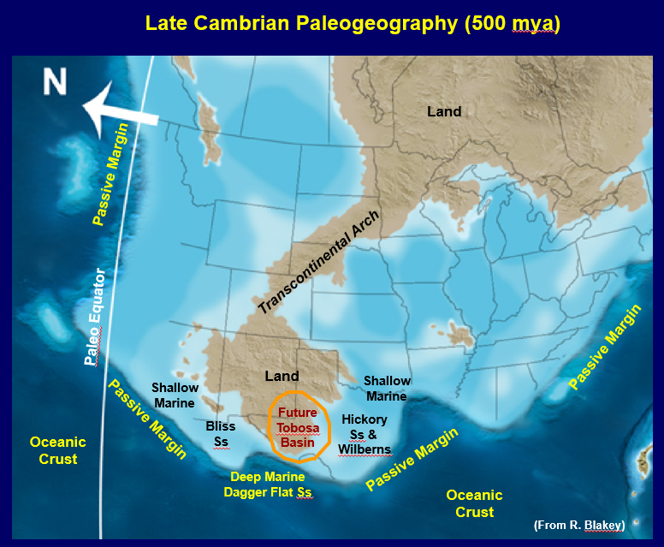
Middle Cambrian: long-term marine transgression underway;
Tobosa Basin still exposed with little to no
sedimentation
Late Cambrian: first marine sediments infiltrate Tobosa Basin
from south and east with deposition of
basal transgressive sands (Bliss) and
shallow marine carbonates (Wilberns)

Slide 8
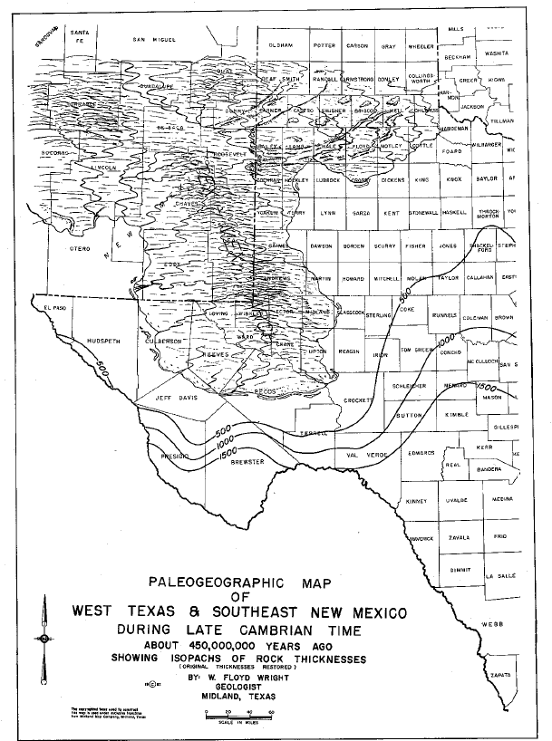
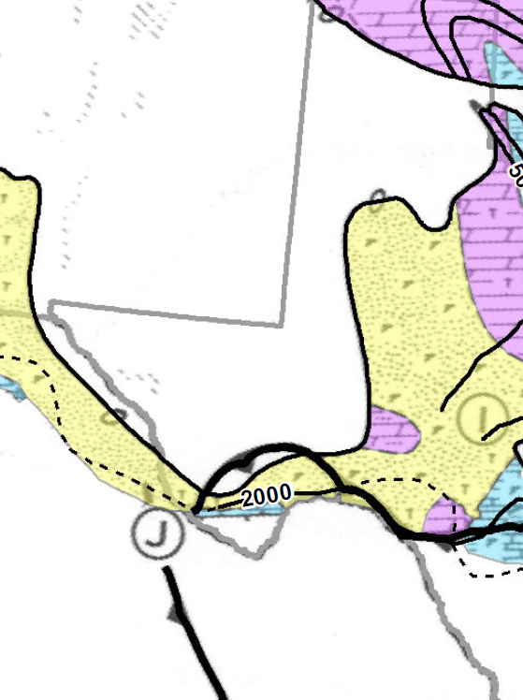
Late Cambrian: Basal transgressive sandstones
Land –
Exposed
Precambrian
Crystalline
Rocks
Outline of
future
Tobosa Basin
Land – Exposed
Precamb.
crystalline rocks
Shallow
Marine
Land –
Exposed
Precambrian
Crystalline
Rocks
Land –
Exposed
Precambrian
Crystalline
Rocks
Wilberns Fm &
Hickory Ss
Wilberns Fm &
Hickory Ss
Shallow
Marine
Shallow
Marine
Shallow
Marine
Shallow
Marine
Bliss
Ss
Bliss
Ss
Bliss
Ss
sandstone
Outline of
future
Tobosa Basin
limestone
Deep Marine
Dagger Flat Ss
Deep Marine
Dagger Flat Ss
dolomite
Cambrian Lithofacies
(From Shell Atlas, 1975)
(From Wright, 1979)

Slide 9
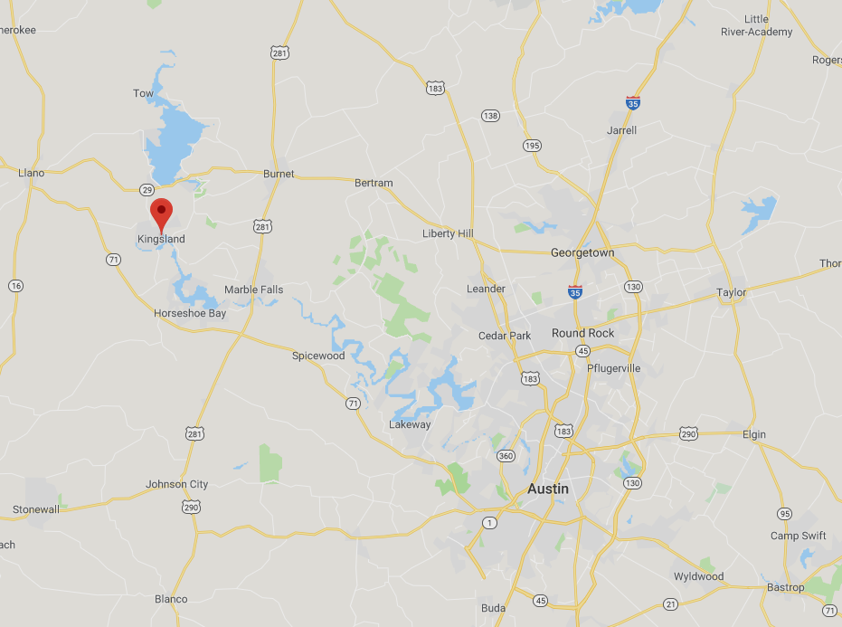
Lion Mountain greensand of the Riley Formation overlain by Welge sandstone (green-yellow) and Morgan Creek limestone (pink-orange) of the Wilberns Formation, FM 1431, east of Kingsland, TX
(photo from Ewing, 2016)
Minimal oil and gas production from Camb. sands in the Permian Basin
Cambrian sand is mined in Brady, Texas, for use in manufacturing and fracking

Slide 10
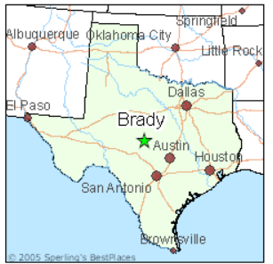
Applications for use include:
Sports fields
Water filtration
Ground water wells
Coatings
Abrasives
Recreational / Traction
Fracking

Slide 11
Ellenburger Group
(Lower Ordovician)

Slide 12
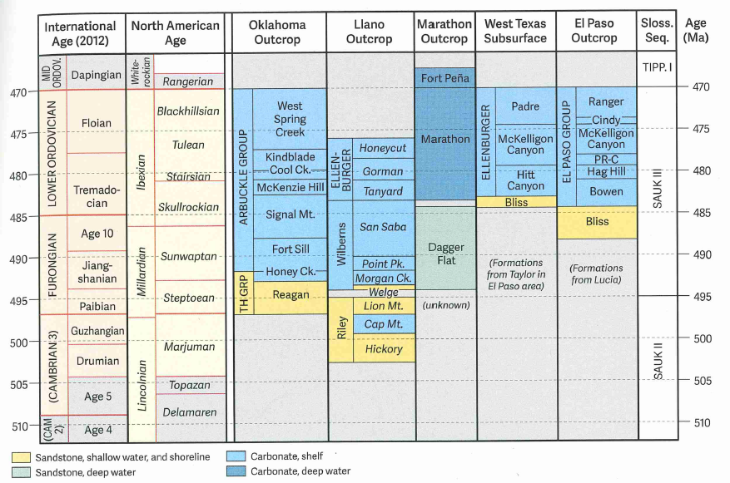
LOWER ORDOVICIAN ELLENBURGER GROUP
Ellenburger dolomites represent an important oil and gas reservoir in the Permian Basin
5 billion barrels oil equiv. from 714 fields since 1936 (Kerans and Loucks, 2019); 1.35 BBO
Ellenburger outcrops: Franklin Mountains in El Paso, TX
(Ewing, 2016)

Slide 13
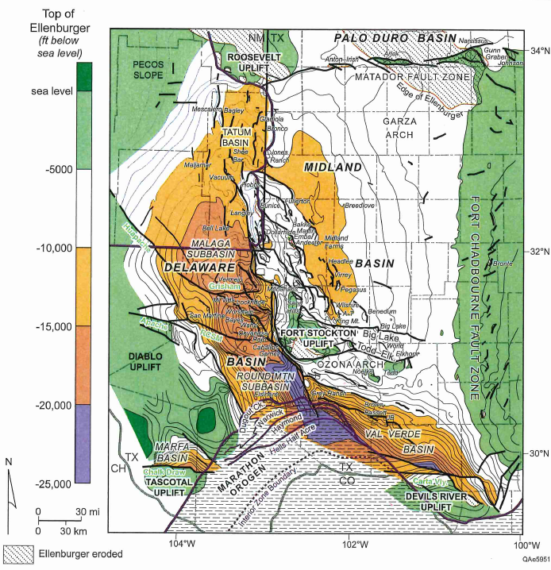
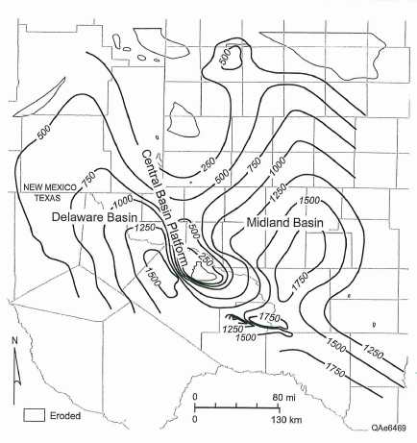
Ellenburger structure, Permian basin
Ellenburger thickness, Permian basin
(Loucks and Kerans, 2019)

Slide 14
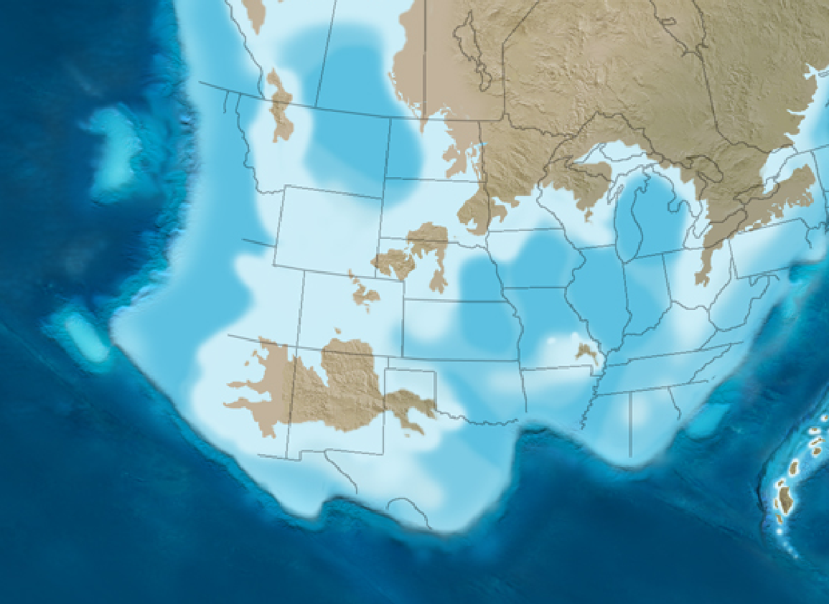
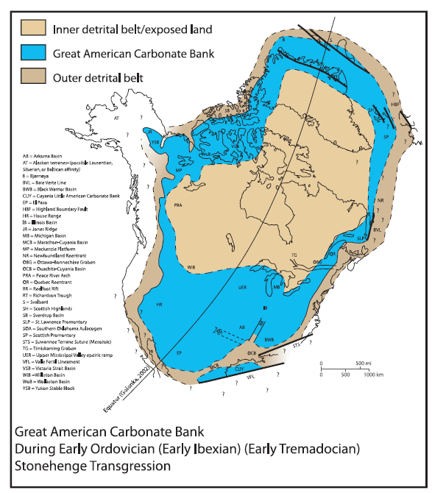
Early Ordovician paleogeography: The Great American Carbonate Bank
Much of N. Amer. covered by a shallow marine sea; widespread shallow marine carbonate deposition (Great American Carbonate Bank)
Land
Future Tobosa Basin located in tropics, a few degrees south of the paleoequator
Passive Margin
Extensive tidal flats developed proximal to land
Equator
Transcontinental Arch
Passive Margin
North Amer.
craton
Land
Shallow
Marine
Passive Margin
Shallow
Marine
Ellenburger
Carbonate
Ouachita
Embayment
Ellenburger
Carbonate
Tobosa
Basin
Oceanic
Crust
Passive Margin
Marathon
Embayment
Deep Marine
Marathon Ls
Oceanic
Crust
(modified from R. Blakey)
(Derby et el., 2012)

Slide 15
Ellenburger depositional system
20 km
(Loucks and Anderson, 1985)
(Ewing, 2016)
Andros Island,
Bahamas

Slide 16
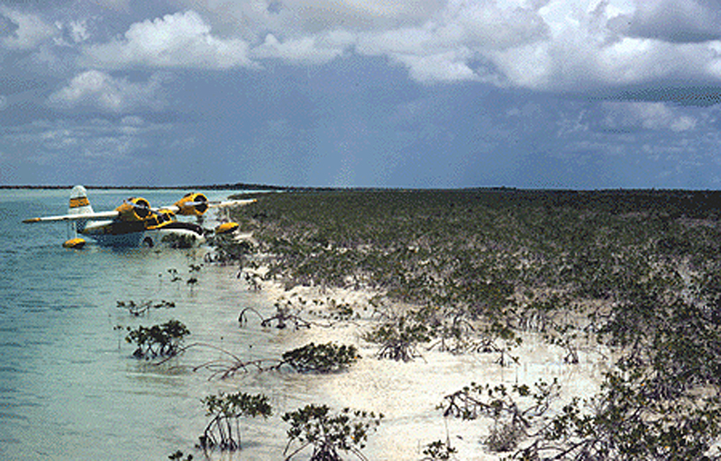
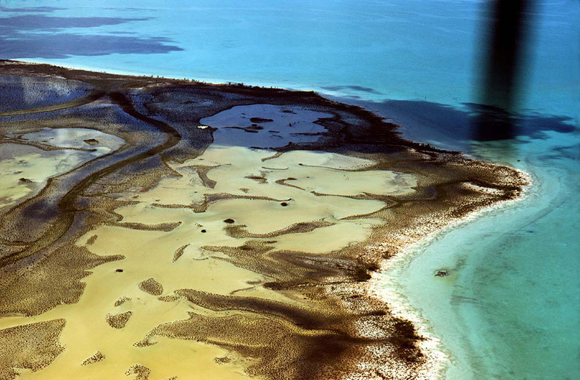
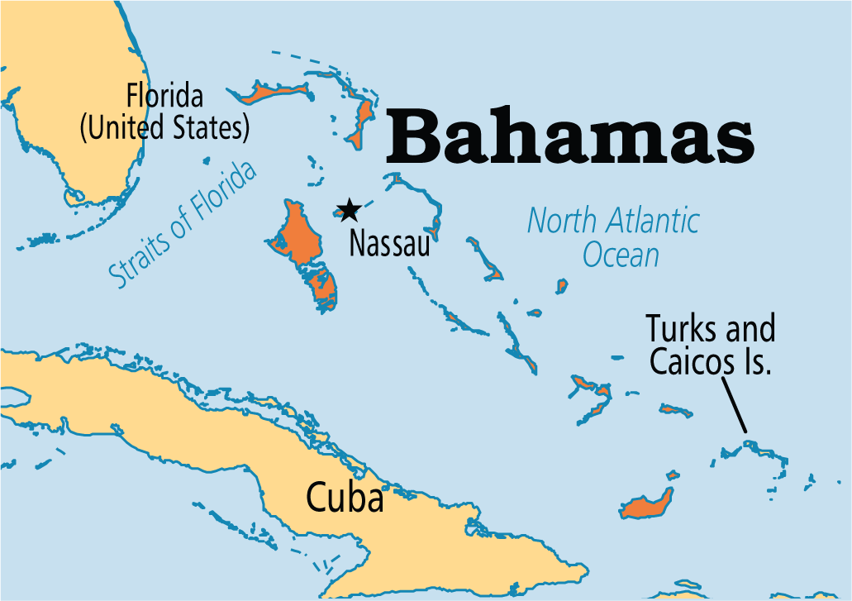
Modern tidal flats, Andros Island, Bahamas
Evaporitic environment with formation of early dolomites
Imagine a large portion of west Texas like this during deposition of the Ellenburger during early Ordovician time
Andros
Island

Slide 17
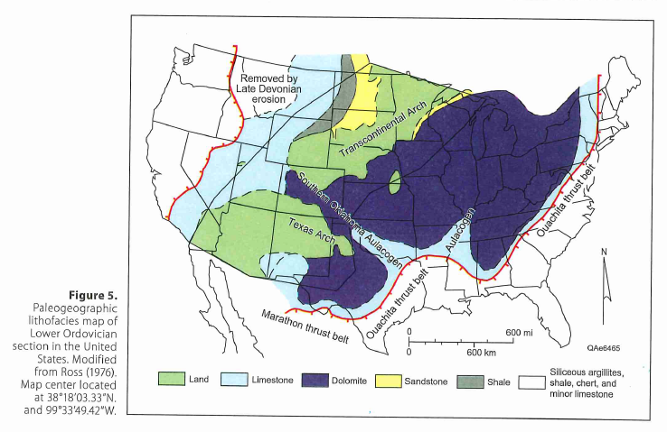
Ellenburger time:
Extensive dolomites
primary (depositional)
secondary (diagenetic)
(Loucks and Kerans, 2019)

Slide 18
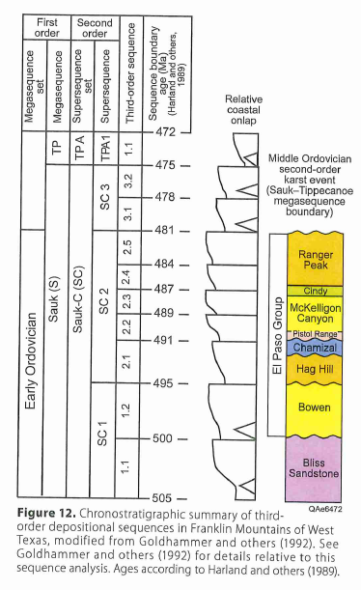
Ellenburger internal stratigraphy: 3rd-order greenhouse tidal flat cycles
Sea level rise
(Loucks and Kerans, 2019)

Slide 19
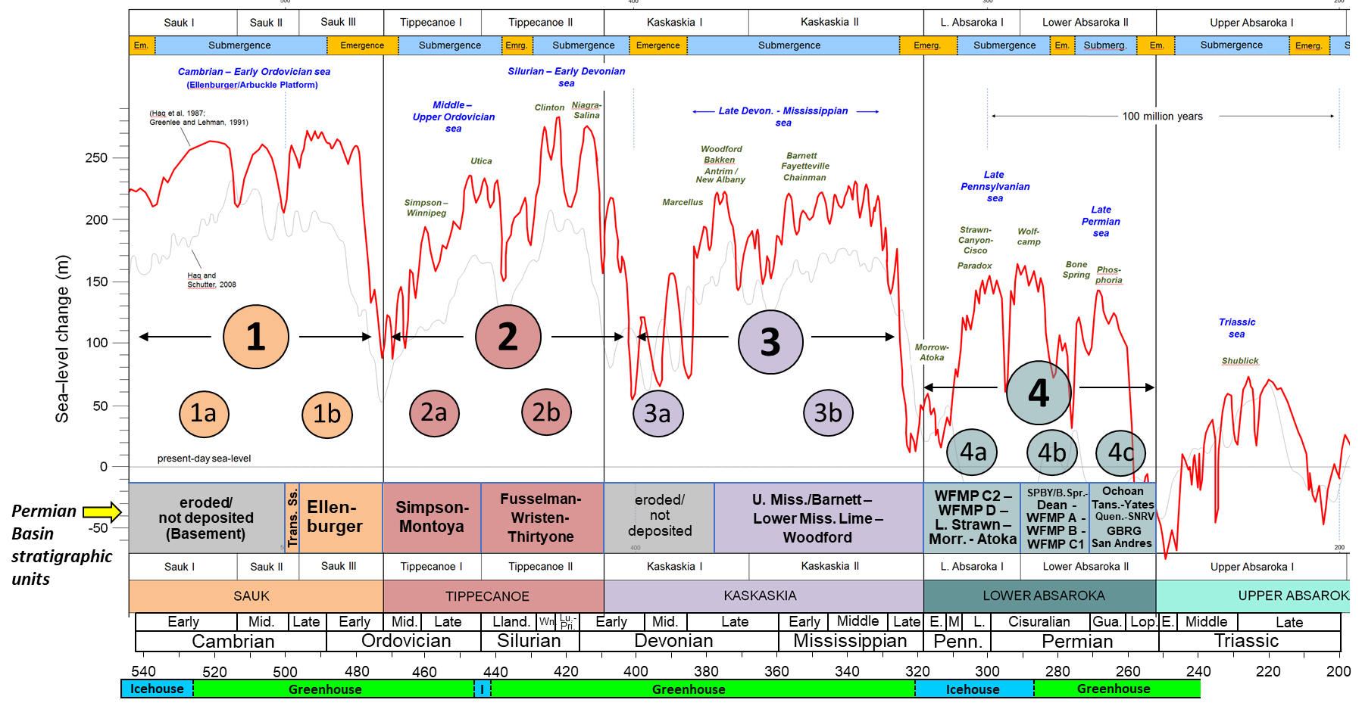
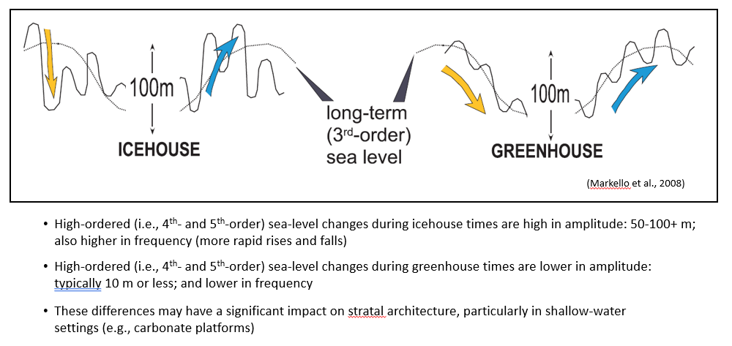
Climate cycles
(greenhouse vs. icehouse)
Earth’s global climate oscillates between two end-member states:
Warm (greenhouse)
Cold (icehouse)
Climate states affect short-term eustacy, which impacts stratal architecture of carbonate platforms
Greenhouse cycles are often stacked shallow-water units (e.g., tidal flats) capped by minor exposure surfaces
Icehouse cycles normally show a greater range of water depths from bottom to top, with more pronounced exposure surfaces

Slide 20
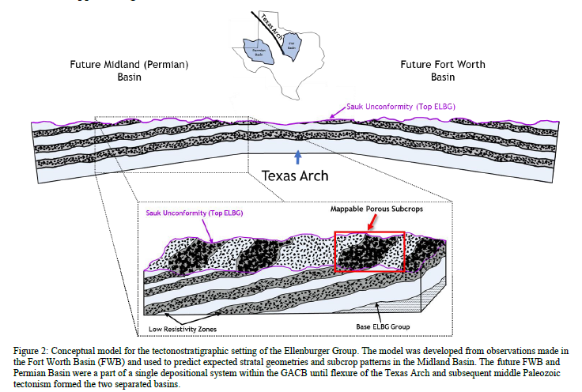
Ellenburger cycles (Loucks and Kerans, 2019)
Regional Ellenburger model: bands of porous subcrops; top Elbg is a karsted surface with caves
End of Elbg time: long-term exposure & karst
Bliss Ss
Time 2: grainstone, possibly capped by a
brief subaerial unconf. (porosity event)
Bliss Ss
(Sanchez et al., URTEC, 2019)
Time 1: transgressive dolomitic tidal flat

Slide 21
Ellenburger karsting and cave formation

Slide 22
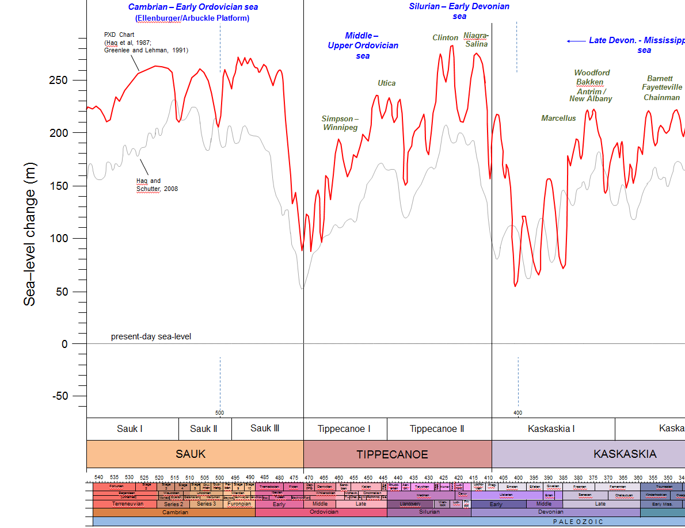
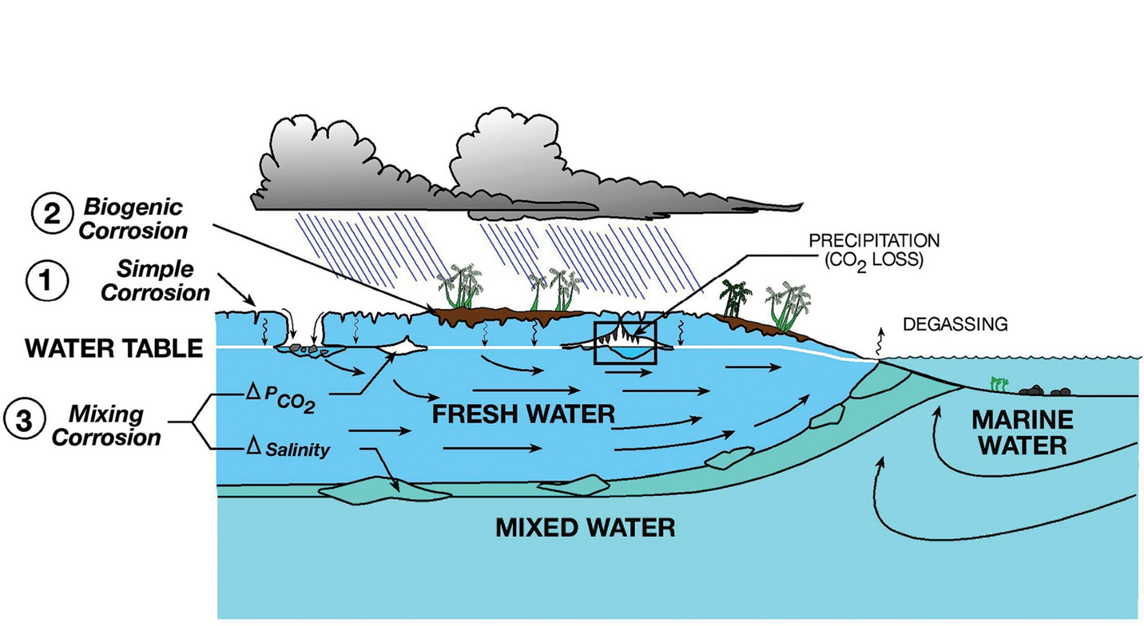
Subaerial Exposure event – Ellenburger Karsting
High
Sea Level
Low
Sea Level
Ellenburger
Group

Slide 23
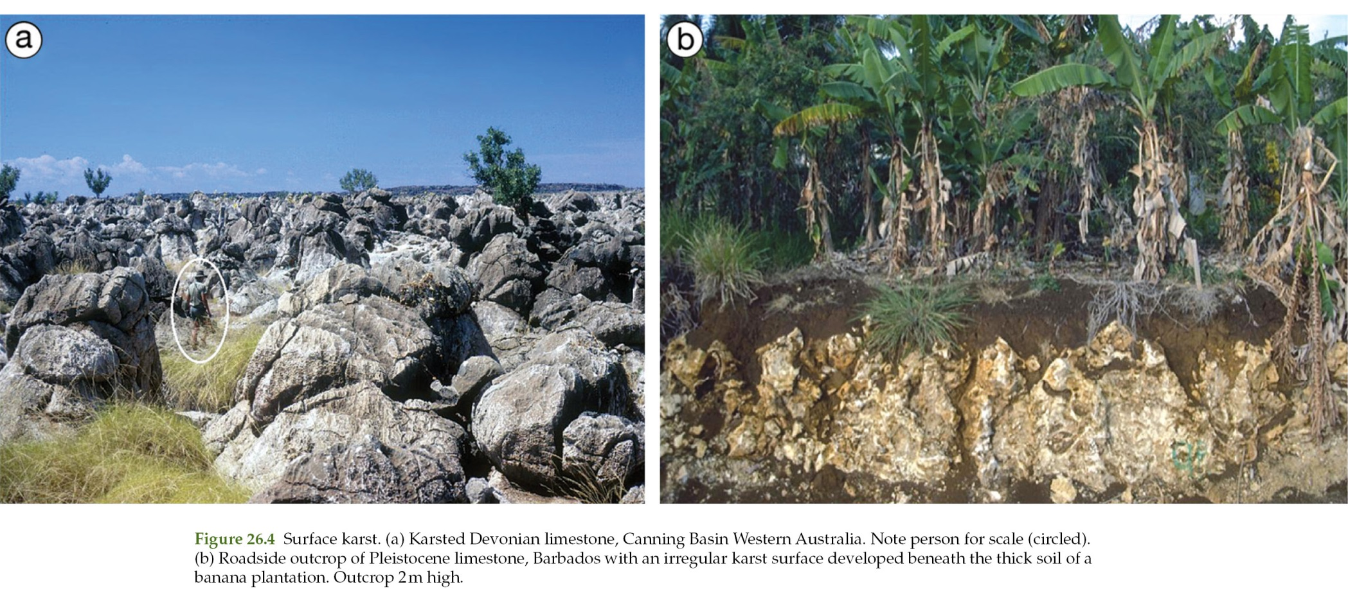
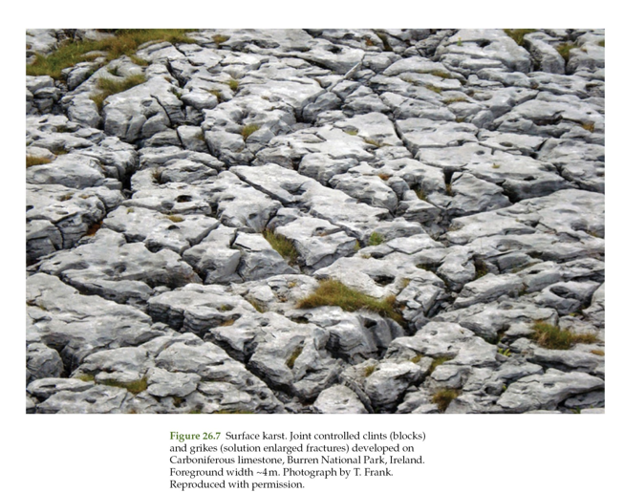
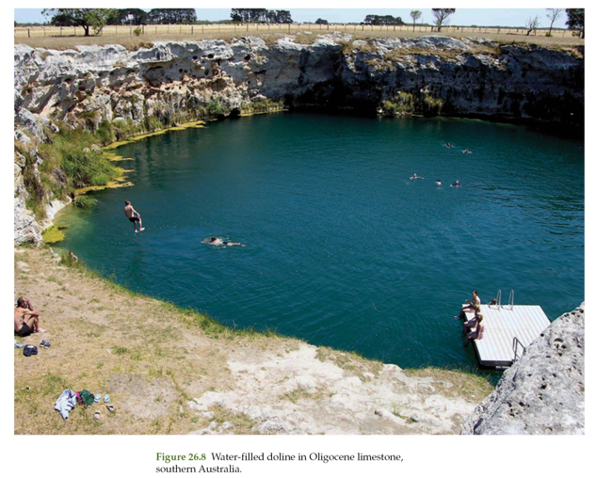
Karst
features
note: no extensive soil zones in Ellenburger (first major land plants post-date Elbg in Middle Ordovician)

Slide 24
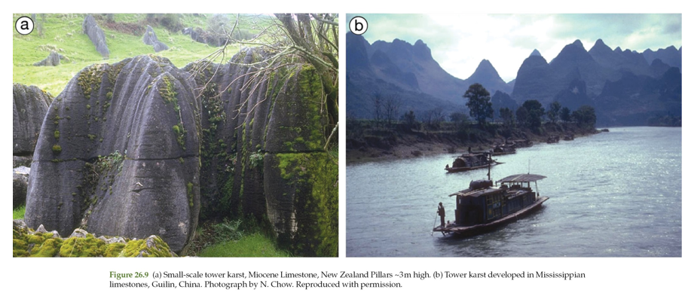
Tower Karst

Slide 25
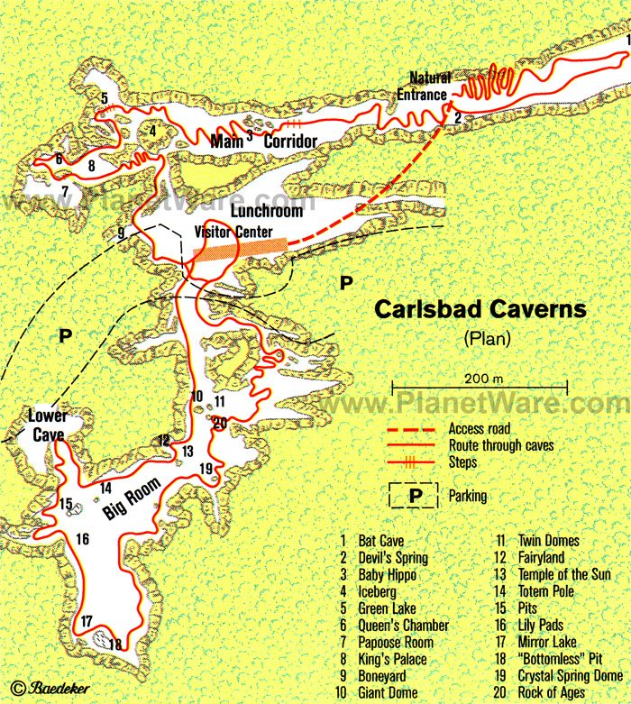
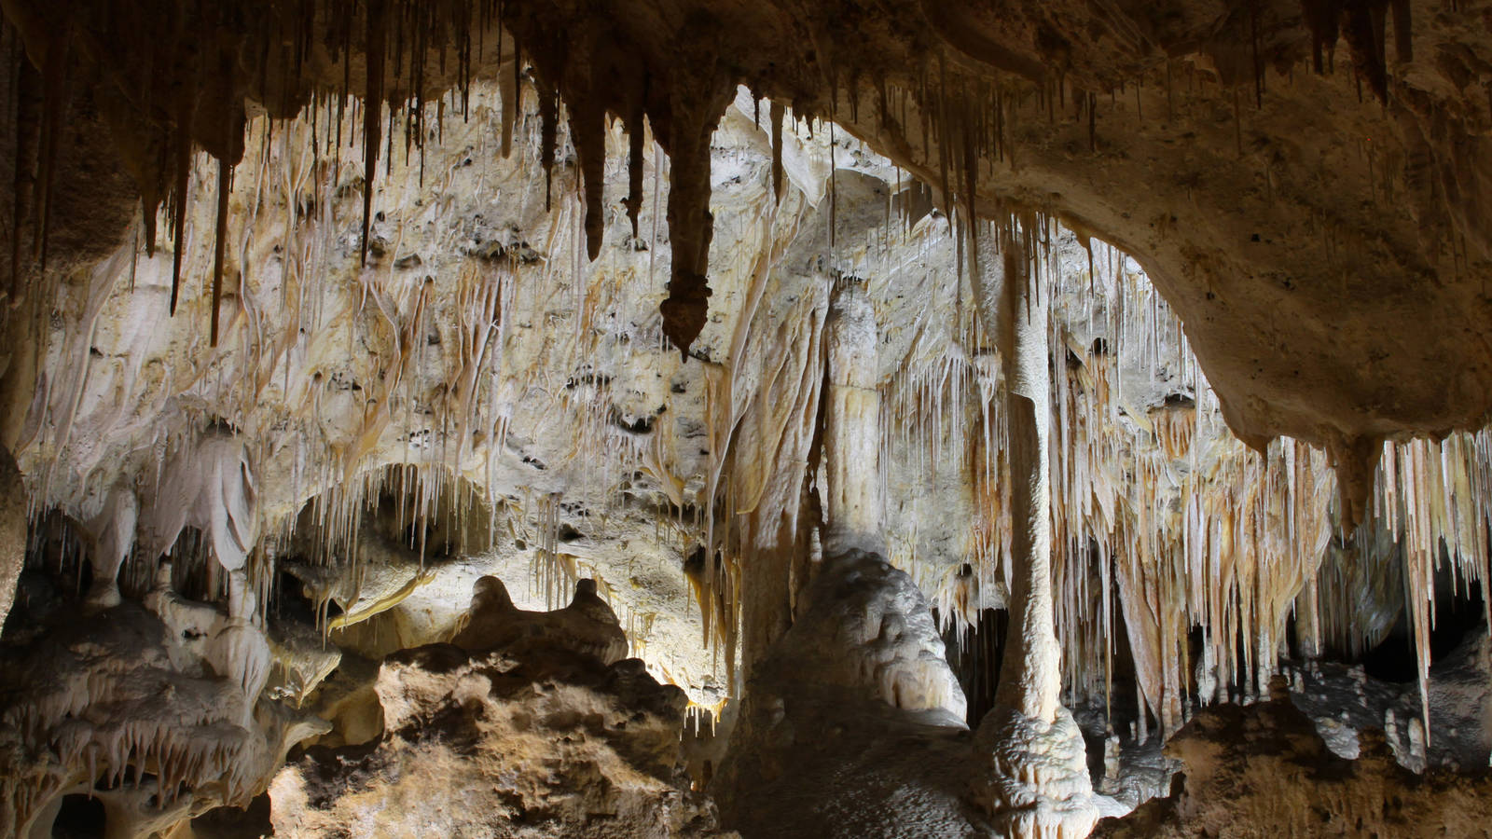
Karsting of limestones: Cave formation

Slide 26
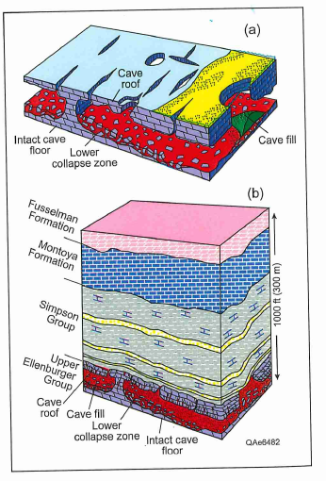
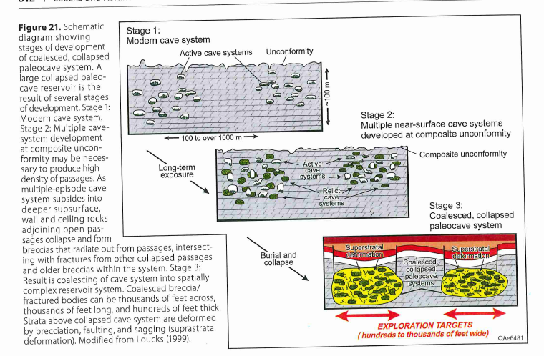
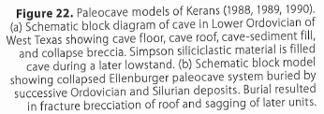
Ellenburger paleocaves
(Loucks and Kerans, 2019)

Slide 27
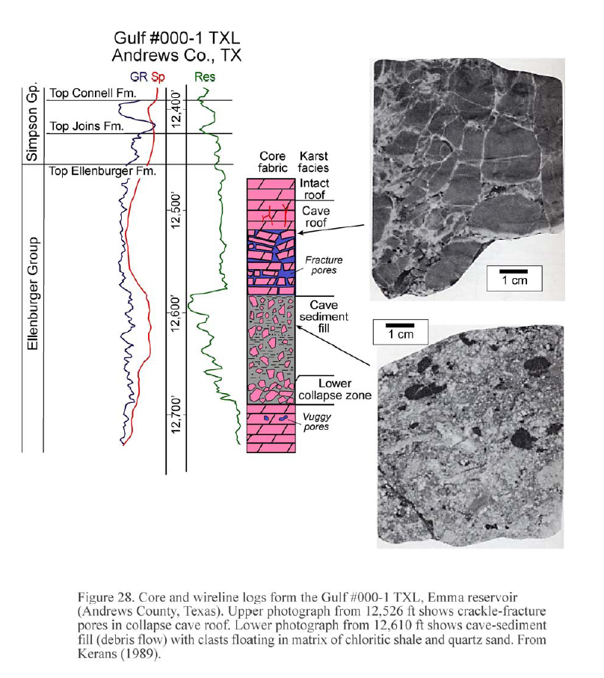
(Loucks and Kerans, 2019)

Slide 28
(Loucks and Kerans, 2019)

Slide 29
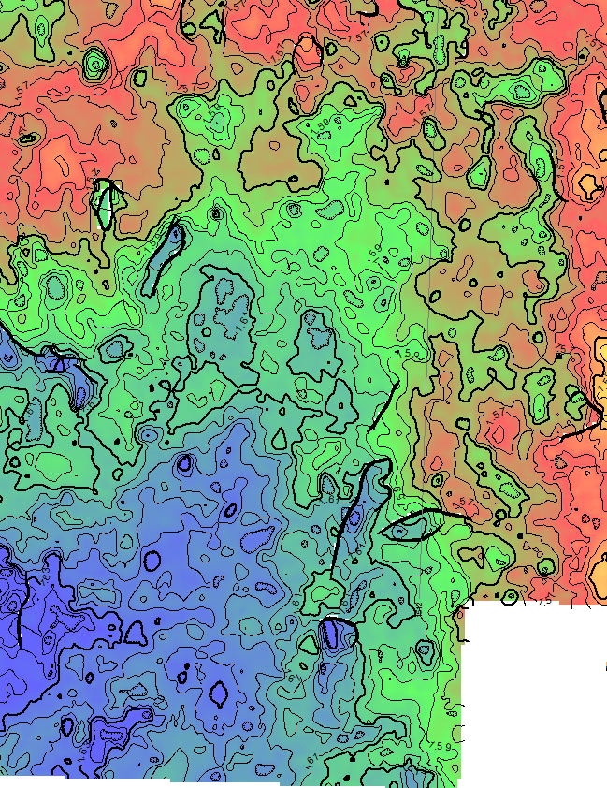
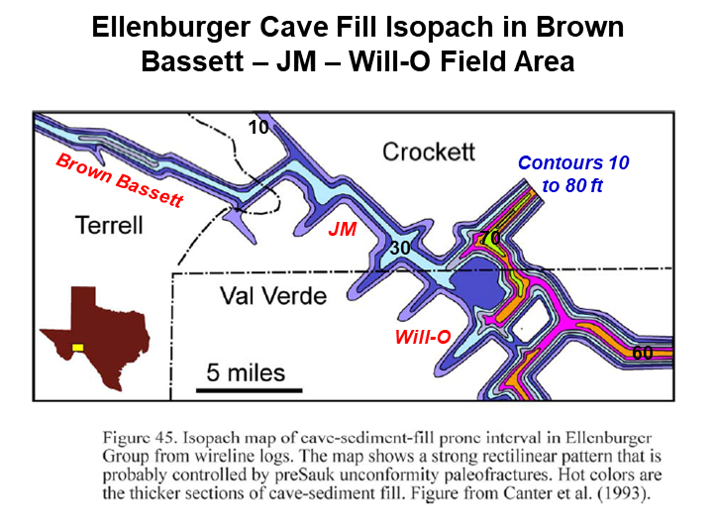
Alignment of Ellenburgner cave fill and sink holes follow NW-SE and NE-SW trends
(From Loucks, BEG Undated Ellenburger Draft Report;
original figure from Canter, et al., 1993)
The alignment of Ellenburger cave fill and sink
holes along NE and NW trends suggest that some
fractures were already present by the end of
Ellenburger time when caves developed. N.A.
Plate orientation was ~80º relative to today’s position,
so those fractures had different orientations then.
(unpublished map based on seismic by
Andy Hooker, Pioneer)
Alignment of Sink Holes
on Strawn Time Structure -- Rocker B Area
(West Side of Rocker B Survey)

Slide 30
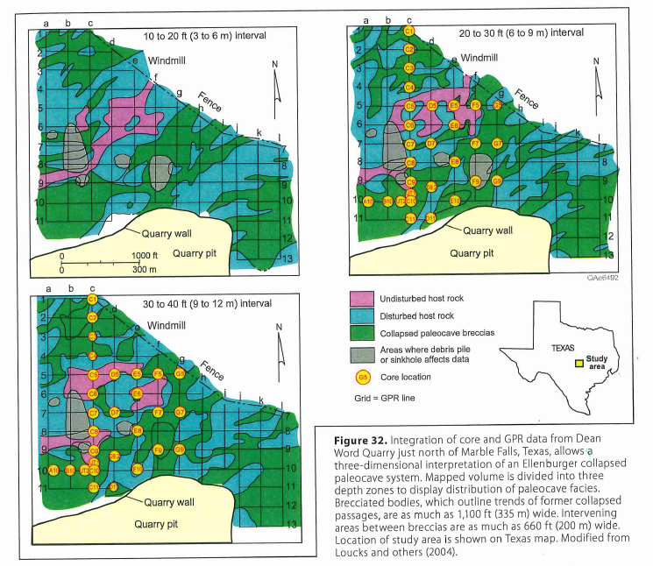
Ellenburger cave system
exposed in quarry near
Marble Falls
in central Texas
(Loucks and Kerans, 2019)

Slide 31
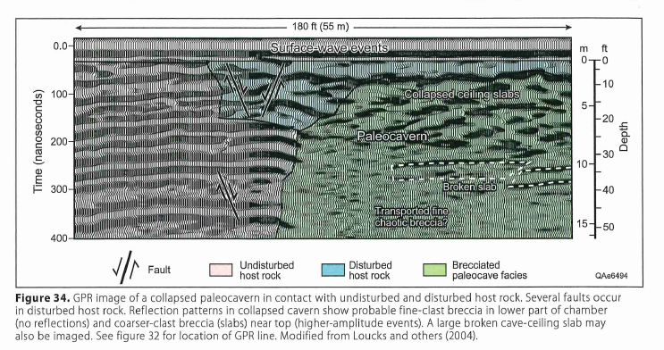
(Loucks and Kerans, 2019)

Slide 32
Ellenburger dolomites: surface and burial
early-stage dolomites
late-stage
(burial) dolomites
(Loucks and Kerans, 2019)

Slide 33
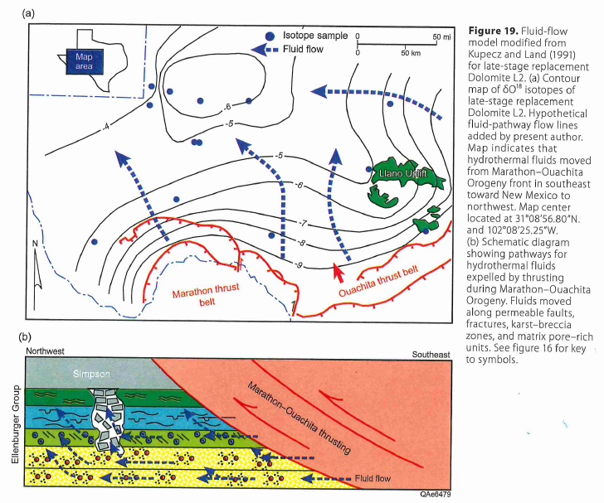
Potential mechanism for late-stage burial dolomitization
See also:
(Loucks and Kerans, 2019)

Slide 34
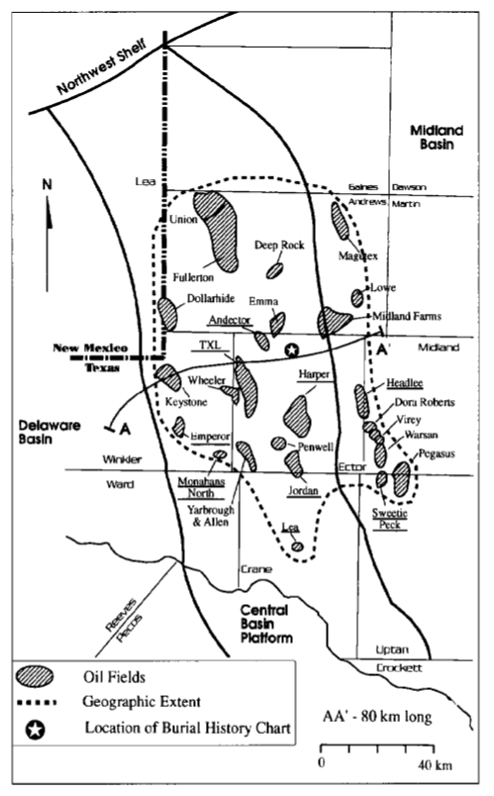
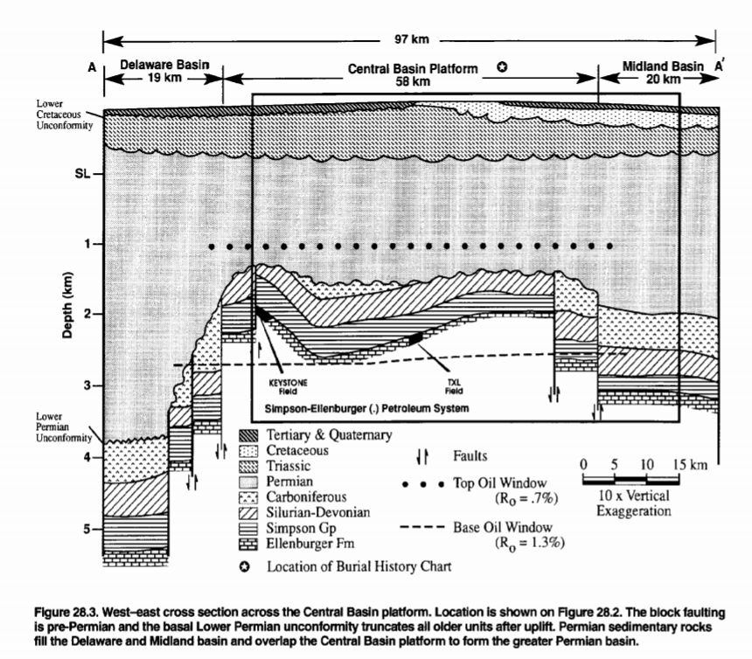
deep basement faults juxtapose organic-rich shales of overlying Simpson Group against porous Ellenburger dolomites
Ellenburger
oil fields on CBU
trap types include faulted anticlines and isolated porosity (strat trap)
(Katz et al, 1994)

Slide 35
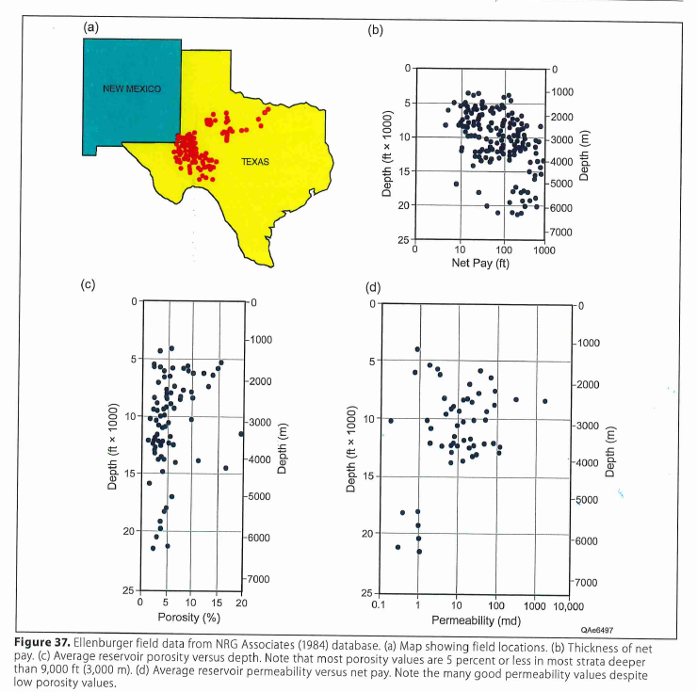
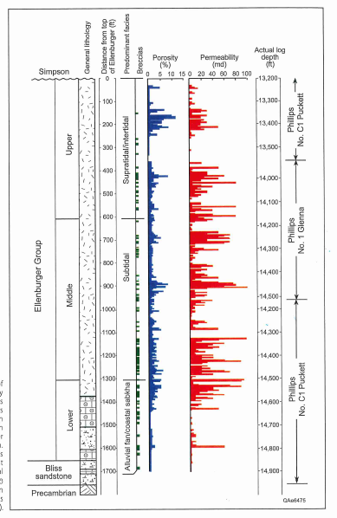
Ellenburger
reservoir
characteristics
(Note cyclicity in porosity
and permeability)
(modified from Loucks and Kerans, 2019)

Slide 36
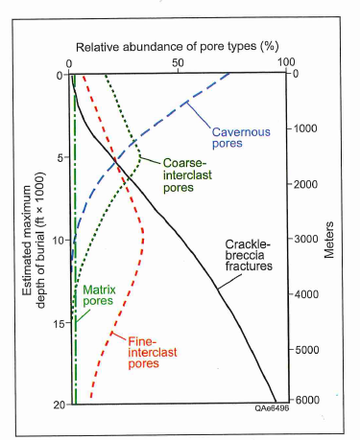
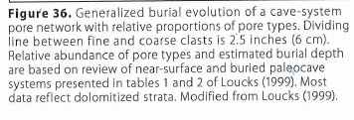
(Loucks and Kerans, 2019)

Slide 37
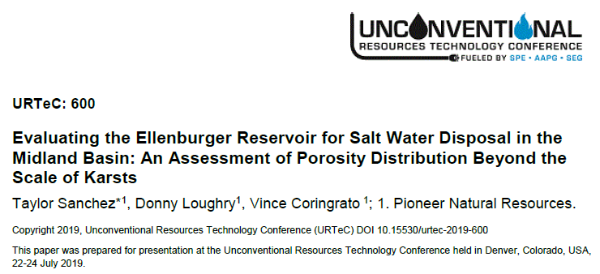
Ellenburger as a potential water disposal zone
In Midland Basin, operators have historically targeted the shallow middle Permian San Andres as the main zone in which to dispose of formation waters
However, some areas of the San Andres are now overpressured, causing both problems with disposal and in the drilling of deeper Spraberry and Wolfcamp horizontal wells
Some operators are hence looking for deeper disposal zones (e.g., Devonian, Ellenburger)
Deep disposal zones have their own issues
Poro-perm is much more difficult to map/predict
Deep zones are often involved with deep basement faults, increasing risk of induced seismicity

Slide 38
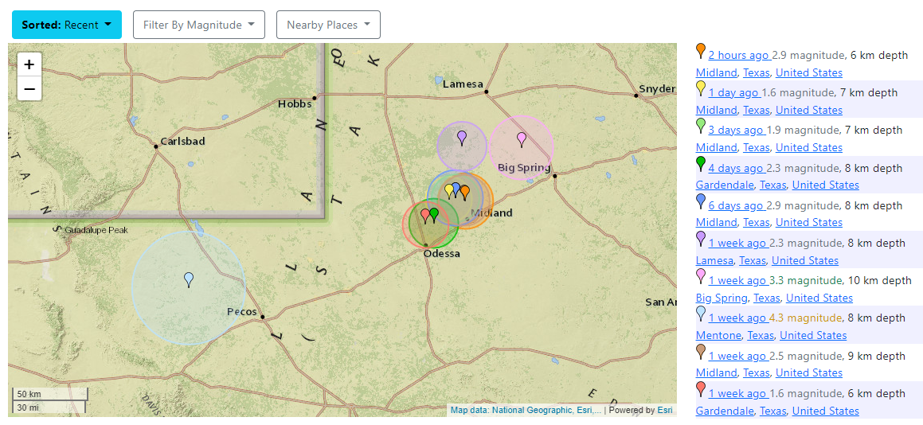
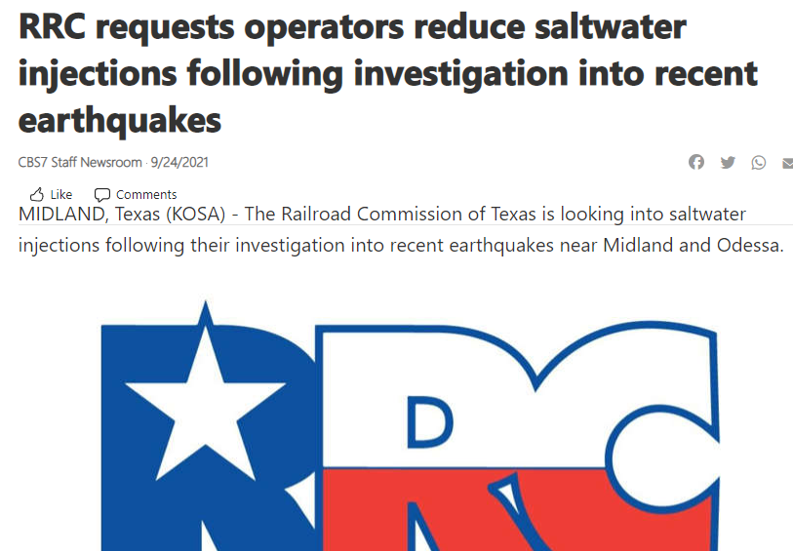
https://earthquaketrack.com/us-tx-midland/recent
Friday, Oct. 1, 2021 8pm
(6km ~ 20,000 ft)

Slide 39
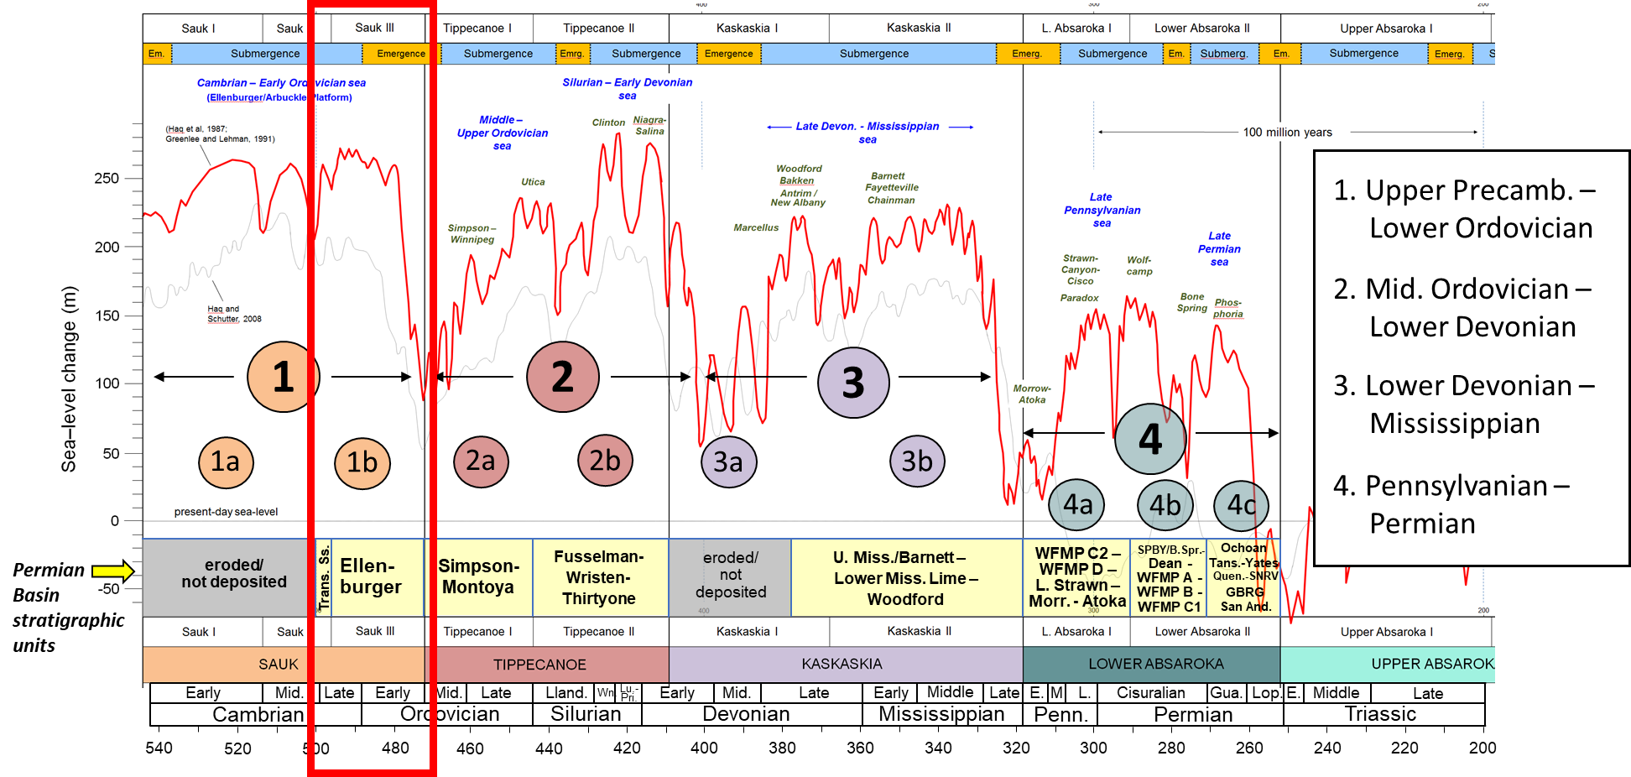
Upper Cambrian – Lower Ordovician of the Permian Basin: Summary
The Late Cambrian – Early Ordovician sea-level cycle (#1b) in the Permian Basin begins with deposition of a succession of basal transgressive sandstones (Bliss), grading upward into a thick package of shallow-water dolomites (Ellenburger Group)
The Tobosa Basin at this time was not yet fully formed – it was part of a broad, shallow-water carbonate platform that encircled the entire North American craton (“Great American Carbonate Bank”)
A significant lowering of global sea-level during Middle Ordovican time exposed the Ellenburger platform for several million years, forming a karsted surface and the development of large cave systems
Historically, the Ellenburger represents an important conventional reservoir target, having produced over 5 BBOE; many large oil fields occur on CBU
In Midland Basin, Ellenburger constitutes a potential produced water disposal zone; recent earthquakes near city of Midland are of concern and study by RRC

Slide 40
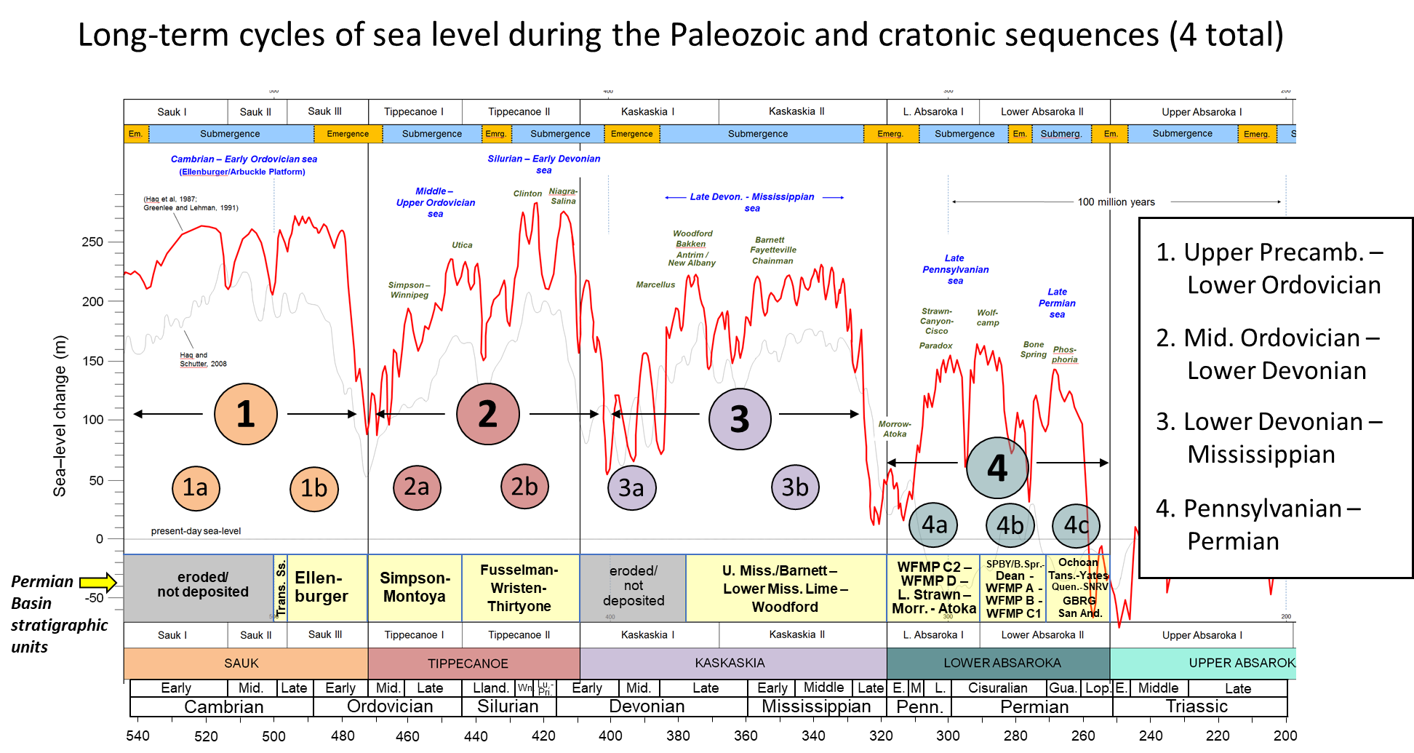
Next session: Tobosa Basin stratigraphy (Mid Ord. – Mississippian)
Megacycles 2 and 3

