Slide 1
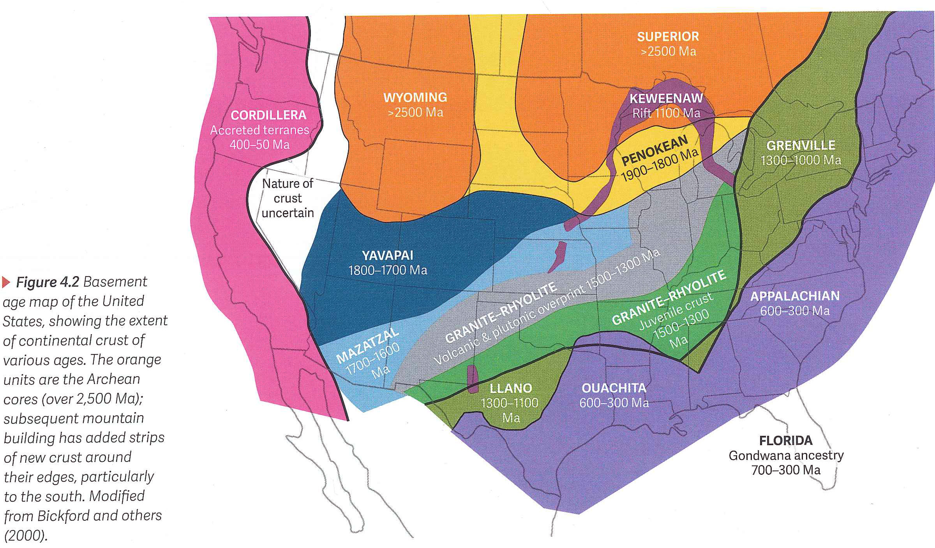
Geology of the Permian Basin
Basement
Lowell Waite
UT Dallas Geoscience
Permian Basin Research Lab
9/13/2021

Slide 2
Geology of the Permian Basin: ELS (Endeavor Lecture Series)
Horseshoe Atoll
Tectonic history – Part 1 (Big Picture)
Tectonic history – Part 2 (Regional elements: ARM, CBU, MFB)
Basement
Cambrian – Lower Ord (Wilberns/Bliss Ss., Ellenburger Gp)
Tobosa Basin stratigraphy (Mid Ord. – Mississippian)
Pennsylvanian (Morrow-Atoka-Strawn-Canyon-Cisco)
Lower Permian (Wolfcamp – Spraberry)
Middle and Upper Permian / Permian Basin petroleum system

Slide 3
Why concern ourselves with an understanding of basement rocks in the Permian Basin ?
Basement rocks constitute limit of possible productive zones
Composition of basement is not uniform throughout Permian Basin region; different basement rock types generate and/or conduct heat differently, impacting the thermal maturation history of overlying organic-rich petroleum source rocks
Structural patterns in the basement often control structural and sedimentation patterns in younger strata

Slide 4
Permian Basin Stratigraphy and Tectonic History
Ma
System
Series
Delaware Basin
CBP & NW Shelf
Midland Basin
Tectonic Phase
252
Formations
Formations
Formations
final basin fill/termination
Dewey Lake
Dewey Lake
Dewey Lake
Ochoan
Rustler
Rustler
Rustler
Salado
Salado
Salado
Castile
Lamar
Tansill
Tansill
Post Orogenic Loading Rapid Subsidence;
Onset of HC Generation
Bell Canyon
Capitan
Yates
Yates
Guadalupian
Delaware Mtn
Group
Seven Rivers
Seven Rivers
Permian
Cherry Canyon
Goat
Seep
Queen
Queen
Grayburg
Grayburg
Brushy Canyon
Upper San Andres
San Andres
Cutoff Member /
1st Carb / Avalon
Lower San Andres
Clear-
fork
Holt /Upper Leonard
( ~ 50 million yrs. duration )
Active Margin
Lwr San Andres
Holt / Upr Leonard
PERMIAN BASIN PHASE
Bone
Spring
1st Sand
Glorieta
Upper
Leonardian
2nd Carb
Upper Clearfork
Spraberry
Middle
2nd Sand
Yeso /
Clearfork
Middle Clearfork
Lwr
Jo Mill
3rd Carb
Stray Sd
Dean
L. SPBY Sh
3rd Sand
Tubb
Lower Clearfork
Wolfcamp A
Wolfcamp
Wolfcamp
Wichita / Abo
Wolfcamp
Wolfcamp B
mid – Wolfcamp unconformity
299
Wolfcampian
Wolfcamp C1
Virgilian
Cisco
Cisco
Cisco
Wolfcamp C2
Early WFMP Event
Missourian
Canyon
Canyon
Canyon
Wolfcamp D
Penn. – Early Permian
Foreland Deformation
Pennsylvanian
Desmoinesian
Strawn
Lime
Strawn
Lime
Strawn
Lime
Detrital
Detrital
Detrital
Strawn Event
Bend Lm
(~ 30 million yrs.
duration)
Atokan
Atoka
Atoka
Atoka
Sh & Detrital
Atokan Event
323
Morrowan
Morrow
Morrow (NW Shelf Only)
Morrow
Morrow Event
Chesterian
Barnett
U. Miss Lm
L. Barnett
U. Barnett
U. Miss Lm
L. Barnett
U. Barnett
Mississippian
Meramecian –
Osagean
L. Miss Lm
L. Miss Lm
L. Miss Lm
359
Kinderhookian
Woodford
Woodford
Woodford
Tobosa Basin
(Middle Ordovician to
Late Mississippian)
Moderate Subsidence
Devonian
Upper
Middle
TOBOSA BASIN PHASE
419
Lower
Devonian (Thirtyone)
Devonian (Thirtyone)
Devonian (Thirtyone)
Silurian
U. Niagaran
Upper Silurian (Wristen)
Upper Silurian (Wristen)
Upper Silurian (Wristen)
L. Niagaran
Fusselman
Fusselman
Fusselman
(~ 150 million yrs. duration)
Passive Margin
444
Alexandrian
Montoya
Montoya
Sylvan Sh.
Cincinnatian
Montoya
Mohawkian
Tulip Crk.
Bromide
Tulip Crk.
Bromide
Tulip Crk.
Bromide
Simpson
Mclish
McKee Sd.
Simpson
Mclish
McKee Sd.
Simpson
Mclish
McKee Sd.
Ordovician
Chazyan
Oil Creek
Waddell Sd.
Oil Creek
Waddell Sd.
Oil Creek
Waddell Sd.
Joins
Connell Sd.
Joins
Connell Sd.
Joins
Connell Sd.
Canadian
Ellenburger
Ellenburger
Ellenburger
Great American Carbonate Bank
485
Ozarkian
(Late Cambrian – Early Ordovician)
Cambrian
Upper
Bliss
Absent
Wilberns
541
Bliss / Hickory / Riley
Precambrian
Basement
Precambrian
Basement
Precambrian
Basement
Basement assembly and breakup of
Rodina supercontinent
Precambrian
(Reed and Waite, 2016)
Grenville Orogeny (1.3 to 1.0 bya)

Slide 5
BASEMENT AGE
AND
COMPOSITION

Slide 6
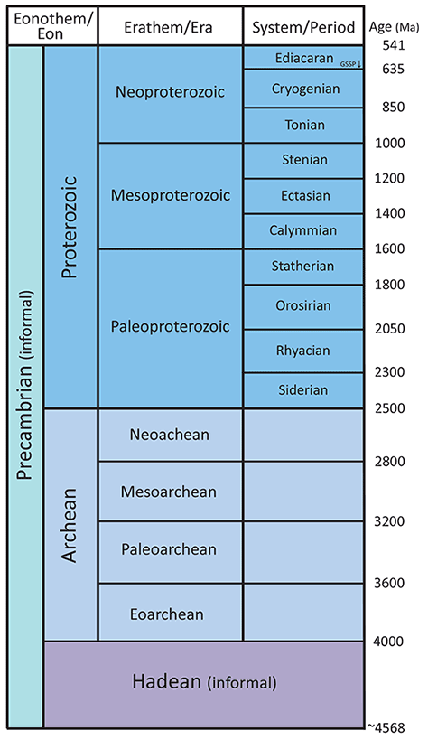
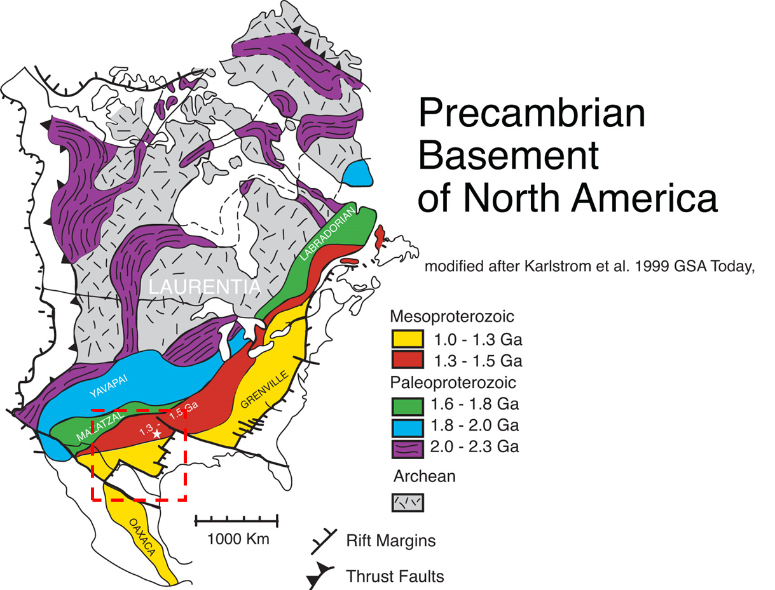
W Texas-New Mexico is underlain by the youngest crust of the Laurentian craton
(Mesoproterozoic: ~ 1.5 to 1.0 Ga)
(Sawin et al., 2013)

Slide 7
Basement terranes of the US
Permian Basin includes Granite-Rhyolite and Grenville/Llano terranes
Grenville (Llano)
Front
(Ewing , 2016, Texas through Time)

Slide 8
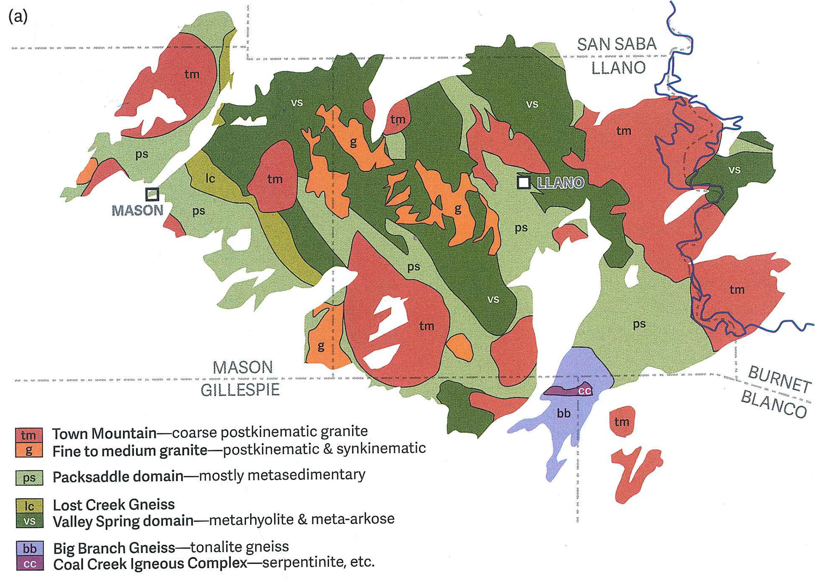
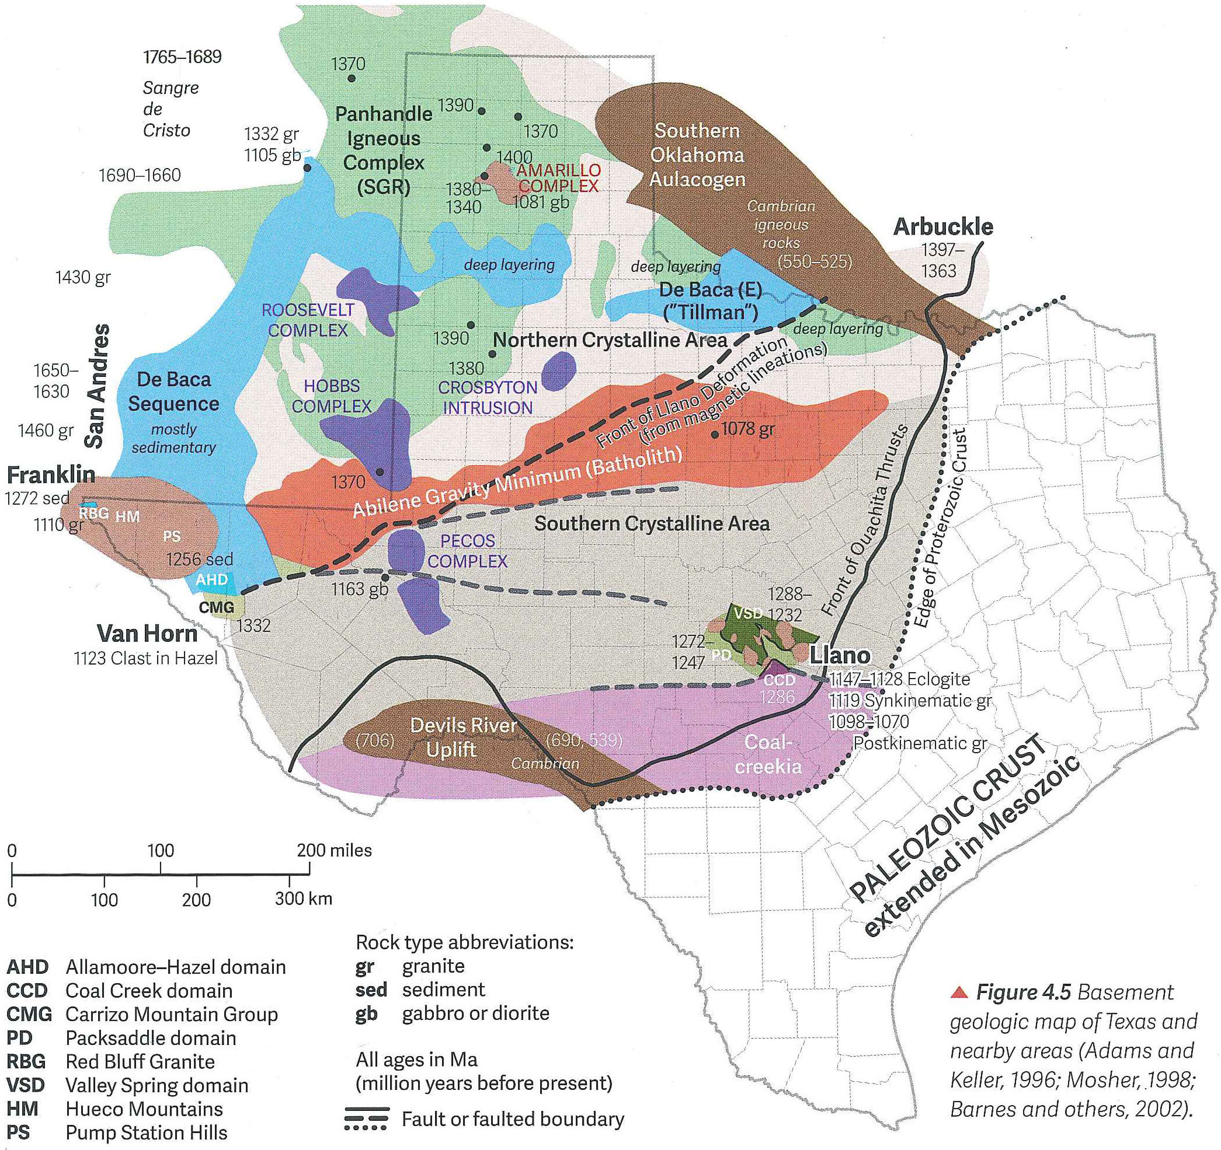
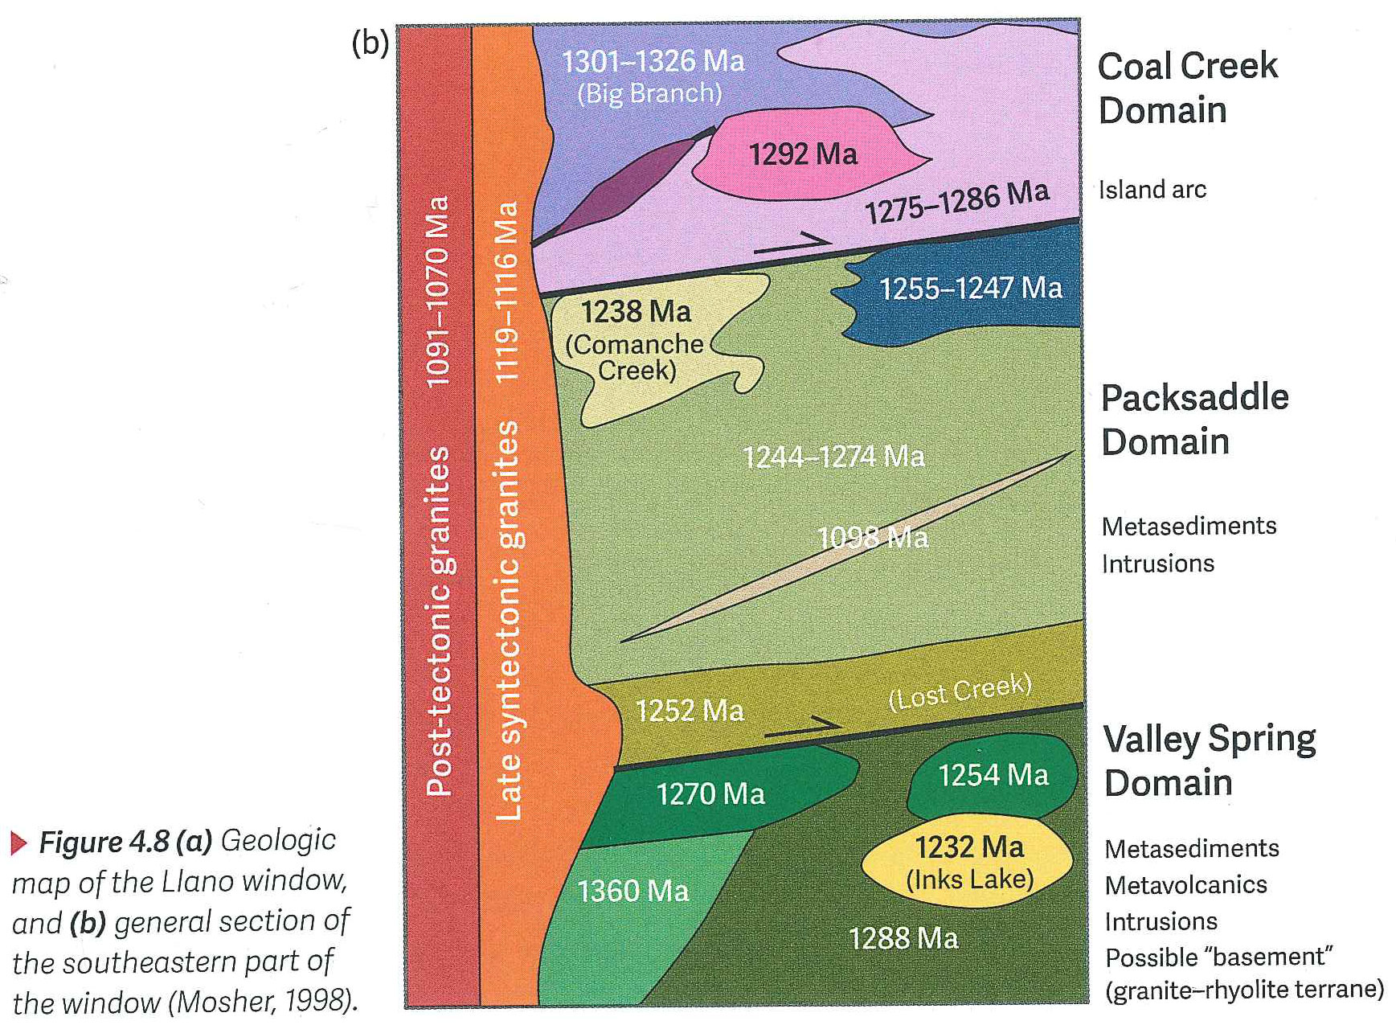
Llano (Grenville) basement is exposed in Llano Uplift (W of Austin)
(Ewing, 2016, Texas through Time)

Slide 9
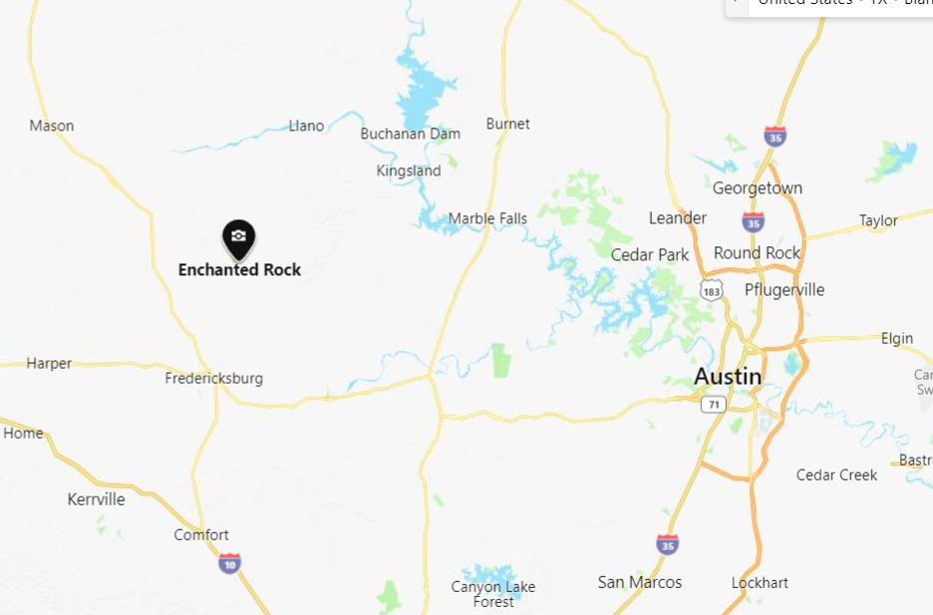
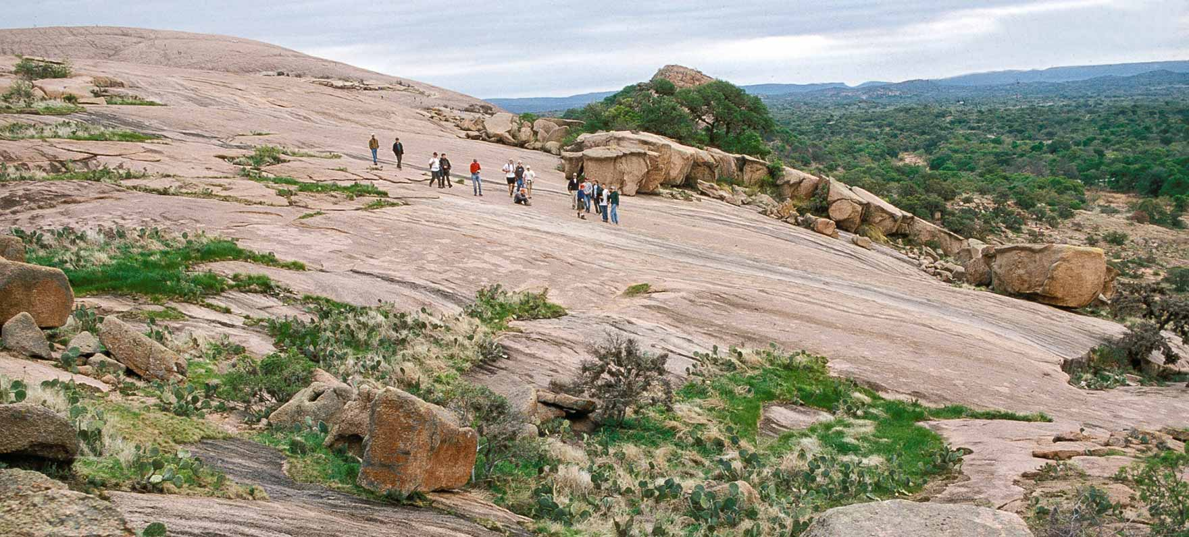
Enchanted Rock State Park, Texas
Exposed basement -- Precambrian granite

Slide 10
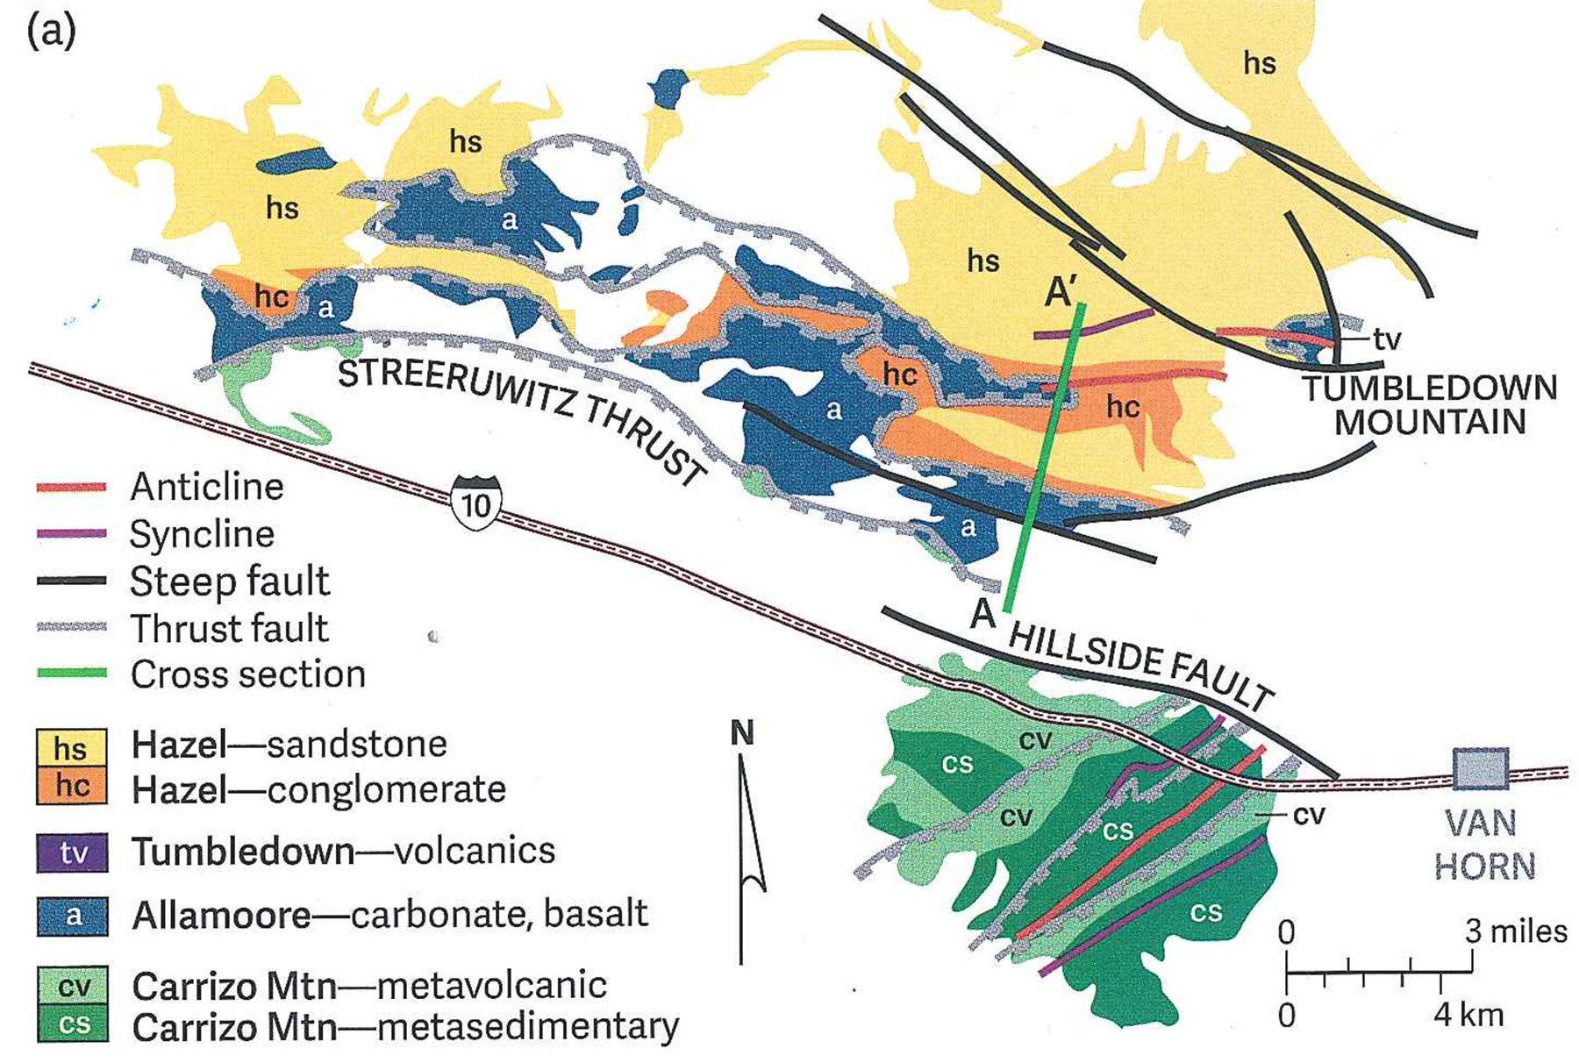
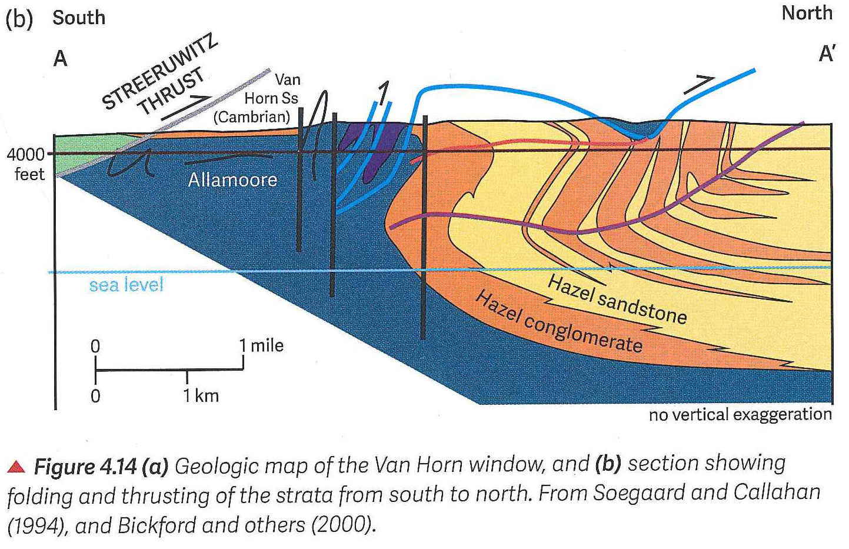
Llano (Grenville) front is exposed in W. Texas (Van Horn)
Ewing, 2016, Texas through Time)

Slide 11
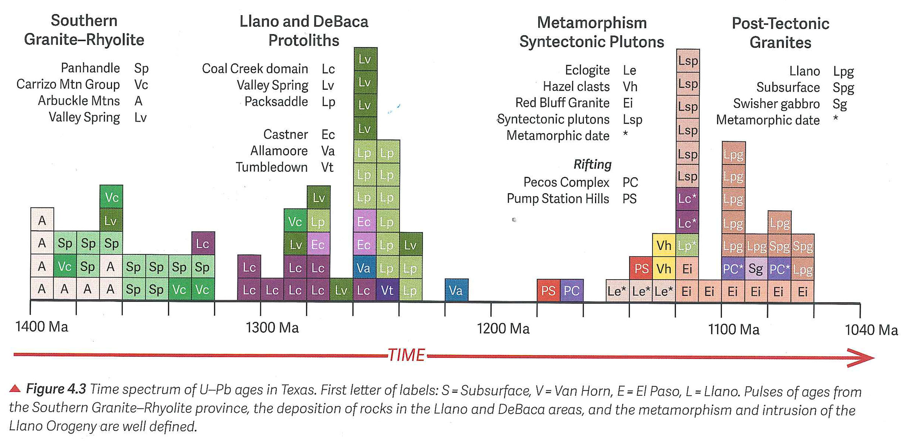
Radiometric ages of Texas basement
(Ewing, 2016, Texas through Time)
Based on outcrop and well samples

Slide 12
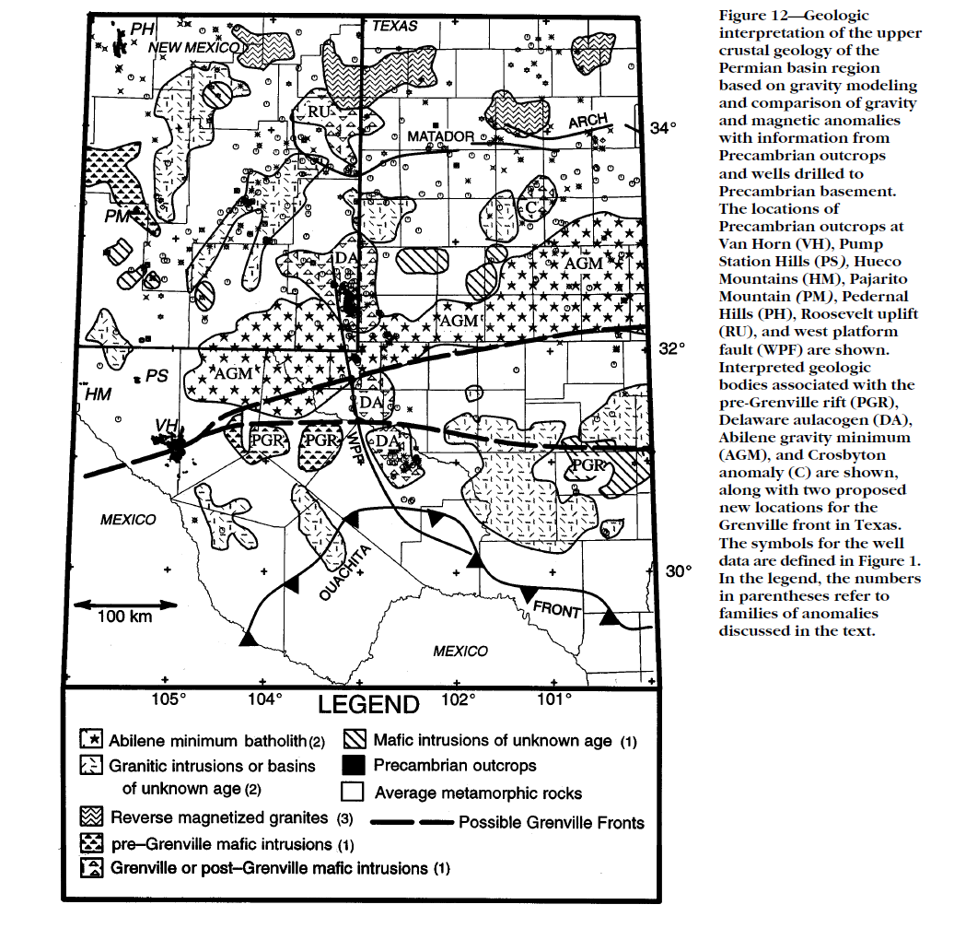
Permian Basin Precambrian Basement Lithology From Gravity, Magnetics, and Wells (Adams and Keller, 1996)
Basement is 1.7 to ~1.0 Billion Years Old
Dominant Rock Types:
Granite & Rhyolite (Granitic)
Layered Norite & Diabase (Mafic)
Schist
Gneiss?
Marble
Other Metamorphic
Central Basin Uplift underlain dominantly
by 0.95 – 1.16 billion year old rift-
related mafics, which influenced
where the uplift formed.
Rift-related sediments no longer
present due to erosion
Grenville thrust front (1.3 to 1.0 bya)
outcrops at Van Horn (VH). Position
of thrust front across Permian Basin
uncertain, but trends ~E-W, suggesting
E-W tear faults in southern Permian Basin,
like the Big Lake and Grisham Faults,
may be inherited from Grenville thrusts
Possible
Grenville
Thrust Fronts
N. Amer. Royalties
#1 Nellie Well
(From Adams & Keller, 1996)

Slide 13
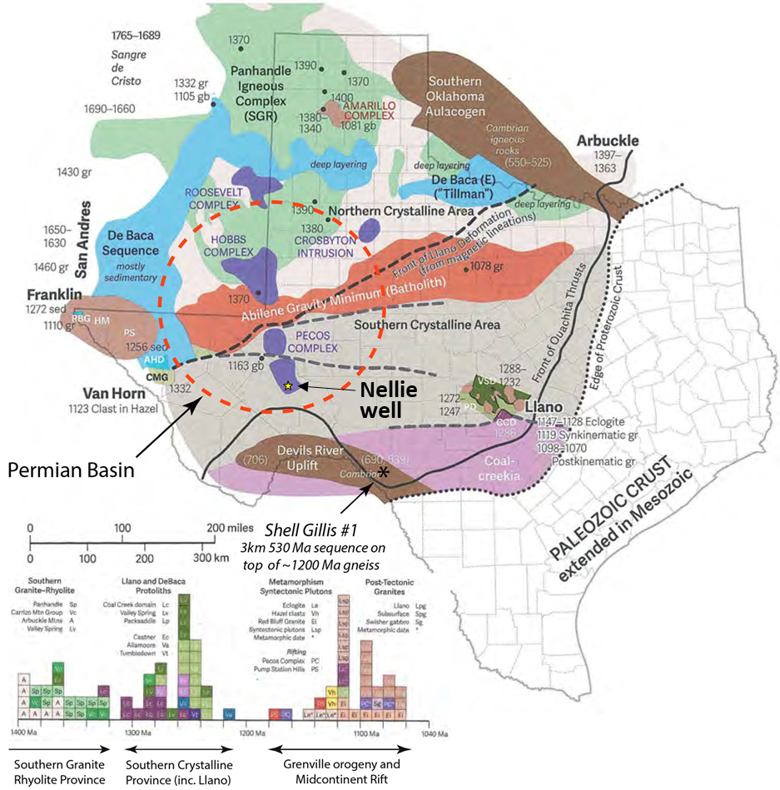
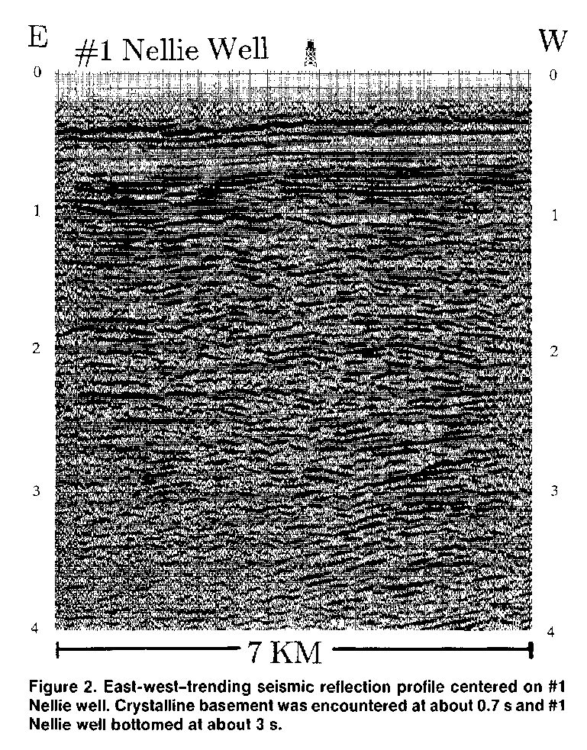
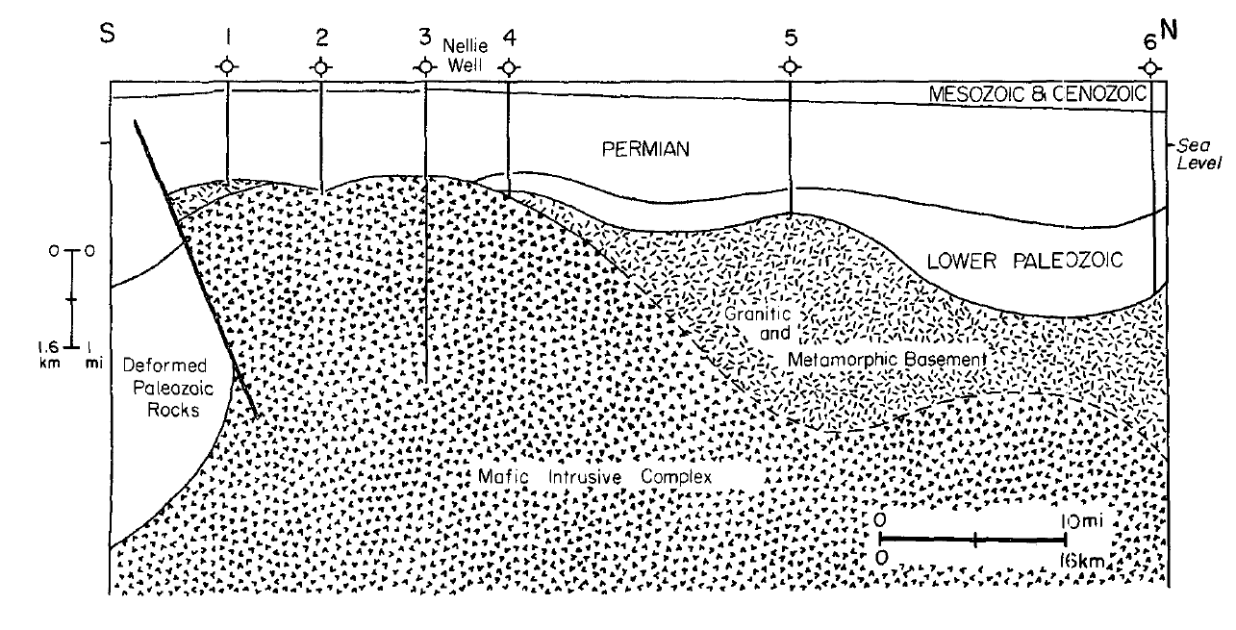
North American Royalties Nellie #1, Pecos Co. –
A Deep Basement Penetration
N. Amer. Royalties
#1 Nellie
Well
N – S Cross Section Across Ft. Stockton High
Todd-Elkhorn
Fault
N. Amer. Royalties
#1 Nellie
Well
Permian
Precambrian Mafic Basement
A
T
Mafic intrusive complex composed of interlayered
norite, anorthosite, orthopyroxenite, and olivine-free
gabbro 1.07 to 1.16 billion years old. (Other nearby
wells penetrated 0.95 billion year old mafics.)
The North American Royalities #1 Nellie well was drilled in 1984 as a subthrust prospect on the Ft. Stockton High. N. Amer. Royalties originally interpreted the arcuate reflectors at 1.5 to 2 sec as subthrust Paleozoic reservoirs beneath a very low angle (4º) thrust bounding the west side of Central Basin Platform. The well drilled 4600’ of Permian and ~14,600’ of mafic Precambrian basement.
(Keller, et al., 1989)

Slide 14
Basement map of Texas: An evolution of interpretation
(Flawn,1956)
(Ewing, 2019)

Slide 15
GRAVITY MEASUREMENTS
AND BASEMENT HEAT FLOW

Slide 16
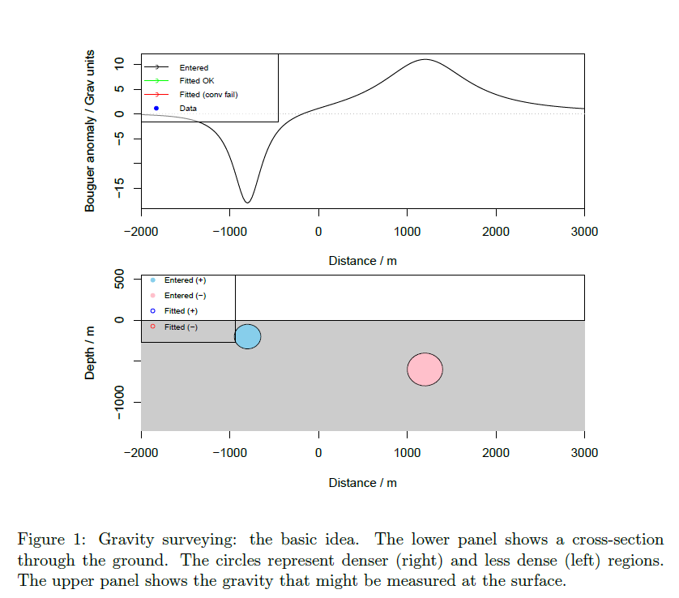
Gravity measurements --
The basic idea
Denser rocks produce gravity highs
Less
Dense
body
Denser body
(Pumphrey, 2014)

Slide 17
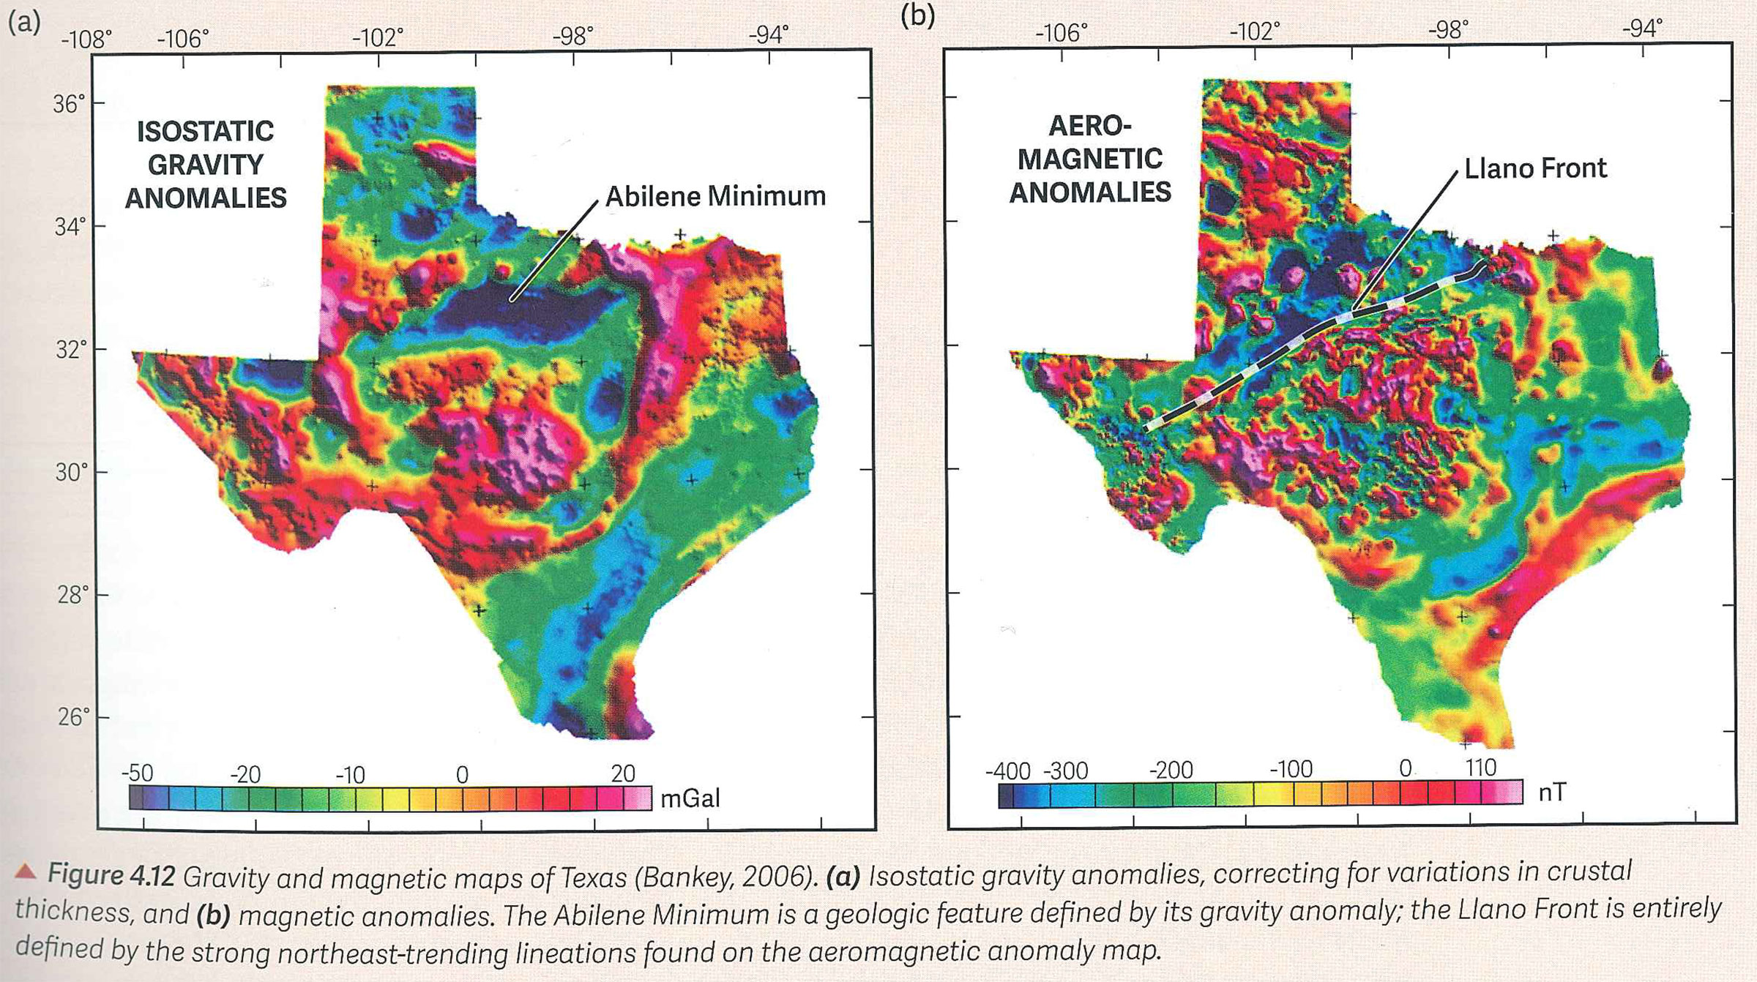
Gravity and Magnetics of Texas
CBU
Llano Uplift
Ewing – Texas through Time

Slide 18
Gravity Models (Adams and Keller, 1996)
M
D
N
N’
Interpreted
Grenville
Front
S’
S
D’
M’
(From Adams & Keller, 1996)

Slide 19
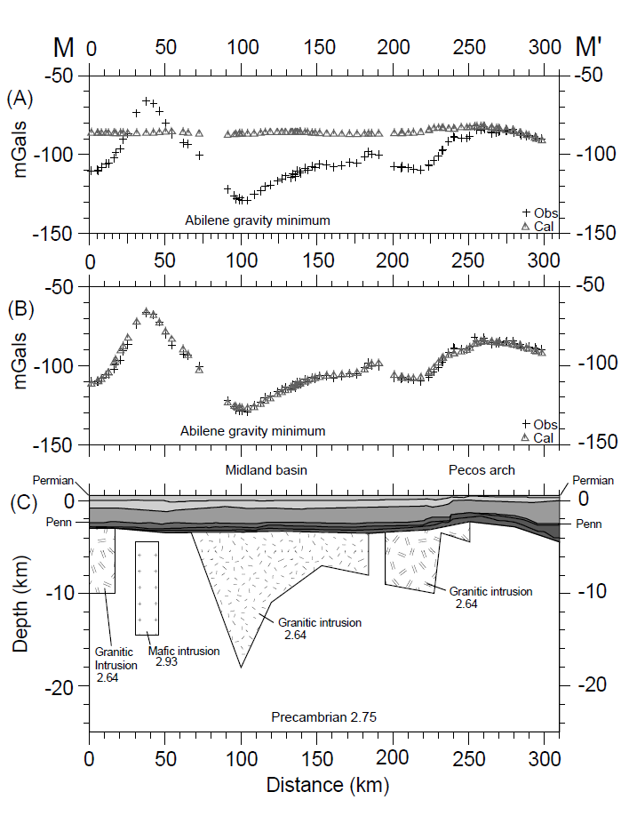
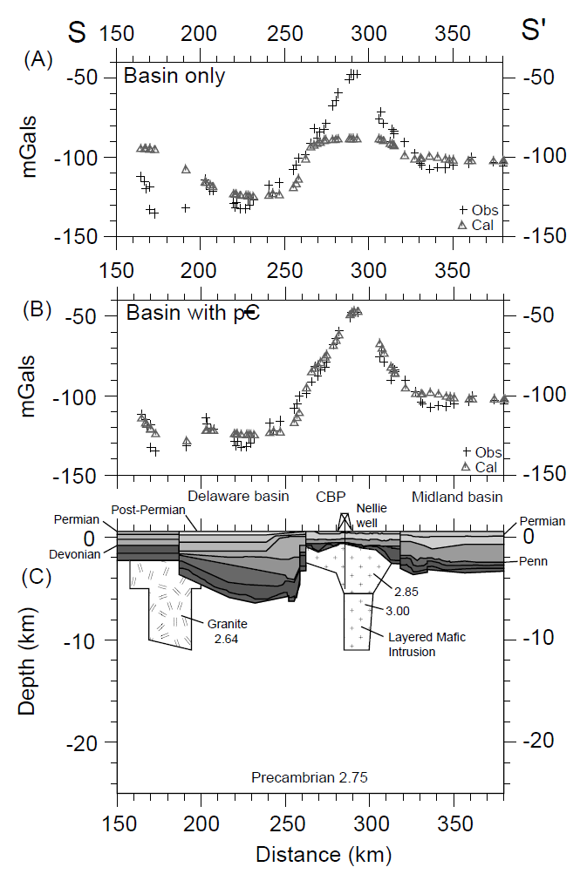
Adams & Keller Gravity Models
M
M’
S
S’
Midland Basin
Delaware
Basin
CBP
Midland
Basin
North
South
West
East
Terry
Gaines
Martin
Midland
Upton
Pecos
Terrell
Impact Of
Only Structure
Jeff Davis
Pecos
Crane
Upton
Model Results
With Constant
Basement
Density –
No Match
Model Results
Gravity
Data
Impact Of
Basement Lithology
Model Results
With Variable
Basement
Densities –
Excellent Match
Input For
Model With
Variable
Basement
Densities
Gravity models & magnetics data support interpretation
of granitic & mafic basement rocks in Permian Basin
(From Adams & Keller, 1996)

Slide 20
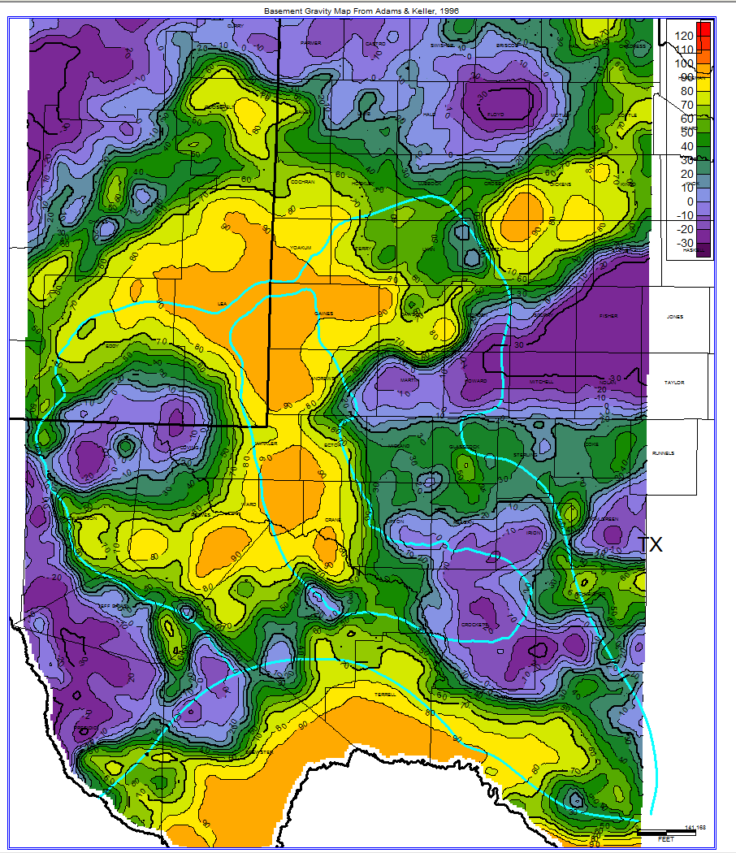
High-resolution Basement Gravity Map of Permian Basin
(Gravity impact of sediments removed by Adams & Keller)
Gravity
Low
Gravity
Low
Gravity low – granitic rocks
(Purples & Blues)
Gravity high – mafic rocks
(Orange, yellow, light green)
Intermediate (Greens) –
metamorphics, intermediate
igneous, or thin intrusives
Interior Zone of Marathon Thrust
Belt composed of weakly to
moderately metamorphosed
thrusted basinal sediments, not
mafic rocks.
Gravity High
Gravity High
mgal
Gravity Low
Central Basin Uplift
Abilene Gravity Minimum
Gravity Low
Gravity High
Midland Basin
Gravity
Low
Eastern Shelf
Delaware Basin
Diablo Uplift
Gravity Low
Gravity
Low
Elsinore
Uplift
Val Verde Basin
Marfa
Basin
(Gravity Map From Adams & Keller, 1996)
(Gravity map digitized by Paul Duckworth)
Interior Zone of
Marathon Thrust Belt
Gravity High
Devil’s River
Uplift
(Tim Reed, Pioneer)

Slide 21
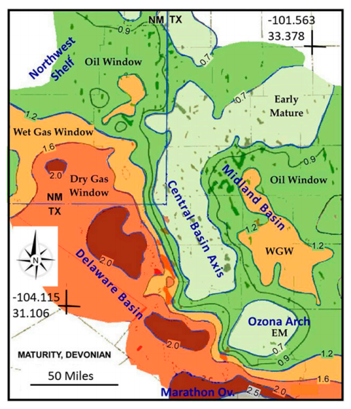
Note correspondence of mafic rocks (gravity highs) and slightly lower maturity values
Woodford maturity (Sternbach, 2020)

Slide 22
RE-ACTIVATION
OF
BASEMENT
TRENDS

Slide 23
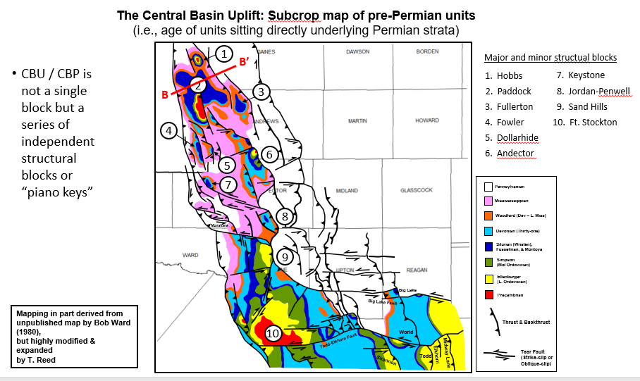
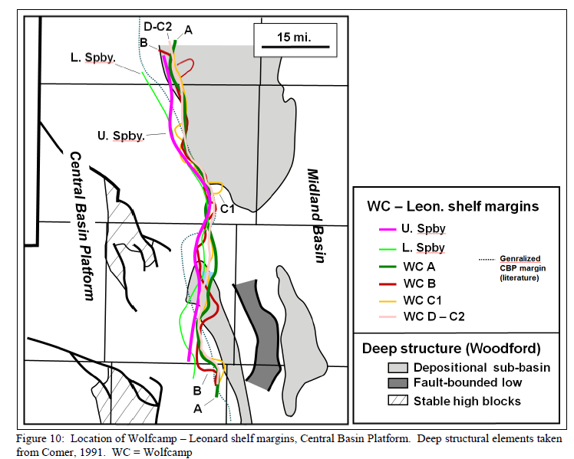
Many large oilfields are housed in Lower Paleozoic carbonates on positive structural blocks and/or in lower and middle Permian carbonates draped over these blocks
Major faults extend into SW Midland County, Upton County, and SE Reagan County; effect thickness patterns of Wolfcamp shale and dispersal patterns of debris flows off of CBP
Major faults on eastern margin of CBU “locked-in” position of Wolfcamp and Spraberry margins
Debris flow
pathway
(modified from Sinclair et al., 2017)

Slide 24
LATE PRECAMBRIAN TO
EARLY CAMBRIAN RIFTING
AND INITIAL TRANSGRESSION
OF SEA

Slide 25
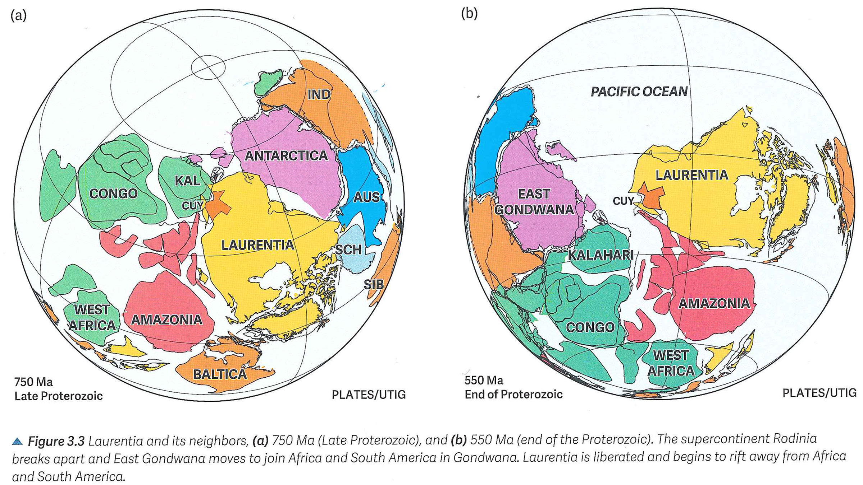
Paleogeographic reconstructions for Neoproterozoic time
Rodinia starts to break up at the end of Neoproterozoic time
Permian Basin
region
(Ewing, 2016, Texas through Time)

Slide 26
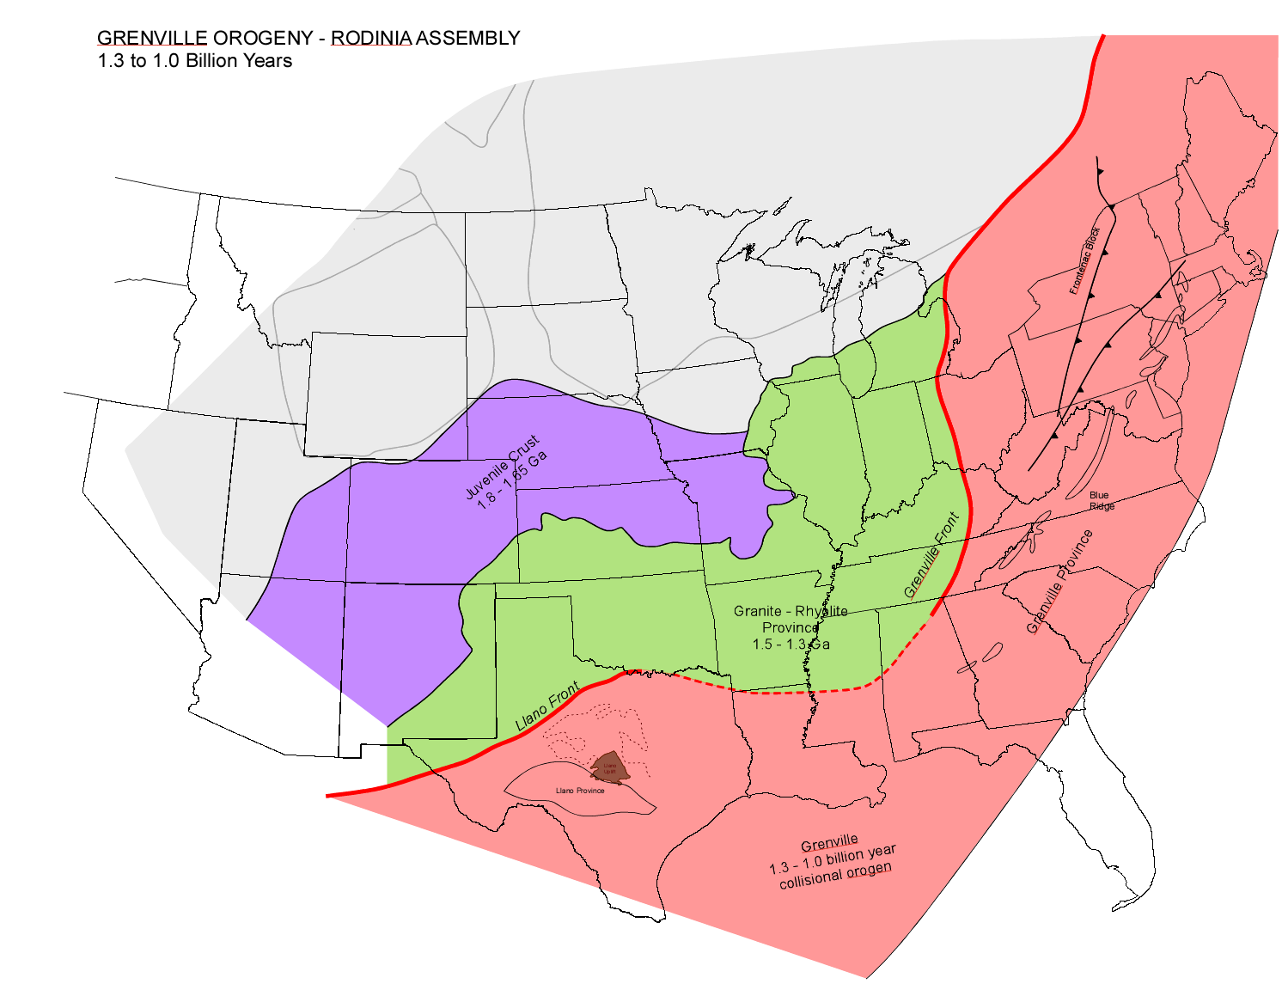
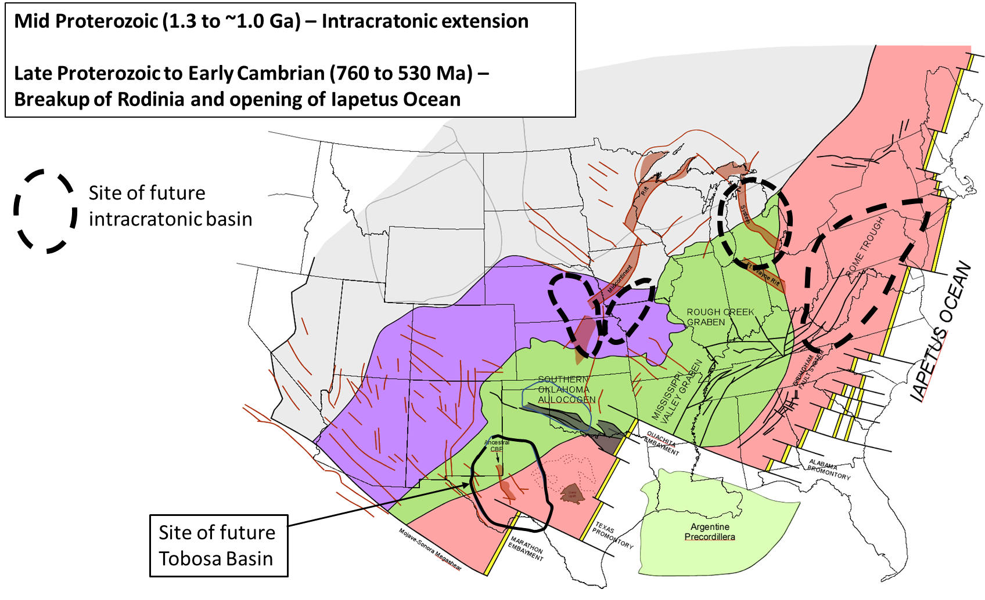

Slide 27
CBP
CBP
(Ewing, 2019, Texas through Time)

Slide 28
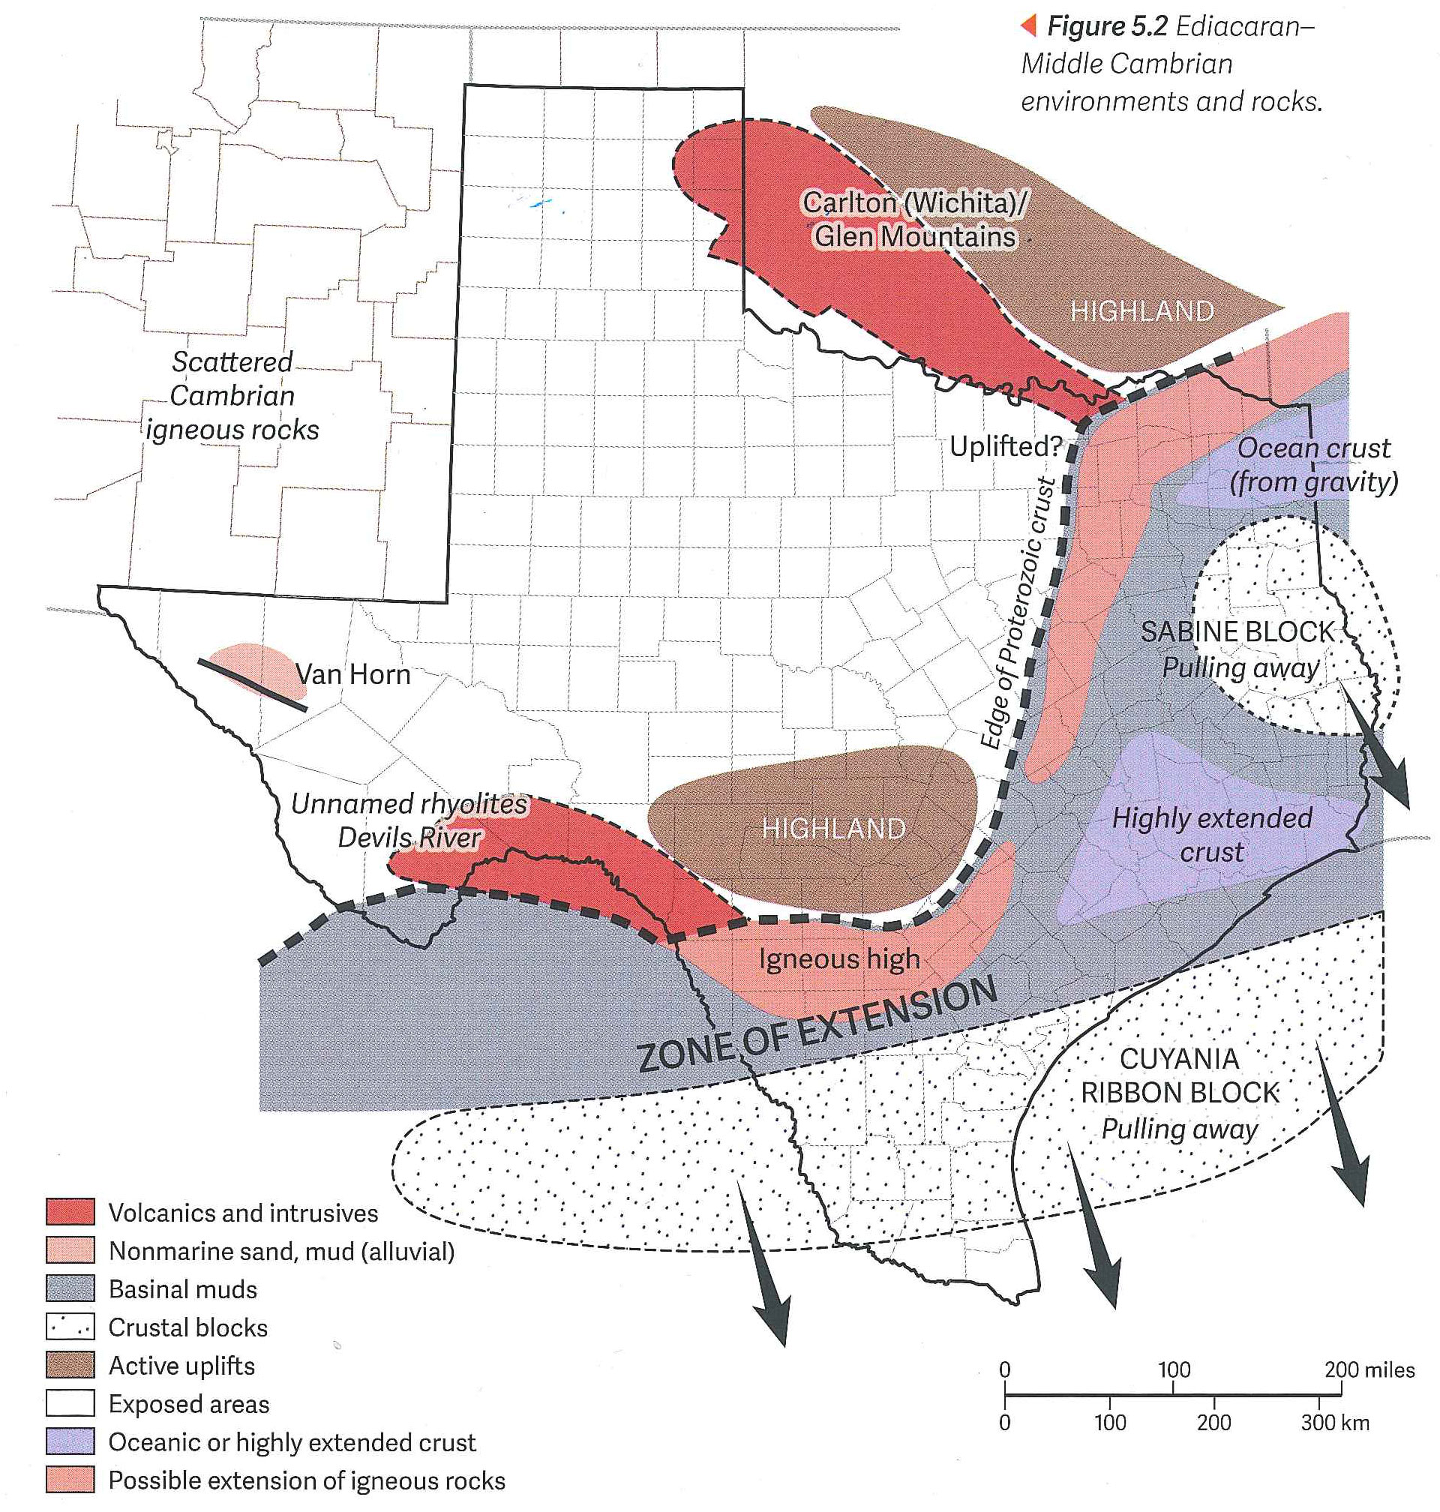
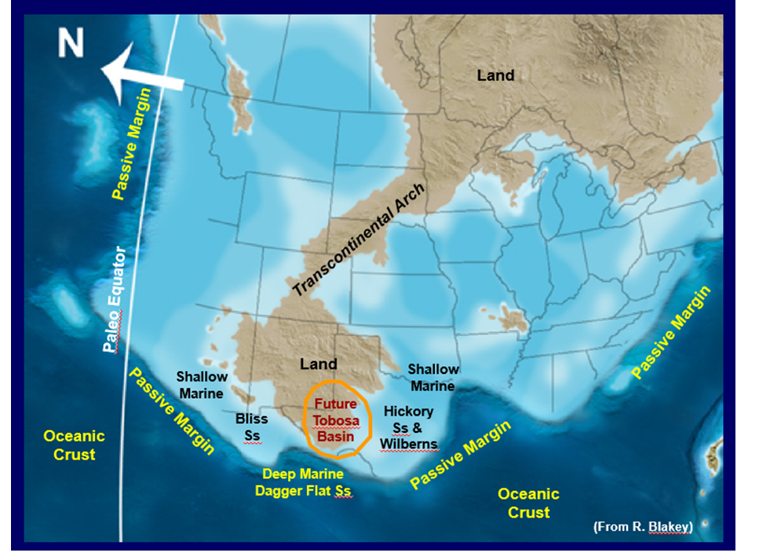
Middle Cambrian
Late Cambrian
site of future
Tobosa Basin
By Late Cambrian time, the seas had transgressed and inundated the Llano region and southern margin of the Tobosa Basin
(modified from Ewing, 2016, Texas through Time)

Slide 29
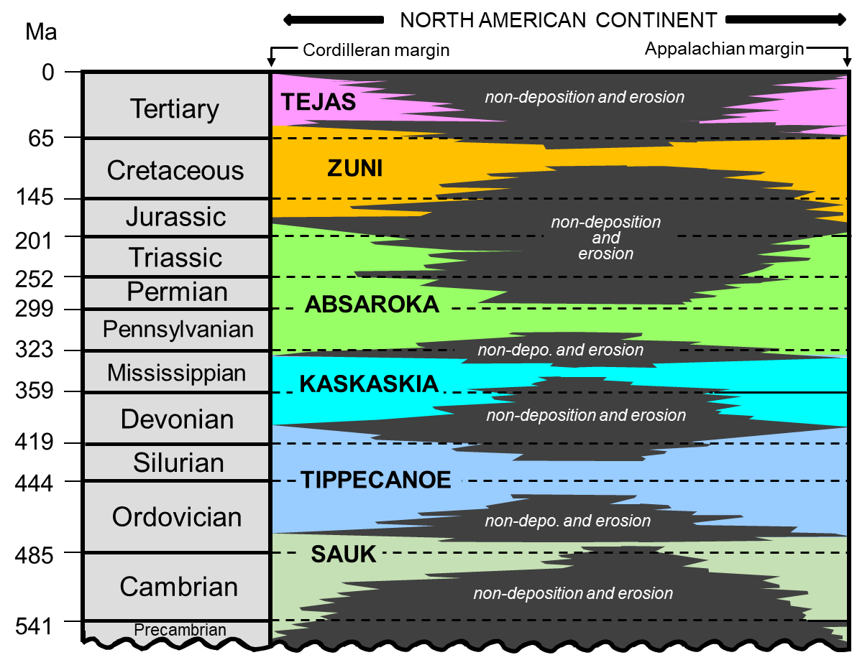
Megacycles of sea-level change (Sloss, 1963)
Long-term cycles of sea-level change on the North American craton lasting 50 Myr or
more were documented by L.L. Sloss in 1963
Seven Phanerozoic megacycles: named after native North American Indian tribes
Correlate to phases of plate tectonics, resulting in the flooding and draining of
epicontinental seas
Upper
Lower
Early
SAUK
CYCLE
TIPPECANOE
CYCLE
KASKASKIA
CYCLE
L. ABSAROKA
CYCLE
U. ABSAROKA
CYCLE
ZUNI
CYCLE
TEJAS
CYCLE

Slide 30
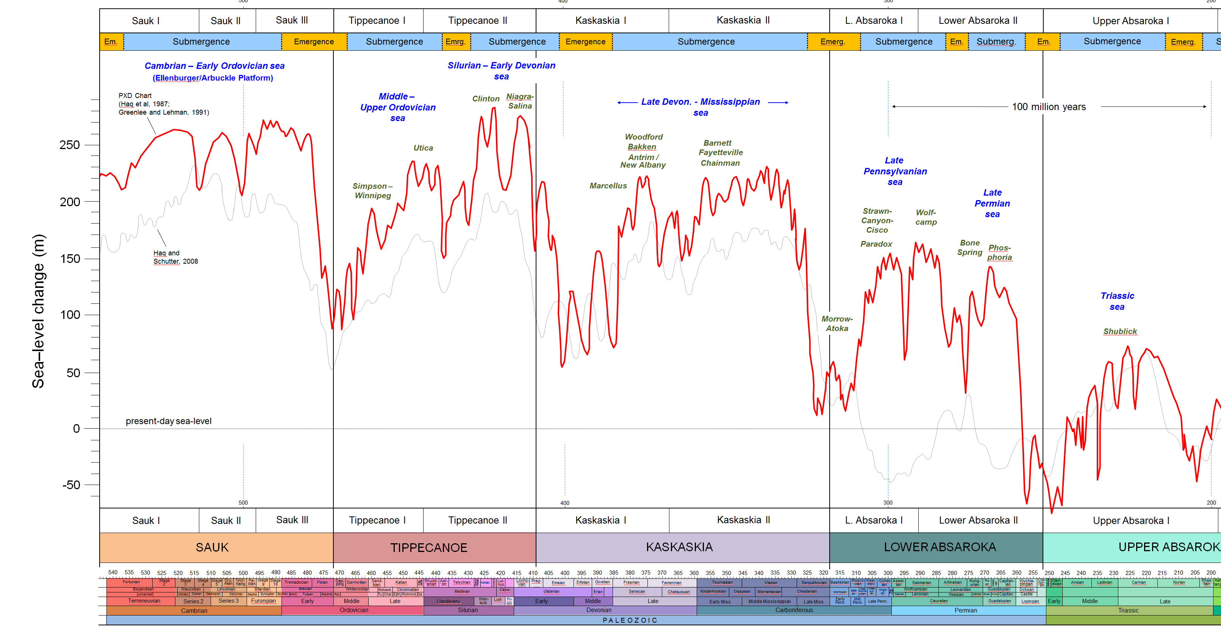
Four long-term cycles of sea level during the Paleozoic (4 megacycles)
Upper Precamb. –
Lower Ordovician
Mid. Ordovician –
Lower Devonian
1
2
3
Lower Devonian –
Mississippian
4
Pennsylvanian –
Permian
Early
Mid.
Late
Early
Mid.
Late
Lu.-
Late
Early
Middle
L.
E.
Lland.
Wn.
Pri.
Early
Mid.
Late
E.
M
Cisuralian
Gua.
Lop.
Middle
Late
Cambrian
Ordovician
Silurian
Devonian
Mississippian
Penn.
Permian
Triassic
540
520
500
480
460
440
420
400
380
360
340
320
300
280
260
240
220
200

Slide 31
Paleozoic: Four long-term cycles (megacycles) = four epicontinental seas
Upper Precamb. –
Early Ordovician
Mid. Ordovician –
Early Devonian
1
2
3
Early Devonian –
Mississippian
4
1a
1b
2a
2b
3a
3b
4a
Pennsylvanian –
Permian
4b
4c
Fusselman-
Wristen-
Thirtyone
eroded/
not
deposited
U. Miss./Barnett –
Lower Miss. Lime –
Woodford
WFMP C2 –
WFMP D –
L. Strawn –
Morr. - Atoka
SPBY/B.Spr.-
Ochoan
Permian
Basin
stratigraphic
units
eroded/
not deposited
(Basement)
Ellen-
burger
Simpson-
Montoya
Dean -
Tans.-Yates
Trans. Ss.
WFMP A -
Quen.-SNRV
WFMP B -
GBRG
WFMP C1
San Andres
Early
Mid.
Late
Early
Mid.
Late
Lu.-
Late
Early
Middle
L.
E.
Lland.
Wn.
Pri.
Early
Mid.
Late
E.
M
Cisuralian
Gua.
Lop.
Middle
Late
Cambrian
Ordovician
Silurian
Devonian
Mississippian
Penn.
Permian
Triassic
540
520
500
480
460
440
420
400
380
360
340
320
300
280
260
240
220
200

Slide 32
Four long-term cycles of sea level during the Paleozoic (4 megacycles)
Upper Precamb. –
Lower Ordovician
Mid. Ordovician –
Lower Devonian
1
2
3
Lower Devonian –
Mississippian
4
1a
1b
2a
2b
3a
3b
4a
Pennsylvanian –
Permian
4b
4c
Fusselman-
Wristen-
Thirtyone
eroded/
not
deposited
U. Miss./Barnett –
Lower Miss. Lime –
Woodford
WFMP C2 –
WFMP D –
L. Strawn –
Morr. - Atoka
SPBY/B.Spr.-
Ochoan
Permian
Basin
stratigraphic
units
eroded/
not deposited
(Basement)
Ellen-
burger
Simpson-
Montoya
Dean -
Tans.-Yates
Trans. Ss.
WFMP A -
Quen.-SNRV
WFMP B -
GBRG
WFMP C1
San Andres
Early
Mid.
Late
Early
Mid.
Late
Lu.-
Late
Early
Middle
L.
E.
Lland.
Wn.
Pri.
Early
Mid.
Late
E.
M
Cisuralian
Gua.
Lop.
Middle
Late
Cambrian
Ordovician
Silurian
Devonian
Mississippian
Penn.
Permian
Triassic
540
520
500
480
460
440
420
400
380
360
340
320
300
280
260
240
220
200

Slide 33
Geology of the Permian Basin: ELS (Endeavor Lecture Series)
Horseshoe Atoll
Tectonic history – Part 1 (Big Picture)
Tectonic history – Part 2 (Regional elements: ARM, CBU, MFB)
Basement
Cambrian – Lower Ord (Wilberns/Bliss Ss., Ellenburger Gp)
NEXT SESSION
Tobosa Basin stratigraphy (Mid Ord. – Mississippian)
Pennsylvanian (Morrow-Atoka-Strawn-Canyon-Cisco)
Lower Permian (Wolfcamp – Spraberry)
Middle and Upper Permian / Permian Basin petroleum system

