Slide 1

The Stuart City Reef Trend, South Texas
A presentation for:
Raven Forest Operating, LLC
August 4, 2021
Lowell Waite
Department of Geosciences
University of Texas at Dallas

Slide 2
Outline
Introduction and regional geologic setting
Edwards petroleum system and depositional facies
Pioneer Natural Resources (PNR) data acquisition, core analysis, and 3D seismic facies mapping
Edwards reef reservoir characterization
Raven Forest prospect, east Texas

Slide 3
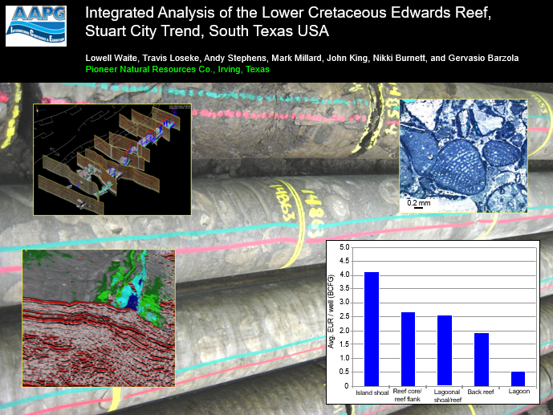
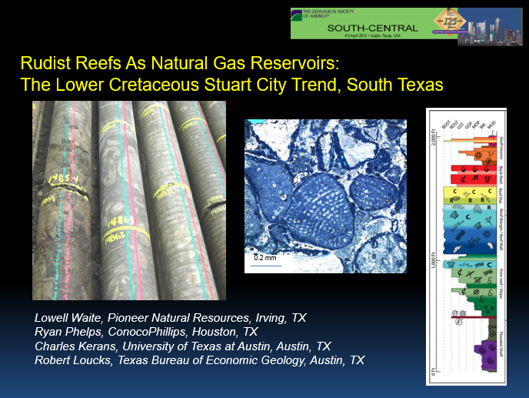
AAPG ICE, Calgary, Canada (2010)
This presentation is a compilation of two talks, which together summarize key learnings from the PNR Edwards exploration project, south Texas (2004 – 2008)
GSA South Central Mtg, Austin, TX (2013)

Slide 4
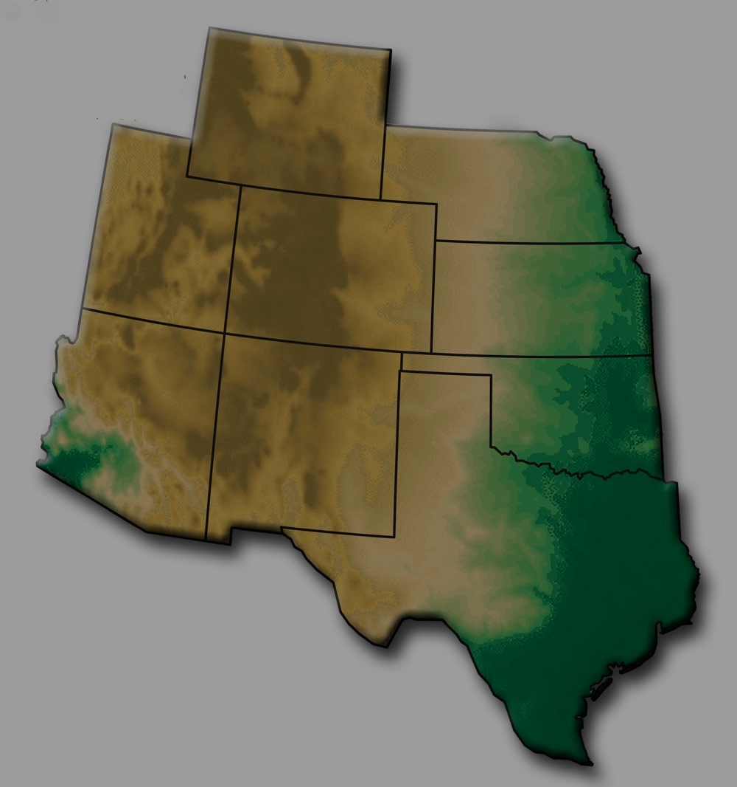
Stuart City Trend, south Texas
Lower Cretaceous (middle Albian) reef complex extending for > 1000 km across
south and east Texas, part of a larger system that rims the circum-GOM Basin
String of natural gas accumulations within reef facies, in combination
structural -
stratigraphic traps;
11,000 – 15,000+ ft.
High temps, pressure
Trend
Avg. porosity: 4 - 5%
AUS
Reef
HOU
Bottom Line:
Microporous
tight gas reservoir
SAT
City
Stuart

Slide 5
Stuart City Gas Fields in South Texas
DFW
1.3 TCFG from + 700 wells
HOU
Fayette
EDWARDS
(ALBIAN)
SHELF
MARGIN
SAT
Moray
Colorado
Stuart City
Word
Reef Trend
Lavaca
Buchel
Yoakum
Wilson
Washburn
Ranch
Atascosa
Dewitt
Karnes
Kawitt
Dilworth
Goliad
Pawnee
Stuart City
McMullen
Bee
Live Oak
LaSalle
Edwards reef
SLIGO SHELF MARGIN
(NEOCOM. – APTIAN)
gas field
50 mi / 80 km

Slide 6
Cretaceous stratigraphy, south Texas
Stage
Group
Series
2nd - order
65
Lithostratigraphy
Supersequences
Maast.
Navarro
Escond.
Olmos
(T-R cycles)
70
San Miguel
R
75
Camp-
Taylor
Anacacho
T
nian
Upson
80
Gulfian
Upper Cretaceous
Austin
Austin Chalk
R
85
Santonian
Coniacian
90
Turonian
Eagle
Eagle Ford
T
Ford
95
Ceno-
Buda
Reef
manian
Wash-
Del Rio
R
100
ita
Georgetown
T
Shelf l.s.
Freder-
A
Edwards
SC
R
105
Albian
icksburg
B
T
Basinal l.s.
Glen Rose
R
110
Comanchean
T
Marl / shale
Upper
R
Sandstone
115
Hensel
Bexar
Zuni II Supersequence Set
(Sloss, 1988)
Aptian
T
120
Mid.
Cow Ck.
James
R
Lower Cretaceous
Trinity Division
Pine Island
125
T
Barrem.
Sligo
R
130
Coahuilan
Lower
Hosston
Sligo Reef
Hauteriv.
T
135
140
Valangin.
Berrias.
Cotton Valley/Bossier
R
145
T

Slide 7
Regional Lower Cretaceous paleogeography
Comanche
East Texas
Basin
updip limit
of salt
Llano Uplift
Devil’s River
Platform
trend
San
Marcos
Raven Forest
Edwards prospect
Arch
Maverick
Basin
Stuart City/Edwards
Reef Margin
(Middle Albian)
Facies
Rio Grande
Salt Basin
Shallow carb. platform
PNR study area
Deep shelf / shelf basin
Slope & basinal
0
50 mi
Land / supratidal
Reef margin

Slide 8
Edwards Reef:
Petroleum system and
Depositional facies

Slide 9
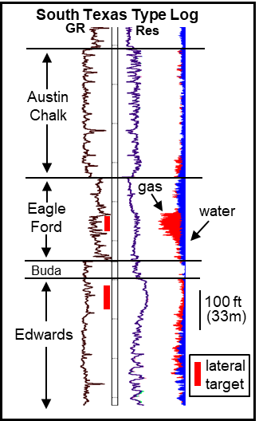
Edwards / Stuart City Trend Petroleum System
SE
5 km
Tertiary
L. Eoc. -
Paleoc.
(vert. not to scale)
BVW
Midway - Wilcox
Maast.-
Camp.
Main shelf-margin fault
Up. Cret.
Buda -
Del Rio -
Georgetown
gas-filled
reservoir
San-Con
Tur. -
Austin - Eagle Ford
Cenom.
Lower Cretaceous
Edwards
Albian
Reservoir facies
Lateral and top seal facies
Microporous rudist-algal reef boundstones, packstones, and skeletal grainstones
Low-perm lagoonal wackestones
Non-porous planktonic foram -calcisphere wackestones
Source rock(s)
Organic-rich calcareous shale, chalk
Trap type: combination
Non-organic terrigenous shale, s.s.

Slide 10
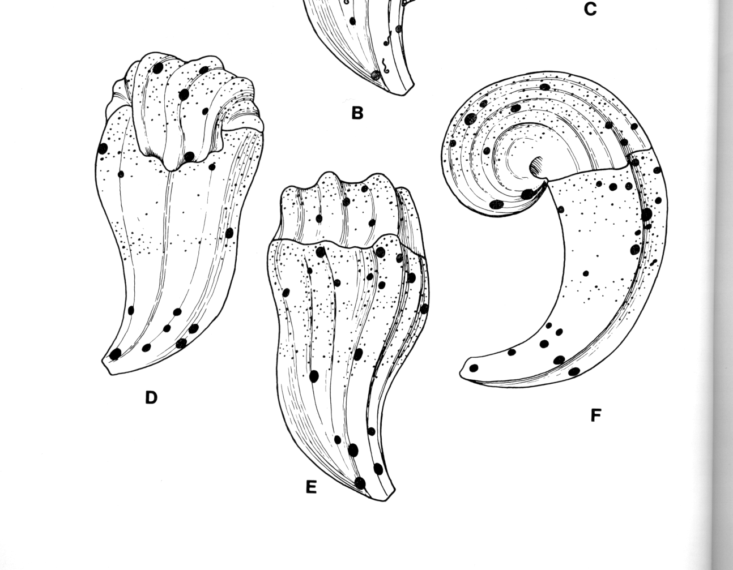
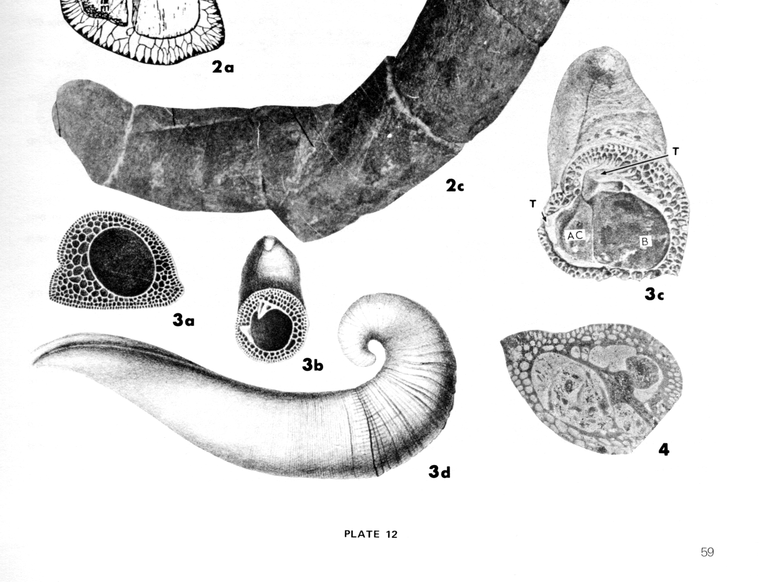
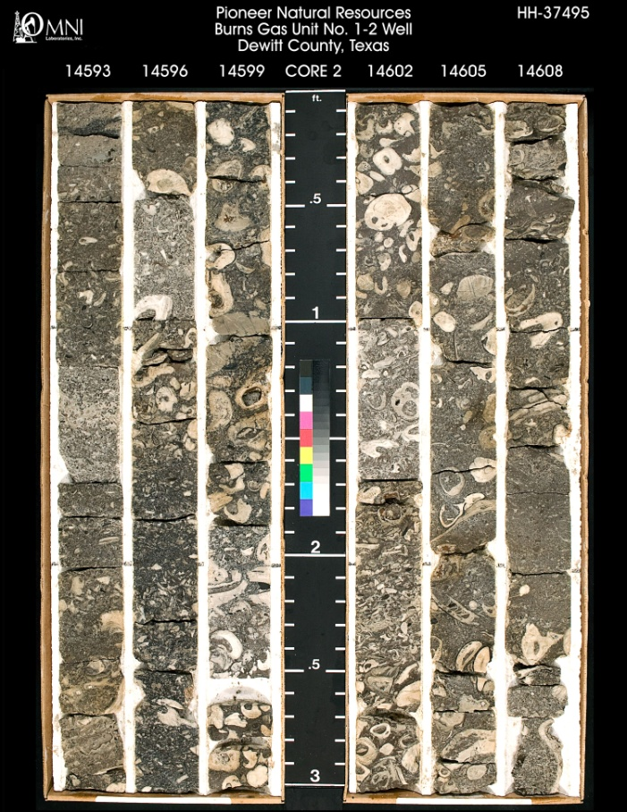
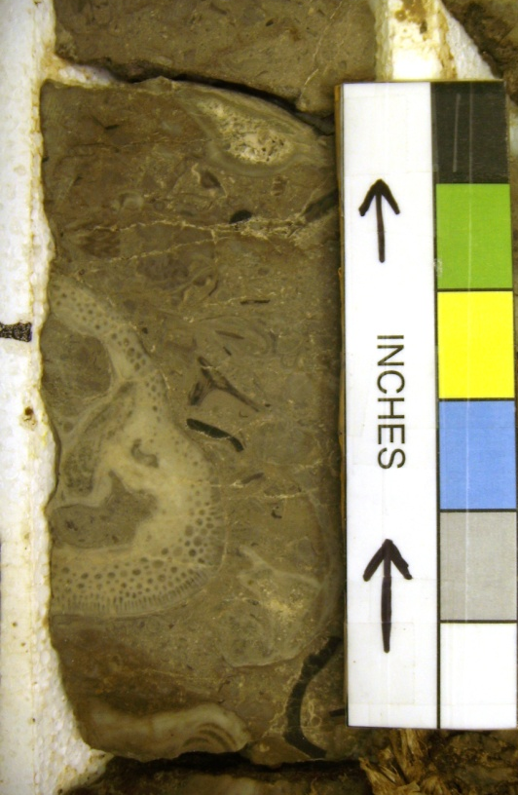
The Rudists…..Cretaceous bivalve reef builders
(Kaufmann & Sohl, 1974)
Upper
valve
Lower
valve
1 in.
Distinctive shell wall
Floatstones
(muddy
matrix)
(Coogan, 1978)

Slide 11
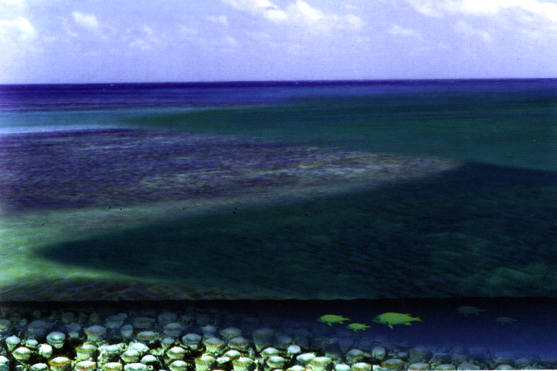
The Rudists…..Cretaceous bivalve reef builders
Caribbean Rudist Framework Assemblages
(Kaufmann & Sohl, 1974)
(Kaufmann & Sohl, 1974)
0
0
0
0
Upper
valve
(Coogan, 1978)
Intertidal
Inner
Lagoon
Middle
Lagoon
Outer
Lagoon
Lagoon
Center
Barrier
Barrier
Outer
Foreslope
Back
Barrier
Foreslope
Rudist
Lower
valve
1 in.
(Kaufmann and Sohl, 1974)
Conceptual drawing of a typical rudist bank,
Tethyan seaway (from Skelton, 2003, The Cretaceous World)
Distinctive shell wall
Floatstones
(muddy
matrix)
(Coogan, 1978)

Slide 12
Stuart City margin at Pawnee Field, Bee Co., TX
A
A’
zzzzz
Southeast
Depth
Pawnee Fld.
(x1000 ft)
13
Austin Chalk – Eagle Ford
Washita
Fredericksburg
Stuart City
14
Glen Rose
15
500 ft
VE=100x
150 m
25 km
15 mi
Pearsall
Peritidal shelf carb.
16
Subtidal shelf carb.
Hosston - Sligo
Deep shelf carb.
Reefal shelf margin
Slope
Superseq.
boundary
Nearshore siliciclastics
Flooded shelf mudrocks

Slide 13
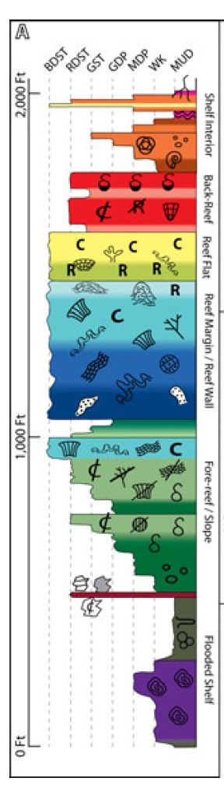
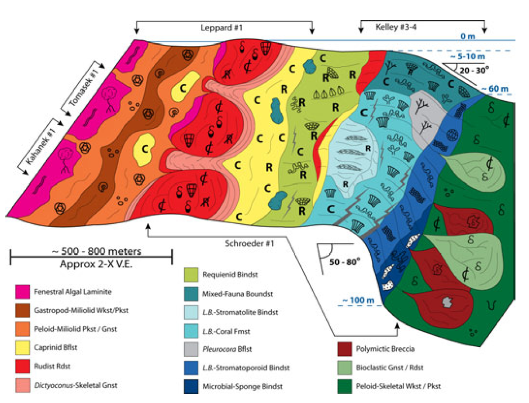
Stuart City Trend: Multiple rock types, six major environments
1
Basinal
3
Reef Margin /
5
Back Reef /
Reef Wall
Shoal
2
Fore-reef / Slope
4
Reef Flat
6
Shelf Interior
6
Reef margin at Pawnee Field, Bee Co., TX
5
4
3
6
5
4
3
2
2
3
1

Slide 14
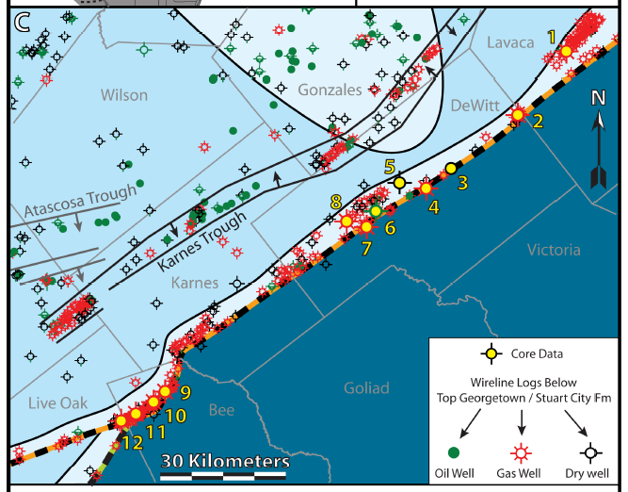
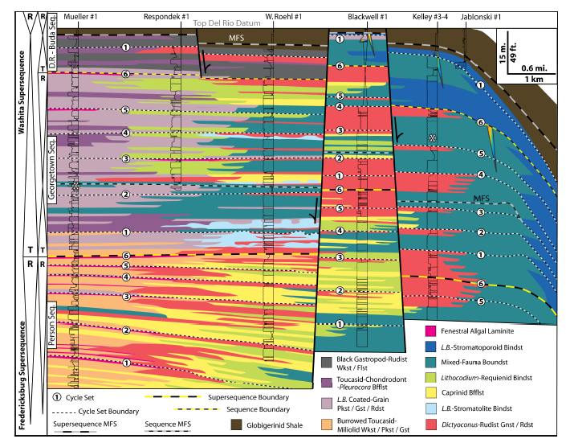
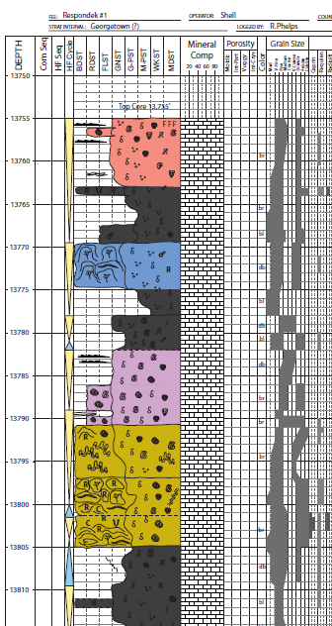
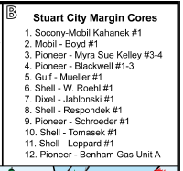
Edwards reefs: a high degree of internal heterogeneity
core/log scale: below 3-D seismic resolution
Difficult to calibrate facies to standard logs
top reef
1
-
6
3rd-order
cycles

Slide 15
Edwards Reef:
PNR data acquisition,
core analysis, and
3D seismic facies mapping

Slide 16
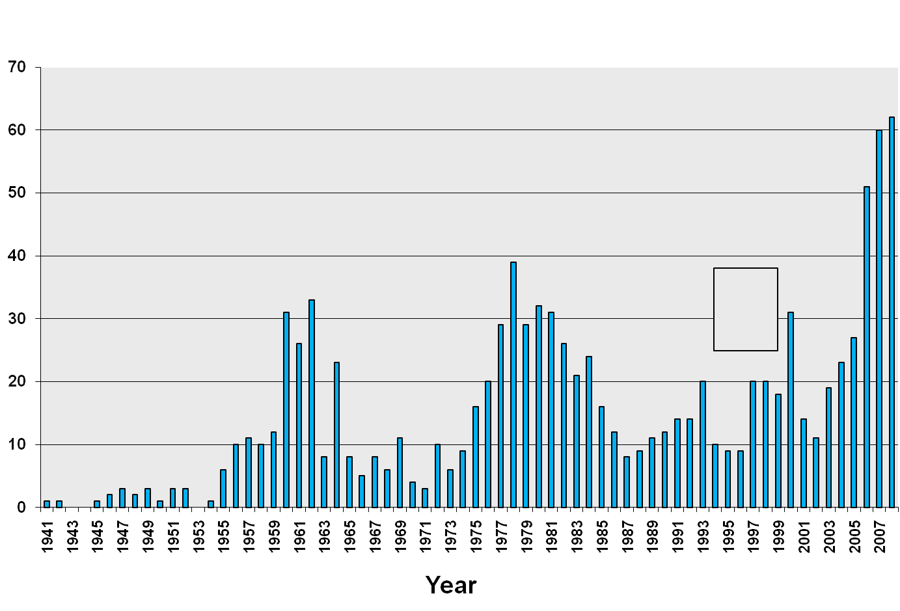
Stuart City Trend Exploration History, South Texas
late 1970’s
boom
Pioneer Nat. Res.
expansion program
begins
Initial exploration
phase
Completions per Year
Pawnee
Field
infills &
initial
laterals

Slide 17
Stuart City Trend Exploration History, South Texas
PNR data acquisition (2005 – 2008)
purchased > 25,000 line-miles 2D seismic
acquired ~ 1700 mi² (4400 km²) new 3D seismic
Acreage leasing:
> 300,000 acres @ $100 -150/acre
late 1970’s
boom
Pioneer Nat. Res.
expansion program
begins
86 wells (deep pilots w/ horizontals)
Initial exploration
phase
7 new extensive cores (300 – 1000 ft)
Completions per Year
Numerous reservoir, production data
Pawnee
Field
infills &
initial
laterals

Slide 18
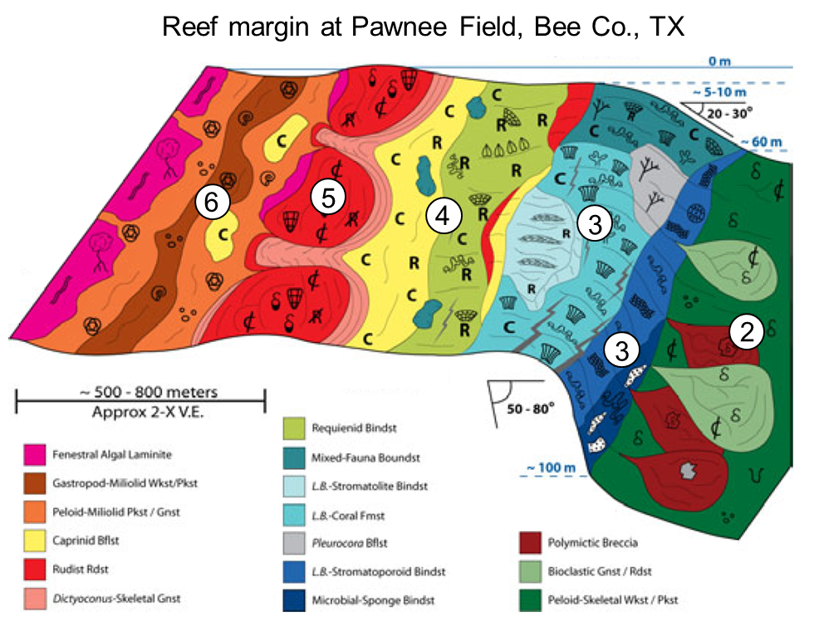
Simplified facies for seismic mapping
Information on ~ 60 cores, detailed description of 7 new PNR cores
lagoonal shoal /
shelf margin reef
patch reef
back reef:
reef core:
island-shoal:
algal-coated
rudist PS/BS
reef flank:
skeletal GS
skeletal PS
rudist WS
lagoon:
sea level
miliolid WS
slope:
planktic
foram -
echinoid
WS
Sligo
margin
50 m
5 km
BS = boundstone; GS = grainstone; PS = Packstone; WS = wackestone

Slide 19
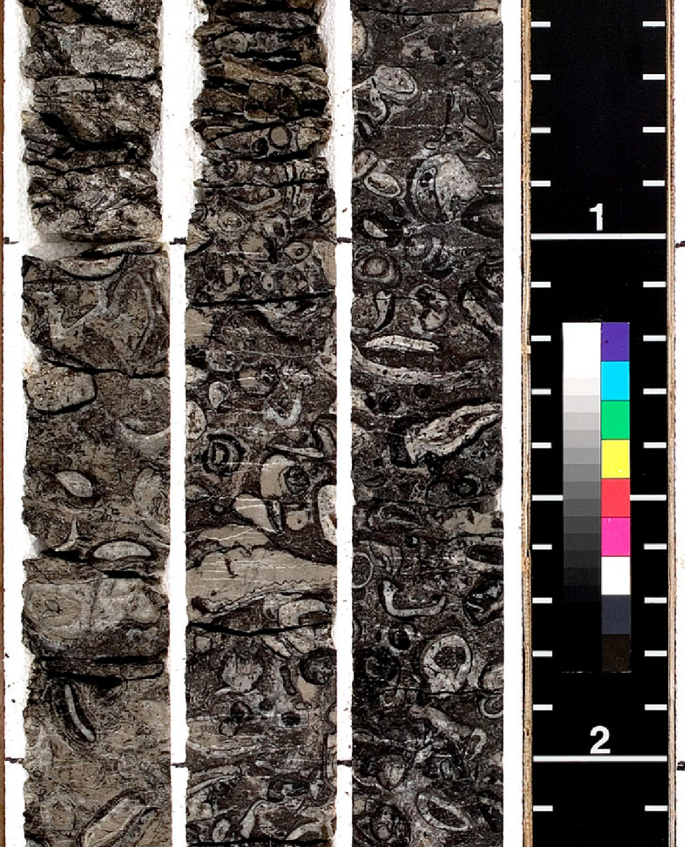
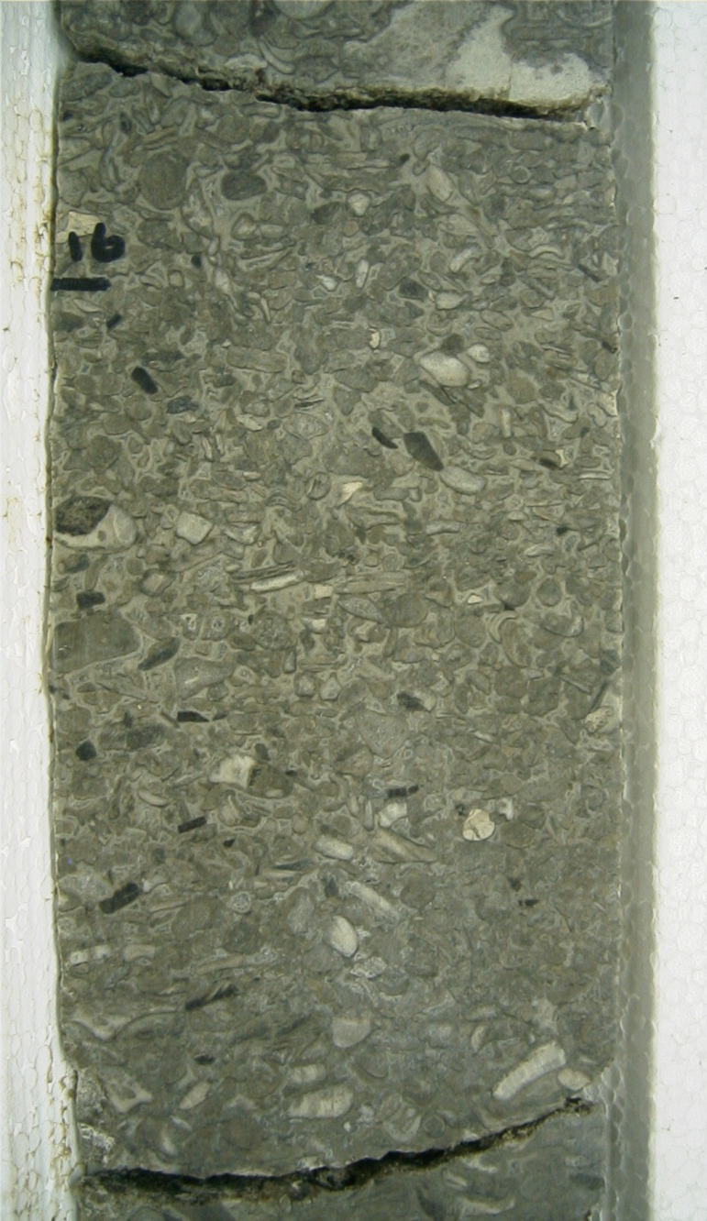
Back reef and Back-reef shoal
Rudist packstone
(algal coated)
Skeletal grainstone
2 in.
2 in.

Slide 20
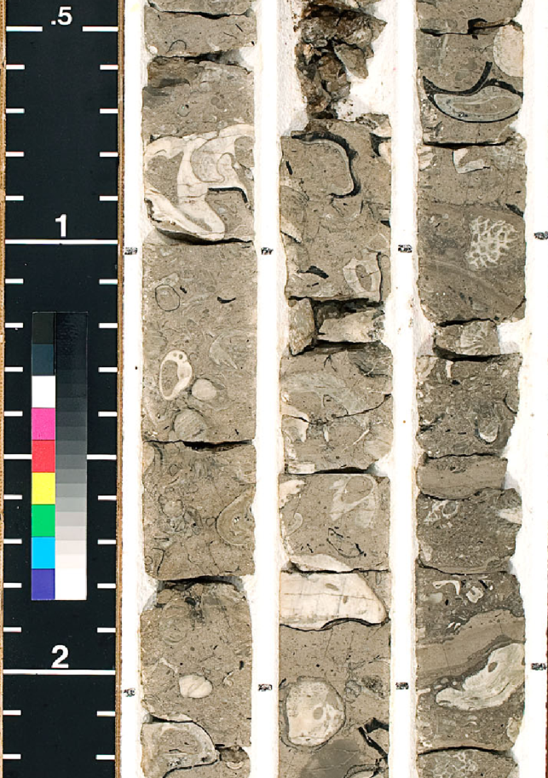
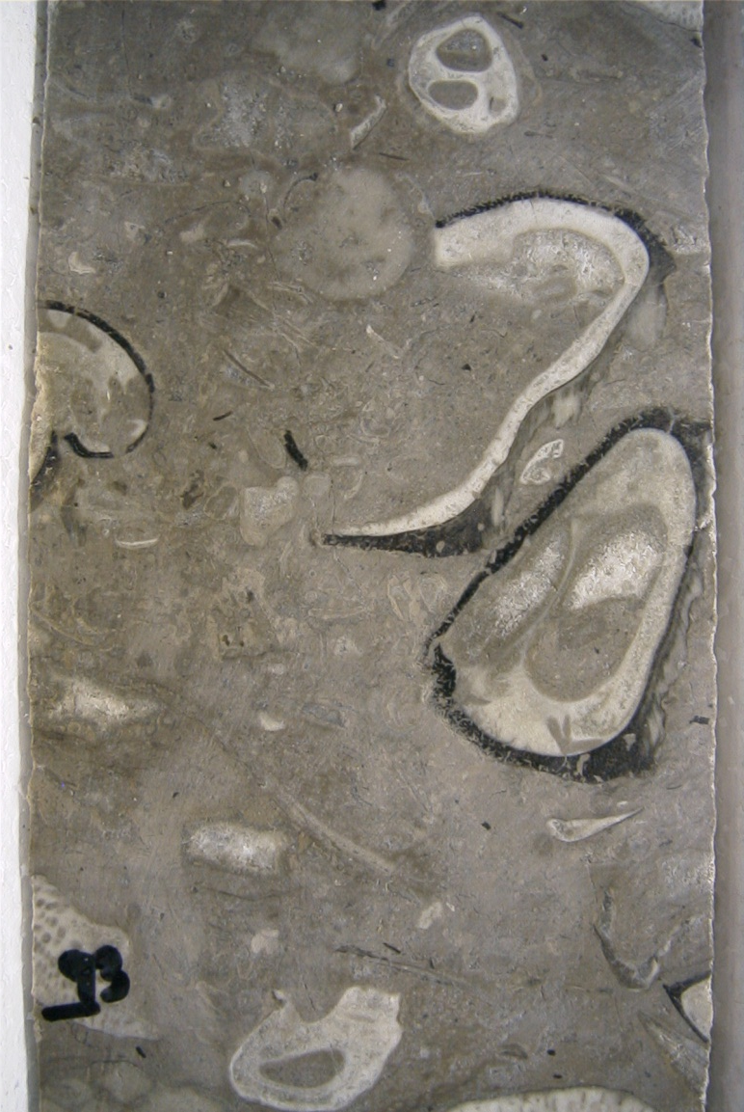
Reef flat
Caprinid and Toucasid floatstones
2 in.
2 in.

Slide 21
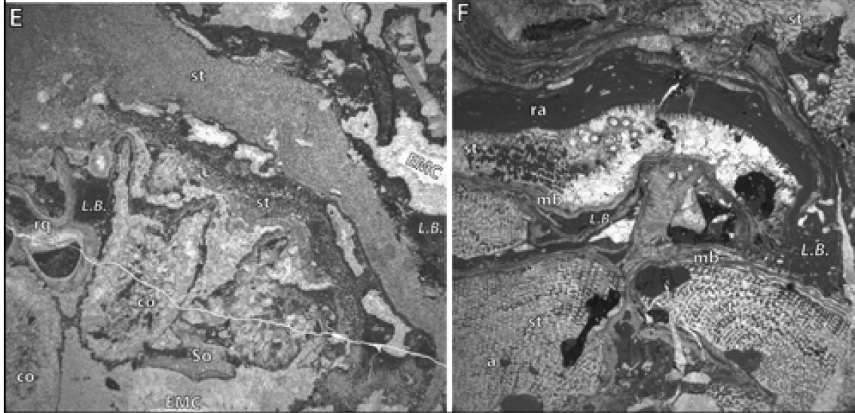
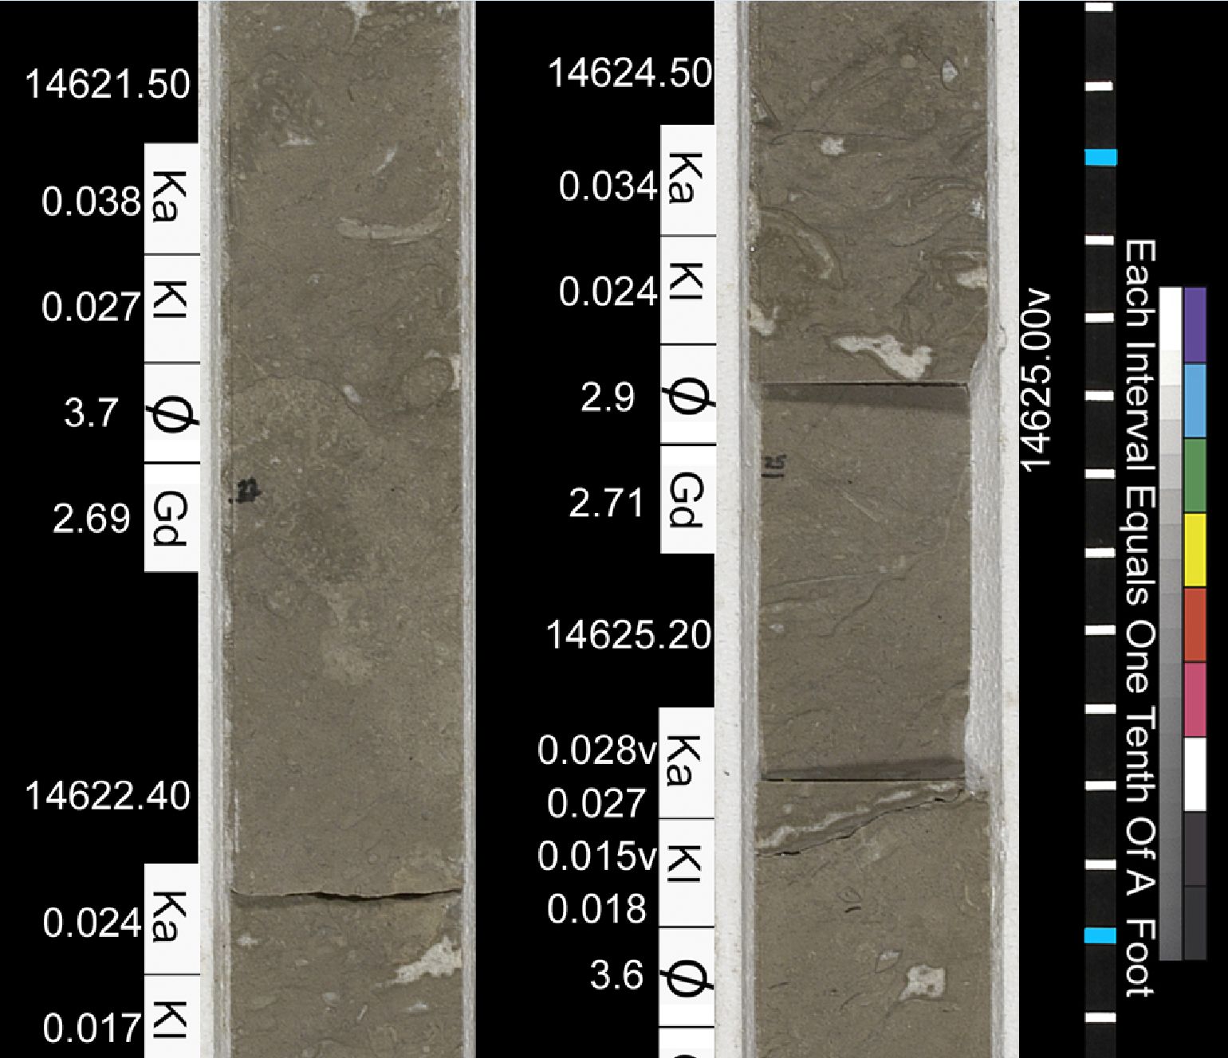
Reef core / Reef wall
14, 620 ft.
14, 624 ft.
rudist
laminar
frag
stromatop.
Rudist –
stromatoporid –
algal
boundstones
coral
red
Litho-
algae
codium
0.25 in.
stromatoporoid
encrusting
red
algae
strom.
strom.
strom.
4 in.
0.25 in.

Slide 22
Simplified facies for seismic mapping
Information on ~ 60 cores, detailed description of 7 new PNR cores
lagoonal shoal /
shelf margin reef
patch reef
back reef:
reef core:
island-shoal:
algal-coated
rudist PS/BS
reef flank:
skeletal GS
skeletal PS
rudist WS
lagoon:
sea level
miliolid WS
slope:
planktic
foram -
echinoid
WS
Sligo
margin
50 m
5 km
BS = boundstone; GS = grainstone; PS = Packstone; WS = wackestone
Calibration of simplified facies from core to 3D seismic allows for regional mapping

Slide 23
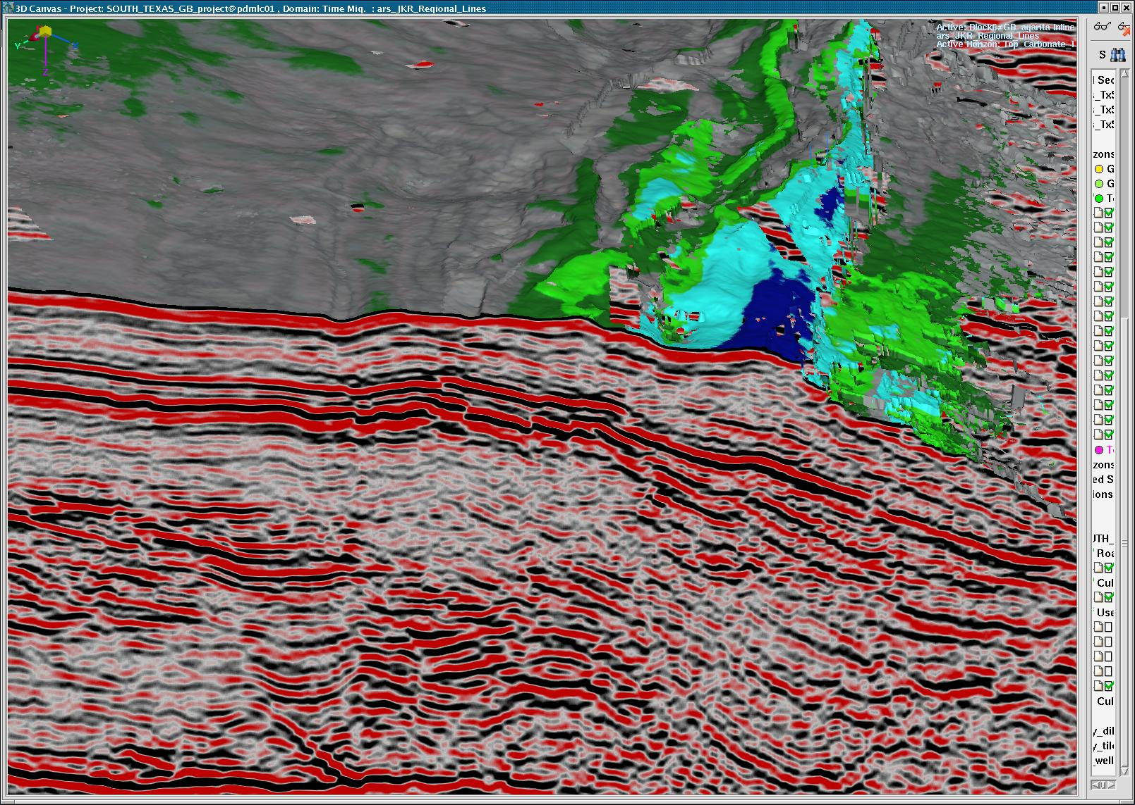
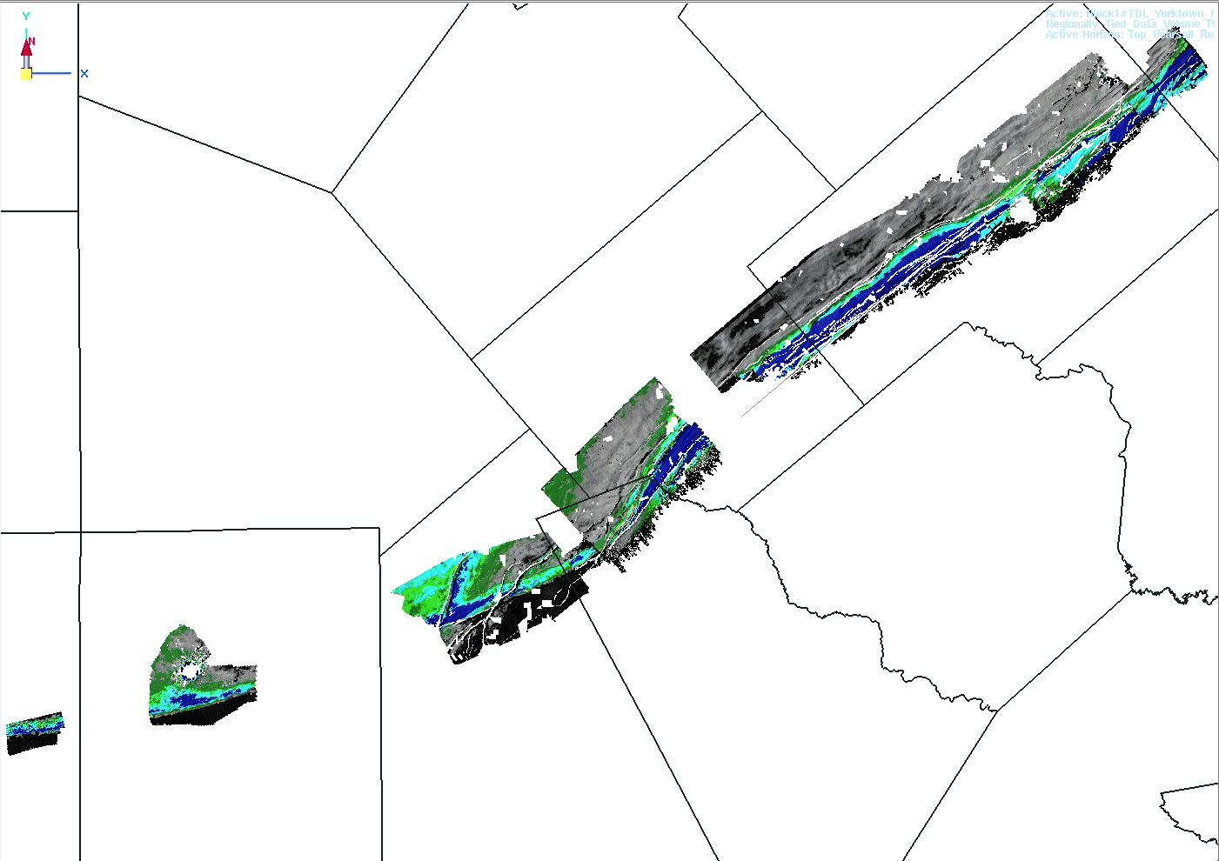

Simplified depositional facies from core calibrated to 3D seismic
cored
interval
isochron
interval
Reef core
Reef flank
Back reef
Lagoon
Core - based model

Slide 24
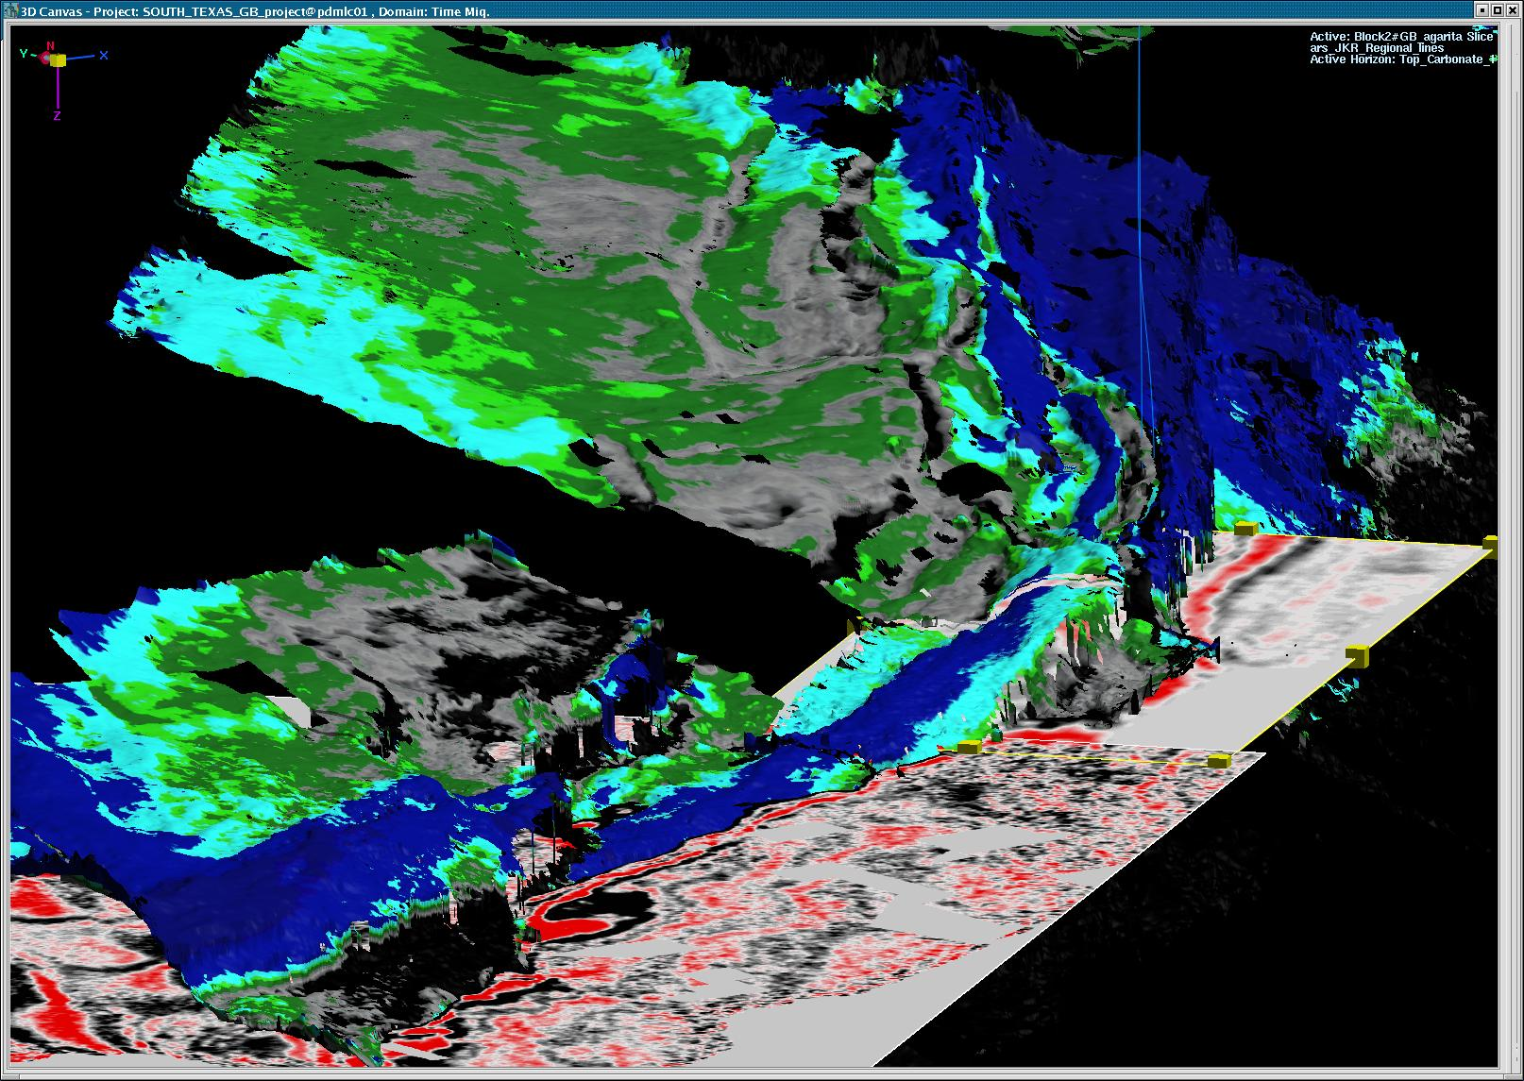
Top Edwards structure
Edwards
reef margin
with seismic facies
interpretation drape
Prominent
ridges
(isolated
Core - based model
reef cores)
Lagoon
Island-shoal
complex
reef platform &
backreef facies
Lagoon
reef core facies
0.5 km
Edwards reef margin

Slide 25
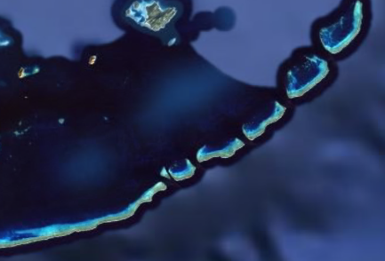
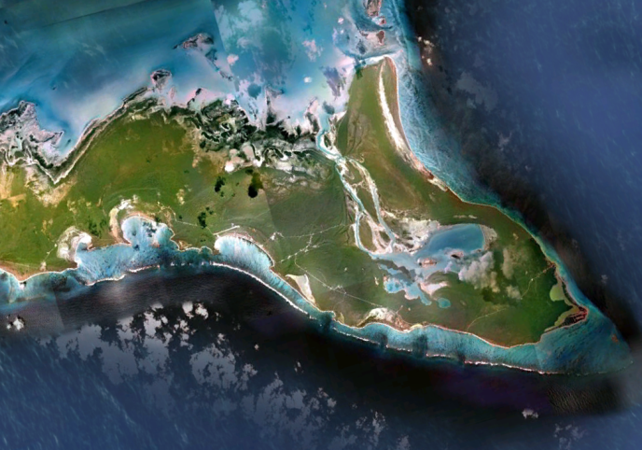
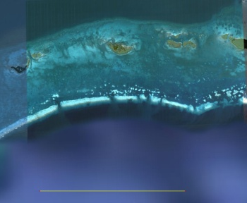
Detailed regional mapping
Reef margin
Struct.
Reef flat
low
Based on 3D seismic, core, well logs
Back reef
Back reef shoal
fault
Patch reef
Live Oak Co.
Karnes Co.
lagoon
N
Dewitt Co.
Sligo shelf margin
Kenedy
(buried)
Bee Co.
Speary / Kawitt
slope &
Pawnee
slope & basin
Shelter Rock
basin
10 km / 6 mi
Crooked Island, Bahamas
Belize, C.A.
Great Barrier Reef,
Australia
10 km / 6 mi
10 km / 6 mi
10 km / 6 mi
(images from
Google Earth)

Slide 26
Edwards Reef:
Reservoir Characterization

Slide 27
Semi-log cross plot: Porosity – permeability by fabric
Schroeder #1 well, Pawnee field (horizontal plugs)
Mudstone
Bee Co., TX API # 42-025-33208-0000
Rudist wackstones
1000
Rudist packstones
Coarse grainstones
100
Fine grainstones
10
Boundstones
Permeability (md)
1.0
0.1
0.01
0.001
0.0
2.0
4.0
6.0
8.0
10.0
12.0
porosity (%)
Avg porosity < 5%
Permeability << 1millidarcy
= Tight limestone

Slide 28
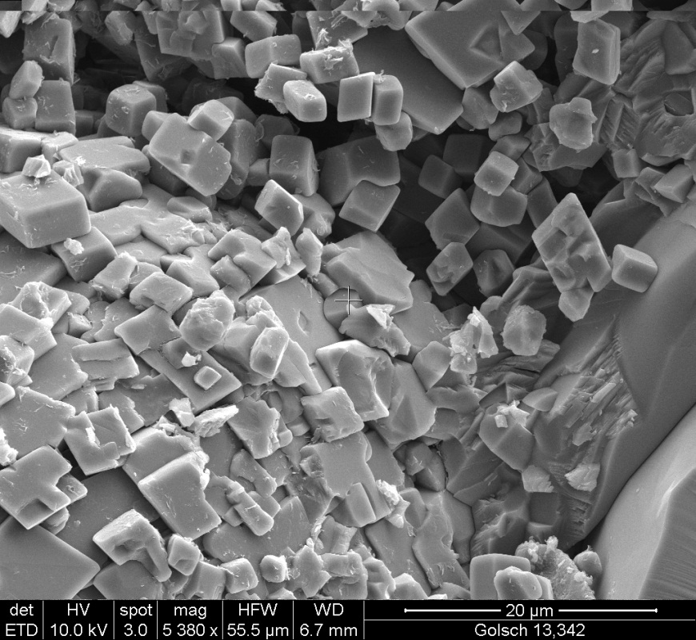
Stuart City Trend reservoir description
Rudist-bearing reef rocks and associated rock fabrics are extremely tight,
with porosity generally less than 5% and permeability less than 1 md
Major pore network consists of micropores (1 – 6 microns in size) associated
with early transformation of Mg-calcite to microrhombic calcite
Micropores occur within grains, in algal-coated grain rims, and in the
ubiquitous very fine peloidal mud matrix,
in all depositional facies
Pore throat sizes are sub-micron

Slide 29
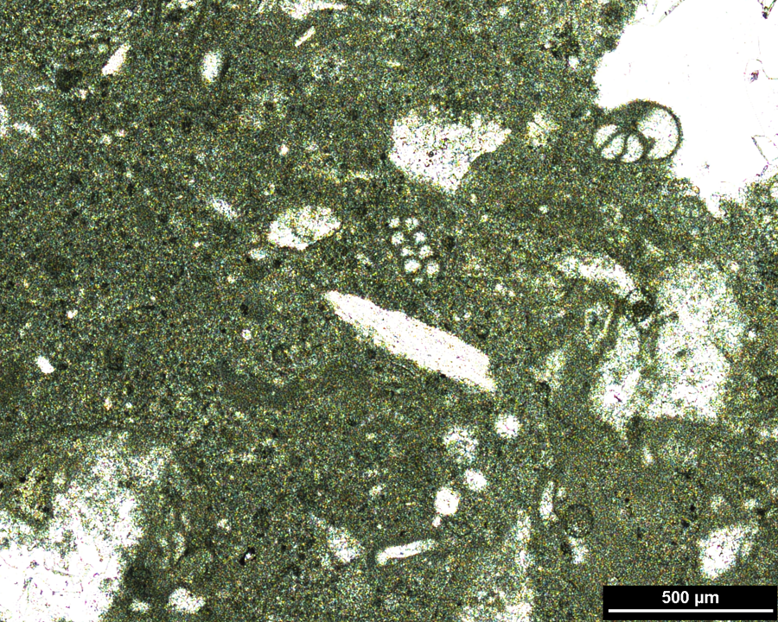
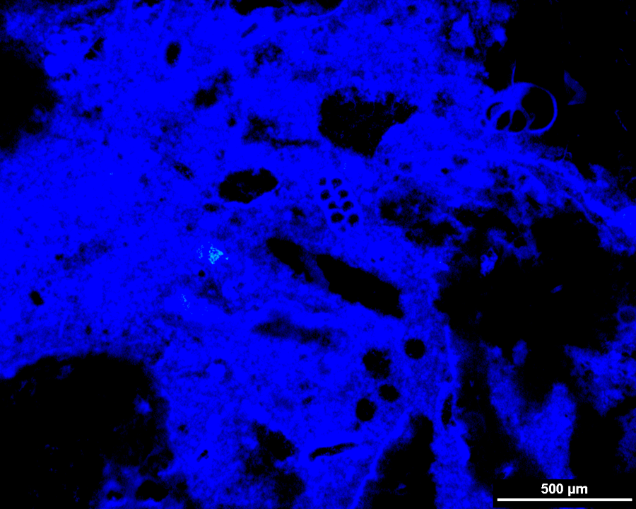
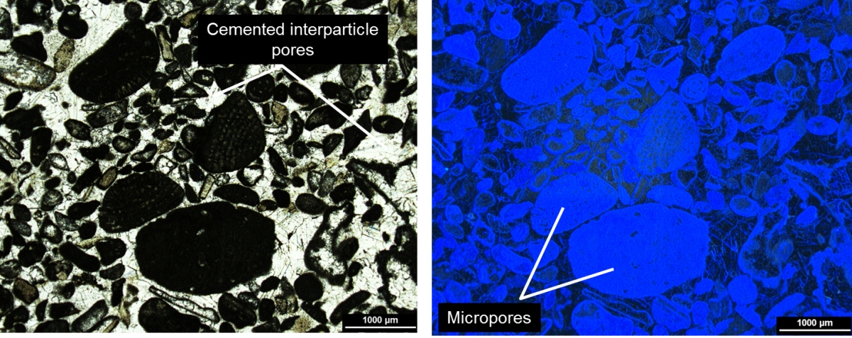
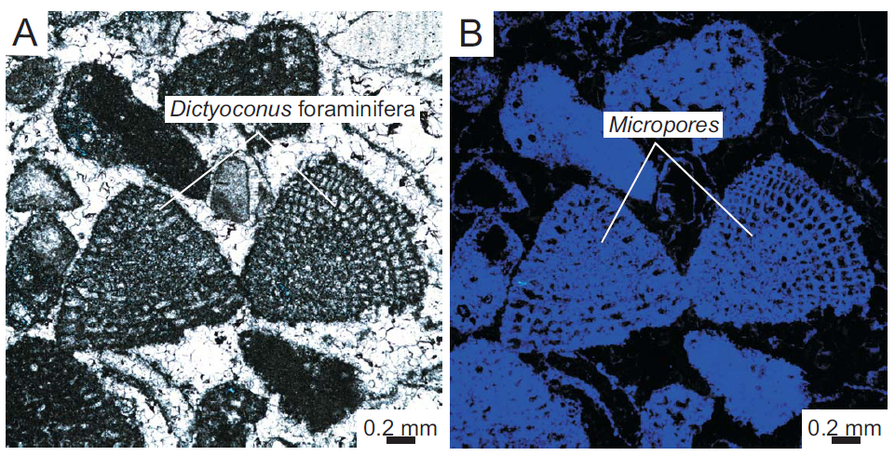
Mud-rich packstone
Plane light; blue
epoxy
Micropores in
lime matrix
Blue-UV light
Micropores in
foram shells
Grainstones
-- Microporous limestone reservoir

Slide 30
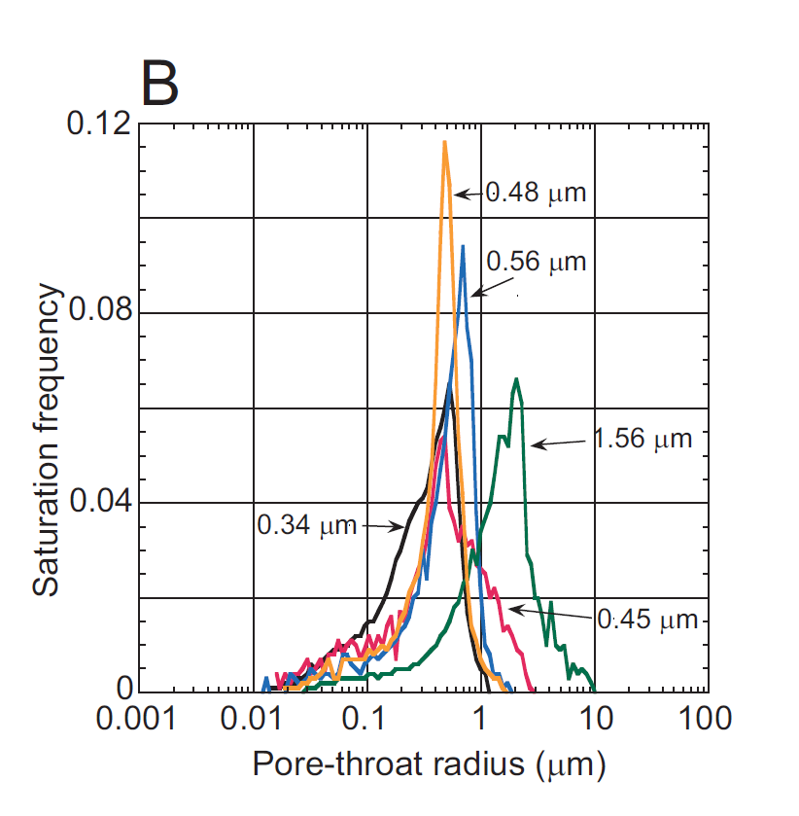
Mud-rich packstone
Plane light; blue
epoxy
Micropores in
lime matrix
Blue-UV light
Pore throat size determination for
5 samples from Schroeder #1, Bee Co.
Mercury injection – capillary pressure
Micropores in
foram shells
Grainstones
(microns)
width of human hair: 100 microns
avg cloud water droplet: 10 microns
red blood cell diameter: 6-8 microns
-- Microporous limestone reservoir with submicron pore throats --

Slide 31
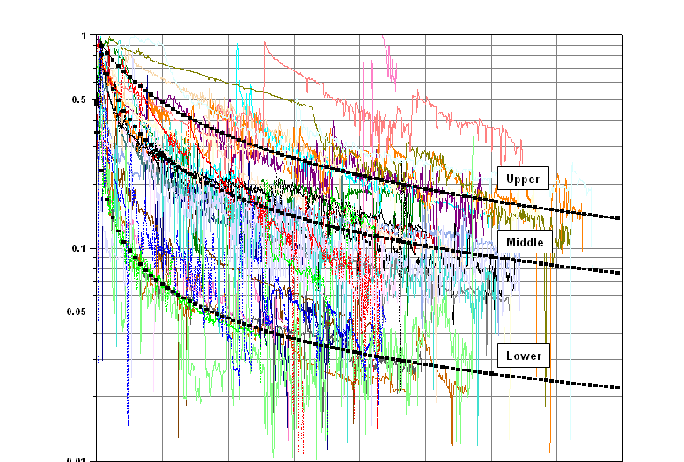
Decline curve analysis, Pawnee Field, Bee Co., TX
- Hyperbolic declines
- Wide range of performance
1
0.5
3000’ laterals
3-stage acid
fracs
Upper Tier
10 - 20 BCF/well
Average daily gas flow rate (normalized)
Middle Tier
0.1
3 - 8 BCF/well
0.05
Lower Tier
1 - 2 BCF/well
0.01
0
1
2
3
4
5
6
7
8
Time, years

Slide 32
Average well EUR by facies
De
5.0
Exploration risk
4.5
n = 127
4.0
3.5
3.0
n = 283
n = 24
2.5
Avg. EUR per well (BCFG)
n = 113
2.0
1.5
1.0
n = 85
0.5
0
Reef
Island
Lagoon
Back
core &
shoal
shoal /
reef
Lagoon
flank
patch reef

Slide 33
Edwards margin: subregions
Sligo (Aptian)
shelf margin
similar structural setting / fault styles
equivalent reservoir depths, trap config. ,
East Texas
Salt Basin
gas columns, drilling & comp. strategies
Yoakum
Channel
6
San
5
Marcos
50 miles
San
Antonio
Arch
Colorado
Edwards (Albian)
shelf margin
Lavaca
Devils River
Trend
4
Maverick
Basin
Dewitt
2
Karnes
Victoria
updip limit
of salt
Edwards (Albian)
shelf margin
1
3
McMullen
Bee
Rio Grande Salt Basin – shallow
Rio Grande Salt Basin – deep
Pawnee Field
San Marcos Arch
Word Field complex
East Texas Salt Basin
Live Oak
La Salle
Edwards gas field
Rio Grande
Sligo (Aptian) shelf margin
Embayment
Corpus
Christi

Slide 34
Edwards Reef:
Raven Forest prospect, East Texas

Slide 35
Regional Lower Cretaceous paleogeography
Comanche
East Texas
Basin
updip limit
of salt
Llano Uplift
Devil’s River
Platform
trend
San
Marcos
Raven Forest
Edwards prospect
Arch
Maverick
Basin
Stuart City/Edwards
Reef Margin
(Middle Albian)
Facies
Rio Grande
Salt Basin
Shallow carb. platform
PNR study area
Deep shelf / shelf basin
Slope & basinal
0
50 mi
Land / supratidal
Reef margin

Slide 36
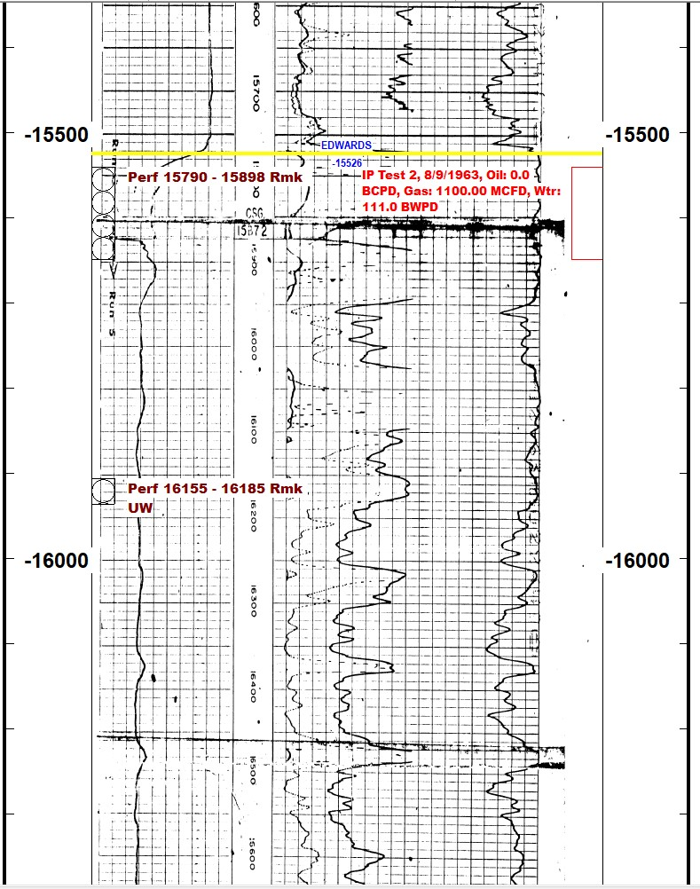
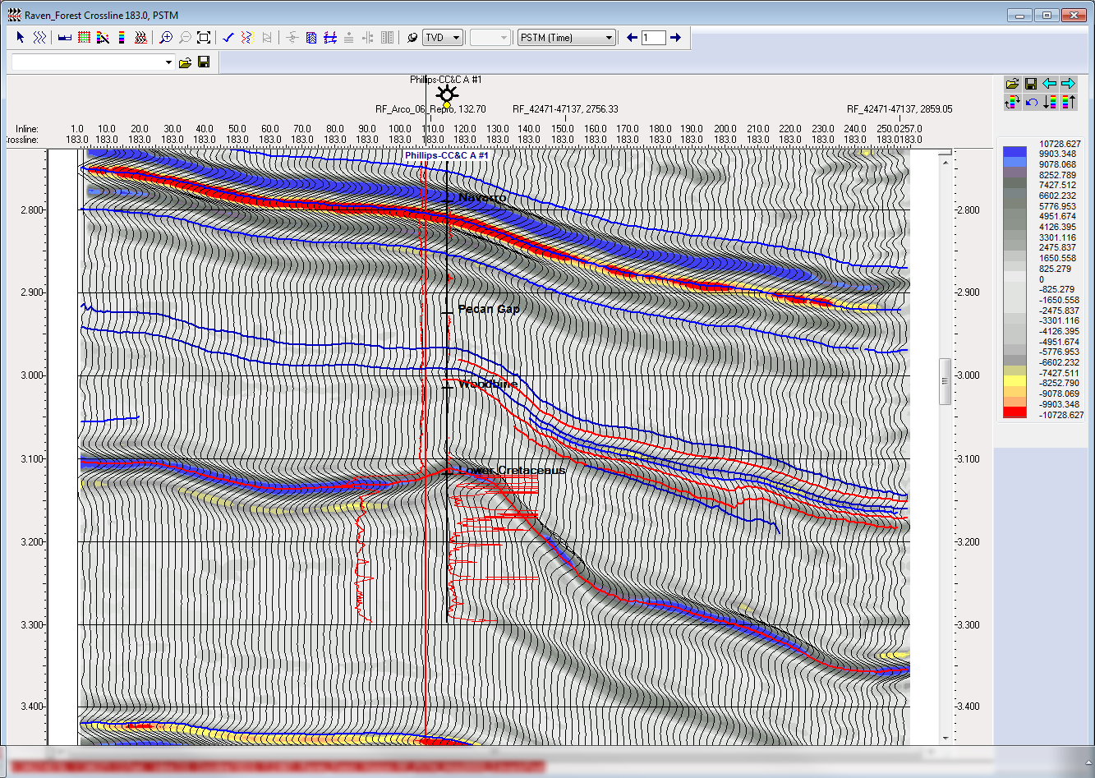
Raven Forest Crossline 183, PSTM All Offsets
1963 Phillips- Central Coal & Coke A #1
Cored, logged and tested 165 net feet of gas
with porosity ranging from 5 to 13% .
Amplitude Dim-Out
8 – 12% core porosity suggests a more conventional-type pore system; microporous mud matrix may also contribute to reservoir performance
Massive, steep shelf margin w/ deep lagoon

Slide 37
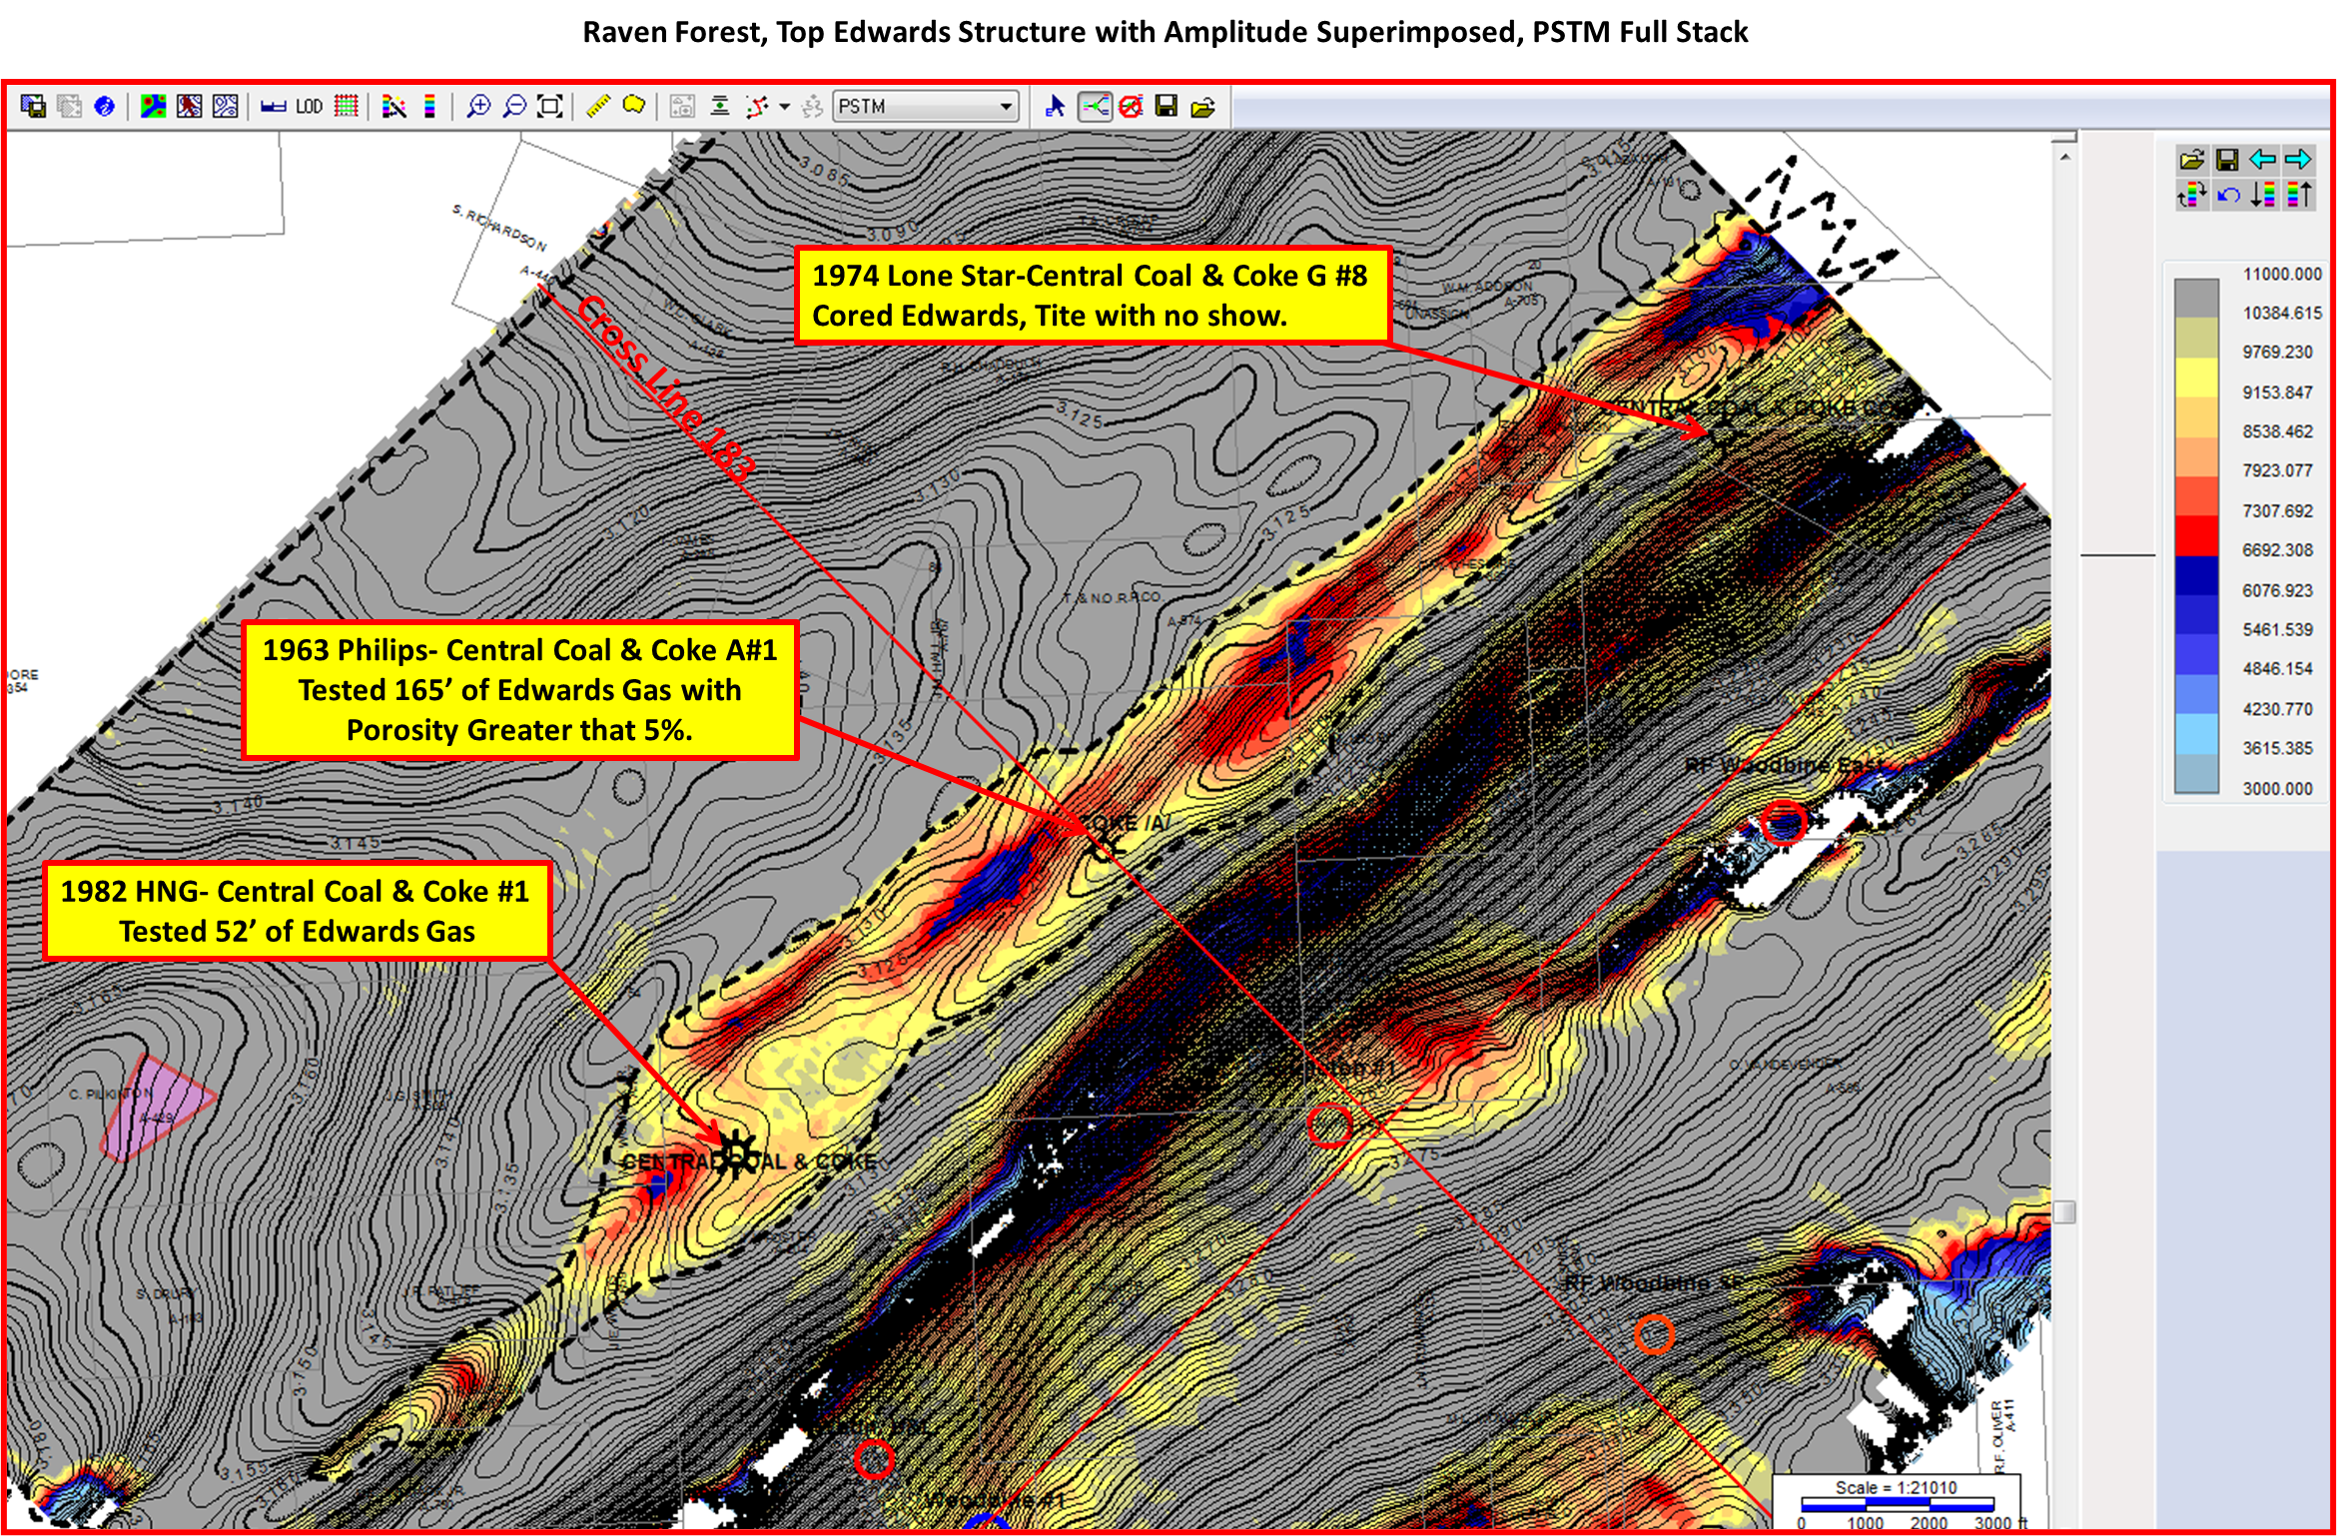
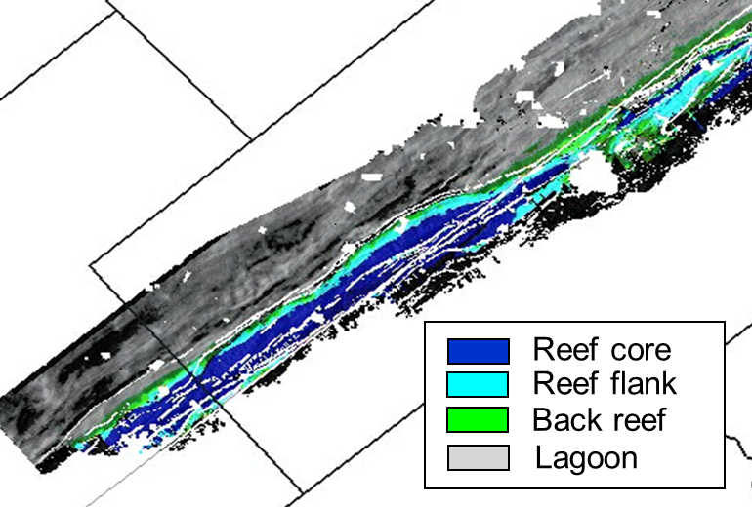
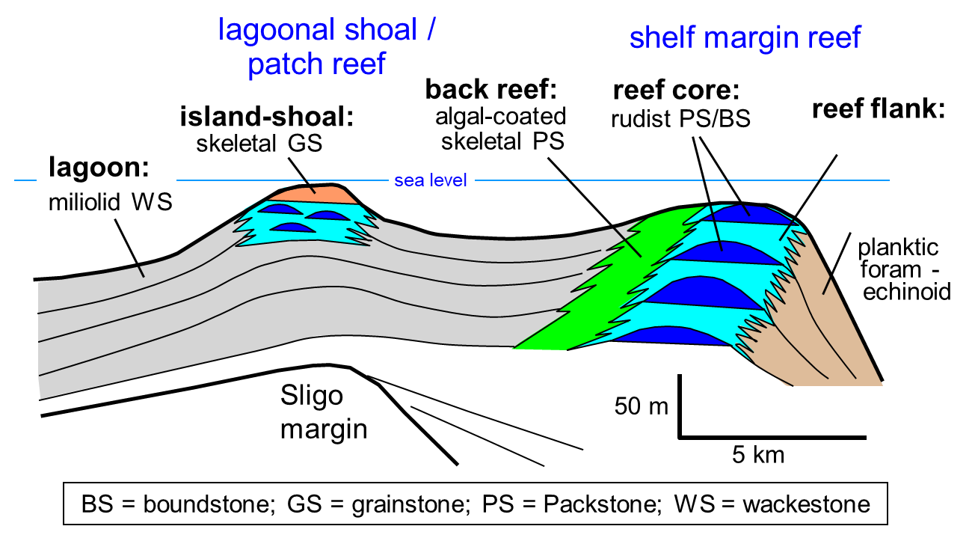
Top Edwards structure suggests multiple reef cores surrounded by reef flank facies

Slide 38
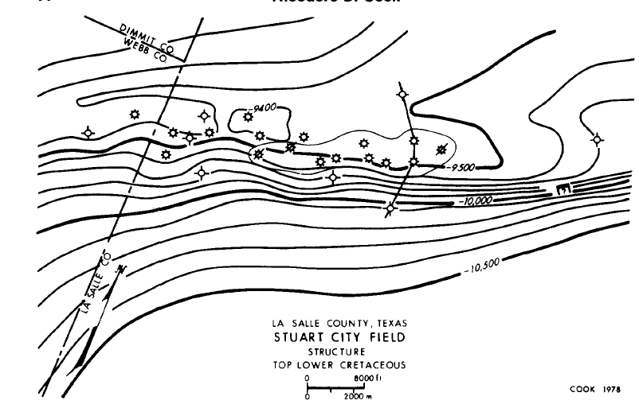
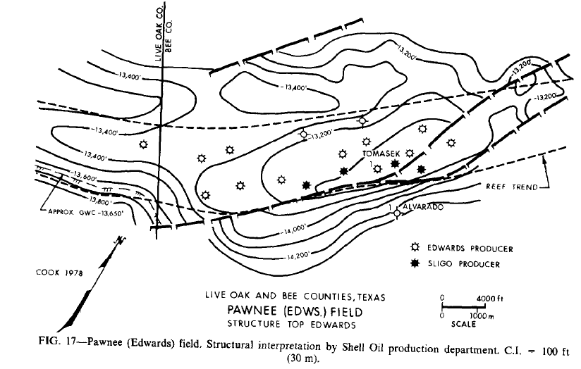
Scale comparison
(Pawnee and Stuart City field maps
from Cook, 1979)

Slide 39
Edwards reef trend: conclusions
Edwards reef fields in south TX are essentially tight limestone reservoirs with limited porosity; reservoir consists mostly of a microporous limestone mud matrix with sub-micron pore throats
Individual reef complexes consist of 5 basic environments (reef core/reef flank/shoal/back reef/lagoon), each of which contains multiple rock types/facies
Vertical and lateral distribution of facies is highly heterogeneous (sub-seismic scale)
Production decline profiles show classic hyperbolic shape; extremely wide-range of reservoir performance
S. TX wells targeting reef core, reef flank, and shoal environments have highest EURs/well
Raven Forest area (Montgomery Co., east TX) appears highly prospective as an Edwards reef target; multiple reef cores surrounded by a variable width of reef flank environments is indicated on 3D; pore system my be largely conventional

