Slide 1
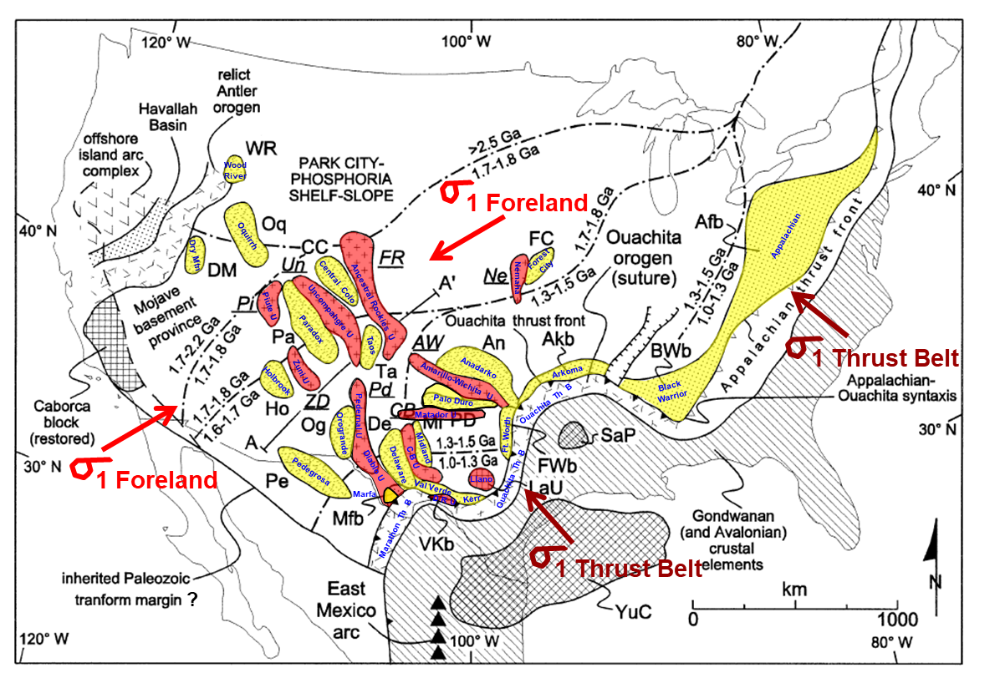
Geology of the Permian Basin
Tectonic History, Part 2
Ancestral Rockies
Central Basin Uplift
Marathon Fold Belt
Lowell Waite
UT Dallas Geoscience
Permian Basin Research Lab
8/16/2021

Slide 2
Geology of the Permian Basin: ELS (Endeavor Lecture Series)
Horseshoe Atoll
Tectonic history – Part 1 (Big Picture)
Tectonic history – Part 2 (Regional elements: ARM, CBU, MFB)
Basement
Cambrian – Lower Ord (Wilberns/Bliss Ss., Ellenburger Gp)
Tobosa Basin stratigraphy (Mid Ord. – Mississippian)
Pennsylvanian (Morrow-Atoka-Strawn-Canyon-Cisco)
Lower Permian (Wolfcamp – Spraberry)
Middle and Upper Permian / Permian Basin petroleum system

Slide 3
Phases of Deformation and Sedimentation in the Permian Basin
1
Mid Proterozoic (1.3 to ~1.0 bya) – Grenville Orogeny and Extensional Phase
Latest Precambrian to early Cambrian – Rifting south of ancestral Permian Basin (Tobosa Basin)
2
3
Late Cambrian – Initial marine transgression and Great American Carbonate Bank (Early Ordovician)
Middle Ordovician to Late Mississippian – Tobosa Basin
4
Pennsylvanian to early Permian Active Margin/Orogenic Phase
  Two initial orogenic pulses (Early Penn. -- Morrowan to mid Atokan and late Atokan )
  First tectonic quiescence phase (Early Penn. – latest Atokan to early Desmoinesian)
  Third orogenic pulse (Early Penn. – early Desmoinesian)
  Second tectonic quiescence phase (mid Desmoinesian to early Permian)
  Fourth orogenic pulse (early Permian – Wolfcampian)
5
4 tectonic pulses
2 periods of quiescence
6
Middle to late Permian Post-orogenic Rapid Subsidence / Sediment Loading Phase
7
Post – Permian Phase

Slide 4
Permian Basin Tectonic History (Part 2)

Slide 5
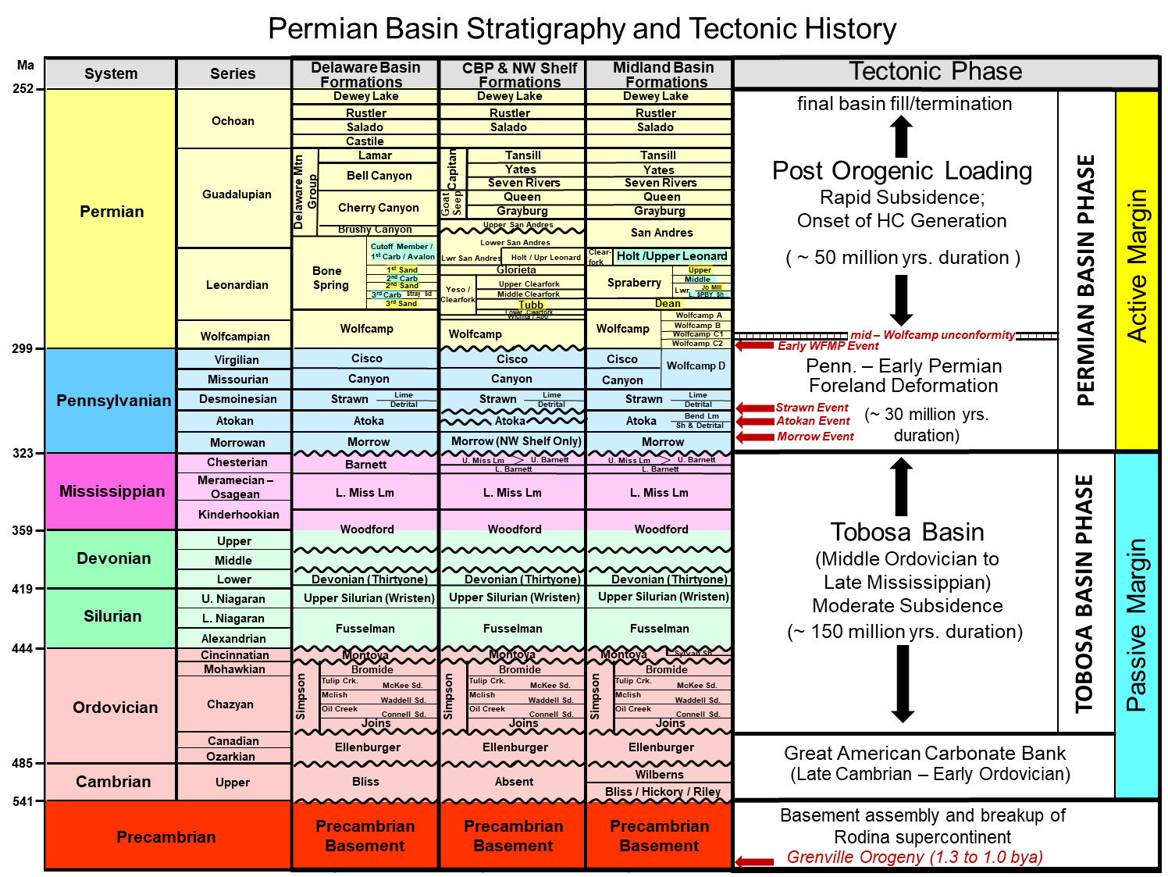
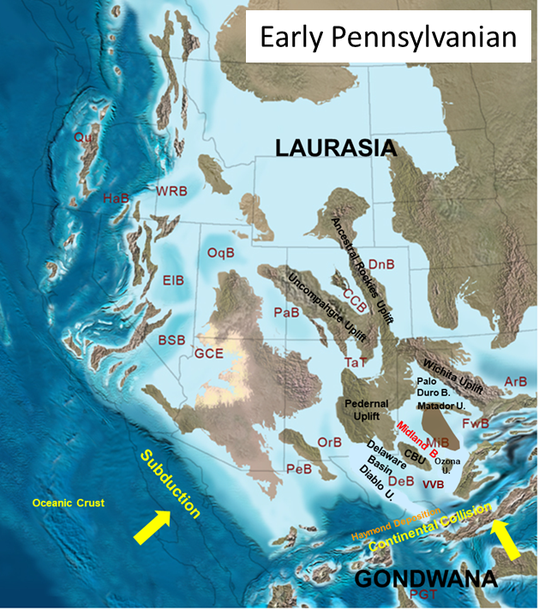
Permian Basin: confluence of two major tectonic systems: (Hercynian fold belt, Ancestral Rockies)

Slide 6
Tectonic history, Part 2: Topics
Two orogenic styles: Thin-skinned vs. thick-skinned
Ancestral Rocky Mountain (ARM) system
Central Basin Uplift (southernmost uplift of ARM)
Ouachita - Marathon Fold and Thrust Belt
Tectonic history of the Permian Basin: Summary

Slide 7
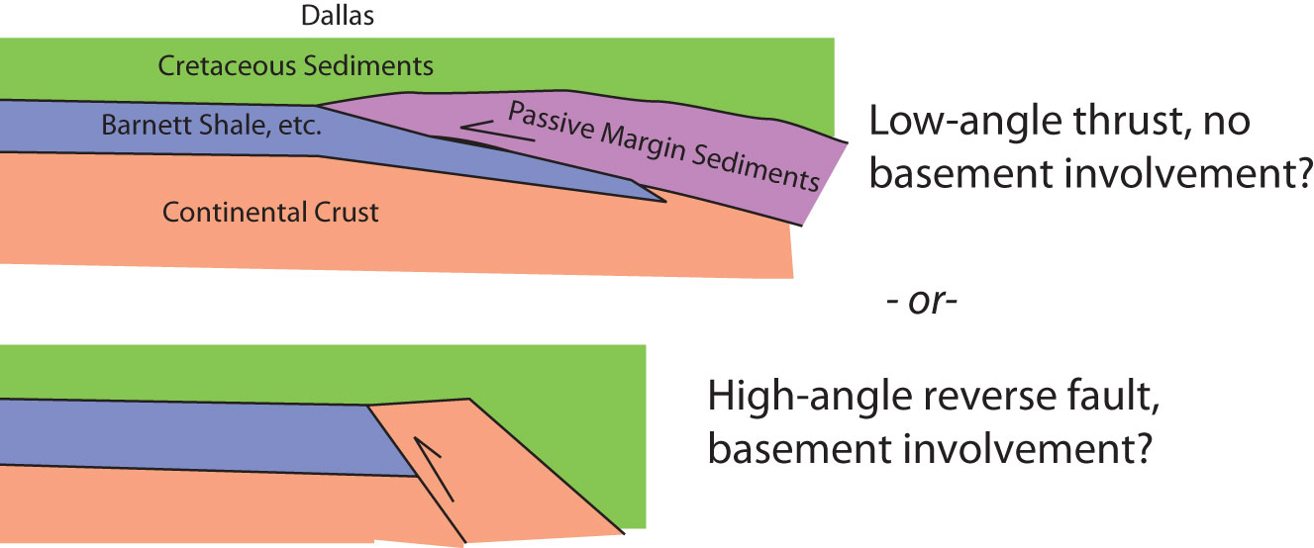
Two distinctive orogenic styles in the Permian Basin during Pennsylvanian – early Permian time
Ancestral Rockies “thick-skin” thrusting
NW-SE trend
vs.
ENE-WSW trend
Ouachita-Marathon “thin-skin” thrusting

Slide 8
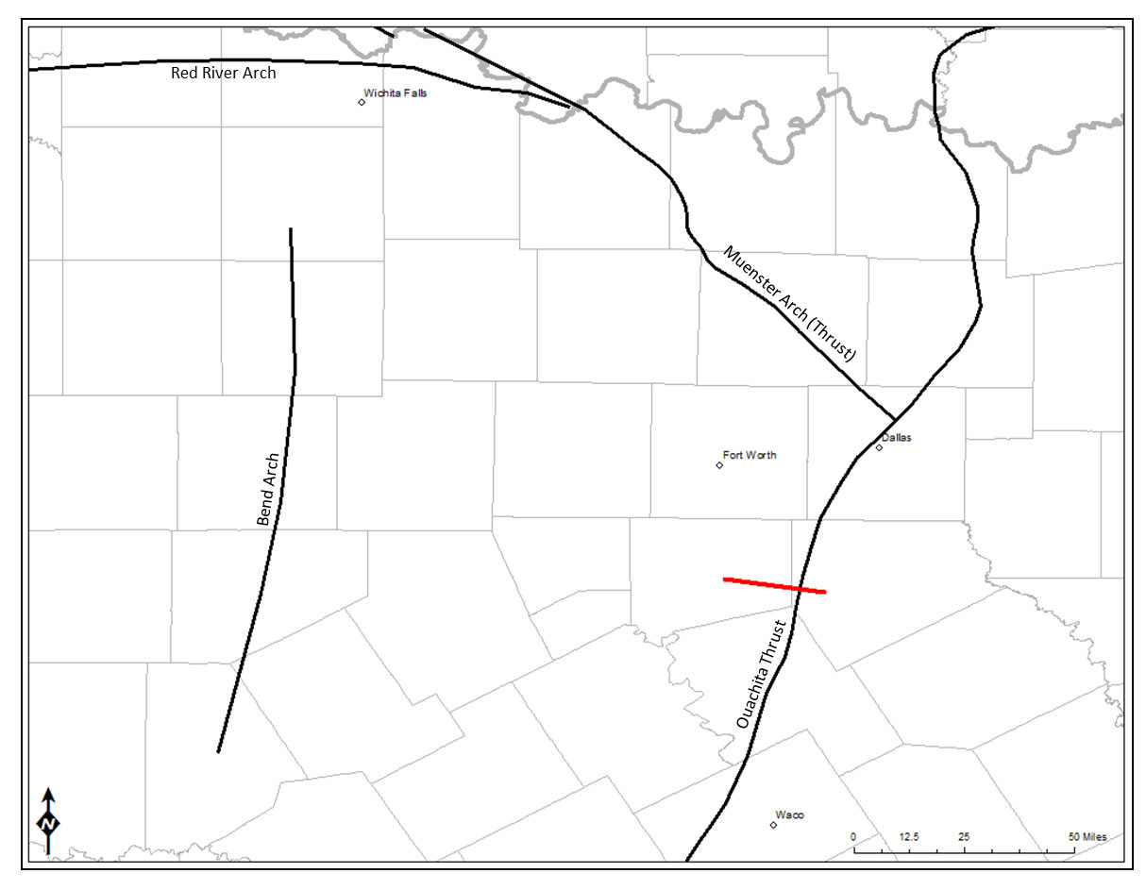
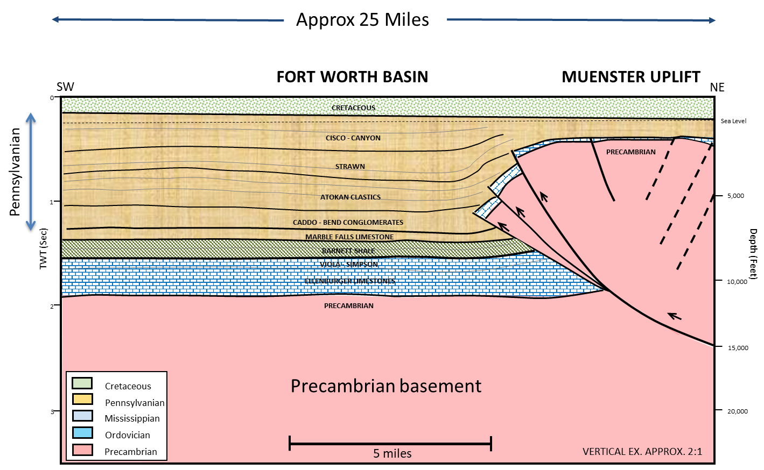
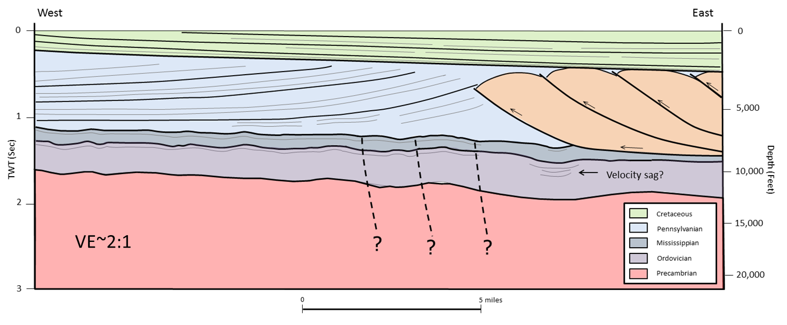
Two contrasting structural styles can be observed near Dallas-Fort Worth
cross sections are diagrammatic, based on 2D seismic; equivalent scales)
Muenster Uplift
Muenster Uplift
Ft. Worth
Dallas
Ouachita Fold and
Thust Belt
Muenster Uplift: (part of Ancestral Rockies)
basement-involved
(thick-skinned deformation)
Ouachita Thrust Belt
Ouachita Thrust belt: basement not involved
(thin-skinned deformation)
(courtesy of Mark George, Pioneer)
Notes:
cross section is diagrammatic, based on early 1980's vintage low fold 2D data (~12-fold)

Slide 9
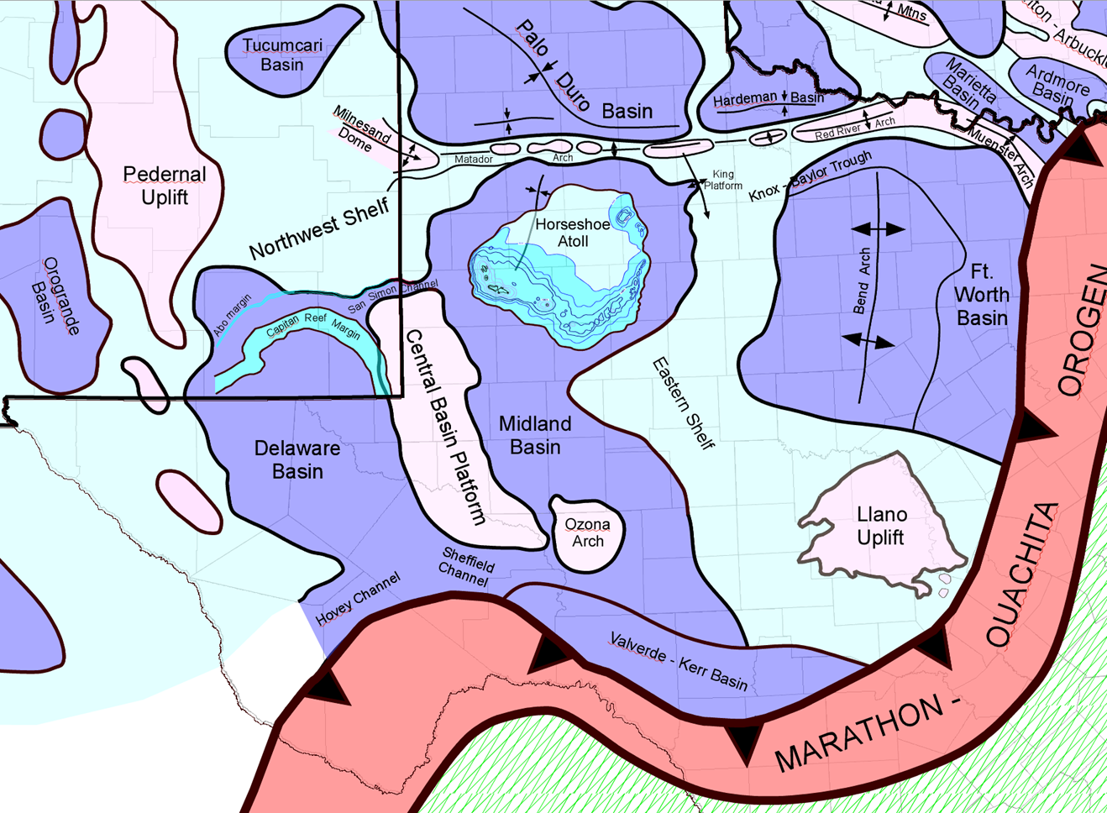
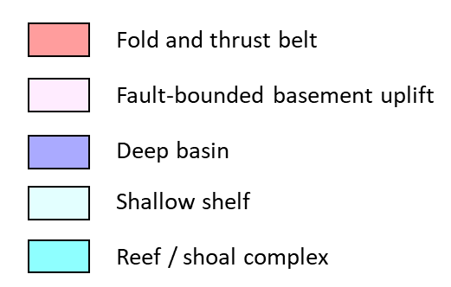
ANCESTRAL ROCKIES
A series of basement-involved uplifts and adjoining sedimentary basins that formed throughout the southwestern U.S. region during
Early Pennsylvanian time

Slide 10
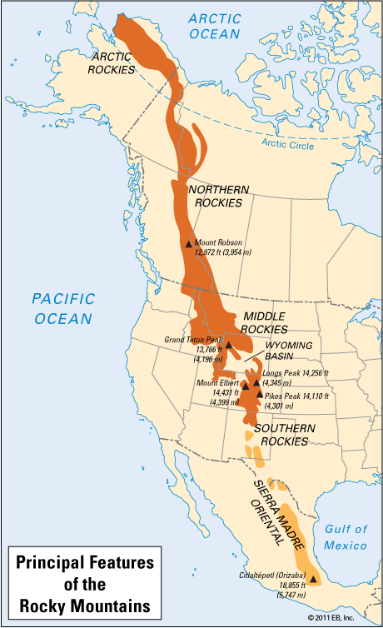
Late Paleozoic Compressional Basement Uplifts and Basins: The Ancestral Rockies
Late Paleozoic Uplifts of the Western U.S. contain:
NW trending folds bounded by low to high angle thrusts
E-W & NNW trending fault zones, commonly high angle, with evidence of a left-lateral strike-slip
component
NE trending fault zones with evidence of right-lateral strike-slip component
Strain data indicates the foreland maximum compressive stress was oriented NE-SW,
perpendicular to the NW trending stress field of the coeval Marathon-Ouachita Thrust Belt
Present-day Rocky Mountains
uplift
basin
(From Dickinson & Lawton, 2010)

Slide 11
This is the orientation of structures observed in the Permian Basin
Restraining Area
(Pop-up structure)
1
Modeled Structures Produced By NE-SW Compressive Stress
Basement uplift
Right-Lateral
Displacement
Left-Lateral
Displacement
Structures Expected With
NE-SW Stress Field
1
Releasing Area
(Pull-apart graben)
1
Modeled Structures Produced By NW-SE Compressive Stress
Releasing Area
(Pull-apart graben)
Left-Lateral
Displacement
Right-Lateral
Displacement
Restraining Area
(Pop-up structure)
Structures Expected With
NW-SE Stress Field
Basement
uplift
1

Slide 12
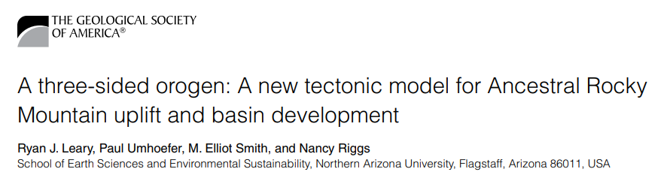
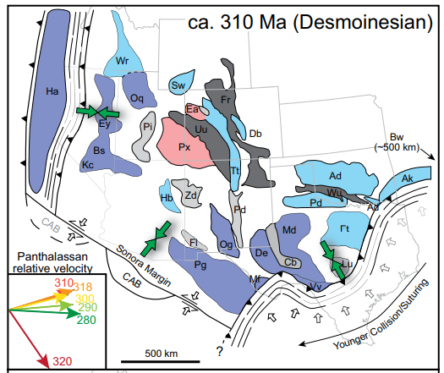
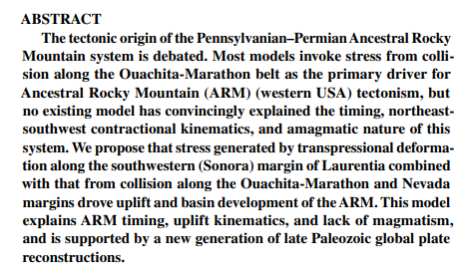
Major change in Pacific plate motion in early Penn.
Sonora margin begins transition from strike-slip to convergent / subducting margin

Slide 13
CENTRAL BASIN UPLIFT
(southernmost uplift of ARM)

Slide 14
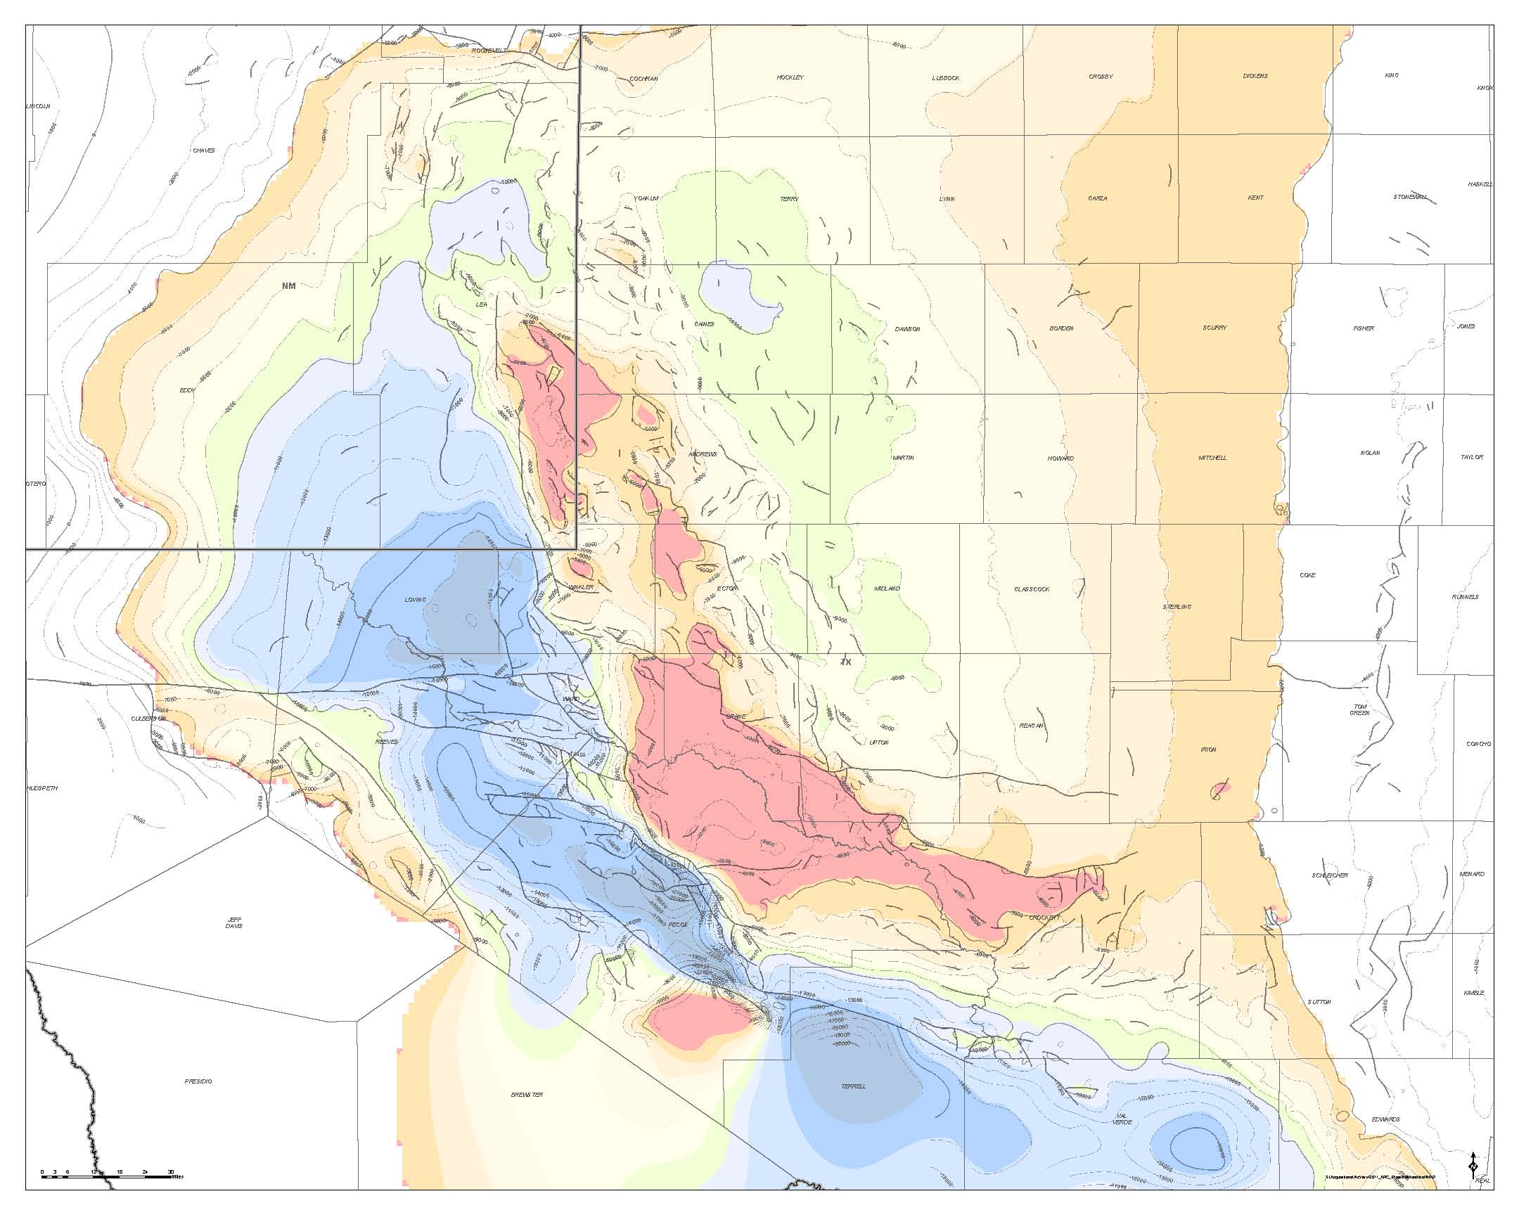
Early Mississippian/Woodford
Structure Map:
Permian Basin
(From Geomap)
Outline of
Central Basin Uplift
Outline of
Central Basin Platform
Northwest Shelf
Tatum
Basin
Central Basin Uplift refers to the
basement uplift
Central Basin Platform refers to the Permo-Penn
carbonate platform that
formed on top of the
basement uplift
The platform covers a smaller geographic area than the uplift, although the two terms are often used interchangeably.
Midland Basin
Eastern Shelf
Central Basin Uplift
Grisham Fault
Delaware Basin
Ft. Stockton
High
Big Lake Fault
Diablo Uplift
Todd-Elkhorn Fault
Ozona
Uplift
Elsinore
Uplift
Puckett-
Grey Ranch
Uplift
Val Verde Basin
Marfa
Basin
Marathon Thrust Belt
Devil’s River
Uplift
Kerr
Basin
(Although not mapped by Geomap, seismic and deep well control indicate that a southerly arm of the Central Basin Uplift extends beneath the Marathon Thrust Belt)

Slide 15
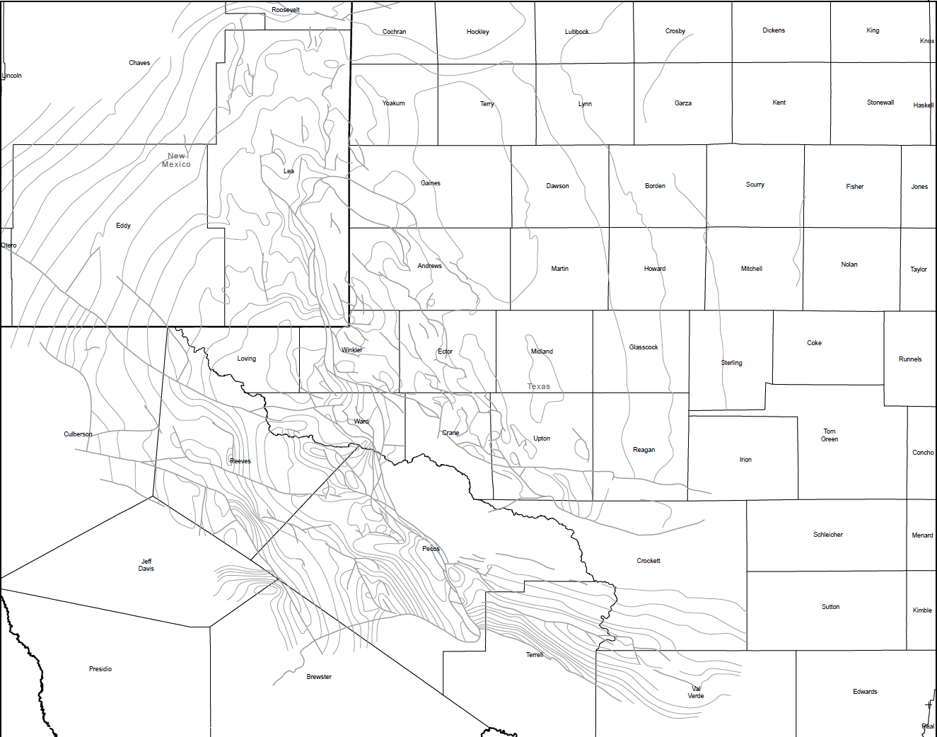
Outline of
Central Basin Uplift
Regional structure
Outline of
Central Basin Platform
Northwest Shelf
Tatum
Basin
E-W cross-section
(next slide)
Midland Basin
Eastern Shelf
Central Basin Uplift
Grisham Fault
Central Basin Uplift = southernmost Ancestral Rocky structure
Delaware Basin
Ft. Stockton
High
Big Lake Fault
Diablo Uplift
Todd-Elkhorn Fault
Ozona
Uplift
Elsinore
Uplift
Puckett-
Grey Ranch
Uplift
Val Verde Basin
Marfa
Basin
Marathon Thrust Belt
Devil’s River
Uplift
Kerr
Basin
Comer, John B. Stratigraphic Analysis of the Upper Devonian Woodford Formation, Permian Basin, West Texas and Southeastern New Mexico. No. 201. Bureau of Economic Geology, University of Texas at Austin, 1991.
Woodford Structure Map: Permian Basin
(From Comer, 1991)

Slide 16
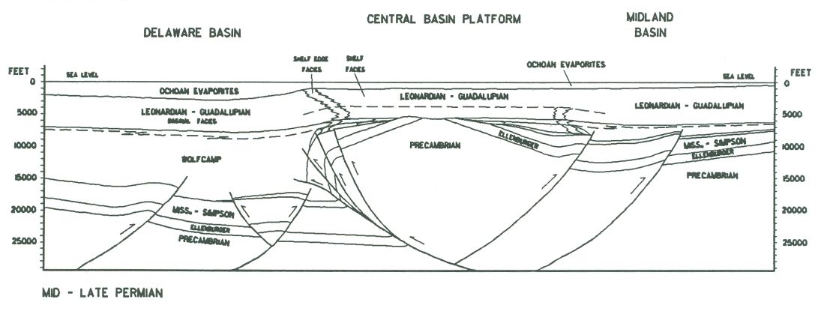
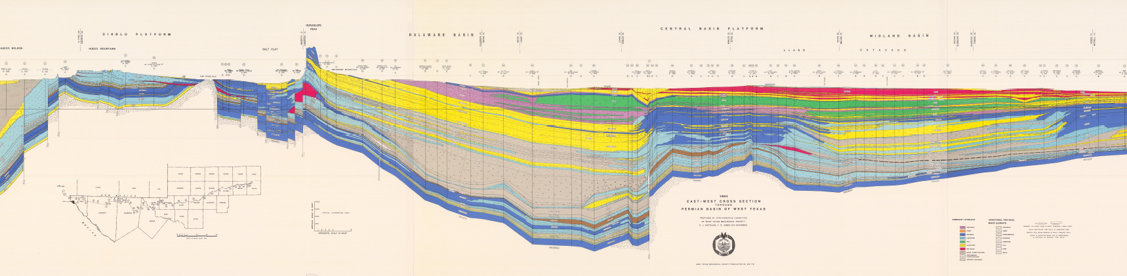
Cross Sections Across The Permian Basin
Central Basin Platform
and Uplift
SW
Ft. Stockton
High
NE
The Central Basin Uplift is bounded by large thrusts on its SW side, therefore the antithetic faults on its NE side can be considered backthrusts. The
Delaware Basin is twice as deep as the
Midland Basin. The Midland Basin is a
piggy-back basin on the backlimb of the
Central Basin Uplift.
WOLFCAMP
WOLFCAMP
Mid to Late Permian
(Unpublished Schematic
Cross Section by Reed, 1989)
W
Diablo Platform
and Uplift
Delaware Basin
Central Basin Platform
and Uplift
Midland Basin
E
WOLFCAMP
TERTIARY
PENN
LEON. & GUAD.
CAMB - MISS
OCHOAN EVAPORITES
OCHOAN EVAPORITES
PRECAMBRIAN
PENN
LEONARDIAN & GUADALUPIAN
LEONARDIAN & GUADALUPIAN
WFMP
LEONARDIAN & GUADALUPIAN
WOLFCAMP
WOLFCAMP
PENN
CAMB - MISS
PENN
CAMB –
MISS
WOLFCAMP
CAMBRIAN - MISSISSIPPIAN
PRECAMBRIAN
PRECAMBRIAN
PENNSYLVANIAN
CAMBRIAN - MISSISSIPPIAN
PRECAMBRIAN
Many thrust and normal faults on this section
are depicted as vertical due to the high degree
of vertical exaggeration (VE = 10.6 X)
Present Day
(WTGS Cross Section – 1984)

Slide 17
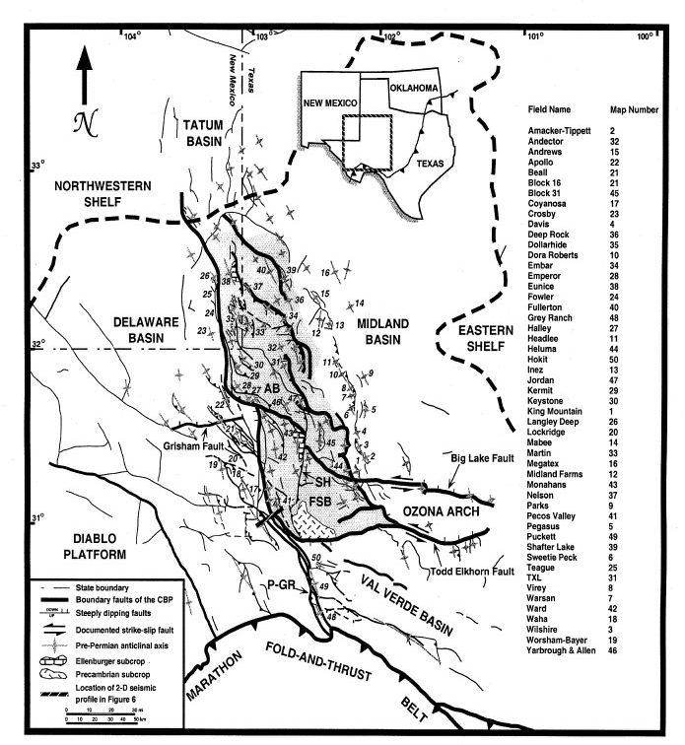
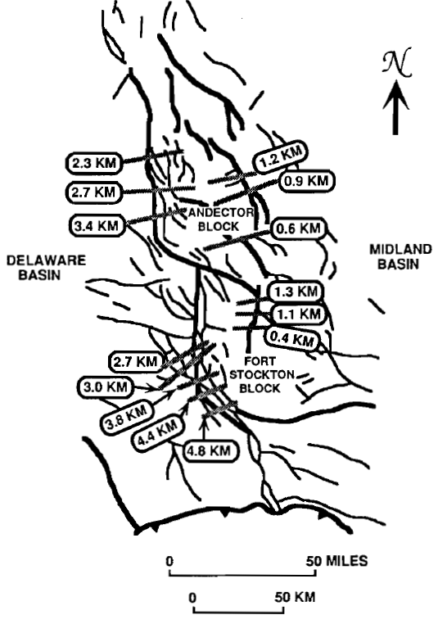
Generalized Tectonic Map of Permian Basin showing complex fault pattern
Thrusts and folds in the Permian Basin trend NW to N; most tear faults trend E-W, WNW, and NE.
Complex fault and fold patterns are typical of compressional basement uplifts.
D
U
D
3.3 KM
U
D
4.0 KM
PUCKETT-GREY
RANCH BLOCK
U
U
D
D
U
D
Calculated Shortening Along Bounding
Faults of the Central Basin Uplift
(Modified From Yang and Dorobek, 1995)
U
Trace of thrust belt
not accurate
(From Tai and
Dorobek, 2000)
AB = Andector Block
FSB = Fort Stockton High Block
SH = Sand Hills Fault
P-GR = Puckett-Grey Ranch Fault Zone

Slide 18
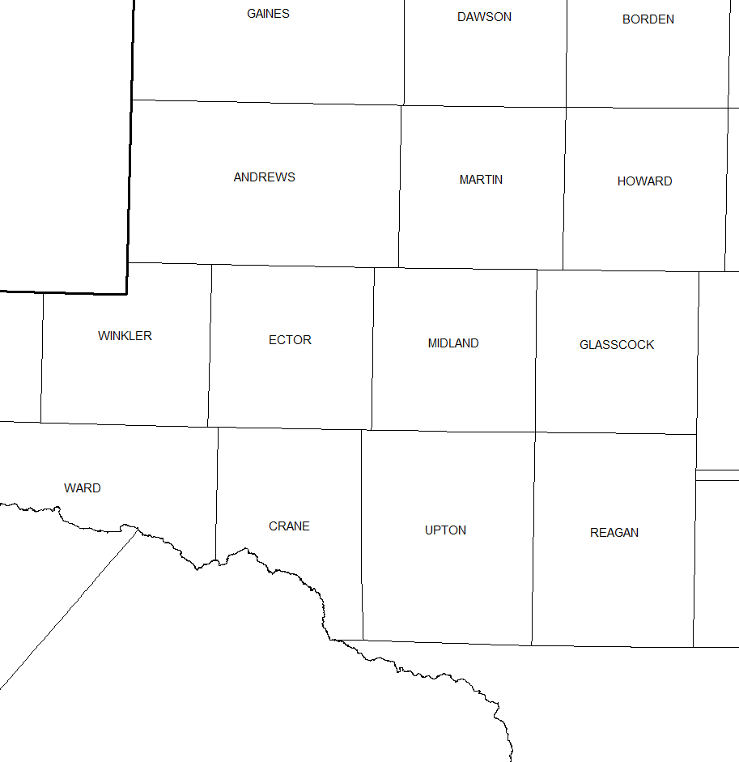
The Central Basin Uplift: Subcrop map of pre-Permian units
(i.e., age of units sitting directly underlying Permian strata)
1
Major and minor structual blocks
B’
CBU / CBP is not a single block but a series of independent structural blocks or “piano keys”
1. Hobbs
7. Keystone
2
3
8. Jordan-Penwell
B
2. Paddock
3. Fullerton
9. Sand Hills
4
4. Fowler
10. Ft. Stockton
5. Dollarhide
6
6. Andector
5
7
Pennsylvanian
Missississippian
8
Woodford (Dev – L. Miss)
Monahans
Devonian (Thirty-one)
Silurian (Wristen),
Fusselman, & Montoya
9
Simpson
(Mid Ordovician)
Ellenburger
(L. Ordovician)
Big Lake
Precambrian
Big Lake Fault
Mapping in part derived from
unpublished map by Bob Ward (1980),
but highly modified & expanded
by T. Reed
10
Thrust & Backthrust
World
Todd-Elkhorn Fault
Midway Lane
Tear Fault
(Strike-slip or
Oblique-slip)
Elkhorn
Shannon
Todd

Slide 19
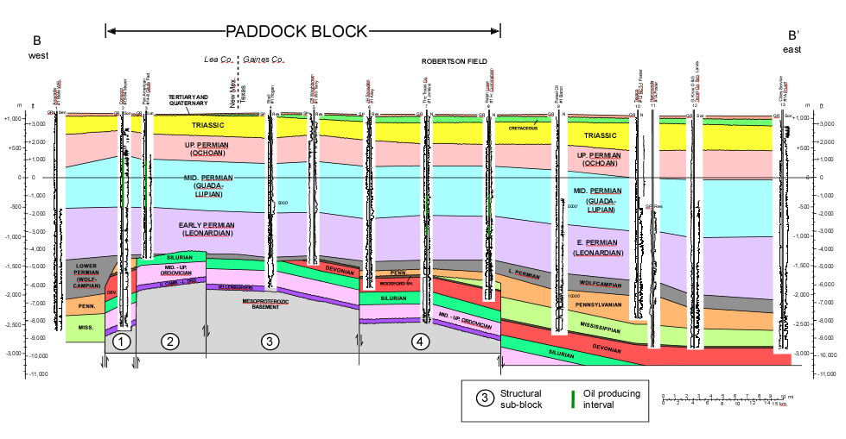
(redrafted from Bebout and Meadors, 1985)

Slide 20
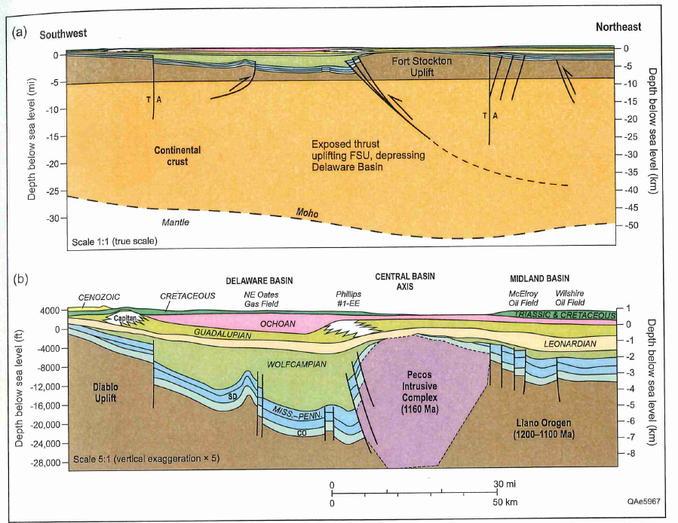
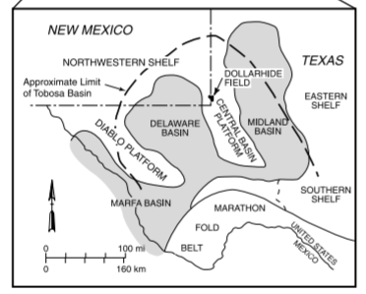
Schematic geologic cross-section across the southern end of the CBP
S. CENTRAL BASIN
UPLIFT
(Ft. Stockton Uplift)
(a) no vertical exaggeration
(b) 5x vertical exaggeration
(Ewing, 2019)

Slide 21
Fault Shape Influences the Profile Shape of Compressional Basement Uplfits
Thrust dip = ~65º
or more
A broadly listric thrust
produces the typical
shape of compressional
basement uplifts –
long back limb; short, steeper
forelimb; all hanging wall beds
raised above footwall
regional dip. At depth, the
thrust will typically dip 20º to 40º
Backlimb
Flexure
Thrusted
Fault-Propagation Fold
Section is line-length
balanced
Thrust dip = ~30º
A nearly planar high-angle
thrust produces uplifts with a
relatively flat, broad backlimb
with little closure and gentle
forelimb. All hanging wall beds
are raised uniformly above
footwall regional dip with
minimal rotation. At depth,
the thrust will typically dip
steeply – 60º to 80º.
Thrust dip = ~70º
Uniformly Uplifted
Block With Minimal
Bed Rotation
Section is line-length
balanced
Thrust dip = ~70º

Slide 22
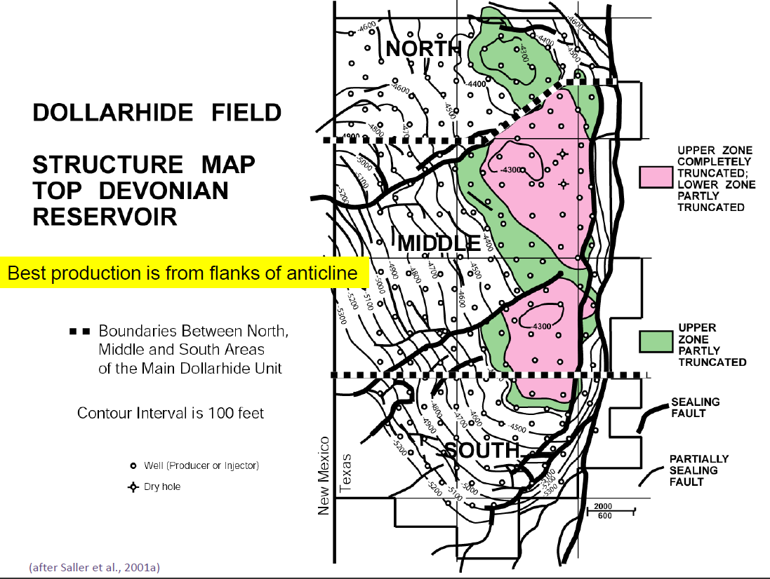
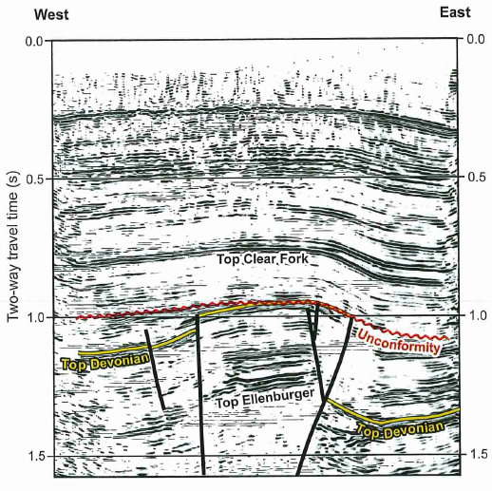
Dollarhide Field on Central Basin Uplift, Andrews County, Texas
Structure Map on Devonian Thirty-one Formation
En echelon anticlines
En echelon tears on anticline.
Fold axis bends around tear
on north side.
D
146 MMBO in place
U
D
U
1
D
U
seismic
line
D
U
1
U
(From Online Report By A. Saller, 2013)
D

Slide 23
Marathon Fold and Thrust Belt
(an extension of the Ouachita Fold and Thrust Belt)

Slide 24
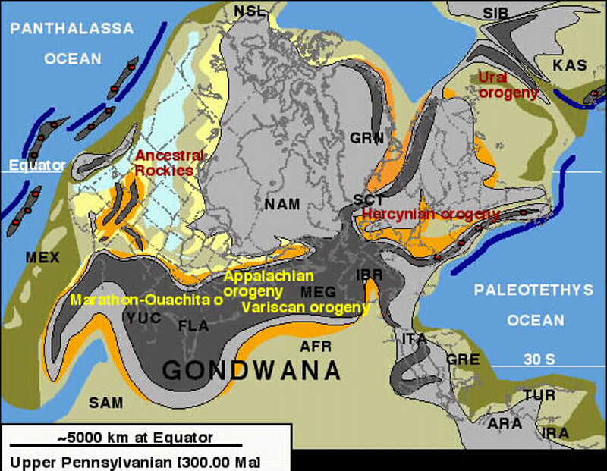
The Ouachita-Marathon fold belt is part of a larger mountain-building event: the Hercynian-Variscan orogeny, which extends into Europe
Permian
Basin
During this event, the southern margin of Laurentia (combined North American and Euro cratons) were subducted under the northern margin of Gondwana

Slide 25
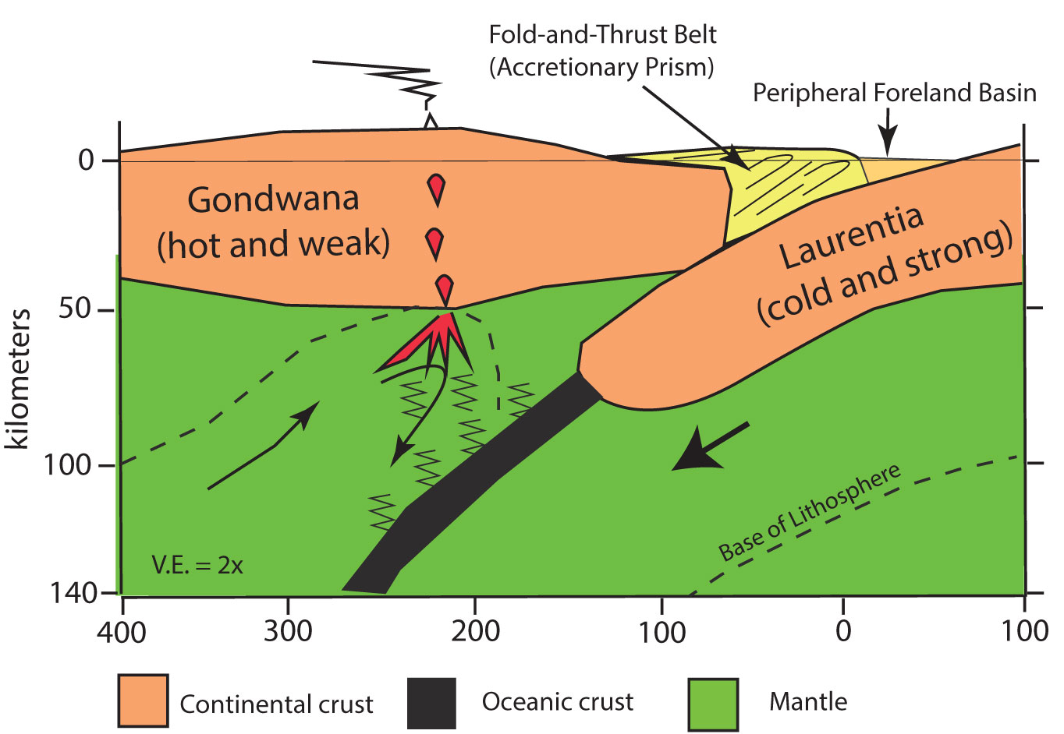
Subduction along southern margin of N America (Laurentian craton):
Gondwana was (weak) over-riding plate; Laurentia was (strong) rigid subducting plate
Peripheral foreland basin (Permian Basin) formed above downgoing Laurentia
SE
Permian Basin
NW
Lack of magmatism in North America
CBU “piano keys” were subsiding as they were being uplifted

Slide 26
Soft vs Hard Docking of Lithospheric Plates
Extended (Rifted)
Passive Margin
Volcanic
Arc
Subduction
Zone
Accretionary
Prism
Sediments
Top Basement
Sediments
Top Basement
Continental Lithosphere
Oceanic Lithosphere
Continental Lithosphere
Pre-Docking – Subduction of oceanic plate; continental plates have not yet collided
Direct contact between continental plates -- stress
transmitted through both sediments and basement
Thrust Belt –
Basement- involved
Compressional Basement Uplifts
(do not always form)
Foredeep
Basin
Thrust Belt –
Basement- involved
Accretionary
Prism
Foredeep
Basin
Sediments
Sed
Sediments
Top Basement
Top Basement
Bsmt
Continental Lithosphere
Continental Lithosphere
Downgoing continental plate partially
subducted beneath overriding plate
Oceanic Lith
Hard Docking – Both continental plates come into full contact; sediments and
basement involved in deformation
No direct contact between continental plates, so stress
transmitted only through sediments, not through basement
Foredeep
Basin
Thrust Belt –
Sediments only involved
Accretionary
Prism
Volcanic
Arc
Hercynian event in N. Amer. was a soft docking
Sediments
Sed
Sediments
Top Basement
Continental Lithosphere
Top Basement
Continental Lithosphere
Oceanic Lithosphere
Only oceanic crust enters
subduction zone
Soft Docking – Continental plates do not come into direct contact; sediments
scraped off downgoing plate as accretionary prism is thrust over it;
sediments only involved in deformation

Slide 27
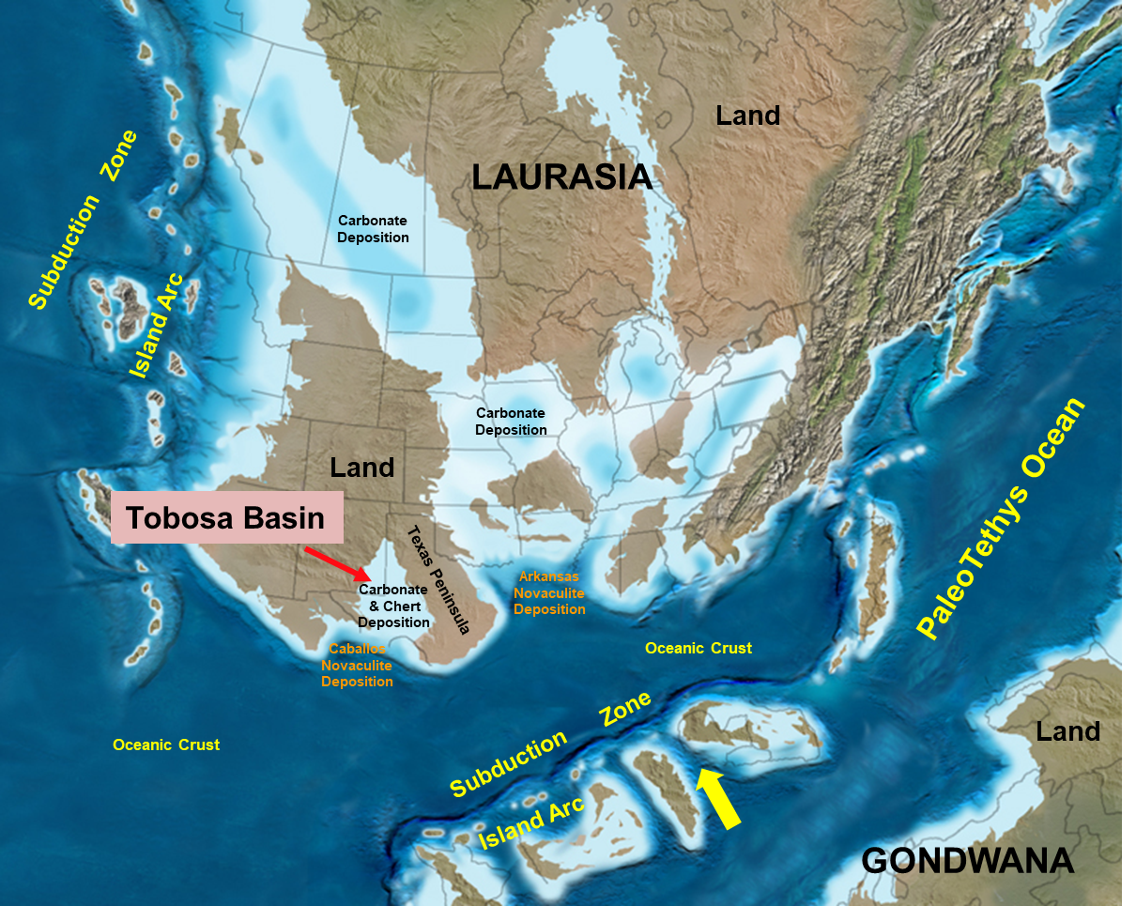
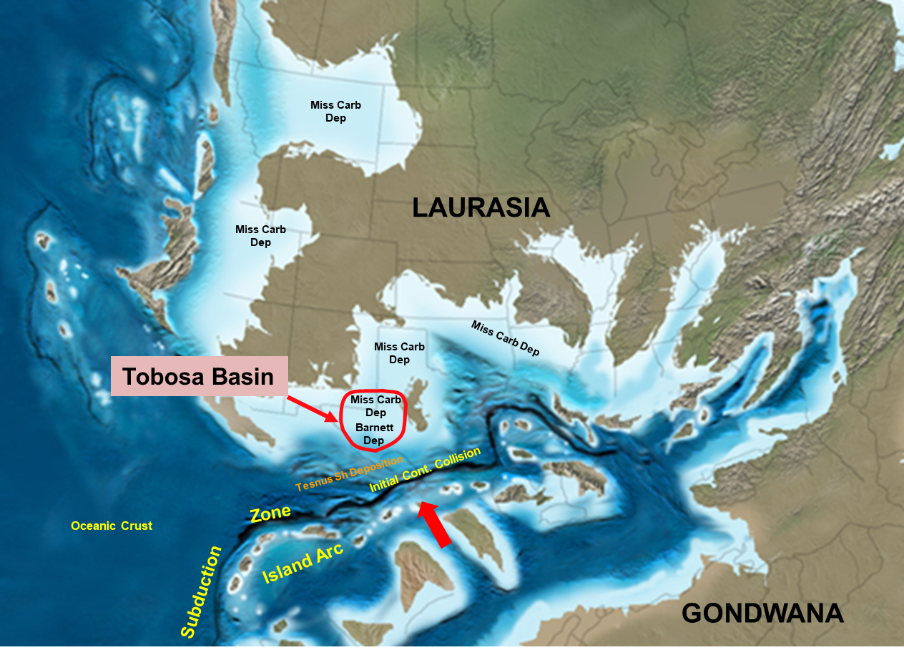
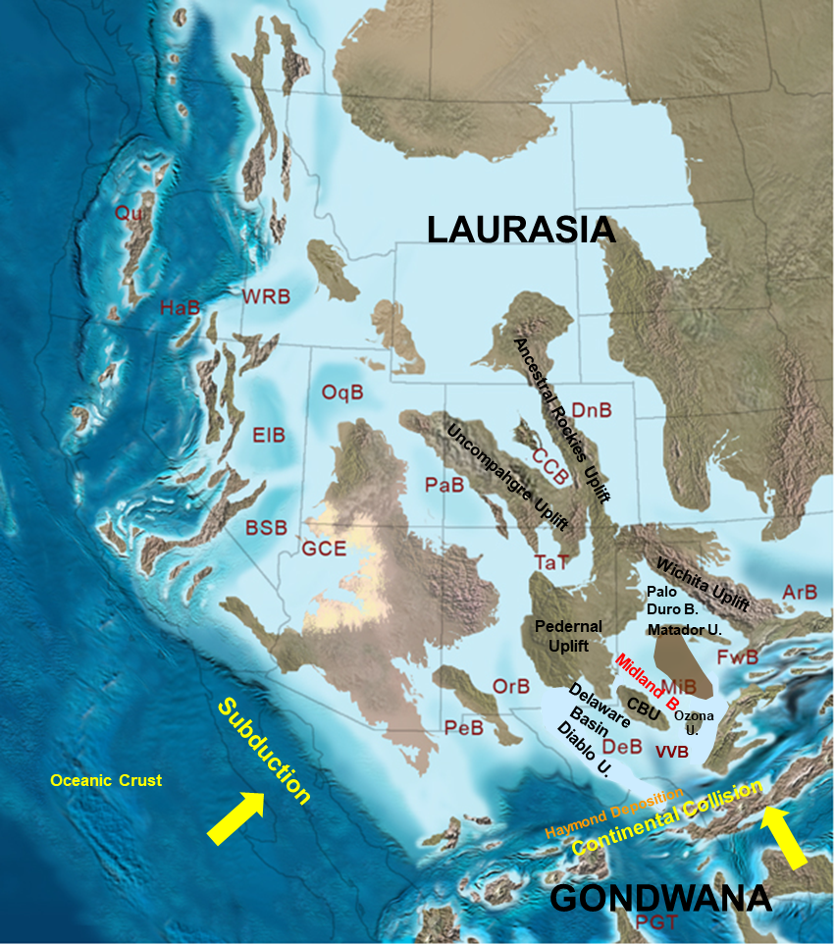
Early Devonian
The soft docking of Gondwana with the southern margin of North America
Late Mississippian
Early Pennsylvanian
(All base maps from Ron Blakey, NAU)

Slide 28
Close-up of
Early Penn
MiB – Midland Basin
DeB – Delaware Basin
ArB –Anadarko Basin
PaDuB – Palo Duro Basin
OrB – Orogrande Basin
PeB – Pedregosa Basin
VVB – Val Verde Basin

Slide 29
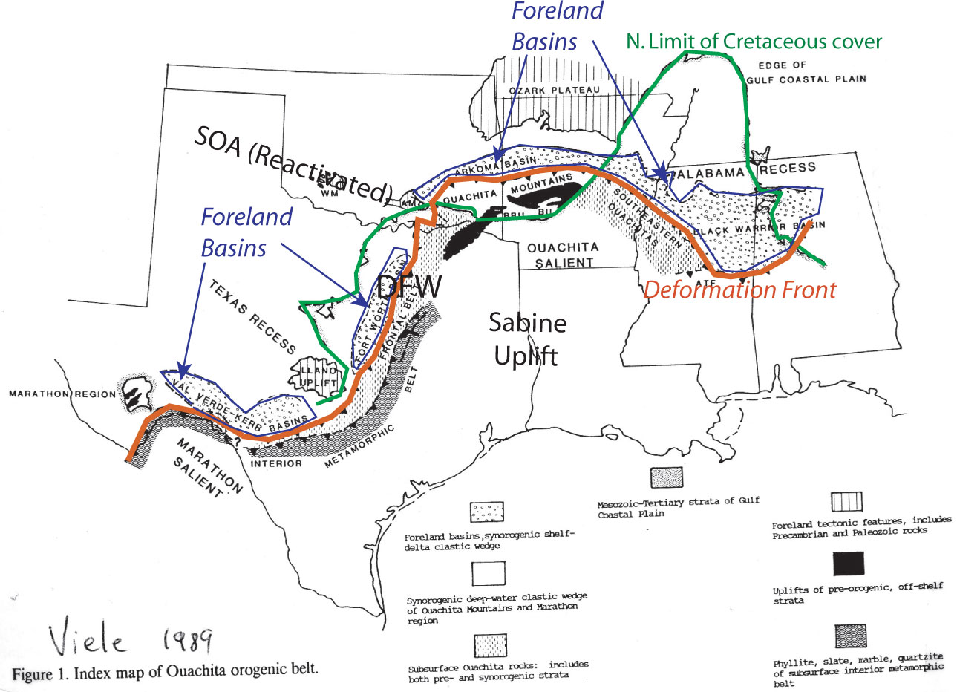
Small fragments of the Pennsylvanian collisional mountains are exposed in the Ouachita mountains of SE Oklahoma and SW Arkansas and in the Marathon mountains of W. Texas. The rest is buried beneath sediments or rifted away during opening of the Gulf of Mexico
Permian
Basin

Slide 30
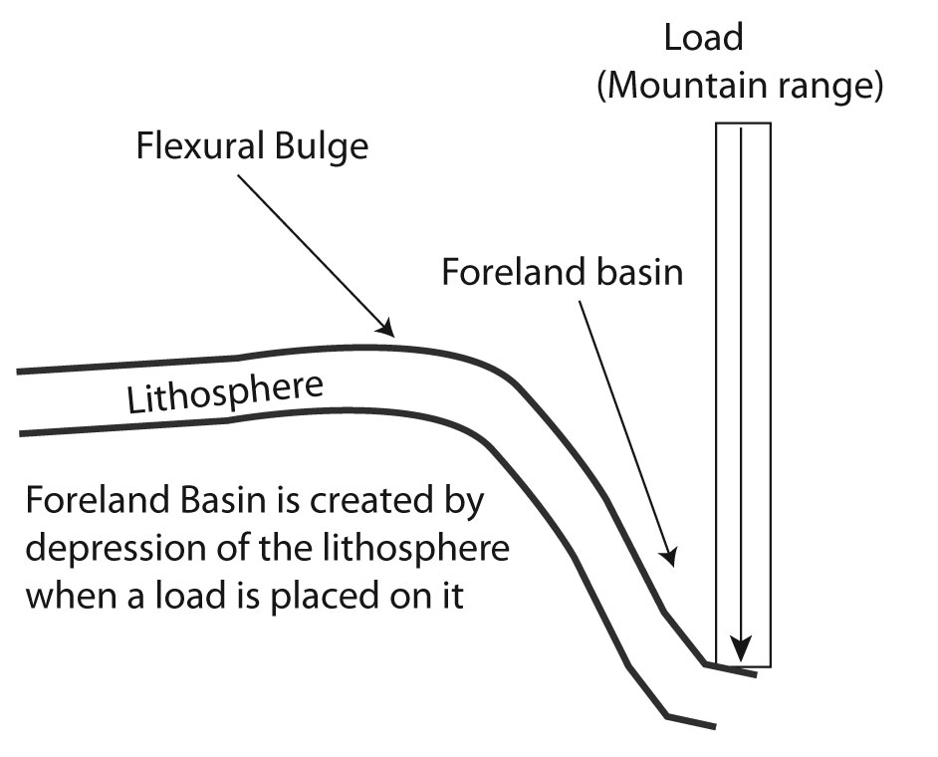
Compressional Sedimentary Basins
(Foreland Basin)
Marathon FTB
Permian basin in Pennsylvanian time

Slide 31
Deep structure (Top Lower Ordovician Ellenburger Gp.)
Pedernal
Uplift
Roosevelt
Uplift
Palo Duro Basin
Matador Fault Zone
NW Shelf
Garza
Platform
Midland Basin
Eastern Shelf
Central Basin Uplift
Delaware Basin
Ft. Chadbourne Fault Zone
Val Verde Basin = foreland basin
Ft.
Stockton
Uplift
Ozona Uplift
Delaware Basin is an extension (?)
Diablo Uplift
Val Verde Basin
Marfa Basin
Marathon
Fold & Thrust
Belt
100 km
(modified from Ewing, 2013 )
(Note: contour depths in feet)

Slide 32
Outline of
Central Basin Uplift
Outline of
Central Basin Platform
Northwest Shelf
Tatum
Basin
Midland Basin
Let’s look at some geologic sections across the Marathon Fold-and-Thrust Belt structure
Eastern Shelf
Central Basin Uplift
Grisham Fault
Delaware Basin
Ft. Stockton
High
Big Lake Fault
Diablo Uplift
Todd-Elkhorn Fault
Ozona
Uplift
G
D
F
Puckett-
Grey Ranch
Uplift
Elsinore
Uplift
F’
Val Verde Basin
G’
Marfa
Basin
Marathon Thrust Belt
D’
Devil’s River
Uplift
Kerr
Basin
Woodford Structure Map: Permian Basin
(From Comer, 1991)

Slide 33
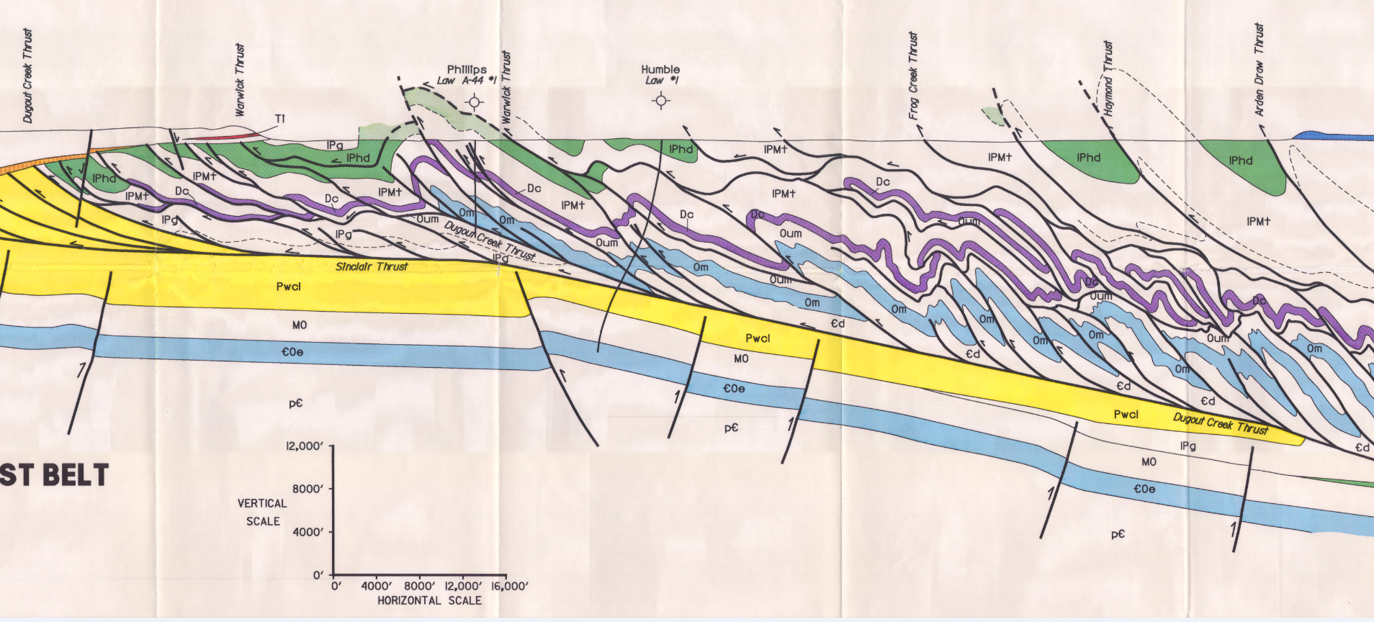
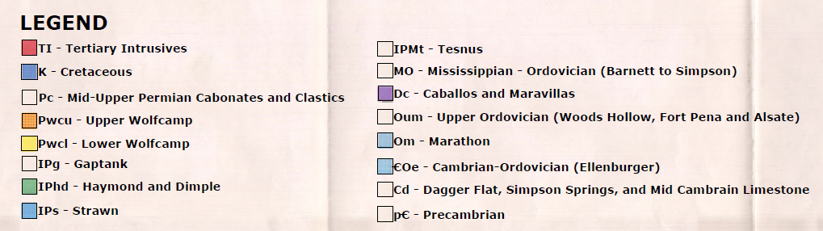
NW
SE
Deformation Style of Shale Dominated – Marathon Thrust Belt:
Closely-spaced Complex Structures
D
D’
Imbricate Zone
Similar
Folds
Detachment folds
Stacked
Duplexes
Tight, closely-
spaced folds
(Section by T. Reed, 1985)
(Tim Reed, unpublished)

Slide 34
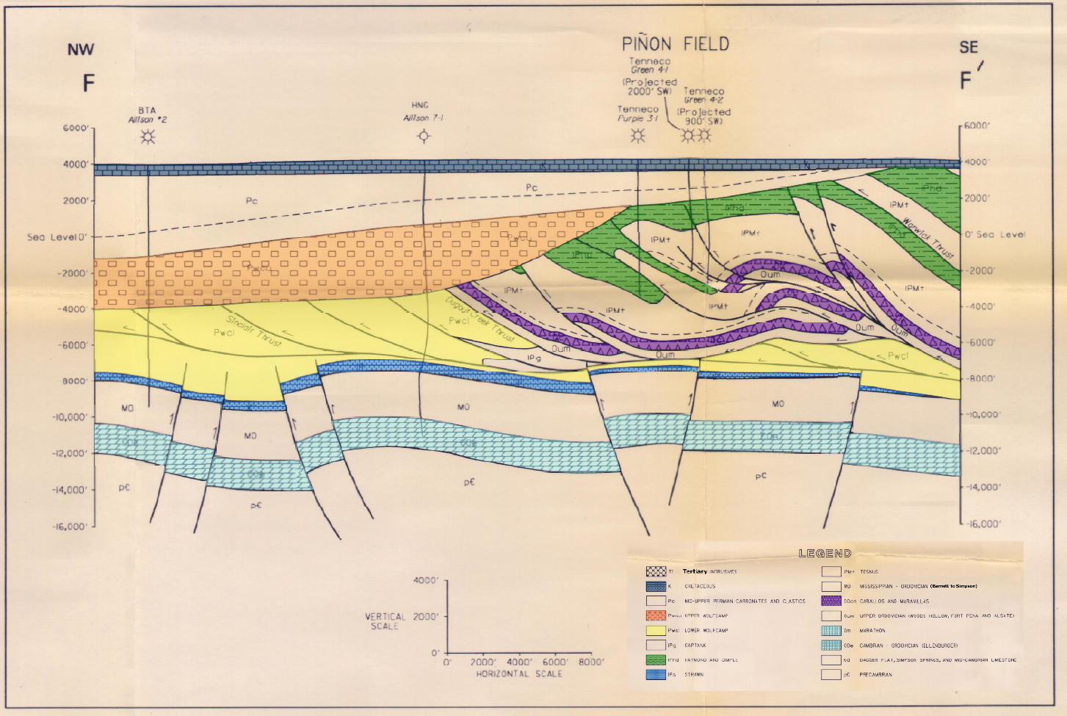
Piñon Field Cross Section F-F’
Production From Caballos, Tesnus, and Dimple
Cretaceous
Leonardian
Haymond & Dimple
Wolfcamp A
Tesnus
Upper Wolfcamp (C1 & B)
Haymond & Dimple
Caballos
Lower Wolfcamp (C2)
Tesnus
Caballos
Ellenburger
Carlsberg Structure –
Southern Portion of Elsinore Uplift
(Section by T. Reed, 1985)
Notes:
Section F-F': The C2 is not the D, it sits directly above the D. It was during WFMP C2 time that high volumes of terrigenous clastics were being delivered into the basin, via the Eastern Shelf and MFTB; some of these clastics are erroneously referred to in the literature as "Canyon" sands, but they are Wolfcampian, not Missourian. Were these clastics the product of a single large river systems, or perhaps numerous smaller ones from slightly different regions? That is the question

Slide 35
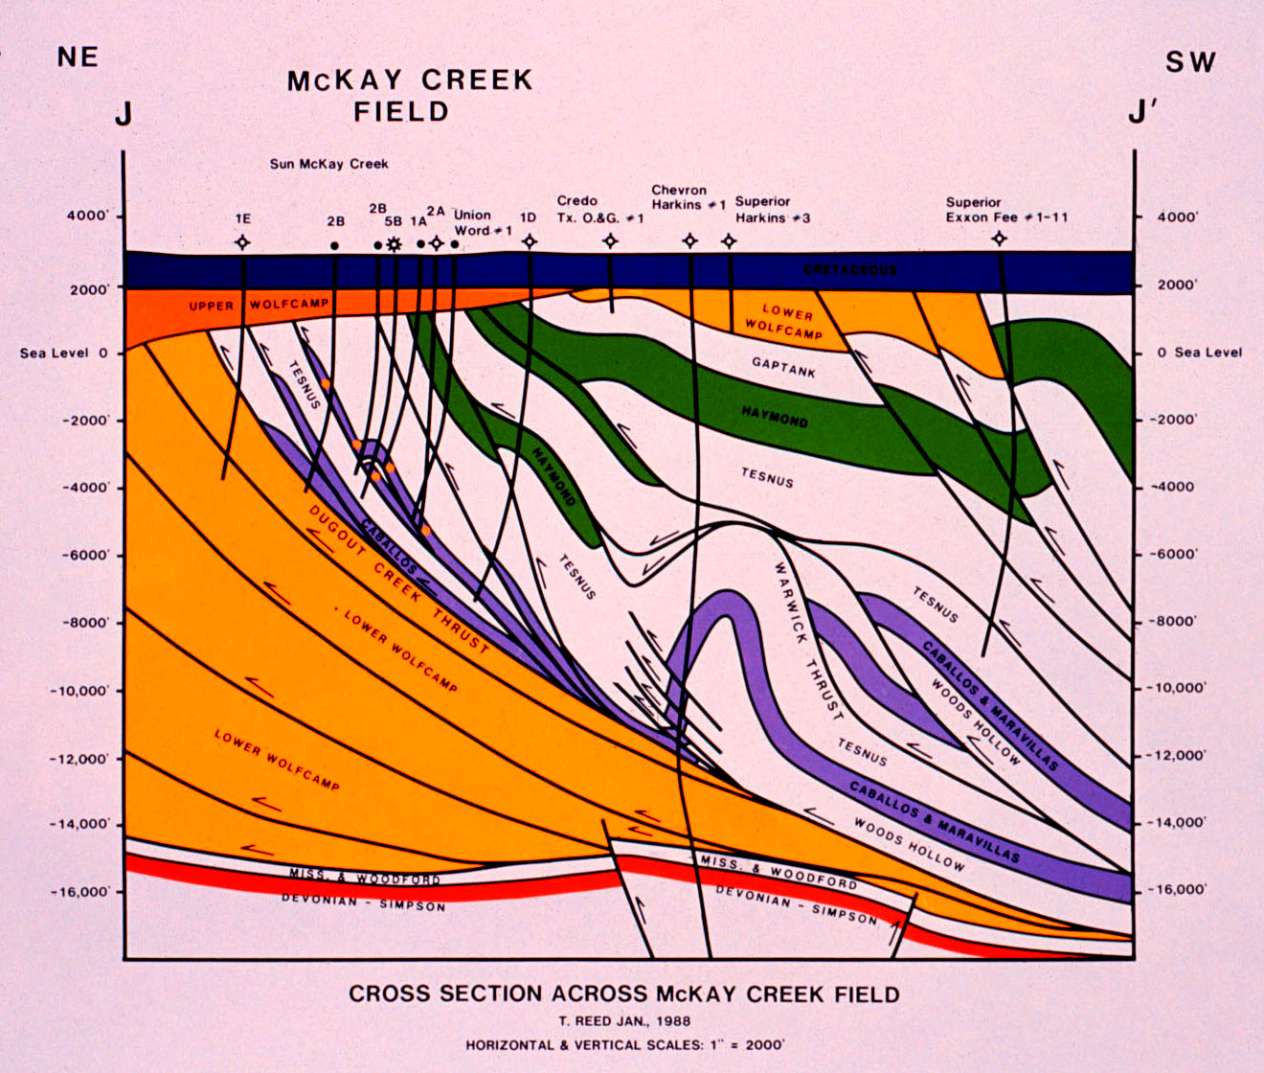
Productive Imbricate Zone
Marathon Thrust Belt
West Texas
G
G’
Cretaceous
Thanks to Tim Reed
Lower Wolfcamp equates, in whole, or part, to Wolfcamp D
Discovered by Sun in 1979
Cumulative Production Through Jan, 2014
1.27 MMBO & 14.78 BCFG

Slide 36
Tectonic History of the Permian Basin:
Overall Summary

Slide 37
Tectonic history of the Permian Basin: Summary
1.3 – 1.0 billion years ago: Grenville orogeny followed closely by extensional event
Breakup of Rodinia supercontinent in latest Precambrian – early Cambrian (rifted margin); Late Cambrian initial transgression; Early Ordovician Great American Carbonate Bank (Ellenburger)
A tale of two basins
Early Paleozoic Tobosa Basin (mid Ordovician to latest Mississippian passive margin)
Late Paleozoic Permian Basin (Pennsylvanian – early Permian active margin)
Four separate orogenic pulses: two in early Penn, one in middle Penn, final one in early Permian
Active tectonic phase is a consequence of soft docking of Gondwana and Laurentia (“thin-skinned” fold belt) and the development of the Ancestral Rockies (“thick-skinned,“ basement-involved uplifts)
The Central Basin Uplift is a complex structure: not a single block, but a collection of smaller, independent blocks “piano keys”
The Central Basin Uplift covers more area than the carbonate platform known as Central Basin Platform
The majority of basin subsidence within the Permian Basin occurs in early and middle Permian time (post-tectonism)

Slide 38
Geology of the Permian Basin: ELS (Endeavor Lecture Series)
Horseshoe Atoll
Tectonic history – Part 1 (Big Picture)
Tectonic history – Part 2 (Regional elements: ARM, CBU, MFB)
Basement
Cambrian – Lower Ord (Wilberns/Bliss Ss., Ellenburger Gp)
Tobosa Basin stratigraphy (Mid Ord. – Mississippian)
Pennsylvanian (Morrow-Atoka-Strawn-Canyon-Cisco)
Lower Permian (Wolfcamp – Spraberry)
Middle and Upper Permian / Permian Basin petroleum system

