Slide 1
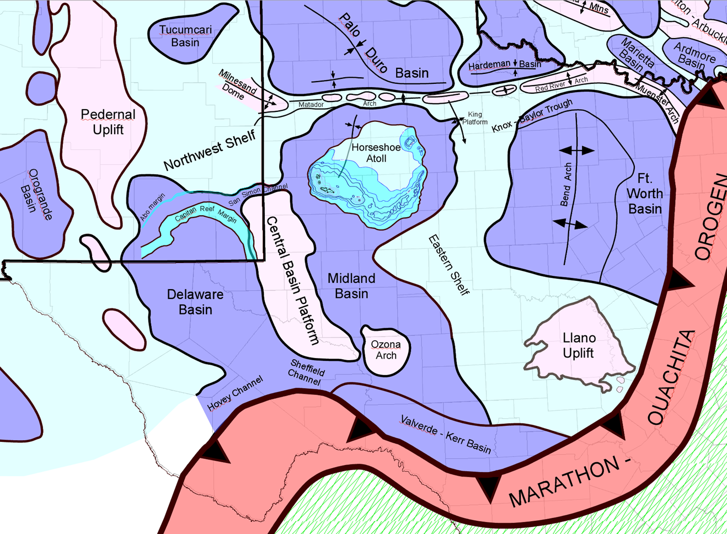
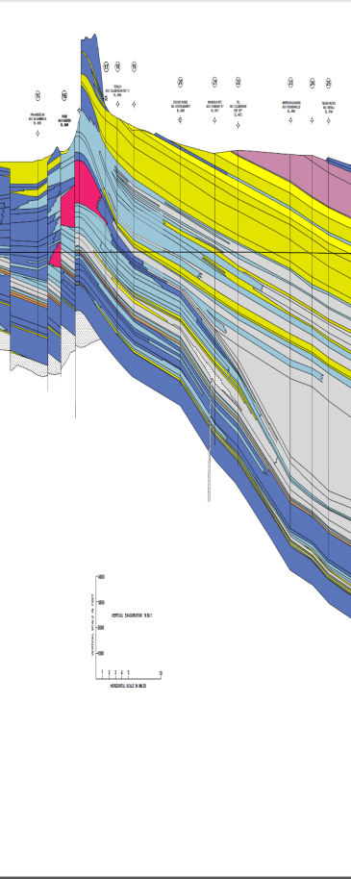
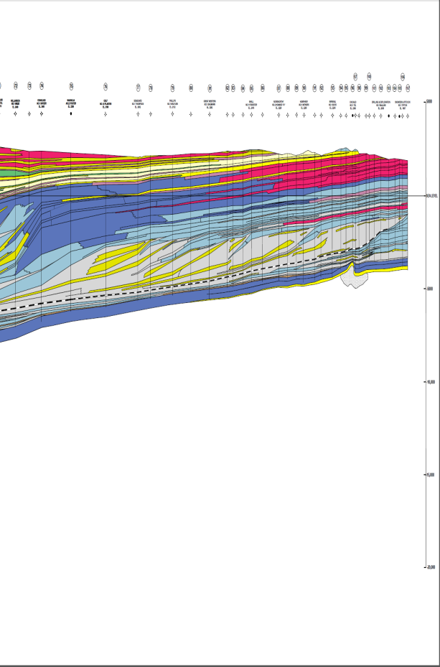
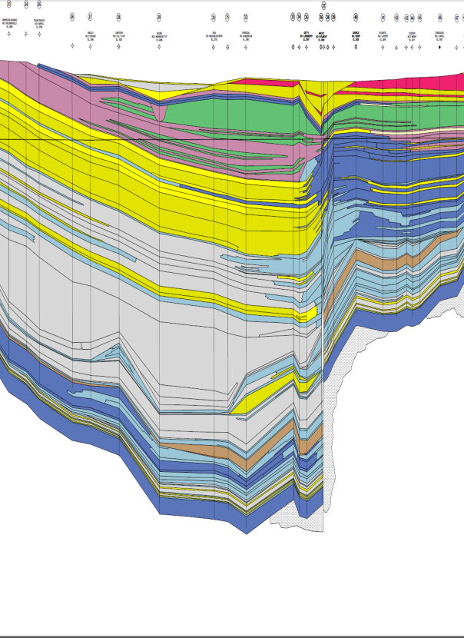
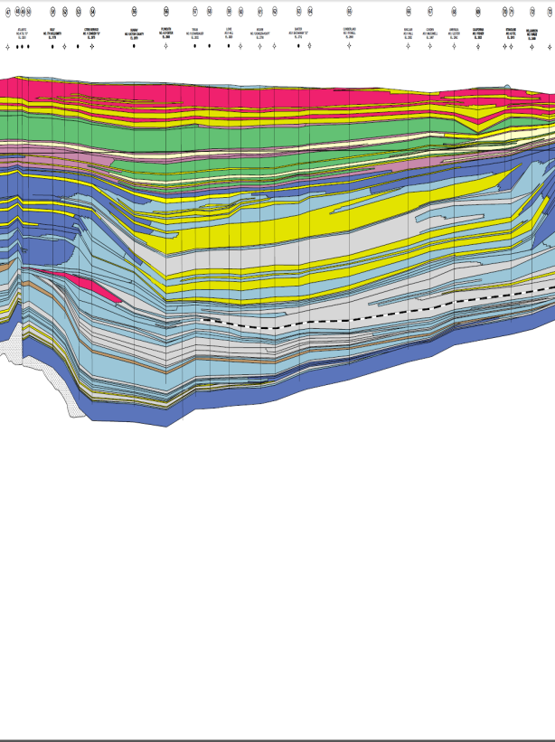
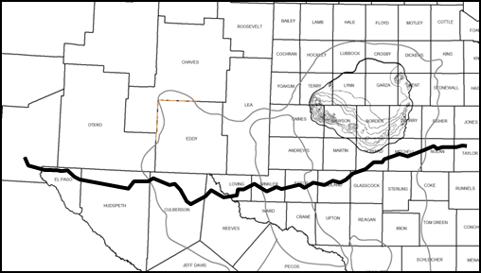
Geology of the Permian Basin
Tectonic History, Pt. 1:
The Big Picture
Lowell Waite
UT Dallas Geoscience
Permian Basin Research Lab
7/26/2021

Slide 2
Geology of the Permian Basin: ELS (Endeavor Lecture Series)
Horseshoe Atoll
Tectonic history – Part 1 (Big Picture)
Tectonic history – Part 2 (Regional elements)
Basement
Cambrian – Lower Ord (Wilberns/Bliss Ss., Ellenburger Gp)
Tobosa Basin stratigraphy (Mid Ord. – Mississippian)
Pennsylvanian (Morrow-Atoka-Strawn-Canyon-Cisco)
Lower Permian (Wolfcamp – Spraberry)
Middle and Upper Permian

Slide 3
Permian Basin tectonic history, Part 1: Key takeaways
The Permian Basin evolved throughout Paleozoic time from a relatively simple, bowl-shaped depression (Tobosa Basin) to a complex series of deep basins (Delaware, Midland basins and surrounding shallow shelves) separated by a significant basement uplift (Central Basin Platform)
This evolution corresponds with changeover from a passive to a tectonically-active margin; seven phases of deformation / sedimentation
A significant amount of post-tectonic subsidence occurred during Permian time (enigmatic)
The amount of tectonic uplift during the Late Cretaceous and Cenozoic greatly impacted the petroleum systems in the western portion of the basin

Slide 4
Tectonic History of the Permian Basin:
Overview

Slide 5
Phases of Deformation and Sedimentation in the Permian Basin
1
Mid Proterozoic (1.3 to ~1.0 bya) – Grenville Orogeny and Extensional Phase
Latest Precambrian to early Cambrian – Rifting south of ancestral Permian Basin (Tobosa Basin)
2
3
Late Cambrian to Early Ordovician – Initial marine transgression and Great American Carbonate Bank
4
Middle Ordovician to Late Mississippian – Tobosa Basin
Pennsylvanian to early Permian Active Margin/Orogenic Phase
5
6
Middle to late Permian Post-orogenic Rapid Subsidence / Sediment Loading Phase
7
Post – Permian Phase

Slide 6
Permian Basin Stratigraphy and Tectonic History
Ma
System
Series
Delaware Basin
CBP & NW Shelf
Midland Basin
Tectonic Phase
252
Formations
Formations
Formations
final basin fill/termination
Dewey Lake
Dewey Lake
Dewey Lake
Ochoan
Rustler
Rustler
Rustler
Salado
Salado
Salado
Castile
Lamar
Tansill
Tansill
Post Orogenic Loading Rapid Subsidence;
Onset of HC Generation
Bell Canyon
Capitan
Yates
Yates
Guadalupian
Delaware Mtn
Group
Seven Rivers
Seven Rivers
Permian
Cherry Canyon
Goat
Seep
Queen
Queen
Grayburg
Grayburg
Brushy Canyon
Upper San Andres
San Andres
Cutoff Member /
1st Carb / Avalon
Lower San Andres
Clear-
fork
Holt /Upper Leonard
( ~ 50 million yrs. duration )
Active Margin
Lwr San Andres
Holt / Upr Leonard
PERMIAN BASIN PHASE
Bone
Spring
1st Sand
Glorieta
Upper
Leonardian
2nd Carb
Upper Clearfork
Spraberry
Middle
2nd Sand
Yeso /
Clearfork
Middle Clearfork
Lwr
Jo Mill
3rd Carb
Stray Sd
Dean
L. SPBY Sh
3rd Sand
Tubb
Lower Clearfork
Wolfcamp A
Wolfcamp
Wolfcamp
Wichita / Abo
Wolfcamp
Wolfcamp B
mid – Wolfcamp unconformity
299
Wolfcampian
Wolfcamp C1
Virgilian
Cisco
Cisco
Cisco
Wolfcamp C2
Early WFMP Event
Missourian
Canyon
Canyon
Canyon
Wolfcamp D
Penn. – Early Permian
Foreland Deformation
Pennsylvanian
Desmoinesian
Strawn
Lime
Strawn
Lime
Strawn
Lime
Detrital
Detrital
Detrital
Strawn Event
Bend Lm
(~ 30 million yrs.
duration)
Atokan
Atoka
Atoka
Atoka
Sh & Detrital
Atokan Event
323
Morrowan
Morrow
Morrow (NW Shelf Only)
Morrow
Morrow Event
Chesterian
Barnett
U. Miss Lm
L. Barnett
U. Barnett
U. Miss Lm
L. Barnett
U. Barnett
Mississippian
Meramecian –
Osagean
L. Miss Lm
L. Miss Lm
L. Miss Lm
359
Kinderhookian
Woodford
Woodford
Woodford
Tobosa Basin
(Middle Ordovician to
Late Mississippian)
Moderate Subsidence
Devonian
Upper
Middle
TOBOSA BASIN PHASE
419
Lower
Devonian (Thirtyone)
Devonian (Thirtyone)
Devonian (Thirtyone)
Silurian
U. Niagaran
Upper Silurian (Wristen)
Upper Silurian (Wristen)
Upper Silurian (Wristen)
L. Niagaran
Fusselman
Fusselman
Fusselman
(~ 150 million yrs. duration)
Passive Margin
444
Alexandrian
Montoya
Montoya
Sylvan Sh.
Cincinnatian
Montoya
Mohawkian
Tulip Crk.
Bromide
Tulip Crk.
Bromide
Tulip Crk.
Bromide
Simpson
Mclish
McKee Sd.
Simpson
Mclish
McKee Sd.
Simpson
Mclish
McKee Sd.
Ordovician
Chazyan
Oil Creek
Waddell Sd.
Oil Creek
Waddell Sd.
Oil Creek
Waddell Sd.
Joins
Connell Sd.
Joins
Connell Sd.
Joins
Connell Sd.
Canadian
Ellenburger
Ellenburger
Ellenburger
Great American Carbonate Bank
485
Ozarkian
(Late Cambrian – Early Ordovician)
Cambrian
Upper
Bliss
Absent
Wilberns
541
Bliss / Hickory / Riley
Precambrian
Basement
Precambrian
Basement
Precambrian
Basement
Basement assembly and breakup of
Rodina supercontinent
Precambrian
(Reed and Waite, 2016)
Grenville Orogeny (1.3 to 1.0 bya)

Slide 7
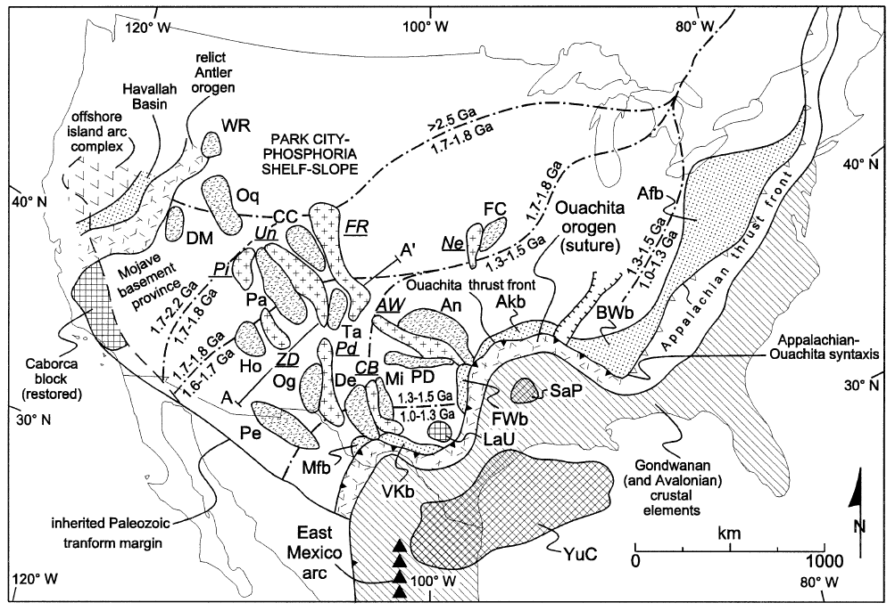
Permian Basin of w. TX and SE New Mexico: southern end of the Ancestral Rockies
Precursor
Tobosa Basin
Fold and thrust belt
Basement uplift
Shallow marine shelf
Reef / shoal complex
Deep marine basin

Slide 8
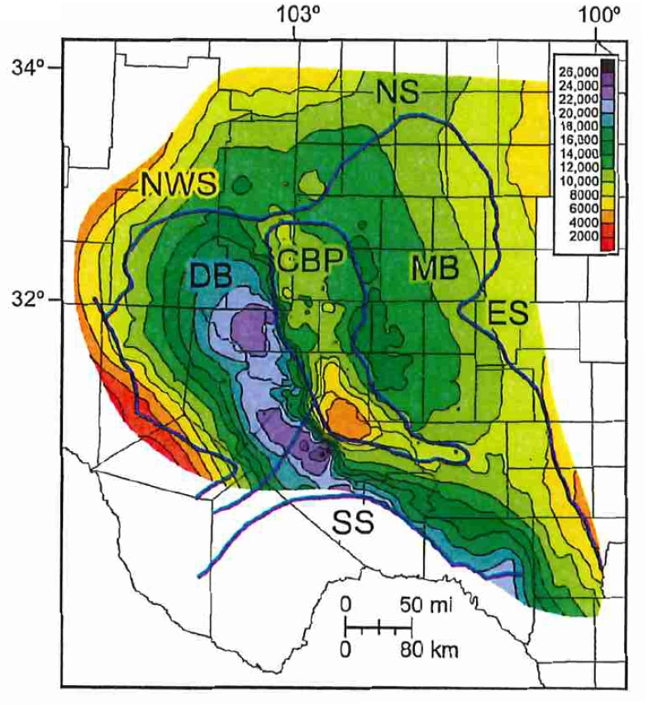
Total thickness of
Paleozoic sediments
(in feet)
(Ruppel, 2019)

Slide 9
Deep structure (Top Lower Ordovician Ellenburger Gp.)
Pedernal
Uplift
Roosevelt
Uplift
Palo Duro Basin
Delaware and
Val Verde basins = foredeep
Matador Fault Zone
NW Shelf
Garza
Platform
Much shallower Midland
Basin separated by
fault-bounded high blocks
(Central Basin Uplift
and Ft. Stockton - Ozona uplifts)
Midland Basin
Eastern Shelf
Central Basin Uplift
Note gentle westward dip on
east flank of Midland Basin &
Eastern Shelf: ~ 0.6º
Delaware Basin
Ft. Chadbourne Fault Zone
Ft.
Stockton
Uplift
Ozona Uplift
Diablo Uplift
Val Verde Basin
Marfa Basin
Marathon
Fold & Thrust
Belt
100 km
(modified from Ewing, 2013 )
(Note: contour depths in feet)

Slide 10
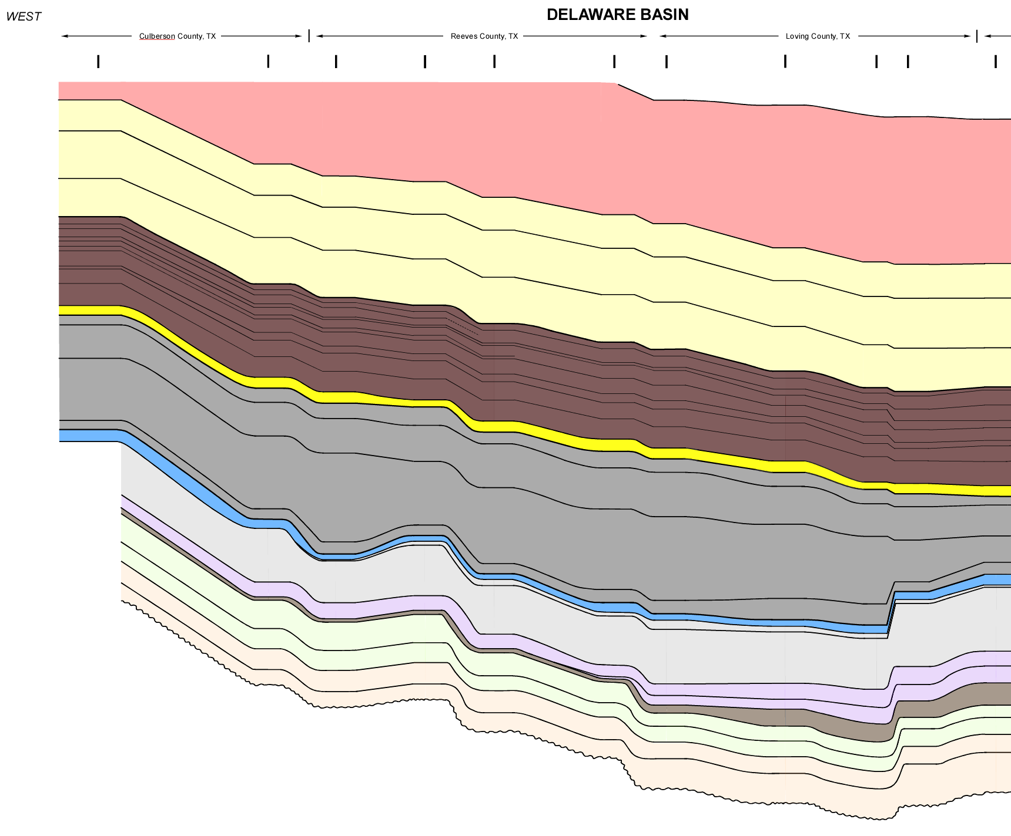
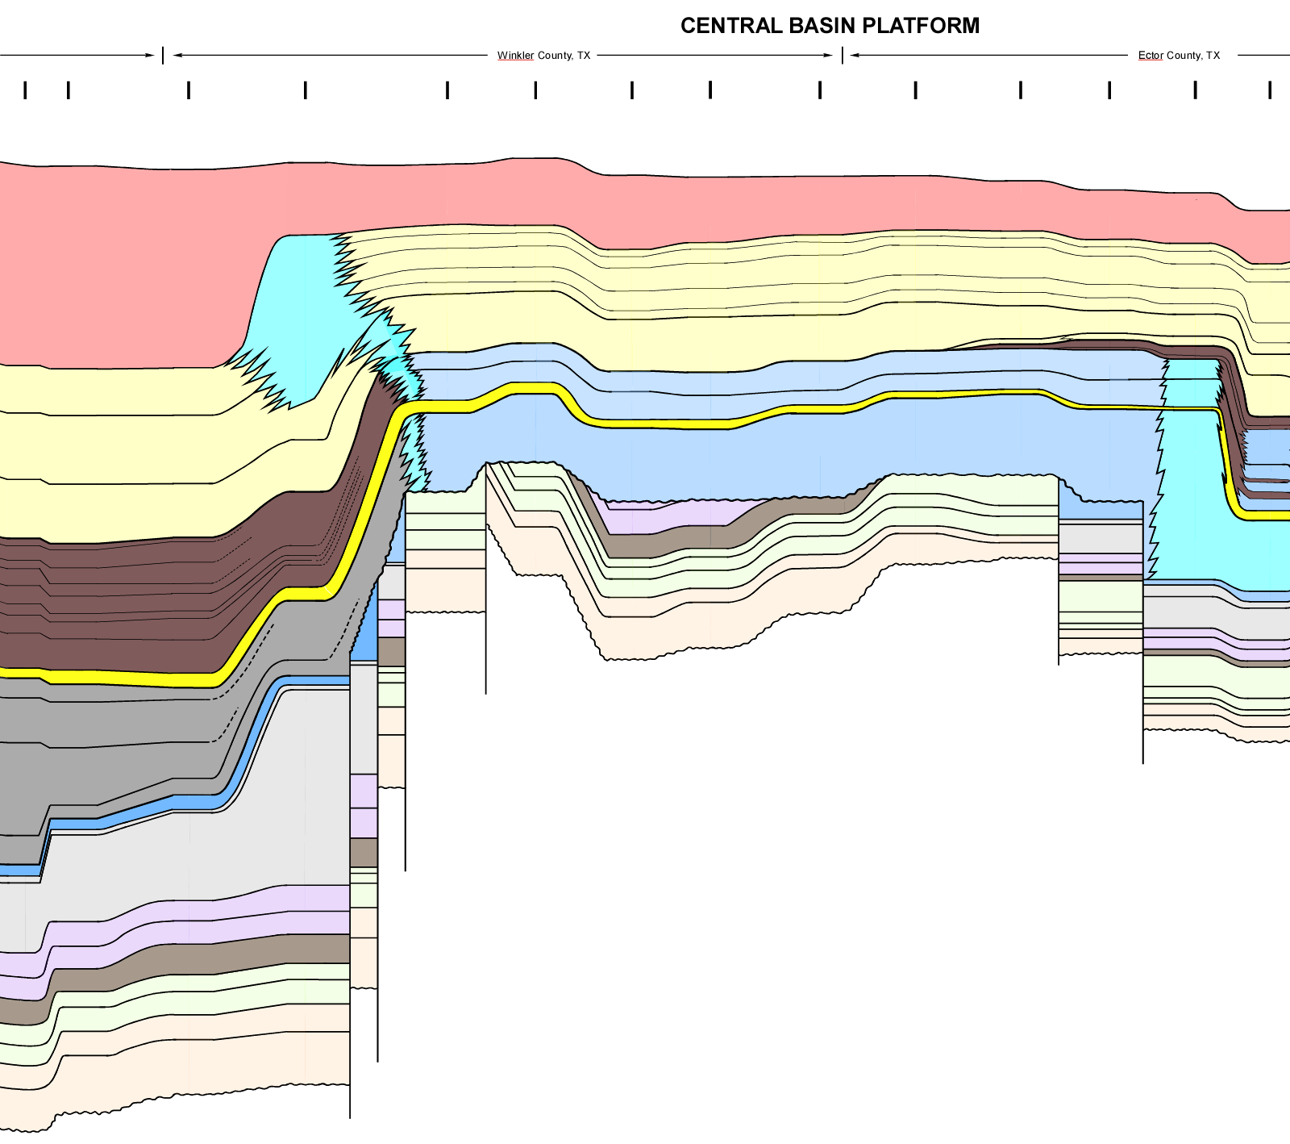
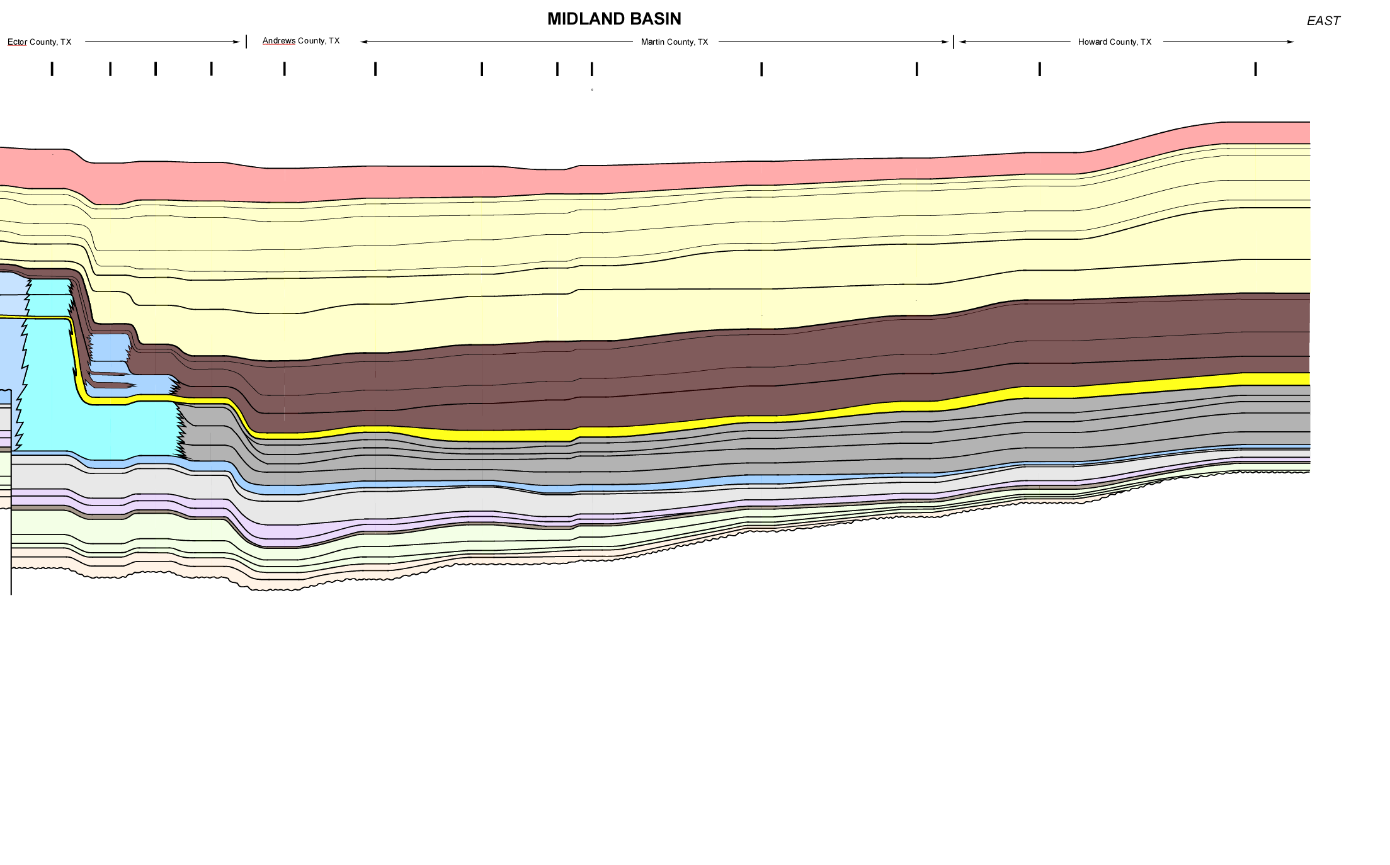
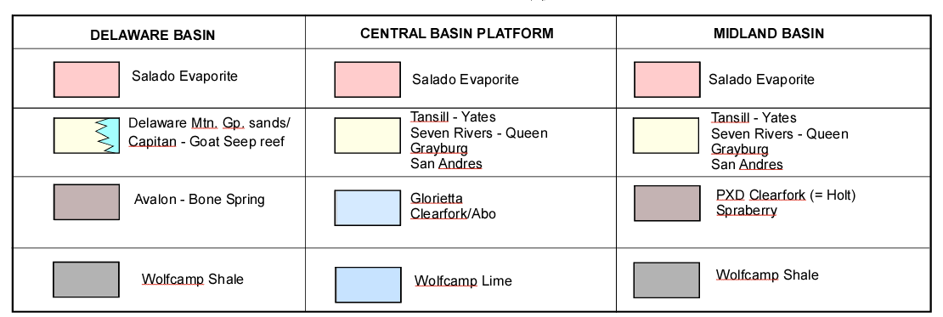
West
East
DELAWARE BASIN
CENTRAL BASIN PLATFORM
MIDLAND BASIN
Culberson
Reeves
Loving
Winkler Co. TX
Ector Co. TX
Martin Co. TX
Howard Co. TX
Subsea
elev.
(feet)
Subsea
elev.
(feet)
+2000
Rustler - Salado
+2000
0
datum: sea level
Tansill-Yates
0
Permian
Capitan
Reef
Glorietta Ss
Seven Rivers-Queen-Grayburg
-2000
Delaware Mtn. Gp.
Upper Clearfork
San Andres
- 2000
Tubb Ss
U. Clearfork
-4000
Lower Clearfork
-4000
Avalon
Abo
Spraberry
Dean Ss
-6000
Bone Spring
Wolfcamp
-6000
-8000
3rd Bone Spring Ss
-8000
Penn.
-10000
Ellenburger
-10000
Ord-Miss
Wolfcamp
0
30 mi.
-12000
-12000
-14000
Strawn
-16000
Atoka
-18000
Ellenburger
L. Paleozoic
Wood-
ford
-20000
Delaware foredeep approx. 2x
deeper than Midland Basin
Continuity of depositional facies between basins (nomenclature differences in post-Wolfcamp units)
Intervening CBP consists of a series of independent, fault-bounded structural blocks
Permian Basin fills progressively in Late Permian time from ENE direction (from Midland Basin side)

Slide 11
Phases of Deformation and Sedimentation in the Permian Basin
1
Mid Proterozoic (1.3 to ~1.0 bya) – Grenville Orogeny and Extensional Phase
Latest Precambrian to early Cambrian – Rifting south of ancestral Permian Basin (Tobosa Basin)
2
3
Late Cambrian to Early Ordovician – Initial marine transgression and Great American Carbonate Bank
4
Middle Ordovician to Late Mississippian – Tobosa Basin
Pennsylvanian to early Permian Active Margin/Orogenic Phase
5
6
Middle to late Permian Post-orogenic Rapid Subsidence / Sediment Loading Phase
7
Post – Permian Phase

Slide 12
Phases of Deformation and Sedimentation in the Permian Basin
1
Mid Proterozoic (1.3 to ~1.0 bya) – Grenville Orogeny and Extensional Phase
  Plate collision along southern and eastern North America
    Thrusting, accretion, and high-grade metamorphism (1.3 to 1.0 bya)
  Widespread extension and mafic intrusions at end of orogeny (1.16 to 0.95 bya)
    Mafic intrusions and probable rifting in location of future Central Basin Uplift
Latest Precambrian to early Cambrian – Rifting south of ancestral Permian Basin
  Rifting along southern and eastern U.S. forming a passive margin (breakup of Rodinia supercontinent)
  Permian Basin region was largely exposed
  No firm evidence of “Delaware Aulocogen”
2

Slide 13
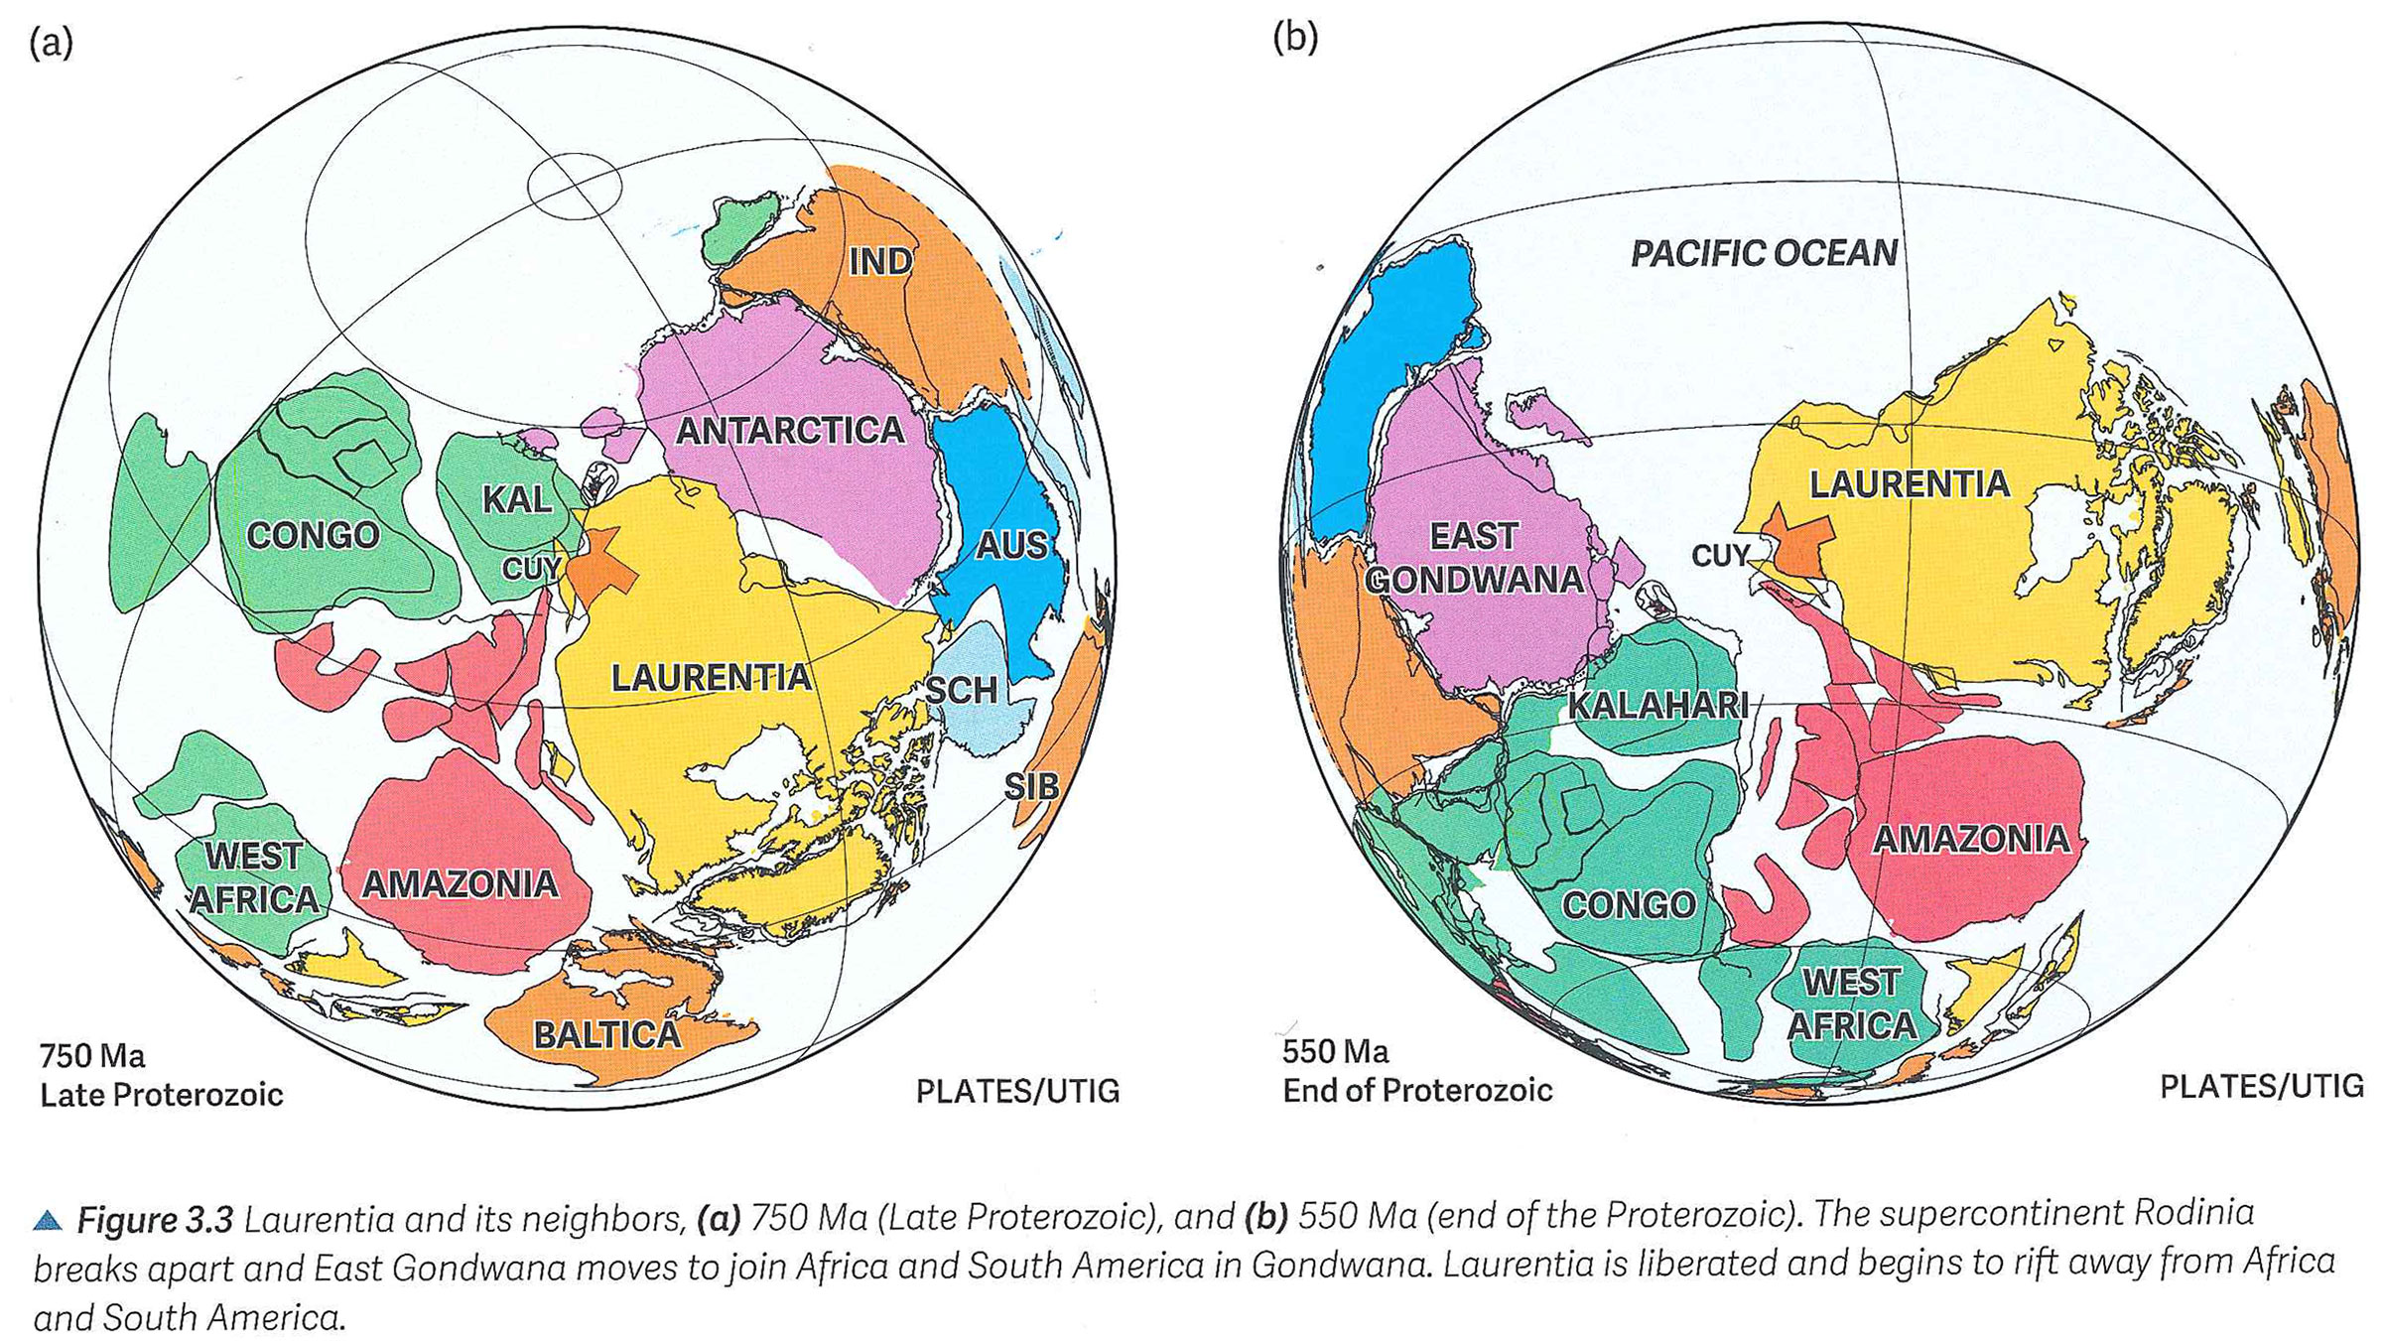
Paleogeographic reconstructions for Neoproterozoic time
West Texas
Ewing – Texas through Time

Slide 14
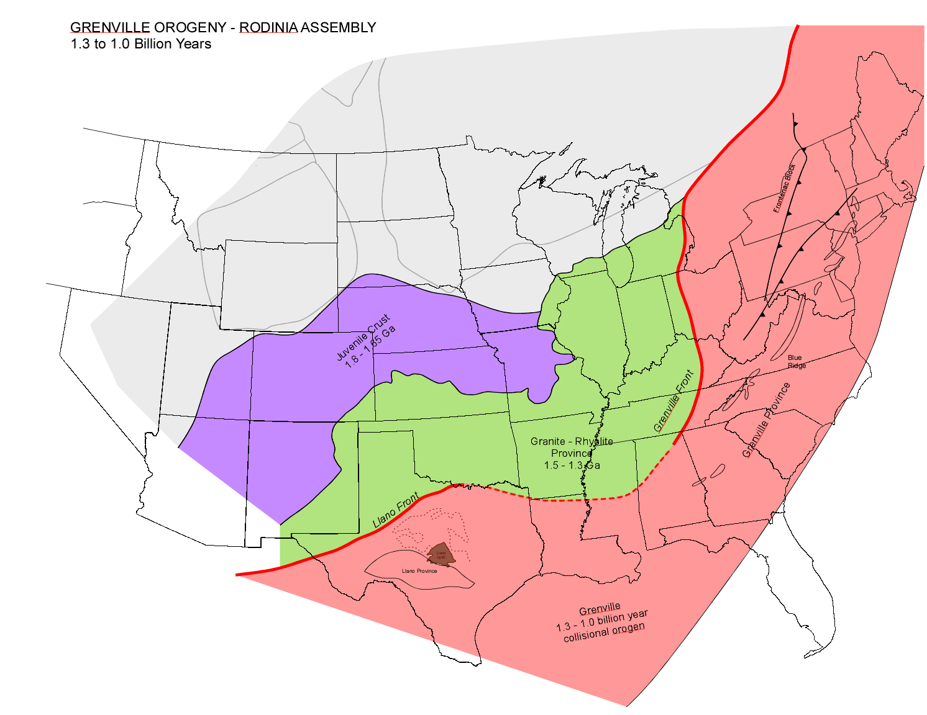
Mid Proterozoic (1.3 to ~1.0 Ga) – Grenville Orogeny
during assembly of Rodinia

Slide 15
Mid Proterozoic (1.3 to ~1.0 Ga) – Intracratonic extension
Late Proterozoic to Early Cambrian (760 to 530 Ma) –
Breakup of Rodinia and opening of Iapetus Ocean
Site of future intracratonic basin
Site of future Tobosa Basin

Slide 16
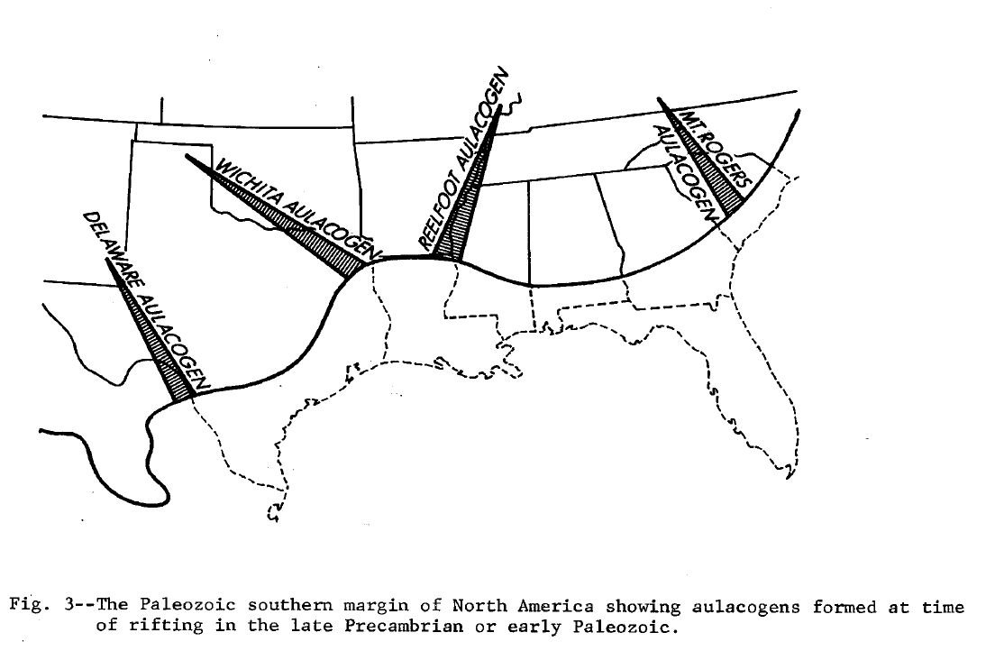
Commonly Interpreted Late Precambrian to Early Cambrian
Aulacogens of Southern and Eastern U.S.
From Walper, 1982

Slide 17
Commonly Interpreted Late Precambrian to Early Cambrian
Aulacogens of Southern and Eastern U.S.
No evidence of Late Precambrian to Early Cambrian Delaware Aulacogen.
However, 0.95 to 1.16 billion year old mafic intrusions beneath Central Basin Uplift
suggest mid Proterozoic intracratonic rifting at end of the Grenville orogeny,
making the rift much older, but not an aulacogen.
Abundant evidence of Late
Precambrian to Early Cambrian
Wichita Aulacogen –
thick Early Cambrian volcanics
and intrusives present in
Wichita-Amarillo Uplift (inversion
structure)
From Walper, 1982
(Walper’s model is intriguing, as it explains the great amount of subsidence within the Permian Basin; but hard evidence for a “Delaware Aulacogen” is lacking)

Slide 18
Phases of Deformation and Sedimentation in the Permian Basin
1
Mid Proterozoic (1.3 to ~1.0 bya) – Grenville Orogeny and Extensional Phase
Latest Precambrian to early Cambrian – Rifting south of ancestral Permian Basin (Tobosa Basin)
2
3
Late Cambrian to Early Ordovician – Initial marine transgression and Great American Carbonate Bank
4
Middle Ordovician to Late Mississippian – Tobosa Basin
Pennsylvanian to early Permian Active Margin/Orogenic Phase
5
6
Middle to late Permian Post-orogenic Rapid Subsidence / Sediment Loading Phase
7
Post – Permian Phase

Slide 19
Phases of Deformation and Sedimentation in the Permian Basin
1
Mid Proterozoic (1.3 to ~1.0 bya) – Grenville Orogeny and Extensional Phase
  Plate collision along southern and eastern North America
    Thrusting, accretion, and high-grade metamorphism (1.3 to 1.0 bya)
  Widespread extension and mafic intrusions at end of orogeny (1.16 to 0.95 bya)
    Mafic intrusions and probable rifting in location of future Central Basin Uplift
Latest Precambrian to early Cambrian – Rifting south of ancestral Permian Basin
  Rifting along southern and eastern U.S. forming a passive margin (breakup of Rodinia supercontinent)
  Permian Basin region was largely exposed
  No firm evidence of “Delaware Aulocogen”
2
3
Late Cambrian – Early Ordovician (Initial marine transgression, Great American Bank)
  Transgressive sand deposited around perimeter of future Tobosa Basin
  Central portion of Tobosa Basin and future Central Basin Uplift area exposed
  Initial subsidence of Tobosa Basin (yoked to Anadarko/Midcontinent); large shallow-water carb. bank
Early Ordovician to Late Mississippian (Tobosa Basin)
  Permian Basin is shallow water intracratonic basin. No evidence of rifting.
    Deposition of carbonates and some clastics
  Marathon Thrust Belt region at this is a deep water basin, probably in part on oceanic crust
    Deposition of clastics, micrite, and chert
    Thrusting begins in Mid-Mississippian
4

Slide 20
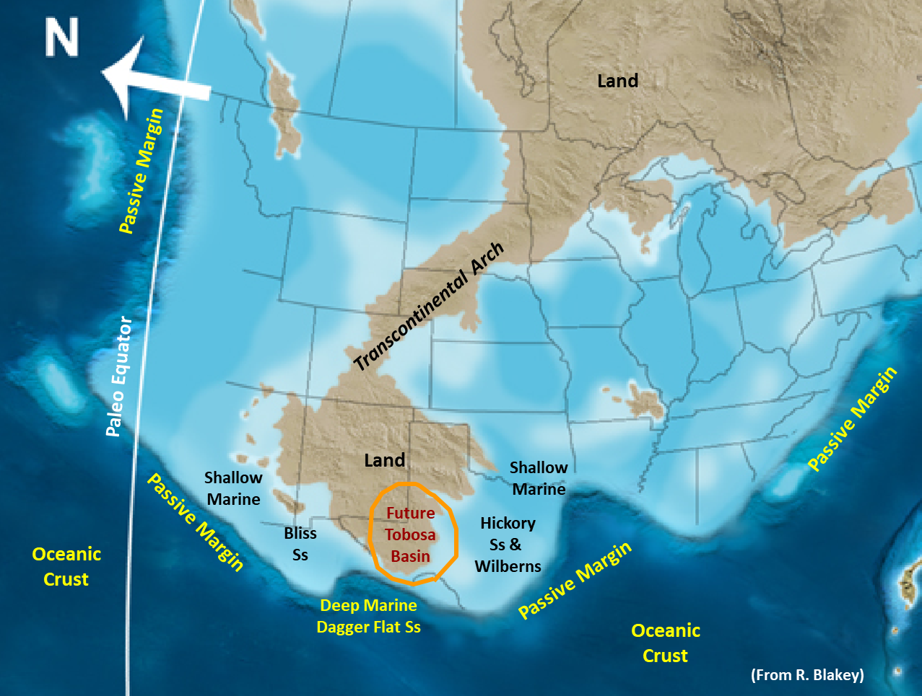
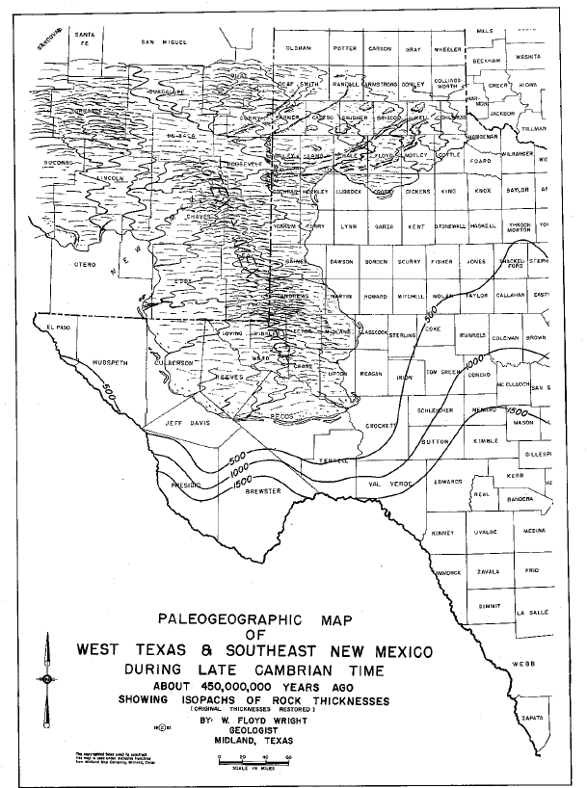
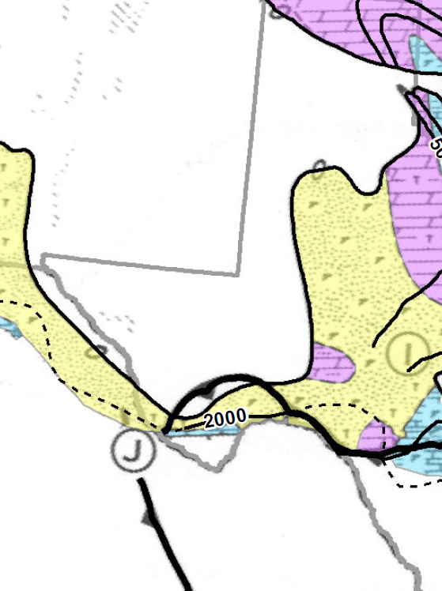
Late Cambrian: Basal transgressive sandstones
Land –
Exposed
Precambrian
Crystalline
Rocks
Outline of
future
Tobosa Basin
Land – Exposed
Precamb.
crystalline rocks
Shallow
Marine
Land –
Exposed
Precambrian
Crystalline
Rocks
Land –
Exposed
Precambrian
Crystalline
Rocks
Wilberns Fm &
Hickory Ss
Wilberns Fm &
Hickory Ss
Shallow
Marine
Shallow
Marine
Shallow
Marine
Shallow
Marine
Bliss
Ss
Bliss
Ss
Bliss
Ss
Outline of
future
Tobosa Basin
Deep Marine
Dagger Flat Ss
sandstone
Deep Marine
Dagger Flat Ss
limestone
dolomite
Cambrian Lithofacies
(From Shell Atlas, 1975)
(From Wright, 1979)

Slide 21
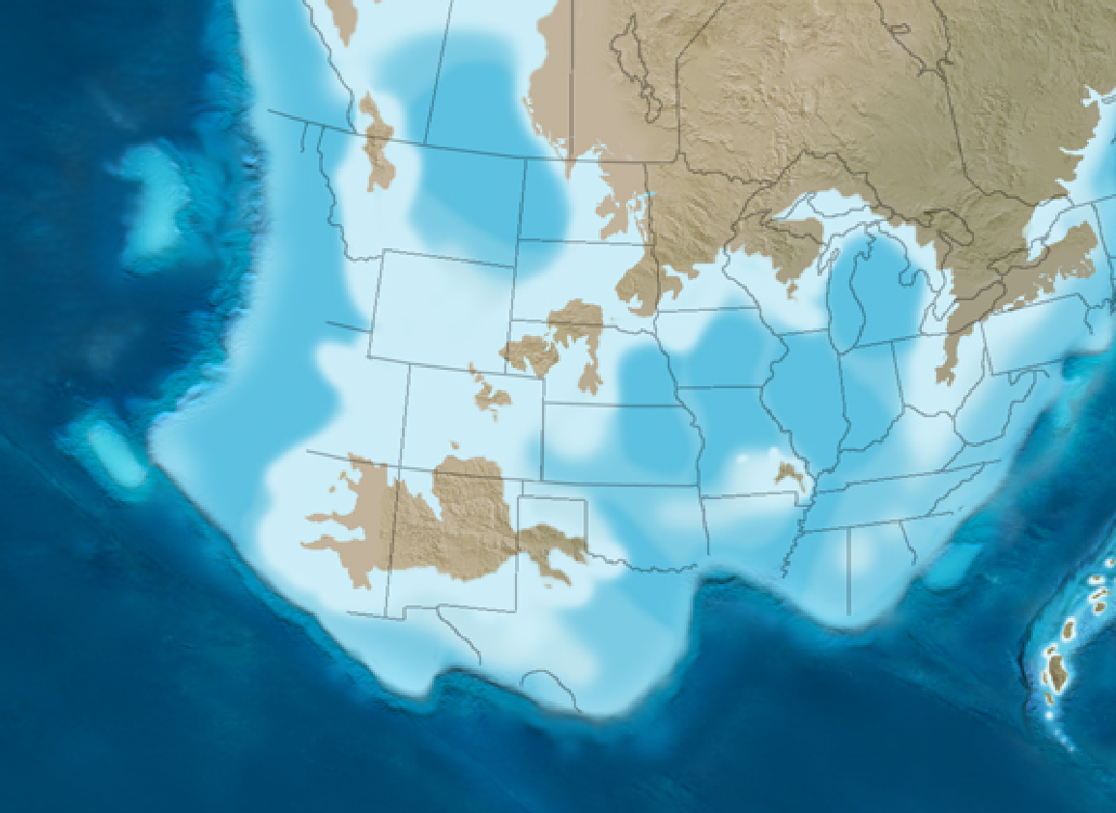
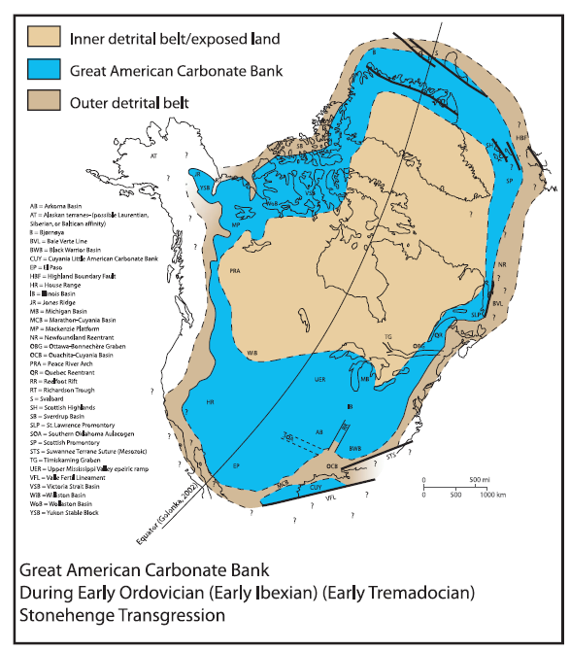
Early Ordovician paleogeography: The Great American Carbonate Bank
Much of N. Amer. covered by a shallow marine sea; widespread shallow marine carbonate deposition (Great American Carbonate Bank)
Land
Future Tobosa Basin located in tropics, a few degrees south of the paleoequator
Passive Margin
Extensive tidal flats developed proximal to land
Equator
Transcontinental Arch
Passive Margin
North Amer.
craton
Land
Shallow
Marine
Passive Margin
Shallow
Marine
Ellenburger
Carbonate
Ouachita
Embayment
Ellenburger
Carbonate
Tobosa
Basin
Oceanic
Crust
Passive Margin
Marathon
Embayment
Deep Marine
Marathon Ls
Oceanic
Crust
(modified from R. Blakey)
(Derby et el., 2012)

Slide 22
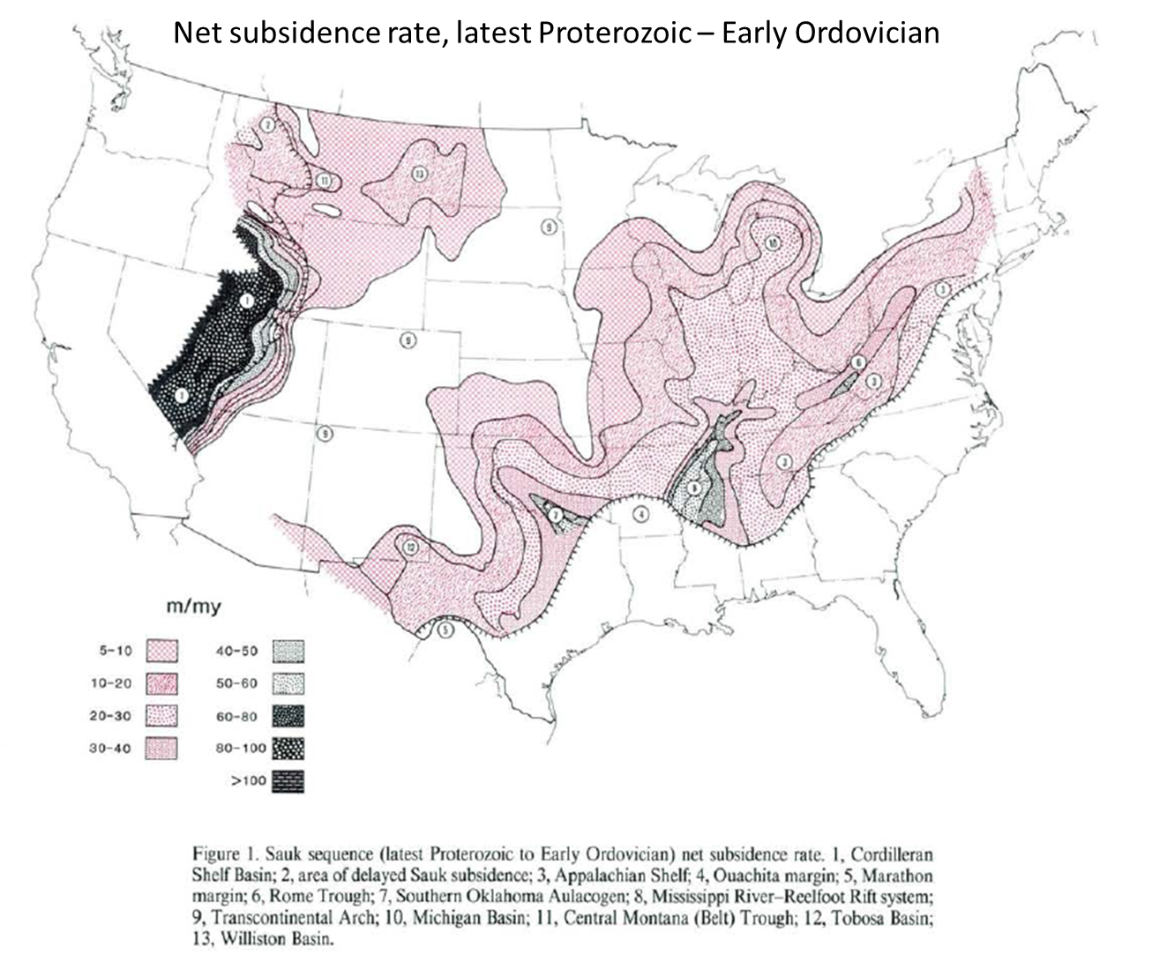
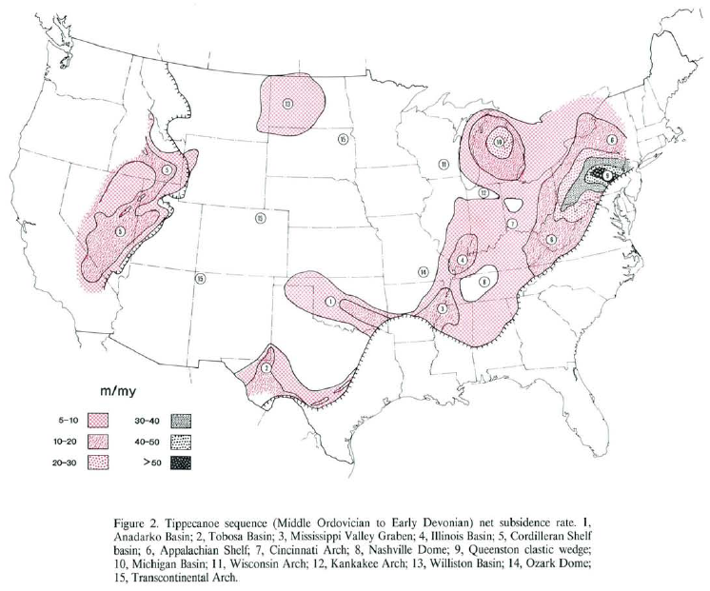
Net subsidence rate, Middle Ordovician – Early Devonian
Transcontinental Arch
Transcontinental Arch
Texas Arch
Structural isolation of Tobosa Basin
West Texas region yoked to Anadarko/Illinois/Mich basins
West Texas region an isolated region of subsidence
(Tobosa Basin)
(Sloss, 1988)

Slide 23
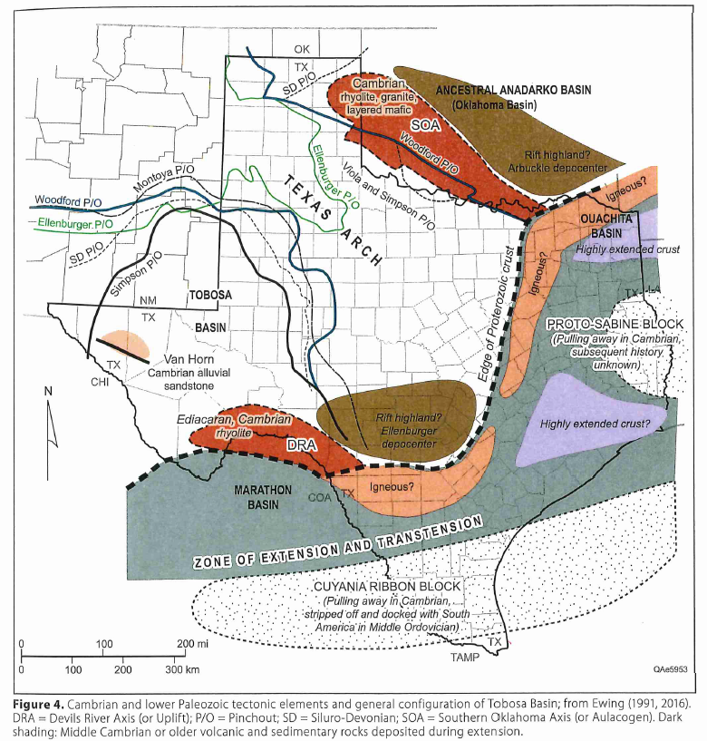
Lower Paleozoic
(Mid Ord. – Mississippian) tectonic elements of Texas
(after Ewing, 2019)
Tobosa Basin in west Texas is now a distinct area of subsidence
Ft. Worth basin
Lowlands (Texas Arch) to the immediate east; Ft. Worth Basin farther east

Slide 24
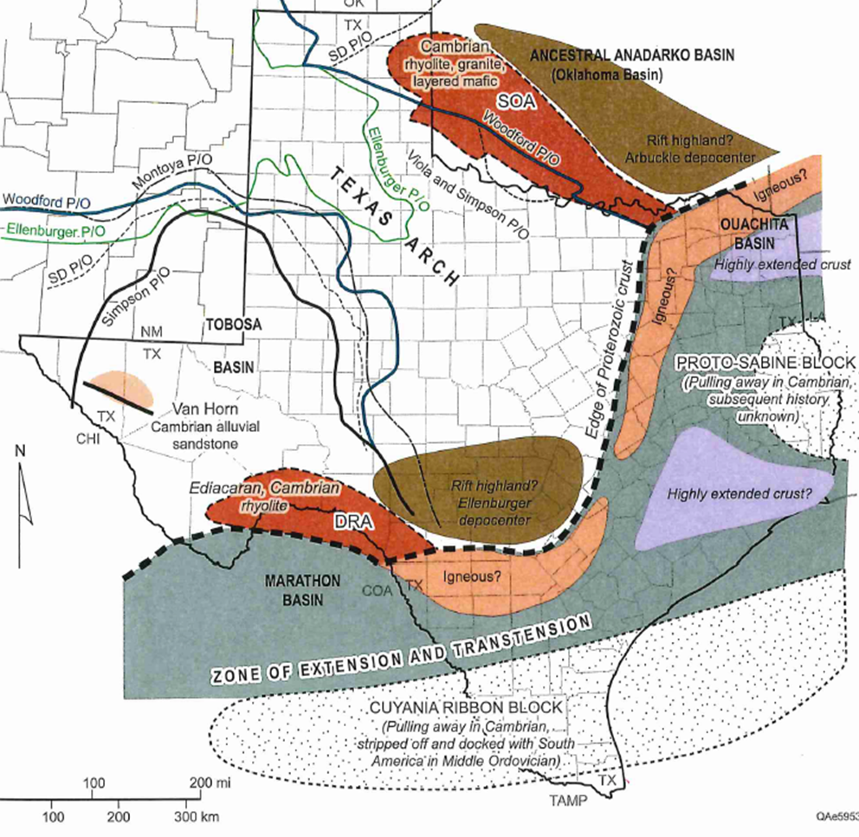
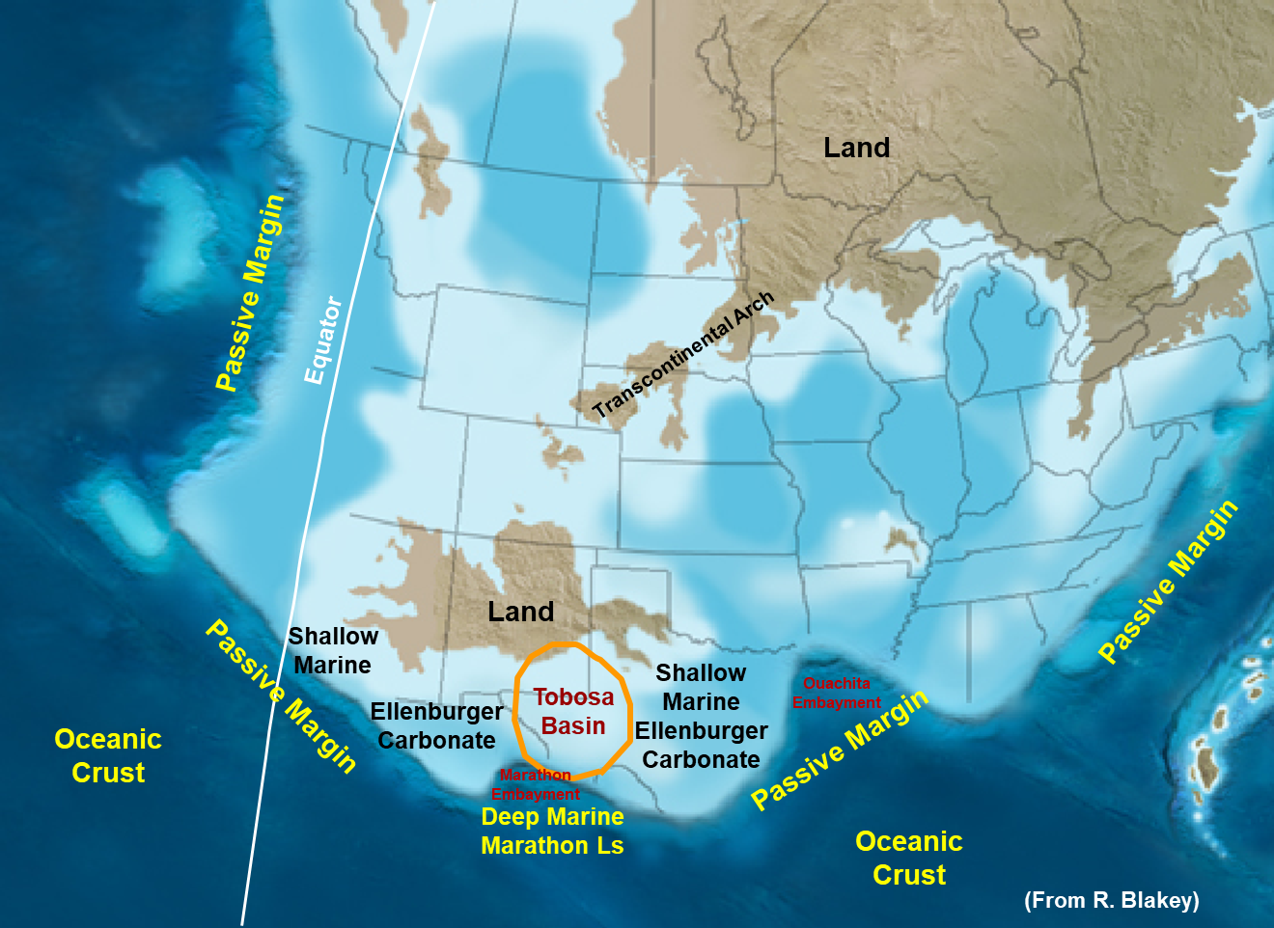
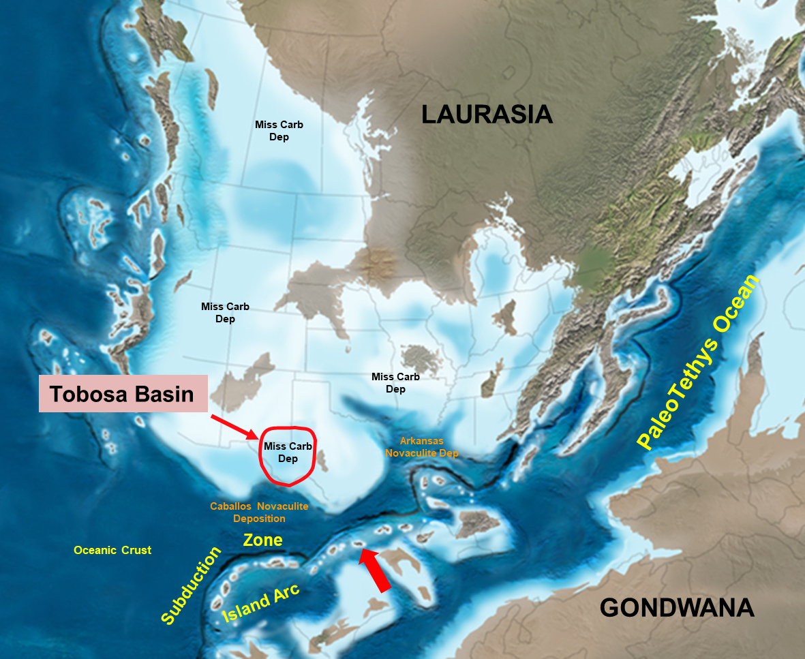
Tobosa Basin: An Early Ordovician through Mississippian intracratonic depression / long-lived passive margin
+ 150 million years in duration
(modified from Tim Reed Mobil Oil, 1989, unpublished)
SW
NE
300 km / 185 mi
+2000
+2000
sea level
0
0
-2000
MIDDLE ORDOVICIAN - MISSISSIPPIAN
-2000
Depth (ft.)
-4000
(ELLENBURGER)
-4000
-6000
LOWER ORDOVICIAN
-6000
-8000
PRECAMBRIAN BASEMENT
-8000
Early Ordovician
Early Mississippian
line of
x-section

Slide 25
Permian Basin Stratigraphy and Tectonic History
Ma
System
Series
Delaware Basin
CBP & NW Shelf
Midland Basin
Tectonic Phase
252
Formations
Formations
Formations
final basin fill/termination
Dewey Lake
Dewey Lake
Dewey Lake
Ochoan
Rustler
Rustler
Rustler
Salado
Salado
Salado
Castile
Lamar
Tansill
Tansill
Post Orogenic Loading Rapid Subsidence;
Onset of HC Generation
Bell Canyon
Capitan
Yates
Yates
Guadalupian
Delaware Mtn
Group
Seven Rivers
Seven Rivers
Permian
Cherry Canyon
Goat
Seep
Queen
Queen
Grayburg
Grayburg
Brushy Canyon
Upper San Andres
San Andres
Cutoff Member /
1st Carb / Avalon
Lower San Andres
Clear-
fork
Holt /Upper Leonard
( ~ 50 million yrs. duration )
Active Margin
Lwr San Andres
Holt / Upr Leonard
PERMIAN BASIN PHASE
Bone
Spring
1st Sand
Glorieta
Upper
Leonardian
2nd Carb
Upper Clearfork
Spraberry
Middle
2nd Sand
Yeso /
Clearfork
Middle Clearfork
Lwr
Jo Mill
3rd Carb
Stray Sd
Dean
L. SPBY Sh
3rd Sand
Tubb
Lower Clearfork
Wolfcamp A
Wolfcamp
Wolfcamp
Wichita / Abo
Wolfcamp
Wolfcamp B
mid – Wolfcamp unconformity
299
Wolfcampian
Wolfcamp C1
Virgilian
Cisco
Cisco
Cisco
Wolfcamp C2
Early WFMP Event
Missourian
Canyon
Canyon
Canyon
Wolfcamp D
Penn. – Early Permian
Foreland Deformation
Pennsylvanian
Desmoinesian
Strawn
Lime
Strawn
Lime
Strawn
Lime
Detrital
Detrital
Detrital
Strawn Event
Bend Lm
(~ 30 million yrs.
duration)
“The Big Transition”
Atokan
Atoka
Atoka
Atoka
Sh & Detrital
Atokan Event
323
Morrowan
Morrow
Morrow (NW Shelf Only)
Morrow
Morrow Event
Chesterian
Barnett
U. Miss Lm
L. Barnett
U. Barnett
U. Miss Lm
L. Barnett
U. Barnett
Mississippian
Meramecian –
Osagean
L. Miss Lm
L. Miss Lm
L. Miss Lm
359
Kinderhookian
Woodford
Woodford
Woodford
Tobosa Basin
(Middle Ordovician to
Late Mississippian)
Moderate Subsidence
Devonian
Upper
Middle
TOBOSA BASIN PHASE
419
Lower
Devonian (Thirtyone)
Devonian (Thirtyone)
Devonian (Thirtyone)
Silurian
U. Niagaran
Upper Silurian (Wristen)
Upper Silurian (Wristen)
Upper Silurian (Wristen)
L. Niagaran
Fusselman
Fusselman
Fusselman
(~ 150 million yrs. duration)
Passive Margin
444
Alexandrian
Montoya
Montoya
Sylvan Sh.
Cincinnatian
Montoya
Mohawkian
Tulip Crk.
Bromide
Tulip Crk.
Bromide
Tulip Crk.
Bromide
Simpson
Mclish
McKee Sd.
Simpson
Mclish
McKee Sd.
Simpson
Mclish
McKee Sd.
Ordovician
Chazyan
Oil Creek
Waddell Sd.
Oil Creek
Waddell Sd.
Oil Creek
Waddell Sd.
Joins
Connell Sd.
Joins
Connell Sd.
Joins
Connell Sd.
Canadian
Ellenburger
Ellenburger
Ellenburger
Great American Carbonate Bank
485
Ozarkian
(Late Cambrian – Early Ordovician)
Cambrian
Upper
Bliss
Absent
Wilberns
541
Bliss / Hickory / Riley
Precambrian
Basement
Precambrian
Basement
Precambrian
Basement
Basement assembly and breakup of
Rodina supercontinent
Precambrian
(Reed and Waite, 2016)
Grenville Orogeny (1.3 to 1.0 bya)

Slide 26
Phases of Deformation and Sedimentation in the Permian Basin
1
Mid Proterozoic (1.3 to ~1.0 bya) – Grenville Orogeny and Extensional Phase
Latest Precambrian to early Cambrian – Rifting south of ancestral Permian Basin (Tobosa Basin)
2
3
Late Cambrian to Early Ordovician – Initial marine transgression and Great American Carbonate Bank
4
Middle Ordovician to Late Mississippian – Tobosa Basin
Pennsylvanian to early Permian Active Margin/Orogenic Phase
5
6
Middle to late Permian Post-orogenic Rapid Subsidence / Sediment Loading Phase
7
Post – Permian Phase

Slide 27
Phases of Deformation and Sedimentation in the Permian Basin
1
Mid Proterozoic (1.3 to ~1.0 bya) – Grenville Orogeny and Extensional Phase
Latest Precambrian to early Cambrian – Rifting south of ancestral Permian Basin (Tobosa Basin)
2
3
Late Cambrian to Early Ordovician – Initial marine transgression and Great American Carbonate Bank
Early Ordovician to Late Mississippian – Tobosa Basin
4
Pennsylvanian to early Permian Active Margin/Orogenic Phase
  Two initial orogenic pulses (Early Penn. -- Morrowan to mid Atokan and late Atokan )
  First tectonic quiescence phase (Early Penn. – latest Atokan to early Desmoinesian)
  Third orogenic pulse (Early Penn. – early Desmoinesian)
  Second tectonic quiescence phase (mid Desmoinesian to early Permian)
  Fourth orogenic pulse (early Permian – Wolfcampian)
5
4 tectonic pulses
2 periods of quiescence

Slide 28
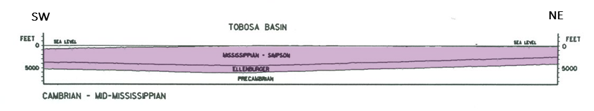
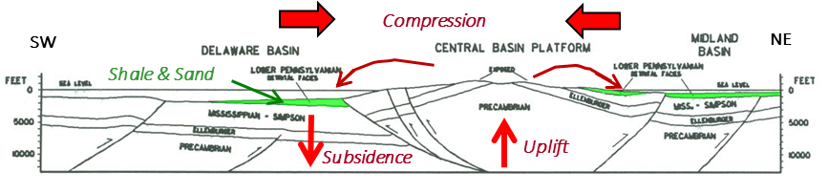
Schematic diagrams illustrating structural evolution of the Permian Basin
Early Ordovician through Mississippian: 500 – 318 mya)
Intracratonic Basin Phase –
Formation of Tobosa Basin
(Early Ordovician through Mississippian)
Broad, bowl-shaped sag
Dominated by shallow water platform carbonate
  deposition with periodic sand and shale input
Early Pennsylvanian (Morrowan to Earliest Desmoinesian: 318 – 308 mya)
Initial Orogenic Phases –
(Early Pennsylvanian – Morrowan
To Earliest Desmoinesian)
Orogenic pulses
Morrow – mid Atoka
Initial phases of uplift due to NE-SW compression
  Erosion of Central Basin Uplift & Pennsylvanian detrital deposition
  Carbonate deposition during intermittent periods of minimal compression
  (tectonic quiescence)
Late Atoka
Early Penn (Strawn detrital)
(Tim Reed, 1989, unpublished)

Slide 29
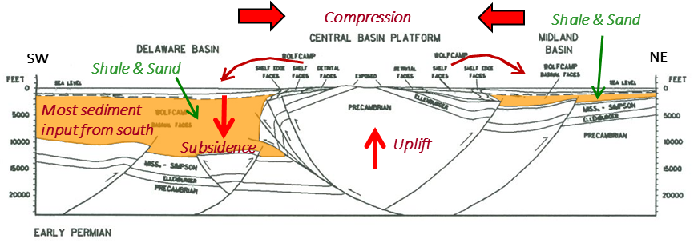
Schematic diagrams illustrating structural evolution of the Permian Basin (continued)
Early Permian (Early Wolfcampian): 299 – 295 mya
Final Orogenic Phase –
(Early Permian -- Early Wolfcampian)
Renewed uplift due to NE-SW compression
  Erosion of Central Basin Uplift
  Clastic input into basins from Marathon / Ouachita Thrust Belt
  and Central Basin Uplift
  Development of mid-Wolfcamp unconformity
  (final large orogenic movement)
(Reed, 1989, unpublished)

Slide 30
Phases of Deformation and Sedimentation in the Permian Basin
1
Mid Proterozoic (1.3 to ~1.0 bya) – Grenville Orogeny and Extensional Phase
Latest Precambrian to early Cambrian – Rifting south of ancestral Permian Basin (Tobosa Basin)
2
3
Late Cambrian – Initial marine transgression
4
Early Ordovician to Late Mississippian – Tobosa Basin
Pennsylvanian to early Permian Active Margin/Orogenic Phase
5
6
Middle to late Permian Post-orogenic Rapid Subsidence / Sediment Loading Phase
7
Post – Permian Phase

Slide 31
Permian Basin Stratigraphy and Tectonic History
Ma
System
Series
Delaware Basin
CBP & NW Shelf
Midland Basin
Tectonic Phase
252
Formations
Formations
Formations
final basin fill/termination
Dewey Lake
Dewey Lake
Dewey Lake
Ochoan
Rustler
Rustler
Rustler
Salado
Salado
Salado
Castile
Lamar
Tansill
Tansill
Post Orogenic Loading Rapid Subsidence;
Onset of HC Generation
Bell Canyon
Capitan
Yates
Yates
Guadalupian
Delaware Mtn
Group
Seven Rivers
Seven Rivers
Permian
Cherry Canyon
Goat
Seep
Queen
Queen
Grayburg
Grayburg
Brushy Canyon
Upper San Andres
San Andres
Cutoff Member /
1st Carb / Avalon
Lower San Andres
Clear-
fork
Holt /Upper Leonard
( ~ 50 million yrs. duration )
Active Margin
Lwr San Andres
Holt / Upr Leonard
PERMIAN BASIN PHASE
Bone
Spring
1st Sand
Glorieta
Upper
Leonardian
2nd Carb
Upper Clearfork
Spraberry
Middle
2nd Sand
Yeso /
Clearfork
Middle Clearfork
Lwr
Jo Mill
3rd Carb
Stray Sd
Dean
L. SPBY Sh
3rd Sand
Tubb
Lower Clearfork
Wolfcamp A
Wolfcamp
Wolfcamp
Wichita / Abo
Wolfcamp
Wolfcamp B
mid – Wolfcamp unconformity
299
Wolfcampian
Wolfcamp C1
Virgilian
Cisco
Cisco
Cisco
Wolfcamp C2
Early WFMP Event
Missourian
Canyon
Canyon
Canyon
Wolfcamp D
Penn. – Early Permian
Foreland Deformation
Pennsylvanian
Desmoinesian
Strawn
Lime
Strawn
Lime
Strawn
Lime
Detrital
Detrital
Detrital
Strawn Event
Bend Lm
(~ 30 million yrs.
duration)
Atokan
Atoka
Atoka
Atoka
Sh & Detrital
Atokan Event
323
Morrowan
Morrow
Morrow (NW Shelf Only)
Morrow
Morrow Event
Chesterian
Barnett
U. Miss Lm
L. Barnett
U. Barnett
U. Miss Lm
L. Barnett
U. Barnett
Mississippian
Meramecian –
Osagean
L. Miss Lm
L. Miss Lm
L. Miss Lm
359
Kinderhookian
Woodford
Woodford
Woodford
Tobosa Basin
(Middle Ordovician to
Late Mississippian)
Moderate Subsidence
Devonian
Upper
Middle
TOBOSA BASIN PHASE
419
Lower
Devonian (Thirtyone)
Devonian (Thirtyone)
Devonian (Thirtyone)
Silurian
U. Niagaran
Upper Silurian (Wristen)
Upper Silurian (Wristen)
Upper Silurian (Wristen)
L. Niagaran
Fusselman
Fusselman
Fusselman
(~ 150 million yrs. duration)
Passive Margin
444
Alexandrian
Montoya
Montoya
Sylvan Sh.
Cincinnatian
Montoya
Mohawkian
Tulip Crk.
Bromide
Tulip Crk.
Bromide
Tulip Crk.
Bromide
Simpson
Mclish
McKee Sd.
Simpson
Mclish
McKee Sd.
Simpson
Mclish
McKee Sd.
Ordovician
Chazyan
Oil Creek
Waddell Sd.
Oil Creek
Waddell Sd.
Oil Creek
Waddell Sd.
Joins
Connell Sd.
Joins
Connell Sd.
Joins
Connell Sd.
Canadian
Ellenburger
Ellenburger
Ellenburger
Great American Carbonate Bank
485
Ozarkian
(Late Cambrian – Early Ordovician)
Cambrian
Upper
Bliss
Absent
Wilberns
541
Bliss / Hickory / Riley
Precambrian
Basement
Precambrian
Basement
Precambrian
Basement
Basement assembly and breakup of
Rodina supercontinent
Precambrian
(Reed and Waite, 2016)
Grenville Orogeny (1.3 to 1.0 bya)

Slide 32
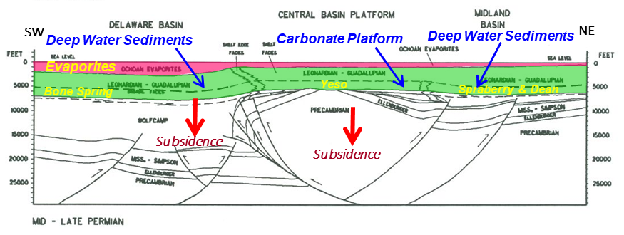
Tectonic Quiescence and Continued Regional Subsidence –
(latest early Permian to late Permian -- Early Leonardian to Ochoan)
Mid to Late Permian (284 – 254 mya)
Alternating periods of carbonate and clastic deposition due to sea level fluctuations
  Carbonate platforms on former uplifts and deep water sediments in basins
  Middle Permian: Midland Basin fills with sediment and becomes evaporitic basin with periodic clastic input
  Late Permian: Delaware Basin fills with evaporites (evaporitic deposition across entire basin)
Question: what caused the post-tectonic subsidence ?
(Reed, 1989, unpublished)

Slide 33
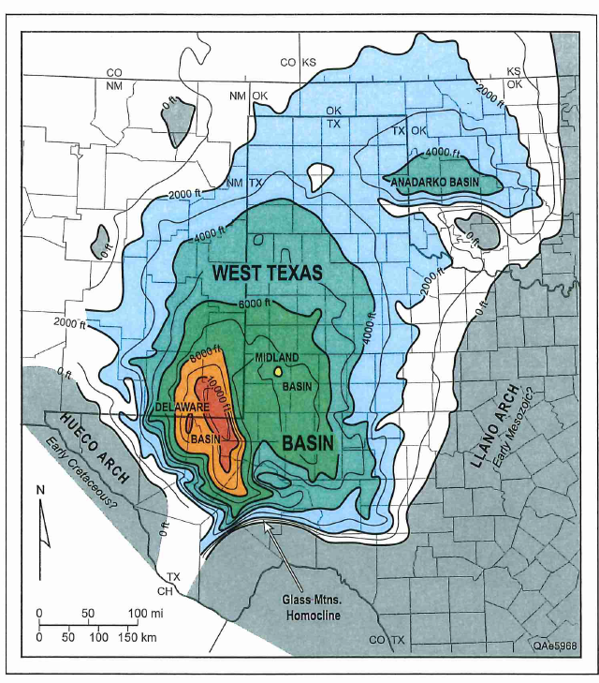
Isopach map of post-Wolfcampian Permian strata (from Ewing, 2019)
Why was there so much subsidence after the main phases of tectonism?
Ewing’s explanation: intracratonic basin subsidence
Alternative mechanism: mantle-based dynamic topography ?

Slide 34
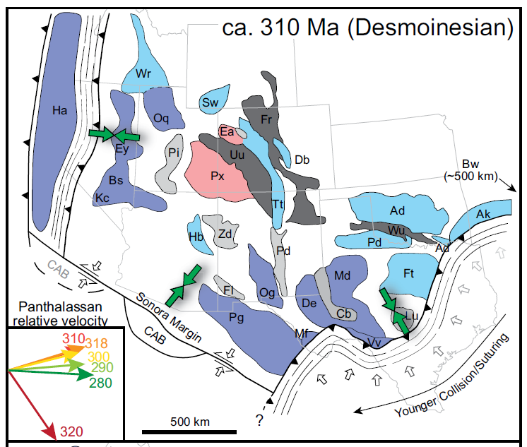
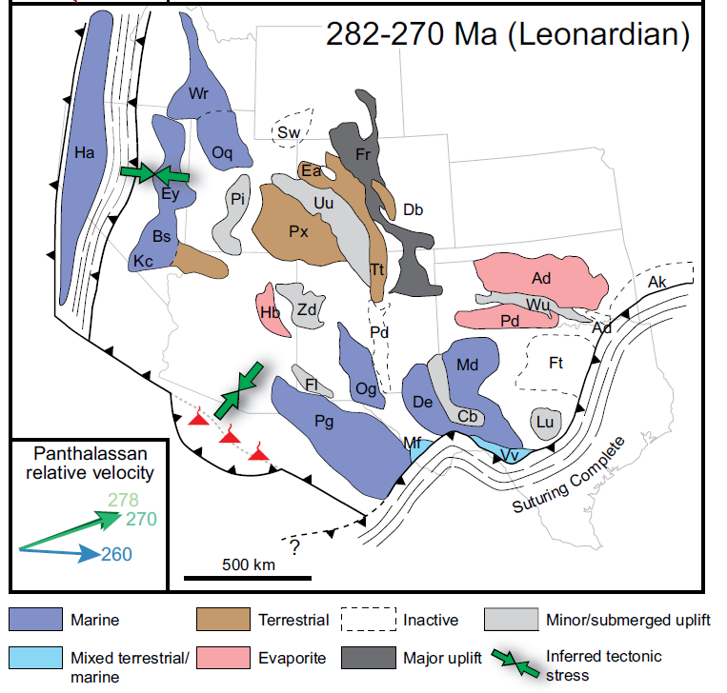
One possibility: Dynamic topography due to flat-slab subduction
(Leary et al., 2017)

Slide 35
Flat Slab Subduction – Before, During, and After
Accretionary
Prism
Volcanic
Arc
Subduction
Zone
Oceanic Lithosphere
Continental Lithosphere
Before Flat Slab Subduction – Oceanic plate subducts at a normal angle
Accretionary
Prism
Compressional Basement Uplifts and Foreland Basins
Subduction
Zone
Continental Lithosphere
Oceanic Lithosphere
During Flat Slab Subduction – Continental plate may increase its convergence rate,
causing it to override the oceanic plate and produce flat slab subduction. Traction between
plates produces compressive stress in continental plate and compressional basement uplifts form.
Accretionary
Prism
Regional Subsidence of Inactive
Basement Uplifts and Foreland Basins
Subduction
Zone
Continental Lithosphere
Oceanic Lithosphere
Mantle flows
into widening
gap between
plates
After Flat Slab Subduction – Oceanic plate begins to sink and returns to a
normal subduction angle. Mantle material flows into the widening gap between the plates. If
the oceanic plate sinks rapidly, and the mantle material can’t flow into the gap quickly enough,
then the continental plate would sink to fill the gap, causing both basins and uplifts to subside.

Slide 36
Phases of Deformation and Sedimentation in the Permian Basin
1
Mid Proterozoic (1.3 to ~1.0 bya) – Grenville Orogeny and Extensional Phase
Latest Precambrian to early Cambrian – Rifting south of ancestral Permian Basin (Tobosa Basin)
2
3
Late Cambrian – Initial marine transgression
4
Early Ordovician to Late Mississippian – Tobosa Basin
Pennsylvanian to early Permian Active Margin/Orogenic Phase
5
6
Middle to late Permian Post-orogenic Rapid Subsidence / Sediment Loading Phase
7
Post – Permian Phase

Slide 37
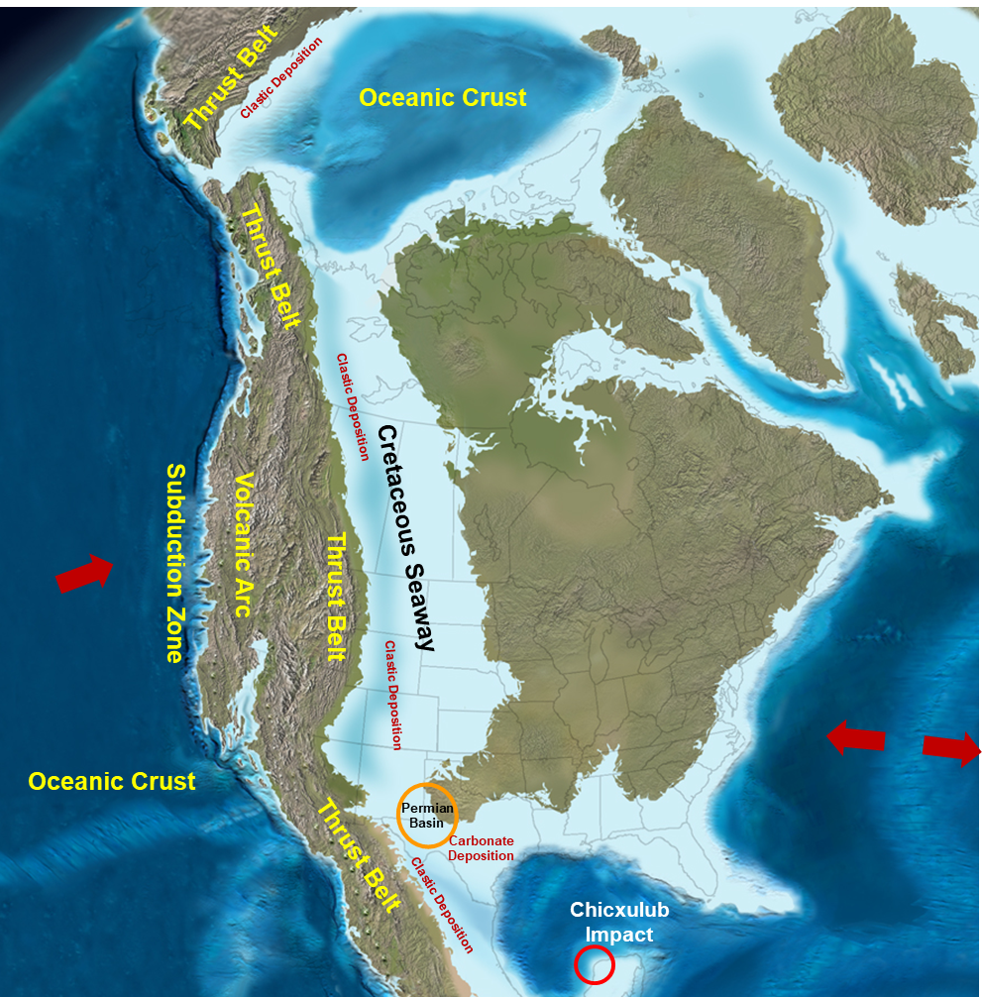
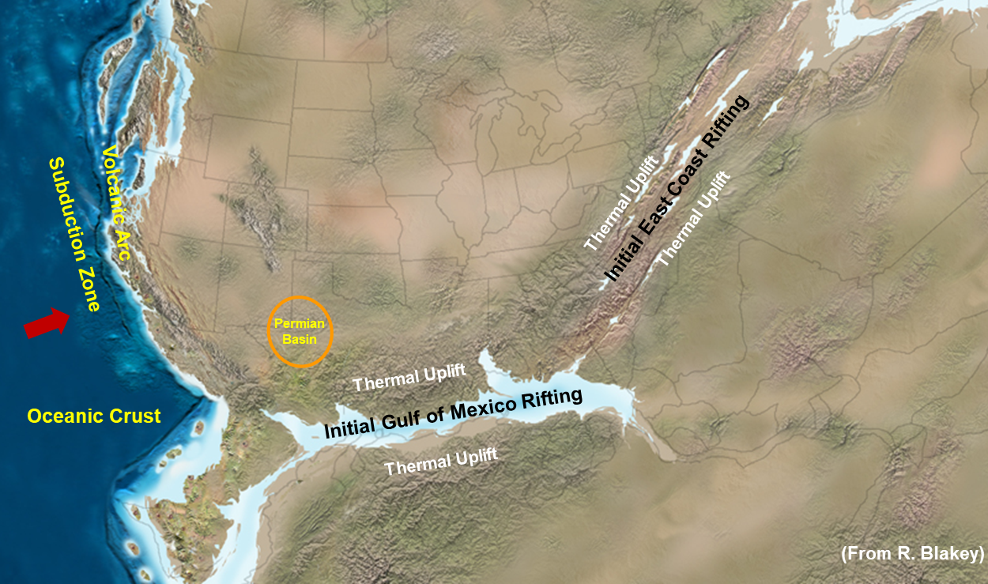
Permian Basin Foreland Cenozoic & Mesozoic Stratigraphic Columns & Tectonic Events
Late Cretaceous
Erathem
System
Series & Stages
Permian Basin
Cenozoic and Mesozoic Tectonic Events
Quaternary
Pleistocene & Holocene
Formations
Pliocene
Ogallala
Basin & Range
Extension
In Westernmost
Permian Basin
Regional Uplift Of Permian Basin Due To Thermal Uplift Associated With Basin And Range Extension West Of
Permian Basin
Neogene
Miocene
Cenozoic
Oligocene
Various Local
Intrusives and
Volcanics
Paleogene
Eocene
Laramide Compression – Reactivation Of
Some Late Paleozoic Faults
Paleocene
Maastrichtian
Late
Campanian
Santonian
Coniacian
Turonian
Inundation By Cretaceous Seaway
Cenomanian
Cretaceous
Albian
Fredericksburg
Edwards
Paluxy
Comanche Peak
Early
Aptian
Barremian
Hauterivian
Valanginian
Mesozoic
Berriasian
Tithonian
Late Triassic
Late
Kimmeridgian
Oxfordian
Regional Uplift Of Permian Basin Due To Thermal Uplift Associated With Late
Stage GOM Rifting And Initiation Of GOM Spreading
Callovian
MIddle
Bathonian
Jurassic
Bajocian
Aalenian
Toarcian
Early
Pliensbachian
Sinemurian
Rifting In Gulf of Mexico (GOM)
Hettangian
Rhaetian
Late
Norian
Cooper Canyon
Dockum /
Chinle
Group
Trujillo
Triassic sedimentation derived from uplift south of Permian Basin associated with initial stages of Gulf of Mexico rifting
Triassic
Carnian
Tecovas
Ladinian
Santa Rosa
Middle
Anisian
E.
Scythian
Dewey Lake

Slide 38
Burial History: Midland Basin center 1D model
Structural traps
Age (Ma)
depth
(x1000 ft)
600
500
400
300
200
100
0
Proterozoic
Carb.
Permian
Eoc.
Camb.
Ord.
Sil.
Devonian
Triassic
Jurassic
Cretaceous
P
O
Mi.
L. Ord (Ellenburger)
Woodford
Cretaceous
+2
Atoka
Triassic
0
Upper Permian
-2
1
2
San Andres
-4
Clearfork
-6
Spraberry
Wolfcamp Shale
-8
1
Atoka
-10
Tobosa Basin phase (passive margin)
Woodford
Avg. subsidence = 3.2m / m.y.
L. Ord (Ellenburger)
-12
3
2
Penn. - E. Perm. (Wolfc.) deformation phase
Pangean uplift /
emergence
Late K
burial
Laramide,
Basin & Range
uplift
-14
Avg. subsidence = 17.1m / m.y.
3
E. to M. Perm. (Leon.-Guad.) loading phase
Onset of
major oil
generation
Max. burial;
2nd oil gen.
pulse
Avg. subsidence = 116 m / m.y.

Slide 39
Burial History: Midland Basin center 1D model
Structural traps
Age (Ma)
depth
(x1000 ft)
600
500
400
300
200
100
0
Proterozoic
Carb.
Permian
Eoc.
Camb.
Ord.
Sil.
Devonian
Triassic
Jurassic
Cretaceous
P
O
Mi.
L. Ord (Ellenburger)
Woodford
Cretaceous
+2
Atoka
Triassic
0
Upper Permian
-2
1
2
San Andres
-4
Clearfork
-6
Spraberry
Wolfcamp Shale
-8
1
Atoka
-10
Tobosa Basin phase (passive margin)
Woodford
Avg. subsidence = 3.2m / m.y.
L. Ord (Ellenburger)
-12
3
2
Penn. - E. Perm. (Wolfc.) deformation phase
Pangean uplift /
emergence
Late K
burial
Laramide,
Basin & Range
uplift
-14
Avg. subsidence = 17.1m / m.y.
3
E. Perm. (Leon.) - Late Perm loading phase
Onset of
major oil
generation
Max. burial;
2nd oil gen.
pulse
Avg. subsidence = 116 m / m.y.

Slide 40
Impact of Tectonic Uplift on Hydrocarbon Accumulations
Studies of uplifted areas have shown that uplift of previously trapped oil and gas
accumulations results in dissipation and loss of those hydrocarbons. With only
1500 m (~4900 ft) of uplift, most hydrocarbons can be lost from a trap, depending on
seal strength.
Impact of uplift:
  Hydrocarbon generation shuts down in kitchens.
  Uplift may distort original trap and induce remigration.
  Uplift results in erosion, diminishing overburden pressure. With less
  overburden pressure, the original reservoir pressure can exceed the strength
  of the seal, causing it to fracture and hydrocarbons escape (blown seal)
  If seal integrity is largely maintained, then less overburden pressure can
  reduce reservoir pressure below bubble point, causing gas to come out of
  solution and cause gas cap expansion in the reservoir, which forces liquid
  hydrocarbons beyond the spill point. This can result in gas-only
  accumulations or highly variable GOR’s across an area
  For uplifted source rocks, low permeability may allow them to retain
  hydrocarbons, but subject to pressure reduction and solution gas expansion, resulting in
  low or erratic pressure and variable GOR’s
(list from Tim Reed, Pioneer)

Slide 41
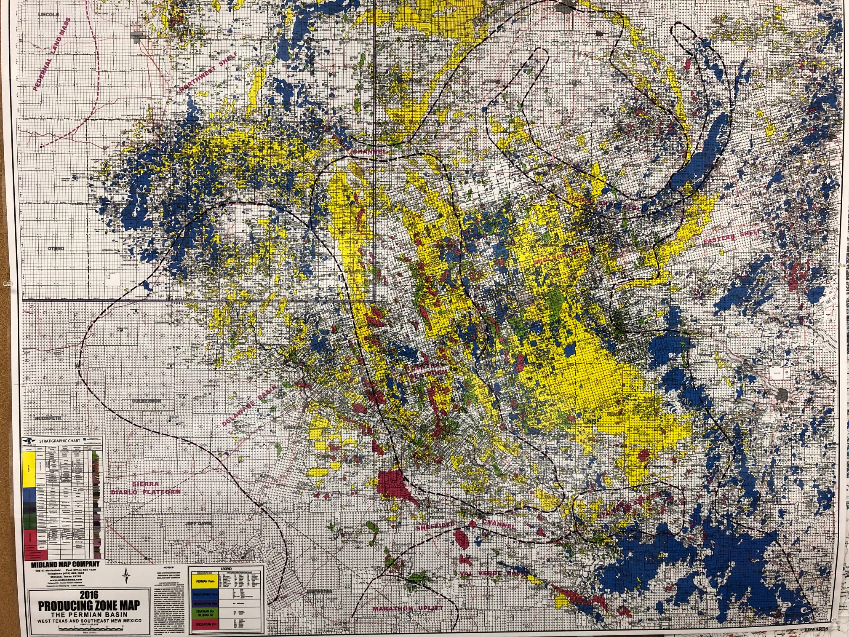
Consequences of too much tectonic uplift on a major petroleum basin
> 1500 m uplift
30 mi
(Midland Map Co.)

Slide 42
Permian Basin tectonic history: Key takeaways
The Permian Basin evolved throughout Paleozoic time from a relatively simple, bowl-shaped depression (Tobosa Basin) to a complex series of deep basins (Delaware, Midland basins and surrounding shallow shelves) separated by a significant basement uplift (Central Basin Platform)
This evolution corresponds with changeover from a passive to a tectonically-active margin; seven phases of deformation / sedimentation
A significant amount of post-tectonic subsidence occurred during Permian time (enigmatic)
The amount of tectonic uplift during the Late Cretaceous and Cenozoic greatly impacted the petroleum systems in the western portion of the basin

Slide 43
End of Part 1
UTD Permian Basin Research Lab website
https://labs.utdallass.edu/permianbasinresearch
Part 2 (next time)
Google/Bing “Permian Basin Research Lab”
Regional topics:
Ancestral Rockies System
Central Basin Uplift
Ouachita - Marathon Fold and Thrust Belt
Tectonic history of the Permian Basin: Summary
Lowell.waite@UTDallas.edu
mobile: 469-583-3546

