Slide 1
Progress from Analytic to Global Perception of Modulations with Increased Familiarity with Music
W. Jay Dowling
Music Perception and Cognition Laboratory (MPaC)
The University of Texas at Dallas

Slide 2
Tonal Hierarchy
Provides a framework for encoding the pitches of a melody
Selects 5-7 pitches out of the 12 semitones to form a “scale”
Establishes a tonal center – “tonic” pitch – and a hierarchical pattern of importance of the other pitches
This can be seen in tonal profiles that describe the hierarchies in different keys.

Slide 3
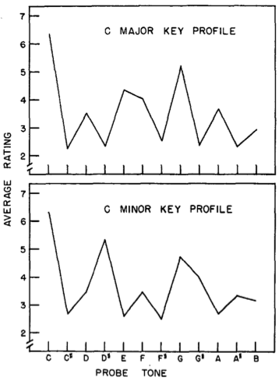
Two Western Tonal Hierarchies
Krumhansl & Kessler (1982)
Key profiles
Notice “in-scale” vs. “out-of-scale” pitches
RATING
PROBE TONE

Slide 4
Melody and the Tonal Hierarchy
The tonal hierarchy defines a set of expectancies
Expectancies guided by general, “schematic” knowledge of the tonal system, and “veridical” knowledge of particular melodies (Bharucha)
For example, out-of-key pitches in Schubert’s Ave Maria – note that they sound perfectly natural in a well-known melody
Increasing familiarity with a piece develops expectancies such that formerly surprising events begin to sound “natural” – and so are no longer sharply differentiated from their context

Slide 5
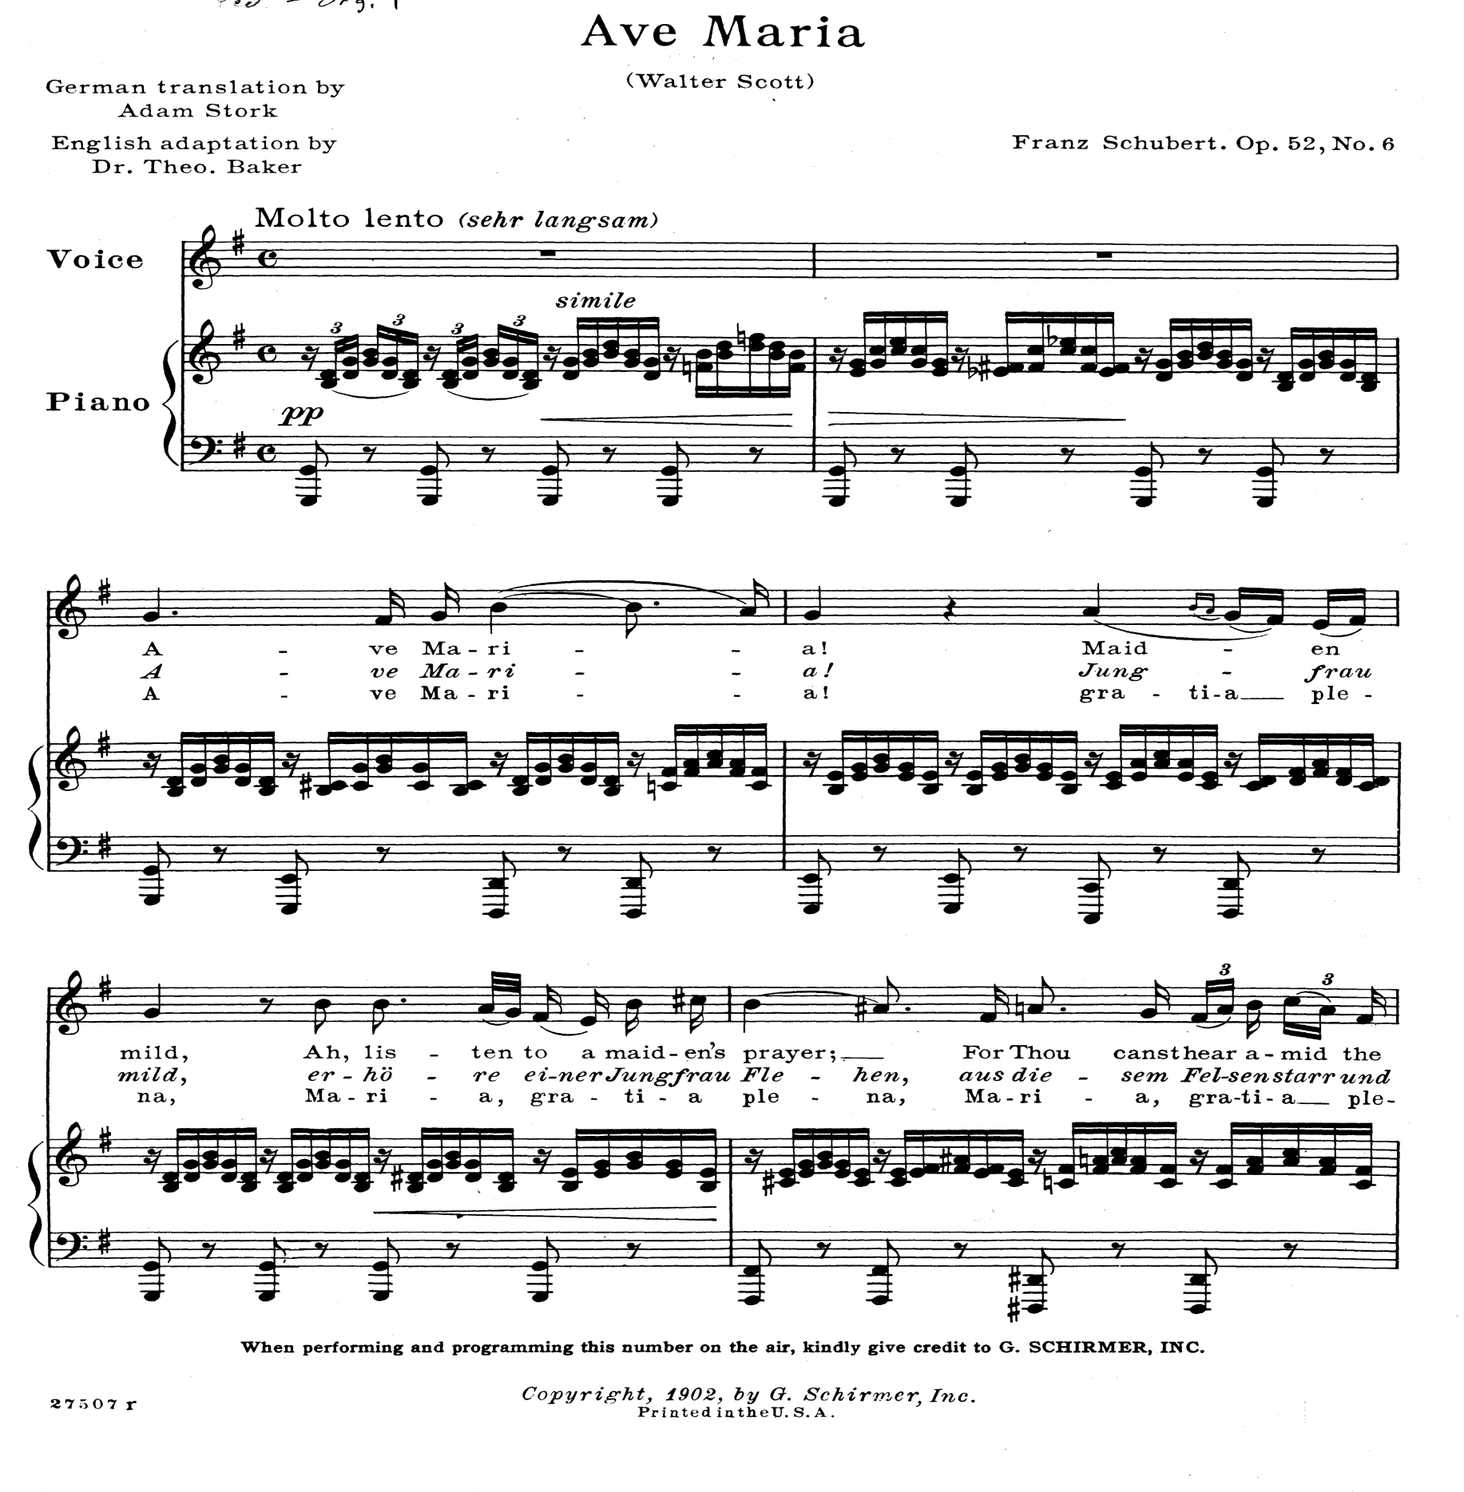

Slide 6
Modulation
Modulation from one “key” to another involves replacing the tonal profile with a new one. This can involve:
  Changing the set of pitches (e.g., C major to C minor)
  Changing the tonal center (e.g., C major to A minor)
  or both (e.g., C major to A major)
Modulation can take us to a closely related key that shares many pitches with the starting key (e.g., C major to G major), or to a distant key that doesn’t (e.g., C major to B major)
Close modulations often heard simply as variants of the original key (tonic-dominant)

Slide 7
Experiments
Listeners hear a musical excerpt in one ear, along with a probe tone in the other ear (one of the 12 possible semitones)
They rate the probe tone continually for how well it goes with the music (Toiviainen & Krumhansl, 2003)
They go through the excerpt 12 times, each time with a different probe
Different listeners hear the 12 probes in different orders, randomly determined

Slide 8
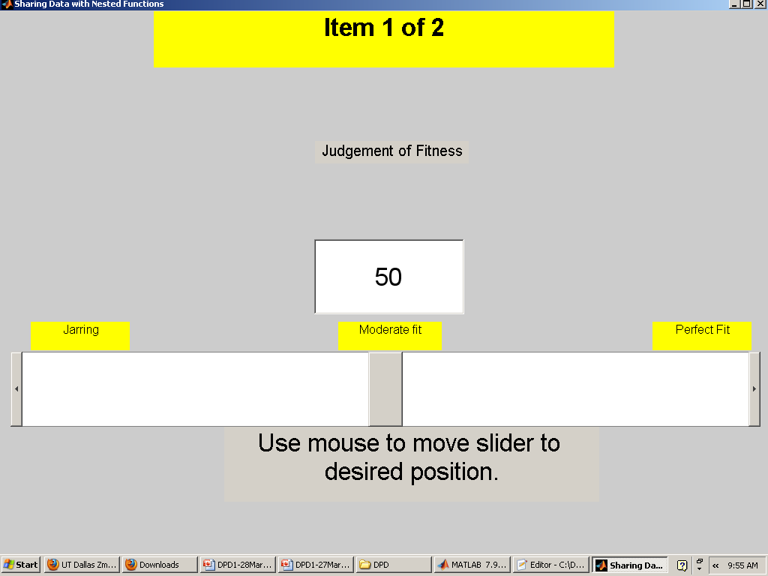

TASK

Slide 9
Experiments
We use the ratings to put together tonal profiles that may change as the listener progresses through the piece
We correlate those profiles with the standard profiles for the possible keys that the listener will encounter
If the listener is following the modulations in their ratings, the correlations will show the shifts from key to key

Slide 10
Experiment 1
There are two kinds of modulation in Carnātic (South Indian classical) music: grahabēdham (like C major to A minor), and rāgamālikā (like C major to C minor)
We used one excerpt of each type, about 1 min long
10 Indian & 10 Western music teachers participated
The Indian teachers were familiar with the excerpts, especially the rāgamālikā excerpt, whereas Western teachers were unfamiliar with both excerpts

Slide 11
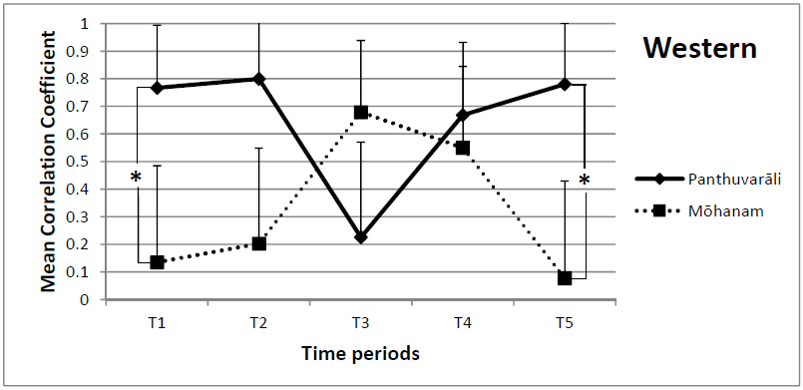
Grahabēdham
(Raman & Dowling, 2016)

Slide 12
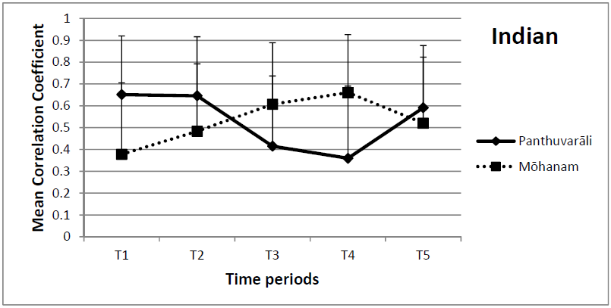
Grahabēdham

Slide 13
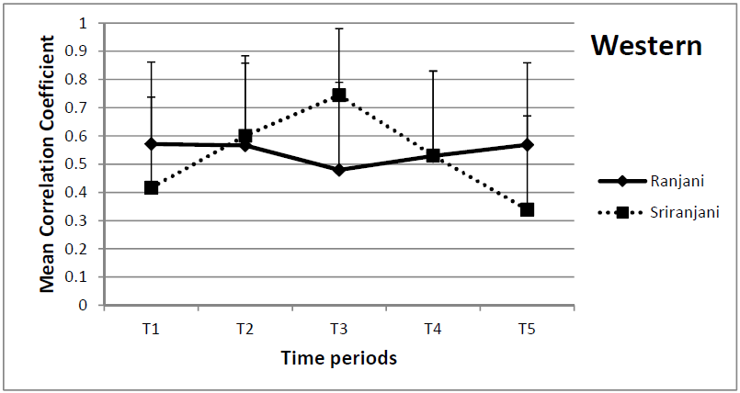
Rāgamālikā

Slide 14
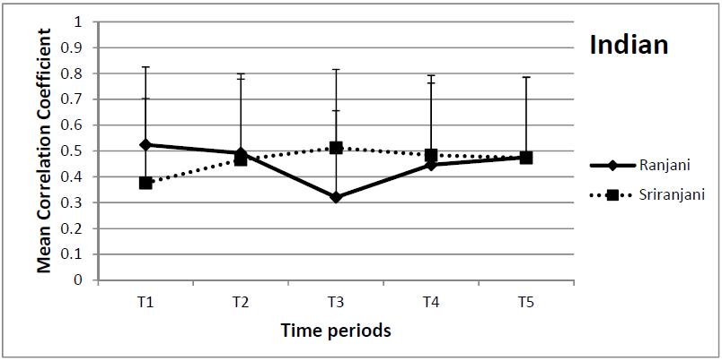
Rāgamālikā

Slide 15
Results
MANOVA: 2 Nationalities X 5 Time Periods
There were main effects of time period for both modulation types: rāgamālikā, F(8,11) = 5.25, p<.01; grahabēdham, F(8,11) = 8.57, p<.001.
The Time Period X Nationality interaction approached significance overall for rāgamālikā, and was significant for the Sriranjani rāgam in particular, F(4,15) = 4.60, p<.01.

Slide 16
Results
For grahabēdham, the Time Period X Nationality interaction was not significant overall (p<.18), but was significant for the individual ragams: Panthuvarāli, F(4,15) = 5.22, p<.01; Mōhanam, F(4,15) = 6.47, p<.01.
Clearly, the Indian teachers were responding in a more global fashion to the modulations than the Western teachers, who were more analytic.
Could this global responding be due to their greater familiarity with the pieces?

Slide 17
Experiment 2
In Experiment 2, we were able to look at possible effects of increasing familiarity
Since listeners heard the excerpts 12 times in the continuous probe-tone method, we could look at their responses during the first 3 hearings compared with the last 3 hearings
The excerpts were the first 2 min of Haydn’s Quartets op. 76, no. 2 (“Quinten”) and op. 76, no. 3 (“Emperor”), starting at the beginning and stopping at the end of the exposition section
The excerpts contained 3 or 4 modulations:
  d minor, F major, f minor, F major
  C major, G major, g minor, E^{b} major, G major

Slide 18
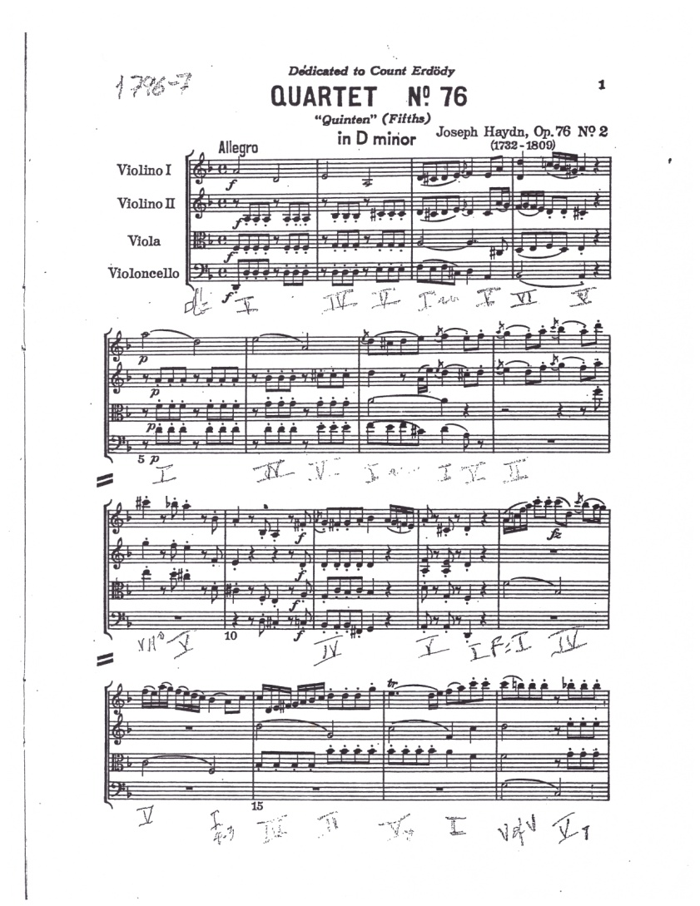
https://www.youtube.com/watch?v=wp2x0YKI7QE

Slide 19
Experiment 2
Blocks of 12 listeners with the same level of musical training complete a Latin square, so that for each trial each of the 12 probes is represented
We will look at the responses of the 60 listeners with more than 5 years of musical training, and the 60 with no musical training
We use the ratings to put together tonal profiles that (we hope) will change as the listener progresses through the piece
We correlate those profiles with the standard profiles for the possible keys that the listener will encounter

Slide 20
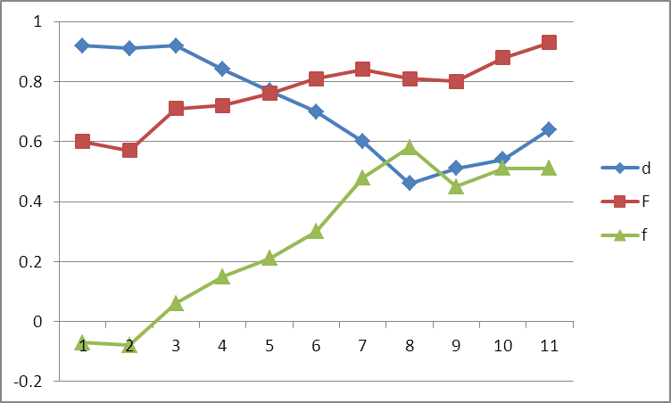
76/2 Exp trials 1-3 d F f F

Slide 21
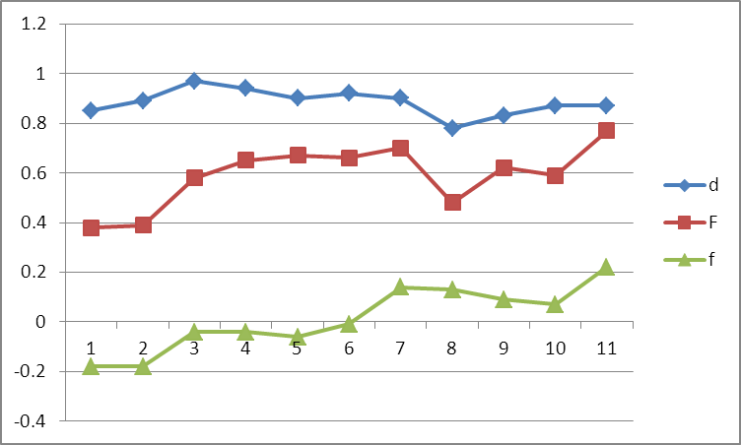
76/2 Exp trials 10-12 d F f F

Slide 22
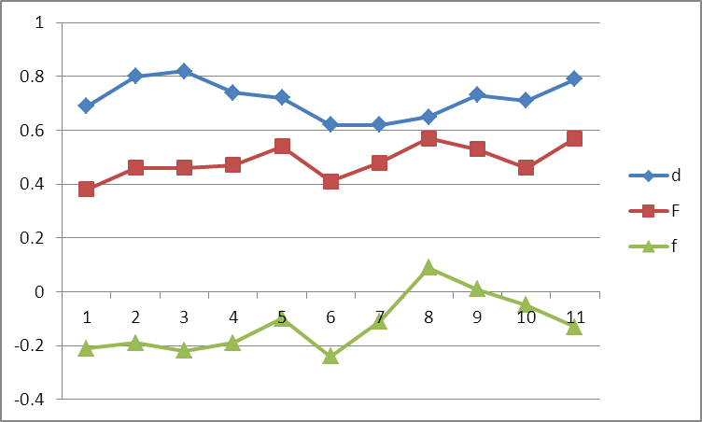
76/2 Inexp trials 1-3 d F f F

Slide 23
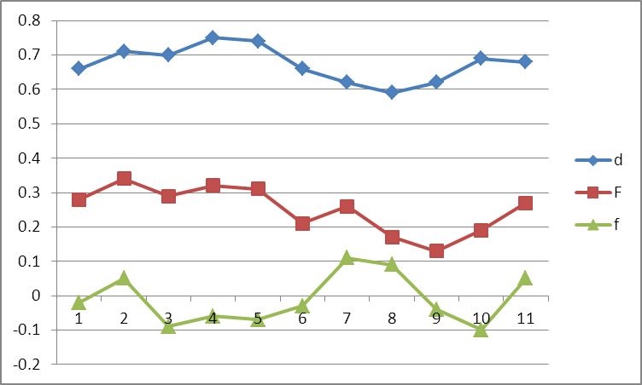
76/2 Inexp trials 10-12 d F f F

Slide 24
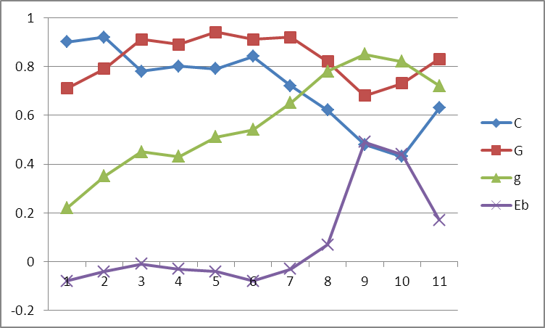
76/3 Exp trials 1-3
C G g E^{b} G

Slide 25
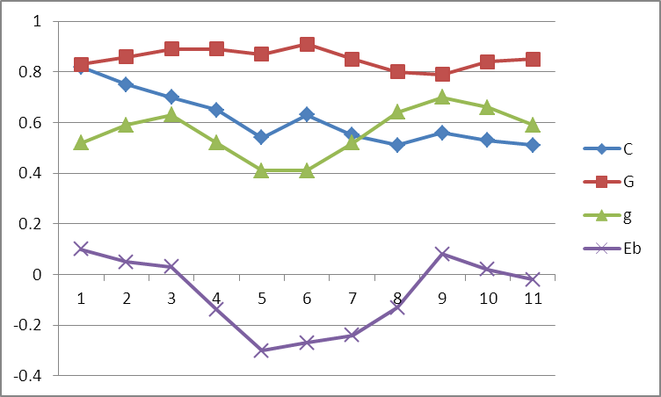
76/3 Exp trials 10-12
C G g E^{b} G

Slide 26
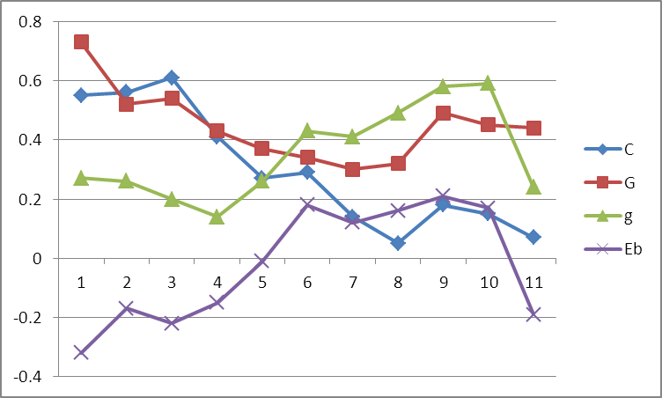
76/3 Inexp trials 1-3
C G g E^{b} G

Slide 27
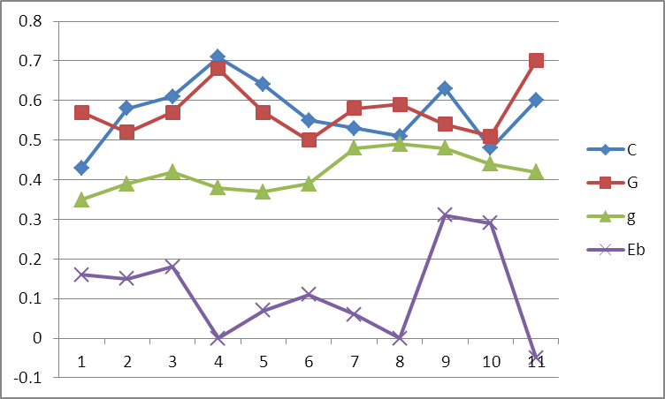
76/3 Inexp trials 10-12
C G g Eb G

Slide 28
Conclusions
The more experienced listeners differentiated the changes of key more clearly
With repeated exposure to the pieces, the sharp differentiation of keys tended to get smoothed out, suggesting that familiarity leads to a more global approach to hearing the piece

Slide 29
Experiment 3
This led us to manipulate familiarity even more strongly
12 student orchestra members performed the task with a piece they were going to learn, but had not seen yet (the finale of Dvorak’s “American” String Quartet)
Then they did the task in the middle of the semester after practicing the piece for 6 weeks
Finally the did the task after playing the piece in their concert

Slide 30
Experiment 3
There were 5 modulations in the first 2 min of the piece, involving 4 keys:
  F major
  A minor
  C major
  Ab major
We looked at sessions 1 and 3, where the difference in familiarity was strongest

Slide 33
Results
ANOVA: 2 Sessions X 10 Time Periods X 4 Keys
Strong Period X Key interaction, F(27,297) = 27.30, p<.0001
The only interaction involving session was Session X Key, F(3,33) = 2.39, p<.09, in which the key means were more spread out in Session 1
This could be taken as a very indirect indication of a global shift, but clearly these listeners started out and finished with quite sharp differentiation among keys

Slide 34
Conclusions
In some cases there are indications of a tendency toward more global perception with increasing familiarity (Indian vs. Western differentiation of Indian modulations; loss of sharp differentiation throughout session by more experienced musicians)
Less knowledgeable listeners tend to a more global pattern of response, correctly tracking the principal keys of an excerpt, but not always tracking shifts of key

Slide 35
Conclusions
However, our attempt at manipulating familiarity with the orchestra members failed to show convincing evidence of a shift from analytic to global perception
It may be that the demands of playing the piece helped maintain those listeners in their more analytic mode
This might contrast with familiarity derived from listening, where expected deviations come to blend into their context, with a resulting more global perception of the piece

Slide 36

THANK YOU
Kieth Gryder
Kevin Herndon
Jaicey Johnson
Chris Lo
Parisa Najafigol
Bhavana Penmetsa
Rachna Raman
Ashwin Ramesh
Franco Sabatini
Alan-Michael Sonuyi
William Stanford
Naveen Subramanian
David Tram
Sahiti Yarakala

