Slide 1
Effects of Key Membership & Interval Size in Perceiving Wrong Notes: A Cross-Cultural Study.
Rachna Raman
4 August 2015

Slide 2
PRIOR RESEARCH
Besson & Faïta (1995)
Behavioral & ERP study
Musicians vs. Nonmusicians
Familiar vs. Unfamiliar Western melodies
ALWAYS the last note
3 types of wrong notes:
in-key with no closure, out-of-key, rhythmic change

Slide 3
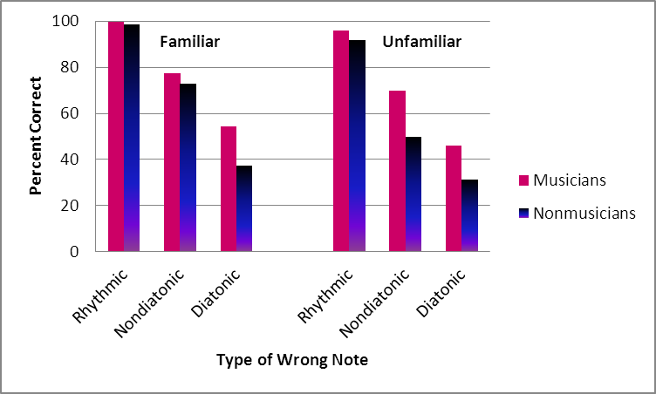
BESSON & FAÏTA
Main effects of music training, familiarity, type of wrong note
Interaction

Slide 4
PILOT STUDY
Dowling & students
Purpose
Effect of key membership, interval size, and direction on perception of wrong note
Musical training

Slide 5
PILOT STUDY
Stimuli
20 familiar Western tunes
80 trials
Types of Wrong Notes
Key: In-key/Out-of-key
Interval: 1 ST/2 ST
Direction: Up/Down

Slide 6
PILOT STUDY
Participants
Western
Musically-trained (> 1 year; M = 5 years)
Nonmusicians (< 1 yr)
DV
Hits, Response times

Slide 7
CONCLUSIONS
95% hit rate
Key and Interval important
Out-of-key, 2 ST
Direction not significant
Musical training
Main effect
No interaction

Slide 8
CROSS-CULTURAL

Slide 9
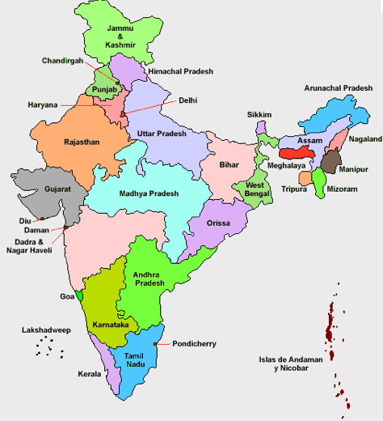
SOUTH INDIAN CLASSICAL MUSIC
Carnātic

Slide 10
WHY STUDY CARNĀTIC MUSIC??
350 rāgams vs. 13 Western modal scales
C D^{b} E F# G A^{b} B C (heptatonic)
C D E^{b} F A B C (hexatonic)
C E^{b} F G B C (pentatonic)

Slide 11
CENTRAL QUESTION
To investigate effects of key membership, interval size, and direction cross-culturally
“pop out”
A complex music system—rāgams
Carnātic vs. Western melodies
Indian vs. Western participants
Musical training

Slide 12
CURRENT STUDY

Slide 13
PARTICIPANTS
30 Indian
Teachers Students Rasikās
17 – 63 years
33 Western
Highly-trained musicians Moderately-trained musicians Nonmusicians
18 – 60 years

Slide 14
PRE-TEST
36 Carnātic & 37 Western popular melodies
All with lyrics
MIDI stimuli
Excerpt duration – 15 s approx.
Familiarity ratings from Indian participants
9-point Likert scale (“9”- highly familiar)

Slide 15
PRE-TEST
Indian participants
Highly familiar 6 Carnātic and 6 Western melodies
6.7 to 8.6 (Carnātic)
8.2 to 8.6 (Western)
Western participants
8.0 to 9.0 (Western)

Slide 16
WRONG NOTES
Key:
In-key/Out-of-key
Interval:
1 ST/2 ST
Direction:
Up/Down
Trials
3 practice trials
48 total trials; 8/song approx.
Counterbalance for Indian participants

Slide 17
TASK
Example: London bridge
Press spacebar as quickly as possible when you hear a wrong note

Slide 18
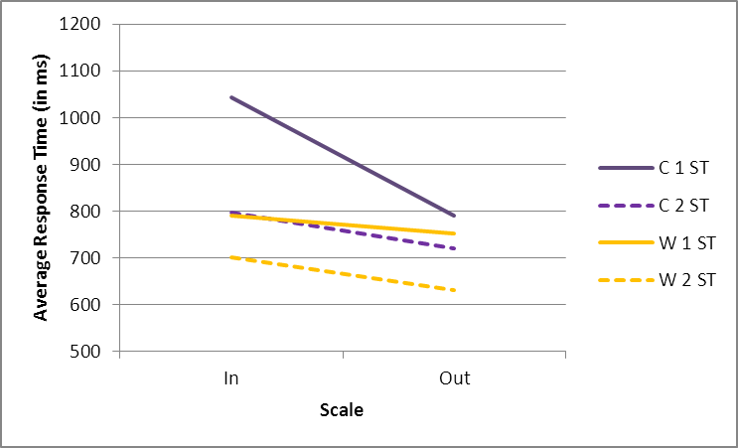
Indian Participants – Carnātic vs. Western Melodies –RT
Key membership*, Interval size*
Type of Melody x Key x Interval*

Slide 19
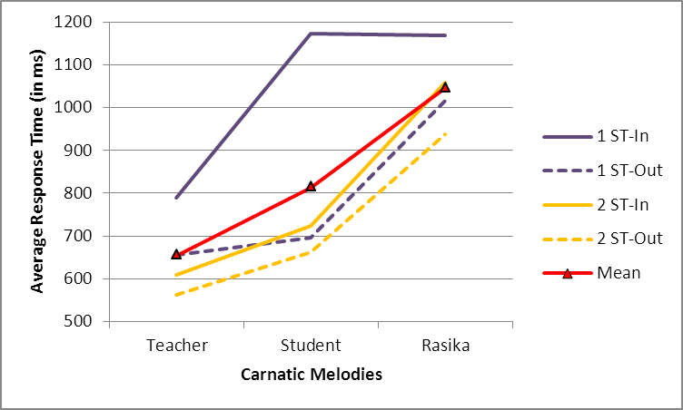
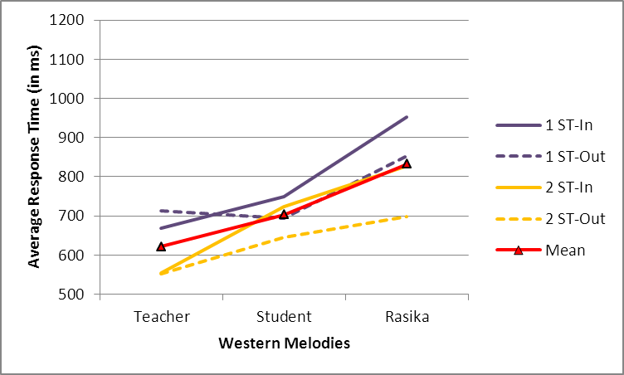
Indian Participants – Carnātic vs. Western Melodies – RT
Music Training*, Type of Melody*

Slide 20
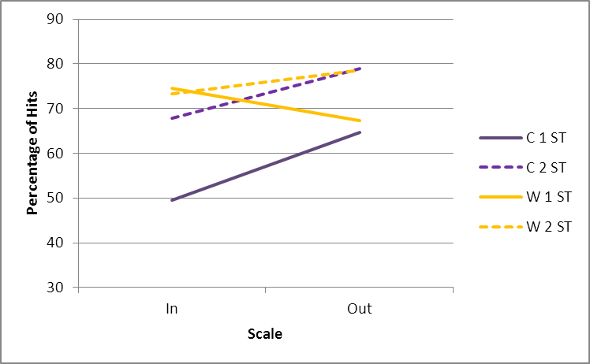
Indian Participants – Carnātic vs. Western Melodies – Hits
Key membership*, Interval size*
Type of Melody x Key x Interval*

Slide 21
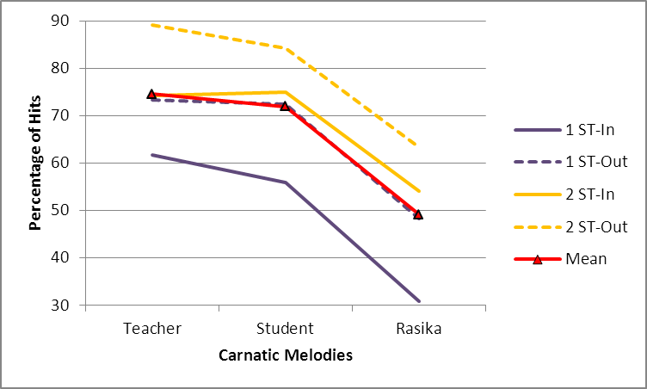
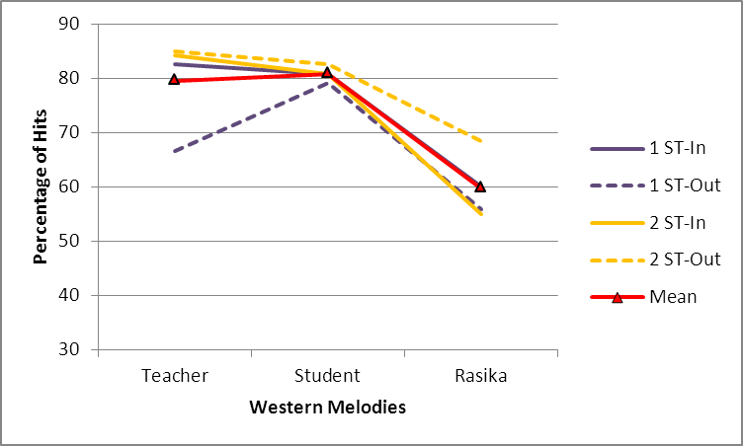
Indian Participants – Carnātic vs. Western Melodies – Hits
Music Training*, Type of Melody*

Slide 22
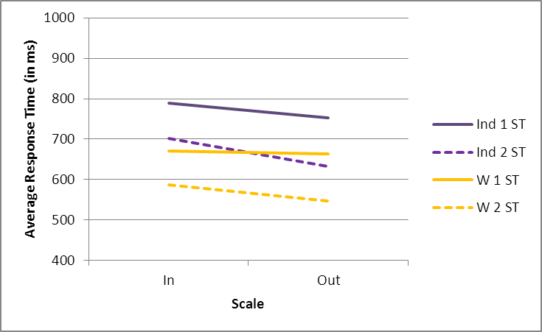
Indian vs. Western Participants – Western Melodies – RT
Key membership*, Interval size*
Key x Interval ^{ns}

Slide 23
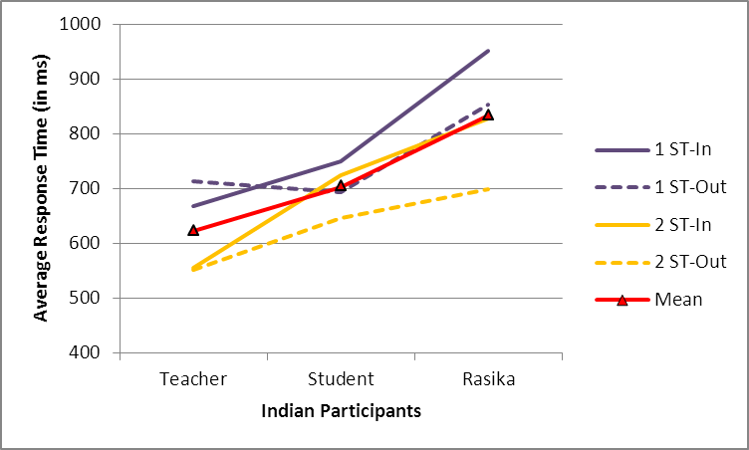
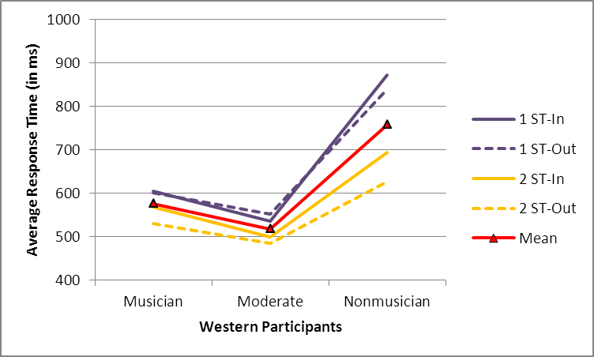
Indian vs. Western Participants – Western Melodies – RT
Music Training*
Nationality of Participants ^{ns}

Slide 24
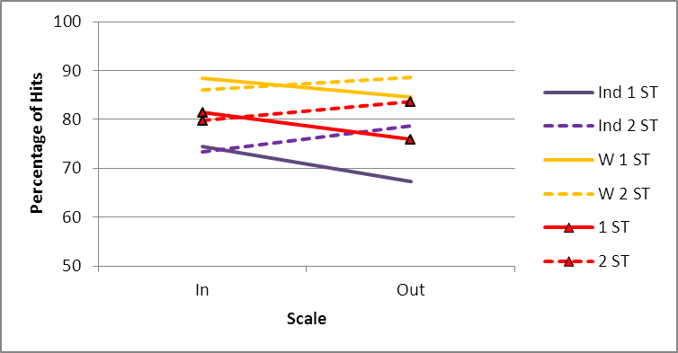
Indian vs. Western Participants – Western Melodies – Hits
Key membership ^{ns}, Interval size*
Key x Interval*

Slide 25
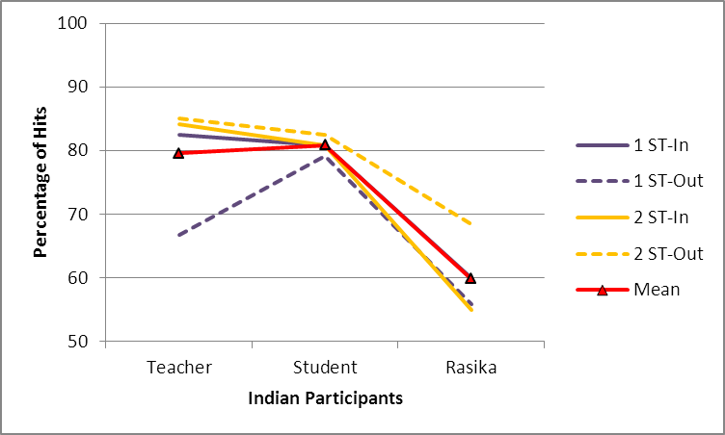
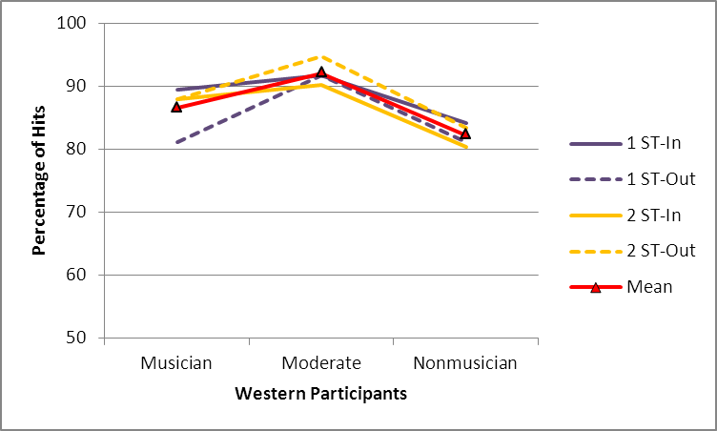
Indian vs. Western Participants – Western Melodies – Hits
Music Training*
Nationality of Participants*

Slide 26
CONCLUSION – 1
Key membership important
Out-of-key
Interval size important
2 ST away from the original note
Faster with out-of-scale and 2 ST

Slide 27
CONCLUSION – 2
Carnātic vs. Western melodies
Indian participants faster and more accurate on Western melodies
Slowest and least accurate with in-scale and 1 ST away (Carnātic)
related to complexity of Carnatic music system

Slide 28
FUTURE DIRECTIONS
Currently working on
Unfamiliar vs. Familiar melodies
Converging evidence from other cultures—Japanese and Persian melodies

Slide 29
THANK YOU
Ashwin Ramesh
Franco Sabatini
Participants

Slide 30
QUESTIONS???

Slide 31
EARLIER STUDY
37 popular Carnātic melodies chosen from online survey
80 trials
30 Indian participants
Carnātic teachers, students, rasikās
MIDI stimuli
Results: Teachers 30% hit rate

Slide 32
CONCLUSION
Conclusion
Complexity of delivering Carnātic rāgams and songs as MIDI
Need highly familiar Carnātic melodies recognizable in MIDI format

